Slide 1


Guide to SP and 424 Submissions
Updated July 2019

Slide 2

SP and 424 forms
SP= Sponsored Projects routing
All submissions that require approval will generate a SP form including
Grants proposals, Subawards In, Letters of Intent*,Data Agreements, Material Transfer Agreements
Each proposal has a unique identifier number
424 forms
Submissions to Federal funding sources require 424 forms.
These are linked to SP record.
Effective 12/28/2015, all federal grant applications submitted using Evisions Cayuse 424 rather than the 424 Adobe packages

Slide 3
How to Assess Cayuse
Request Access by contacting your Departmental Business Administrator
Process takes a minimum of 24 hours- please request access as soon as you know you are going to submitting a proposal/ included on someone else’s submission.
Business Administrators:
Access is requested in IRIS using the following transaction:
SESATAUTH000 - IRIS User Tools -> User Access -> Satellite System User Request
Business staff simply enter personnel number and request access type (researcher or admin); use the "researcher" designation for anyone who will be paid from a sponsored project.

Slide 4
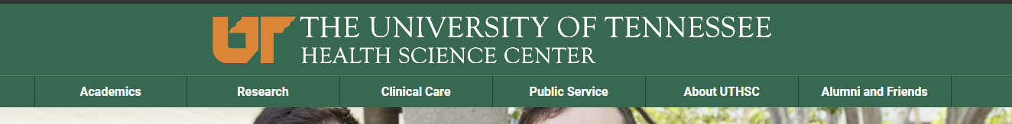
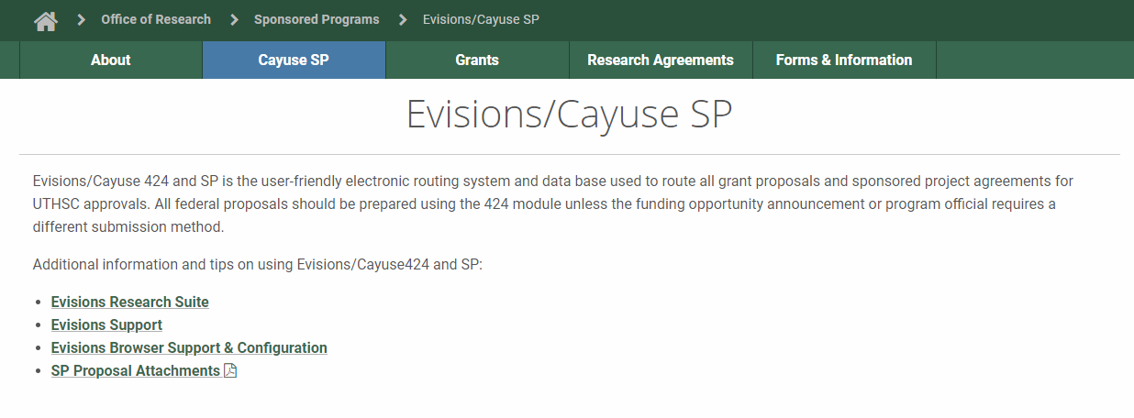
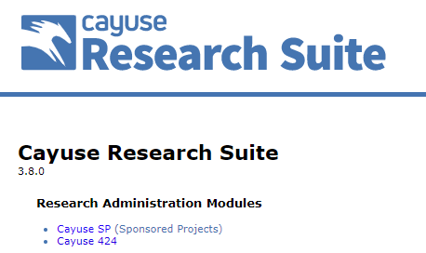

How to Assess Cayuse
If you are asked to log in- use your net id and password

Slide 5
What happens when I submit via Cayuse?
Proposal populated by PI/ Departmental Administrators
Finalized Proposal routed for approval & Certified by PI
Departmental Approval
(Average 1-2 business days-
longer at times of high-volume submissions)
Submission
In Compliance
Office of Sponsored Programs Review
Approval
Errors- Returned to PI for Correction

Slide 6
When should I start a Cayuse Proposal?
AS SOON AS POSSIBLE!!
It really is never too early!
Identify FOA you wish to respond to.
Draw up a checklist of key dates, requirements and exceptions
Contact your Departmental Administration team as soon as possible- they are an invaluable resource in generating the required documentation needed for internal approval, and will be able to assist with departmental time lines.
Start a Cayuse proposal!

Slide 7
When should I start a Cayuse Proposal?
AS SOON AS POSSIBLE!!
It really is never too early!
UTHSC Faculty Senate approved a 5-working-day internal deadline for all grant applications
The FINAL version of the application is due to OSP on that date.
Minimum amount of time you should allow-Departmental Approval takes on average 1-2 business days
Why final?= Revision requests after routing mean mistakes can be made/missed
Agency deadline past 5 p.m. Central time = UTHSC deadline is 5 p.m. Central
Grant applications that arrive past the 5-working-day advance deadline will be reviewed as time permits but are not guaranteed to meet the agency submission deadline

Slide 8
Do I start 424 or SP first?
Start with the first page of SP and build the link to the 424 package
This provides you with the proposal number so that OSP can assist you with questions
Complete the 424 then the rest of the SP, importing the budget from 424*
*Modular Budgets will not autofill- use Summary or Detailed.

Slide 9
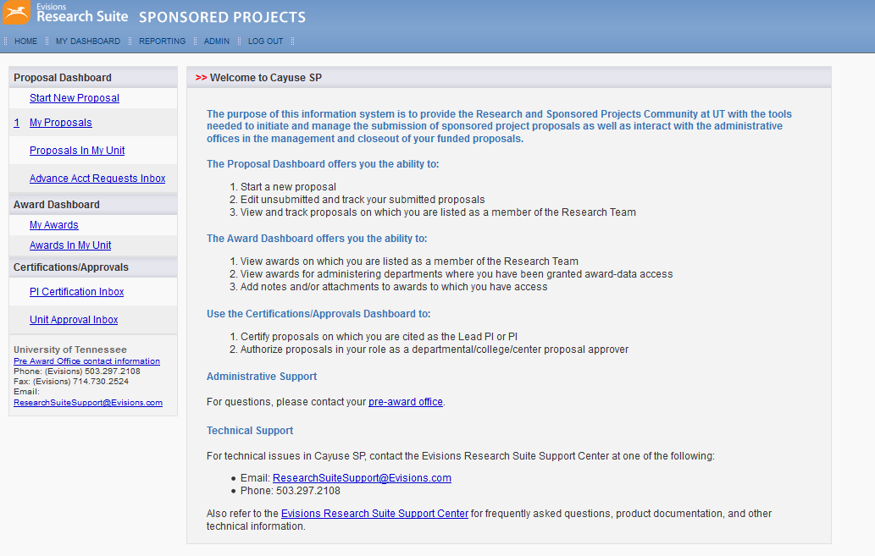
Starting a Proposal

Slide 10
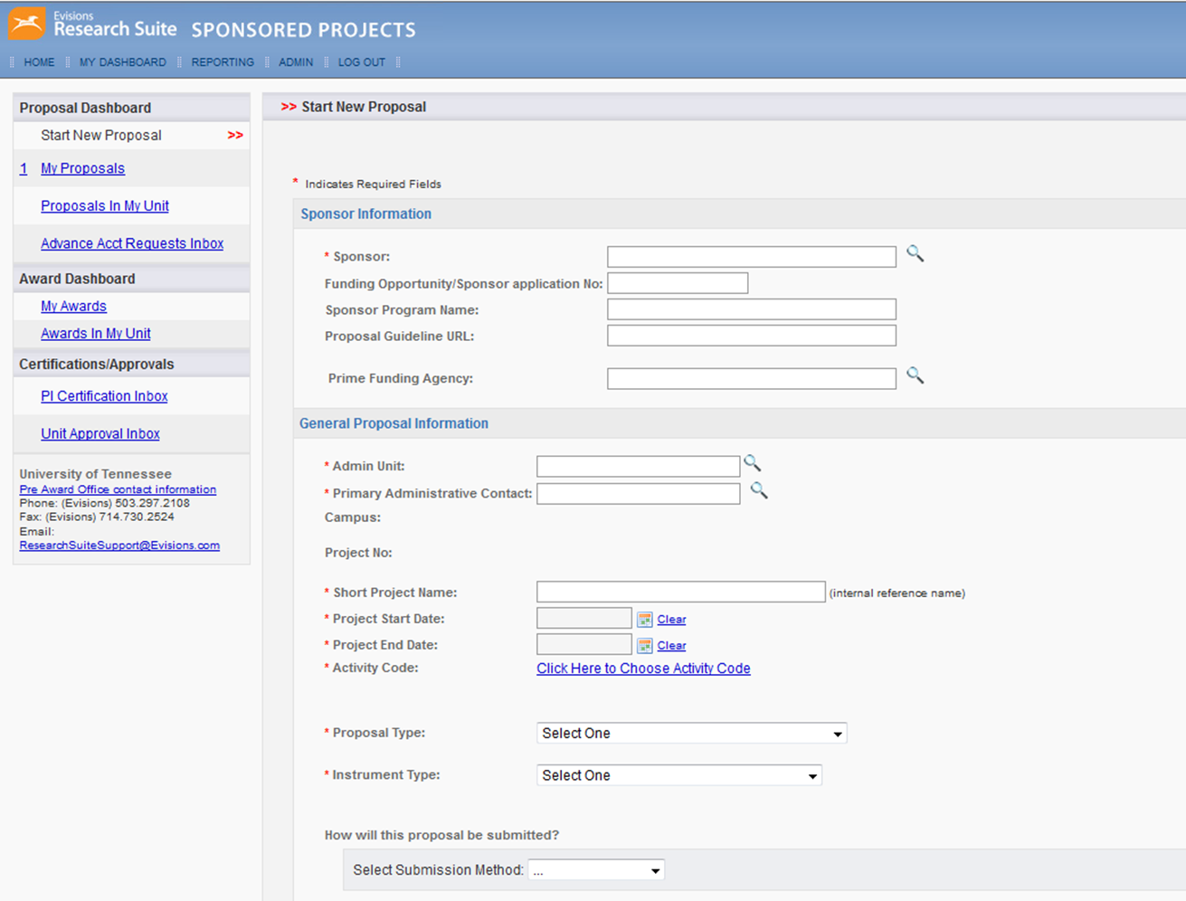
Starting a Proposal
“Sponsor Not Listed” – Contact OSP : egrants@uthsc.edu with Sponsor Details before a proposal is routed
Complete as much as possible
URL or Attach Guidelines in the Attachment Section- especially important for Foundation proposals
Sponsor = Who is paying UTHSC
Prime Sponsor = origin of funding
e.g. a Subaward to University of Memphis where prime is NIH
Search for Admin unit by U# or first few letters of name
Admin contact is dept person to be contacted- NOT PI
Short Project Name: Smith-R01-key word
ALL * Boxes must be complete to save. Proposal not generated until saved

Slide 11
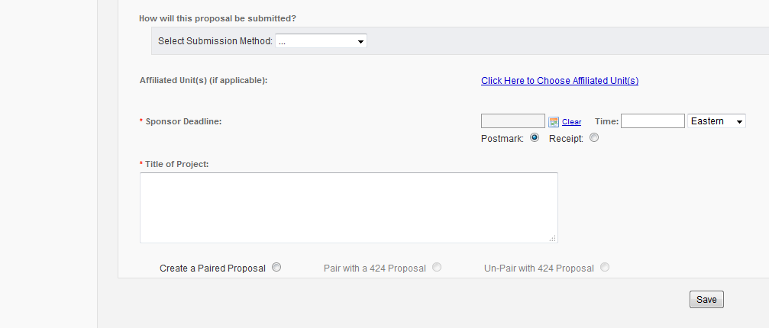
Linking to a 424

Slide 12
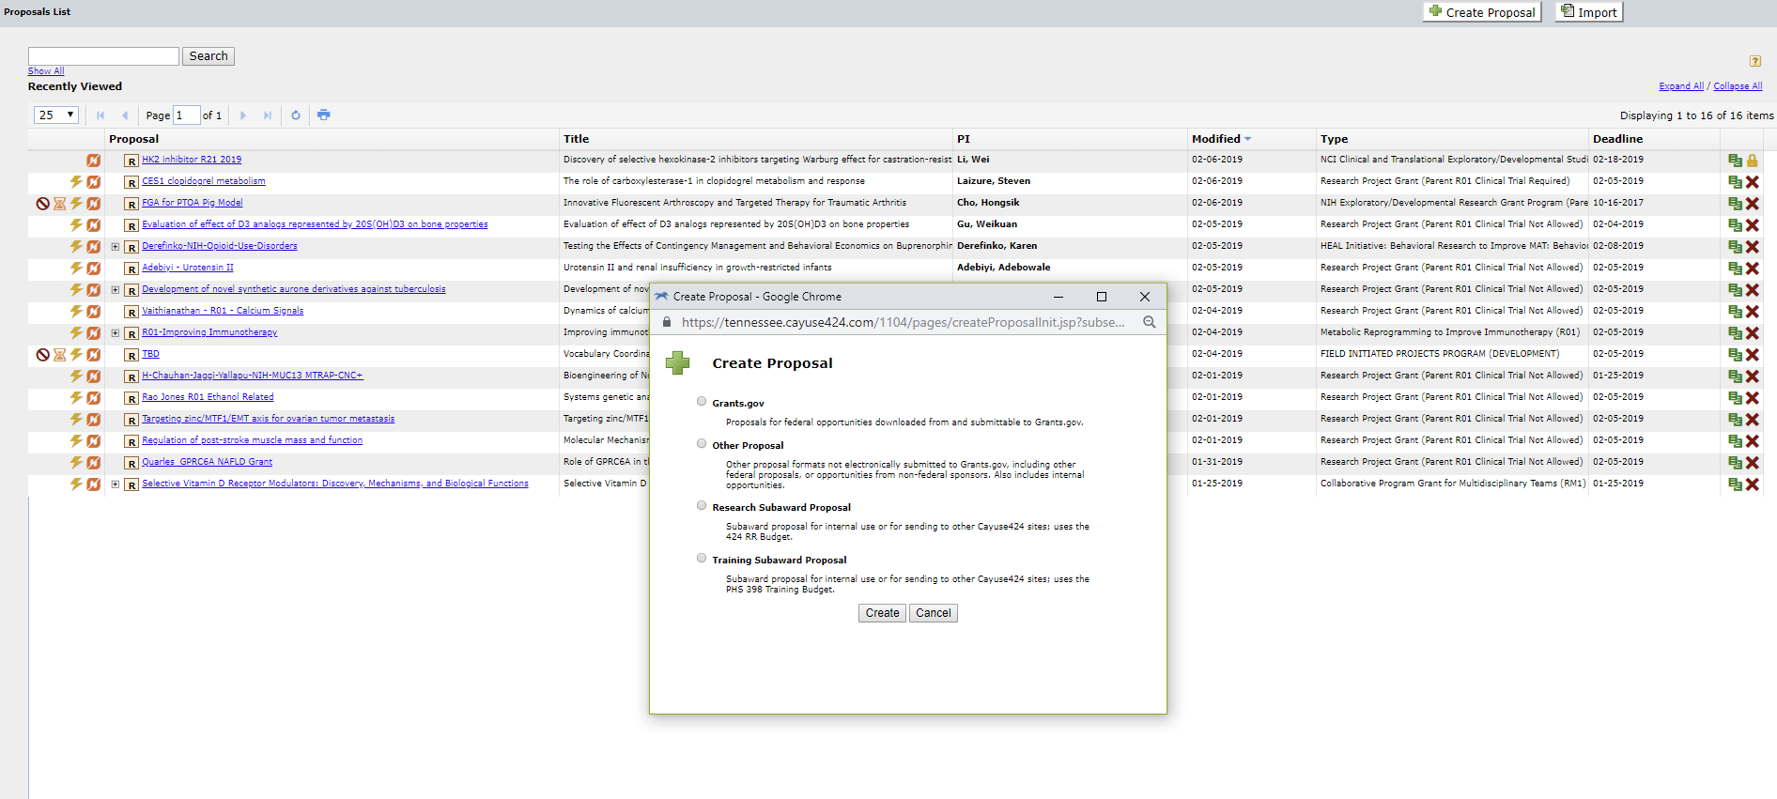
Linking to a 424

Slide 13
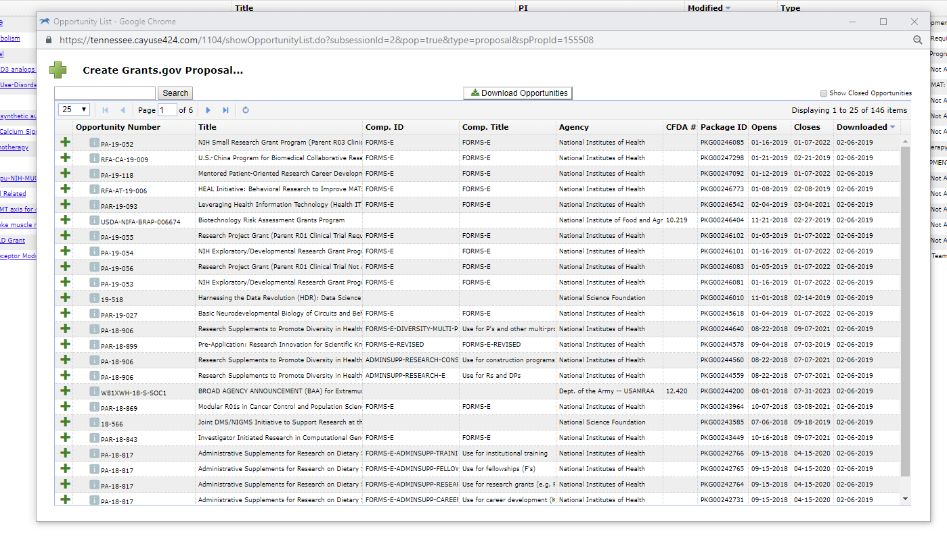
Linking to a 424

Slide 14
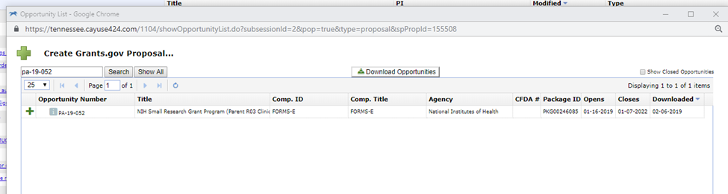
Linking to a 424

Slide 15
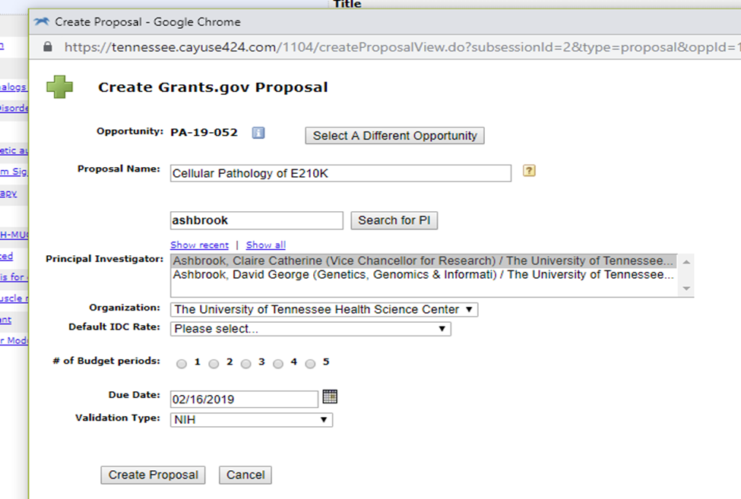
Linking to a 424

Slide 16
Completing a 424
The following slides demonstrate what the majority of 424 forms will look like when submitting to NIH based of the R series.
F, K and U Series will look different, but contain most of the same information in a different layout.
DoD proposals will look different, as will 424 submissions to Department of Justice, Department of Education, SAMSHA etc.

Slide 17
424 Key Icons and Buttons
Use the Yellow Lightning Bolt to see the specific details of the Funding Opportunity Announcement (FOA) you are applying for.
This tab will allow you to confirm the FOA you are applying under is still open for submissions.
Use the Printer Icon to print a PDF of the proposal (all or parts). You can also use this feature to create a PDF of the Proposal
Click the Yellow Pencil to autofill information from a list of possible options

Slide 18
424 Key Icons and Buttons
Click the long gray button to see how many ERRORS or WARNINGS are currently in the Cayuse application.
Errors and some Warnings will lead to rejection of the proposal by the funding agency .
Proposals should have 0 errors before they are routed for approval.
Clicking on the blue LINK text within this window will take you to the location that is generating the ERROR or WARNING.

Slide 19
424 Key Icons and Buttons
Always exit Cayuse 424 by clicking the [Sign Out] Link in the upper right corner. If you exit by simply clicking X you may “lock out” others from this proposal.
NEVER click and “take’ the lock that is held by someone else without contacting them first. Doing so may result in the irrevocable loss of data

Slide 20
Completing a 424
Use the correct Agency and Series guidelines along with your FOA to complete the required forms.
OSP’s Guide to Cayuse 424 Submissions contains examples of forms that have been annotated to reflect the required content for some sections for personnel based at UTHSC.
Ensure you save your work!
Make sure you only have one tab open for each SP and 424 at a time, more than one can overwrite data, and create errors.
Adding Non-UTHSC Sites or Personnel:
Use the Pencil tool to select any UTHSC autofill person.
When the site or person is added to the page- use backspace to delete the information that has been auto filled.
Enter the correct information for your non-UTHSC personnel or site.
Save.

Slide 21
Completing the SP form
When the 424 package is complete/ if you do not require a linked 424 package- complete the SP forms.
Commons Issues and Helpful Hints
Submit for routing button will not be available until all elements of the form have a green checkmark- for some sections that don’t apply you will have to mark a box to show this.
Investigators/Research Team:
Only one person can be identified as Lead PI ( this would be the contact PI).
Credit should be allocated to all personnel holding an investigator role- must equal 100%
Calendar Months effort and Sponsored Effort % should match
Budget:
Summary/Detailed/Autofill
Costshare? It MUST be included here in order for the proposal to obtain the correct approvals. Not declaring it here will result in the proposal being delayed in review whilst approval is obtained.

Slide 22
Completing the SP form
Commons Issues and Helpful Hints
Conflict of Interest:
Review carefully- triggers checks for FCOI training when routed. If not completed FCOI training- do as soon as possible- reminder emails.
Regulatory Compliance:
Review very carefully- should match 424 forms and/or Sub-Recipient forms as applicable.
Subcontractors:
If not available contact egrants@uthsc.edu in same way request sponsor is added
Any Sub-sites should be reflected on the Locations tab.
Export Control:
Should match 424
NIH increased interest in Foreign Collaborations since 2018- ensure full disclosure.
Submission Notes- use them to communicate with OSP- Continuous Submission/F&A Cap/ Unusual Restriction or Requirement

Slide 23
Routing a Proposal
Submit for Routing- DOES NOT MEAN SUBMITTED TO SPONSOR
All Principal Investigators must certify
Departmental Approval Stage
OSP Review
Institutional Approval
Submission

Slide 24
Common Errors and Issues
424s routing with error warnings
Bio sketches-
Outdated Bio sketch format- Must say 2020 in top right corner
Incorrect eCommons IDs
Incorrect date format in Education/Training
More than the allowable 5 Contributions to science with 4 publications allowed for each.
Incorrect Inclusion of Videos
Not using the PHS Assignment Request forms
Not re-auto filling SP budgets after amending the 424.
Communication Difficulties during review

Slide 25

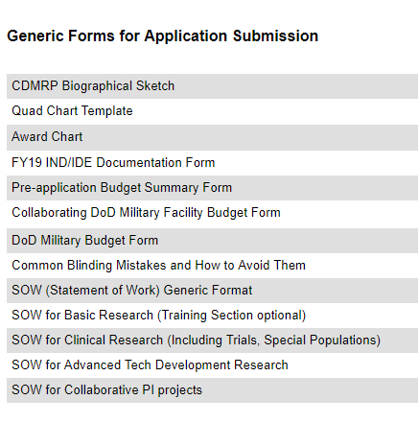
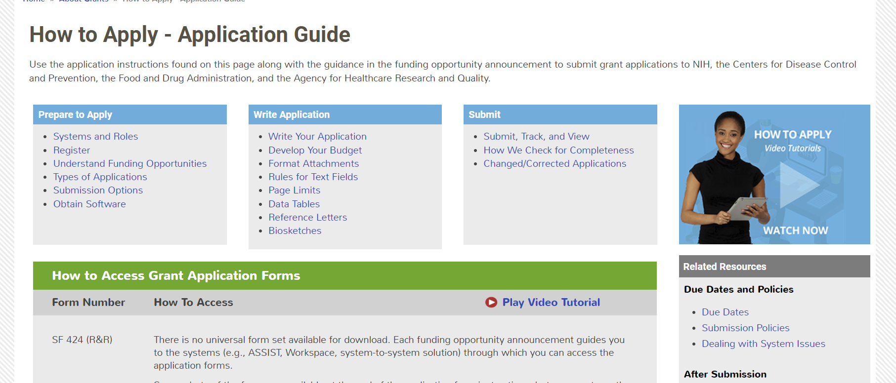

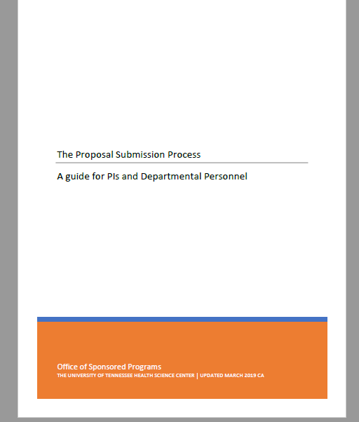
Additional Resources
Your Departmental
Administration

Slide 26


Any Questions?

Slide 27
Office of Sponsored Programs-
Pre-Award Contacts
Sarah White
Associate Vice Chancellor for Research
swhite82@uthsc.edu Phone: 901.448.2359
Ginny Geer
Manager
vgeer@uthsc.edu
Phone: 901.448.5587
Brenda Murrell
Director, Proposal and Award Management
bmurrell@uthsc.edu
Phone: 901.448.5571
Claire Ashbrook
Sponsored Programs Administrator
cashbroo@uthsc.edu
Phone: 901.448.1877
egrants@uthsc.edu

