Slide 1
Elyra 7:
Zen Black Introduction and Light Path Settings
Rachel Escue Helms, PhD, Microscopy Manager
Advanced Imaging Core (AIC)

Slide 2
ZEN BLACK INTRO
ADVANCED IMAGING CORE
ELYRA 7: ZEN BLACK INTRODUCTION AND LIGHT PATH SETTINGS
Zen Black is the software program used for acquiring images on the Elyra 7. The program also performs post-acquisition processing and method-specific processing, including for structured illumination microscopy (SIM) and single-molecule localization microscopy (SMLM) images.
Files are saved as .czi (the proprietary Carl Zeiss Image format) to preserve image metadata, but they can be exported in all major image file formats such as .tif, .png, and .jpg.

Slide 3
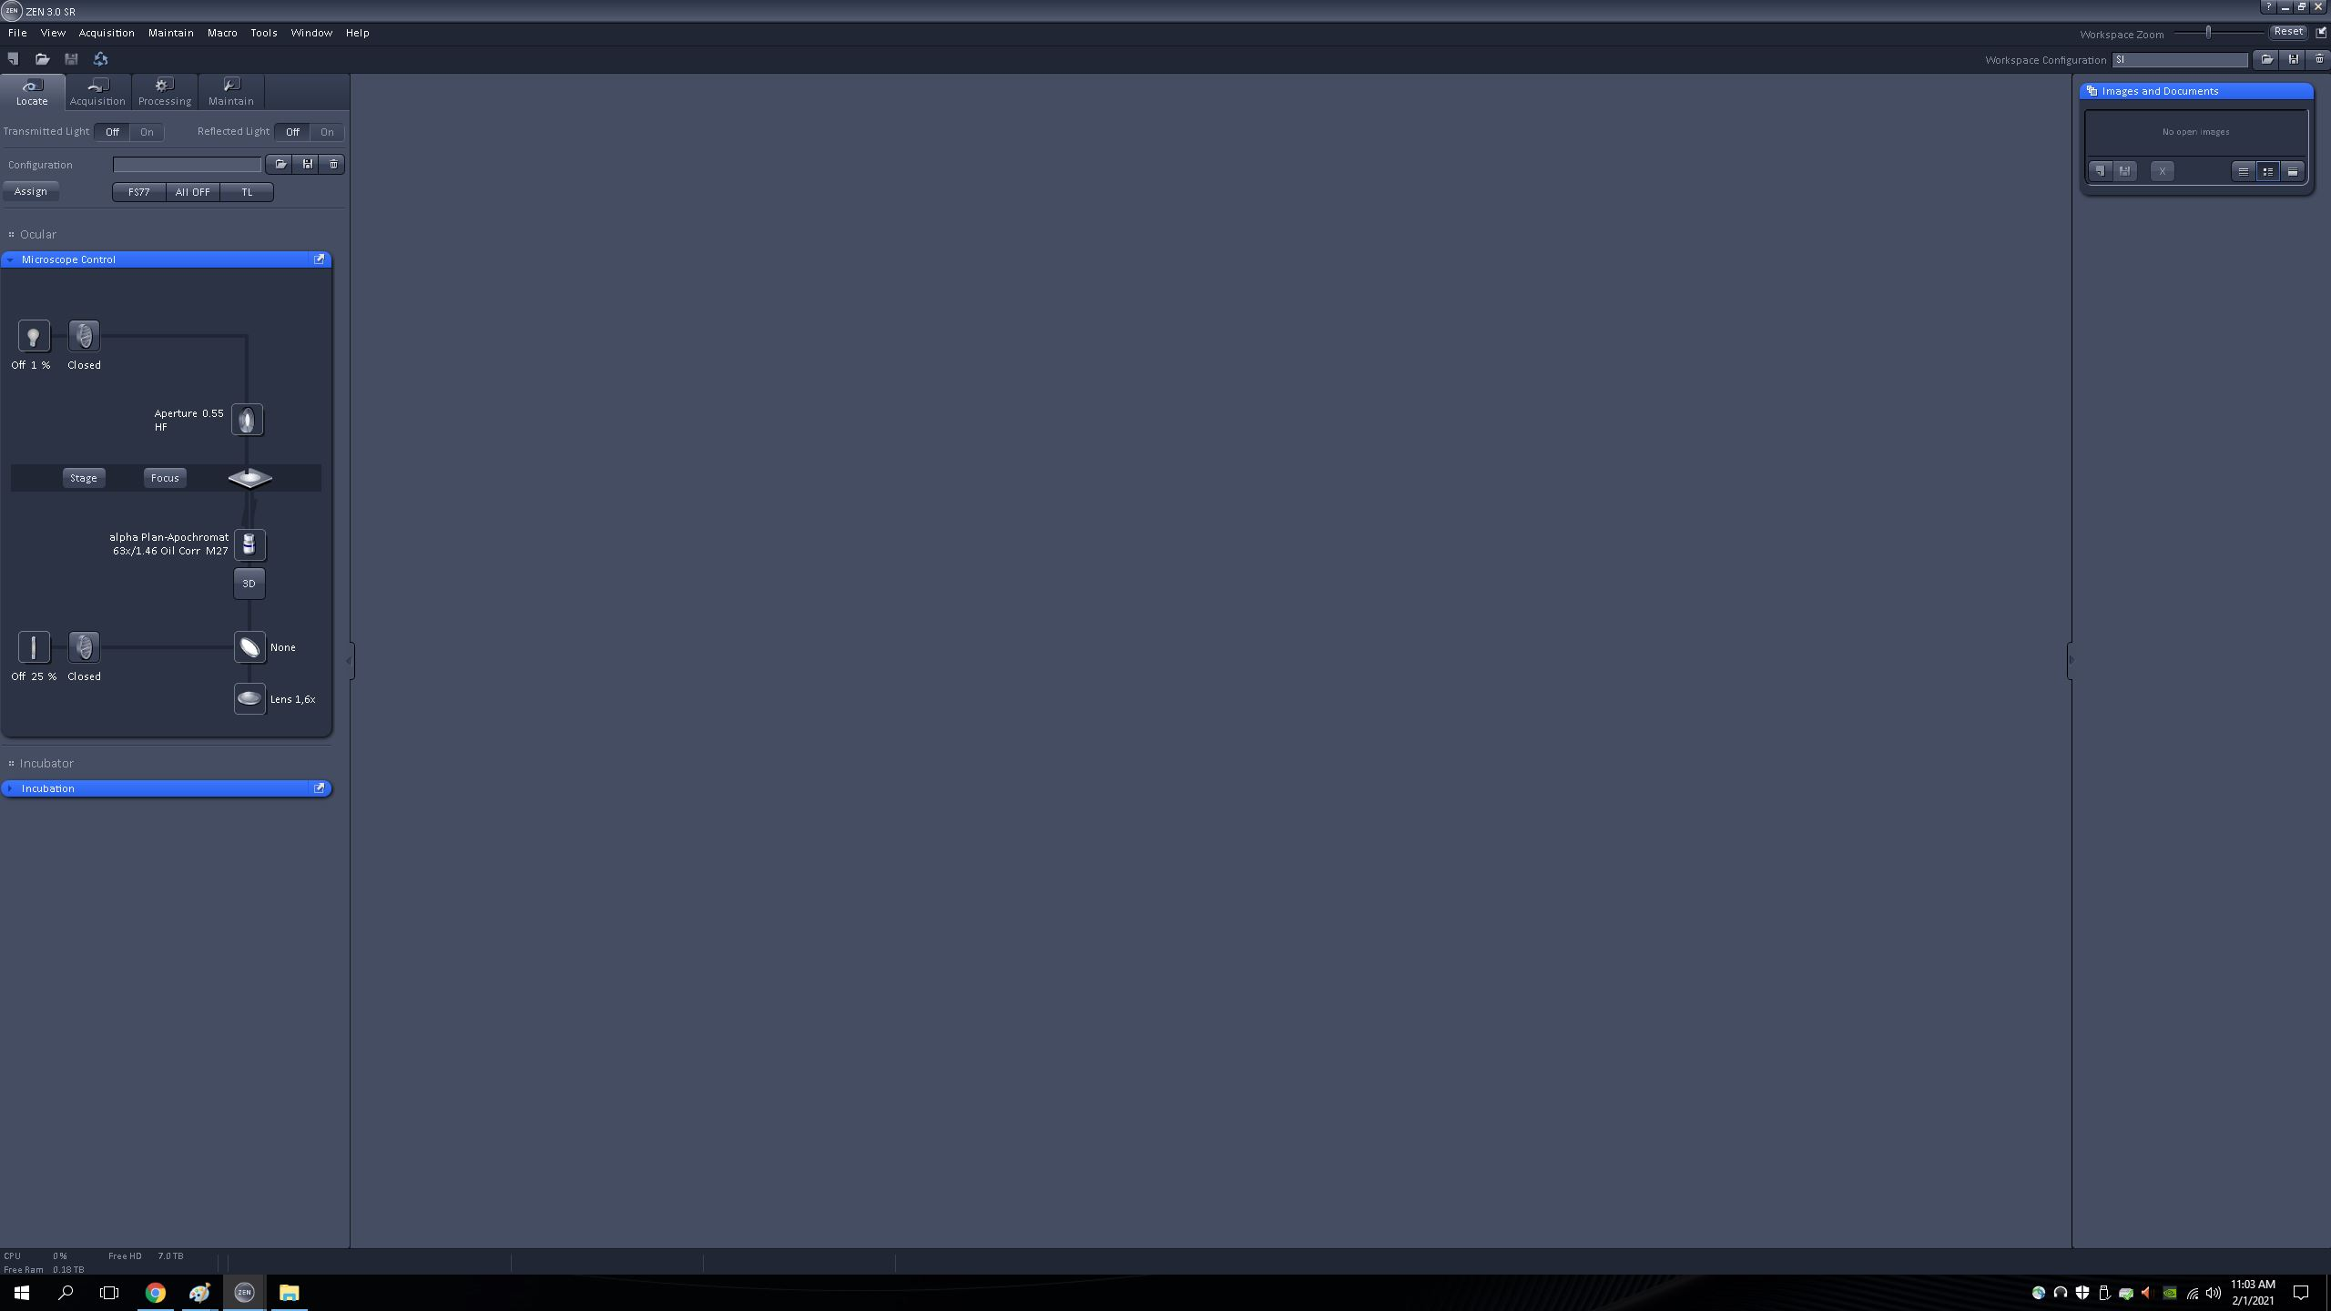
ZEN BLACK INTRO
ADVANCED IMAGING CORE
ELYRA 7: ZEN BLACK INTRODUCTION AND LIGHT PATH SETTINGS
Zen Black functions are separated into 4 tabs:
  LOCATE, ACQUISITION, PROCESSING, and MAINTAIN.
  You will only be using the first three tabs (if anything on the MAINTAIN tab needs to be adjusted, please inform the Core Manager.)
  The most commonly used/altered settings will be covered in this guide.
    For complete settings, refer to the Zen Black manual (available in the AIC).

Slide 4
OPENING THE PROGRAM
ADVANCED IMAGING CORE
ELYRA 7: ZEN BLACK INTRODUCTION AND LIGHT PATH SETTINGS

Slide 5
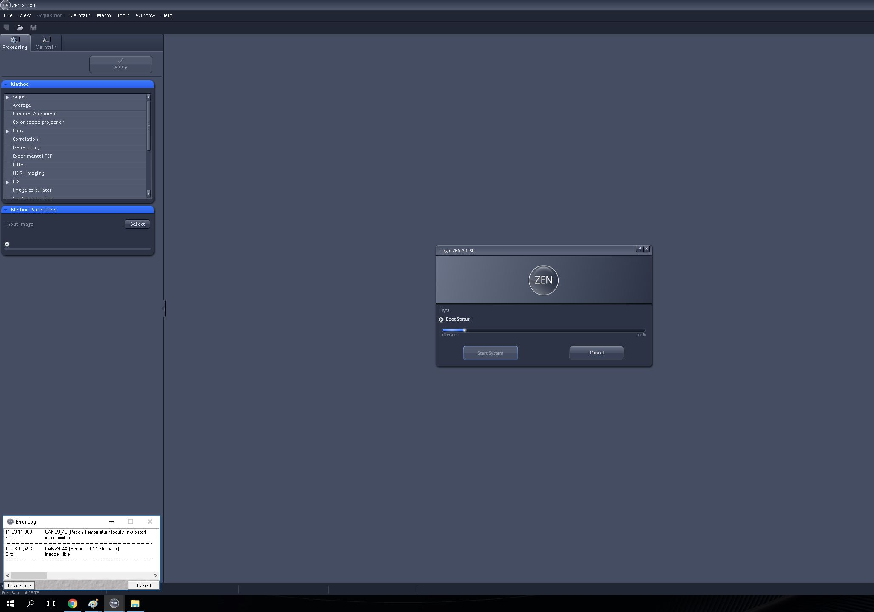
OPENING THE PROGRAM
ADVANCED IMAGING CORE
ELYRA 7: ZEN BLACK INTRODUCTION AND LIGHT PATH SETTINGS
1
Select START SYSTEM in the pop-up.
2
An error log automatically begins when the system does not register the incubation and heating systems. This is normal, however, please report any additional errors to the Core Manager.

Slide 6
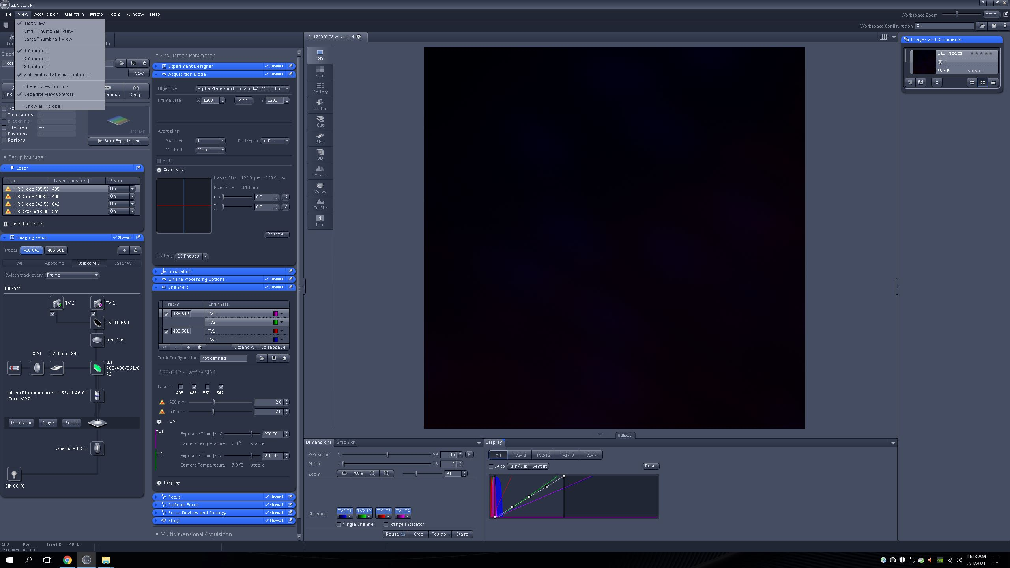
OPENING THE PROGRAM
ADVANCED IMAGING CORE
ELYRA 7: ZEN BLACK INTRODUCTION AND LIGHT PATH SETTINGS
Select VIEW > SHOW ALL (GLOBAL)
  Many settings are not automatically visible when first opening the program without turning this option on.

Slide 7
LOCATE TAB
ADVANCED IMAGING CORE
ELYRA 7: ZEN BLACK INTRODUCTION AND LIGHT PATH SETTINGS

Slide 8
LOCATE TAB
ADVANCED IMAGING CORE
ELYRA 7: ZEN BLACK INTRODUCTION AND LIGHT PATH SETTINGS
This tab is for scanning the sample through the eye piece.
  Three pre-set light path buttons are available for your convenience.

Slide 9
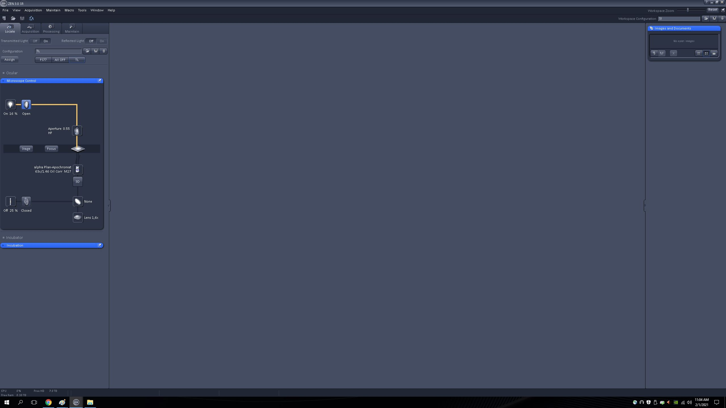
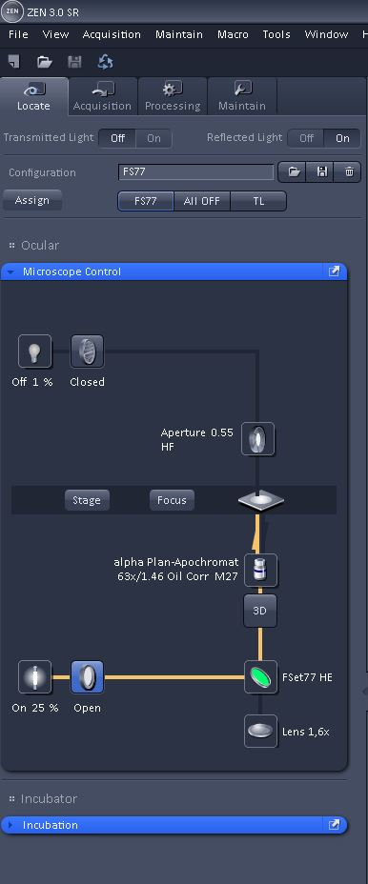
LOCATE TAB
ADVANCED IMAGING CORE
ELYRA 7: ZEN BLACK INTRODUCTION AND LIGHT PATH SETTINGS
The TL (TRANSMITTED LIGHT) option is for brightfield viewing of the sample.
Turn this up to 100% via the lightbulb icon for a lamp-like illumination within the laser-safe box.
The FS77 option uses the FSet77HE filter, allowing you to safely view a fluorescence illumination of the sample.
Choose the ALL OFF option after finding your desired area and before proceeding to the ACQUISITION tab.

Slide 10
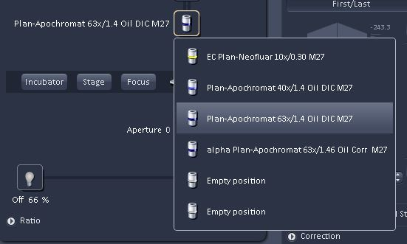
LOCATE TAB – OBJECTIVE SELECTION
ADVANCED IMAGING CORE
ELYRA 7: ZEN BLACK INTRODUCTION AND LIGHT PATH SETTINGS
The objective can be changed by clicking on the OBJECTIVE icon and choosing from the dropdown menu

Slide 11
ACQUISITION TAB
ADVANCED IMAGING CORE
ELYRA 7: ZEN BLACK INTRODUCTION AND LIGHT PATH SETTINGS

Slide 12
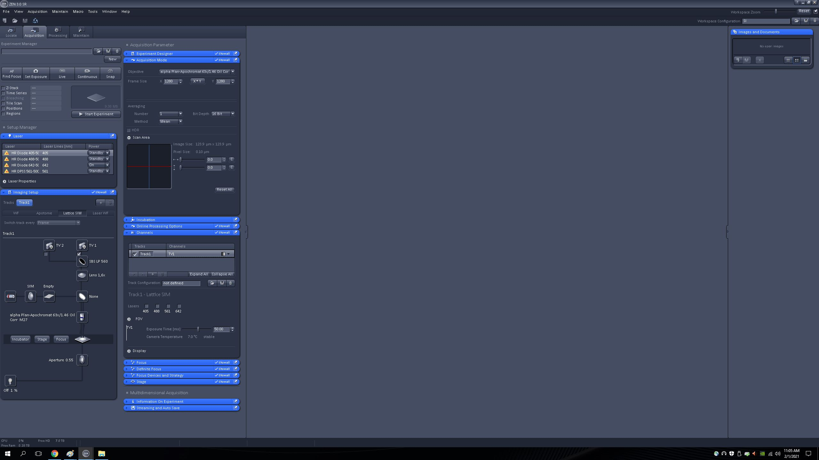
ACQUISITION TAB
ADVANCED IMAGING CORE
ELYRA 7: ZEN BLACK INTRODUCTION AND LIGHT PATH SETTINGS
Note: The bulk of your imaging time will be spent on this tab.

Slide 13
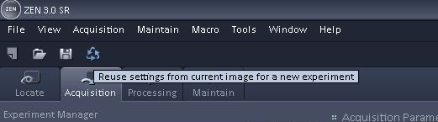
ACQUISITION TAB
ADVANCED IMAGING CORE
ELYRA 7: ZEN BLACK INTRODUCTION AND LIGHT PATH SETTINGS
One of the easiest ways to set up an experiment is to open an image from your last successful experiment and “reuse” the settings by clicking the RECYCLE button.
  NOTE: This is a shortcut and should not be substituted for confirming your settings before each experiment.
  NOTE: Objective selection is independent from this option, and reusing settings will not make the system bring up the previous objective.
Independently selecting the light-path settings without a previous image will be covered next.

Slide 14
ACQUISITION TAB – ACQUISITION MODE
ADVANCED IMAGING CORE
ELYRA 7: ZEN BLACK INTRODUCTION AND LIGHT PATH SETTINGS

Slide 15
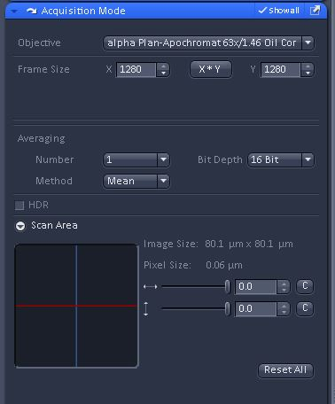
ACQUISITION TAB – ACQUISITION MODE
ADVANCED IMAGING CORE
ELYRA 7: ZEN BLACK INTRODUCTION AND LIGHT PATH SETTINGS
Click the X*Y button to open a dropdown list of common image sizes.
The SCAN AREA shows where within the available field of view you are imaging (most useful when cropping).

Slide 16
LIGHT PATH SETTINGS
ADVANCED IMAGING CORE
ELYRA 7: ZEN BLACK INTRODUCTION AND LIGHT PATH SETTINGS

Slide 17
LIGHT PATH SETTINGS
ADVANCED IMAGING CORE
ELYRA 7: ZEN BLACK INTRODUCTION AND LIGHT PATH SETTINGS
1
1 IMAGING SETUP box
  Selection of imaging modality (Widefield, Apotome, Lattice SIM, Laser WF)
  Displays light path for selected modality, including grating, filter sets, and beam splitters.
2 CHANNELS box
  Track and channel specific settings, including laser power and exposure times
2

Slide 18
LIGHT PATH SETTINGS – CHANNELS
ADVANCED IMAGING CORE
ELYRA 7: ZEN BLACK INTRODUCTION AND LIGHT PATH SETTINGS
NOTE:
The terms “tracks” and “channels” are often used interchangeably when talking about image acquisition settings. In the case of the Elyra, there are dual cameras, allowing for 2 channels to be imaged on 1 track.
When working with live cells, using the dual cameras will decrease the imaging time.
When working with fixed cells/tissues and time is not a factor, keeping the channels on separate tracks is often more convenient.
Camera selections can be made in the adjacent IMAGE SETUP box (covered next).

Slide 19
LIGHT PATH SETTINGS – CHANNELS
ADVANCED IMAGING CORE
ELYRA 7: ZEN BLACK INTRODUCTION AND LIGHT PATH SETTINGS
To add a new track
3) Select color you want displayed for each channel
Clicking the down arrow opens a pop-up for color selection.
1) Click the “+”
A new “blank” track will be listed
2) Name the track
Not an essential step, but future-you will be grateful. Track info (including user-defined names) are listed in the image metadata.
Saving the track configuration is not recommended, as there’s no guarantee another user will not modify it. If you have a configuration that works for you, open your images and recycle the settings.
3) Select the lasers and appropriate laser power
If it is a new experiment/fluorophore, start @ 1-1.5% laser power and then increase (or decrease) as necessary.
4) Set the exposure time
A new “blank” track will be listed

Slide 20
LIGHT PATH SETTINGS – CHANNELS
ADVANCED IMAGING CORE
ELYRA 7: ZEN BLACK INTRODUCTION AND LIGHT PATH SETTINGS
Selecting LASER WF as the imaging mode opens up additional settings in the FOV section related to the 3 different illumination modes (Epi/HiLo/TIRF).

Slide 21
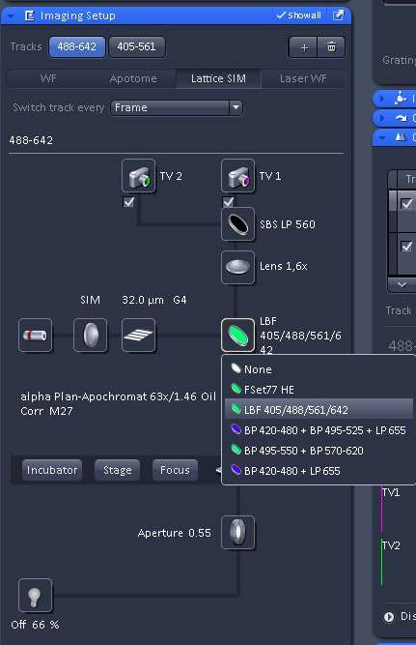
LIGHT PATH SETTINGS – IMAGING SETUP
ADVANCED IMAGING CORE
ELYRA 7: ZEN BLACK INTRODUCTION AND LIGHT PATH SETTINGS
While settings can be adjusted to user specifications, Zen Black has many default settings for the light path depending on imaging modality and laser line being used (for example, the size grating used for SIM imaging)
User input is mainly needed for the selection of the main beam splitter (light reflecting onto and exciting the sample) and the secondary beam splitter (splitting the signal between the two cameras).
For all experiments requiring laser illumination, using the LBF 405/488/561/642 filter is recommended. (The other filter sets are better suited for widefield/ brightfield illumination.)

Slide 22

LIGHT PATH SETTINGS – IMAGING SETUP
ADVANCED IMAGING CORE
ELYRA 7: ZEN BLACK INTRODUCTION AND LIGHT PATH SETTINGS
The secondary beam splitter routes the signal to the camera(s).
  SBS LP 560 – allows light above 560nm to pass through to TV 1, and anything below 560nm is directed to TV 2.
  SBS BP 490-560 + LP 640 – allows light between 490nm and 560 nm or light above 640nm to pass to TV 1, and anything outside of this range to pass to TV 2.
Checking the box under TV 1 and/or TV 2 sets up that camera to capture images for the selected track.

Slide 23
BONUS! HOW DO I KNOW WHEN I HAVE SET THE LASER TO AN APPROPRIATE LEVEL?
ADVANCED IMAGING CORE
ELYRA 7: ZEN BLACK INTRODUCTION AND LIGHT PATH SETTINGS
If it is your first time imaging on the Elyra, or first time using a specific fluorophore, you will need to determine the laser attenuation (power) percentage for each channel individually.
Start by getting an image in focus using the LIVE setting on the ACQUISITION tab (we’ll go into more detail on this later)

Slide 24
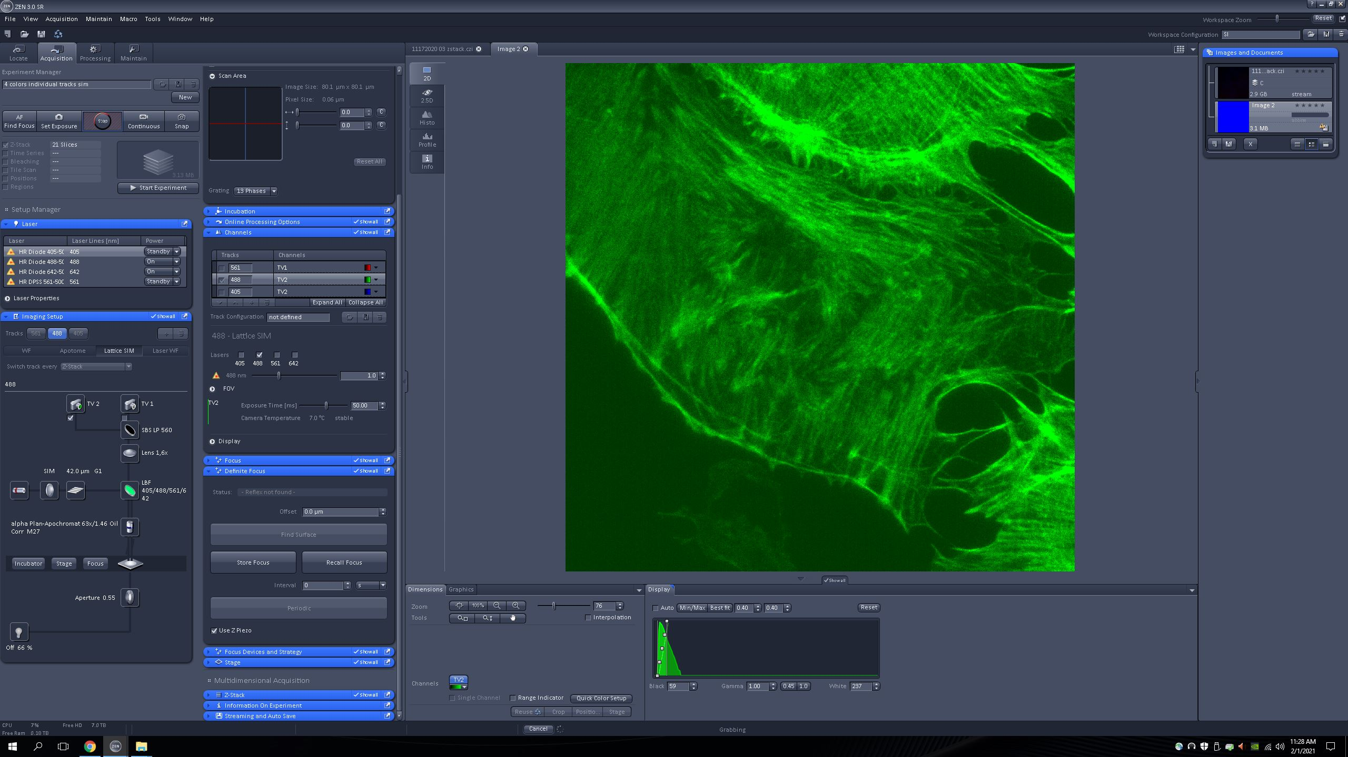
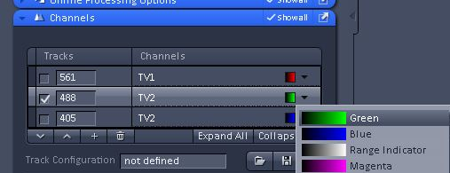
Not too bad, but it looks like some areas are saturated (therefore, structures are not well defined)
Keeping it in LIVE mode, let’s change the display from green to “Range Indicator” (dropdown box in CHANNELS)

Slide 25
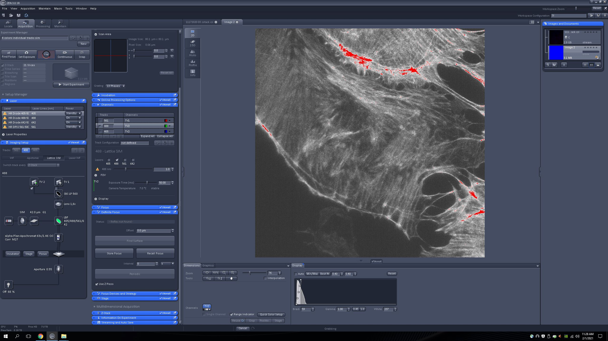
The range indicator mode let’s you know if your image has areas that are too bright (shown in red) or too dim (shown in blue, but none in this image).
For this image, we can see that we need to turn the laser down a bit.

Slide 26
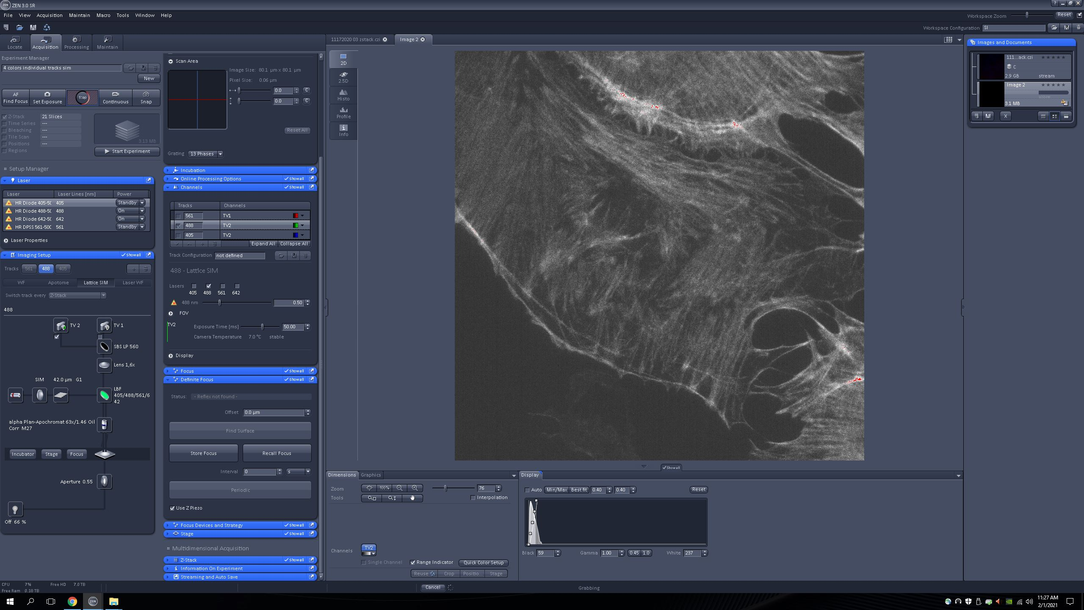
Much better!

Slide 27
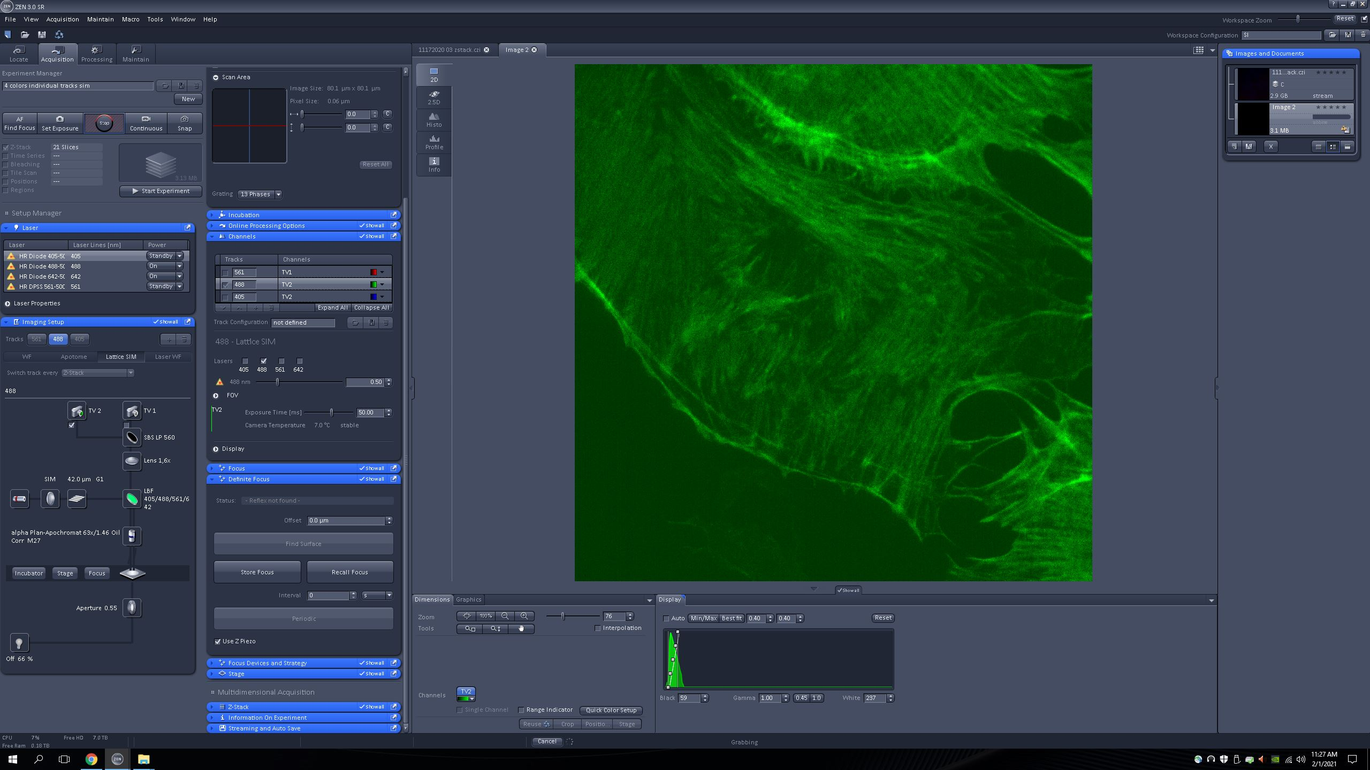
Much better! Notice the structural elements revealed after decreasing the laser. While this will be subjective to your experimental targets, you will generally want to value clarity over intensity.
BEFORE
AFTER

Slide 28
ADVANCED IMAGING CORE
ELYRA 7: ZEN BLACK INTRODUCTION AND LIGHT PATH SETTINGS
You are now ready to take an image!
Don’t worry, we’ll walk you through that too. 😉

