Slide 1
Common UTHSC IRB Audit Findings
Lucy Del Mar, MD, CCRP
March 28, 2022
Notes:
My name is Lucy Del Mar.
I am the IRB Compliance Advisor, and I would like to thank you for attending to today's presentation in Common UTHSC IRB Audit Finding.
We hope this presentation will provide new insights and tools that will help you to be compliant with the regulations and local policies

Slide 2
Authority to audit
45 CFR 46.109(e)
An IRB shall conduct continuing review of research covered by this policy at intervals appropriate to the degree of risk, but not less than once per year, and shall have authority to observe or have a third party observe the consent process and the research.
Notes:
The federal regulations give the IRB the authority to audit approved research studies, under Title 45 of the CFR, sub part 46(e) , so you will be compliant with the federal regulations by showing the IRB Compliance Advisor all study records including the ones with PHI.

Slide 3
UTHSC IRB policy
The UTHSC IRB has the authority to review at any time all research records and materials including, but not limited to: informed consent documents; regulatory files; IRB files; subject's research and medical records, including the results of procedures and tests performed during the course of the research; arrangements for the storage of investigational articles (including drugs, devices, or biologics) and specimens; and protections for the security of paper and electronics research records, as well as for the transmission of the data and specimens to other sites.
Research compliance auditing staff also have the authority to observe the informed consent process and the conduct of the research, and to interview subjects either during or after their participation in research activities.
Notes:
The purpose of this policy is to provide written guidance on operational requirements for compliance auditing activities.

Slide 4
Goals of auditing
Assure protection for human subjects are implemented
Verify that protections for human subjects are properly documented
Assess compliance with applicable regulations, guidance, and local policies
Assure that the University and affiliated institutions remain in good standing with federal agencies that have oversight of human subject research activities
Confirm that study data are accurate and reliable
Notes:
The process of compliance auditing is meant to accomplish several goals:
Because UT accepts federal research dollars, then all research is subject to federal regulations.
A poorly conducted study in one department may produce severe consequences for the entire university.

Slide 5
Always be prepared
Don’t wait until you receive an audit notice to go through your study files and organize.
Conduct the study with the idea that someone will come behind you and review the study files – will they understand what happened?
Institutional audits
Call us about any issues you are having.
Study sponsor monitoring visits
IRB audits
Other investigators
FDA/OHRP
NIH
Notes:
How can we accomplish these goals?

Slide 6
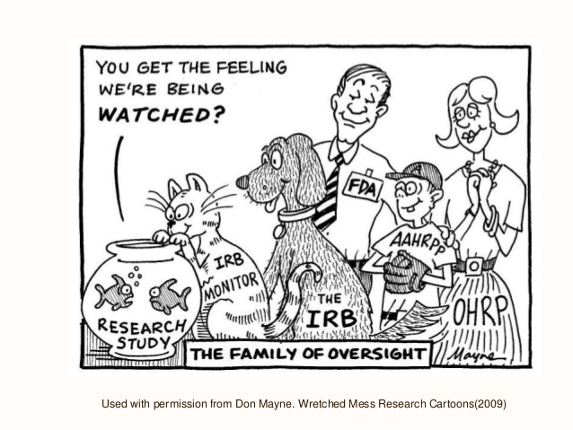
Notes:
I think this cartoon gives you a goo idea of the family of oversight.

Slide 7
The audit process
The IRB conduct different types of audits:
Random/Routine
For-Cause
Training
Investigator Initiated
Informed consent
Notes:
There are 5 types of audits that may be conducted by the request of the UTHSC IRB Director or Associated Director:
1)RANDOM: most of our audits are random and the IRB Compliance advisor selects studies at random.
2)FOR-CAUSE: Can be triggered when the IRB is made aware of:
a)Any report of suspected non-compliance;
b)-Research terminated by the IRB due to investigator not submitting continuing review, or failure to respond to a request for information from the IRB;
c)-Questions regarding the accuracy of continuing review reports;
d)-Studies reporting large number adverse events and/or protocol deviations; or
e)-Studies designated as high risk by the Board.
3)TRAINING: to support new researchers or researchers who initiate projects without external monetary support. Generally performed shortly after the project receives initial IRB approval.
4)INVESTIGATOR INITIATED: investigator or research coordinator may request it to assist in keeping records and procedures in compliance with federal regulations and institutional policies, or to prepare for a sponsor or federal agency audits.
5)INFORMED CONSENT: This audit is intended to support researchers in conducting the informed consent process, observation of consent interviews, evaluation of the training provided to key study personnel obtaining informed consent, review the process of documenting informed consent, and/or review how consent documents are stored.

Slide 8
The audit process
The Investigator is notified via iMedRIS correspondence regarding the audit
The Investigator completes the Pre-Audit Form via iMedRIS within two weeks of the audit request. However, for-cause audits require the form to be submitted within one week of the audit request
Typically requires a response within two weeks
Following the audit, we will send a copy of the audit report and a letter outlining any items that need further action based on the findings.
Sent to: PI, study contacts, Research Admin. Specialist (if applicable)

Slide 9
Report of audit findings
Audit report submitted to IRB Director or Associate Director for review and action.
Minor deficiencies identified in compliance with regulatory and or local IRB policies:
  Request for further explanations
  Implementation of corrective actions by the Investigator
  Study revisions
  Serious deficiencies identified with federal regulations and, or local IRB policies:
    Audit report reviewed at the next full Board meeting.
    Determinations of study suspension or termination by the full Bard.
    Potential corrective actions by the full Board.
Notes:
When minor deficiencies are found, the response of the principal investigator will be reviewed by the IRB Compliance Advisor in consultation with the IRB Director or Associate Director to determine whether all outstanding issues have been addressed. Further communication may occur as necessary until all issues are resolved.
When serious deficiencies, the audit report will be reviewed at the next full Board meeting. The Board will determine if suspension or termination of the study is warranted.
SUSPENSION/Termination: individuals will be notified in writing within 48 hours of the Board’s determination: PI, UTHSC department chair and/or division chief, sponsor, UTHSC Vice Chancellor for Research and officials of the institution in which the research is being conducted, OHRP, or FDA as appropriated. The basis for the suspension or termination will be clearly delineated in the communication.
-PI may appeal the IRB’s decision regarding corrective actions, or suspension or termination of a study with a written request is submitted to the IRB Director within 10 business days after the IRB notification. The IRB Director will confer with the section chair to determine whether the appeal warrants further consideration. If so, the appeal will be considered at the next meeting of the section of the Board that approved the original action being appealed. At the discretion of the IRB Director, the PI may be granted the opportunity to make a presentation to the Board regarding the issue.
Copies of audit reports and correspondence are filed in iMedRIS, as well as in the IRB Compliance Advisor’s electronic files. In addition, copies can be located in the Audit submission, which will be placed on the electronic meeting agenda and sent electronically to Board members before the Board meeting each applicable week when the agenda is finalized.

Slide 10
Correcting problems - General considerations
If it isn’t documented, it didn’t happen!
Research Records should tell a story – Who, What, When.
No project should have just informed consent forms!
In general, the higher the risk level and the more involved the study, the more documentation required.
Organization is key!
Have some method of organization and know how everything is grouped.
Can lead to HUGE problems.
  Can lose data, visits, entire files – could be a HIPAA violation!
  Not submitting things to the IRB in a timely fashion or at all.
Notes:
What is not documented, is not done!!
Make sure to maintain accurate and adequate documentation

Slide 11
Correcting problems - General considerations
Know the local policy and guidelines.
Visit our SOP page
Read the document, “Things to Remember When Conducting Research,” and use the Project Checklists found here: http://www.uthsc.edu/research/compliance/irb/researchers/tools-guides.php
Call the IRB office when you are unsure!
Notes:
To avoid problems know the local policies and guide lines

Slide 12
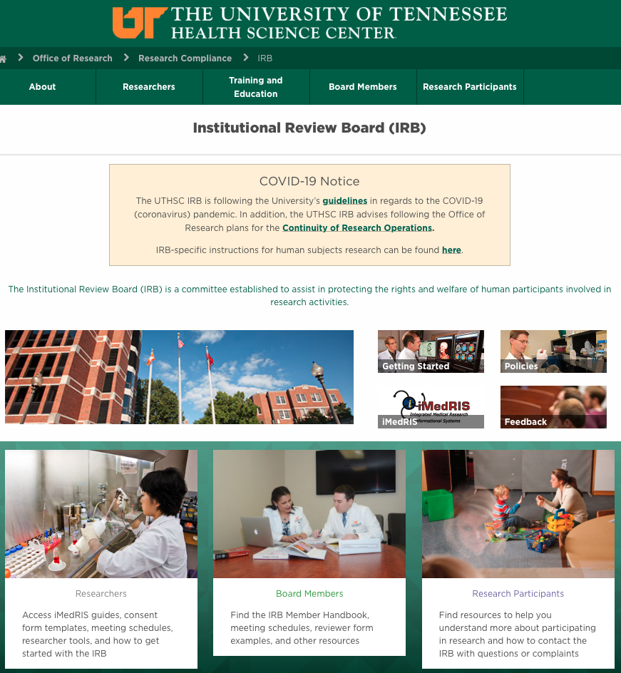
Main IRB website:
https://uthsc.edu/research/compliance/irb/index.php

Slide 13
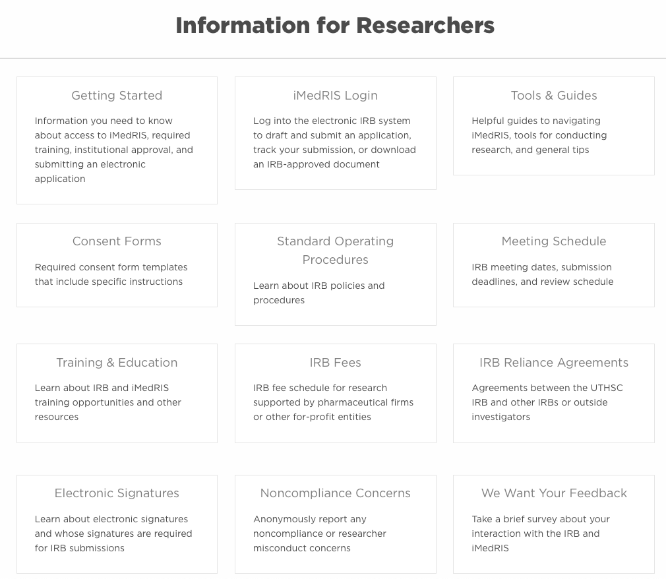

Slide 14
IRB Standard Operating Procedures (SOPs)
IRB Review
Informed Consent & Confidentiality
Vulnerable Populations in Research
Continuing Review/Revisions/Closures/Records
Safety Reports & Protocol Deviations
Advertisements & Recruitment Materials
Drug/Biologic/Device
Regulatory Compliance
Notes:
Here you will find the IRB SOPs that will help you with the conduct of the study.

Slide 15
Audit program 2020 – present
95 % of audited studies exhibited problems in at least one area:
  79 % Consent Process
  63 % Policy Adherence
  63 % Protocol Adherence
  42 % Accuracy and Completeness of Study Records
  26 % Enrollment Numbers
  16 % Inclusion/Exclusion Criteria
  11 % Data Confidentiality
Notes:
These past two years were very challenging to continue performing IRB audits due to the COVID-19 pandemic, but we manage as everyone else.

Slide 16
Consent process
Violations:
Missing consent forms.
Unapproved/unstamped/expired consent forms were used to consent subjects.
Missing the dates/times of consent form signature.
Missing signatures for the person obtaining consent and, or the investigator.
Subject did not initial some or any of the pages.
Notes:
Subject consent/assent and LAR/parent signatures must be BEFORE the person obtaining the consent/investigator sign.
Consent must be obtained before any study procedures are performed.
Person obtaining consent must sign immediately (or as soon as possible) after the subject/LAR.
Investigator must sign within 72 hrs. per UTHSC IRB policy
If y the consent form is missing,
you would not be able to use the data collected on that subject

Slide 17
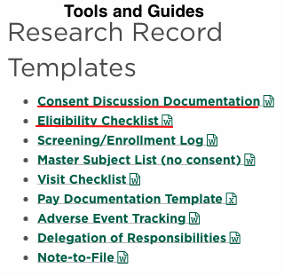
Consent process
Violations:
Altering the consent process without having been approved by the IRB first.
Enrolled subjects consented by people not listed as key
study personnel or as having the responsibility for obtaining
informed consent (Section 415 of your study application).
Child assent not obtained and, or no reason documented
for not obtaining assent.
No consent discussion documentation.
Notes:
Altering the consent process approved by the IRB:
We will find notes in the consent form regarding obtaining telephone consent and a note that may read: “Father was not present during the study visit. Called father on the phone and he gave verbal consent for his son to participate.”
The consent discussion documentation is required for our IRB: explain the insert.

Slide 18
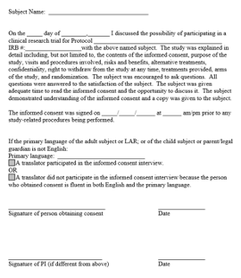
Required: Consent discussion
Consent discussion documentation:
Original signed consent form was kept by the investigator,
and a copy was given to the subject.
The study was explained to the subject, and the subject
had the opportunity to ask questions.
Consent was obtained prior to research procedures.
Any other pertinent details related to the subject.
Can be in another format, such as a checklist, as long as
you also note any special issues or concerns as they arise.
Notes:
You can adjust this template, or do it as a check list, whatever works best for you. The important thing is that this document should accompany the consent form

Slide 19
How to prevent and correct consent violations?
Become familiar with the UTHSC Informed Consent policies.
Before starting the consent process, check to make sure you have the latest approved version from IRB. Tip: get the last stamped-approved version directly from iMedRIS each time.
Check informed consent forms before a subject leaves – 60 seconds can save you months of work trying to fix it later!
An investigator must sign the consent form within 72 hours after the subject and the person obtaining consent.
You must keep the original, signed consent form in the study files.

Slide 20
How to prevent and correct consent violations?
Do not keep enrolling if you notice issues with your first few subjects.
Re-consenting: Make sure you do not repeat the same violation. Re-consenting is not recommended for minor violations that can be corrected through other means.
Check informed consent forms before publishing any data!!
Be sure to note any deviations/discrepancies in the subject’s file.
You can request consent training, and the IRB may require it following the audit. We may also require an audit of the consent process.
Call the IRB if you are not sure!!!!

Slide 21
Policy Adherence
Violations:
Accrual of subjects was continued after IRB approval lapses
Reporting the wrong enrollment numbers
Not reporting screen fails or withdrawals/terminations
Making changes to the consent form
Adding research personnel but not revising the study application
Adding/removing procedures

Slide 22
How to prevent policy violations
Continuing review of research:
Full board and FDA-regulated studies – Continuing review submitted in the timeframe and manner prescribed by the IRB, but not less than once per year.
Expedited studies approved prior to January 21, 2019.
Collect, where possible, information regarding the gender and racial/ethnic origin of all subjects.
Consent/enrollment log recommended.
Remember: Enrollment occurs when the consent form is signed, not when the subject begins/completes research procedures

Slide 23
How to prevent policy violations
Revisions to approved studies:
Obtain prior approval from the IRB for any modifications of previously approved research.
  Even changes that you think are minor could change the status of the study from exempt to expedited or expedited to full board.
  Exposing subjects to risks that they did not agree to, or they are expecting something that they are not getting.

Slide 24
Protocol adherence
Violations:
More information or data was recorded than described in the application/protocol/consent form.
Not performing all procedures during the study visit.
Adding study procedures without IRB approval
Not giving a copy of the informed consent form to the subject.

Slide 25
How to prevent and correct protocol adherence violations?
Become familiar with the UTHSC policies.
Ensure study personnel is familiar with the protocol, including inclusion/exclusion criteria and procedures.
Use a master list/enrollment log and keep it updated!
Create checklists for procedures/information to be collected to help with consistency between subjects.
Review study records frequently.
Notify all study personnel of approved revisions.
If the same protocol deviation comes up repeatedly, maybe a revision is in order

Slide 26
How to prevent and correct protocol adherence violations?
Follow the local policy:
The principal investigator is responsible for reporting all Major Protocol Deviations occurring at the local research site to the IRB.
A major deviation:
  Has harmed or posed a significant risk of substantive harm to the subject;
  Has compromised the scientific integrity of the data collected;
  Appears to result from willing/knowing misconduct on the part of an investigator/staff; or
  Appears to involve some other serious or continuing noncompliance with federal, state, or local research regulations.

Slide 27
How to prevent and correct protocol adherence violations?
All major deviations should be reported as soon as possible, but no later that 5 working days after the investigator/coordinator becomes aware of the event.
Minor deviations do not have to be reported to the IRB; however, a note-to file should be made in the research record indicating:
  What the minor deviation was;
  The reason it occurred; and
  The communication that took place or plan implemented so that the deviation would not occur again.
  Remember that the continued occurrence of minor deviations could compromise the scientific integrity of the research data collected.

Slide 28
Accuracy and completeness of study records
Violations:
Missing study visits
Incomplete documentation of study visits
Not performing all study procedures
Missing surveys/questionnaires
Payment methods not kept according to IRB approved application and to UT policies
Subject eligibility not documented
Inappropriate error correction made to study records

Slide 29
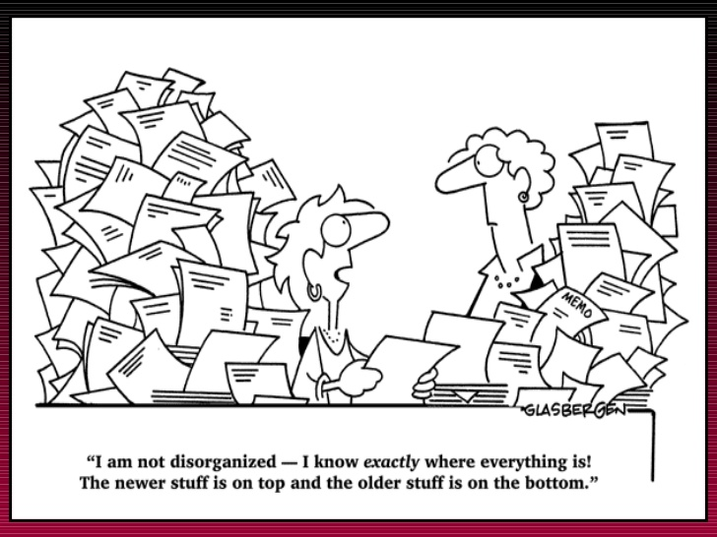
Notes:
Having research records organized will avoid many issues, and will help you to have a better control over the conduct of your study.

Slide 30
Ways to organized
By Subject number/code or initial
Chronological Order
By Visit or procedure
By family
For large files, use ringed binders
For studies with multiple visits or sub-studies, use dividers
Have files all in one place
Label in a way that makes sense to every
Not Recommended
All studies for one subject in the same file
Stacks of paper with no folders or dividers

Slide 31
ALCOA+ Principles (Data Integrity)
Attributable: traceable (who, when)
Legible: easy to read, written in a permanent medium (not pencil)
Contemporaneous: recorded as it happened
Original: source information should be kept in their original form
Accurate: source completely reflects the actual observations
Complete: record study data on time
Consistent: data should be able to recreate the sequence of events
Enduring: data should be kept over time
Available: accessibility of the data for review and inspection when needed
Notes:
ALCOA+ principles describe the components to ensures data integrity. It was introduced by the FDA in the 90, and it is still in use.

Slide 32

Enrollment Number Violations
The number of subjects that signed the informed consent does not match what Is reported to the IRB in the renewal application.
Enrollment occurs when the consent form is signed, not when the subject is randomized. Therefore, an estimate of screened failures should be incorporated into the target enrollment number submitted to the IRB. Also, the number of subjects who signed the consent form, not just the number of randomized subjects, should be included on the renewal application under the number of subjects accrued.

Slide 33
How Do We Correct Them?
Keep a consent log to track enrolled subjects. A template is available at:
http://www.uthsc.edu/research/compliance/irb/researchers/tools- guides.php
If you need more subjects, submit a Form 2: Change Request & Amendments for IRB review and approval before enrolling additional subjects.
Notes:
Also, more subjects may be enrolled that was approved in the study application. Check your IRB-approved study application, under section 1400, and know how many subjects you are approved to enroll.

Slide 34

Inclusion/Exclusion Criteria
Violations:
Subjects did not meet the inclusion/exclusion criteria for the study.
No source documentation confirming eligibility criteria was recorded.

Slide 35
How do we correct them?
READ the protocol and KNOW the eligibility criteria.
Use an eligibility checklist. The UTHSC IRB policy requires documentation that the subject met inclusion criteria and did not meet exclusion criteria before a subject is consented.
If it is determined that a subject did not meet criteria at
the time of enrollment, the data cannot be used.
Notes:
If your study has an inclusion/exclusion criteria this check list should be included.
This is a good way to confirm if a subject meets enrollment criteria
Talk about the insert and where to find the template.

Slide 36
Data Confidentiality
Violations:
Consent forms and study-related paper documents not securely stored.
Consent forms and study-related paper documents stored in a location not disclosed in the study application.
Other violations that can occur:
Electronic data with PHI not password-protected
Data being transmitted in a non-secured manner
Biospecimens are labeled with identifiers rather than being coded
Notes:
Investigator needs to follow what was describe in the study application to protect subject confidentiality:
Records store in locks cabinets
Address of the store location is stated in the IRB application.
Electronic databases should be password protected.

Slide 37


Summary of best practices
Perform all and only those research procedures that are specifically described in your IRB-approved application.
Use compliance tools & checklist available on the IRB website. The TN-CTSI also provides a number of tools and resources for researchers.
Use the consent form & research records to carefully document all aspects of the informed consent process.
Submit continuation applications three weeks before your expiration date.
Secure approval for all study revisions prior to implementation.

Slide 38
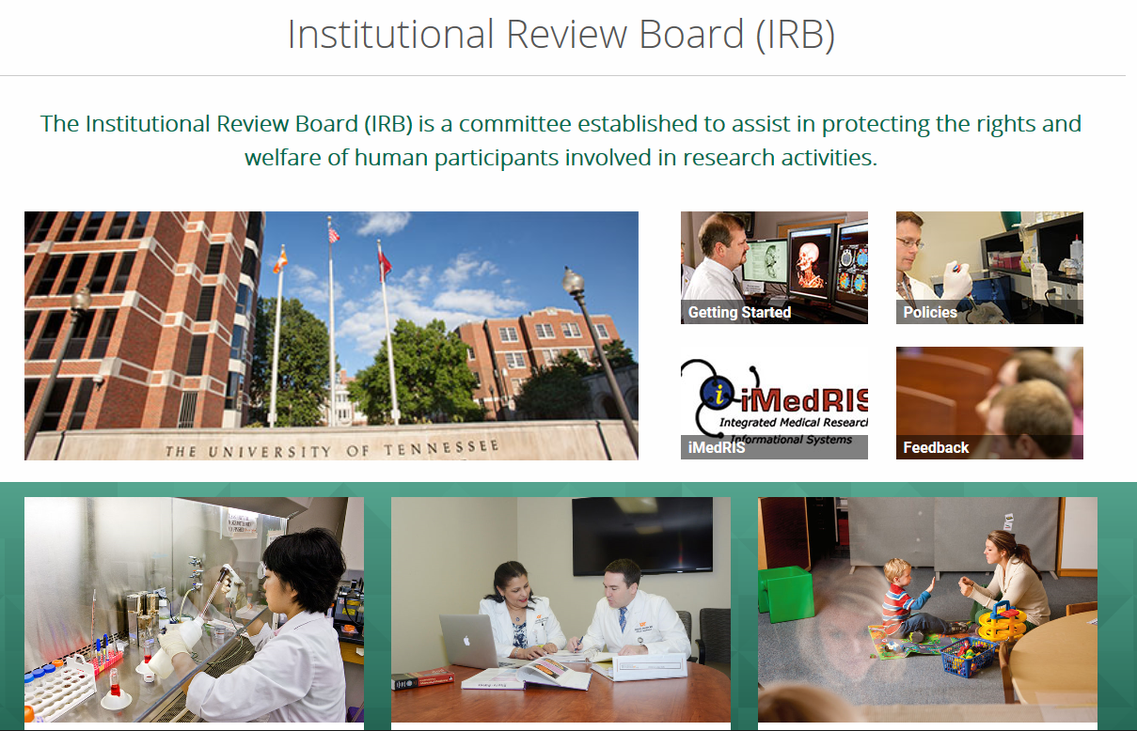
Thank you!
www.uthsc.edu/research/compliance/irb

