Slide 1
Ethics: Case Studies and Discussions
Derita Bran, BSN, RN, CCRC
Molly Rolen, BSN, RN, CCRC

Slide 2
Objectives
Identify ethical principles when conducting research
Recognize types of misconduct
Discuss ethical problem-solving solutions/strategies

Slide 3
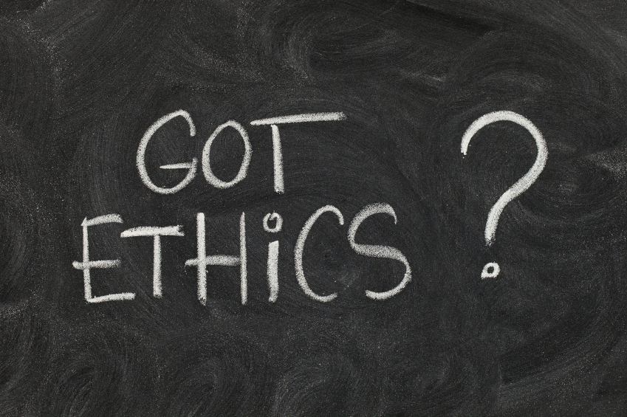
Overview
Declaration of Helsinki
Belmont Report
Nuremburg Code
Office of Research Integrity (ORI)

Slide 4
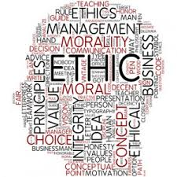
Definition of Ethics
Ethics:
Moral principles that govern a person's behavior or how an activity is conducted
The discipline dealing with what is good and bad, and with moral duty and obligation
The basic concepts and fundamental principles of decent human conduct
A system of moral principles
Standards of right and wrong that prescribe what humans ought to do, usually in terms of rights, obligations, benefits to society, fairness, or specific virtues

Slide 5
Ethics in Research
Provides guidelines for the responsible conduct of research
Guides decision making
Assists in dilemma resolution
Based on a person’s own values

Slide 6
Ethical Principles
The ethical principles involving research that researchers must adhere to are the principles of:
Justice, Beneficence, Non-maleficence, Accountability, Fidelity, and Autonomy
The ethical principles aligned with doing a good job in any context should always be integrated when conducting research. Those principles include:
Honesty, Objectivity, Integrity, Carefulness, Openness, Credit, Responsibility, and Respect

Slide 7
Ethical Obligations in Research
Adherence to responsible conduct of research (RCR) guidelines will help an investigator
Avoid departures from accepted ethical research practice and prevent the serious deviations that constitute research misconduct

Slide 8
Types of Misconduct
Research misconduct (falsification, omission, or fabrication of data, plagiarism)
Misrepresenting research data
Collaboration issues (authorship, ownership of data)
Conflict of interest
Involved in ethic violations through the wrong actions of other
Confusion between research and routine care
Coercion/undue influence
Lack of data integrity
* Honest mistakes/errors are not considered research misconduct *

Slide 9
Historical Cases of Misconduct
U.S. Public Health Service Syphilis Study at Tuskegee
Nazi trials
Eric Poehlman
Andrew Wakefield

Slide 10
Questions to Ask
What is the problem or issue?
Get a clear statement of the problem without bias
Usually takes more than one person to determine the problem
Seek expert advice
What is the relevant information?
Need correct information
Understand the scope and details
Determine which facts impact the issue or outcome

Slide 11
Questions continued
What are the different options?
Difference of opinions
Policies and procedures
Ethical principles

Slide 12
Case 1: Payment for Participation
Scenario: A 34 y/o female with low economic status is approached to participate in a Phase 1 drug study that offers a large amount of compensation. This potential participant could happily use the money to supplement her household expenses, such as groceries for her 2 children.
She has a history of some negative reaction to medications, none that have required intervention outside of stopping the drug. The study design includes 50% of the total payment ($600) until the last day of the 4 day treatment. Day 1-3 payment is $100 each day. Day 4- $300 payment.
Are there undue Influences/Inducements to participate?
Are the payment arrangements ethical?
Effective informed consent vs coercion to participate due to payment?
Retention method?
How much remuneration is the right amount?

Slide 13
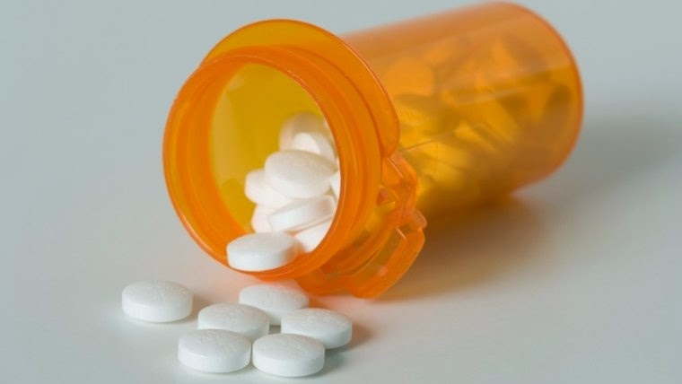
Case 2: Randomization and Benefits
Scenario: A subject is participating in a oncology clinical trial. The clinical trial is a randomized, double-blinded, placebo-controlled study of an investigational oncology drug. Participation is to last two years.
After 6 months, one subject is not experiencing any signs of improvement and may be getting worse.
The subject asks the PI if he is in the treatment or placebo arm. He is requesting to be taken out of the trial if he is in the placebo arm. The PI believes the subject is in the placebo arm.
What are the ethical dilemmas?
What should the PI do?
What would you do?

Slide 14
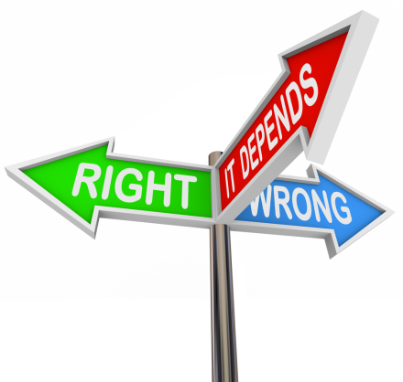
Case 3: Assessment of Cognitive Abilities
Scenario: 27 y/o male patient who a PI indicates should be enrolled on a study. The PI assesses the potential subject as being able to consent for himself because his records show him to be an adult without the need of guardianship or a legal authorized representative.
The subject usually has his grandmother, whom he lives with, present for all appointments however, she is not present with him at this visit.
The coordinator assesses the cognitive ability of the potential subject and does not believe he has the appropriate understanding of the study to sign informed consent on his own behalf.
Are the legal guidelines being met?
Are the ethical concerns of the coordinator relevant?
What courses of action should be taken?

Slide 15
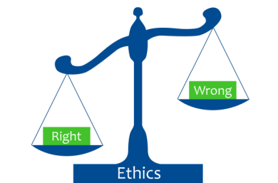
Case 4: Informed Consent
Scenario: A family is being approached to consent their 13 y/o child (age of assent) to a research study with no direct benefit to the patient. The study involves a few blood draws and an hour long MRI.
The patient is fluent in English and the parents seem to understand the majority of what is spoken; however, their native language is Spanish. On record they have refused the option to use an interpreter for standard-of-care medical issues. The PI, who is also the specialist caring for their son, is aware of this. The PI gives an abbreviated version of the study and explains the consent form and directs the coordinator to consent the subject and parents. The coordinator is present for the consent and feels that the parents are not understanding some of the details.
The parents agree to consent their child to the study. The patient does not want to participate, as he has had an MRI before which made him very upset and anxious and does not want to undergo multiple needlesticks.
What are the factual concerns/have any policies been violated?
How much weight should assent be given?
What would you do?

Slide 16
Occurrence of Misconduct
How common is research misconduct?
Data were not collected on research misconduct until the 1990s
Overall estimated cases of research misconduct in the US is one case out of every 100,000 investigators. There are approximately 2 million active investigators in the US
Received allegations of misconduct by the US Office of Research Integrity
198 average in 1992-2007
271 average in 2004-2007
217 in 2007
201 in 2008

Slide 17
Ask the Right Questions
Which choice could stand up to further publicity and scrutiny?
Which choice could you not live with or live with?
What would the wisest person you know do if he/she were in your situation/ethical dilemma?
Which choice would be the most ethical, just, fair, or responsible?

Slide 18
Things to Consider
After considering all of your options you might find it difficult to decide what to do. If this is the case, then you may want to consider others ways of making the decision:
Go with your intuition
Seek guidance
Ask more questions
Gather more information
Explore different options
*In the end, when making a decision regarding an ethical dilemma,
you have to be able to justify your decision*

Slide 19
What are Your Resources?
Are there any people who can offer ethical advice for research?
It may be useful to seek advice from a:
Trusted colleague
Senior researcher
Department chair
Compliance officer
Staff member/Director of an Institutional Review Board

Slide 20
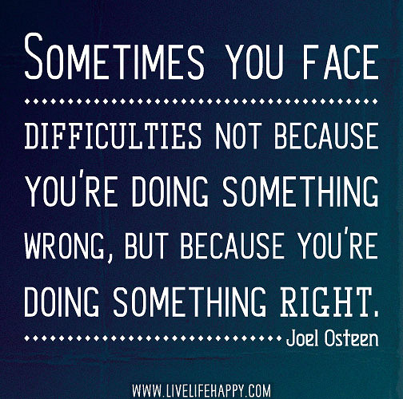
Conclusion
Treat ethical dilemmas as learning opportunities and grow as researchers
There are differences in people’s responses to ethical issues
Ethical issues will continue
Protect research subjects from harm

