Slide 1
Protocol Deviation and Appropriate CAPA Derita Bran, MSN, RN, CCRC

Slide 2
Objectives
Define CAPA
Describe the components of a CAPA
Creating appropriate CAPAs for different types of protocol deviations
Explanation of best practices when creating a CAPA

Slide 3
Compliance
ICH GCP 4.5.1 states the following:
The investigator/institution should conduct the trial in compliance with the protocol agreed to by the sponsor and, if required, by the regulatory authority(ies), and which was given approval/favorable opinion by the IRB/IEC. The investigator/institution and the sponsor should sign the protocol, or an alternative contract, to confirm agreement
ICH GCP 4.5.2 states the following:
The investigator should not implement any deviation from, or changes of, the protocol without agreement by the sponsor and prior review and documented approval/favorable opinion from the IRB/IEC of an amendment, except where necessary to eliminate an immediate hazard(s) to trial subjects, or when the change(s) involves only logistical or administrative aspects of the trial (e.g., change in monitor(s), change of telephone number(s))

Slide 4
Compliance
ICH GCP 4.5.3 states the following:
The investigator, or person designated by the investigator, should document and explain any deviation from the approved protocol
ICH GCP 4.5.4 states the following:
The investigator may implement a deviation from, or a change in, the protocol to eliminate an immediate hazard(s) to trial subjects without prior IRB/IEC approval/favorable opinion. As soon as possible, the implemented deviation or change, the reasons for it, and, if appropriate, the proposed protocol amendment(s) should be submitted: (a) To the IRB/IEC for review and approval/favorable opinion; (b) To the sponsor for agreement and, if required; (c) To the regulatory authority(ies)

Slide 5
Compliance
FDA Guidance:
The Investigator will conduct the study(ies) in accordance with the relevant, current protocol(s) and will only make changes in a protocol after notifying the sponsor, except when necessary to protect the safety, the rights, or welfare of subjects;
(b ) Will comply with all requirements regarding the obligations of clinical investigators and all other pertinent requirements in this part;
(c ) Will personally conduct or supervise the described investigation(s)

Slide 6
Non-Compliance
Failure (intentional or unintentional) to comply with:
applicable federal regulations,
state or local laws,
the requirements or determinations of the IRB/sponsor/protocol
institutional policy
regarding research involving human subjects
Non-compliance can result from actions or omissions

Slide 7
Prevention vs Reactive Approach
Ways to prevent issues when conducting research:
PI Oversight
Well-trained research team
Well-written protocol
SOPs/MOPs
Appropriate DOAL
QA/QI system
Mentoring program for junior faculty/team members
Culture that encourages study team members to seek clarification
Adequate monitors/auditors

Slide 8
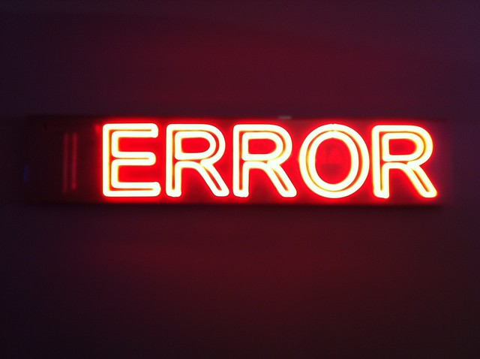
Deviations are INEVITABLE

Slide 9
Do all errors/mistakes/oops require a correction?
Do all errors/mistakes/oops require a CAPA?

Slide 10
Protocol Deviations
Occur when study procedures
depart from the
IRB approved protocol

Slide 11
Steps to Take When Protocol Deviations Occur
Immediate corrections should be focused on protecting the rights, welfare, and safety of subjects and reporting
Document of the deviation
Consider the reporting requirements and report appropriately
You may also need to notify subject(s) of the issue identified
Develop an applicable CAPA

Slide 12
What is a CAPA?
Stands for:
Corrective and Preventive Action Plan
CAPA is
a system/process for resolving quality issues and prevention of repeat occurrences

Slide 13
FDA’s Definition of Corrective Action
The FDA indicates that corrective action plans are absolutely necessary to resolve
problems and noncompliance in clinical investigations
Corrective actions are those taken to resolve a problem and preventive actions are those actions that keep the problem from recurring
Corrective action is action to eliminate the cause of a detected non-conformity or other undesirable situation
There is a difference between correction and corrective action

Slide 14
CAPA Process
IDENTIFY the issue/event/deviation
EVALUATE the extent of the issues and ASSESS the risk of harm for subjects
CORRECT the issue: develop REACTIVE steps to correct the immediate problem
UNDERSTAND the issue: IDENTIFY and ANALYZE the underlying cause(s) and extent of the problem(s)

Slide 15
CAPA Process
DETERMINE needed change/actions, PREVENT future issues: be PROACTIVE
DEVELOP/IMPLEMENT the CAPA in a clear and concise manner
COMMUNICATE/REPORT/DISSEMINATE information to appropriate persons/authorities, including training
EVALUATE processes for effectiveness (this is never ending)
CLOSURE of CAPA

Slide 16
Root Cause Analysis (RCA)
A root cause analysis (RCA) is the process of identifying and documenting the root cause and the downstream effect on the causal chain
RCA should focus on identifying underlying problems that contribute to error rather than focusing on mistakes made by individuals

Slide 17
Root Cause Analysis
Develop a root cause analysis as soon as possible after the event/issue has been identified
Collect information from all individuals involved with the event
Review current processes
What happened? Identify the issue/event
Why and how did the issue occur? What were the steps leading up to the event?
Who/what was affected by the issue?
Any risks to the subject(s)/data integrity?
How often did the issue occur?
Are you identifying a trend?
How serious was the event?
Keep asking “who, what when, where, and how” until you reach the root cause
Ask WHY 5 times until it can’t be asked again

Slide 18
RISK ANALYSIS
After immediate corrections have been made, evaluate the risk of the deviation
Assess any actual/potential risks for subjects
Take immediate action to protect subjects
Evaluate any reporting requirements

Slide 19
Writing the CAPA
Once the root cause has been identified, the next step is to develop a corrective and preventive action plan to eliminate the root cause

Slide 20
From Emory University
CAPAs must be thorough (SMART CAPA)
Specific: Compliant with regulations, addresses the full observation or root cause, accountable to named individual or role
Measurable: Action can be measured to demonstrate whether it is adequate to address root cause
Achievable: Addresses all implicated processes and levels
Realistic: Plan can be carried out given resources, knowledge and expertise
Time-bound: Assigned to a person or role who can accomplish action in a given time period, addresses urgency and criticality

Slide 21
Best Practices
SHOULD BE WRITTEN TO EXPLAIN AN ERROR AND RESOLUTION TO THE ISSUES IN A FORWARD THINKING MANNER
A CAPA SHOULD BE WRITTEN ON DEPARTMENT/
INSTITUTION FORM
SHOULD BE MAINTAINED AS AN ESSENTIAL DOCUMENT IN THE REGULATORY FILE
SHOULD BE SIGNED/DATED BY THE AUTHOR AND THE PI
TAKE RESPONSIBILTY FOR THE ERROR/EVENT/
ISSUE
Make sure to DO WHAT YOU SAY YOU WILL DO
APPROPRIATELY ASSESS CAUSES OF THE PROBLEM
TRAIN STAFF ON NEW PROCESSES
EVALUATE TO ENSURE YOUR CAPA WORKS
DOCUMENT EVERY STEP OF YOUR CAPA

Slide 22
Don’ts When Writing a CAPA
Don’t promise corrective/preventive actions that could never
realistically be carried out

Slide 23
Deficient CAPAs
Not addressing why the problem occurred
Not providing enough detail when writing the CAPA
• Not outlining a timeframe of the corrective actions
Not addressing how you will evaluate the implementation/effectiveness of the corrective actions
Not developing SOPs when needed
Not performing an adequate root cause analysis
Not specifying the role/responsibilities of the PI when developing/implementing/evaluation the CAPA
Not providing adequate documentation of the CAPA process

Slide 24
CAPA Forms
Header
Description of the Event/Issue
Root Cause Analysis
Immediate Action
Planned Corrective Action
Personnel Responsible for Ensuring the CAPA is Implemented
Implementation with Dates
Resolution
Evaluation
Comments
Signatures/Dates
Documentation of actions until the CAPA is closed
Supporting documentation

Slide 25
Evaluation of the CAPA
CAPAs must be evaluated over time
Effectiveness check is the final step of the CAPA process
Ensure that the CAPA has addressed the root cause and that the problem has not recurred
If the CAPA has not addressed the root cause, amend the CAPA as necessary
Train on the process
Implement the process
Re-evaluate

Slide 26
Situation 1
Multiple reportable SAEs were not reported to the Sponsor/IRB within the appropriate timeframe

Slide 27
Situation 2
Subjects 001-005 did not have safety study labs performed on visits 1 and 4

Slide 28
Situation 3
The DOAL was not completed accurately and in a timely manner

Slide 29
Situation 4
Page 4 of the ICF was not initialed
This page contained the risk/benefit explanation

Slide 30
Situation 5
Numerous consent
form irregularities
have been made including the use of the incorrect version and the lack of re‐consenting as needed
How do you
determine the
root cause?
Is this reportable to
the IRB?
Who is responsible
for implementation?
Does this CAP apply to one or all studies?

Slide 31
Summary
Successful resolution depends on identifying the real cause of the issue
Development of a CAPA that addresses issue
Closure occurs when the CAPA has effectively resolved the issue and is in place to prevent it from recurring in the future
Process improvement is continuous
Remember: minor issues can grow and may have negative impacts on the safety of patients, the study results,
and the reputation of the site, CRO and sponsor

