Slide 1
RESEARCH 103
Session 3:
PART 2: Using REDCap for Data Capture
Parya Zareie, MS
Lokesh Chinthala, MS

Slide 2
What is REDCap?
REDCap is a secure web-based application that supports data capture and management for research studies
Originally designed at Vanderbilt University, it is now used at more than 2000 institutions worldwide
REDCap is user friendly and menu-driven processes for rapidly developing databases
Does not required in-depth IT knowledge or constant IT Tech Support to use
Users will be able to quickly and intuitively build and manage research data forms and surveys

Slide 3

Common Misconceptions about REDCap
REDCap is designed for Collecting Information
It is:
  Not a Data Storage system
  Not a Statistical/Analytical tool
  Not a Data Anonymization tool

Slide 4
Features
Create forms for data entry and surveys
Enter data with workflow for managing the project
Surveys delivered to participants electronically
Reuse of forms for multiple events/arms
Data export to common statistical packages with de-identification tools
Data import from Excel and XMl formats
API capability
Real time quality rule checks and post collection data query resolution
Full audit trail

Slide 5
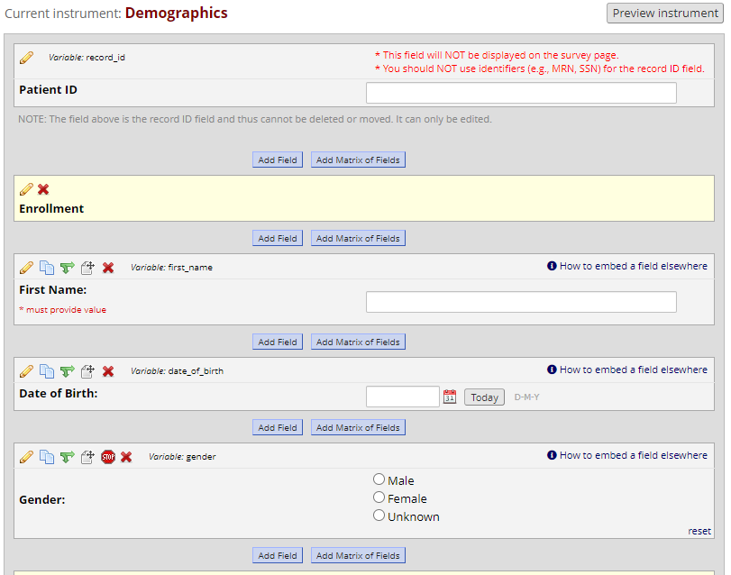
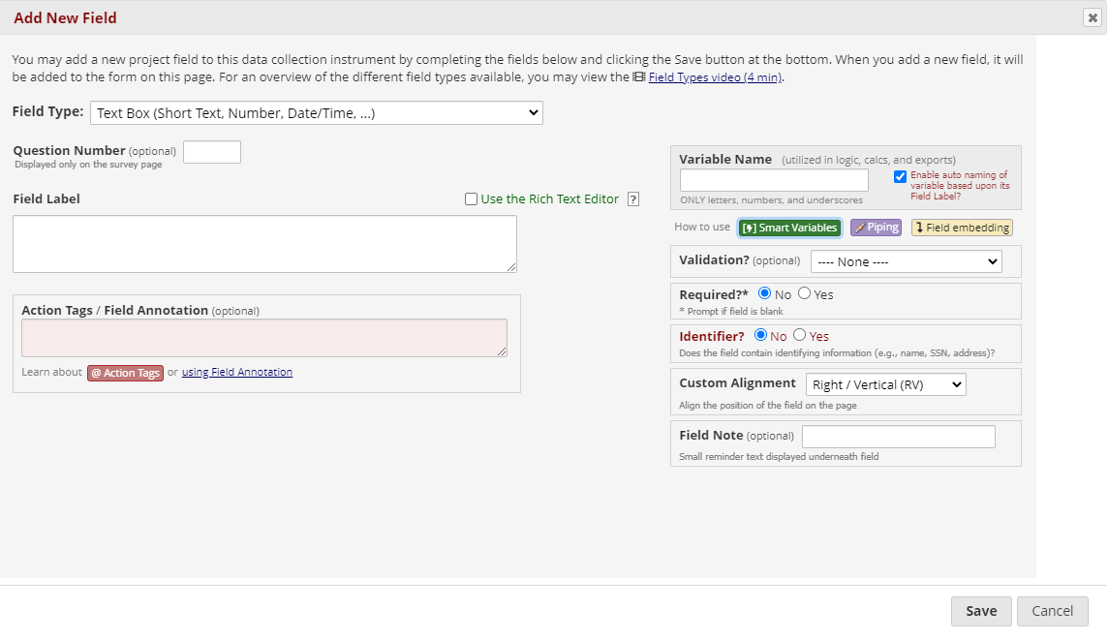
Form Development
Notes:
The 'Piping' feature in REDCap allows you to inject previously collected data into text on a data collection form or survey, thus providing greater precision and control over question wording.
In REDCap Field Notation, variable names always point to data fields in the project. However, another type of entity exists called 'Smart Variables' that allow you to reference information other than data fields. Smart Variables are context-aware and thus adapt to many different situations in which they can know who the current user is, what event is currently being viewed, whether or not an instrument is being viewed as a survey or data entry form, etc. In this way, Smart Variables are dynamic (and thus 'smart') because they adapt to the current context in which they are used.
The 'Field Embedding' feature in REDCap is the ultimate way to customize your surveys and data collection instruments to make them look exactly how you want.

Slide 6
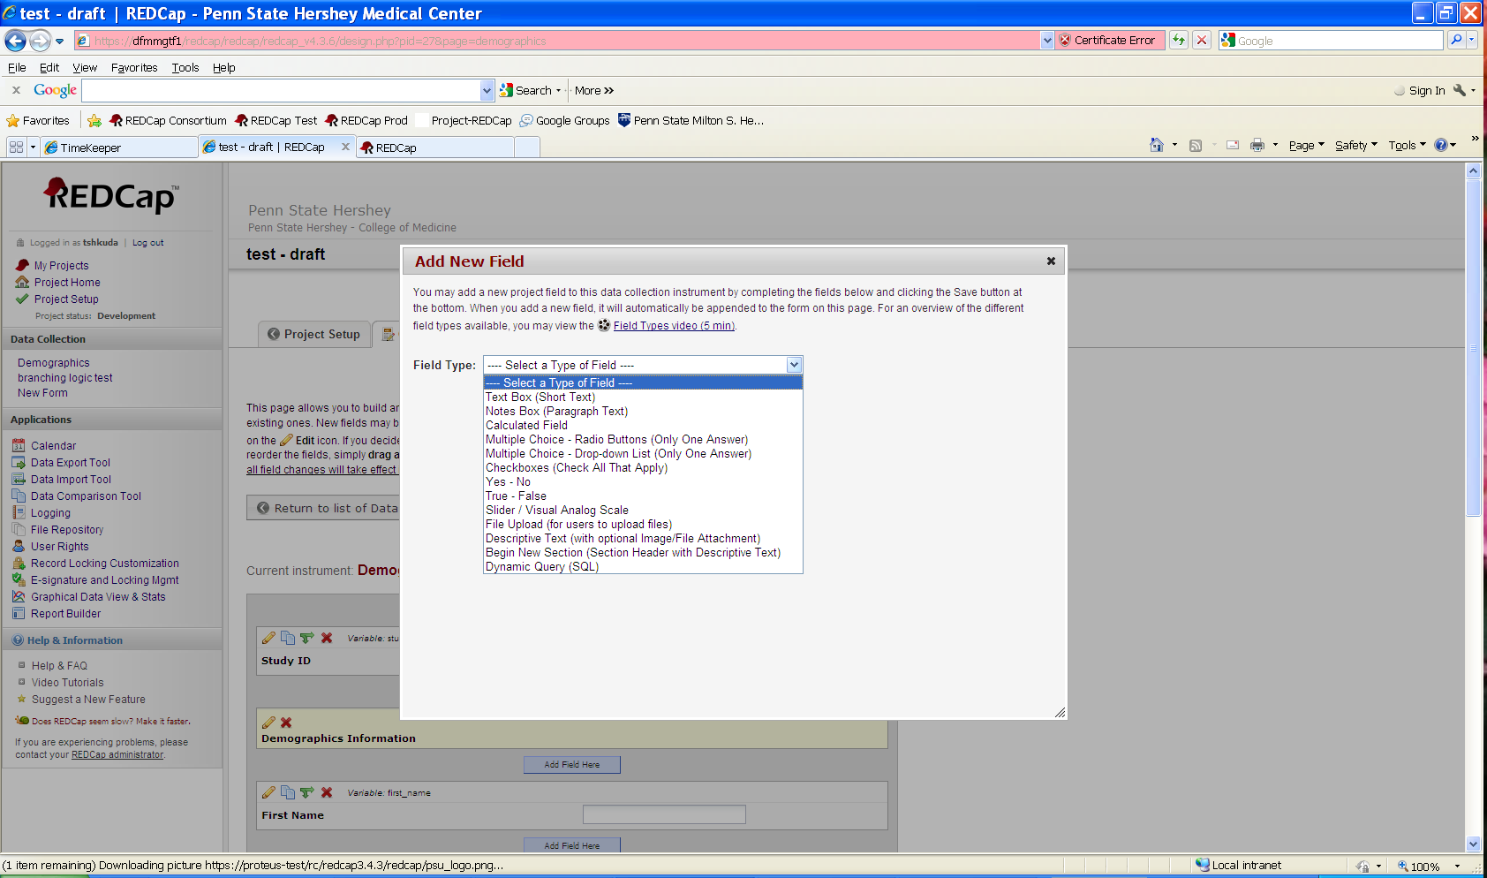
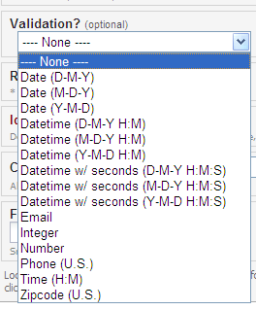
Field Types and Validation
Define Field Type
Determine validation

Slide 7
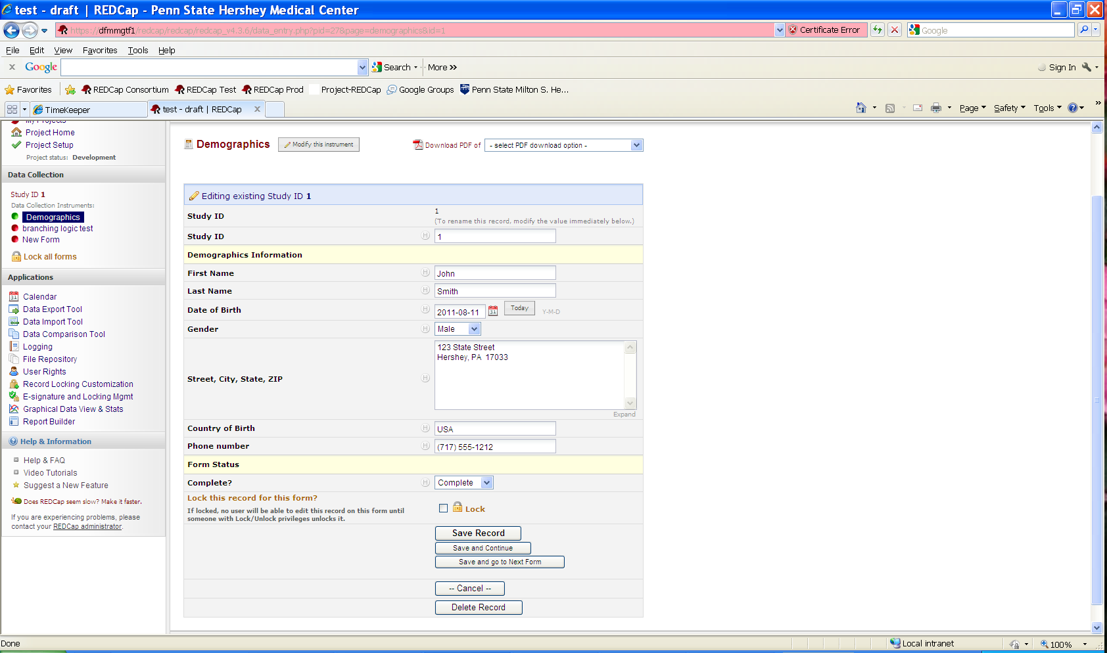
Data Entry

Slide 8






Reporting & Exporting Data
Exports to most common statistical packages
De-identification Options
  Automatic removal of pre-specified identifiers
  Date Shifting
  Automatic removal of text and note fields
Develop quick reports for quality control
Audit logs

Slide 9
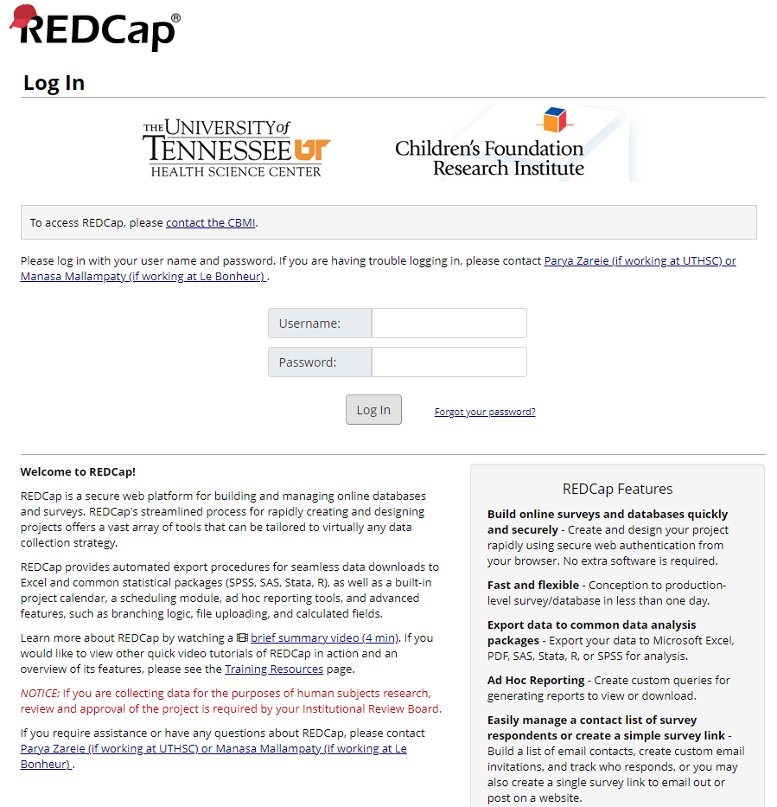
REDCap Demo
Hands on experience with redcap.uthsc.edu

Slide 10
Security & Integrity
Audit logs
Role-based user rights
Annual Risk Analyses
Developed Standard Operating Procedures for:
  Training
  Access
  Risk Management
  Test Plans
Regularly scheduled network security scans
Regularly receives updates
Data stored in the Data Center and backed up nightly

Slide 11
Training
REDCap Introductory Session
  Offered Monthly by Center for Biomedical Informatics at University of Tennessee Health Science Center (Both in person and via Zoom)
  Required for at least one project member
Vanderbilt tutorials
  Available free on web (www.project-redcap.org)
  Excellent step-by-step instructions through all modules
Peer Training

Slide 12
More information
Visit our website at https://uthsc.edu/cbmi/services/redcap.php
Vanderbilt University’s website for REDCap www.project-redcap.org
For further information, contact: redcap@uthsc.edu
Questions…

