Slide 1
Social Media in Research Recruitment
Recruitment & Retention Series
SESSION 7:
Ashley G. Evans, BA, MS

Slide 2
Overview
Social Media Scope
Utilizing Social Media
Tips & Resources

Slide 3
Social Media Scope

Slide 4
Why Use Social Media?
Access to a wider range of potential participants
Facilitating information sharing through social networks
Free or relatively inexpensive to use
Unlimited recruitment opportunity
Targeted advertisements
Notes:
Social media is media designed to be disseminated through social interaction using highly accessible and scalable publishing techniques. Social media uses Internet and web-based technologies to transform how people communicate with one another and receive news, information and entertainment.
Utilizing social media is beneficial because:
There is Access to a wider range of potential participants
Facilitating information sharing through social networks
Free or relatively inexpensive to use
Unlimited recruitment opportunity
Targeted advertisements

Slide 5
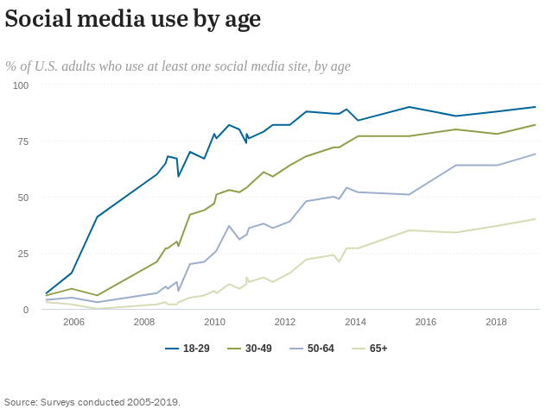
Who’s Using Social Media?
72% of the public uses some type of social media
  Ages 18 to 29: 84%
  Ages 30 to 49: 81%
  Ages 50 to 64: 73%
  Ages 65 and older: 45%

Slide 6
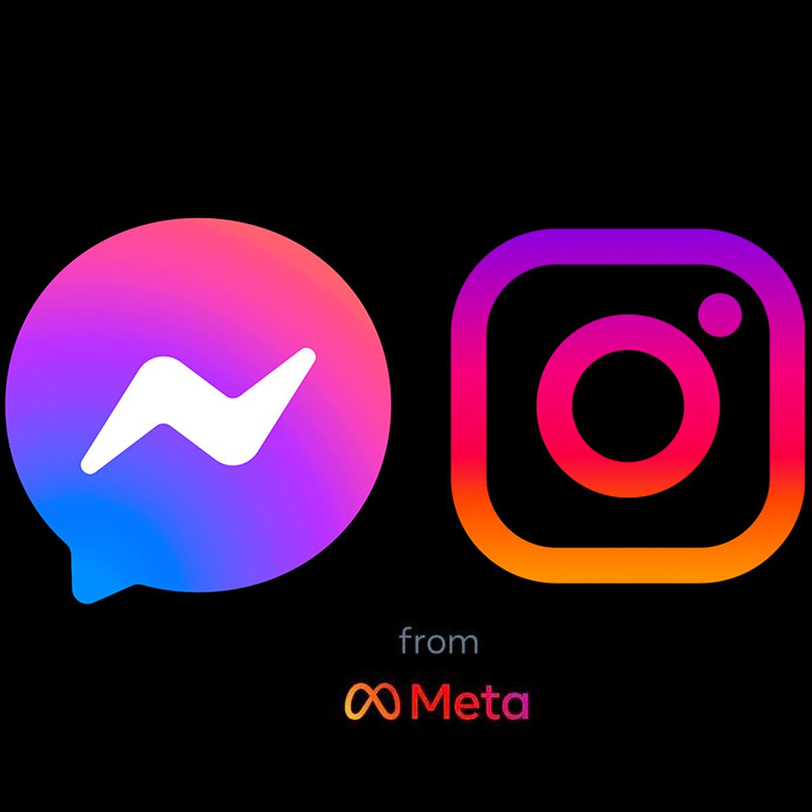
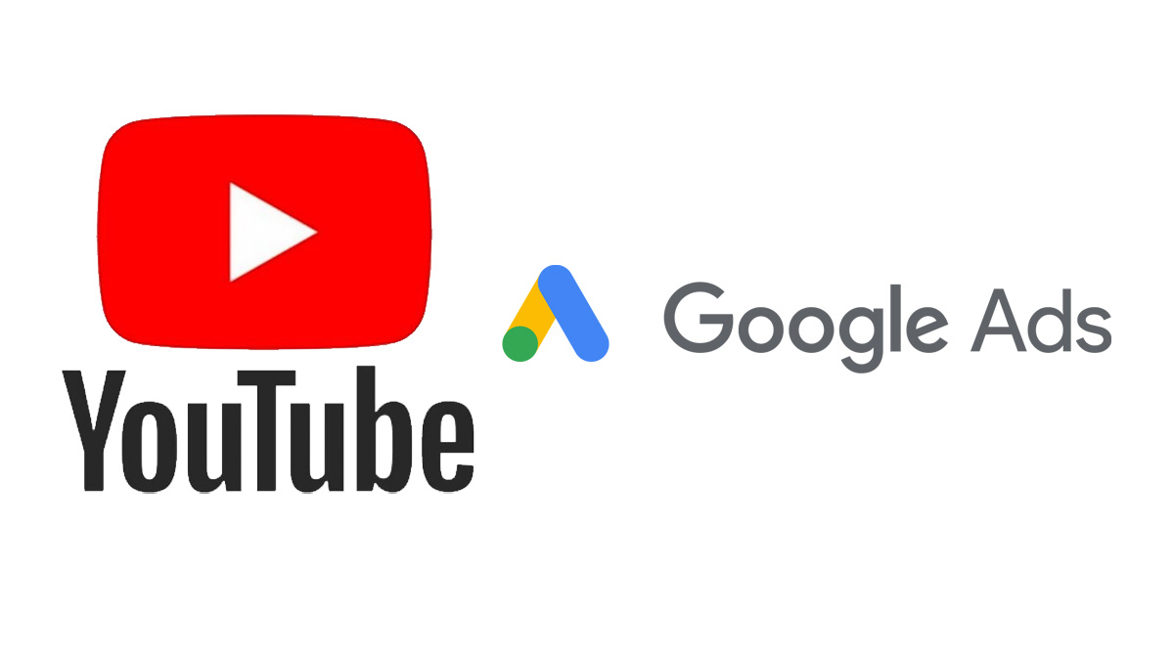

Popular Social Platforms
Facebook (Meta)
X
Instagram (Meta)
Youtube (Google)

Slide 7
Common Social Media Measurements
Impressions
Engagement
  Likes (page & posts)
  Favorites
  Comments
  Shares
  Retweets
  Followers
Notes:
Impressions: The number of people or users who view your advertisement. Although you may be making impressions, you also want engagement
Engagement is when a user is actually interacting with the content you post. Engagement can include such things as liking, sharing, reposting, retweeting, and commenting on your posts

Slide 8
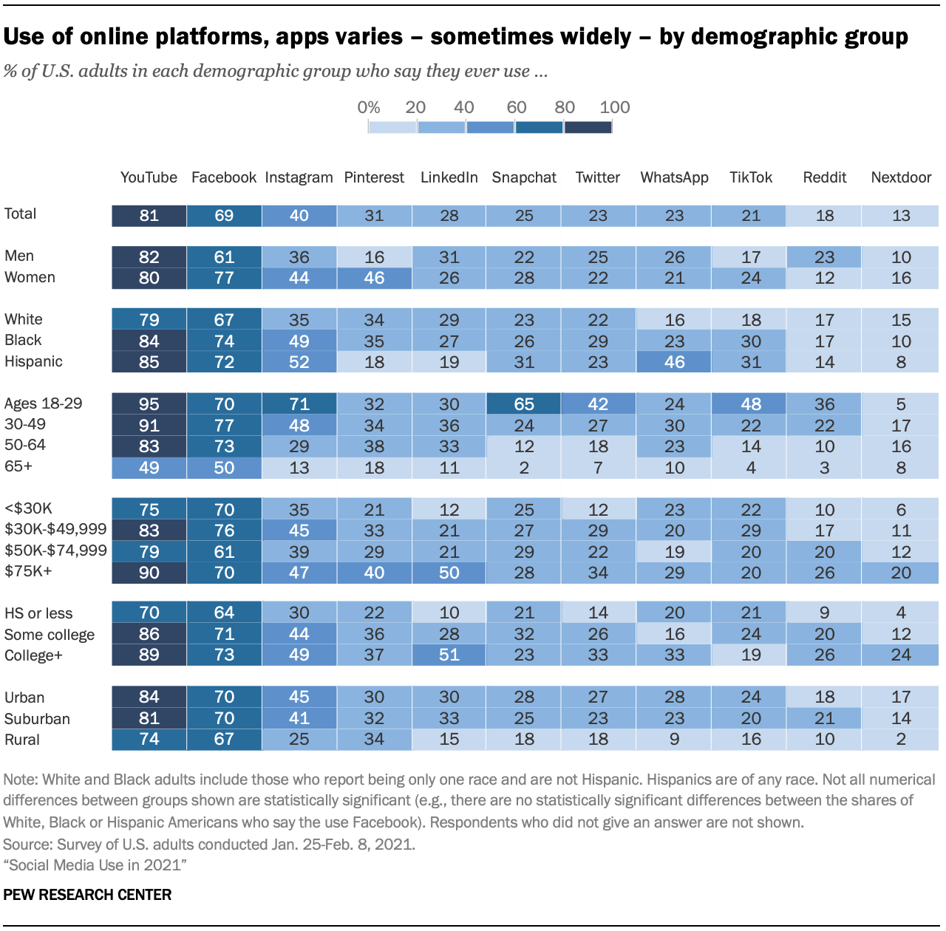
Where’s Your Audience?
YouTube and Facebook are the most popular platforms
WhatsApp (Meta) is most common among Hispanic Americans
Instagram & Snapchat is most popular among 18-29 year olds
Notes:
Identifying where your audience will help determine which social media platform is best for you.
YouTube and Facebook are the most popular platforms.
WhatsApp is most popular among Hispanic Americans
Instagram & Snapchat is most popular among 18-29 year olds
Although only about 45% of those 65 and older use social media, you are most likely to find them on Facebook.

Slide 9
Utilizing Social Media

Slide 10
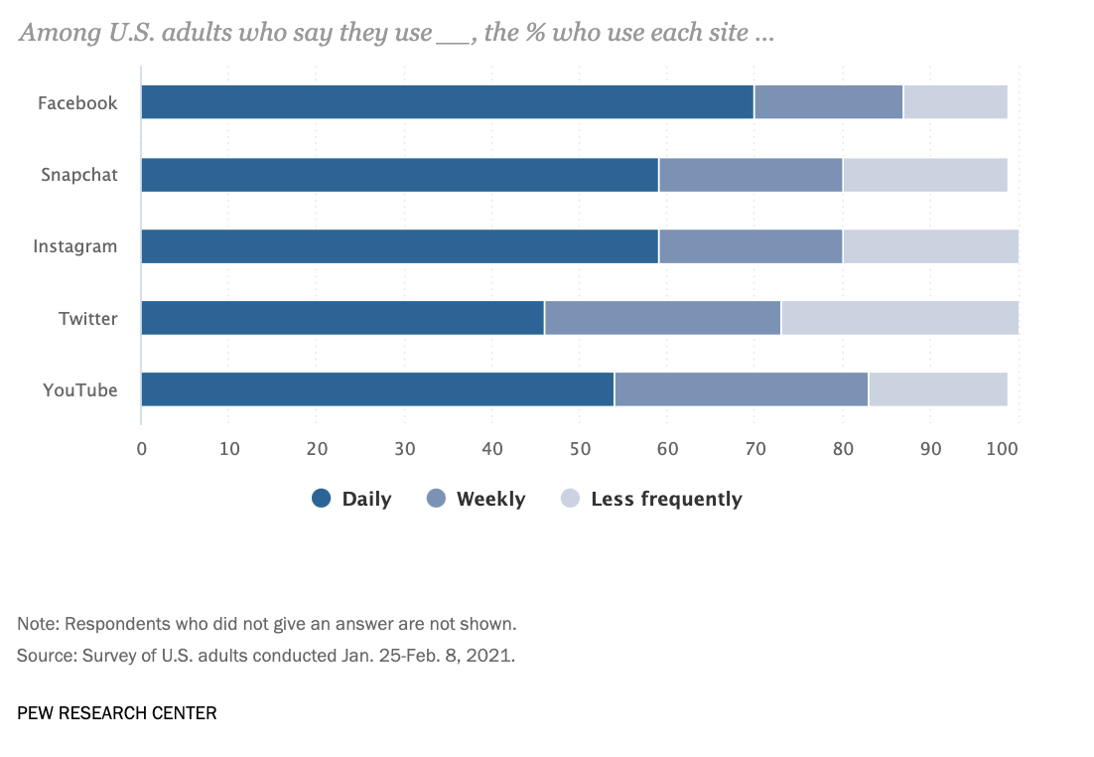
How Much Time Do You Have?
How much time will you dedicate to recruitment?
When should you post?
How often should you post?
How much effort will be spent managing your page(s)?
Notes:
Before officially utilizing social media as a recruitment & engagement tool, you and your study team should address a few of these questions related to how much time is going to be spent managing the social media platforms you plan to use.
Be aware of your collective capacity and capabilities.
This graphic from Pew Research shows that no matter platform, people are often utilizing social media daily so consider that when initially establishing your social media approach.

Slide 11
Creating Your Study Page
Who are you?
  Study name
  Visual/Logo
What is your study about?
  Study description
  Study purpose
Where is the study team located?

Slide 12
Creating Your Study Page
Target audience
  Age
  Gender
  Ethnicity
  Health History
  Other criteria
How do potential participants learn more or sign up?
  More information/sign up link
  Contact information

Slide 13
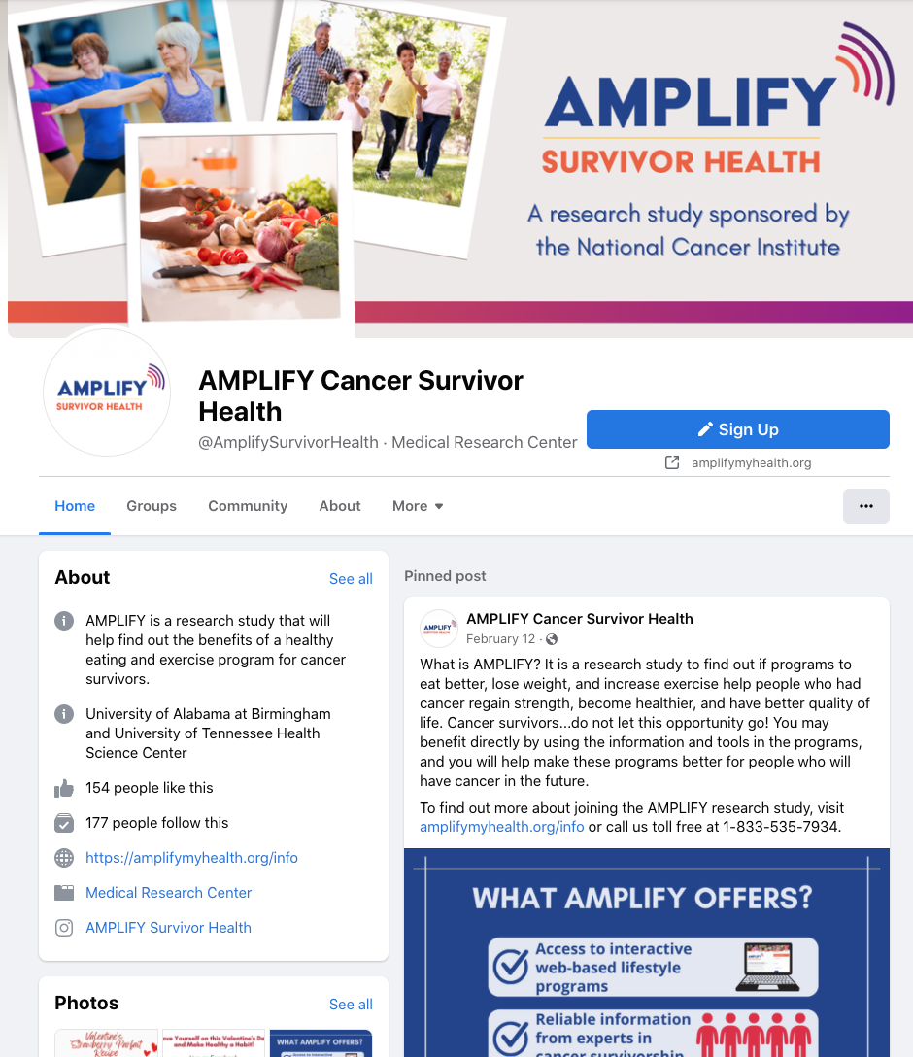
Facebook Page Example
AMPLIFY Cancer Survivor Health
Study name
Logo
Short description
Study team location
Signup link
Website/Instagram link
Pinned post
Notes:
Facebook is a common platform utilized for research studies because of its popularity so I wanted to provide a study page example from Facebbook.
This example is from AMPLIFY Cancer Survivor Health. Myself, along with the TN-CTSI Director, Dr. Michelle Martin are a part of the AMPLIFY team.
AMPLIFY has a good page setup because it not only looks legitimate and professional while also making sure to include important aspects such as:
Study name
Logo
Short description
Study team location
Signup link
A Website and Instagram link to learn more
And a Pinned post about what they have to offer

Slide 14
Social Media Content Ideas
Advertisements
  Flyers
  Short videos
Relevant articles
  Make sure to credit original sources
Tip sharing
Facebook Live
Use & create #hashtags
Notes:
Post content that is intriguing to your population. Share other Facebook pages. Provide content that is useful.
When using or posting online material that includes direct or paraphrased quotes, thoughts, ideas, photos, or videos, always include citations. Provide a link to the original material if applicable
With Facebook lives you can host talks and panels where you discuss relevant topics and questions that relate to your study and purpose. Take this opportunity to invite study team leaders, experts, and other stakeholders who might be relevant to a Facebook live conversation
Hashtags are basically topics. They also help measure engagement over time in one place

Slide 15
Types of Social Media Advertising
Organic
Typically, no cost
Organization/user delivers posts to audience
Limited to who already follows or engages with your page
Paid/Sponsored
Post is boosted to users beyond who like/follow page
Broader, more tailored reach
Higher cost (price varies)
Notes:
There are typically two types of advertisements on social media –“organic” and “paid/sponsored”

Slide 16
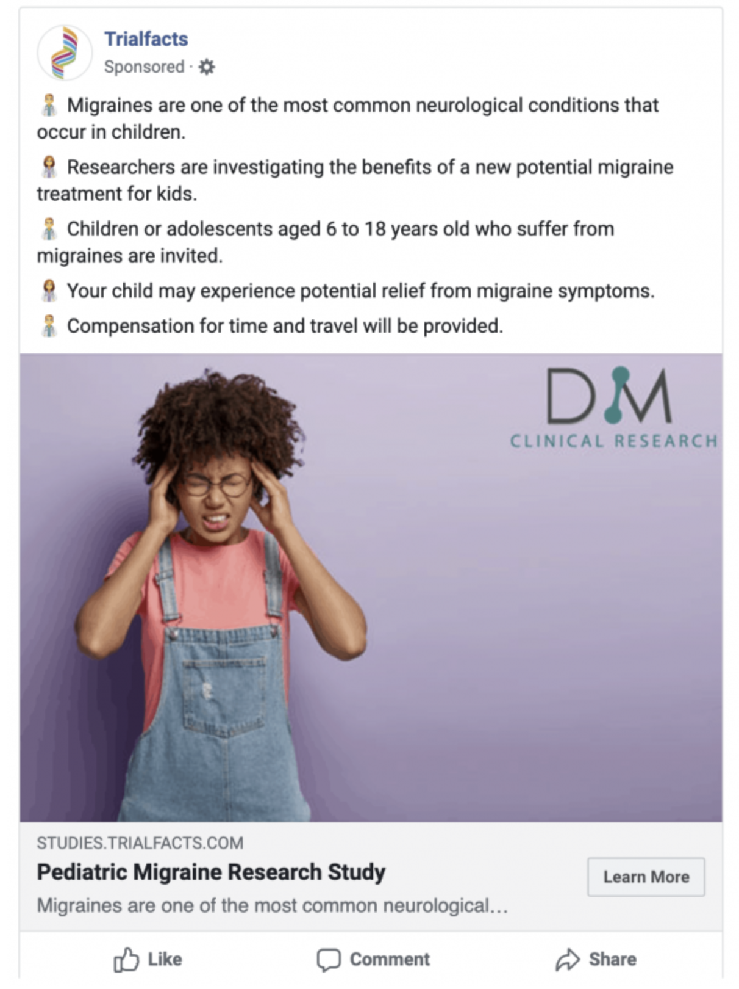
Advertising Examples (Facebook)
Visual is emphasized
More concise text
Link to page/website
Notes:
On the screen is an example of a Facebook advertisement from Trialfacts focused on clinical research on migraines within pediatric populations.
Social media is much more focused on catching individuals attention and there is usually A LOT of things competing for individuals attention on social media. If you are a Facebook, TikTok, or Instagram user then you understand how easy it is to end up on social media way longer than you expected because on the many things posts, pictures, and videos that catch your attention.
On social sites, your advertisement has to stand out so visuals, graphics, and videos should be emphasized with the description being more concise than a traditional AD.
The bulleted points include a short description, the purpose of the study, the target audience, potential benefits and value the study adds to the individuals life, a photo, and a link to learn more about the study.
A major benefit to using social media advertisements to promote your study are the access metrics. Likes, comments, and shares give you simple measurements of how much engagement your AD is receiving and if people comment or share, it provides you an opportunity to interact with your audience.

Slide 17

Graphic Design Resource
Canva
  Free
  Various templates
  Create logos, flyers, invitations & more

Slide 18
Tips & Resources

Slide 19
Tips for Social Media Recruitment
Stay engaged
Follow and connect with other organizations
Promote your study
Measure your success
Be adaptable
Notes:
Stay engaged
Regularly post
Following and connecting with organizations can help you establish informal community partners and expand your reach.
Promote your study
Social media sites often provide paid ways to boost your study that might aid in your recruitment approach.
Measure your success
Identify the messages that are driving the most traffic and engagement. Utilize user analytics! Facebook, Twitter, and Instagram offer analytics that provide more in-depth metrics and details on how well your messages are doing and who they are reaching and engaging with.
Be adaptable with your recruitment strategy & practices
With the information gained from the metric(s) you chose, it is best to update your recruitment strategy to produce better results
For example, Was there a day or time that saw more user engagement and would be the best time to advertise?
Was there a certain advertisement type or design that produced better results?
What were the lessons learned from the metrics that can be used to update your strategy?

Slide 20
Concerns to Keep in Mind
UTHSC Social Media Policy
  Have at least two social media admins
Website privacy/terms of use
Varying results from study to study
Budget & costs
IRB approval required
Notes:
When utilizing social media, get familiar with the UTHSC communications & social media policy to make sure you stay within university guidelines.
Website Privacy and Terms of Use. Facebook for example, has advertising policies and restrictions that you might need to get familiar with before posting an AD on the platform
Review and regulatory concerns: Across social media platforms, there is no government of self-regulated rules across all platforms. Therefore, you as a researcher may have to take the extra steps and considerations to protect your potential participants.
Varying results
IRB Approval is required for all advertisements and other materials.
If You are interested in utilizing social platforms in your recruitment plan, you must also gain IRB approval.

Slide 21
Resources
NIH Guidance Regarding Social Media Tools
U.S. HHS Guidance on Institutional Review Board Review of Clinical Trial Websites
Beginner’s Guide to Using Facebook Advertising for Patient Recruitment (Trialfacts)
Meta Ad Library
  To search: Select country→ Ad category: All Ads → Keyword: clinical trials

