Slide 1
Recruiting & Retaining Families
Recruitment & Retention Series
SESSION 6:
Ashley G. Evans, BA, MS

Slide 2
Overview
Recruiting Families
Retaining Families
Resources
Notes:
In today’s presentation we will cover:
Strategies of recruiting families, retaining families, and other resources

Slide 3
Recruiting Families
Notes:
So let’s get started with recruiting families. Remember, Recruitment is not a one-time event, but an ongoing effort throughout the life of a study. When working with families it is important to be prepared, well-informed, and flexible.

Slide 4
Defining Families in Clinical Trials Research
To participate in research studies, children need the consent of a parent or legal guardian
Parent means a child’s biological or adoptive parent.
The term “legal guardian” does not include:
  Grandparents
  Non-custodial parents
  Adult siblings
  Step-parents
  Other adult family members
Notes:
Although there are many ways to define families in the world, within clinical trials research, only parents and/or legal guardians can give consent for children in research studies
The term “legal guardian” as used here does not include:
Grandparents
Non-custodial parents
Adult siblings
Step-parents
other adult family members
Unless such individuals are authorized by a court of law to make decisions about general medical care for the child.

Slide 5
Engage with Community Organizations
Hubs to connect with families include:
  Doctor’s offices
  Resource & community centers
  Schools
  Childcare centers
  Libraries
  Religious institutions
  Government agencies
Notes:
I always emphasize building relationships and trust with your audience before officially attempting to recruit them.
A good start to find families is at community organizations.
Hubs to connect with Families include:
Groups for new parents at the hospital or a medical clinic
Family resource centers or parenting support organizations
Schools and Childcare centers looking to provide additional programming for parents
Libraries
Religious institutions
And Government agencies
Connecting with community organizations may help bring more participants to your study through relation and endorsement from organizations families already trust.

Slide 6
Engage with Community Organizations
Attend community events
  Tabling
  Deliver introductory speech
  One on one conversations
Interest meetings & presentations
Flyers
Conduct site visits
Get to know your audience
  Discover their interests
Notes:
If granted permission, you can also engage within community organizations.
You can do this by attending community events. Often at community events their opportunities to table, deliver an introductory or elevator speech, and have one on once conversations.
In my own experience, attending community events not only introduced me to potential participants but also allowed me to gather a better idea of the community the organization serves and their audience’s cultural identity.
Community organizations, such as community centers, may also offer you the space to have an interest meeting or deliver a presentation.
Conducting regular site visits is also a great way to regularly engage within organizations and stay abreast of what’s going on in the community and with your target audience.
Remember, Your goal in engaging with community organizations and their associated audiences to learn more about them. Learning more about them will assist you in discovering their interests and tailoring your recruitment strategy for the best fit.

Slide 7
Planning Recruitment
Identify obstacles to enrollment
  Obtaining buy-in from everyone involved
  Time commitment
  Location
    Accessibility
    Appropriate size
    Community or laboratory settings
Notes:
Once you have begun to engage with community organizations, you’ll probably know them a bit better and opportunities and obstacles with recruitment.
Often when recruiting families, obstacles become magnified. Why do obstacles become magnified? Because when dealing with families you are dealing with a system of interdependent people instead of just one person.
An issue with recruiting families is obtaining buy-in from all parties involved. For example, One parent may be willing to participate but the other does not. A parent may want their child to participate, but the child does not. Although parents manage consent for children, obtaining children’s assent is important. It not only incorporates them in the decision making process, but it can definitely influence the parents attitude and final decision. Children are people too so having their approval and ultimate satisfaction is important in achieving your study goals and overall objectives.
Time commitment is also often an issue. Parents and families lead busy lives. Think of ways to get them involved that adds little to no stress or strain on their schedules. Think of organizing your study after schools, on the weekends, or virtually.
Location may also be an obstacle. Think of our own organization, UTHSC. It’s not very parking friendly. Many universities are like that and it is actually been perceived as a deterent even for individuals.
Have your sessions in a place that is accessible, comfortable, and can accommodate all the families invited to participate in your study.
If it’s necessary to have your study done in a laboratory setting, offer parking passes/validate parking for participants.
If your study can be done in a community setting, having it there. It also might be beneficial to recruit participants at the site where visits will be held. Community settings are often more “neutral” and helps balance out researcher-participant power dynamics. Community settings are also typically more parking friendly and is often closer to the building and free. Having your study within a community setting enhances translational and community engaged research practices.

Slide 8
Planning Recruitment
Identify obstacles to enrollment
  Willingness to disclose information
  Sociocultural factors
  COVID-19
    Virtual enrollment options
Notes:
Families can be seen as private or closed systems. Therefore, you may struggle with a willingness to disclose information. This is why it’s important to establish trust, be transparent, and reassure families you do not intend to cause them or their loved one’s harm. Be upfront about what you may and may not need from them as participants. You don’t want to end up in situation where a participant feels misled or lose a once confirmed participant and have to restart your recruitment process.
Also, families are social and cultural groups that lie within even larger sociocultural groups and societies. This is why being aware of the social and cultural norms is important because it may impact your recruitment strategy. This involves doing your research on familial groups who are apart of your target audience.
Social and cultural groups with a history of marginalization may be hesitant to enroll in a research study. It is your job to be aware of this as a well-informed research and be prepared to address and find a solution for this potential obstacle.
Lastly, COVID-19 has impacted all of our lives. If possible, consider virtual options for recruitment and clinical trials. Virtually connect with existing groups through social media might be a viable option for initial connection and observation.
Virtual enrollment options are sometimes less costly, the geographic reach may extend beyond a local community, and often weather doesn’t stand in the way. Many parents don’t want to bring their children out in inclement weather because it makes things that more difficult.

Slide 9
Advertising Recruitment
Marketing and outreach efforts that often connect with families include:
  Phone calls
  Face to face conversations
  Attending community events
  Advertisements
  Paid or organic social media posts
  Email listervs
Include outreach and recruitment efforts in IRB submission
Notes:
Opportunities for marketing and outreach efforts include:
Phone calls
Face to face conversations
Flyers posted or distributed by community partners
Advertisements in school district newsletters and local newspapers and TV and radio. Posting flyers around community organizations is a good indirect way to advertise and put your name & study out there. Community organizations often offer physical bulletin boards
Paid or organic social media posts
And also Email listervs
Be sure to include outreach and recruitment efforts you plan to use in your IRB application.

Slide 10
Advertising Recruitment
What is the goal of the study?
What will enrollment add to the family’s lives?
  How will enrollment help their child’s development?
What are risks to enrollment?
Are you trustworthy?
Communicate in easily understood language
  Use words and phrases a family would use
Notes:
When thinking of how to get the attention of families through advertisement, consider these questions
What is the goal of the study? You should include a short description of what you and your team are looking to discover.
What will enrollment add to their family’s lives? How could it help them or make their life easier?
More specifically, how will enrollment help their child’s development? Parents want their best for their children. When marketing to families, really focus on how it help the child.
It’s important to address the benefits but people also want to know potential risks. Respond to potential concerns right in the AD.
As stated earlier, families are often private systems who are protective of one another. How are situating yourself as trustworthy? Always disclose your affiliations Utilizing a logo on your flyers and other forms of communication to reinforce your legitimacy.
Lastly, communicate in simple, easily understood language. Whenever appropriate, A tip is to include words or phrases that a family would use.

Slide 11
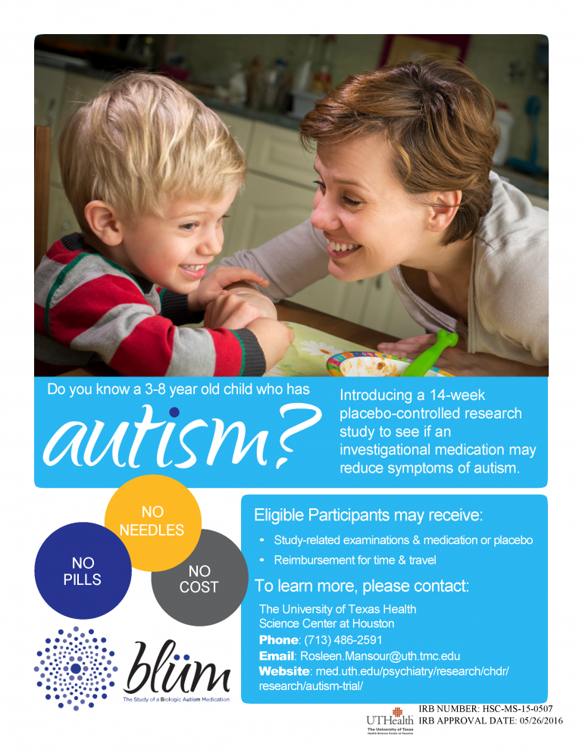
Advertisement Example
Inquisitive Headline
Study topic/General description
Photo
Potential risks
Call to action
Contact Information
Logo
Easily understood language
IRB information
Notes:
Here’s an example from a study at the University of Texas Health Science Center on Autism.
This advertisement is visually appealing while also including necessary information.
It includes an inquisitive headline along with the study topic and general description.
There is also a visual of parent and child.
I think that it is good that they address potential risks and obstacles such as pills, needles, and cost
They include a call to action, contact information, study and university logo
And lastly, there is also the IRB number and IRB approval date listed. Remember to always obtain IRB approval for advertisement materials

Slide 12
Consent & Assent
Informed Consent
  Obtained from adults (typically 18 & older)
Assent
  Obtained from children who have not reached legal age
Assent should be obtained from children unless a child is not capable of assenting
Both parents need to give permission unless:
  A parent is not reasonably available
  One parent has sole legal custody of the child
Notes:
I made reference earlier to consent and assent and wanted to expand upon it. You have not officially recruited an individual until they have given informed consent.
When enrolling families into clinical trials, consent from an adult must be obtained. If enrolling children, assent should also be obtained.
Informed consent is given by an individual with the clear understanding and appreciation of the facts in place, the implications, as well as the consequences of what they consent to participate in.
Legally, children are not able to give true informed consent until they turn 18. So, before taking part in a clinical trial, they are asked for their assent.
Assent means that they agree to take part. They may also dissent, which means they do not agree. Unlike informed consent, assent is not always required by law, though IRBs may require it.
Mere failure to object, absent affirmative agreement, should not be construed as assent
Even if assent is not required, children will still benefit from going through the assent process. Doing so can help them feel more in control and engaged in the trial. It shows that they have a say in what happens to them and that their questions and input are valued.

Slide 13
Retaining Families

Slide 14
Communicate with Families
Maintain pathways of communication
  Be aware of participants preferred method of contact
Offer incentives
  Gift cards
  Homework help for children
  Food
  Transportation
  Refer a friend
  Referrals to other providers
Notes:
The key to a successful study is retaining participants.
To do this, you should maintain pathways of communication.
Communication is a two-way street. That means just as you feel comfortable communicating with them, let them know they can communicate with you about any questions, concerns, or sudden instances.
For example, difficulty understanding consent forms has been cited as reason why some people choose not to participate in a study. Sometimes questions about the consent form and/or study were not adequately answered by team members and that level ambiguity impacts decisions. Families are protective units and children in particular, are a protected population. It’s important for communication to be open and for individuals to feel clear about what they have signed.
Inclusion or lack communication can impact motivation and overall interest in remaining in a study
Offering incentives can also be helpful and act as motivation remain in a study. Incentives that usually stand out for families include:
Gift cards
Homework help for children
Food
Transportation
Refer a friend opportunities that may lead them to additional incentives
Referrals to other providers once the study has concluded

Slide 15
Communicate with Families
Check in & invest time
  Send reminders
    Texts
    Emails
    Remind (app)
  Be understanding & accommodating
  Show gratitude & appreciation
Notes:
The key to a successful study is retaining participants.
To do this, you should maintain pathways of communication.
Check in with families and invest time
This can be done through:
Sending reminders.
Texts, Emails, and something like the Remind app. Remind app. It’s designed to be an educational communication platform but can also be utilized for studies and it’s free
Measuring & showcase progression. This can be done by reminding participants how many study sessions are left or by doing evaluations and surveys collecting thoughts and opinions.
Also show gratitude & appreciation
Thank families for participation
Certificates
Host appreciation events
Acknowledgement goes a long way

Slide 16
Communicate with Families
Ask for feedback
  Measure and showcase progression
  If participants decide to leave the study, ask why

Slide 17
Resources

Slide 18
Resources
Consent & Assent
HHS.gov Research with Children FAQ’s
NIH National Cancer Institute Patient Safety in Clinical Trials
Suggestions for Consenting/Assenting Research Subjects/Participants
Notes:
Here are resources on consent & assent including:
FAQ’s from the U.S. Department of Health & Human Services
NIH National Cancer Institute on Patient Safety in Clinical Trials
Suggestions for Consenting/Assenting Research Subjects/Participants from the NIH’s National Institute of Dental and Craniofacial Research (NIDCR) Suggestions for Consenting/Assenting Research Subjects/Participants

Slide 19

Resources
Engaging Children & Families
Guide to Recruiting Families for Community Programs (LENA)
Steps for Engaging Young Children in Research– Volume 1: The Guide (University of Brighton)
Steps for Engaging Young Children in Research – Volume 2: The Researcher Toolkit (University of Brighton)
Ongoing Communication Reflection Tool (Flamboyan Foundation)
Notes:
Here are resources for engaging families:
First is a guide to recruiting families for community programs from. LENA stands for Language ENvironment Analysis and is a national nonprofit focused early talk technology and data-driven programs.

