Slide 1
rEDW and TriNetX
Recruitment & Retention Series
SESSION 3:
Lokesh Chinthala

Slide 2
Who is CBMI?
Center for Biomedical Informatics
Supported by UTHSC
Mission
  Develop and support a state-wide EDW (TriNetX)
  Perform research to advance medical knowledge utilizing advanced informatics technique
Director: Robert Davis, MD, MPH

Slide 3
rEDW
Research Enterprise Datawarehouse
A single, comprehensive and integrated repository of all clinical and research data from multiple clinical sources
Provides a unified picture of the care a patient has received
It facilitates investigators to retrieve data at patient and encounter level
Data is available mostly from 01/01/2014

Slide 4
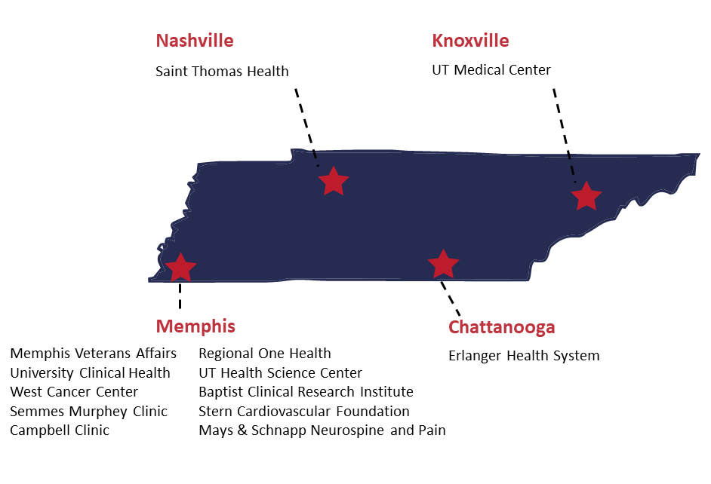
rEDW – Data sources
Currently available
  Methodist Le Bonheur Healthcare, Memphis
  UT Medical Center, Knoxville
  University Clinical Health, Memphis
  St. Thomas, Nashville
  Erlanger Health System, Chattanooga
In the process of adding data from
  Regional One Health, Memphis

Slide 5
Domain areas
Demographics
Visits
Diagnosis
Procedures
Labs
Vital Signs
Medications
Clinical notes

Slide 6
Data availability
 | MLH | UTMCK | STH | UCH
Visits | 14,561,678 | 1,325,806 | 5,973,645 | 1,504,677
Peds | 4,044,121 (28 %) | 64,680 (5 %) | 375,622 (6 %) | 510,443(66 %)
Adult | 10,517,557 (72 %) | 1,262,551 (95 %) | 5,598,023 (94 %) | 994,234 (34 %)
Patients | 1,630,632 | 452,060 | 1,185,003 | 214,834
Peds | 535,369 (32 %) | 52,243 (12 %) | 183,353 (15 %) | 70,276 (32 %)
Adult | 1,141,356 (68 %) | 403,966 (88 %) | 1,013,645 (85 %) | 150,763 (68 %)
Procedures | 20,734,349 | 1,567,241 | 1,648,164 | 1,534,949
Diagnosis | 69,231,170 | 8,172,638 | 23,558,023 | 1,672,477
Lab events | 173,279,138 | 44,609,787 | 80,329,720 | 369,256
Medications | 95,736,832 | 27,334,359 | 49,716,239 | 612,886
Vital Signs | 402,531,620 | 115,011,647 | 174,913,316 | 1,575,362

Slide 7





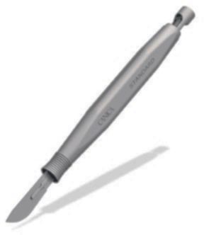

Data Flow
UTHSC Firewall
Demographics
Lab Results
Enterprise Data Warehouse
MLH
1
Diagnoses
3
2
UTMC, Knoxville
CTN2
Procedures
Medications
Limited Dataset (OMOP CDM)
Text documents
St Thomas, Nashville
Erlanger, Chattanooga
(Regional One, Memphis)
Federated Model EDW. UTMCPHI is maintained in EDW separate from each other Healthcare Organization
CTN2 access to UTMCPHI is behind UTHSC and MLH firewalls, and subject to Business Associate Agreement (BAA) with UTHSC
UTHSC has Business Associate Agreement (BAA) with TriNetX
Tabular data returned meets standard for de-identification under
45 CFR 164.514(b)(1)
Queries only
Only tabular data returned 4
INFORMATION FROM TRINETX. CONFIDENTIAL.

Slide 8
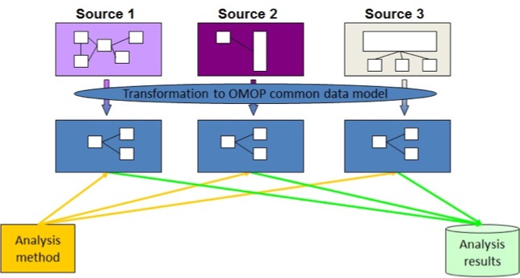
OMOP CDM
Source: https://www.ohdsi.org/data-standardization/the-common-data-model/

Slide 9
OMOP CDM
The Observational Medical Outcomes Partnership
Allows for the systematic analysis of disparate observational databases
Transform data into a common format and representation (terminologies, vocabularies, coding schemes)
The disparate coding systems can be harmonized—with minimal information loss—to a standardized vocabulary
Designed to support the conduct of research to identify and evaluate associations between interventions and outcomes caused by these interventions
Outcomes can be efficacious (benefit) or adverse (safety risk)

Slide 10
Standard tables
Person
Visit Occurrence
Location
Condition Occurrence
Procedure Occurrence
Drug Exposure
Measurement
Note
Note NLP
Care Site

Slide 11
Navigating Clinical Research
Ask a clinical question with research potential
Generate hypotheses with available aggregate data
Draft a research question
Obtain data
TriNetX
Available registries
IRB
Biostats
rEDW
Research personnel

Slide 12
TriNetX
A cloud-based health research platform
Provides visual and tabular data summary of the rEDW
Contains standardized aggregated pediatric and adult healthcare data
Can be used as ‘Prep to research’ tool
Available to all UTHSC researchers through UTHSC- CBMI
Proprietary crosswalks between coding systems (E.g., ICD10 & CPT)
Patient level data

Slide 13
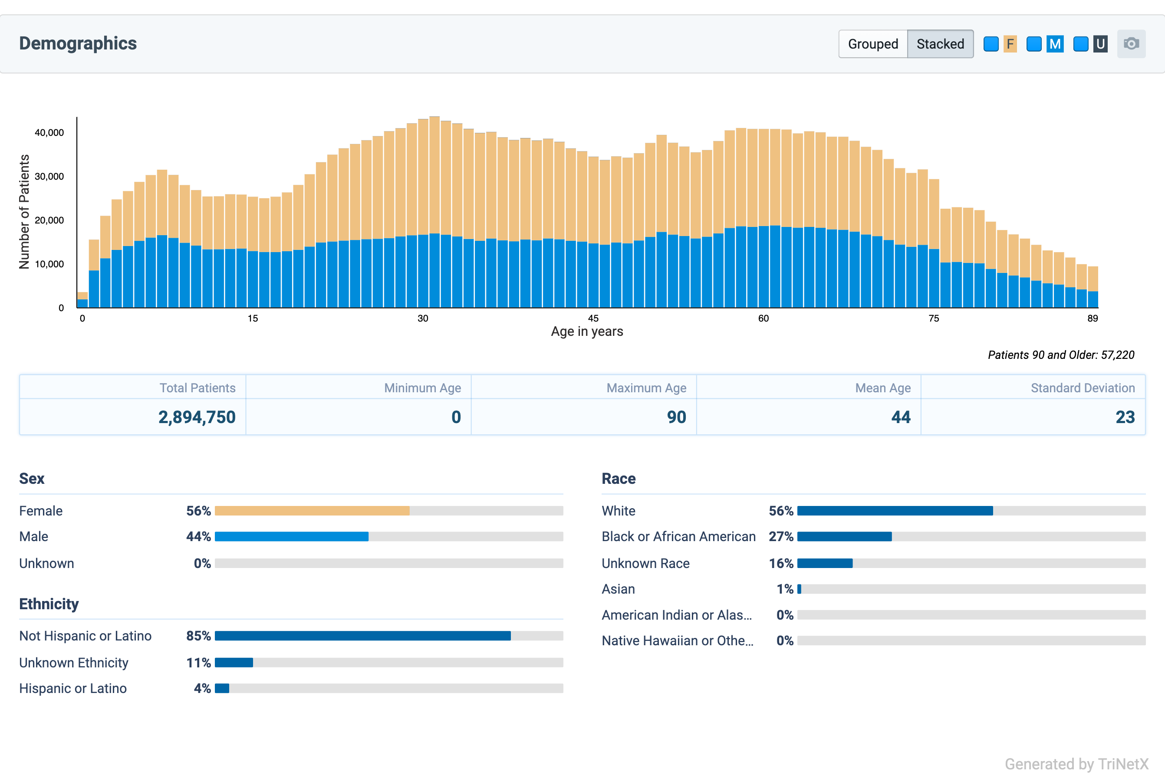
TriNetX

Slide 14
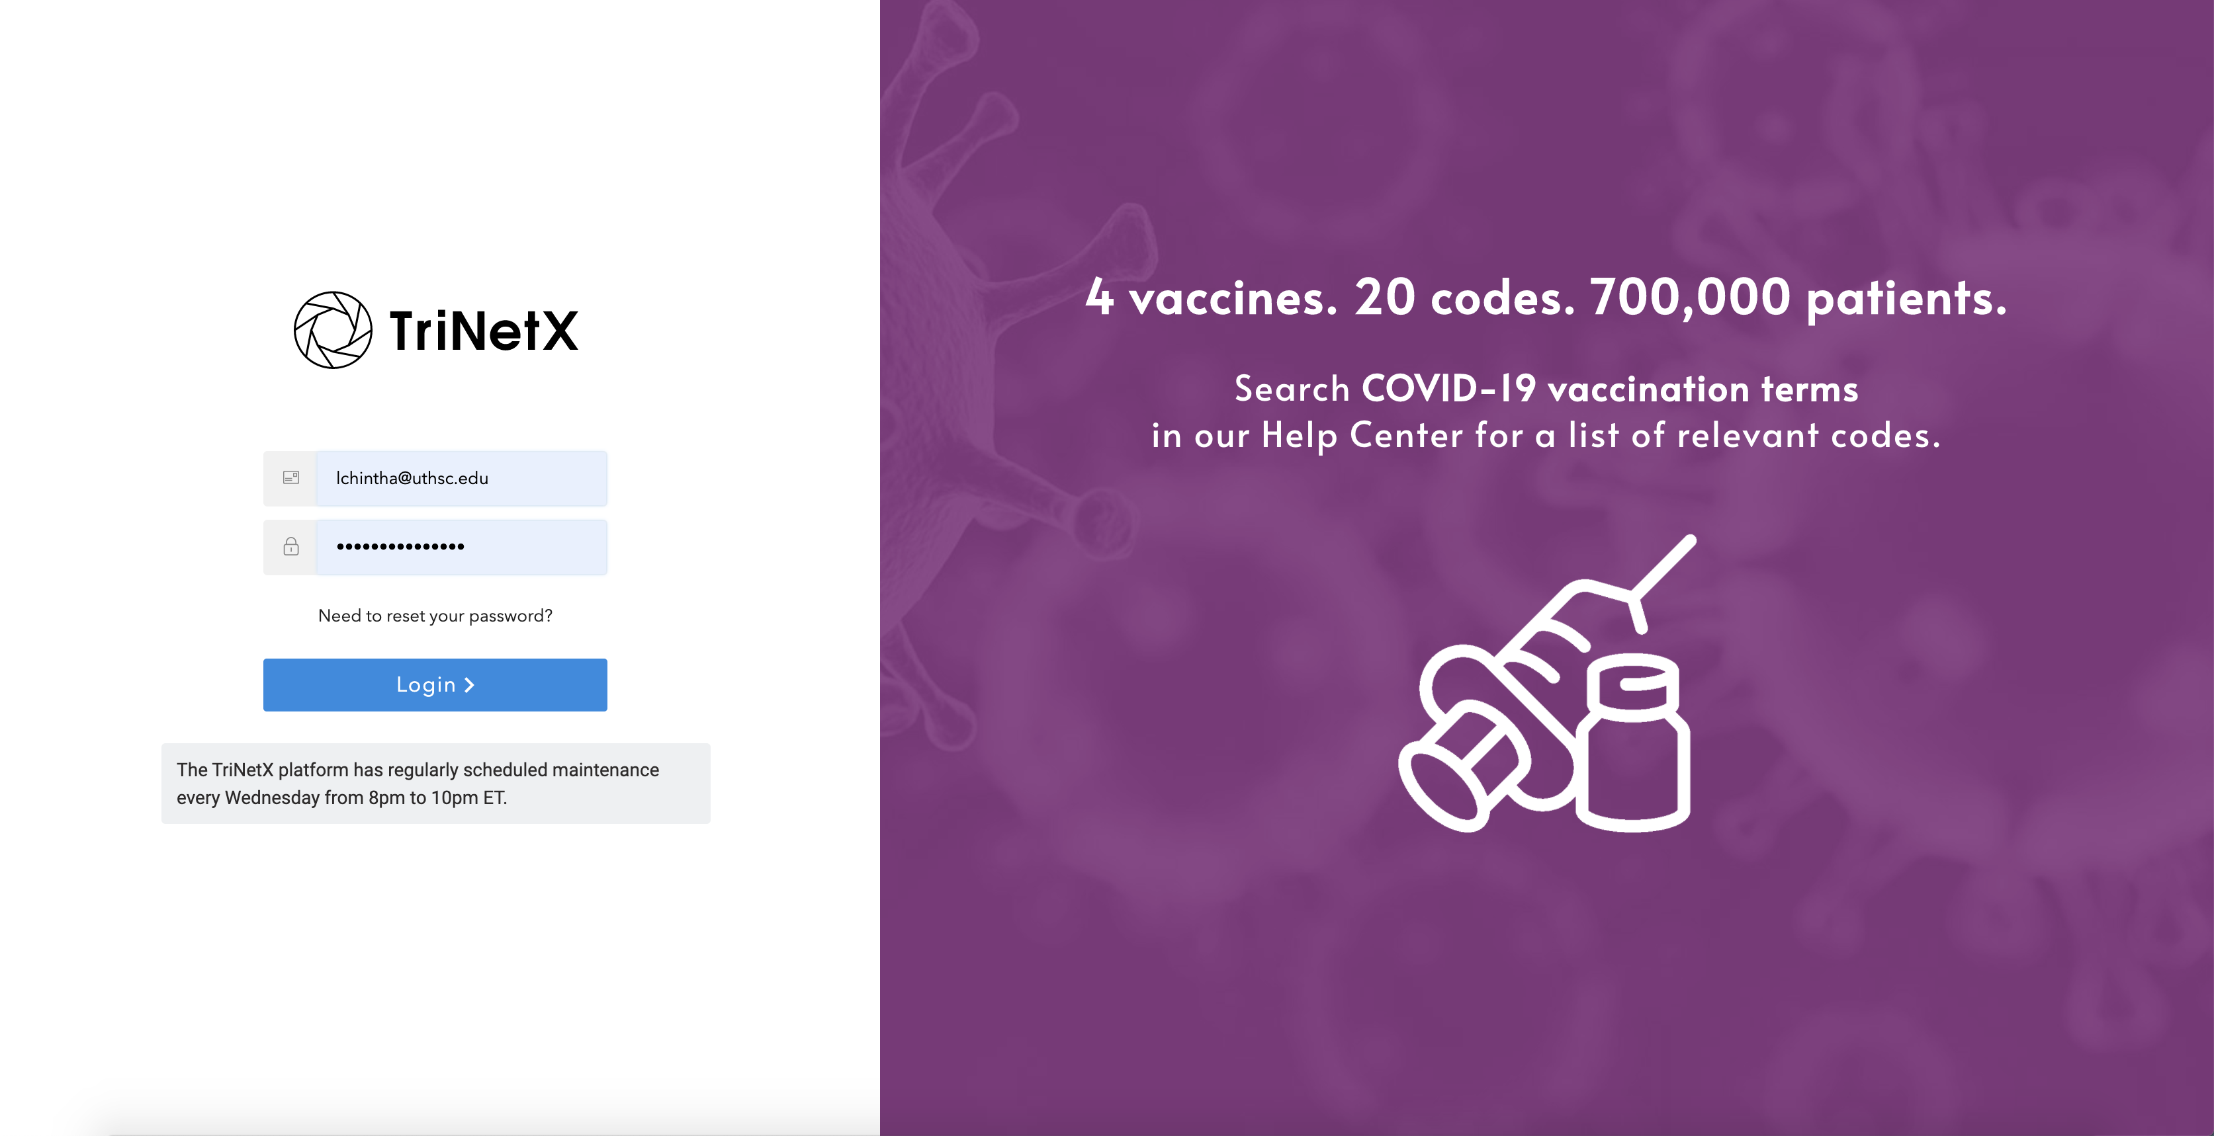
TriNetX Demo

Slide 15
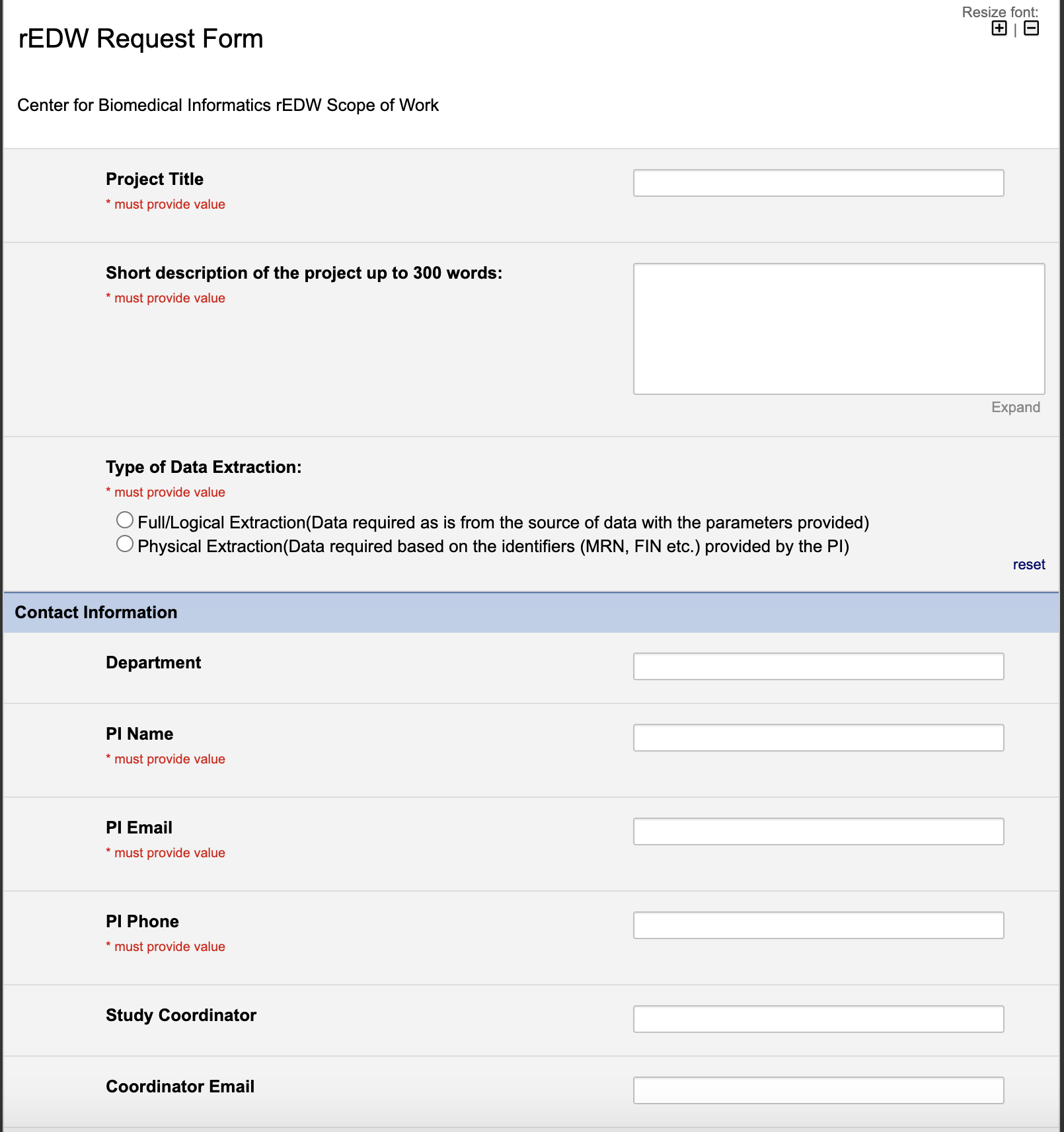
Initiation of Support

Slide 16
Contact
https://uthsc.edu/cbmi/services/trinetx.php
TriNetX and rEDW related questions - Lokesh Chinthala lchintha@uthsc.edu
Monthly training sessions or ad-hoc peer-to-peer training sessions
Training resources by TriNetX
  https://support.trinetx.com/hc/en-us/categories/115000239168

Slide 17
Thank you!

