Slide 1
Research Integrity and Preventing Research Misconduct
PRINCIPAL INVESTIGATOR RESEARCH TRAINING
SESSION 9:
Karen C. Johnson, MD, MPH
Michael L. Christensen, PharmD

Slide 2
Objectives
Describe research misconduct federal regulations
Provide examples of research misconduct
Overview how to prevent research misconduct
Outline resources available to UTHSC investigators for maintaining research integrity and preventing research misconduct

Slide 3
What Is Scientific Integrity?
Scientific integrity refers to maintaining the quality and objectivity of the research activities, such that they are sound and worthy of the public’s confidence.
In fostering scientific integrity, one must assure:
scientific findings are objective, accurate, honest and readily available to the public
the development of policies based on science is conducted with appropriate transparency.

Slide 4
Research Misconduct 42 CFR 93.103
Fabrication – make up data or results and reporting them
Falsification – manipulating research materials, equipment, or processes or changing or omitting data or results such that the research is not accurately represented in the research record
  Selective excluding data from analysis
  Misinterpreting data to obtain desired results, ie inappropriate use of statistical methods
  Doctoring images in publications
Plagiarism – use ideas, information, process or results by others without giving appropriate credit
  Important to note that you also cannot plagiarize your own work such as word for word description of research methods
Does not include honest error or differences of opinion or in interpretations of data, act must be committed intentionally
From 1992 – 2018, 284 people have been sanction by the US Office of Research Integrity (ORI), 90% for falsification/fabrication, 10% for plagiarism

Slide 5
42 CFR 50 Subpart F and 42 CFR 93
– governs institution that receive PHS support
42 CFR 50 Subpart F – Conflict of interest
  Institutional responsibilities regarding management and reporting investigator of conflicts of interest
42 CFR 93 Research Misconduct
  Defines the responsibilities for compliance for institutions receiving PHS support
  Establishes the Office of Research Integrity

Slide 6
Research Misconduct
Using inappropriate, harmful, dangerous research methods
Poor research design
Violation of human subject protocols
Abuse of laboratory animals
Not preserving data, bad data management, withholding data
Claiming undeserved authorship, denying authorship to contributors
Failure to correct the publication record
Personal misconduct and financial misconduct
Organisation for Economic Co-operation and Development Global Science Forum

Slide 7
Key elements of Research Misconduct
Intentional
Knowing
Reckless
Significant departure from accepted research practice
Proven by a preponderance of the evidence
42 CFR 93.104

Slide 8
Motives for Misconduct
Academic pressure to publish
Low funding levels
Financial gain
Pressure on trainees to produce favorable research results
Professional vanity
Lack of understanding of the research process
Psychiatric illness
Pressure to accrue participants
Low funding level puts pressure on researchers
Pressure on mentees to produce research results

Slide 9
Research Misconduct Process
Inquiry
Investigation
Consequences
Notes:
First, is it Misconduct?
Inquiry: Committee determines whether or not sufficient evidence exists to warrant an Investigation
Investigation: Committee determines whether or not the Respondent committed misconduct intentionally
Consequences: Termination, 5 year debarment from NIH-funded research, supervision/oversight
Remember the web site?
As you might imagine, policy dictates that misconduct must be reported. But potential complainants should carefully consider the benefits and risks of bringing allegations forward…

Slide 10
Research Misconduct Process
Inquiry: determines whether sufficient evidence exists to warrant an investigation
  Confidential
  Within the university
  Determines merit
  If no merit found no notification required
Notes:
First, is it Misconduct?
Inquiry: Committee determines whether or not sufficient evidence exists to warrant an Investigation
Investigation: Committee determines whether or not the Respondent committed misconduct intentionally
Consequences: Termination, 5 year debarment from NIH-funded research, supervision/oversight
Remember the web site?
As you might imagine, policy dictates that misconduct must be reported. But potential complainants should carefully consider the benefits and risks of bringing allegations forward…

Slide 11
Research Misconduct Process
Investigation:
Determines whether or not misconduct was committed and its scope
Assesses the integrity of the scientific record and recommends remediation
Recommends sanctions
Institution must notify the sponsor
Can be conducted by university or ORI
Notes:
First, is it Misconduct?
Inquiry: Committee determines whether or not sufficient evidence exists to warrant an Investigation
Investigation: Committee determines whether or not the Respondent committed misconduct intentionally
Consequences: Termination, 5 year debarment from NIH-funded research, supervision/oversight
Remember the web site?
As you might imagine, policy dictates that misconduct must be reported. But potential complainants should carefully consider the benefits and risks of bringing allegations forward…

Slide 12
Research Misconduct Process
Consequences:
  sanctions, including termination of employment and debarment from federal research participation
  remediation of scientific record
  public notification
  imprisonment
Notes:
First, is it Misconduct?
Inquiry: Committee determines whether or not sufficient evidence exists to warrant an Investigation
Investigation: Committee determines whether or not the Respondent committed misconduct intentionally
Consequences: Termination, 5 year debarment from NIH-funded research, supervision/oversight
Remember the web site?
As you might imagine, policy dictates that misconduct must be reported. But potential complainants should carefully consider the benefits and risks of bringing allegations forward…

Slide 13
Benefits of Whistleblowing
To ensure that the scientific record is correct
To comply with regulations
To prevent future misconduct
To protect one’s own reputation or the reputation of another
To punish wrongdoer
Notes:
Consider Benefits and Risks to individuals and to science & society
GO THROUGH LISTS
Allegations can be made anonymously, but difficult to proceed and difficult to truly hide identity of Complainant
Of course, the goal is to avoid becoming involved in misconduct at all. Here are some suggestion for avoiding it…

Slide 14
Risks of Whistleblowing
Allegations are not borne out
Time, effort and emotion intensive
Retaliation by respondent or respondent’s institution
Gain reputation as a trouble-maker
Notes:
Consider Benefits and Risks to individuals and to science & society
GO THROUGH LISTS
Allegations can be made anonymously, but difficult to proceed and difficult to truly hide identity of Complainant
Of course, the goal is to avoid becoming involved in misconduct at all. Here are some suggestion for avoiding it…

Slide 15
Whistleblower Protection
Institutions are required to protect the whistleblower to the maximum extent possible, the privacy of those in good faith report apparent misconduct and to undertake diligent efforts to protect the positions and reputations of those persons, who in good faith report apparent misconduct
Federal Whistleblower Protection Act of 1989

Slide 16
Office of Research Integrity (ORI)
Formed in 1993
Responsible for PHS grants (NIH, CDC, ect)
Responds to reports of misconduct
Responsible for promoting Integrity
Reports to the Secretary of the US DHHS
ORI has statutory authority to respond to allegations of research misconduct when supported by Public Health Service funds, 42 USC 289b
https://ori.hhs.gov/

Slide 17
ORI Functions and Activities
Receive and assess allegations of research misconduct
Determine ORI jurisdiction
Oversee institutional inquiry and investigation reports and procedures
Make determinations of misconduct or recommendations for settlement
Participate in civil or criminal cases of alleged research misconduct directly or through other offices, including HHS OIG, US Attorney’s Office or in collaboration with other federal agencies

Slide 18
ORI Functions and Activities
Protect the confidentiality of respondents, complainants, and witnesses
Protect the complainant from retaliation through regulatory obligations imposed on the research institutions
Provide education in the responsible conduct of research
Collaborate with the research community to improve biomedical research
Exclude dishonest investigators from PHS and Federal agency funded research
Make public findings of misconduct so that institutions and individuals will be aware of wrongdoing
42 CFR 93.300 (d)

Slide 19
ORI Functions and Activities
Participate in civil or criminal cases of alleged research misconduct directly or through other offices, including HHS OIG, US Attorney’s Office or in collaboration with other federal agencies
Maintain the assurance of 4,000 research institutions for responding to misconduct
Correct or retract scientific papers to protect the integrity of the published literature and the public

Slide 20
Scientific research is built on a foundation of trust. Public trust will only endure if the scientific community devotes itself to the values associated with ethical scientific research and reporting.
Consequences of Research Misconduct
Harm to individual and society with the introduction of an unsafe product (drug) or therapy or the failure to receive effective therapy (anti-vaccine).
Damage to science itself – fortunately, the research record is inherently self-correcting through replication and validation, but this may take time.
Damage to science and public trust – we are currently living through an assault on science with the COVID pandemic.
Damage to careers of Co-investigators
Organisation for Economic Co-operation and Development Global Science Forum

Slide 21
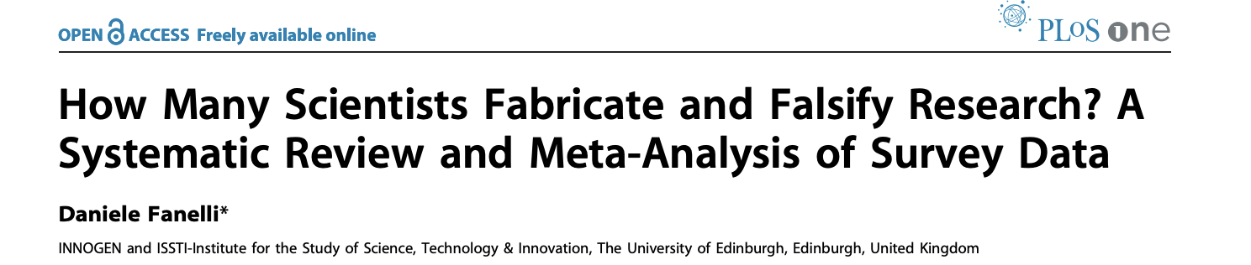
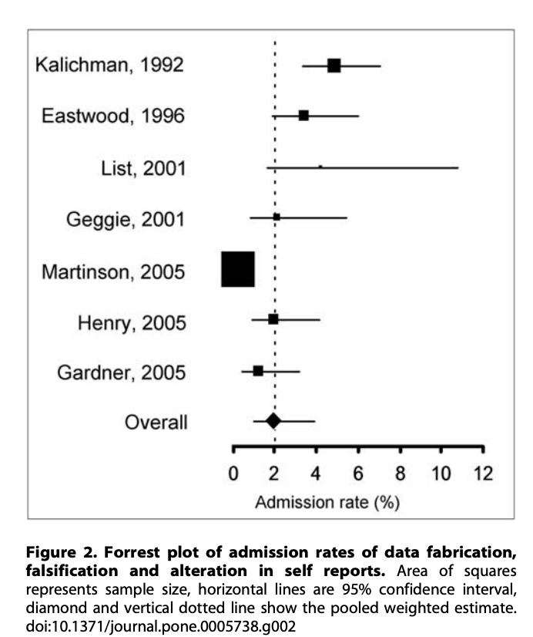
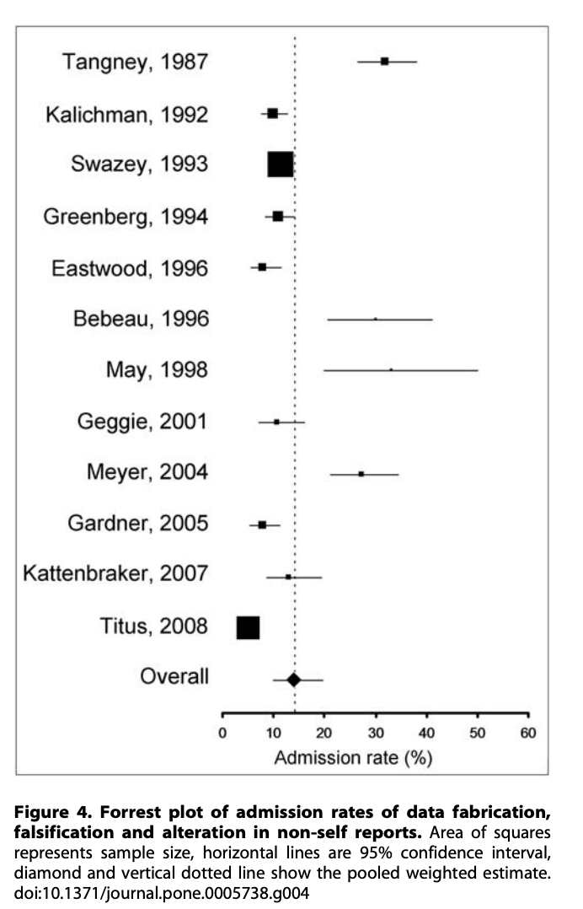
Admit
Misconduct
7 studies
Observed
Misconduct
12 studies
Notes:
Only quantitative survey data assessing how many researchers have committed or observed colleagues committing scientific misconduct in the past were included in the review. Survey asking opinions or perceptions were excluded. From 3276 studies identified they found 18 studies to include in the meta-analysis.

Slide 22
Famous Fraud Cases
Andrew Wakefied (UK) physician published series of papers in Lancet (1998) linking MMR vaccine to autism and inflammatory bowel disease “autistic enterocolitis”. Led to sharp decline in vaccination and outbreaks of measles around the world. Data was derived from 12 children and parenteral observation
Undisclosed financial conflicts of interest funding from lawyers working on antivaccine cases
British General Medical Council found Wakefield dishonest in his research, subjected minors to unwarranted procedures and mischaracterized their samples

Slide 23
Famous Cases
Hwang Woo-Suk faked claims of cloning human embryonic stem cells published in Science 2005. Oocytes came from 2 junior members of his laboratory. Seoul University determined that none of the DNA in the cell lines matched the DNA from the somatic cell donors.
Lessons Learned
  Responsible conduct of research is an international issue
  Conduct of research education is important. PHS requires all graduate students on training grants to received education.
  Peer review is no panacea, difficult to detect research misconduct
  Audit data and research records
  Authorship and accountability
Resnik DB. Account Res 2006;13:101

Slide 24
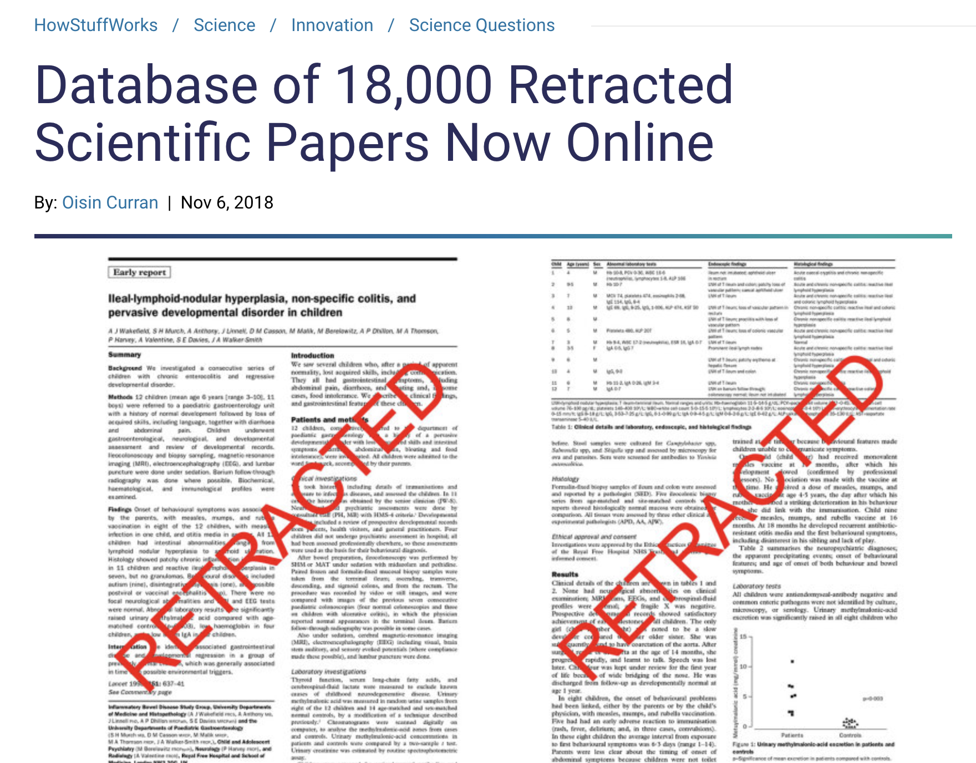
https://science.howstuffworks.com/innovation/science-questions/database-18000-retracted-scientific-papers-now-online.htm

Slide 25
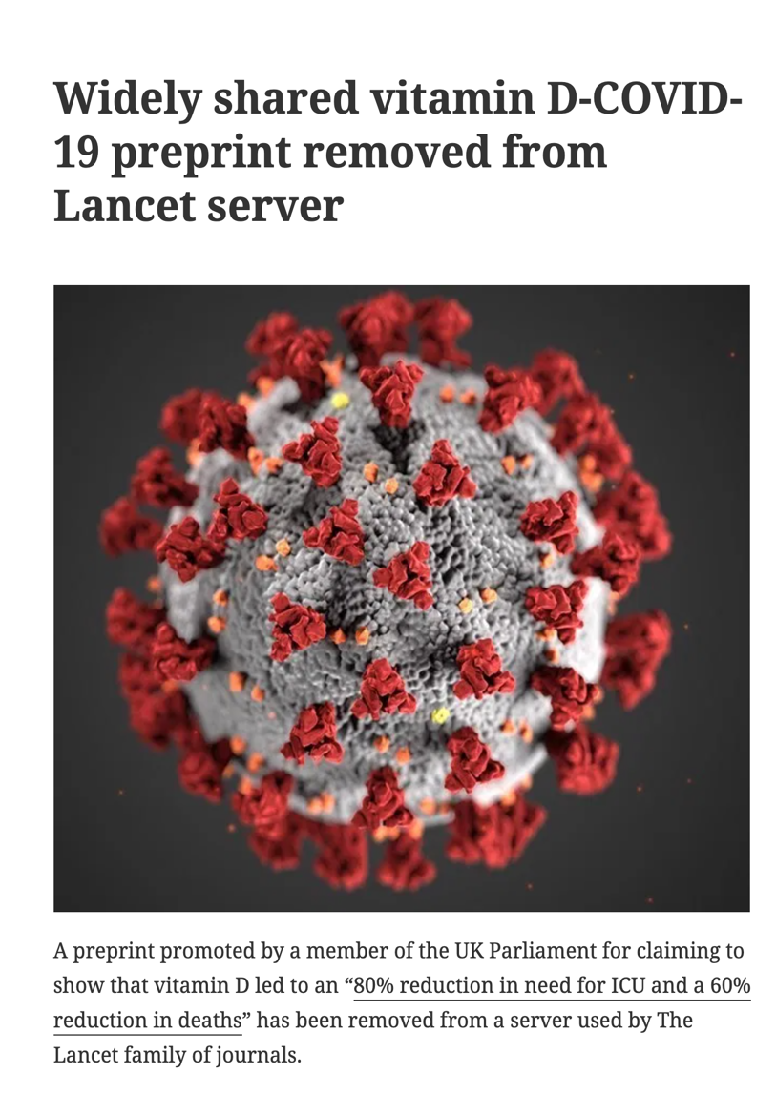
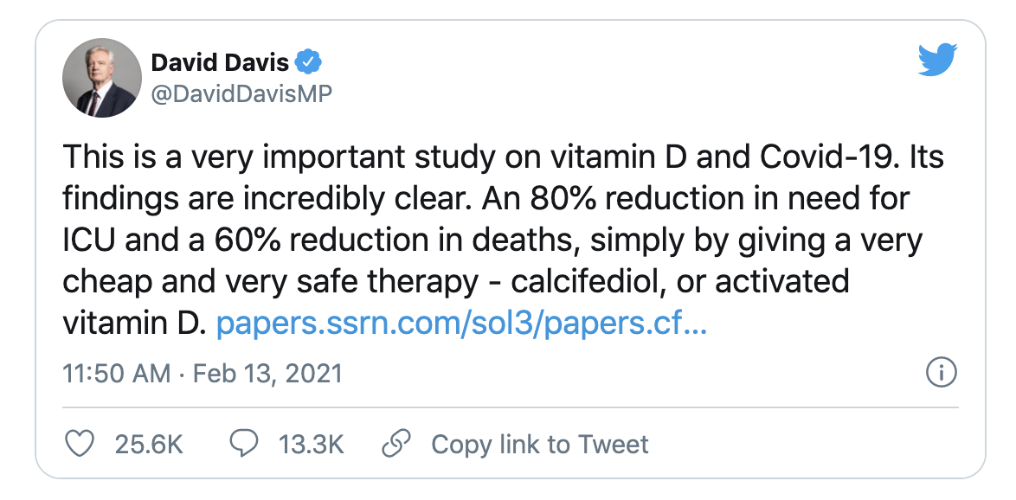
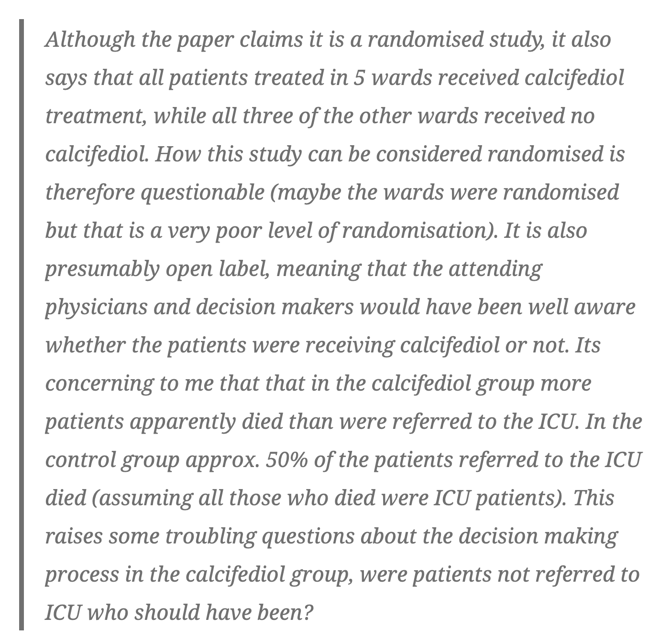
https://retractionwatch.com/retracted-coronavirus-covid-19-papers/
75 papers have been retracted
87,000 papers published - US News 3/1/21

Slide 26

Institutional Responsibility
Institutions are required to have policies for handling scientific misconduct to be eligible to receive federal funds (42 CFR 50)

Slide 27
How to Prevent Research Misconduct
Oversight/supervision by senior researcher
Policy and Procedure Manual
Methods of Operations
Clean and Complete Source Documentation
Record Retention policy
Processes for early detection and self-correction on non-compliance
Periodic research integrity training – currently require certain training for researchers, ie human subjects, animal use, lab safety

Slide 28
Office of Research Regulatory Support
Wesley Byerly, PharmD, Sr. Associate Vice Chancellor
Institutional Review Board
  Human subjects research
Institutional Animal Care and Use Committee
  Animal research – Jeffery Steketee, PhD, Chair
Institutional Biosafety Committee
  Research utilizing rDNA and other biohazardous material
  Infectious organisms, toxins, allergen, venoms
Export Control
  Covers release of covered technologies to foreign nationals in US
Research Safety Affairs
  Promotes regulatory compliance among researches with diversity of regulations from the CDC, OSHA, EPA, NIH, NRC, et al - Tim Barton, MS, Director
Research Integrity –
  Mark Miller, PhD, Research Integrity Officer

Slide 29
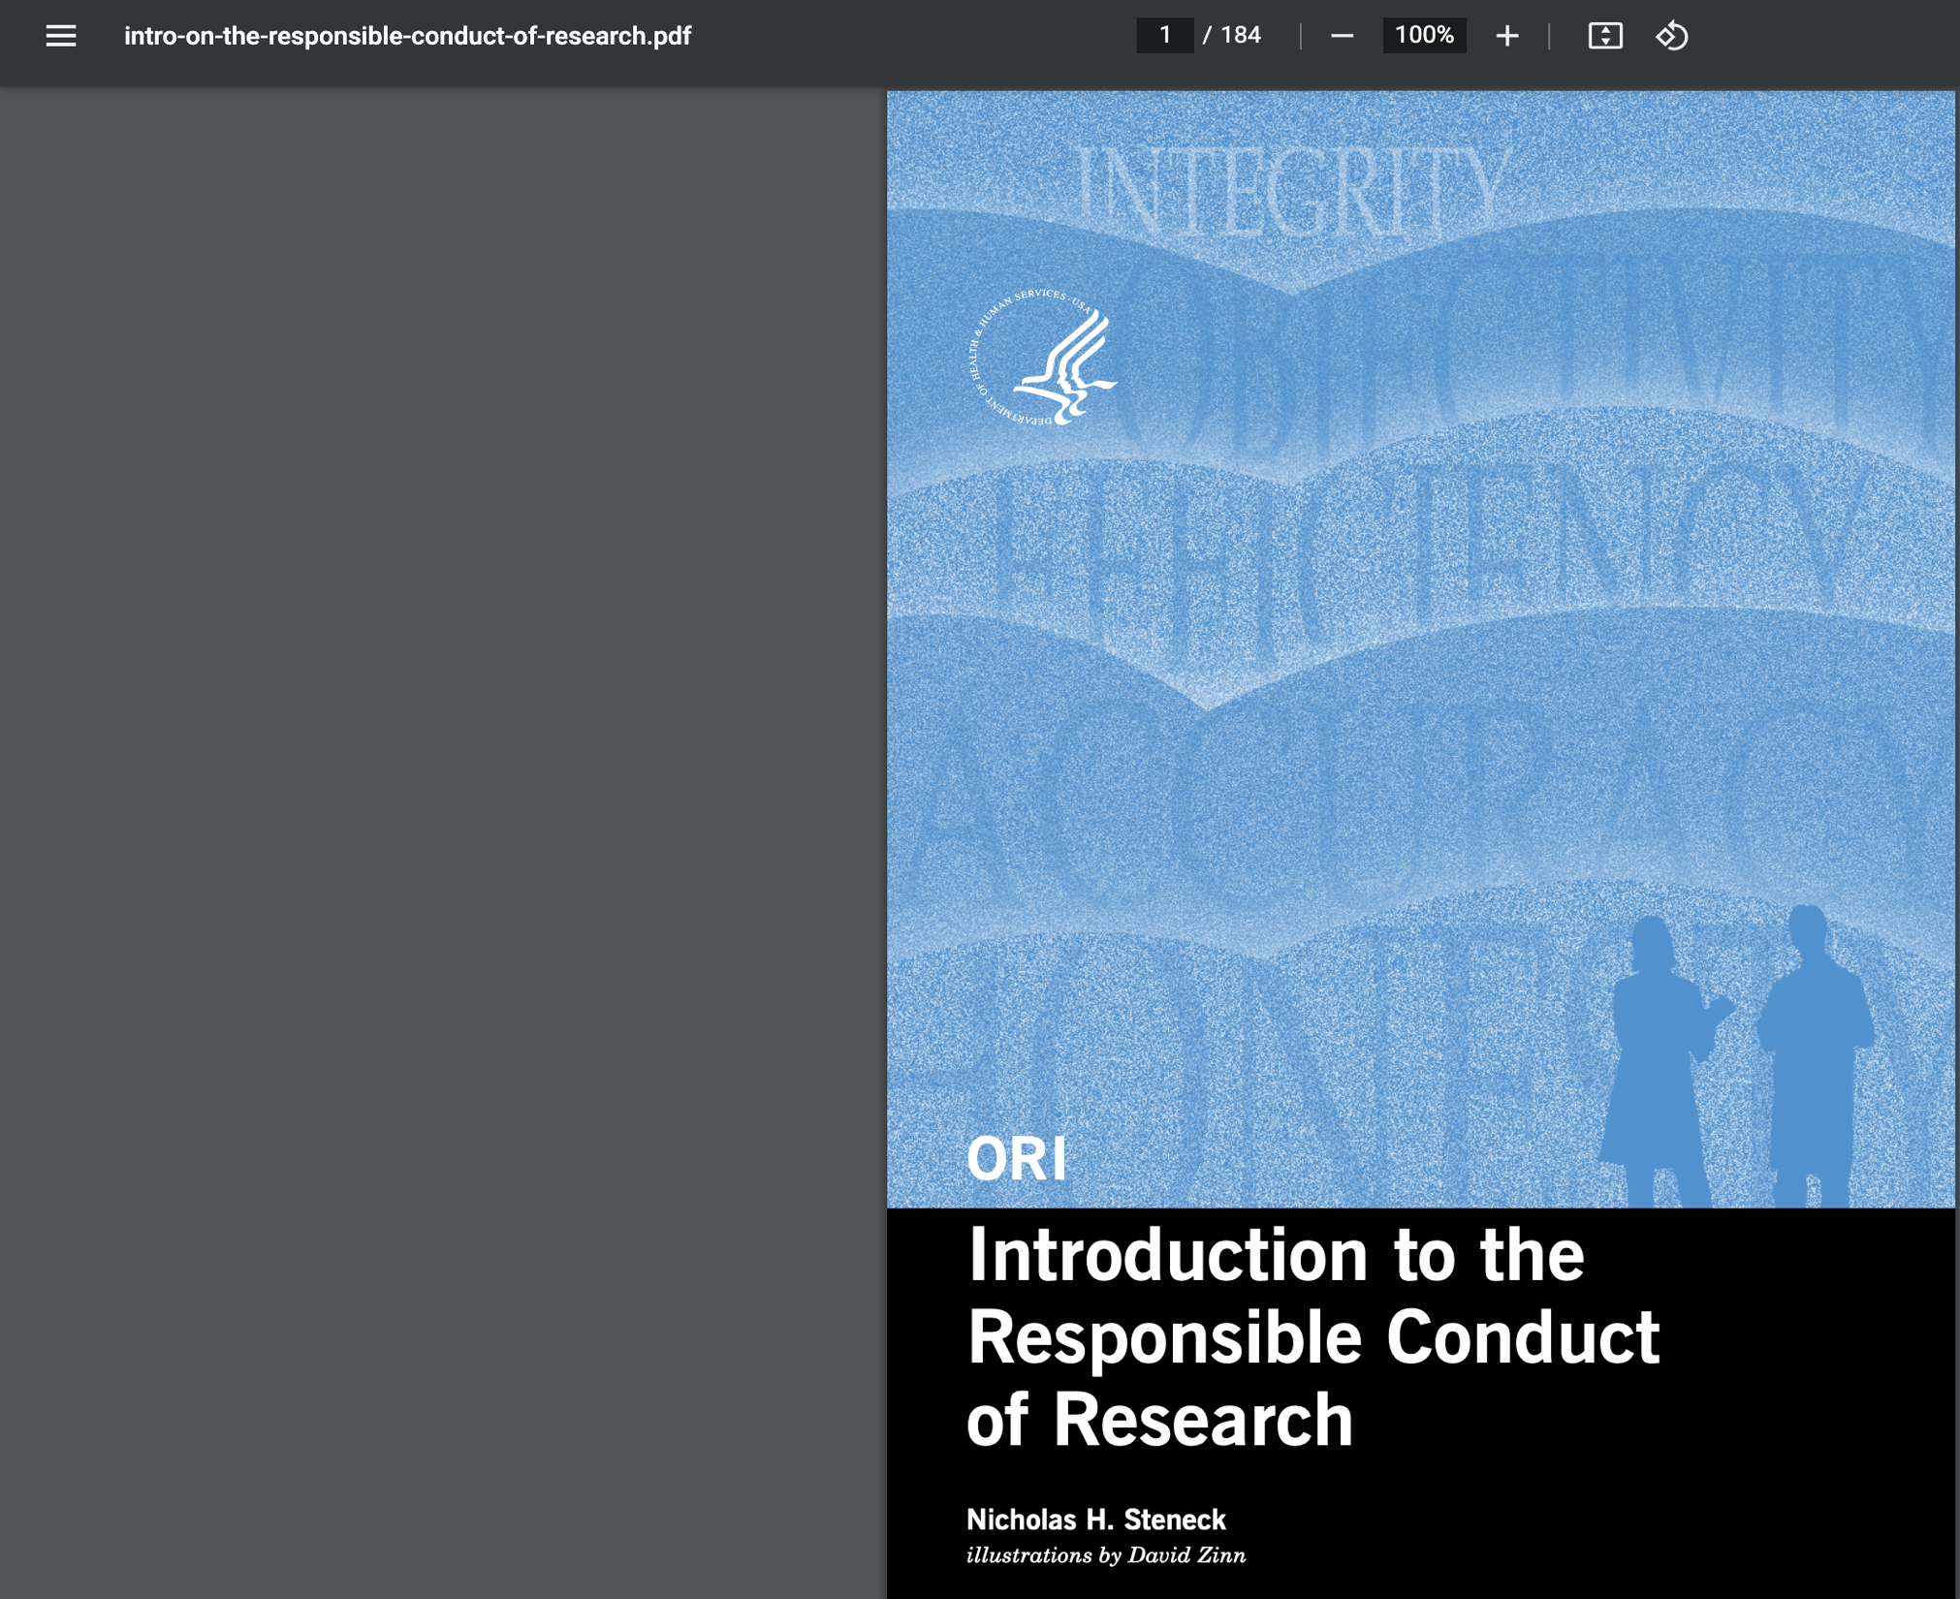
Contents
Shared Values
Rules of the Road
Research Misconduct
Planning Research
Protection of Human Subjects
Welfare of Laboratory Animals
Conflicts of interest
Conducting Research
Data Management Practices
Mentor and Trainee Responsibilities
Collaborative Research
Reporting and Reviewing Research
Notes:
I have taken just one of the online resources available to researcher under the Responsible Conduct of Research tab that is an introduction ot the responsible conduct of research.

Slide 30
Questions???

