Slide 1
Responsible Conduct of Research
PRINCIPAL INVESTIGATOR RESEARCH TRAINING
SESSION 7:
Sandra Arnold, MD, MSc

Slide 2
Outline
Introduction to human subjects research
Responsibilities of investigator
Consent issues
Data management
Scientific rigor and reproducibility
Responsible authorship and publication
Conflicts of interest in research
Peer review
Research misconduct

Slide 3
Belmont Report
Statement of basic ethical principles and guidelines around the conduct of human subjects research
Outlines 3 basic ethical principles
  Respect for persons – individuals are treated as autonomous agents and those with diminished autonomy are entitled to protections
  Beneficence – protection from harm and maximizing potential benefits while minimizing possible harms (refers to individuals but also society as a whole)
  Justice – equal distribution of the benefits and burdens of research
https://www.hhs.gov/ohrp/regulations-and-policy/belmont-report/read-the-belmont-report/index.html

Slide 4
Human subjects
Research involving human participants entails a rigorous responsibility for the wellbeing of the research subjects
Human participants make an important contribution to science, and this commitment must invite in return the utmost in respect and diligence from the researcher
That respect and diligence should include planning studies so that the potential benefits(to both the subject and society)outweigh any risks
In addition, steps must be taken to ensure that subjects are selected equitably and that they make an informed decision when consenting to participation in the study
Informed consent requires that patients be fully informed of the risks and benefits of the research, be competent to evaluate this information, and make a decision free from coercion and other inappropriate influences
https://www.hhs.gov/ohrp/

Slide 5
Participation in science is a societal privilege
Honesty and fairness in proposing, performing, and reporting research
Accuracy and fairness in representing contributions to research proposals and reports
Proficiency and fairness in peer review;
Collegiality in scientific interactions, communications and sharing of resources
Disclosure of conflicts of interest
Protection of human subjects in the conduct of research
Humane care of animals in the conduct of research
Adherence to the mutual responsibilities of mentors and trainees
Office of Research Integrity https://ori.hhs.gov/

Slide 6
Responsibilities of the Investigator
The investigator is the responsible leader of the research team and as such is responsible for ensuring that:
  The protocol is scientifically valid and of value
  Resources are adequate to complete the study
  There will be sufficient oversight of study activities and delegated tasks to others
  Research is conducted in compliance with federal regulations and local IRB and University policies and procedures
  IRB approval is obtained and maintained through continuing review, unanticipated problem, and protocol deviation reports
Office of Research Integrity https://ori.hhs.gov/

Slide 7
Responsibilities of the investigator
All changes will be IRB approved and study procedures will only be performed by IRB-approved personnel
All changes will be IRB approved and study procedures will only be performed by IRB-approved personnel
Informed consent is obtained and is valid, voluntary and well documented; assent obtained from children who can assent
Data and study records stored and retained appropriately according to requirements
Analyses adhere to pre-planned protocol analysis plan and accepted statistical principles
Office of Research Integrity https://ori.hhs.gov/

Slide 8
Responsibilities of the Investigator
For an FDA study, the investigator signs the 1572 statement of investigator that says:
  Personally conduct or supervise investigation
  Follow protocol- only make changes after notifying the sponsor unless subject at risk
  Ensure all persons assisting with the study are informed of obligations Inform subjects that drugs are being used for investigational purposes
  Ensure informed consent (21 CFR Part 50) and IRB review, approval and reporting (21 CFR Part 56)
  Report to sponsor adverse events (21 CFR 312.64); read and understand the IB.
file:///C:/Users/sarnold5/Downloads/FDA-1572_508_R6_FINAL%20(1).pdf

Slide 9
1572 – Statement of Investigator
Maintain adequate and accurate records (21 CFR 312.62) and make them available for inspection in accordance with 21 CFR 312.68
Ensure initial and continuing review by an IRB and report all changes to research and unanticipated problems involving risks to subjects, not make any changes without IRB approval except where necessary to eliminate immediate hazards
Comply with other requirements in 21 CFR
file:///C:/Users/sarnold5/Downloads/FDA-1572_508_R6_FINAL%20(1).pdf

Slide 10
Responsibilities of the Investigator
Standards for clinical care of patients
≠
Standards for academic research
≠
Standards for FDA regulated research

Slide 11
Informed consent
You must obtain informed consent from research subjects (unless research is exempt or IRB issues a waiver of consent)
Consent requirement based on the principle of “respect for persons” (Belmont report)
  Requires that all subjects “be given the opportunity to choose what shal or shall not happen to them”
The informed consent process much have these three features:
  Disclosure of information needed to make informed decision
  Facilitation of understanding what is disclosed
  Promotion of voluntariness of the decision
Office of Research Integrity https://ori.hhs.gov/

Slide 12
Informed consent
Active process of sharing all information needed for subject or subject representative to make a decision for themselves or another person
Ideally done face to face but can be done via mail, telephone, video or fax
Subjects should be given opportunity to ask questions, seek clarification, discuss with friends and family
All critical information should be completely disclosed
Information should be conveyed in understandable language
Written information should be presented but a signed document in and of itself does not constitute informed consent
Office of Research Integrity https://ori.hhs.gov/

Slide 13
Informed consent
Information that must be included:
Explanation of the purposes of the research and description of procedures including the experimental procedures
Description of foreseeable risks; description of benefits; description of alternatives
Confidentiality of records, with whom information will be shared
Compensation for injury
Who to contact with questions or in event of injury
Statement that participation is voluntary and there will be no penalty or loss of benefits to refusal
Office of Research Integrity https://ori.hhs.gov/

Slide 14
Data management
Research data is information collected, stored and processed in a systematic manner to meet the objectives of the research
Important considerations include:
  data selection – the process of determining data type, source and appropriate collection instruments
  Data collection – process of gathering and measuring information on variables of interest in a systematic fashion to answer research questions (test hypotheses and evaluated outcomes)
  Data analysis – apply statistical techniques to evaluate, illustrate and present data
Office of Research Integrity https://ori.hhs.gov/

Slide 15
Data management
  Data handling –process of ensuring proper storage, archiving, and/or disposal of data in a safe and secure manner during project and at its conclusion
  Data reporting and publishing – preparing and disseminating research findings to scientific community
  Data ownership – possession of and responsibility for data
Additional issues to consider
  Making sure all study personnel understand and implement these concepts appropriately
  Future uses of data
  Importance of appropriate data handling and storage with regards to human subjects confidentiality
Office of Research Integrity https://ori.hhs.gov/

Slide 16
Data handling
Encompasses electronic and non-electronic systems
Electronic storage included desktop and laptop computers, thumb drives, CD/DVD, cloud
  Protect systems’ and individual files with login and passwords
  Manage access rights
  Regularly update virus protection to prevent vulnerability of data
  Limit physical access to equipment and storage media
  Ensure data recoverability in case of emergencies
  Regularly update electronic storage media to avoid outdated storage/retrieval devices
  Backup multiple copies in secured multiple locations
  Encrypt files when wireless devices are used
Office of Research Integrity https://ori.hhs.gov/

Slide 17
Scientific Rigor and Reproducibility
Important part of human subjects research protections
Individuals volunteer for research, in part, out of altruism and the understanding that they are making a contribution to science and helping others in the future
Studies that are not well designed or analysed appropriately, are not scientifically rigorous violate the obligations of beneficence since they do not maximize the benefits to the individual (including societal benefits)
IRBs should consider the scientific rigor of human subjects research when considering approval
https://www.nih.gov/research-training/rigor-reproducibility#:~:text=The%20application%20of%20rigor%20ensures,the%20next%20phase%20of%20research

Slide 18
Scientific Rigor and Reproducibility
Clinical trials registration also play an important role in helping to maintain scientific rigor in clinical research
Helps fulfill ethical obligations to participants and research community at large
Provide a public record of basic study results
Reduces publication bias (promotes reporting of negative results, prevents changing of outcome measures)
Helps editors understand context of results from registered studies
Required by law and required by journals for publication
https://www.nih.gov/research-training/rigor-reproducibility#:~:text=The%20application%20of%20rigor%20ensures,the%20next%20phase%20of%20research

Slide 19
Authorship
Act of authorship with dissemination of research findings carries societal and ethical responsibilities like all other parts of scientific investigation
Authorship is publicly putting your name to your research achievements
  Accepting accolades, counting publications
  Accepting responsibility for errors, controversies etc.
Authorship discussions should start at the outset of research not directly before submission
http://www.icmje.org/

Slide 20
Authorship and collaboration
Before any work is undertaken, collaborators should reach a common understanding of:
  the goals of the project and anticipated outcomes;
  the role each partner in the collaboration will play;
  how data will be collected, stored, and shared;
  how changes in the research design will be made;
  who will be responsible for drafting publications;
  the criteria that will be used to identify and rank contributing authors;
  who will be responsible for submitting reports and meeting other requirements;
  who will be responsible for or have the authority to speak publicly for the collaboration;
  how intellectual property rights and ownership issues will be resolved; and
  how the collaboration can be changed and when it will come to an end.
http://www.icmje.org/

Slide 21
Authorship
Authorship entails the ability to publicly take responsibility for the contents of a project.
Generally, only those who make substantive intellectual contributions to a project should be listed as authors
The order of authorship should be based on the degree of importance of each author’s contribution to the project.
Examples of substantive contributions include
  aiding in the conceptualization of the hypotheses,
  designing the methodology of the investigation
  significantly contributing to the writing the manuscript
Ghost authorship and guest authorships not acceptable
http://www.icmje.org/

Slide 22
International Committee of Medical Journal Editors (ICJME)
Defines an author by these criteria:
Substantial contributions to conception or design, acquisition, analysis, or interpretation of data AND
Drafting the work or revising it critically for important intellectual content AND
Final approval of the version to be published AND
Agreement to be accountable for all aspects of the work ensuring that questions related to accuracy or integrity of any part of the work are appropriately investigated and resolved
http://www.icmje.org/

Slide 23
Conflicts of Interest
Implies the potential for bias
Situation in which financial or other personal considerations have the potential to compromise or bias professional judgment and objectivity
An apparent conflict of interest is one in which a reasonable person would think that the professional’s judgment is likely to be compromised
A potential conflict of interest involves a situation that may develop into an actual conflict of interest
It is important to note that a conflict of interest exists whether or not decisions are affected by a personal interest
Is not research misconduct
https://ori.hhs.gov/education/products/columbia_wbt/rcr_conflicts/foundation/index.html

Slide 24
Conflicts of Interest
Applies to circumstances beyond those financial – more intangible
May be academic/intellectual based on competitive nature of science and desire for personal gain
  Delaying peer review/publication of a manuscript under peer review to increase chances for your own manuscript
  Giving positive reviews for a manuscript that reinforces your own science
  Negatively reviewing a competitor’s manuscript
  Delaying publication of results for personal advantage
Other types of COIs:
  Conflicts of commitments
  Conflicts of conscience
  Biases in judgement in clinical research
https://ori.hhs.gov/education/products/columbia_wbt/rcr_conflicts/foundation/index.html

Slide 25
Peer review
Grant proposals and manuscripts submitted for publication are routinely reviewed by peers
Peer review lead to improvements in study designs, data analysis, or the articulation of results
It provides quality assurance by acting as a mechanism for rejecting proposals and articles that do not meet quality standards
Peer review requires that the reviewer be an expert in the subject under review.
Reviewers must avoid any real or perceived conflicts of interest that might arise because of a direct competitive, collaborative or other close relationship with one or more of the authors of the material under review
Peer reviews must be objective and should be based solely on scientific evaluation of the material under review, and within the context of published information
All material under review should be treated as confidential information.
  It should not be used to the benefit of the reviewer
  It should not be shared, copied, retained, or used in any manner by the reviewer
Office of Research Integrity https://ori.hhs.gov/

Slide 26
Research misconduct
Research misconduct means fabrication, falsification, or plagiarism in proposing, performing, or reviewing research, or in reporting research results. Research misconduct does not include honest error or differences of opinion.
Fabrication is making up data or results and recording or reporting them.
Falsification is manipulating research materials, equipment, or processes, or changing or omitting data or results such that the research is not accurately represented in the research record.
Plagiarism is the appropriation of another person's ideas, processes, results, or words without giving appropriate credit.
Office of Research Integrity https://ori.hhs.gov/

Slide 27
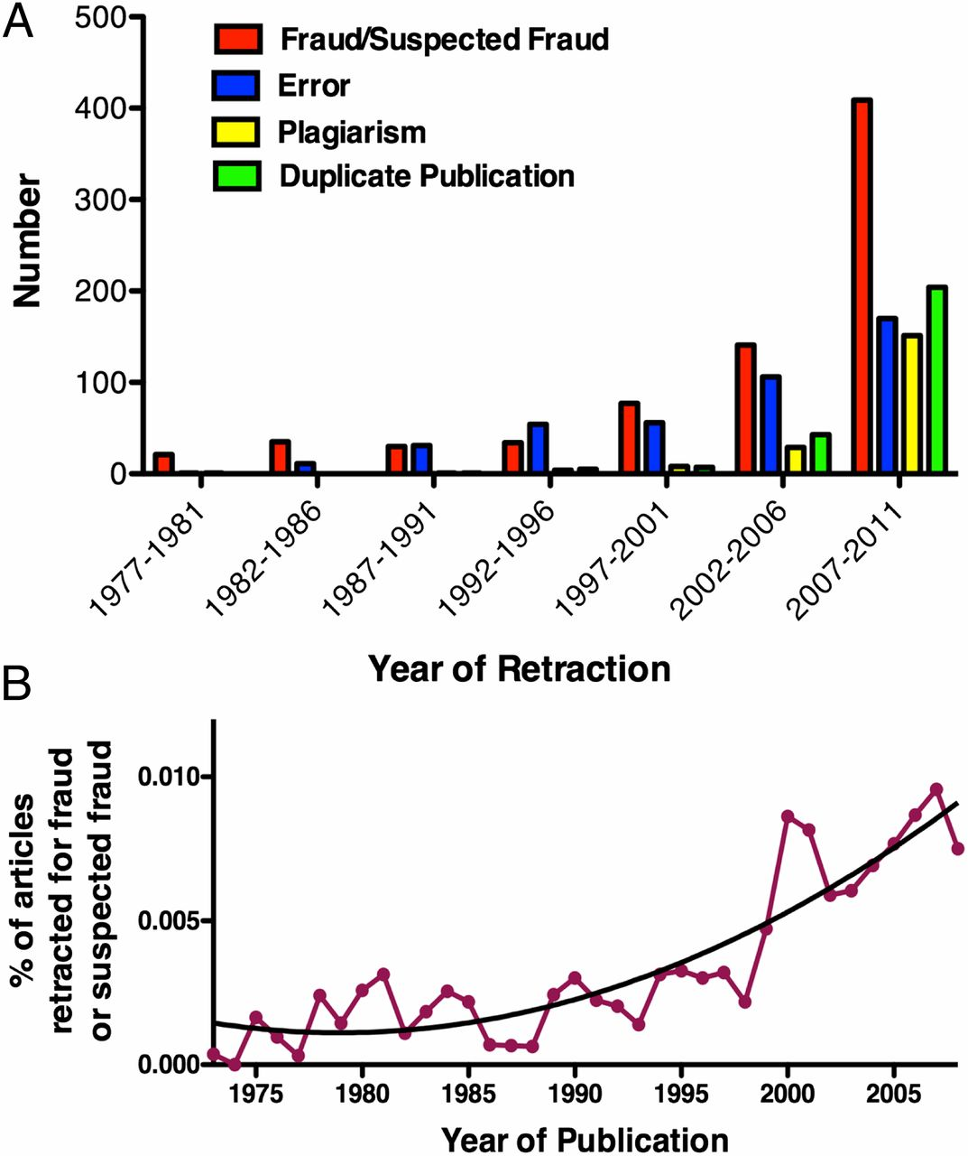
PNAS October 16, 2012 109 (42) 17028-17033;

Slide 28
Scientometrics (2013) 96:573–587

Slide 29
Scientometrics (2013) 96:573–587

Slide 30
Summary
Science is a self-regulating profession
Public trust relies scientists to conduct research and all the attendant components with integrity
This applies to human subjects research in addition to bench science
All aspects of research must be carried out with these important underpinnings in mind in order to maintain societal trust in this integrity
Questions about conduct of human subjects research can be addressed to the IRB

