Slide 1
SOCRA Mid-South Chapter Meeting March 26, 2021
Clinical Trial Budgets- The Basics
Rene´ Jooste, PhD, M Pharm, CCRP
Lesley Rachal HMBA, RN, BSN, CCRP
Clinical Trials Finance Office
St Jude Children’s Research Hospital

Slide 2
Learning Objectives
Recognize the role of a coverage analysis as essential starting point
Policies guiding Coverage Analysis
Identify the key cost components of a clinical trial budget
Importance of a research fee schedule
Hidden costs

Slide 3
Overview
Coverage Analysis
Definition
Policy
Checklist
Examples
Budget Basics
Identify components of a clinical trial budget
Identify all costs, including hidden costs
Best practices for budget negotiation
“Preliminary Budgets”

Slide 4
Determines if patient care costs are the financial responsibility of sponsor, other funding source , or qualify for reimbursement by health insurance
Comprehensive Analysis of clinical trial related documents
Basis of research billing compliance process
Coverage Analysis

Slide 5
Coverage Analysis

Slide 6
Clinical Trials Policy- NCD 310.1
Identifying “Routine Care” per the NCD310.1 policy
“Routine care” does not necessarily mean what the physician routinely does
“Routine care” is the care a patient with this diagnosis would receive if not treated on a research study at a peer institution
“Routine care” does not equate to “standard of care” at your institution
“Routine care” allows for more than conventional/standard care, e.g. the IV administration of an investigational drug or monitoring for toxicities if the study meets NCD 310.1 qualifying criteria

Slide 7
Conventional/Routine Care vs Research
Would physician perform this service at the required frequency for a patient not in the study?
Is physician able to document the medical necessity of the item or service in the medical record for every subject?
Will physician use the test for the direct clinical management of every patient enrolled in the research study?
IF ANY ANSWER IS NO, probably not conventional care
Support an increase in extramural funding for St Jude clinical trials

Slide 8
Research Activities w/o Question
Optional activities
IND drugs
Correlative / exploratory studies e.g. PK
Hybrid activities, e.g. imaging with extra time added for research activities
No medical necessity
Screening activities for eligibility
Healthy volunteers
Multiple imaging modalities

Slide 9
Would you consider these research activities ??
Imaging at higher frequencies ? Yes
Multiple imaging modalities ? Depends
Lab tests at frequent intervals (needle sticks) ? Depends
Mandatory hospitalization ? Depends
Biopsies after a few cycles ? Depends
MRD evaluations ? Depends
Hybrids- e.g. BMT with IND stem cell product ? Yes
Off-label drug use ? Depends

Slide 10
Coverage Analysis Checklist
Gather essential documentation (protocol, consent, Lab Manuals, IB, CTA)
Determine whether the study is a qualifying clinical trial per NCD310.1
Identify all Items and services that are part of the clinical trial
Identify Items and services to be paid for by sponsor or provided at no cost to site or study participants
Identify items and services that will not generate charges in the billing system (e.g. informed consent)
Are the remaining items and services routinely provided outside of the clinical trial to patients with the same disease as the study subjects?
Research vs conventional/routine care
Can the items and services not routinely provided outside of the clinical trial to patients with the same disease be billed to Medicare ?(do they qualify per Medicare definition of routine care per NCD310.1 and if so, justification needs to be documented)

Slide 11
Financial Analysis

Slide 12
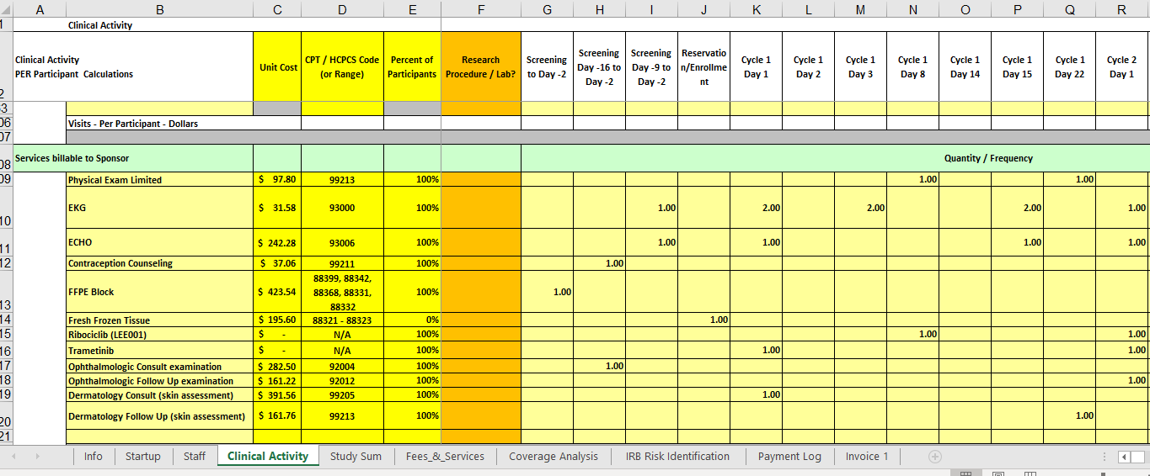

Slide 13
Budget Basics
Identify components of a clinical trial budget
Identify all costs, including hidden costs
Best practices for budget negotiation

Slide 14
How Much does a Clinical Trial Cost?
Average cost of phase 1, 2& 3 clinical trials across therapeutic areas is around $4, $13 & $20 million respectively
Pivotal (phase 3) studies for new drugs approved by FDA cost a median of $41,117 per patient
cost estimates across therapeutic areas reported by Aylin Sertkaya et al., in a report submitted to US DHHS 2016

Slide 15
Budget Components
Study participant (per subject) costs
Staff time
Admin fees
Indirect costs
Correlative Objectives

Slide 16
Before you Start
Institutional Research Fee Schedule (federal, non-federal)
“Payments for research services should be fair market value for legitimate, reasonable, and necessary services.” (HHS OIG, 2003 Notices) Promoting Objectivity in Research (CFR, Title 42)
“The fair market value is the price at which the property would change hands between a willing buyer and a willing seller, neither being under any compulsion to buy or to sell and both having reasonable knowledge of relevant facts.” (CFR, Title 26)

Slide 17
Budget Development Process

Slide 18
Required Documents
Sponsor’s budget template
Contract
Protocol-Schedule of Assessments
Informed Consent
May need:
Imaging Manual
Laboratory Manual
Pharmacy Manual

Slide 19
Cost Analysis
Read the Protocol
Do not create the budget from the study calendar (or the sponsors budget draft)only. Read through protocol text to ensure it matches the calendar.
Not all cost items are included in the schedule of assessment
Beware of lab panels. If SOE or budget lists a lab panel check the protocol to see what is included in the panel
Example: Comprehensive Chemistry Panel includes 14 tests; sponsors often include additional tests which will need to be accounted for
Be flexible-sponsor may not be willing to add a budget item titled a certain way but may be willing to offer another descriptor that would cover the fee
Value in second pair of eyes to review for accuracy

Slide 20
Single or Multi-Site ?
Never underestimate time and number of sites to recruit
Underestimating will result in greatly exceed budgeted infrastructure costs (coord center, trial leadership, data management/statistical support) usually based on FTE even though per subject costs remain the same: e.g. 8 years to do planned 5 year study
If you need more sites later, start‐up costs for sites will fall short

Slide 21
Study Initiation (Start-up)
Coverage and budget analysis
Investigational phcy and PK shared resource start-up
Admin preparation and submission to regulatory committees
Consent translation
Feasibility review- may include a site visit
SIV (site initiation visit)
Training

Slide 22
Per Participant Costs
Cost to complete all activities (including optional) listed on the protocol SOE
Include research staff time associated with each activity –PI, research nurse/coordinator, data management
Clinical activities associated with CPT code and research fee schedule
Activities not associated with a CPT code- clinical or research staff can assist with hourly fee for prof activity or budget (including supplies) for basic research
Sample acquisition and shipping fees for central labs

Slide 23
Procedures & Personnel Costs
Non-routine care procedures ‐ fee schedule
CPT or Procedure code for each test determined to be research related
Study personnel –“effort” estimates by time (mins/hrs/ per visit) typical personnel & estimated salary/benefits (MD Investigator, clinical study coordinator (RN), non RN trial coordinator for each item on the SOE
Use upper range of salaries since West and East coast institutions have higher costs of living

Slide 24
Indirect Costs (overhead)
Applied to ALL items in any Industry Sponsored Budget
Non negotiable
Double check advertising, subject stipends, and invoiced items to ensure the sponsor will pay the overhead
Many sponsors consider these “flow-through” items

Slide 25
Screen Failures
Is sponsor only paying for procedures performed (prior to subject being deemed a screen failure)? Include staff time for screening
Is sponsor paying the full cost of the screen failure? E.g., sponsor will pay 80% of the screening visit for screen failures
Is there a ratio? E.g., for every 3 patients randomized sponsor will reimburse 1 screen failure
Is there a cap on number of screen failures?

Slide 26
Stipends
Is there a subject stipend? How much is the stipend?
Confirm the amount in the budget matches the informed consent and includes indirect costs
Who will be paying the subject- sponsor or study team?
Can be used to cover travel, parking and meals
Subject to IRB approval-must be included in the informed consent

Slide 27
Study Close Out
Prepare for study close out visit
Complete all study reports
Packaging and storage of study records
Complete all outstanding queries
Invoicing
Final report
Does CTA allow for queries after close-out?

Slide 28
Invoiceables
May not happen to every participant
Assign a cost and multiply by total # of possible occurrences
Include in total budget
Screen failures
Regulatory e.g. adverse events, annual reports
Monitoring visits and queries
Clinical activities e.g. Echo or MUGA

Slide 29
Hidden Costs
project management for multi-site
consent translation
potential for unscheduled visits
data entry & analysis (using sponsor portal for eCRF)
site visits, monitoring
inflation for multiyear studies
central lab shipping

Slide 30
Negotiating with Sponsor
Qualities of a Good Negotiator
Planning skills
Ability to think clearly under stress
Communication skills
Product/industry knowledge
Personal integrity

Slide 31
Negotiating with Sponsor
Provide detailed, line-item cost for each activity
Use the words, “Our costs of participating in the trial”
Provide Memo with standard admin fees and justifications
Remember, the Sponsor wants your site and the PI involved in the trial as a thought leader
Escalate concerns to a manager

Slide 32
Payment terms
Payment Terms and Frequency
When will the sponsor make per Subject payments?
Quarterly? After monitoring visits?
What triggers payments (milestones) ?
eCRF completion? Monitoring visits?
Invoice
Startup Fee
Does the original contract state when the startup fee will be paid and that this is non-refundable
Screen Failures
Holdback
Invoiceables
Time frame for submitting invoices?

Slide 33
“Preliminary Budgets”
What do they expect to be clinical care
Visits
What do they expect the Sponsor to provide
Drug
Monetary support over the drug
What Collaborative Studies do they want to include
Pharmacokinetic studies
Genomic Studies
Labs
Diagnostic Imaging
Primary Investigator has a new protocol

Slide 34
Key Questions
Do they have a preliminary protocol or schema of evaluations to share
What type of study design
What disease process will they be treating
What are the objectives of the study
What Correlative Studies will be involved
Pharmacokinetics
Other departments involved?

Slide 35
Key Questions (cont.)
How many patients
How long to accrue, length of treatment, estimated study end
Will we have more than one site
Who is going to hold the IND
Who are they collaborating with
Will we need special software
What data is the sponsor interested in

Slide 36
Perform a Preliminary Coverage Analysis
Be sure to complete to the best of your abilities, ask questions, who is providing what?
Any correlative test being completed by your institution?
Get the laboratory/radiology/psychology information and ask for cost (any supplies, equipment or software needed)
Estimate to the best of your ability all the projected cost, review with your PI, make necessary changes

Slide 37
Negotiating Tips
Ask for a per patient enrollment fee vs. milestone
If multiple sites/Strata/Difficult Study, ask for Project management time
Ask for eCRF development costs
Monitoring fees

Slide 38
Negotiating Tips (cont.)
If sponsor not willing to pay for all parts of the trial, be very specific as to what information they will receive in the contract
Contact with study team and sponsor very important, communication is key
Holding IND? Ask for reimbursement
Inflation and yearly fees such as Annual IRB, Pharmacy Storage, Record storage

Slide 39
Presentation to the Sponsor
I always ask for everything imaginable up front, all they can say is no
Make them aware what it truly cost to run the trial
If they only want to fund certain amount, I still present the entire budget and explain what their money gets them. Study team helps with this part
Show what you are paying for and what they are paying for in budget

Slide 40
QUESTIONS ?
rene.jooste@stjude.org
lesley.rachal@stjude.org

