Slide 1
Writing for Patient Recruitment & Other Patient Facing Materials
Teresa Carr RN, BS, CCRC, CIP
Samantha Ransone PhD, RN
Notes:
Sam’s intro: I lead a team of strategic health communicators who create education and information on pediatric cancer and other diseases for patients and families no matter where they receive treatment across the world.

Slide 2
Objectives
Understand federal regulations and guidance for clinical research and impact on patient facing materials
Understand IRB Review of patient facing materials
Learn strategies to promote health literacy in patient facing clinical research communications
Learn methods of distribution for patient facing materials in clinical research

Slide 3
What are patient facing materials?
Activity #1: Using the chat, list some examples of patient-facing communications used in clinical research.
Notes:
In the chat of the meeting, have the participants name a few examples of what they think patient facing materials are in clinical research.

Slide 4
Examples of Patient Facing Materials
Informed consent
Surveys
Participant diaries
Study summaries
Recruitment Tools/Advertisements
    Media
    Letters/postcards

Slide 5
Methods & Materials used to Recruit Research Subjects
Traditional Media:
Print:
  Newspaper
  Magazines
  Posters
  Flyers
  Brochures
  Recruitment letters
    Patients
    Local Physicians
Radio​
Television​
Internet​
  Digital pre-screeners and websites​
Word of mouth​
Social Media:
Social Network (FaceBook)
Microblog (Twitter)
Image/Video sharing sites (YouTube)
Blogs
Forums
Other:
Electronic health records (EHR) matching
Patient networks through nonprofits
Patient registries
Full- service patient recruitment companies
Notes:
We are not going to talk about how to create each of these materials, but rather, we are going to discuss the tools you will need to write any patient facing material in a way that will meet both the regulatory and patient/family information needs.

Slide 6
Federal Regulations
“Human Subjects” research is regulated by two federal bodies:
Office of Human Research Protections (OHRP) applies to all research associated with federal funding (e.g., NIH, NCI, etc)
45 CFR 46 and Subparts B [Pregnant Women, Human Fetuses and Neonates], C [Prisoners], and D [Children]
Food and Drug Administration (FDA) applies to all research of medical products
  21 CFR Part 56 [IRBs] and 21 CFR 50 [Protection of Human Subjects]
  21 CFR may also impact content of material/information provided to patients/research participants, such as, 11, 312, 812, etc
Notes:
How are these methods and materials regulated? The department of Health and Human Services house two federal agencies which provide the Codes of Federal Regulation & Guidance Documents that govern the conduct of human subject's research. OHRP utilizes 45CFR46, parts B, C, and D. FDA utilizes 21CFR50 for HS and 21CFR56 for IRBs. FDA also oversee Parts 312 Investigational Drugs, 812 Investigational Devices and Part 11 which regulates electronic records and signatures.

Slide 7
IRB FDA & OHRP Criteria
The OHRP and FDA require Institutional Review Board (IRB)
review and have authority to approve,
require modifications in,
or disapprove all research activities covered by the IRB regulations.
The IRB ensures appropriate safeguards exist to protect the rights and welfare of research subjects
The IRB is expected to review all the research documents, communications, and activities that bear directly on the rights and welfare of research subjects of the proposed research. This includes all promotional and/or recruitment communications.
Notes:
These two agencies require Institutional Review Boards – review and approve, require modifications in or disapprove research activities; ensure appropriate safeguards exist to protect the rights and welfare of research participants and are to review all research documents, communications and activities that bear directly on the rights and welfare of participants in the proposed research. This would include all promotional and/or recruitment communications.

Slide 8
FDA Guidance
FDA considers advertising and/or communication specifically for potential study subjects to be the start of the informed consent and subject selection process
Advertisements/communications/information should all be reviewed and approved by the IRB as part of the package for initial review
If the clinical investigator decides to advertise at a later time or provide other forms of communications to subjects, the materials should be submitted to the IRB as a modification to the ongoing study
Notes:
Bullet 1: This often happens well before the actual presentation of a research consent document to a patient. So, #2...
#3 Should the investigator decide to advertise or provide other forms of communication to study participants after the study is approved these materials would be submitted for review and approval as a modification.

Slide 9
FDA Expectations of the IRB
The IRB should review:
All outreach materials to assure they are not unduly coercive and do not promise cure or treatment beyond what is outlined in the consent and protocol
Final copy of printed advertisements to evaluate the relative size and type used and other visual effects
Final audio/video tape. Scripts may be reviewed and approved prior to taping to preclude re-taping.
Notes:
Bullet 1: This is critical when studies may involve subjects who are likely to be vulnerable to undue influence. [21 CFR 50.20, 50.25, 56.111(a)(3), 56.111(b) and 812.20(b)(11).]
Bullet 3: This will save time and money. and then, When you submit the final audio/video for review it can be completed through expedited procedures.

Slide 10
IRB Review: Outreach Materials
Does Require review:
Ad copy for digital channels
Website text for a landing page about the clinical trial
Pre-screener
Scripts for team members who speak to patients about the trial
Video advertisements
Mock-ups of print advertisements
Drafts of radio advertisements
Other patient-facing outreach materials, as noted in guidelines
Does NOT require review:
Communications intended only to be seen or heard by health professionals, such as doctor-to-doctor letters
Other materials prepared for non-patient audiences, such as outreach to investors
News stories
Study Listings on Clinical Trials Websites
  National Institutes of Health (NIH) – http://www.clinicaltrials.gov
  NIH National Cancer Institute’s cancer clinical trials listing (Physician Data Query [PDQ])
  Government-sponsored AIDS Clinical Trials Information Service (ACTIS)
Notes:
#1 - Digital channels: including Facebook, Twitter, paid search platforms, and banners

Slide 11
Clinical Trials Websites
Clinical Trials Websites that provide only directory study listings with basic descriptive information about clinical trials in general do not need to be reviewed by an IRB.
IRB review and approval of listings of clinical trials on the Internet would provide no additional safeguard and is not required when the system format limits the information provided to basic trial information:
    Title
    Purpose
    Protocol summary
    Basic eligibility criteria
    Study site location(s)
    How to contact the site for further information
Beyond basic information requires IRB review and approval
Notes:
For further clarification, IRB review and approval is not required for CT Website posting when the information is limited to the basic trial information. This consists of …

Slide 12
FDA Guidance: Outreach materials
Outreach materials should include information to help patients make an informed decision to participate. This might include:
  The purpose of the research (plain language)
  The condition under study
  A summary of eligibility criteria
  Participation benefits (within FDA guidelines)
  A general description of time commitment for the trial
  The name and address of the research site
  Who to contact for more information
Notes:
For the materials that require IRB review you should include information that helps patients make an informed decision about participation.

Slide 13
FDA Guidance: Outreach Materials
Outreach materials should not:
Make claims that the investigational treatment is safe or effective, or that it is equivalent or superior to existing treatments. This includes both explicit and implicit claims.
Use language such as "new treatment," "new medication," or "new drug" without explaining that the treatment is investigational.
  For example, "new investigational medication" may be approved, but "new medication" would not be approved.
Promote "free medical treatment" to refer to the study-related care patients will receive
Emphasize compensation
Notes:
Bullet 1: The IRB will review content, as well as the font size and type, and other visual effects, in determining whether materials are too promissory.
Bullet 2: It needs to be clear that the medication is not FDA approved.
Bullet 3: You should not promote "free medical treatment" to refer to any study related care that the patients will receive.
Bullet 4: If the trial is paid, compensation may be mentioned, but not emphasized through larger or bold type

Slide 14
How should materials be created?
Health literacy in clinical research
Plain language writing
Readability tools
Examples of patient instruction
Examples of patient recruitment materials
Notes:
I am going to touch on a few things briefly and show some examples, but the biggest thing I want you to take away from our discussion is that my team is a resource you can and should use!

Slide 15
Health Literacy and Clinical Research
Personal health literacy is the degree to which individuals are able to find, understand, and use information and services to inform health-related decisions and actions for themselves and others
Organizational health literacy is the degree to which organizations equitably enable individuals to find, understand, and use information and services to inform health-related decisions and actions for themselves and others
Healthy People 2030: https://health.gov/healthypeople/priority-areas/health-literacy-healthy-people-2030
Notes:
To answer the question “how should materials be created” you first need to understand the principles of personal and organizational health literacy.

Slide 16
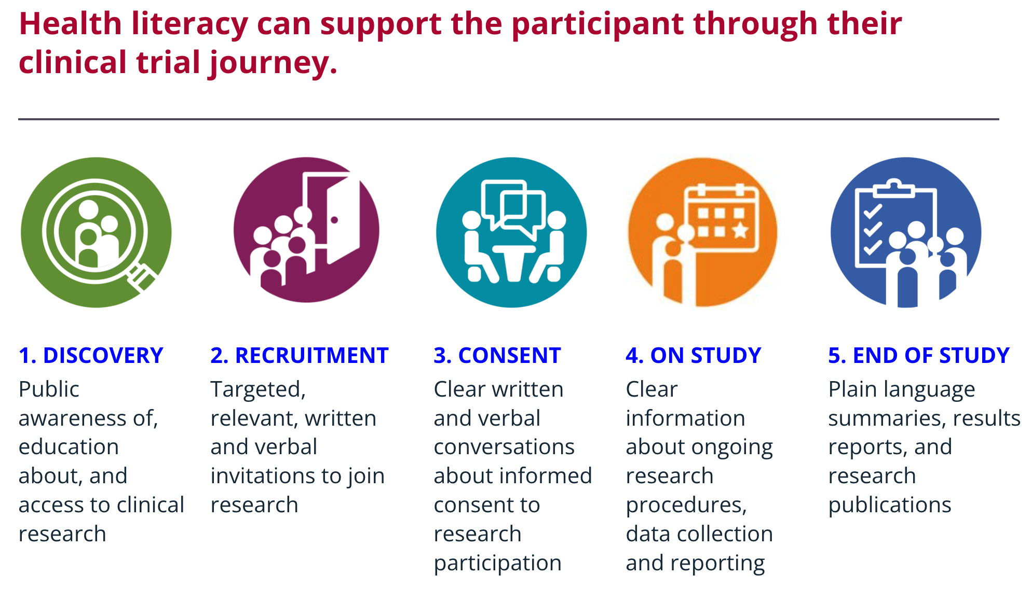
Health Literacy and Clinical Research
Notes:
When they learn about the research
When they are asked to join a specific study
When they are guided through a consent process to decide if the study is right for them
When they begin their study visits and go through study procedures as participants
When they reach the end of their time in the research study

Slide 17
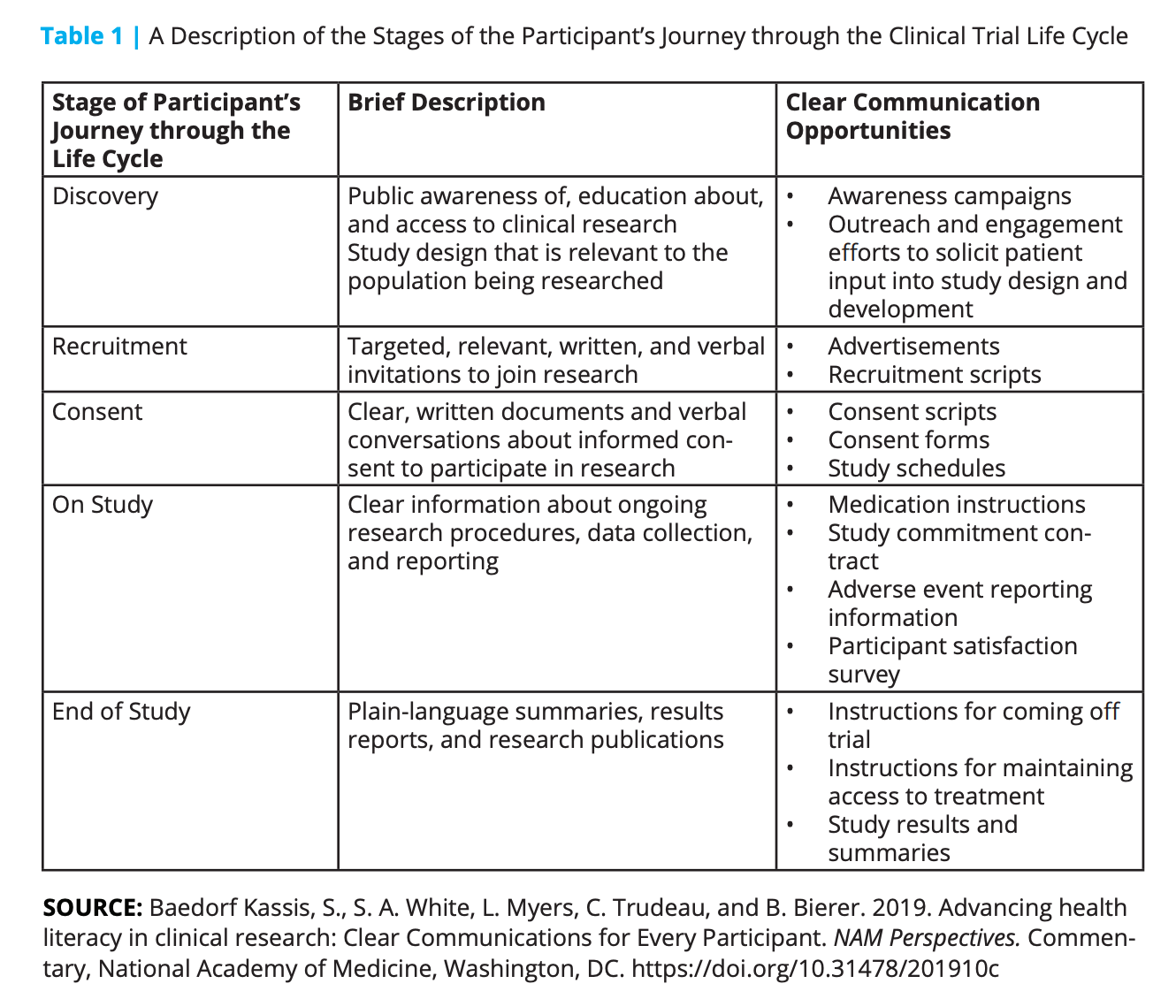

Slide 18
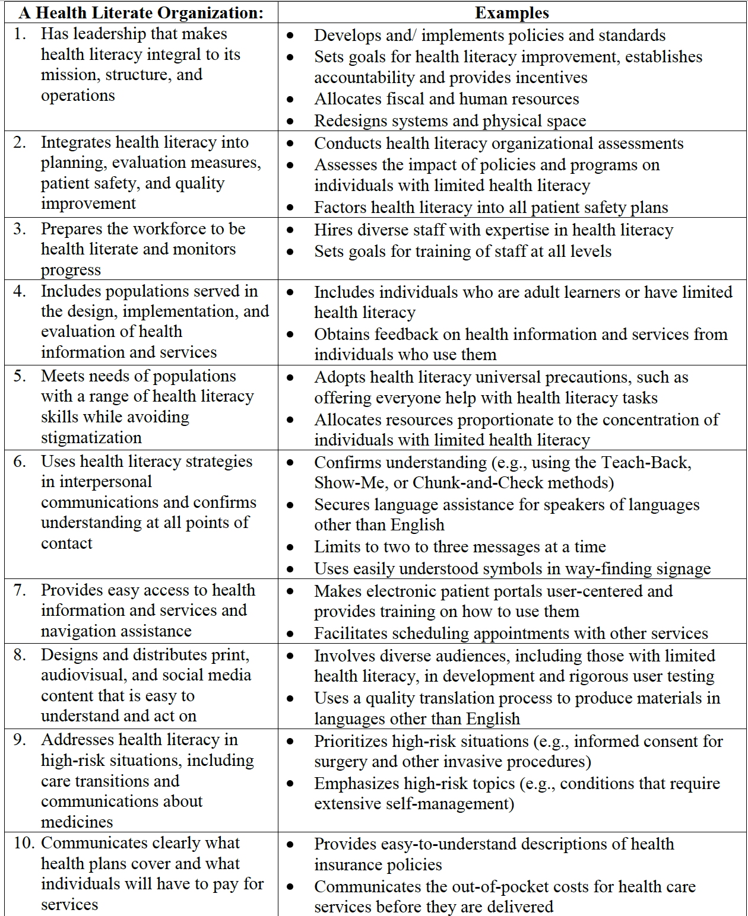

Health Literacy and Clinical Research

Slide 19
Plain Language Writing
Plain language is:
Common, everyday words except for necessary technical terms
Use of personal pronouns (“we” and “you”)
Active voice
Logical organization
An easy-to-read format, including bullets, tables and free use of whitespace
Plain language is not:
Writing less precisely
“Dumbing down” or using baby talk
Attempting to be folksy or too informal
Leaving out necessary technical or legal terms
Notes:
Plain language makes communication actionable and understandable; it also makes it easier to translate into other languages.
Plain language and readability go hand in hand – both are central to promoting health literacy in clinical research

Slide 20
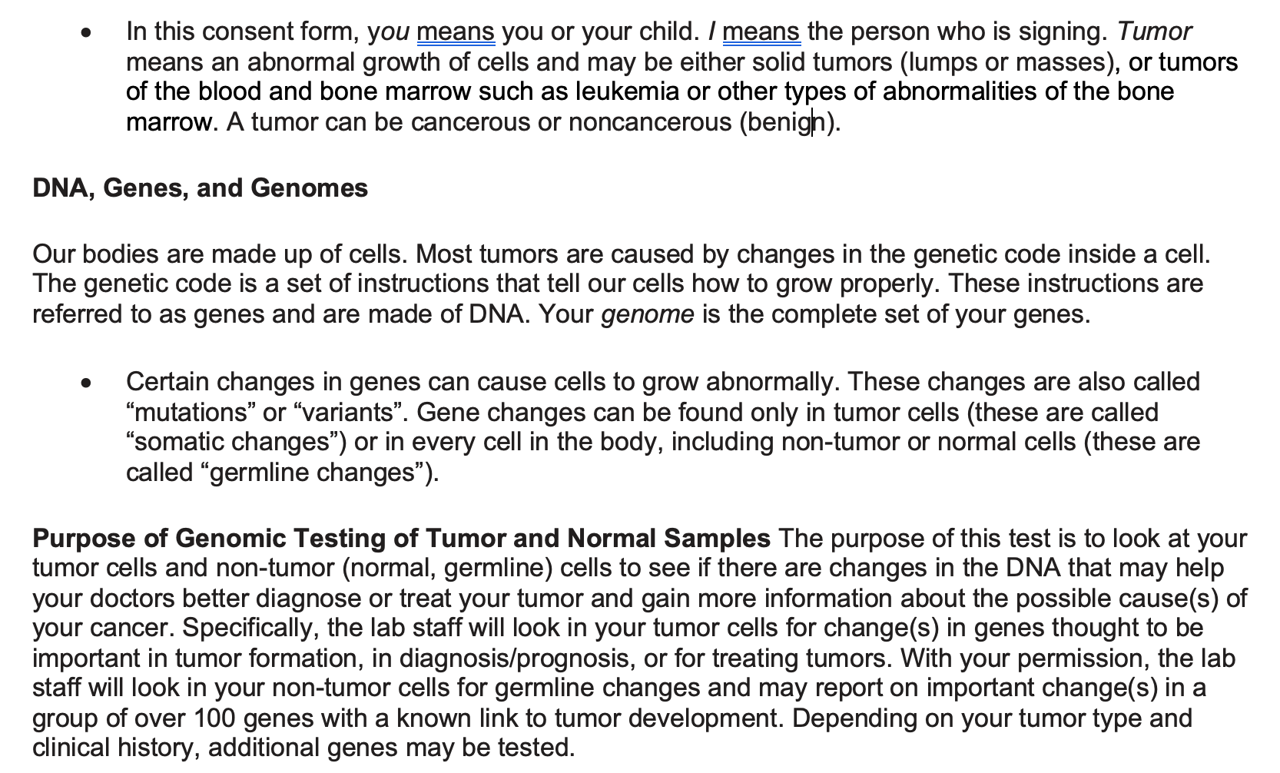
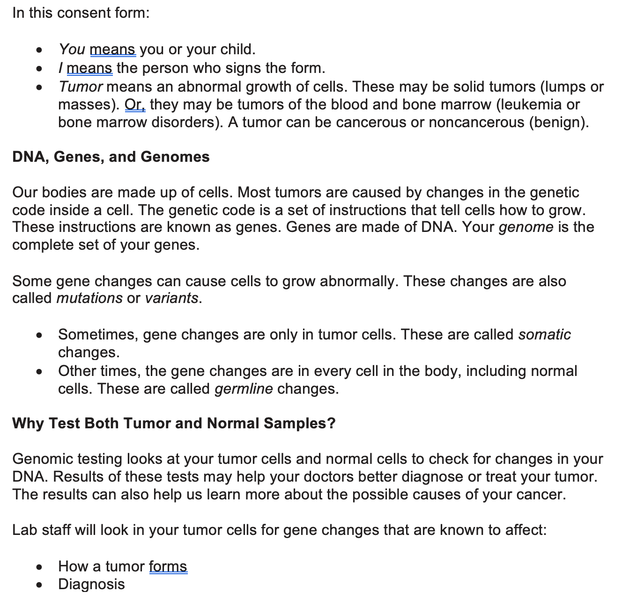
Example: Plain Language Consent
Consent for Genomic Testing of Tumor and Normal Samples

Slide 21
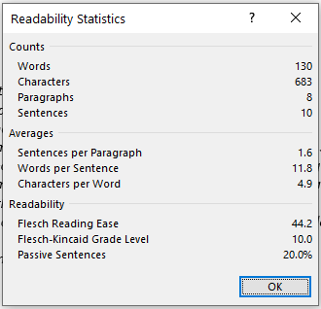
Readability Statistics: Averages
Sentences per paragraph: aim for 2 or fewer
Word per sentence: aim for 14 or fewer
Characters per word: aim for 5 or less
It is more important to have short words than short sentences. Words should be a maximum of 2 syllables when possible. (Sometimes this is not possible because of required technical and legal terms.)
Notes:
Enable readability statistics in Word.
Once you finish editing your document in Word, you go to “Review” and “Spelling & Grammar.” After spell check runs, the readability stats automatically appear on the screen.

Slide 22
Readability Statistics: Readability
Flesch Reading Ease: Aim for 60-70 (higher is better)
Flesch-Kincaid Grade Level (aim for 6th grade). This is the number to look at first. It is difficult to achieve because we have a lot of long words in our cancer/catastrophic disease research and treatment.
Passive sentences: Aim for zero
Everybody is rushed and distracted, so regardless of the audience, simpler is always better. Make it easy on readers so that you increase the odds they read it.
Notes:
Italics and underlined text are more difficult to read than Roman type
5 people read the headline for every 1 who reads the story
3 people read the photo caption for every 1 who reads the story
News heads: aim for 8 words or less
Deck (subhead): 14 words or less.
Web heads: 5 or less words: subj/verb, topic
Web heads: the first 11 characters count most. Lead with topic—make it clear, not clever.
Avoid –ing heads
Deck (kicker under head): 95% read it. May be the ONLY thing they read.

Slide 23
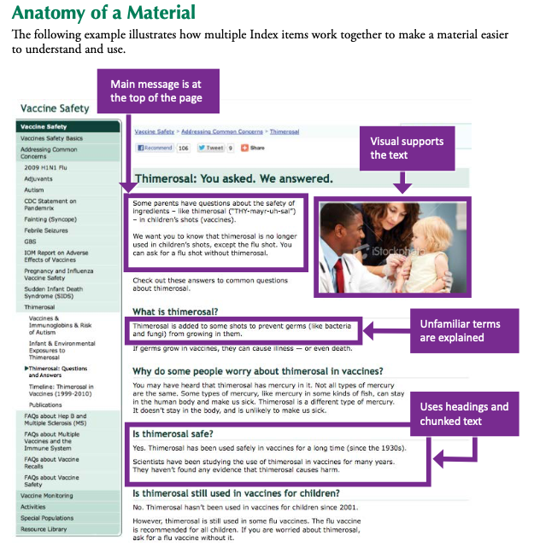
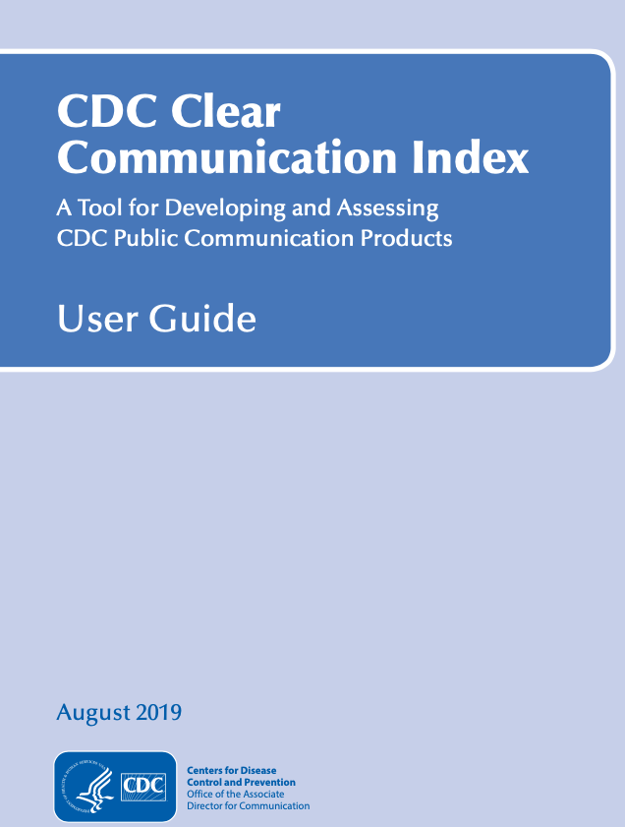
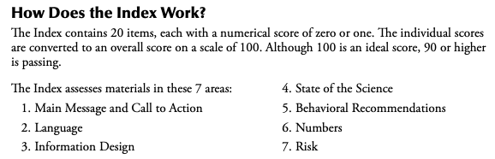
Notes:
Talk through the slide – the CCI contains 20 items.

Slide 24
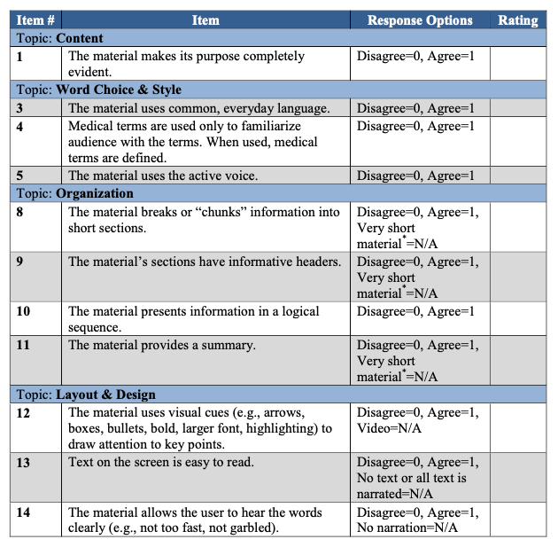
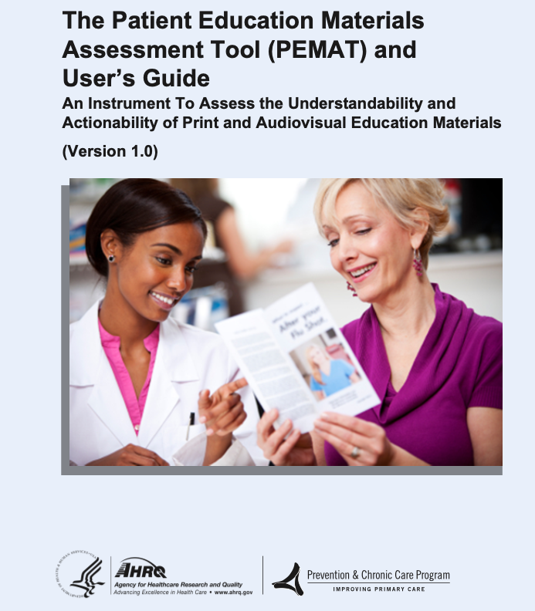
Notes:
In the literature PEMAT is the most commonly used measure to evaluate written and audiovisual education materials.
The PEMAT provides two scores for each material—one for understandability and a separate score for actionability. To score you must make sure you have rated the material on every item, including indicating which items are Not Applicable (N/A). Except for Not Applicable (N/A) items, you will have given each item either 1 point (Agree), or 0 points (Disagree). Ideally, our materials should be scored at least 90% in both understandability and actionability.
Here are some examples of what is included in the PEMAT scoring rubric.

Slide 25

Example 1: Patient Instruction
Scenario: You are scheduled for a surgical procedure tomorrow. A bottle of liquid is given to you along with a pre-operative instruction sheet that says:
“12 hours before your procedure, cleanse your body with this fluid.”
What do you do?
Notes:
Drink the fluid
Bathe/shower with the fluid

Slide 26



Slide 27

Example 1: Patient Instruction
Impact of “minor” miscommunication not so minor:
Costs to patient – delayed treatment, time off work and potentially loss of wages, out of pocket expenses for transportation and parking
Costs to health care system – underutilized surgical suite, wasted human resources

Slide 28

Example 2: Patient Instruction
Scenario: A little boy has an ear infection and needs antibiotics. The parent was given instructions to give the boy 2 pills a day for his ear infection. The parent put the pills in the child’s ear.
What are some possible reasons this happened?
Notes:
[Parents couldn’t read the prescription, font too small, language too complex, some cultures are not accustomed to tablets or pills- are use to liquid medicine etc-]
Loss of trust – do you have questions? What questions do you have?
Did anyone tell you how to use the fluid?

Slide 29
Activity: Creating a Study Flyer
Scenario: You need to create a flyer to recruit participants for a weight loss study.
Which of the following should not be included on the flyer? Put your answer in the chat.
The purpose of the research
The condition under study
Monetary incentive
A summary of eligibility criteria
A general description of time commitment for the trial
The name and address of the research site
Who to contact for more information
Notes:
C

Slide 30
Example #1
Lose Weight Fast and Receive Cash!!!
Join an existing weight-loss study.
Are you a teenager?
Are you fat and want to lose weight?
If you answered YES to these questions, you may qualify to participate in a weight loss study.
You will receive a free medical evaluation and participate in a cutting-edge nutrition program.
You will also receive $$$ money $$$ and parking vouchers. No medications will be given.
Call (213) 456-9870 for more information.
Is this ready for IRB approval?
Notes:
So you delegated this responsibility and this came back to you for review.
What are the issues?
The advertisement is misleading concerning its purpose.
There is an emphasis on monetary compensation.
The advertisement uses catchy words such as exciting, fast, cutting-edge, and free.
Ages for eligibility are not specified.
The purpose of the study is not specified.
No mention is made about the study being “research.”
Terms such as fat may be insulting.
The name of the contact person is not included.
The study location is not included.
It’s not written in plain language

Slide 31
Example #1: IRB not approved
The advertisement is misleading concerning its purpose.
There is an emphasis on monetary compensation.
The advertisement uses catchy words such as exciting, fast, cutting-edge, and free.
Ages for eligibility are not specified.
The purpose of the study is not specified.
No mention is made about the study being “research.”
Terms such as fat may be insulting.
The name of the contact person is not included.
The study location is not included.

Slide 32
Example #2
Weight-Loss and Diabetes-Prevention Study
Be part of an important Nutrition Research Study
Are you between 13 and 21 years of age?
Do you want to change your eating habits in order to lose weight?
If you answered YES to these questions, you may be eligible to participate in a nutrition research study.
The purpose of this research study is to compare the effectiveness or different diets in preventing type 2 diabetes. Benefits include a comprehensive medical evaluation and nutrition program. Participants will also receive monetary compensation and parking vouchers. No medications will be given.
Both adolescents (13 years of age and older) and adults (21 years of age and younger) are eligible. The study is being conducted at Central Hospital.
Please call John Smith at (555) 123-4357 for more information.
Is this ready for IRB approval?
Notes:
Approach is straight forward and honest.
“Research” is specified.
Ages for eligibility are included.
Purpose of the study is clearly stated.
Benefits are included.
Contact person’s name is included.
Institution is identified.

Slide 33
Example #2: IRB approvable
Approach is straight forward and honest.
“Research” is specified.
Ages for eligibility are included.
Purpose of the study is clearly stated.
Benefits are included.
Contact person’s name is included.
Institution is identified.
But what about readability?
Notes:
Remember: If you make changes after a recruitment tool is already approved, it will have to go back through the IRB.

Slide 34
Example #2: Before Plain Language
Weight-Loss and Diabetes-Prevention Study
Be part of an important Nutrition Research Study
Are you between 13 and 21 years of age?
Do you want to change your eating habits in order to lose weight?
If you answered YES to these questions, you may be eligible to participate in a nutrition research study.
The purpose of this research study is to compare the effectiveness or different diets in preventing type 2 diabetes. Benefits include a comprehensive medical evaluation and nutrition program. Participants will also receive monetary compensation and parking vouchers. No medications will be given.
Both adolescents (13 years of age and older) and adults (21 years of age and younger) are eligible. The study is being conducted at Central Hospital.
Please call John Smith at (555) 123-4357 for more information.
Notes:
So, what are some things you can do to improve the understandability and actionability of this flyer?
No passive sentences/phrases
No Italics
Font is at least 12 point
Bulleted information for clarity
Bold font for important information
Left justified
A lot of white space

Slide 35
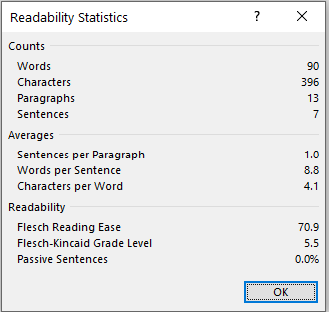
Example #2: After Plain Language
Lose Weight and Prevent Diabetes
Are you age 13–21?
Do you want to lose weight?
Do you want to prevent diabetes?
If so, you may want to take part in a new research study at Central Hospital.
This study compares how well different diets prevent type 2 diabetes.
If you take part, you will get:
A free medical check-up
A healthful eating program
Free parking
$___ at the end of the study
You will not take medications as part of this study.
Learn more: Call John Smith at (555) 123-4357.
Notes:
Grade level is 5.5
No passive sentences/phrases
No Italics
Font is at least 12 point
Bulleted information for clarity
Bold font for important information
Left justified
A lot of white space
Just remember – you will need to have your information go through a plain language review before submitting to the IRB. Any changes made after IRB approval would need to go back through the review process.

Slide 36
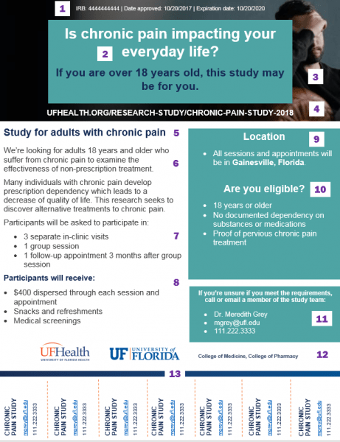
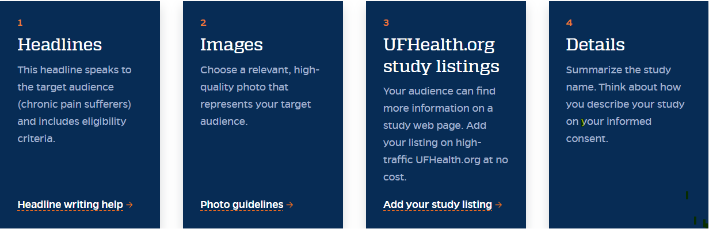
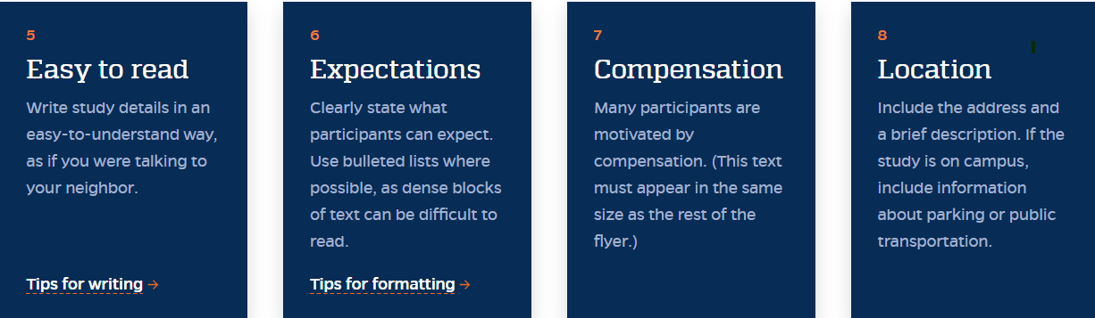
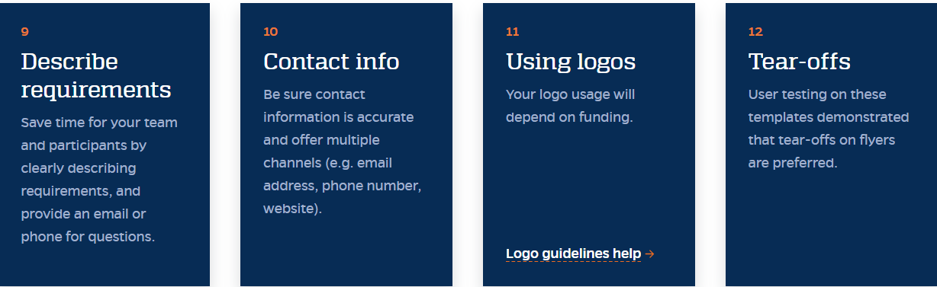
CTSI - UFL
https://www.ctsi.ufl.edu/research/participant-recruitment/recruitment-flyers/best-practices-for-recruitment-flyers/
Notes:
Clinical and Translational Science Institute

Slide 37



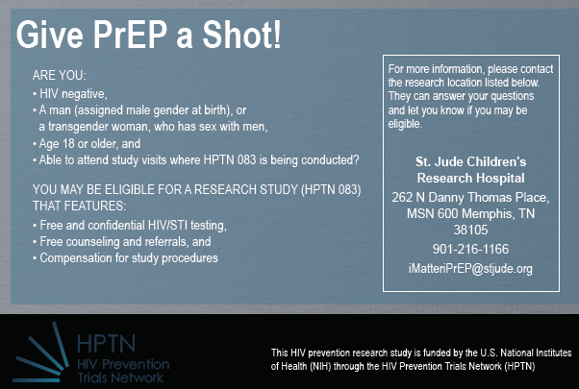
Clinical Trial Flyer/Palm Card

Slide 38
IRB Review: Audio and Visuals
Facial expressions, settings, and actions may implicitly communicate messaging that is not allowed by the FDA.
Images that imply results from the treatment may be considered too promissory by your IRB.
One safe route is to depict empathy or empowerment, which can be just as effective and are less likely to be rejected by your IRB.
If you choose to use imagery with pills or another image of medication, such as an inhaler, make sure the trial is using the same kind of intervention to avoid confusion.
Notes:
Images that imply results: For example, for an exercise-induced asthma trial, you don’t want to show people running marathons. While images shouldn't imply benefits from the trial, try choosing ones that convey life with the disease or that capture a positive experience interacting with medical professionals. Make sure that the images accurately portray your patient community, too.

Slide 39
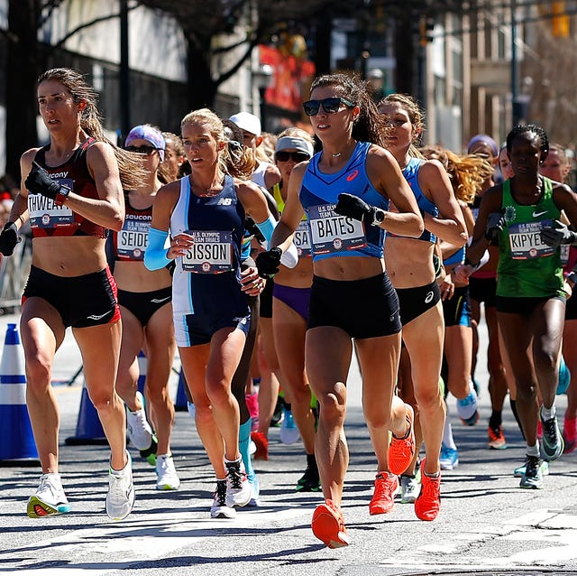
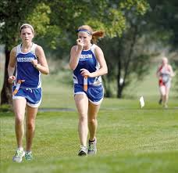
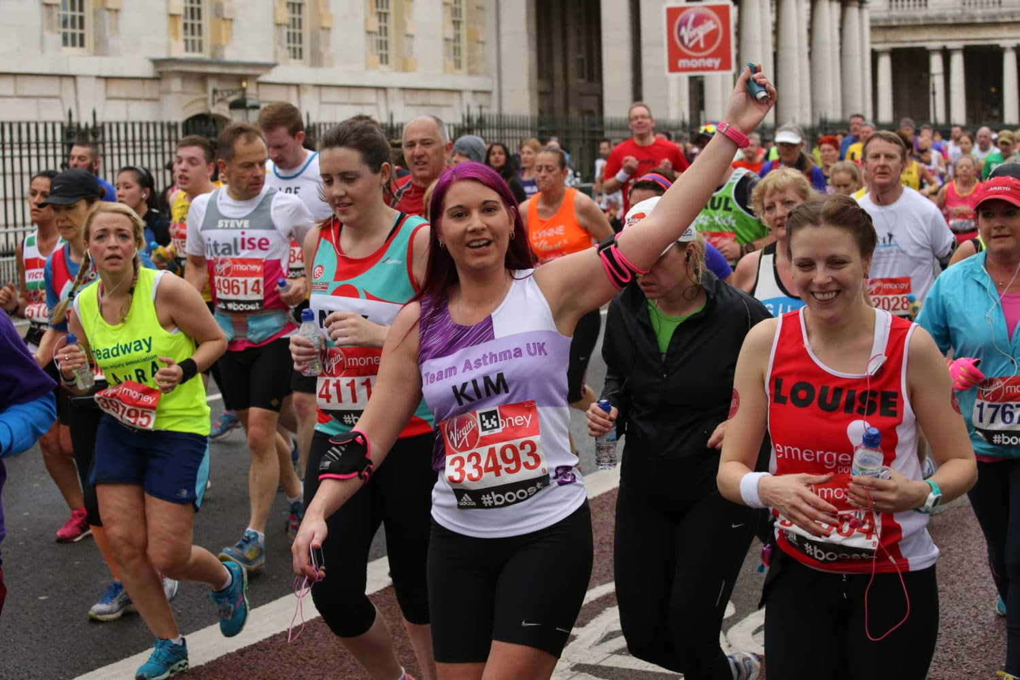
IRB Review: Audio and Visuals
Notes:
Images that imply results: For example, for an exercise-induced asthma trial, you don’t want to show people running marathons. While images shouldn't imply benefits from the trial, try choosing ones that convey life with the disease or that capture a positive experience interacting with medical professionals. Make sure that the images accurately portray your patient community, too.

Slide 40
Questions/Comments
Clinical Research Quality Management and Education
Teresa Carr RN, BS, CCRC, CIP
Teresa.carr@stjude.org
Office: 901-595-2034
Cell: 901-337-8621
Medical Content Outreach (Strategic Communication, Education and Outreach)
Samantha Ransone PhD, RN
Samantha.ransone@stjude.org
Office: 901-595-1560
If you need help with plain language writing and review, please contact patienteducation@stjude.org

Slide 41
References
FDA Information Sheet: Recruiting Study Subjects Guidance for Institutional Review Boards and Clinical Investigators January 1988 Final. https://www.fda.gov/regulatory-information/search-fda-guidance-documents/recruiting-study-subjects
Antidote: Clinical Trial Advertising Guidelines. https://www.antidote.me/blog/clinical-trial-advertising-guidelines-to-follow-for-irb-submission
Institution Review Board Management and Function: Advertisement for Research. Second Edition by Elizabeth Banker and Robert Amdur
Clinical Trial Websites: When is IRB Review Required and What Should IRBs Consider with Reviewing? (OHRP Guidance, 2005) | HHS.gov

Slide 42
References
OHRP Elements of Consent: https://www.hhs.gov/ohrp/regulations-and-policy/regulations/45-cfr-46/revised-common-rule-regulatory-text/index.html#46.116
https://mrctcenter.org/health-literacy/tools/overview/
https://nam.edu/wp-content/uploads/2019/10/Advancing-Health-Literacy-in-Clinical-Research.pdf
http://centerforhealthguidance.org/health-literacy-principles-checklist.pdf
SJCRH HRPP Policy 07.722, Legally Effective and Prospectively Obtained Informed Consent and Assent for Research and Documentation: https://home.stjude.org/hrpp/Policies/01-722.pdf
SJCRH HRPP Policy 01.737, Human Subjects Research Recruitment and Compensation: https://home.stjude.org/hrpp/Policies/01-737.pdf

Slide 43
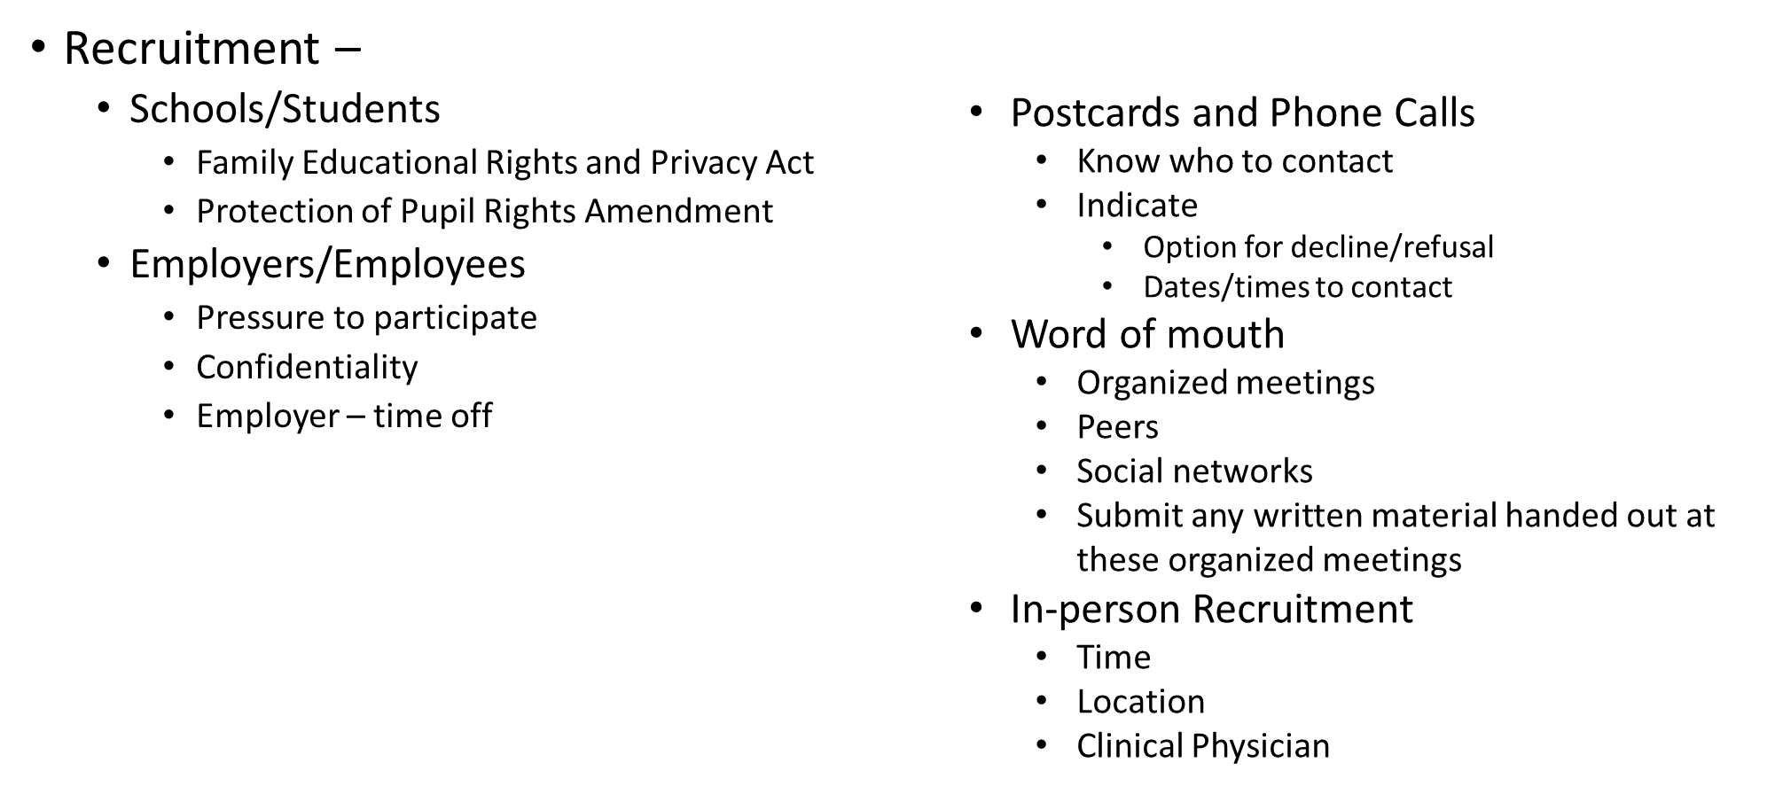
Media Advertisements

Slide 44
Media Advertisements
Recruitment Letters –
  First step in recruitment process
  Nature of the research –
    May need to include all elements normally disclosed in an informed consent document
  May choose to explain purpose, what is involved, risks and benefits, compensation offered, voluntary participation.
  Sensitive information – vague to protect ppt
  Should include how ppt was identified for contact
    Population of patients
      Previously seen by the investigator
      New patients
      Patients from another investigator
  Should include how current or future care will be affected
  Will results be released to the ppts
  Specifics on how to respond
  If planning to follow up with phone call

Slide 45
Media Advertisements
Research a large number of potential subject
Interested individuals – may not be looking
Utilize same guidelines as printed forms of advertisement
Taped/video - Subtle forms of coercion in
Tone of voice
  Speed of speech
  Inclusion of soothing background music
Social Media
  FaceBook, Twitter,

Slide 46
Social Media Advertisements
NIH Clinical Research Trials AND YOU
Guidance Regarding Social Media (SM) Tools
focused on SM tools and technologies that allow people to exchange information in real (or delayed time) on platforms that are public — including but not limited to — social networks (such as Facebook), micro blogs (such as Twitter), automated feeds (such as RSS), image/video sharing sites (such as YouTube), social bookmarking services, blogs, forums and other emerging technologies with the purpose of social interaction.
In the SM environment the movement and placement, context and content of information, may all be manipulated. Also, audiences may be highly-targeted without individuals in those audiences self-selecting to be reached (as in the purchase of a magazine, responding to a poster, or seeing an ad and calling an 800 number.)

Slide 47
Social Media Advertisements
NIH Clinical Research Trials AND YOU
Guidance Regarding Social Media Tools
Questions PI should consider:
Privacy – Non-US Government owned – 3rd party
  When considering whether a Third-Party Web site or Application (TPWA) is appropriate for NIH use, you must ensure all uses of Third-Party Web sites and Applications comply with existing OMB Guidance, HHS and NIH policies with respect to privacy, system security and data safeguarding standards.
Placement of Ads – ability to choose sites for advertisement
Locked format – if not “locked” how information is presented

Slide 48
Social Media Advertisements
NIH Clinical Research Trials AND YOU
Guidance Regarding Social Media Tools
Questions PI should consider:
Privacy of interested individuals
  Security wall for further information
  Not use data until eligible and consented
  Interactive nature of SM
  Portability and secure handling of information –
    encryption of laptops, sensitive information during transport, and reporting unintended breaches
  Consider invasive nature of joining groups – undermine trust

Slide 49
Informed Consent
Informed consent provides a potential participant with:
an understanding of the clinical investigation
adequate information to allow for an informed decision about participation in the clinical investigation
an appropriate amount of time to ask questions and to discuss the research protocol with family and friends
continued information as the clinical investigation progresses or as the subject or situation requires

Slide 50
Informed Consent: Basics
Description of Clinical Investigation
A statement that the study involves research
An explanation of the purposes of the research
The expected length of them for participation
A description of the procedures to be completed during enrollment and throughout the trial; includes identifying any procedures that are SOC and experimental
Risks and Discomforts
A description of any predictable risks
Any possible discomforts that could occur (e.g., IV placement, injections, blood draw for lab needs)
Benefits
Any possible benefits that may be expected
Alternative Procedures/Treatments
Information about alternative procedures or courses of treatment (if any) that might benefit the participant
Confidentiality
A statement describing confidentiality of information collected, how records that identify participants will be kept, and the possibility of inspection (FDA, OHRP, NIH, Sponsors)

Slide 51
Informed Consent: Basics
Compensation and Medical Treatment in the Event of Injury
For research involving more than minimal risk, there must be an explanation as to whether any compensation or any medical treatments are available if injury occurs
And, if so, what they consist of, or where further information may be found
Contacts
An explanation of whom to contact for answers to questions about the research and research subjects' rights
And whom to contact in the event of a research-related injury to the subject
Voluntary Participation
A statement that participation is voluntary, refusal to participate will involve no penalty or loss of benefits to which the subject is otherwise entitled, and the subject may discontinue participation at any time without penalty or loss of benefits to which the subject is otherwise entitled
Notes:
Minimal risk: the probability and magnitude of harm or discomfort anticipated in the research are not greater in and of themselves than those ordinarily encountered in daily life or during the performance of routine physical or psychological examinations or tests

Slide 52
Informed Consent: Basics
Identifiable Private Information or identifiable biospecimens (one of the following)
A statement that identifiers might be removed from the identifiable private information or identifiable biospecimens and that, after such removal, the information or biospecimens could be used for future research studies or distributed to another investigator for future research studies without additional informed consent from the subject or the legally authorized representative, if this might be a possibility; or
A statement that the subject's information or biospecimens collected as part of the research, even if identifiers are removed, will not be used or distributed for future research studies.
Notes:
Minimal risk: the probability and magnitude of harm or discomfort anticipated in the research are not greater in and of themselves than those ordinarily encountered in daily life or during the performance of routine physical or psychological examinations or tests

Slide 53
Informed Consent: Additional Elements
The following are provided when the IRB determines the information is needed for the prospective subject to make the decision to participate:
Unforeseeable Risks
A statement that the treatment/procedure may involve risks to the subject (or to the embryo or fetus, if the subject is or may become pregnant) that are currently unknown
Involuntary Termination of Participation
Anticipated circumstances under which the subject’s participation may be terminated by the investigator without regard to the subject’s consent
Additional Costs to the Participant
Any additional costs that may result from participation in the research
Consequences of Subject’s Decision to Withdraw
The consequences of withdrawal from the research and procedures for orderly termination
Notes:
+ When to include additional elements?

Slide 54
Informed Consent: Additional Elements
Providing Significant New Findings to Subjects
A statement that new findings developed during the course of the research which could influence participant willingness to continue in the study will be provided
Number of Subjects
The approximate number of subjects involved in the study
Compensation
Amount and schedule of payments
Other Elements:
A statement that biospecimens (even if identifiers are removed) may be used for commercial profit and whether the subject will or will not share in this profit
A statement regarding whether clinically relevant research results, including individual research results, will be disclosed to subjects, and if so, under what conditions
For research involving biospecimens, whether the research will (if known) or might include whole genome sequencing

Slide 55
Clinical Trial Advertising Best Practices
In addition to adhering to FDA guidelines, it's also important to create advertising materials that connect with patients. When designing outreach materials, consider these tips to help ensure your ads are patient-friendly while still following the rules.
Research advertising policies on digital media platforms. You should do this before submitting your outreach materials. Not only do certain platforms like Facebook and Google ads have advertising policies and restrictions, but they also have character limits. It’s critical to make sure you’re submitting materials to your IRB that you’re confident will be approved by the digital platforms you plan on using for advertising.

Slide 56
Clinical Trial Advertising Best Practices
Talk about the condition the same way patients do. Use patient blogs, advocacy groups and nonprofits, social media, and message boards to understand the language patients use to discuss their condition. This research can help you avoid using jargon to discuss your trial and ensure patients will understand your ads.
Be mindful of reading level. As you create your outreach materials, keep in mind that the average American reads at a 7th-8th grade level, and most likely does not have a medical background. Websites like Hemingway Editor can help you measure the readability of your content and reading level, and provide you with tips on adjustments you can make to improve the accessibility of your content.

