Slide 1
An Overview of Evidence Based Medicine (EBM) Resources
Library Training Series
SESSION 8:
Leah Cordova, MLIS

Slide 2
Brief Overview of EBM
EBM Library Resources
Primary original research
Secondary pre-appraised
Research synthesis
Research summaries
Q & A
Today’s
Discussion

Slide 3
PATIENT VALUES
RESEARCH EVIDENCE
CLINICAL EXPERIENCE
Evidence-Based Medicine
An Overview

Slide 4
Notes:
https://www.ncbi.nlm.nih.gov/pmc/articles/PMC3789163/

Slide 5
Research Evidence
Clinical Expertise
Patient Values

Slide 6
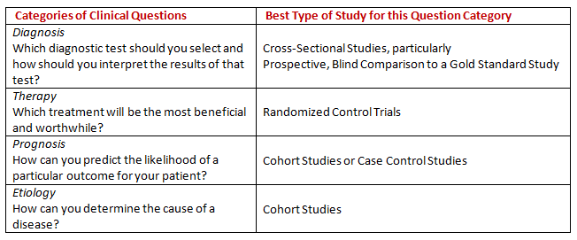
Things to Consider when identifying sources of evidence
Not all research articles are created equal!
Specific study designs help answer specific research questions

Slide 7
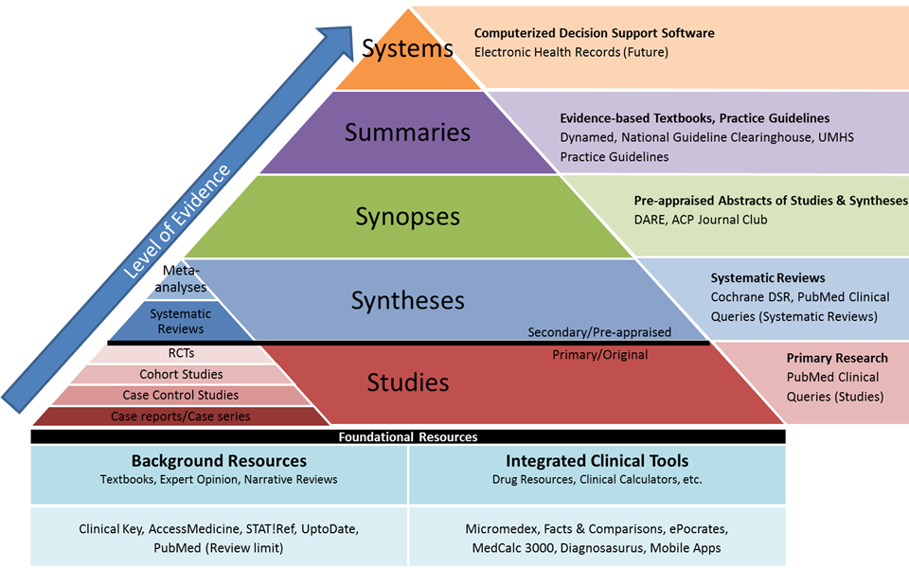

Slide 8
Primary Original Research
Research Syntheses
Research Summaries

Slide 9
PATIENT VALUES
RESEARCH EVIDENCE
CLINICAL EXPERIENCE
Evidence-Based Medicine
Library Resources

Slide 10
CINAHL
Cumulative Index to Nursing and Allied Health Literature covers materials in nursing and the allied health fields.
Embase
One of the most comprehensive biomedical literature databases
PubMed/Medline
A leading biomedical literature databases
TRIP
a clinical search engine designed to allow users to quickly and easily find and use high-quality research evidence to support their practice and/or care.
Primary Original Research

Slide 11
Agency for Healthcare Research and Quality Evidence-Based Reports
Cochrane Library
Systematic Reviews and protocols from the Cochrane Collaboration, DARE, NHS, HTA, and more
Joanna Briggs Institute EBP Database
Systematic reviews and summaries form JBI
Research
Syntheses

Slide 12
Point-of-Care Tools
UpToDate
Evidence-based clinical topic summaries
Lexicomp
a point-of-care tool offering information regarding drugs, diseases, toxicology, diagnostic tests, and patient information
Practice Guidelines
Research
Summaries

Slide 13
Library Services
For Researchers

Slide 14
Library Research Guide for Clinical Researchers https://libguides.uthsc.edu/clinicalresearchers

