Slide 1
Library Training Series
SESSION 5:
Enhancing Your Search Skills
Tamara Nelson, MLIS, EdS, AHIP

Slide 2
Learning Objectives
Identify search terms for a research topic
Develop an effective search string based on a broader research topic or idea
Explore advanced search features of commonly used databases (e.g., PubMed, Embase, Cochrane, & Scopus)

Slide 3
Agenda
The PICO Formula
Developing the Search
Search Strategies
Advanced Search Features

Slide 4
The PICO Formula:
Identifying Key Concepts & Terms

Slide 5
PICO
PICO frames your clinical research question and helps to:
Focus the question by identifying key concepts
Define the concepts to be used in the literature search
Determine if articles retrieved in the search are relevant

Slide 6
PICO Formula
P
I
C
O
PICOT is another variation of PICO where “T” represents time, the type of therapy, or study
Population
Patient
Problem
Who are the patients?
Where are the patients?
What is the problem?
Intervention or Exposure
What do we do to them?
What are they exposed to?
Comparison
What happens?
What are they exposed to?
Outcome
What happens?
What is the outcome?

Slide 7
Types of PICO Questions
  Used to determine which test is more accurate and precise in diagnosing a condition
  Used to determine the clinical course over time and likely complications of a condition
  Used to determine the meaning of an experience for a particular individual, group or community
  Used to determine which treatment leads to the best outcome
  Used to determine the greatest risk factors or causes of a condition
Diagnosis or Diagnostic test
Prognosis or Prediction
Meaning
Intervention or Therapy
Etiology

Slide 8

Formulating the Question:
  Intervention/Therapy Example:
  In ___________(P),
  what is the effect of ________(I)
  on __________(O)
  compared with _______ (C)?
  Meaning Example:
  How do ____________(P)
  with ______________(I)
  perceive ___________ (C)?
Remember you can always rearrange or omit elements in PICO

Slide 9
Developing the Search

Slide 10
The Process
PICO
Question
Keywords
Keywords
Keywords
Use terms that are commonly used and essential to your research question

Slide 11
Scenario: Susie is a 65-year-old woman who has come to you complaining about frequent canker sores. Susie currently only takes Metoprolol (a beta blocker) for her hypertension.
Clinical Research Question: In an elderly patient with hypertension being treated with beta blockers, what is the best treatment for oral lesions?
P
I
C
O
Population
Patient
Problem
Elderly
Intervention or Exposure
over-the-counter numbing agents
(Orajel, UlcerEase, OraBase B, etc.)
Comparison
Prescription anti-inflammatory agents (Apthasol, Kenalog, Diprolene, etc.)
Outcome
Relieve the outbreak of oral lesions caused by a beta blocker prescribed for the treatment of hypertension
What keywords can be extracted from our PICO?

Slide 12
Keywords vs Subject Headings
Keywords | Subject Headings
natural language words describing your topic - good to start with | pre-defined "controlled vocabulary" words used to describe the content of each item (book, journal article) in a database
more flexible to search by - can combine together in many ways | less flexible to search by - need to know the exact controlled vocabulary term
database looks for keywords anywhere in the record - not necessarily connected together | database looks for subjects only in the subject heading or descriptor field, where the most relevant words appear
may yield too many or too few results | if too many results - also uses subheadings to focus on one aspect of the broader subject
may yield many irrelevant results | results usually very relevant to the topic
Source: MIT Libraries

Slide 13
Search Strategies

Slide 14
Boolean Operators
The three basic Boolean operators are AND, OR, and NOT.
You can use Boolean operators to focus your search and produce more productive results.
OR
AND
NOT

Slide 15
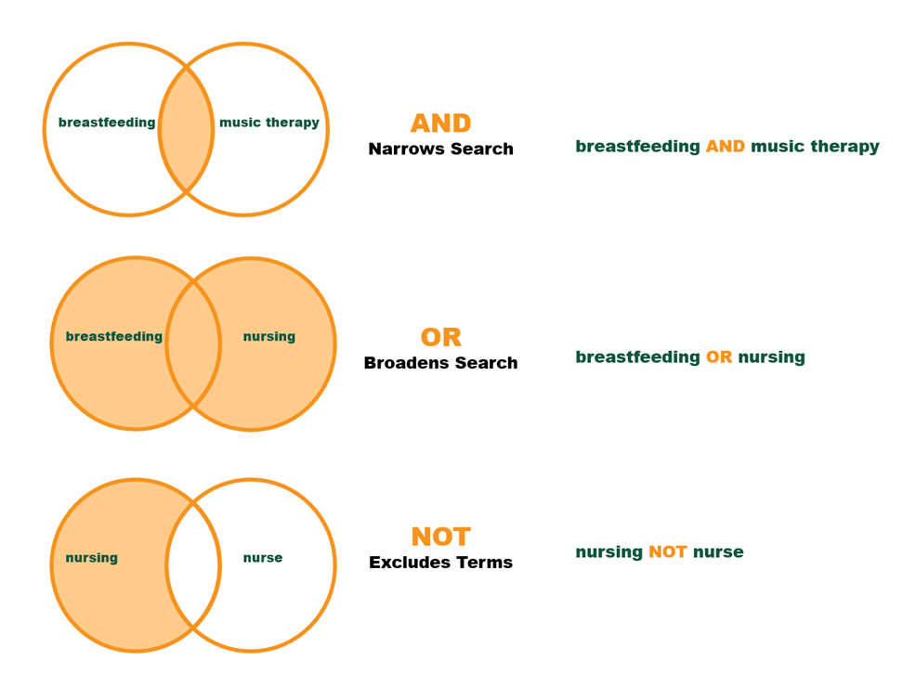

Slide 16
Search Logic: Nesting
Databases are machines that require precise language to operate how you want.
Use searching logic in conjunction with Boolean operators to build the search that you really mean.
Databases recognize AND as the primary operator and will connect concepts together with AND unless you tell them otherwise.
Combine AND with OR operators in a search using parentheses correctly for the best search strategy.

Slide 17
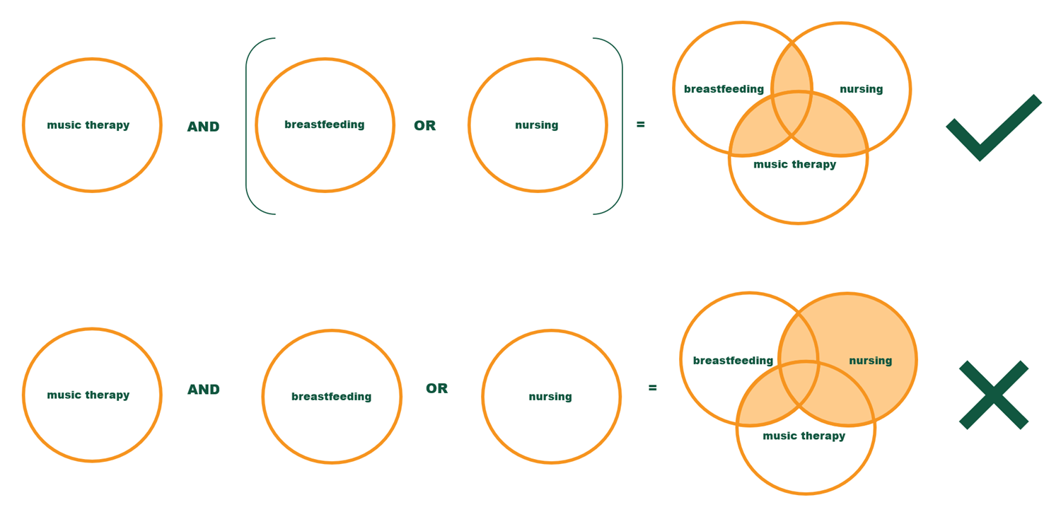

Slide 18
Advanced Search Features

Slide 19
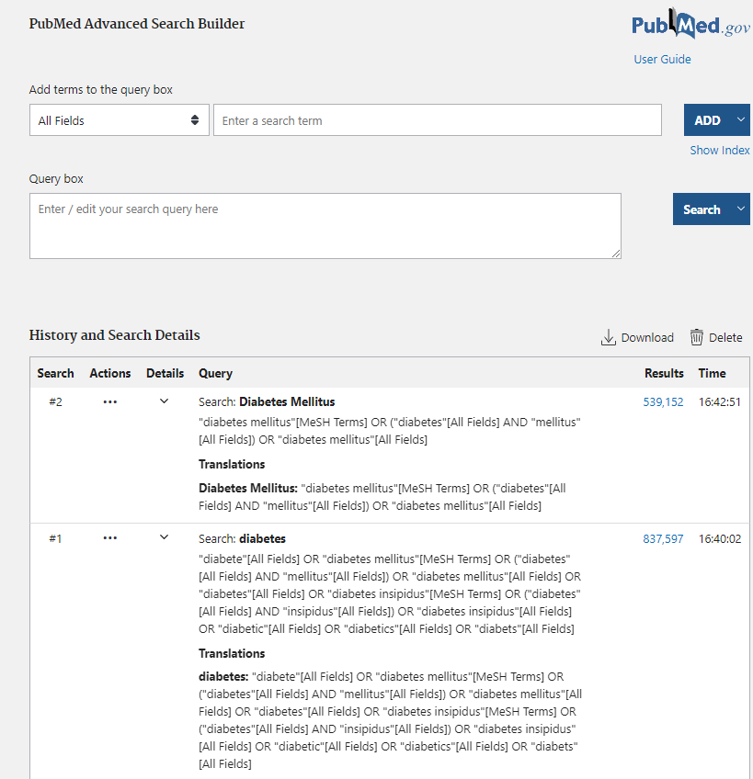
PubMed
Advanced Search Builder
MeSH database
Filters/Limiters

Slide 20
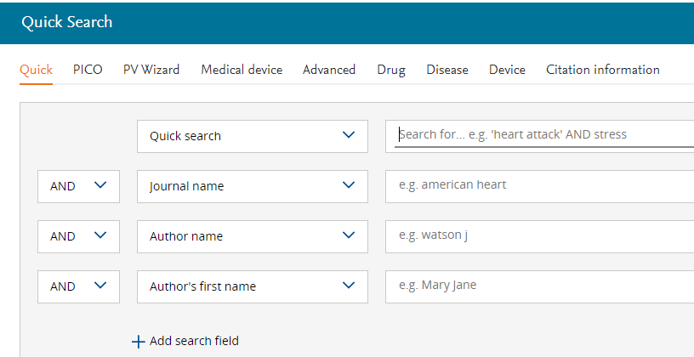
Embase
9 Advanced Search Builders
Emtree database
Filters/Limiters

Slide 21
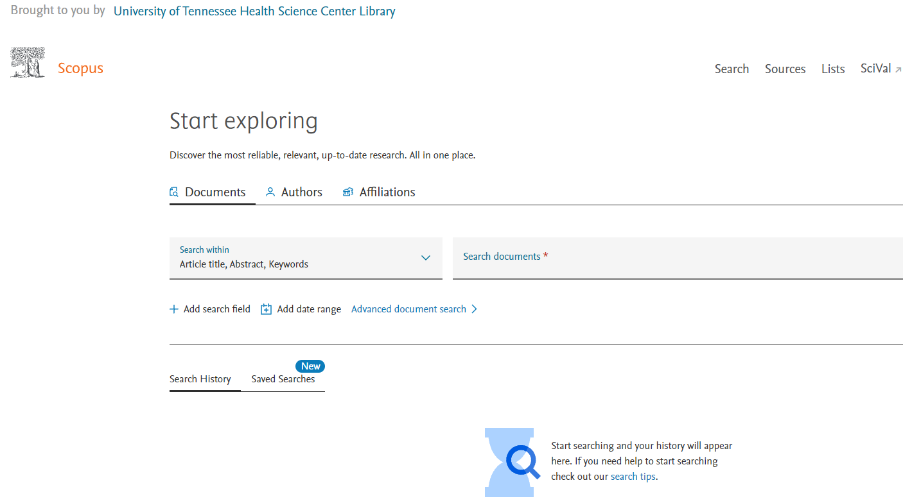
Scopus
Document Search
Author
Affiliation
Sources/Subject Areas

Slide 22
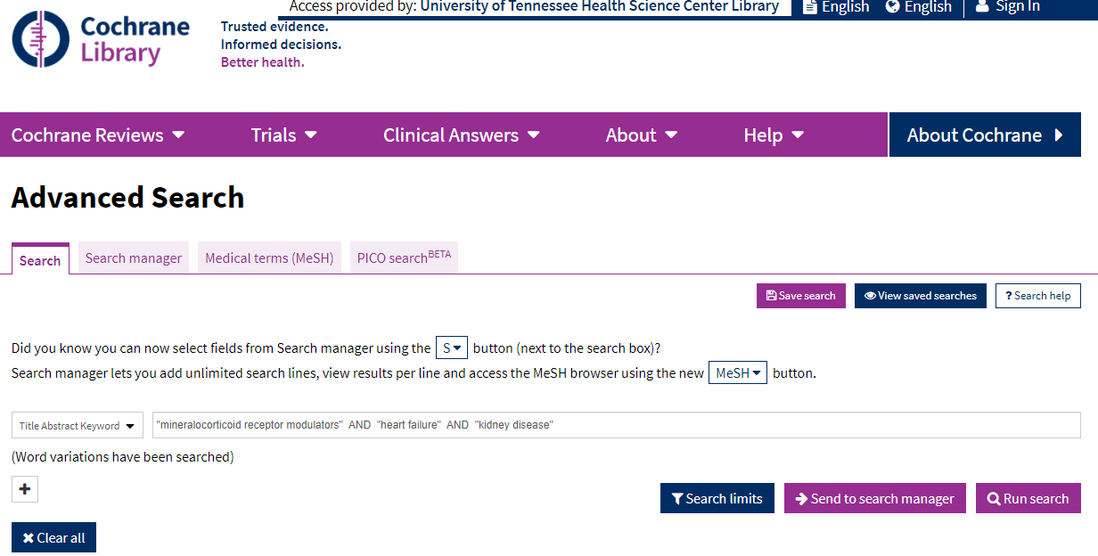
Cochrane Library
Advanced Search
Search manager
Medical Terms (MeSH)
PICO search

Slide 23
Questions?
Contact library@uthsc.edu

Slide 24
Clinical Researchers Resources
Introduction to MeSH
Building a PubMed Search
Library 101 Research

