Slide 1
Data analysis strategies and how they can enhance the proposal
Grant Writing Seminar Series
SESSION 8:
Fridtjof Thomas, PhD

Slide 2
About the presenter
Professor at the Division of Biostatistics, Dept. of Preventive Medicine
At UTHSC since 2007
NIH HEAL Data Stewardship Group that specifically works with assuring that the nationwide hundreds of HEAL‐projects comply to the NIH Policy for Data Management and Sharing that has taken effect Jan. 25, 2023. (HEAL = Helping to End Addiction Long‐term Initiative; heal.nih.gov).
Design and Analysis Committee of the EARLY trials (2010‐2016 – “Early Adult Reduction of weight through LifestYle intervention,” a collection of seven randomized clinical trials funded by the National Heart, Lung, and Blood Institute (NHLBI) and the Eunice Kennedy Shriver National Institute of Child Health and Human Development (NICHD) of the National Institutes of Health (NIH))
Member of the Biostatistics Collaborative Core at the Southeast Regional Center of the NIH‐NHLBI‐ funded Women’s Health Initiative (WHI) study that has recruited over 160,000 women in over 40 clinical centers nationwide. (2010‐2017)
Grant review experience since 2012 from
  Department of Defense’s Congressionally Directed Medical Research Program (DoD CDMRP)
  NIH Epidemiology of Chronic and Infectious Disease Study Section
  NIH Neurological, Aging, and Musculoskeletal Epidemiology (NAME) Study Section
14+ years Associate Editor of The Journal of Statistical Computation and Simulation (JSCS; a Taylor & Francis print journal since 1972)
2
2

Slide 3
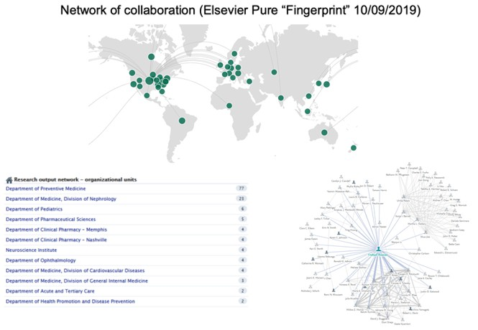
3
3

Slide 4
Outline
What makes or breaks a proposal?
Outcomes, Missing Data, Surrogate endpoints, Adverse events
Intend‐to‐treat analysis (ITT)
Clustering/grouping of observations
Pre‐planned vs. ad hoc subgroup analyses
Heterogeneity of treatment effects (HTE) with respect to sex/gender and race
Data Management and Sharing plan (DMS)
4
4

Slide 5
What makes or breaks a proposal?
Most importantly:
  Are you using sound science?
  What is your innovation?
The analytical plan cannot safe your proposal, but it will sink it in a hurry if not put together thoughtfully
Reviewers need to find “objective reasons” why they don’t like a proposal: the fewer targets the analytical plan offers for that, the better
Make sure that
  reviewers easily find what they are looking for
  the analytical plan is connected to your research question
  measures (including time points) are consistent throughout
It is difficult to get funded!
It is not all that difficult to have a better proposal than most I have seen when reviewing grants – but that takes time and effort!
5
5

Slide 6
How strong will your derived evidence be?
Levels of evidence
1a Systematic review of high quality RCTs with similar results and effect sizes for many different RCTs.
1b Individual high quality RCT with high precision (narrow confidence interval) 1c All or none
2a Systematic review of cohort studies with similar results and effect sizes. 2b Individual cohort study or low quality RCT (e.g., <80% follow‐up)
2c “Outcomes Research” and ecological studies (based on average exposures etc. of populations of geographical or temporal units)
3a Systematic review of case‐control studies 3b Individual case‐control study
Case‐series and poor quality cohort and case‐control studies
Expert opinion (unless critically appraised or based on “first principles”)
Source: Oxford Centre for Evidence‐based Medicine https://www.cebm.net/2009/06/oxford‐centre‐evidence‐based‐medicine‐ levels‐evidence‐march‐2009/
6
6

Slide 7
All or none: Example “Bubble Boy” disease
Babies born without functional immune system.
SCID‐X1: 1 in 50,000‐100,000 affected; caused by a mutation in a gene (IL2RG)
Most die within first year of life. (Only about 20% have access to a suitable sibling for a bone‐marrow transplant as the existing cure.)
St. Jude announced April 18, 2019: Gene therapy cure for babies with X‐linked severe combined immunodeficiency
“The gene therapy, produced in the Children’s GMP, LLC, manufacturing facility on the St. Jude campus, involved use of a virus to transport and insert a correct copy of a gene into the genome of patients’ blood stem cells. Following the treatment, the children began producing functioning immune cells for the first time, according to St. Jude, and most patients were discharged from the hospital within one month.” [All 8 babies started to produce complete sets of immune cells.]
https://www.stjude.org/inspire/news/bubble‐boy‐scid‐x1‐cure.html https://www.stjude.org/research/news‐publications/research‐highlights/2019‐research‐highlights/st‐ jude‐gene‐therapy‐holds‐promise‐for‐treating‐several‐diseases.html
7
7

Slide 8
Outcomes
Outcomes: Be ambitious but realistic
  pilot studies go a long way!
  An R21 is not an underfunded R01
Missing Data:
  Missing covariate information vs. missing endpoints
  20% attrition in behavioral intervention studies might be acceptable, 10% is better – requires work to achieve!
  Differential loss to follow‐up needs to be addressed in the analytical plan
Surrogate endpoints: e.g., progression free survival
Adverse events:
  Always occur and need to be reported/summarized (may or may not be related to the intervention)
  How do adverse events impact on your outcome/collection of measures?
8
8

Slide 9
Missing Data
Keep it to a minimum
Mention the word “multiple imputation”, know what it means, and have a realistic approach to it
Complete case analysis or “last observation carried forward” doesn’t cut it in most cases
Include sensitivity analyses
9
9

Slide 10
Bias: What do we mean by bias?
Statistical theory (not further covered here)
  Sample variation
  Estimation: if expected value = true value, estimator is unbiased
  Asymptotically unbiased if value converges to true value if 𝑛 → ∞
  Bias‐variance trade‐off in prediction
Publication bias (not further covered here)
Bias due to “distorting” true relationships: https://catalogofbias.org/ (CEBM/University of Oxford)
  E.g., confounding incl. “confounding by indication”
  E.g., selection bias (incl. “immortal time bias”)
  E.g., measurement bias/assessment bias
  (…)
Bias analysis (E‐values! ‐ VanderWeele TJ, Ding P. Sensitivity Analysis in Observational Research: Introducing the E‐Value. Ann Intern Med. 2017 Aug 15;167(4):268‐274. doi: 10.7326/M16‐2607. Epub 2017 Jul
11. PMID: 28693043.)
10
10

Slide 11
“Distorting” true relationships
What is a “true relationship”?
Example: What is the true odds ratio (OR) for a specific exposure and a specific event?
Operational definition: The true OR is the odds ratio that would be observed in a perfectly executed randomized clinical trial (RCT) that is large enough to make sample variation practically unimportant.
11
11

Slide 12
“Distorting” true relationships (cont.)
The following aspects have to be addressed:
Selection bias
Measurement bias (misclassification – outcome or covariate; exposure misclassification; systematically missing activities/episodes, e.g., in activity data; recall bias, telescoping bias, etc.)
Blinding/masking of evaluators
Cases and non‐cases/controls need identical ways to determine covariates and outcomes!
“Immortal time bias” in time‐to‐event analyses
Differential loss‐to‐follow‐up
“Artefacts” due to utilizing existing data for a different purpose (e.g., billing data; medical prescription data to determine adherence to medication)
12
12

Slide 13
“Distorting” true relationships (cont.)
Related to data analysis:
Collection/extraction of data
Should the analyst be blinded to treatment group? (“Group A” vs “Group B” instead of explicit “Treatment” and “Control”)
Unintentional programming errors
Undetected problems with the convergence of computational algorithms
Validation of the data incl. approaches to unusual observations
“fishing expeditions” (and multiplicity in testing in general)
Any form of “P‐value maximization approaches”, such as
  thresholds for continuous variables to achieve “maximal significance”
  picking definitions for events, exposure measures, etc. based on resulting “significance”
  etc., etc.,…
Make sure your statistical plan does not raise these concerns!
13
13

Slide 14
Intend‐to‐treat analysis (ITT)
Evaluation of participants as randomized
Protects against bias due to, e.g.,
  differential loss to follow‐up
  differential adherence to the treatment
Breaks down if missing data is present!
Often combined with an “per‐protocol” or “as‐ treated” analysis (see Hulley et all ch. 11)
14
14

Slide 15
Clustering/grouping of observations
Is there any grouping structure you should account for?
Group/cluster randomization? (Contamination of groups; not practical to individually randomize)
Adjustment in other grouping structures (e.g., physician office even when individually randomized) that can/should be addressed in the analysis? (Often in form of mixed effects models with grouping structure being a random effect)
15
15

Slide 16
Pre‐planned vs.
ad hoc subgroup analyses
Ad hoc analyses will be made and should be acknowledged (e.g., when safety issues arise during the trial)
Pre‐plan what is important to you and adjust for the multiplicity in testing accordingly
Think about details, e.g.:
  ANOVA with post‐hoc analysis using Tukey’s honest significant difference
  Dunnett's test to adjust for a single comparison/control group but several active intervention groups
16
16

Slide 17
Fishing expeditions
“Throw everything in the kitchen sink to the wall and see what sticks”
Here is what can stick:
Facts about Abraham Lincoln and John Fitzgerald Kennedy and their assassinations in 1865 and 1963, respectively. Jones and Muirhead (2012) found the following:
They were elected 100 years apart (1860 and 1960)
They were both assassinated on a Friday in the presence of their wives
Lincoln was shot in Ford’s Theatre; Kennedy was shot in a Ford car.
Both assassins were known by three names – John Wilkes Booth and Lee Harvey Oswald, with 15 letters in each complete name.
Booth shot Lincoln in a theatre and fled to a warehouse; Oswald shot Kennedy from a
warehouse and fled to a theatre.
Both succeeding vice‐presidents named Johnson (Andrew and Lyndon), with 13 letters in their names and born 100 years apart (1808 and 1908).
Can this be coincidence?
See Jones and Muirhead (2012): https://rss.onlinelibrary.wiley.com/doi/full/10.1111/j.1740‐9713.2012.00545.x
17
17

Slide 18
You can easily do better!
Follow this principle to avoid the worst pitfalls:
“Draw your assumptions before your conclusions.”
Miguel Hernán, Prof. of Biostatistics and Epidemiology, Harvard CAUSALab
18
18

Slide 19
Heterogeneity of Treatment Effects (HTE)
Race and gender! (Unless you have an acceptable reason for not considering these variables).
NIH: “The purpose of this Notice is to inform the research community that NIH is amending its NIH Policy and Guidelines on the Inclusion of Women and Minorities as Subjects in Clinical Research to include a requirement that recipients conducting applicable NIH‐defined Phase III clinical trials ensure results of valid analyses by sex/gender, race, and/or ethnicity are submitted to Clinicaltrials.gov.” https://grants.nih.gov/grants/guide/notice‐files/NOT‐OD‐18‐014.html
FDA: Evaluation of Sex‐Specific Data in Medical Device Clinical Studies
https://www.fda.gov/files/medical%20devices/published/Evaluation‐of‐Sex‐Specific‐Data‐in‐Medical‐ Device‐Clinical‐Studies‐‐‐Guidance‐for‐Industry‐and‐Food‐and‐Drug‐Administration‐Staff.pdf
Patient‐Centered Outcomes Research, especially PCORI
PCORI Methodology Standards
HTE:
  How are HTEs assessed?
  Should there be adjustments for multiplicity in testing?
  Which type of subgrouping variables?
  Should a HTE‐analysis be reported even when the overall treatment effect is not statistically significant?
  When reported, what should be reported and why?
19
19

Slide 20
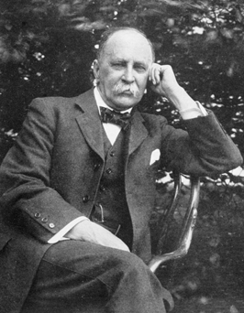
Heterogeneity of Treatment Effects (HTE)
“Variability is the law of life, and as no two faces are the same, so no two bodies are alike, and no two individuals react alike and behave alike under the abnormal conditions which we know as disease”
Sir William Osler
1849 – 1919; Canadian physician and “Father of modern Medicine”
"William Osler c1912" by Unknown ‐ [1]. Licensed under CC BY 4.0 via Wikimedia Commons ‐ http://commons.wikimedia.org/wiki/File:William_Osler_ c1912.jpg#mediaviewer/File:William_Osler_c1912.jpg
20
20

Slide 21
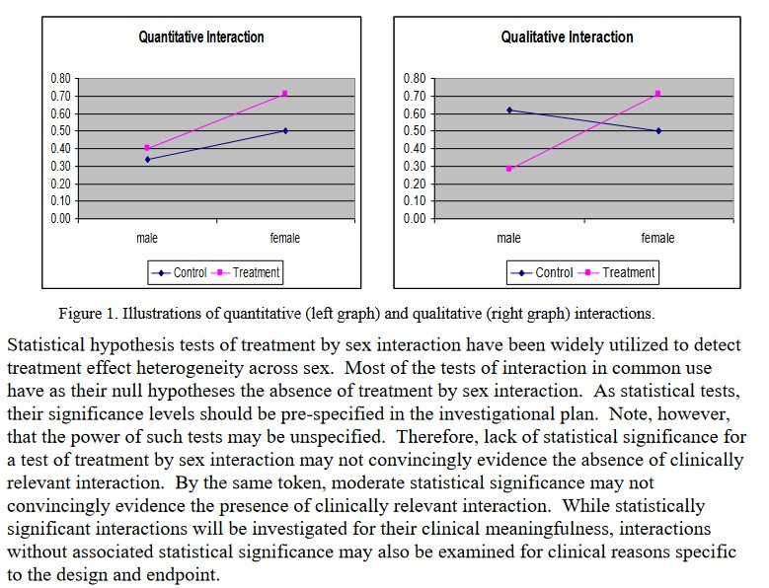
Heterogeneity of Treatment Effects (HTE)
FDA: Evaluation of Sex‐ Specific Data in Medical Device Clinical Studies https://www.fda.gov/file s/medical%20devices/pu blished/Evaluation‐of‐ Sex‐Specific‐Data‐in‐ Medical‐Device‐Clinical‐ Studies‐‐‐Guidance‐for‐ Industry‐and‐Food‐and‐ Drug‐Administration‐ Staff.pdf
21
21

Slide 22
PCORI’s HTE guidelines
Varadhan R, Stuart EA, Louis TA, Segal JB, Weiss CO. Review of Guidance Documents for Selected Methods in Patient Centered Outcomes Research: Standards in Addressing Heterogeneity of Treatment Effectiveness in Observational and Experimental Patient Centered Outcomes Research.
Source: http://www.pcori.org/assets/Standards‐in‐Addressing‐ Heterogeneity‐of‐Treatment‐Effectiveness‐in‐Observational‐and‐ Experimental‐Patient‐Centered‐Outcomes‐Research.pdf: PCORI; 2012. Accessed 01/23/2015.
22
22

Slide 23
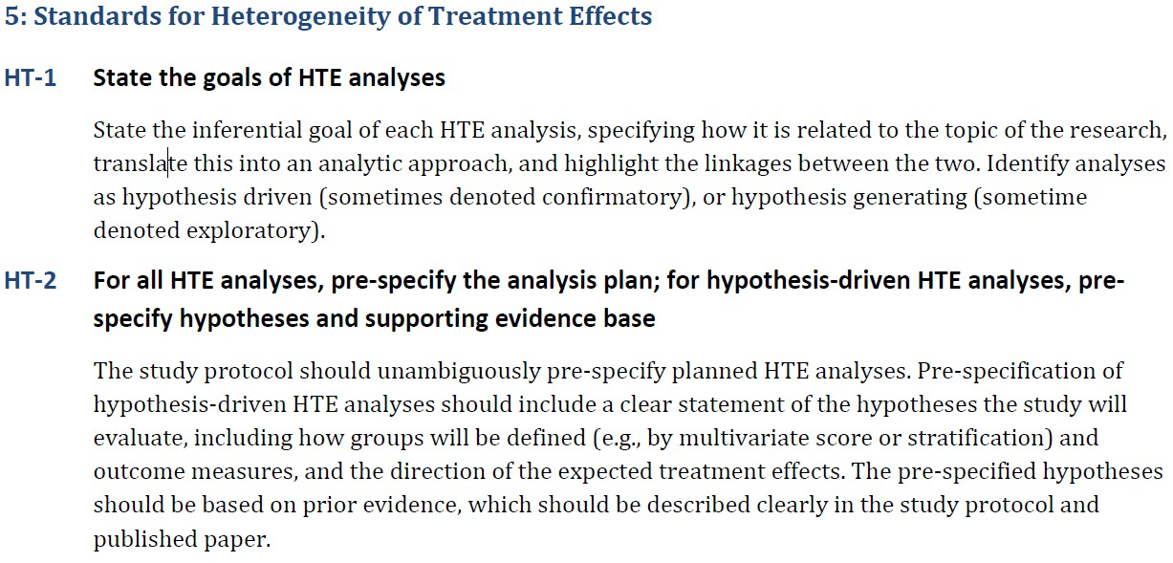
Source: http://www.pcori.org/assets/Standards‐in‐Addressing‐Heterogeneity‐of‐Treatment‐Effectiveness‐in‐Observational‐ and‐Experimental‐Patient‐Centered‐Outcomes‐Research.pdf: PCORI; 2012. Accessed 01/23/2015.
23
23

Slide 24
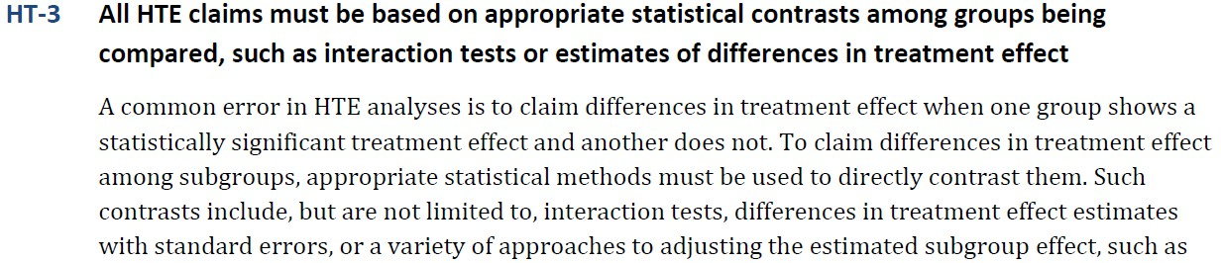
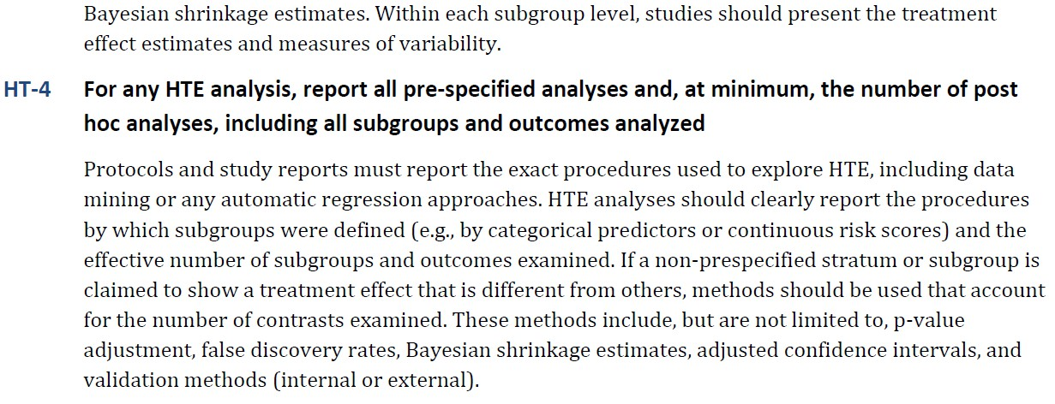
Source: http://www.pcori.org/assets/Standards‐in‐Addressing‐Heterogeneity‐of‐Treatment‐Effectiveness‐in‐Observational‐ and‐Experimental‐Patient‐Centered‐Outcomes‐Research.pdf: PCORI; 2012. Accessed 01/23/2015.
24
24

Slide 25

HTE
Definition HTE:
“the non‐random, explainable variability in the direction and magnitude of treatment effect”
Beneficial and adverse responses of interest
Assessment of HTE is essential in patient‐ centered outcomes research
Stakeholders such as patients, clinicians, and policy makers have to understand HTE to make informed decisions
25
25

Slide 26
HTE (cont.)
Two main goals:
Estimate treatment effect for clinically relevant subgroups (→ subgroup analysis)
Predict whether a specific individual might benefit from treatment (→ predictive learning; not covered here)
26
26

Slide 27
HTE (cont.)
Subgroup analysis (SGA) is the most common analytic approach for examining HTE
They propose minimum standards for SGA:
  Prior planning
  Careful analysis
  Responsible reporting
27
27

Slide 28
HTE (cont.)
Two types of SGA:
estimating treatment effect separately within levels of baseline covariates
modeling the interaction between the treatment and covariates
28
28

Slide 29
How are HTEs assessed?
Common approach ‐ example:
Outcome Y is binary and logistic regression is estimated. Treatment effect is log‐odds ratio of
Y = 1 when treatment indicator 1 vs. 0 (“averaged” over other covariates)
29
29

Slide 30
How are HTEs assessed? (Cont.)
Separate models are estimated within strata of covariates, say, X = 1 and X = 2, resulting in θ₁ and θ₂.
HTE is inferred when association in group 1 is statistically significant and in group 2 is not, or vice‐versa.
Observation: This is incorrect for inferring HTE (but it is correct for estimating stratified treatment effects)
30
30

Slide 31
How are HTEs assessed? (Cont.)
At a minimum: Test for HTE needs to test whether the difference between the two stratified treatment effects is zero using a Wald test. (Default in SAS PROC FREQ RISKDIFF option is METHOD=WALD)
Better: Model the interaction between treatment and X
31
31

Slide 32
How are HTEs assessed? (Cont.)
Stratified effects :
Interaction term :
Test for significance of interaction term!
Easy to implement even when X has more than two levels or is continuous.
32
32

Slide 33
Should there be adjustments for multiplicity in testing?
PCORI complains about “the myopic view of SGA as a hypothesis testing problem rather than as an estimation problem” and the “dichotomization of SGA into confirmatory (hypothesis‐testing) and exploratory (hypothesis‐generating) analyses”
Suggestion: descriptive HTE analysis
33
33

Slide 34
Which type of subgrouping variables?
Demographics (e.g., age and sex – always?)
Behavior (e.g., smoking)
pathophysiology (e.g., measures of disease severity)
genetic markers
comorbid conditions (e.g., diabetes status in cardiovascular disease trials)
“Studies might use descriptive HTE for sub‐populations for which limited evidence is available in the literature, such as the priority populations specified by the Agency for Healthcare Research Quality, including women, children, minorities, elderly, individuals with disabilities, and rural populations” (p. 3)
Source: http://www.pcori.org/assets/Standards‐in‐Addressing‐Heterogeneity‐of‐Treatment‐Effectiveness‐in‐ Observational‐and‐Experimental‐Patient‐Centered‐Outcomes‐Research.pdf: PCORI; 2012. Accessed 34 01/23/2015.
34

Slide 35
Should there be adjustments for multiplicity in testing? (cont.)
“In descriptive HTE analysis, the focus is on estimation
of treatment effects in pre‐specified subgroups. Each study reports these effect estimates and their standard errors in order to facilitate future meta‐analysis.”
→ No, descriptive HTE analysis does not need to be adjusted for multiplicity in testing, but confidence intervals have to be provided.
35
35

Slide 36
Should an HTE‐analysis be reported even when the overall treatment effect is
not statistically significant?
Yes!
Argument: There is no theoretical argument that suggests that, e.g., males and females cannot have effects in opposite direction effectively cancelling when “averaging” (especially when comparison is not placebo).
36
36

Slide 37
What should be reported and why?
Point estimates and standard errors to facilitate future meta‐analyses
All HRT tests even if not statistically significant because statistical significance is not necessarily expected when study is not powered adequately (but descriptive HTE still adequate)
37
37

Slide 38
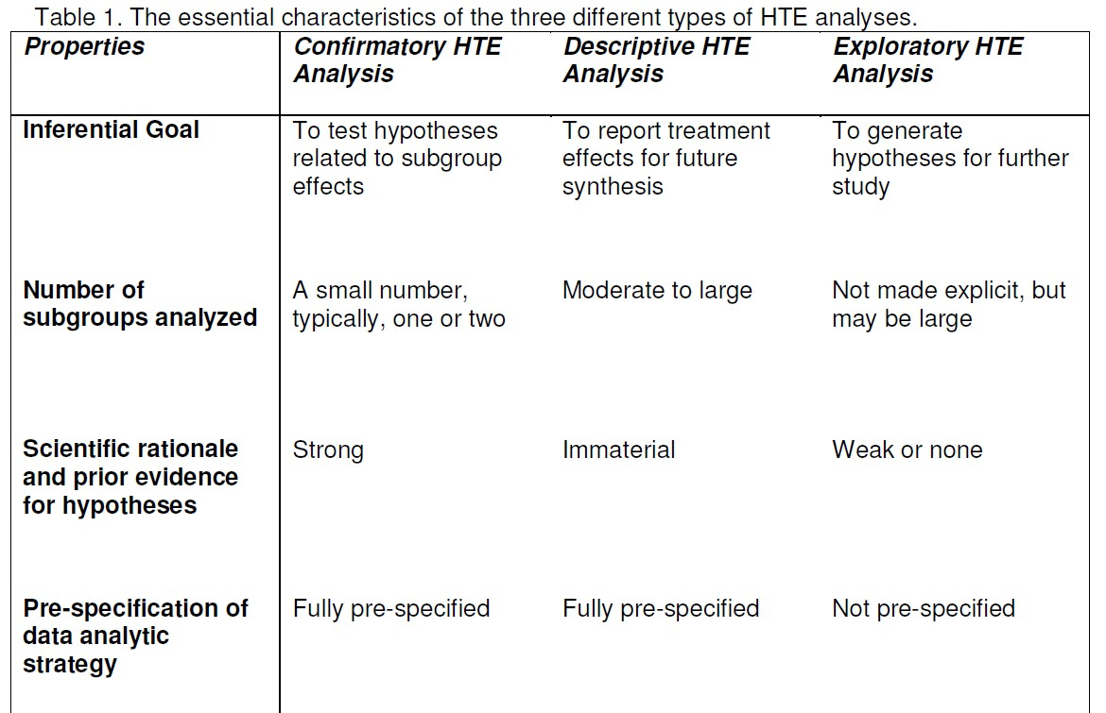
38
38

Slide 39
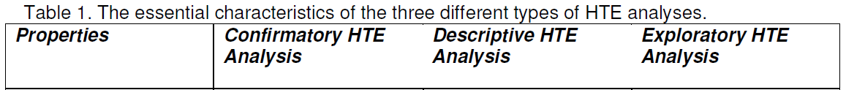
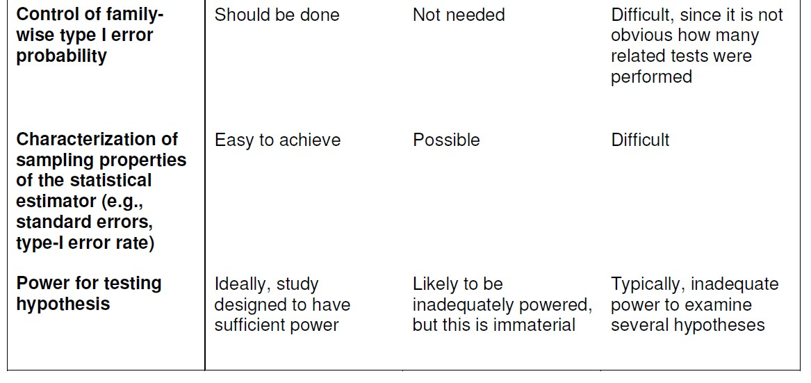
39
39

Slide 40
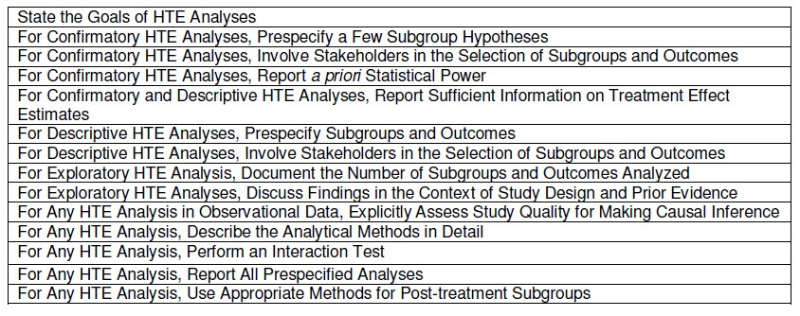
Proposed Minimum Standards for HTE Analysis in PCOR
(Box 1, p. 8)
40
40

Slide 41


Data Management and Sharing Plan (DMS)
https://sharing.nih.gov/
41
41

Slide 42


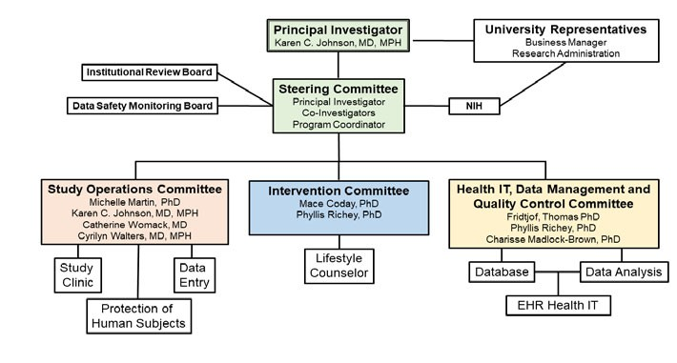








Example from CHAMPS study
Structure of Study Team
42
42

Slide 43
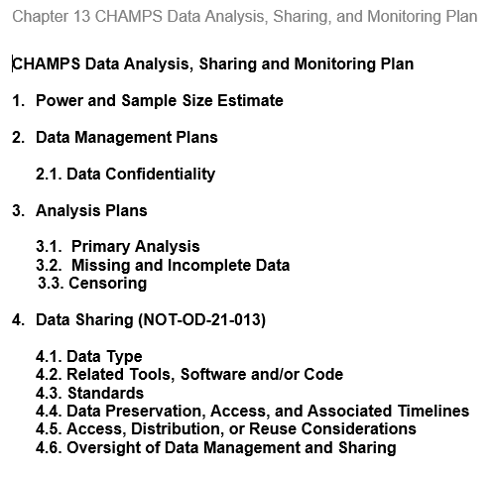


Example from CHAMPS study
MOP
43
43

Slide 44


4. DATA SHARING (NOT-OD-21-013)
The CHAMPS study will prepare and distribute an electronic dataset with scientific data, incl. electronic versions of any paper forms that might have been used in data collection. Confidentiality of individual participants will be maintained with all releases of data. The final CHAMPS study analytical database will be processed according to HIPAA definitions for public data sharing. During this process, the participant data will be de-identified by using processes which include but are not limited to: removal of identifiers, translation of dates to delta time values, and assignment of random study identifiers. Out of this process will be a series of de-identified data files representing the final analytical data set. These data files will be provided in a standard format that is readable across a variety of applications and operating system platforms. Documentation that will be provided along with the data sharing file that may include but is not limited to: data dictionary, data code book, valid variable ranges, the protocol, MOP, and intervention manual or programs. The data release documentation will provide detailed, organized documentation of study variables and clear instructions on how to install and access the data. CHAMPS intents to make all data available as outlined in the Final NIH Policy for Data Management (NOT-OD-21-013). However, CHAMPS has been funded before Jan 25, 2023, and is therefore technically not covered by the new NIH data management and sharing policy.
44
44

Slide 45

4.1 Data Type
The scientific data to be generated is from 250 randomized participants and originates from questionnaires (socio-demographics, medical history, medications, diet/DHQ III, physical activities/GPAQ and sedentary behavior, alcohol and smoking, neighborhood environment, quality of life/PROMIS, social determinants of health, technology use), clinic measures (vital signs, weight, height, waist and hip circumference), and others (adverse events, intervention participation/video viewing through webpage analytics).
Data that will be preserved and shared consists of questionnaire and clinic visit data on the individual level, as well as processed data summarizing intervention exposure/web-viewing on the individual level.
Metadata is publicly available at the U.S. National Library of Medicine in the ClinicalTrials.gov database (Identifier: NCT05410353; https://www.clinicaltrials.gov/ct2/show/NCT05410353 ) and will be updated throughout the conduct of the study. In addition, structured metadata will be created as required by the respective repositories that will be used.
DHQ III = Diet History Questionnaire III
GPAQ = Global Physical Activity Questionnaire
PROMIS = Patient‐Reported Outcomes Measurement Information System (NIH)
45
45

Slide 46
4.2 Related Tools, Software and/or Code
All data will be shared as comma-separated values (CSV) files with UTF-8 encoding that do not require specific software for reading/encoding. Data sets will be of rectangular arrangement with rows corresponding to participants.
46
46

Slide 47
4.3 Standards
Mostly standardized questionnaires are used such as the DHQ III, GPAQ, or PROMIS. A detailed account is available in the Manual of Procedures (MOP), Chapter 11: Data Collection. Unique participant identifiers will link entries in the various data sets. Data dictionaries will be provided for the available data sets.
DHQ III = Diet History Questionnaire III
GPAQ = Global Physical Activity Questionnaire
PROMIS = Patient‐Reported Outcomes Measurement Information System (NIH)
47
47

Slide 48
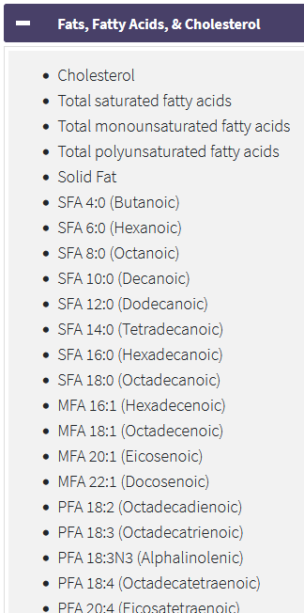
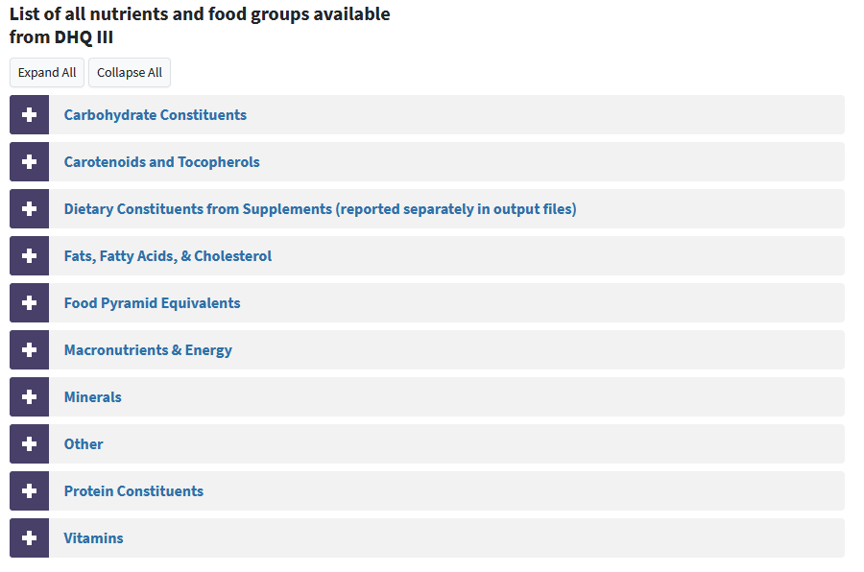
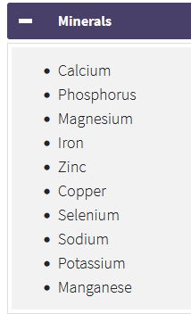
48
48

Slide 49
4.4 Data Preservation, Access, and Associated Timelines
Metadata available at ClinicalTrials.gov (Identifier: NCT05410353) will be archived by the U.S. National Library of Medicine. The collected human subject data is identifiable protected health information (PHI) under The Health Insurance Portability and Accountability Act of 1996 (HIPAA).
To the extent possible, data that we will make available will be de-identified of PHI using the Safe Harbor de-identification method as defined in §164.514(a) of the HIPAA Privacy Rule. We foresee to be able to furnish such limited data sets at the point in time of publications
and these will contain the information needed to reproduce the main analyses in the respective publication. Because limited data sets remain protected health information under HIPAA, access to the data will need to be controlled by data use agreements (DUAs) and disclosure will only be for the purpose of research, public health or health care operations. These data sets are intended to be posted in a repository “close” to the publication (e.g., in PubMed) or in a repository explicitly named in the publication.
A comprehensive scientific data set will be posted in a repository by the end of the project performance period. That comprehensive scientific data will include electronic versions of any paper forms that might have been used as well as scientific data not (yet) used in the study publications: e.g., the DHQ-III data output with comprehensive information about carbohydrates, vitamins, minerals, protein constituents, etc. will be released as available in this study. To protect the privacy or our participants, we will remove “facial” identifiers such as names, medical record numbers, etc., but will possibly not create a data set formally classified as limited data under HIPAA, and access will have to be controlled.
We anticipate that the produced data is of value for the larger research community, institutions, and/or the broader public, and therefore prefer repository-solutions with anticipated “indefinite” storage such as ClinicalTrial.gov, PubMed, or other NIH-recommended repositories. The scientific data will be findable and identifiable by the references in the respective publications as well as through the metadata provided to the repositories (incl. ClinicalTrials.gov; Identifier: NCT05410353; https://www.clinicaltrials.gov/ct2/show/NCT05410353 )
Supporting material that will also be made available includes the Study Protocol/Manual of Operations (MOP), Statistical Analysis Plan (SAP), Informed Consent Form (ICF), and the analytic code for main analyses.
49
49

Slide 50
4.5 Access, Distribution, or Reuse Considerations
The IRB approved informed consent allows for usage of the collected scientific data for other medical research (secondary research). Individual details obtained from participants can be provided in publications or presentations, but they cannot be discussed in a way that would allow to identify the participant.
All our released data will remain protected health information under HIPAA, and access
to the data will need to be controlled by a data use agreement (DUA; for limited data sets), an IRB approval (for data not de-identified by the Safe Harbor method as defined in §164.514(a) of the HIPAA Privacy Rule), and disclosure will only be for the purpose of research, public health or health care operations.
FAIR = Findable, Accessible, Interoperable, and Reusable https://fair‐research.org/
Is your research reproducible?
Is your data processing and are your statistical analyses reproducible?
50
50

Slide 51
4.6 Oversight of Data Management and Sharing
Compliance with this DMS plan is monitored by the PI of the study, Dr. Karen Johnson, during the project performance period. The HIPAA Privacy Rule requires appropriate safeguards to protect the privacy of protected health information and sets limits and conditions on the uses and disclosures that may be made of such information without an individual’s authorization. This liability is transferred to the respective repository when data sets are surrendered to these repositories.
51
51

Slide 52

Health Sciences Library Research Support
https://www.uthsc.edu/library/research.php https://libguides.uthsc.edu/data/uthsc‐data
General Support Services, email library@uthsc.edu
Literature searches, systematic reviews, citation managers
Data Support Services, email jnewman@uthsc.edu
Assessing & improving research impact (h‐index, citation metrics, etc) Writing Data Management Plans (DMPs)
Selecting appropriate data repositories for storage and sharing
Basic data wrangling in Excel and OpenRefine _{Jess Newman, MSIS} Enhancing data visualizations
Research Data and Scholarly Communications Lead at the Health Sciences Library
Locating data for re‐use
Identifying & evaluating journals for publication Open Access publishing
Copyright and licensing
Slide content provided by the UTHSC Library/Jess Newman
52
52

