Slide 1
CERTIFICATION EXAM PREPARATION COURSE
SESSION 9:
Essential Documents, Part I

Slide 2
Handouts/Reference sheets/Worksheets:
Good Documentation Best Practices
List of Essential Documents
Regulatory Binder Best Practices
Regulatory Binder Set-up
Essential Documents Reference Sheet
Regulatory Binder Tabs/Documents Worksheet
Webinars:
Research 101, session 7
Research 102, session 8
Research 102, session 4

Slide 3
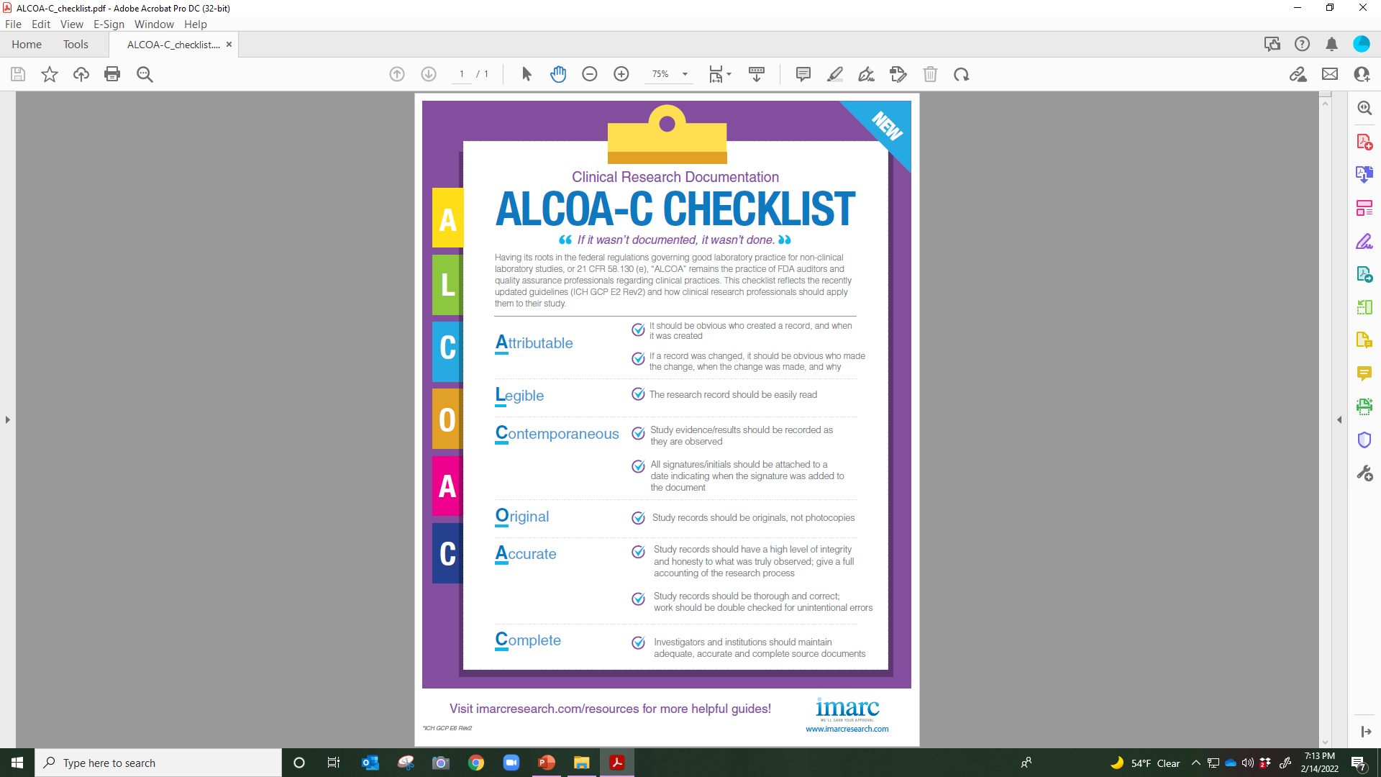

Slide 4

ICH GCP E6 (R2)
1.23 Essential Documents
  Documents which individually and collectively permit evaluation of the conduct of a study and the quality of the data produced

Slide 5
ICH GCP E6 (R2): Section 8
Essential Documents for the Conduct of a Clinical Trial
Documents which individually and collectively permit evaluation of the conduct of a study and the quality of the data produced
Essential documents serve to demonstrate the compliance of the investigator, sponsor and monitor with the standards of Good Clinical Practice and with all applicable regulatory requirements
Filing essential documents at the investigator/institution and sponsor sites in a timely manner can greatly assist in the successful management of a trial by the investigator, sponsor and monitor
These documents are also the ones which are usually audited by the sponsor's independent audit function and inspected by the regulatory authority(ies) as part of the process to confirm the validity of the trial conduct and the integrity of data collected

Slide 6
ICH GCP E6 (R2): Section 8
Essential Documents for the Conduct of a Clinical Trial
A description is given of the purpose of each document, and whether it should be filed in either the investigator/institution or sponsor files, or both
It is acceptable to combine some of the documents, provided the individual elements are readily identifiable
Trial master files should be established at the beginning of the trial, both at the investigator/institution’s site and at the sponsor's office
A final close-out of a trial can only be done when the monitor has reviewed both investigator/institution and sponsor files and confirmed that all necessary documents are in the appropriate files
Any or all of the documents addressed in this guideline may be subject to, and should be available for, audit by the sponsor’s auditor and inspection by the regulatory authority(ies)

Slide 7
ICH GCP E6 (R2): Section 8
ADDENDUM:
The sponsor and investigator/institution should maintain a record of the location(s) of their respective essential documents including source documents
The storage system used during the trial and for archiving (irrespective of the type of media used) should provide for document identification, version history, search, and retrieval
Essential documents for the trial should be supplemented or may be reduced where justified (in advance of trial initiation) based on the importance and relevance of the specific documents to the trial

Slide 8
ICH GCP E6 (R2): Section 8
ADDENDUM:
The sponsor should ensure that the investigator has control of and continuous access to the CRF data reported to the sponsor
The sponsor should not have exclusive control of those data
When a copy is used to replace an original document (e.g., source documents, CRF), the copy should fulfill the requirements for certified copies
The investigator/institution should have control of all essential documents and records generated by the investigator/institution before, during, and after the trial

Slide 9
ICH GCP E6 (R2): Section 8
Essential Documents for the Conduct of a Clinical Trial
The minimum list of essential documents which has been developed is found in Section 8. The various documents are grouped in three sections according to the stage of the trial during which they will normally be generated:
  1) BEFORE the clinical phase of the trial commences
  2) DURING the clinical conduct of the trial
  3) AFTER completion or termination of the trial

Slide 10
ICH GCP E6 (R2) Section 8.2
Set Up to Show You Where the Document Should be Maintained:
  Investigator/Site Files
  Sponsor Files/Both the investigator/site and Sponsor files

Slide 11
ICH GCP E6 (R2) Section 8.2
Before the Clinical Phase of the Trial Commences

Slide 12
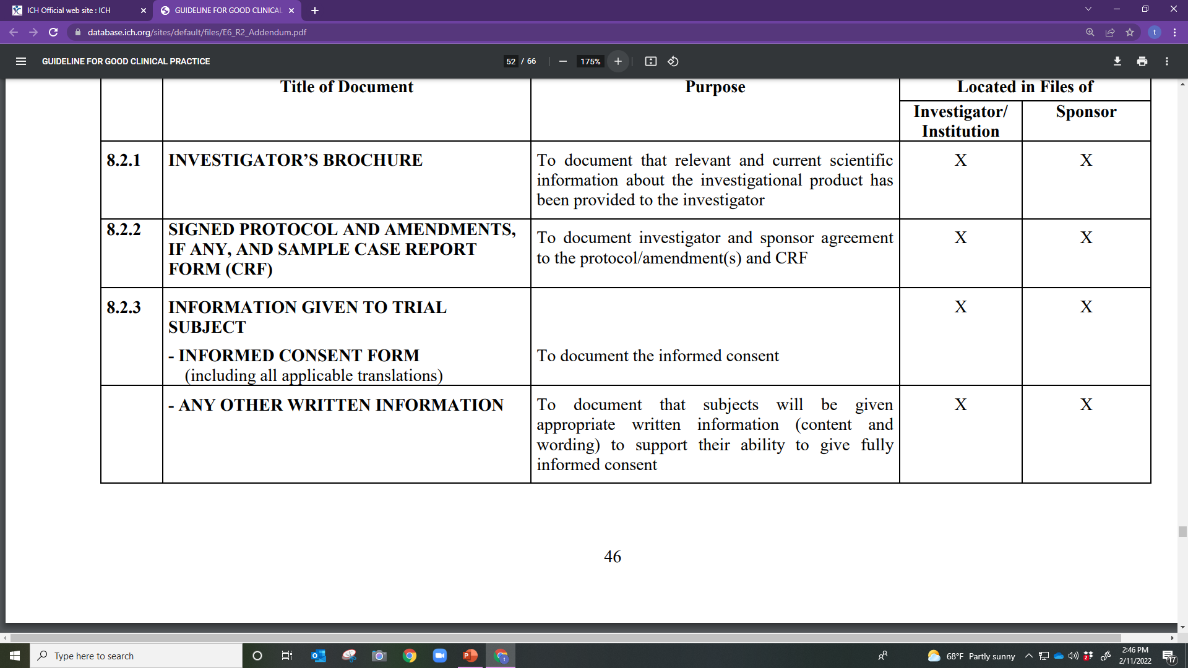

Slide 13
Investigator Brochure
Signed Protocol, and Amendments
Sample Case Report Forms
Information Given to Trial Subject
Any Other Written Information

Slide 14
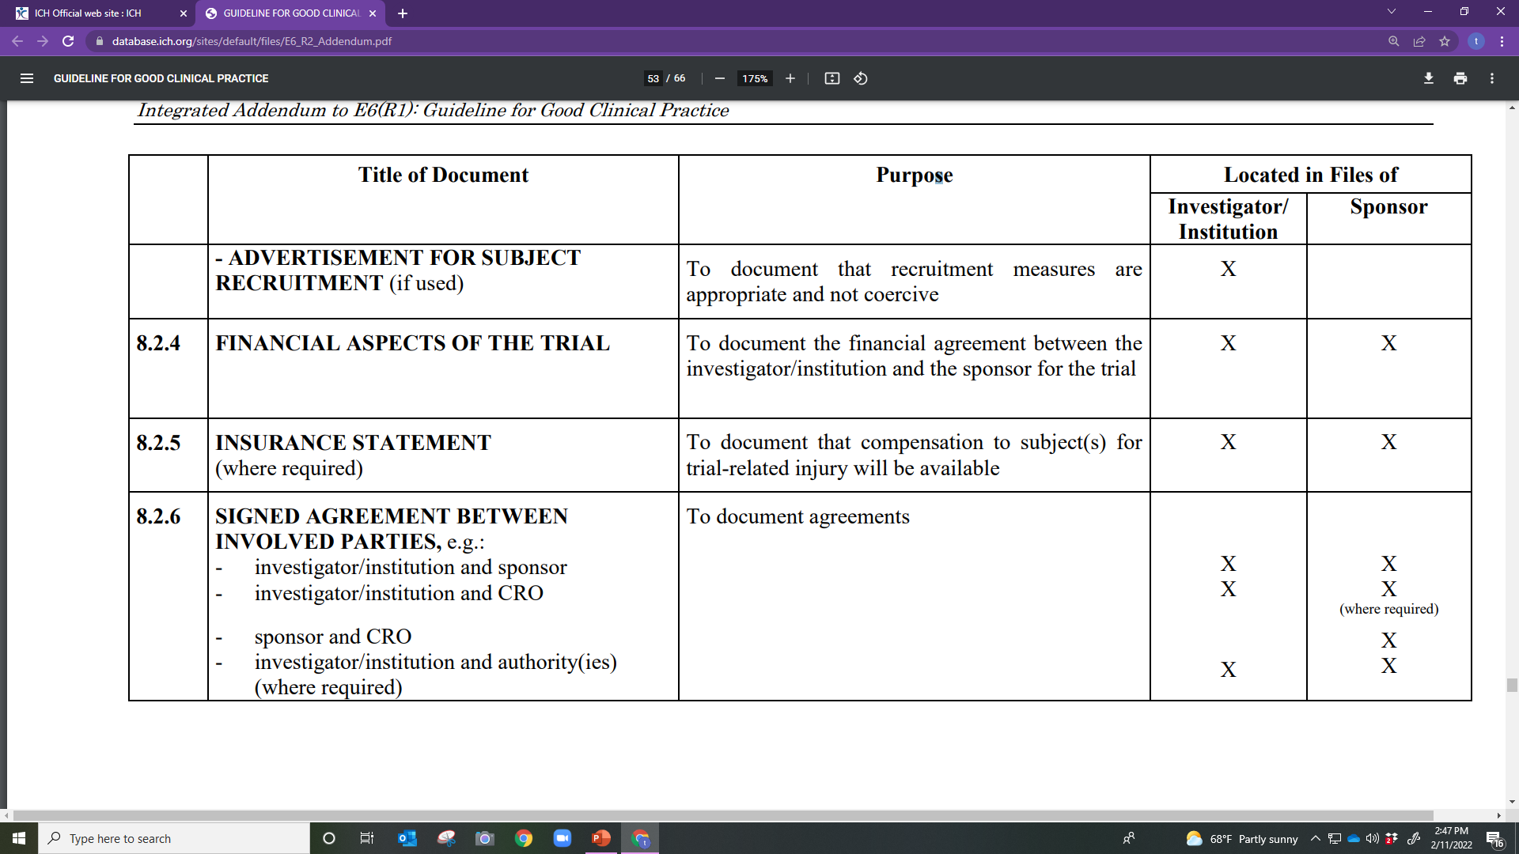

Slide 15
Advertisement for Subject Recruitment
Financial Aspects of the Trial
Insurance Statement, as applicable
Signed Agreement Between Involved Parties

Slide 16
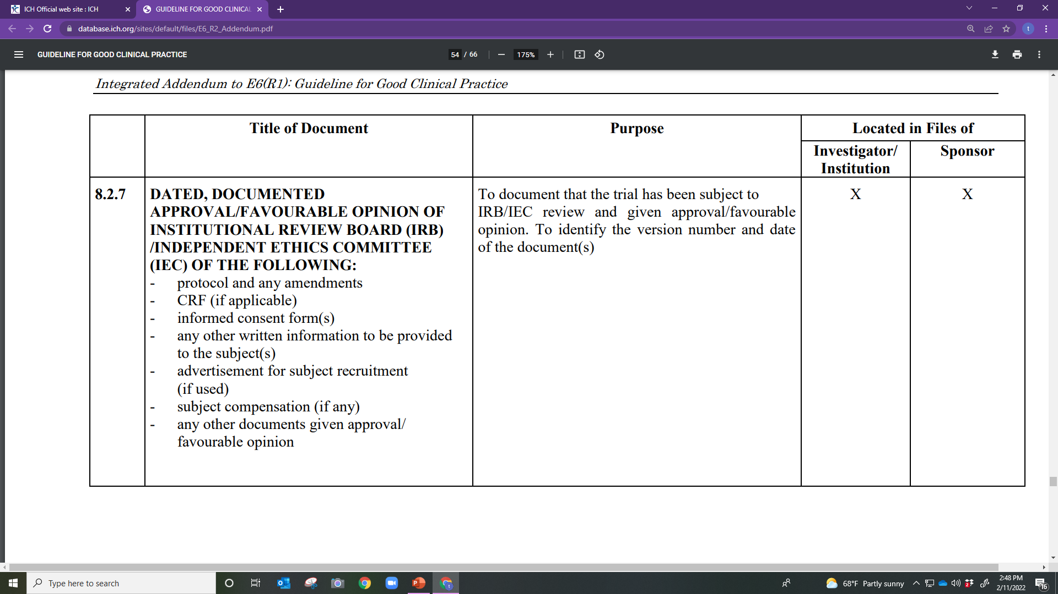

Slide 17
Dated, Documented Approval/Favorable Opinion of IRB /IEC of the Following:
Protocol and any amendments
CRF (if applicable)
Informed Consent Form(s)
Other written information to be provided to the subject(s)
Advertisement for subject recruitment (if used)
Subject compensation (if any)
Other documents given approval/ favorable opinion

Slide 18
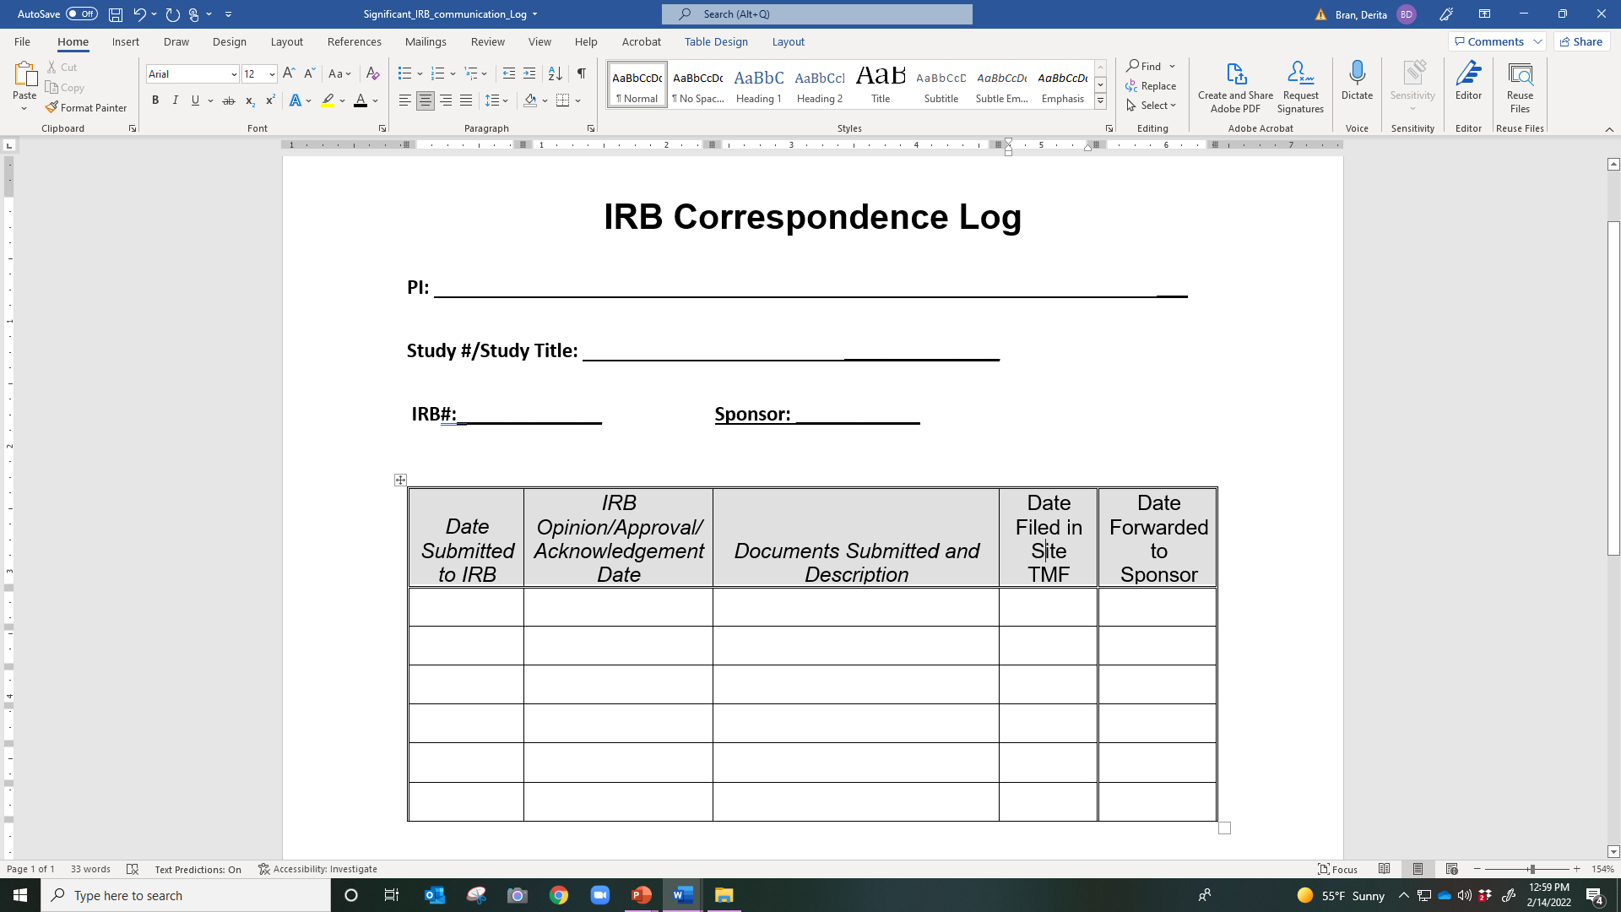
IRB Correspondence Log

Slide 19
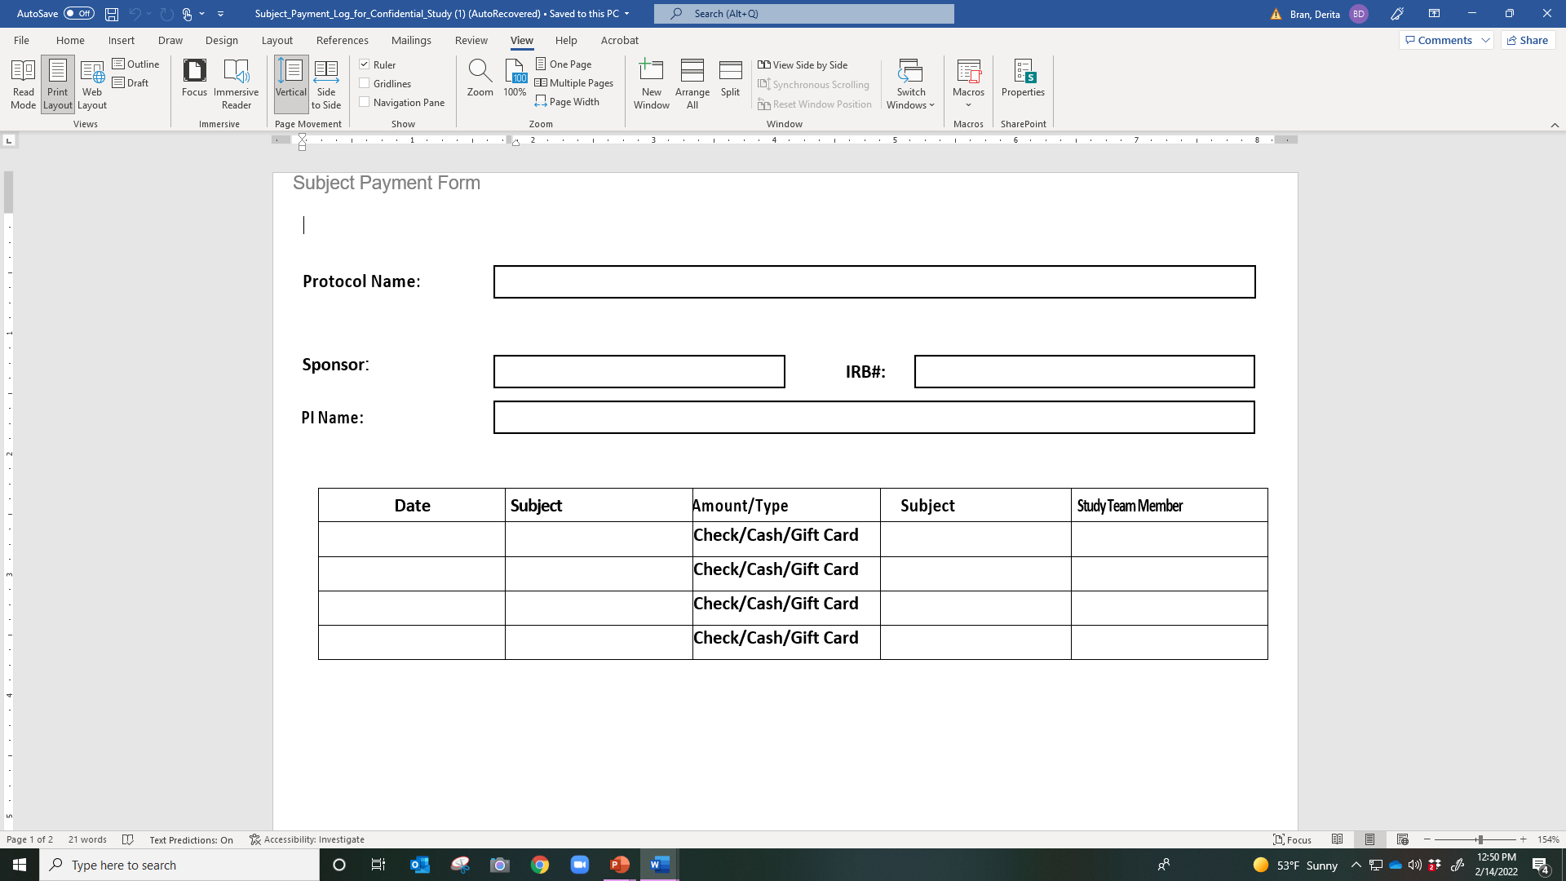
Example Subject Payment Form

Slide 20
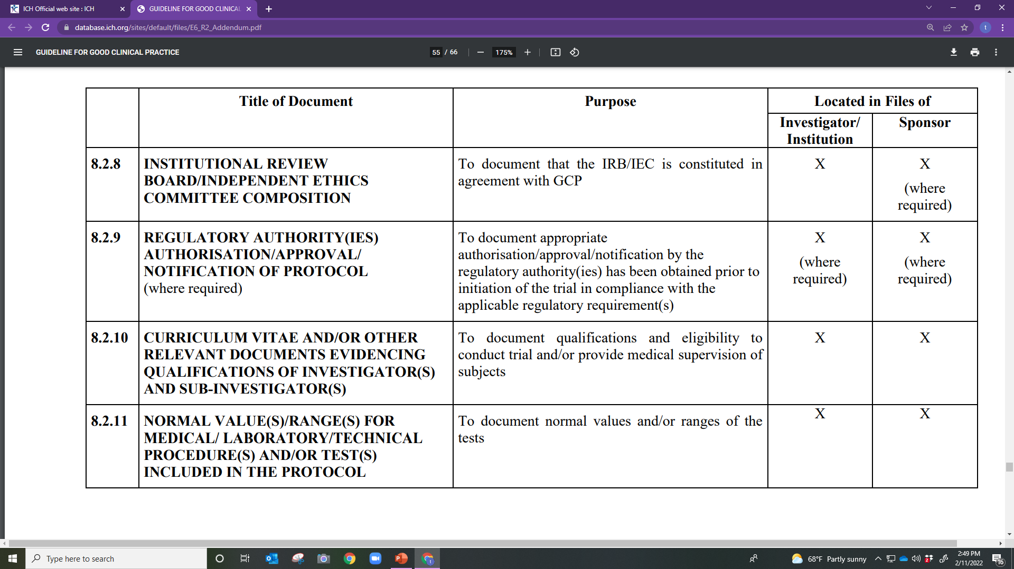

Slide 21
IRB/IEC Composition
Regulatory Authority(ies) Authorization/Approval/ Notification of Protocol (where required)
Curriculum Vitae and/or Other Relevant Documents Evidencing Qualifications of Investigator(s) and Sub-Investigator(s)
Normal Value(s)/Range(s) for Medical/ Laboratory/Technical Procedure(s) and/or Test(s) Included in the Protocol

Slide 22
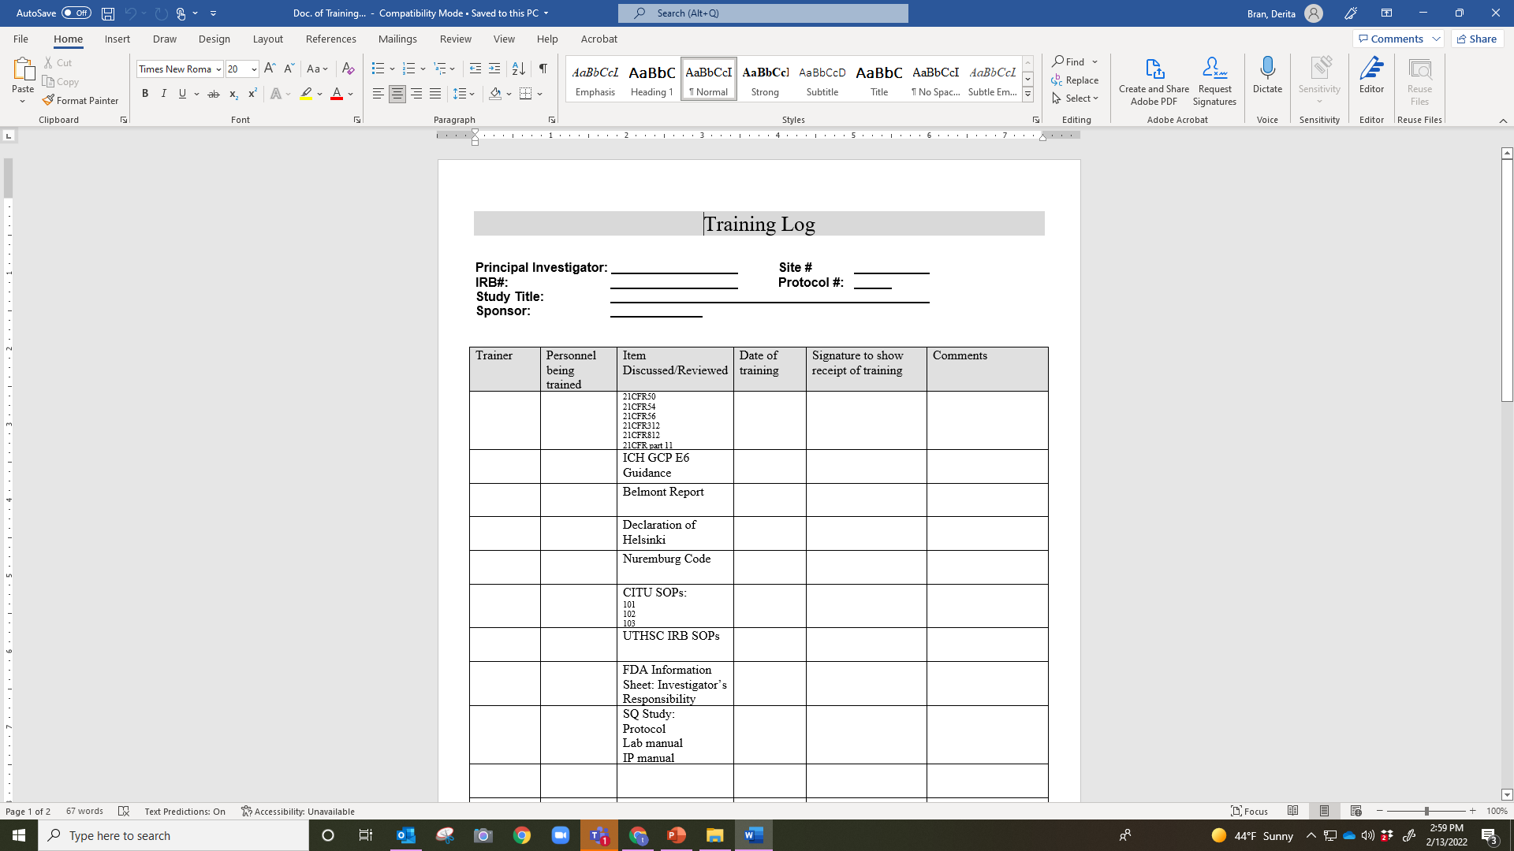

Slide 23
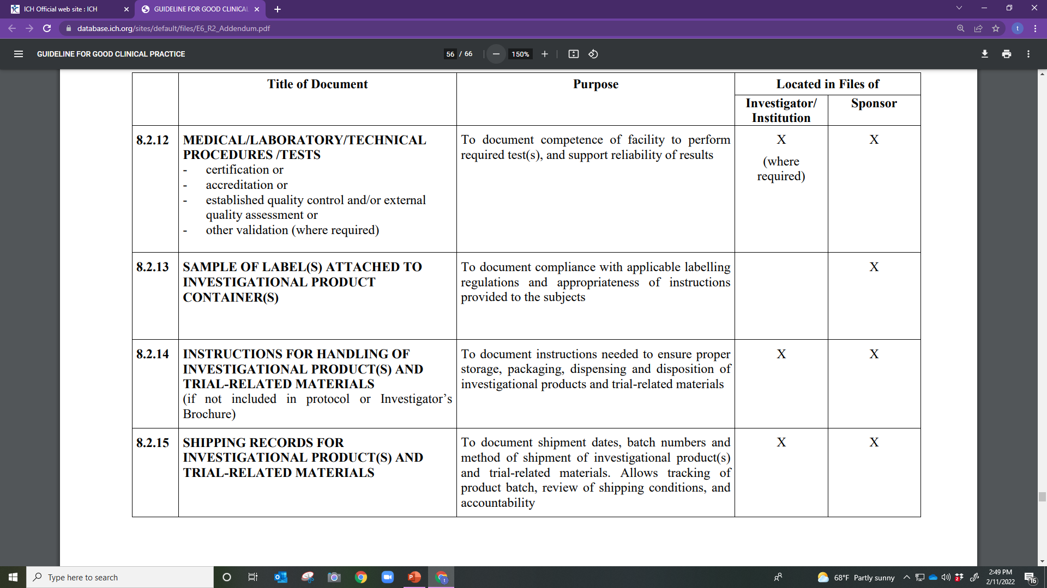

Slide 24
Medical/Laboratory/Technical Procedures /Tests
Certification/accreditation/established quality control and/or external quality assessment/other validation (where required)
Sample of Label(s) Attached to IP Container(s)
Instructions for Handling of IP(s) and Trial-Related Materials (if not included in protocol or Investigator’s Brochure)
Shipping Records for IP(s) and Trial–Related Materials

Slide 25
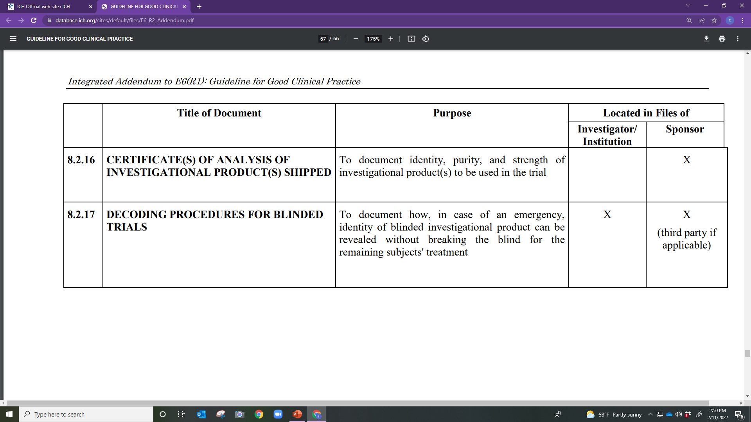

Slide 26
Certificate(s) of Analysis of IP(s) Shipped
Decoding Procedures for Blinded Trials

Slide 27
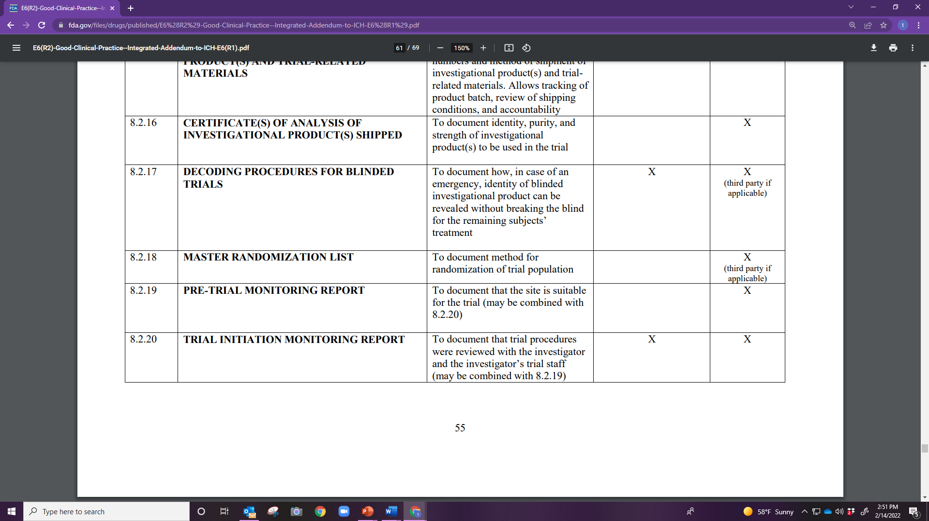

Slide 28
Master Randomization List
Pre-Trial Monitoring Report
Trial Initiation Monitoring Report

Slide 29
ICH GCP E6 (R2) Section 8.3
During the Clinical Conduct of the Trial

Slide 30
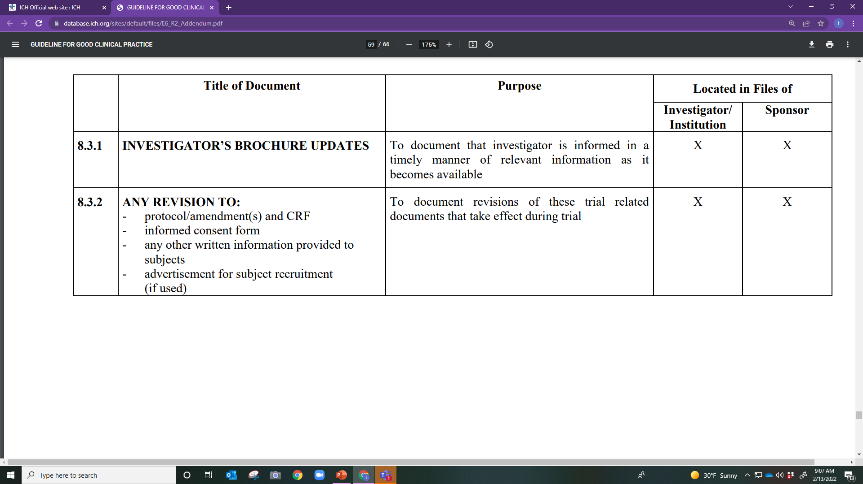

Slide 31
IB Updates
Any Revision to the following:
Protocol/amendment(s)
CRF
Informed Consent Form
Any other written information provided to subjects
Advertisement for subject recruitment (if used)

Slide 32
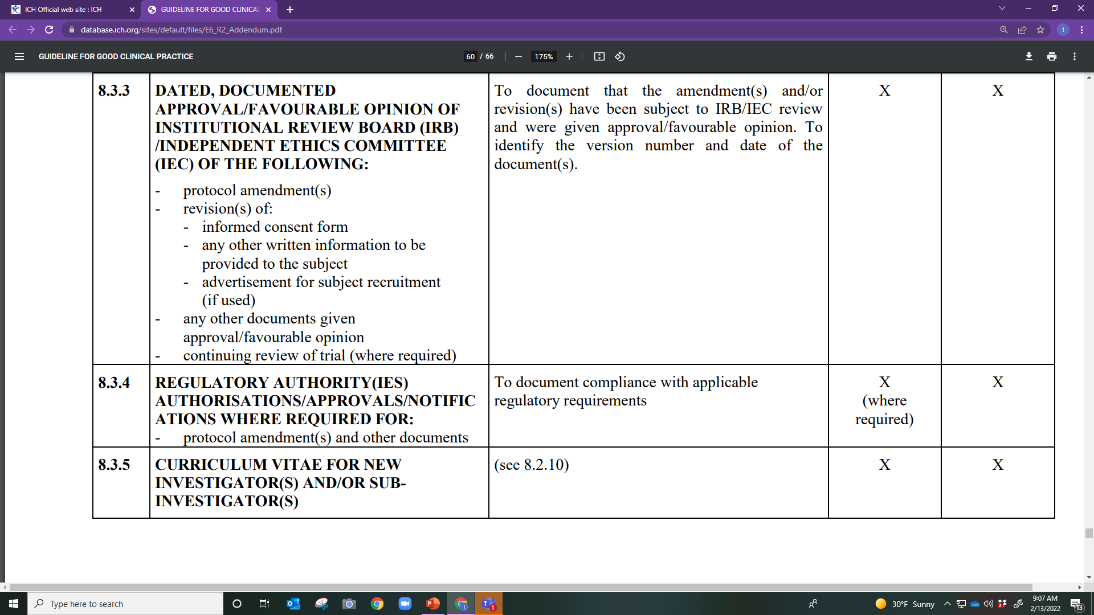

Slide 33
Protocol amendment(s)/revision(s)
Revised informed consent form
Updated written information to be provided to the subject
New advertisement for subject recruitment
Continuing IRB/IEC review of trial, as required
CVs/Resumes for new study team members
Updated CVs/Resumes, as applicable

Slide 34
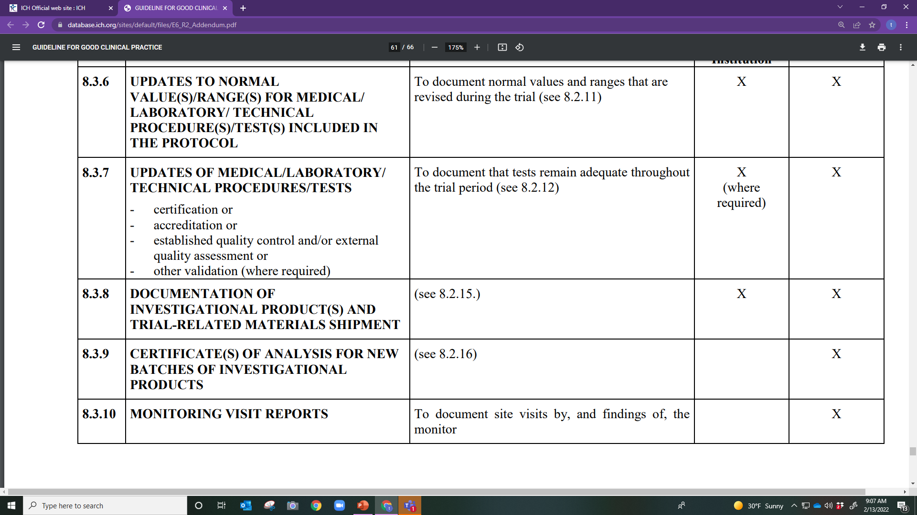

Slide 35
Updates to Laboratory/Test normal/ranges
Changes in Lab/testing facility
Receipt of IP and trial-related materials
Monitoring visits reports and responses

Slide 36
Monitoring Log
Study Protocol/IRB #s: PI: Sponsor:
Date of Visit | Signature of Monitor | Printed Name of Monitor | Signature of Staff Present | Printed Name of Staff

Slide 37
Essential Documents Part 2
Thursday 2/17

Slide 38


Slide 39

What is the purpose of the Investigator's Brochure (IB)?
A. Provides investigators and others in the trial information necessary to comply with the protocol and understand the purpose for the trial
B. Provides a collection of clinical and non-clinical data on the investigational product relevant to the study
C. Provides a collection of only clinical data on the investigational product relevant to the study
D. A and B
E. All of the above

Slide 40
Essential Documents individually and collectively permit the evaluation of a clinical trial and the data quality.
True
False

Slide 41
Who is responsible for keeping an up-to-date IB?
A. The sponsor
B. Investigator
C. IRB/IEC
D. CRO

Slide 42
ALCOA-C stands for Attributable, Legal, Contemporaneous, Original, Accurate and Complete
True
False
Notes:
Legal should be legible

Slide 43
The following documents should be collected before the trial is initiated except the _________.
A. Protocol deviation form
B. Signed and executed agreements
C. Blank CRF
D. Signed Protocol page

Slide 44
The IRB/IEC membership list only needs to be collected at the beginning of the clinical trial.
True
False

Slide 45
The IP certificate of analysis of the IP is the responsibility of the ___.
A. Subject
B. CRO
C. Sponsor
D. PI

Slide 46
When should TMFs be established?
A. At initiation of the study
B. At the qualification visit
C. At the beginning of the study
D. At the monitoring visit

