Slide 1
CERTIFICATION EXAM PREPARATION COURSE
SESSION 8

Slide 2
Handout/Reference sheets:
Study Start-up
NIH guideline-study-start-up document
Study start-up Tips
SOP reference sheet from Session 9
Webinars:
Research 101, session 4
Research 102, session 4

Slide 3

3 Stages of Conducting a Clinical Trial per GCP
Pre-Study
During the conduct of the clinical trial
Study completion/termination

Slide 4
Today’s Discussion
SOPs
Training
Conflict of Interest (COI)
New Drug Application (NDA)
Regulatory divisions of the FDA overseeing products
Getting the word out

Slide 5


Slide 6
ICH GCP E6 (R2)
1.55 Standard Operating Procedures (SOPs) Detailed, written instructions to achieve uniformity of the performance of a specific function
5.l Quality Assurance and Quality Control
  5.1.1 The sponsor is responsible for implementing and maintaining quality assurance and quality control systems with written SOPs to ensure that trials are conducted and data are generated, documented (recorded), and reported in compliance with the protocol, GCP, and the applicable regulatory requirement(s)

Slide 7
ICH GCP E6 (R2)
5.5 Trial Management, Data Handling, and Recordkeeping
  The sponsor should base their approach to validation of such systems on a risk assessment that takes into consideration the intended use of the system and the potential of the system to affect human subject protection and reliability of trial results
  Maintains SOPs for using these systems
  The SOPs should cover system setup, installation, and use
  The SOPs should describe system validation and functionality testing, data collection and handling, system maintenance, system security measures, change control, data backup, recovery, contingency planning, and decommissioning

Slide 8
List of Possible Needed SOPs
Training
Development/Approval/Distribution/Training/Review/Maintenance of SOPs
Responsibilities/Roles of Study Team
Study Feasibility Assessment
Informed Consent Process
Protection of Subjects
Conflict of Interest
Subject Recruitment
Misconduct
SAEs/AEs
IP Accountability
Monitoring
Study Closure
Essential Documents
Confidentiality

Slide 9
Writing an Effective SOP
Decide the title of the needed SOP
Lay out all procedures/
each step needed
Possibly create a flow diagram
Identify responsible parties that will be conducting the tasks of the SOP
Test the steps/procedures of the SOP before implementation to everyone
Approval process
Training
Implementation

Slide 10
Example of a SOP Layout
Header
  Institution/Department information
  Title of SOP
  Page _ of _
  Approval information
    Who approved by
    Date of approval
    Date first effective
    Version date
Purpose
Background
Scope
Procedure
Applicable Regulations/guidelines/policies
Definitions
Reference
Attachments
  flowchart
  lists
  tools, logs
Revisions

Slide 11
Tips for
Writing SOPs
SOPs should be:
  Clearly written, explaining the procedures needed to perform a task
  Written to ensure compliance with regulations and guidance
  Approved by the identified parties before implementation
  Implemented after responsible parties have received training
  Reviewed at least annually
  Maintained (all previous versions also)

Slide 12


Slide 13
Checklist for Training
Read CDA/CTA/Budget
Read 1572 and know HIPAA guidance
Read current version of the protocol
Read current version of approved ICF
Read all IRB approved materials for the study
Discuss initiation of study, subject participation, enrollment period
Discuss recruitment, enrollment, and consenting procedures
Discuss roles of each study team member
Discuss the study procedures to be performed at each visit
Review procedures for obtaining, handling, shipping, and storage of specimens
Verify study members possess the skills/credentials requires to perform their role
Review forms to be used
Discuss study product accountability, dispensing, and storage
Discuss FDA regulations and ICH GCP guidelines to ensure compliance
Discuss appropriate billing procedures
Human Subject Protection and Conflict of Interest

Slide 14
Benefits of Training
Ensure compliance, elevate and standardize site performancexx
Protect the safety and well-being of subjects
Assure the rights of subjects are preserved
Improve the quality of data collected
Identify roles and responsibilities for the study
Assist in be familiar with the study IP and procedures to be performed
Essential role in overall career development
Assists in obtaining the right knowledge to help prevent misconduct
Develop, foster, and maintain a culture of integrity in science
Discourage and prevent unethical conduct
Empower researchers to hold themselves and others accountable to high ethical standards
Improve the ability to make responsible choices

Slide 15

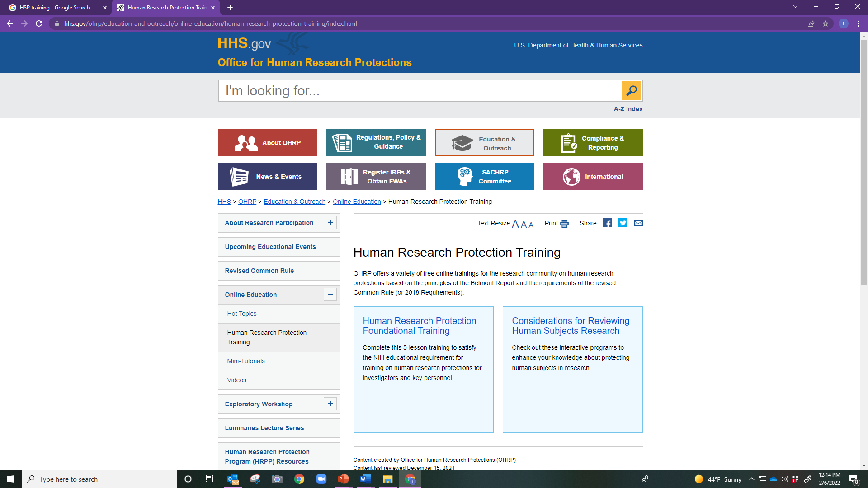
HSP and GCP Training

Slide 16
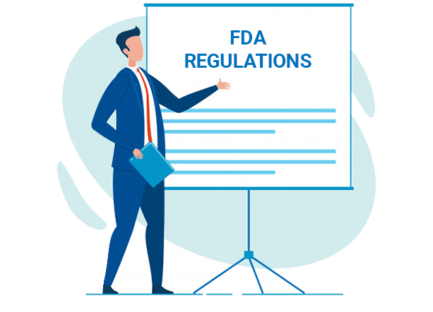
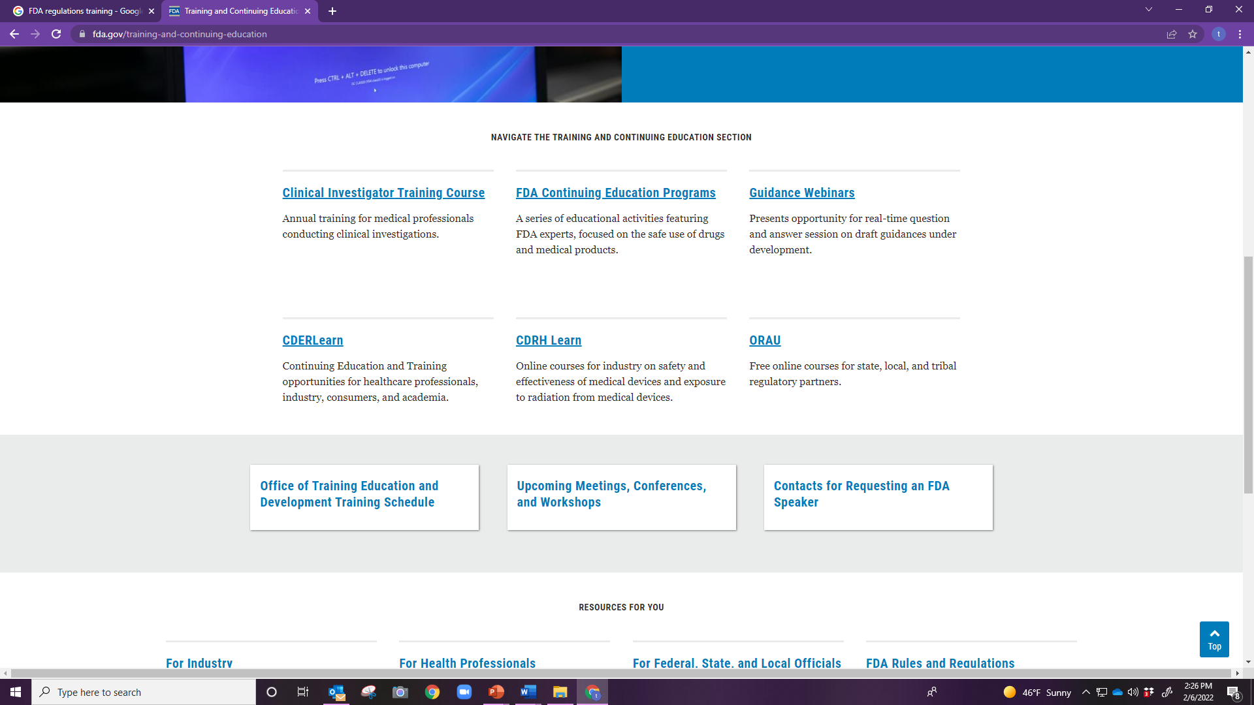
FDA Regulations
https://www.fda.gov/training-and-continuing-education

Slide 17

IATA DGR Training
Training for shipping dangerous goods by air
Covers:
  how to use the IATA Dangerous Goods Regulations
  shipper and operator responsibilities
  the proper methods to safely identify, document, package, mark, label, handle, and load individual classes of dangerous goods

Slide 18
Conflict of Interest Training
Dependent on:
institution
site
department

Slide 19
Protocol Training for an Industry –Sponsored Trail
Prior to conducting clinical research
  Prior to any study-related research procedures being initiated, initial protocol specific training is typically conducted by the sponsor, a sponsor representative, or a delegated trainer during a site initiation visit (SIV) or initial training meeting
  This training usually excludes self-training

Slide 20
Ongoing Protocol Training
Routine meetings should be held throughout the clinical trial to:
  conduct protocol refresher training as necessary
  to review study status, subject enrollment, adverse events, deviations, monitoring findings, assignment of responsibilities, etc.
Meetings after a protocol amendments should occur to provide additional training may be required for the investigator and study personnel, depending on the scope and nature of the changes

Slide 21
Documentation of Training
All protocol-specific training records for the PI, sub-investigators, and other study personnel should be maintained with the study records
Training records are generally maintained in the Regulatory Binder with the other study essential documents
Individual training records that are not protocol-specific (GCP, HIPAA, CITI, etc.), can be maintained separate from the study records in an electronic or paper individual training file
These training records should be made available for review by the study monitor or a regulatory inspector upon request.

Slide 22
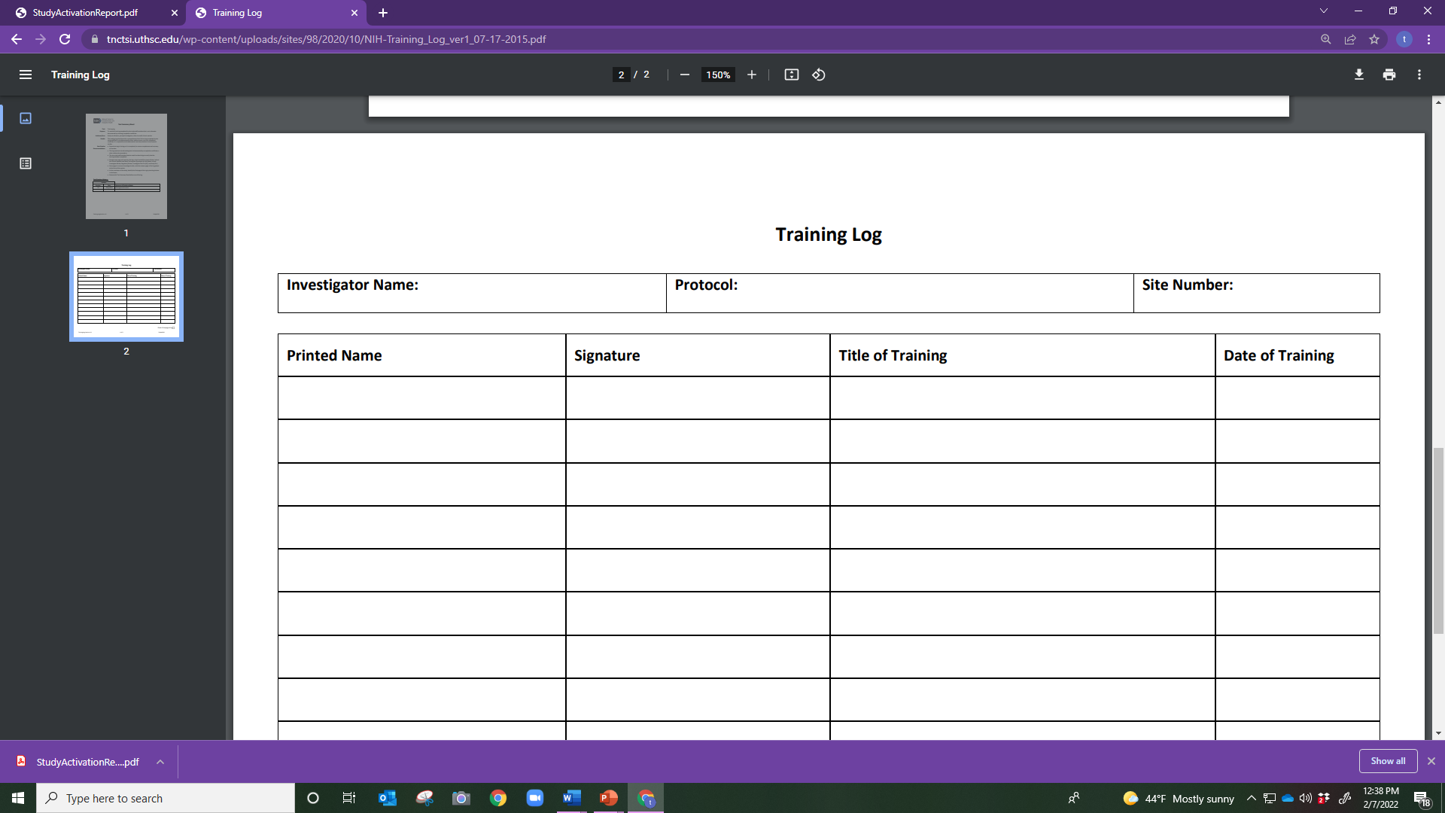
Training Log Example

Slide 23


Slide 24
Getting the Word Out
This is not just addressing advertising for recruitment and enrollment
The study team needs to notify all healthcare workers that may have contact with the study team and any study procedures
Develop a liaison/rapport with the doctors/nurses/ CMA of clinics/hospitals you may be recruiting out of

Slide 25
Drug Development Process
Step 1
Discovery and Development
Step 2
Preclinical Research
Step 3
Clinical Research
Step 4
FDA Drug Review
Step 5
FDA Post-Market Drug Safety Monitoring

Slide 26
New Drug Application(NDA)
Formal request to the FDA to approve the IP as marketable
Submitted by the sponsor usually after Phase III studies
After sufficient safety and efficacy data has been collected
Approval process
FDA will respond with a letter
Approval letter must be obtained before the IP can be marketed

Slide 27
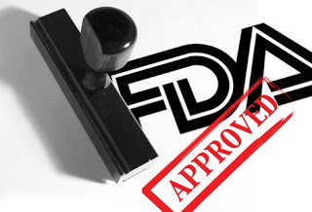

Slide 28

Center for Drug Evaluation and Research (CDER)
Performs an essential public health task by making sure that safe and effective drugs are available to improve the health of people in the United States
Part of the U.S. Food and Drug Administration (FDA)
Regulates over-the-counter, prescription drugs, and more including:
biological therapeutics
Generic drugs
Fluoride toothpaste
Antiperspirants
Dandruff shampoos
Sunscreens

Slide 29

Center for Biologics Evaluation and Research(CBER)
Organization within the FDA
Responsible for ensuring safety and efficacy of the following:
Vaccines
Blood and blood products
Cells
Tissues
Gene therapies
Most pediatric clinical trials since 2010

Slide 30

Center for Devices and Radiological Health(CDRH)
Organization within the FDA
Responsible for the regulation of medical devices
pre-market
post-market

Slide 31


Slide 32
____is responsible for vaccines, blood/blood products, cells, tissues, and gene therapies obtaining FDA approval.
A. CBER
B. CDER
C. CDRH

Slide 33
The drug regulations also apply to biologics and vaccines: however, there are specific regulation for devices.
True
False

Slide 34
Before a clinical trial begins the sponsor must file a/an ___ with the FDA.
CBER
CDER
IND
D. IDN

Slide 35
Most sponsors will ship the IP after the execution of the CDA.
True
False

Slide 36
The purpose of the financial Disclosure Form (FDF) is to identify any potential conflict of interest that may bias a clinical trial.
True
False

Slide 37
The purpose of the site initiation visit is to ensure only the PI has a clear and accurate understanding of protocol procedures and how the study should be conducted.
True
False

Slide 38
An IND is needed for all of the following except:
A. A new compound/IP
B. A new indication or an unapproved indication of a drug
C. Off label use at the discretion of a physician of an approved drug
D. A new dose form or dosage level or a new drug combination

Slide 39
ICH GCP defines quality assurance as which of the following?
A. Act of overseeing the progress of a clinical trial
B. Plans to perform inspections of clinical trials
C. Planned and systematic action to ensure that the data is generated, recorded, and reported according to GCP
D. Planned and systematic action to officially review a clinical trial

