Slide 1
CERTIFICATION EXAM PREPARATION COURSE
SESSION 7:
Study Startup, Part I

Slide 2
Handout/Reference sheets:
Study Start-up
NIH guideline-study-start-up document
Study start-up Tips
Webinars:
Research 101, session 4
Research 102, session 4

Slide 3
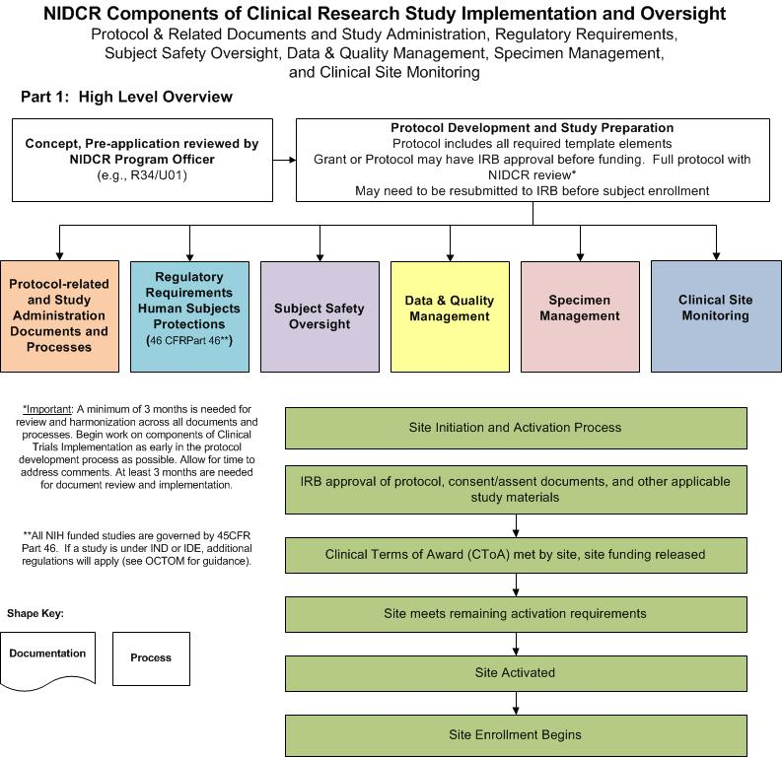

Slide 4
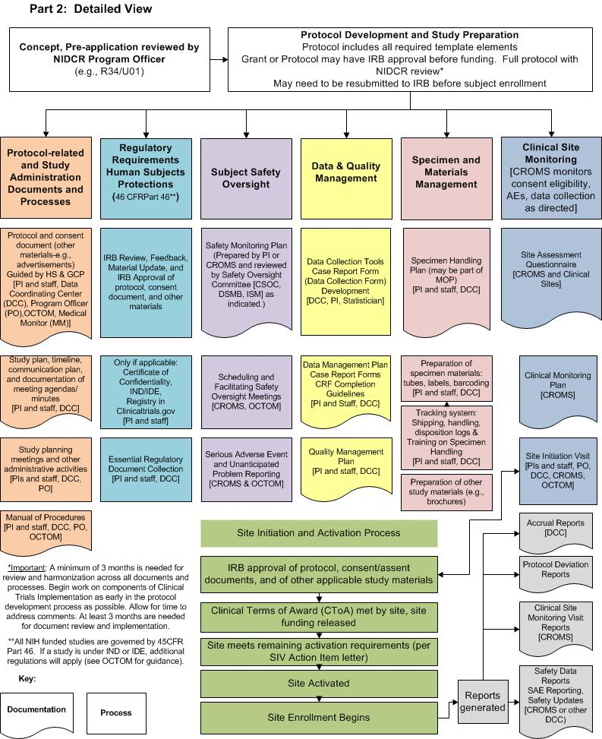

Slide 5
3 Stages of Conducting a Clinical Trial per GCP
Pre-Study
During the conduct of the clinical trial
Study completion/termination

Slide 6
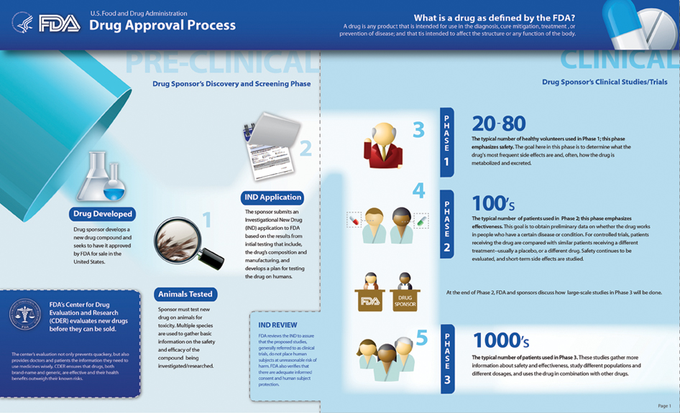

Slide 7
Study Steps to be Discussed in Today’s Session
Drug Discovery
Pre-Clinical Research for clinical trials
Seeking approval of a new IP
Preparing to conduct a clinical trial

Slide 8
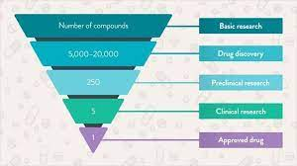
Drug Discovery
Process through which potential new medicines are identified
Involves a wide range of scientific disciplines, including biology, chemistry and pharmacology

Slide 9
Pre-Clinical Research
Also known as non-clinical research
Studies that do not involve human subjects
Conducted in order to begin human subject trials
Purpose:
Provide information on safety and possibly efficacy in animals
Data includes:
Data on acute toxicity
Metabolism of the drug
Starting dose for humans

Slide 10
Pre- clinical Studies of Product Candidates
involve the activities that connect drug discovery in the laboratory to initiation of human clinical trials
can be designed to identify a lead candidate from several IPs being developed
select the best formulation
determine the route, frequency, and duration of exposure
ultimately support the intended clinical trial design

Slide 11
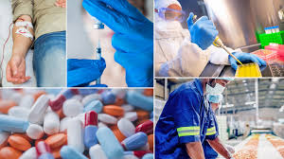
Investigation New Drug Application
Fda.gov

Slide 12
Investigational New Drug (IND)
Sponsor shall submit an IND to FDA if the sponsor intends to conduct a clinical investigation with an investigational new drug
A sponsor shall not begin a clinical investigation subject to § 312.2(a) until the investigation is subject to an IND which is in effect in accordance with § 312.40.
Such a clinical investigation is not permitted to proceed without the prior written authorization from FDA. FDA shall provide a written determination 30 days after FDA receives the IND or earlier
312.22 General principles of the IND submission
312.23 IND content and format

Slide 15
Cost of Research and Development
Nearly 90 percent of drug candidates fail to reach the market.
Often these failures occur in human trials, suggesting that traditional models for efficacy and safety testing are insufficient for biologic drugs
On average, pharmaceutical companies spent about one-quarter of their revenues (net of expenses and buyer rebates) on R&D expenses in 2019
The pharmaceutical industry spent $83 billion dollars on R&D, in 2019
Adjusted for inflation, that amount is about 10 times what the industry spent per year in the 1980s.
On average, the Food and Drug Administration (FDA) approved 38 new drugs per year from 2010 through 2019 (with a peak of 59 in 2018), which is 60 percent more than the yearly average over the previous decade
Only about 10 percent of drugs entering clinical trials are ultimately approved for introduction by the FDA
In recent studies, estimates of the average R&D cost per new drug range from less than $1 billion to more than $2 billion per drug
The development process often takes a decade or more, and during that time the company does not receive a financial return on its investment in developing that drug

Slide 16
Clinical Trials
Conducted after sufficient pre-clinical studies have been performed to prove the potentiality of safety in humans
Involve the participation of human subjects
Test the safety and efficacy of an IP
Phases 0-4
IIIB
May be conducted while the NDA is pending approval
Purpose- to gather additional information regarding safety, use in special populations

Slide 17
Study Start-up
Begins with the development of a clinical research study plan in the form a protocol
Other study documents:
Consent documents
Data collection or case report forms
SOPs
Checklists and logs
The above other study documents will be helpful (if not already required) to implement a clinical study

Slide 19
Preparing to Conduct a Study
PI/Site Qualification
Protocol feasibility assessment by PI
SOPs
Essential Documents/Regulatory File/Trial Master File
Site Source Documents/Visit checklists
Budget negotiation
Agreements/Contracts
Investigator/Study team documents (Credentials)
IRB submission and Subsequent approval
Training
Delivering/discussing study information to other departments/institutions
Site Initiation

Slide 21
PI/Site Qualification
How does a sponsor choose a site?
Past experience with the investigator/site
Current capability/infrastructure (staff and facility)
Patient population/potential for enrollment
PI qualifications/experience
Any competing studies at the site
PI’s available time to conduct the study
Accreditation of any local facilities that may perforn study procedures ( USG, labs)
Investigator/site selection for participation
Site questionnaire
Confidentiality Disclosure Agreement (CDA)
Possible site Qualification visit
Performed to assist in choosing the best investigators/sites for study success

Slide 22
Preparing for Site Qualification and Selection
Review the protocol synopsis (all involved study team)
Seek clarification for areas that need additional information
Perform study feasibility assessment
Maintain confidentiality

Slide 24
Feasibility Assessment from the Site’s Perspective
Questions to ask:
Who is the sponsor/What is the reputation of the sponsor?
Do we have the available staff and infrastructure/resources/time to conduct the study?
Do we have the patient population for successful recruitment?
Does the design of the study meet the scientific rigorous standards?
Is the risk/benefit ratio favorable/appropriate?
What is the difficulty level of conducting the study?
What are the subject procedures and time of participation?
Is the proposed budget adequate?

Slide 25
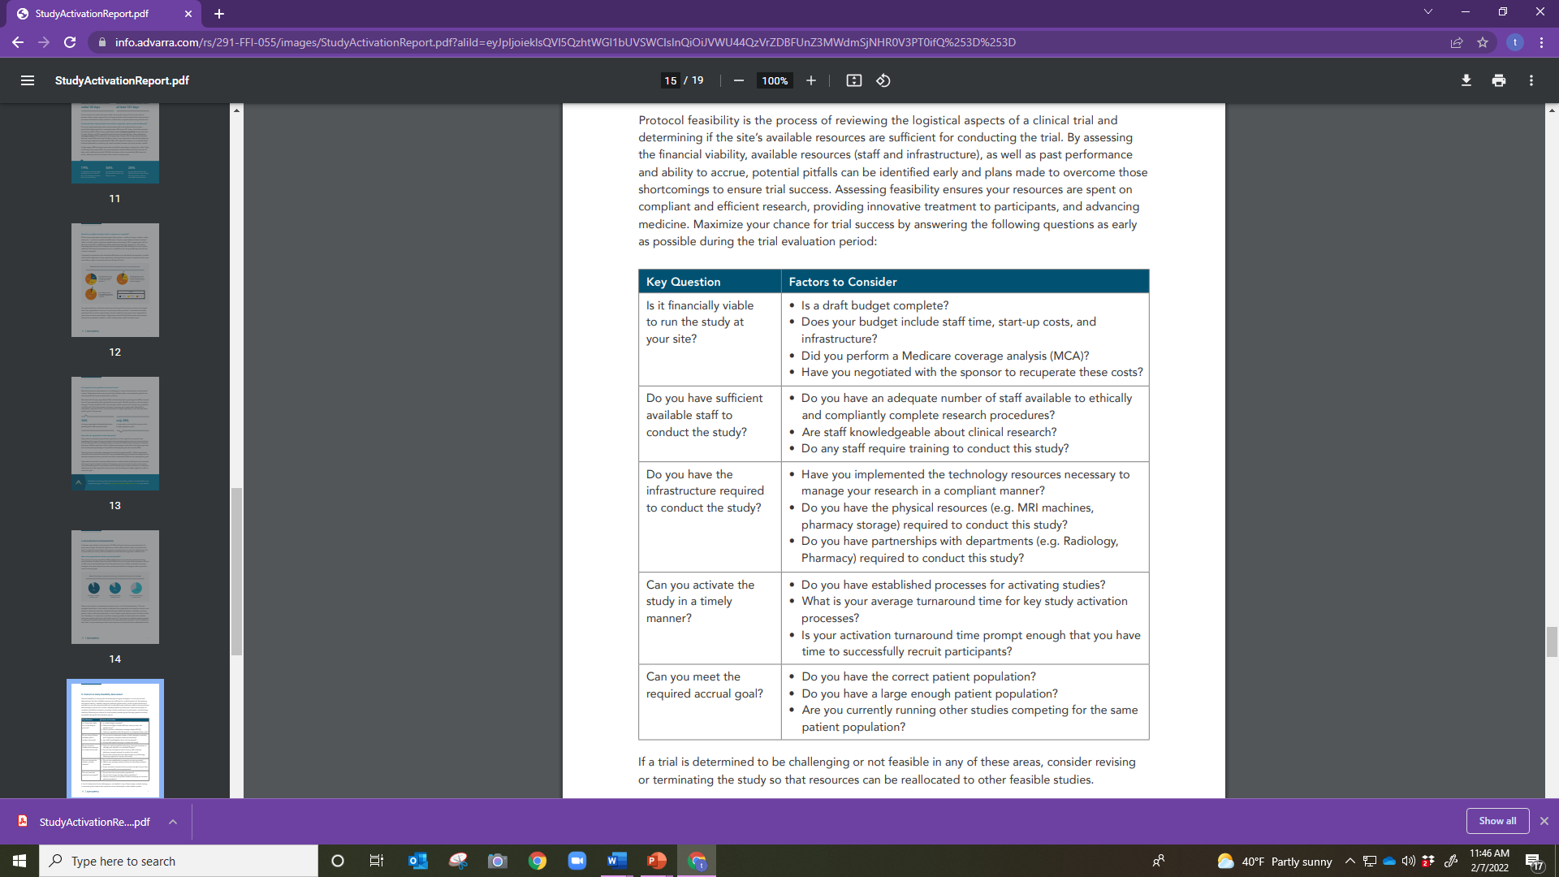

Slide 26
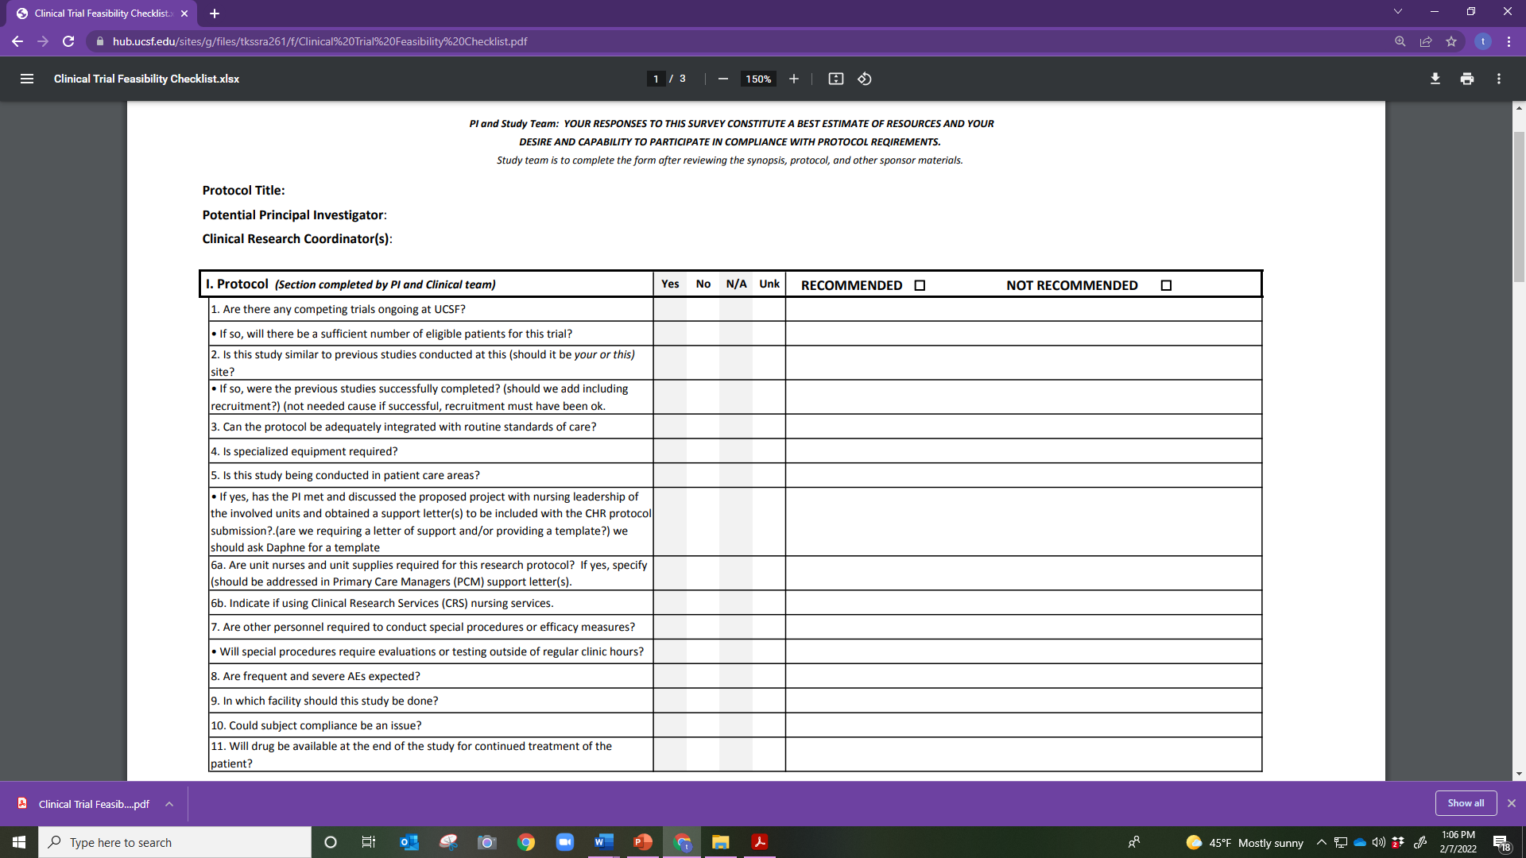

Slide 27
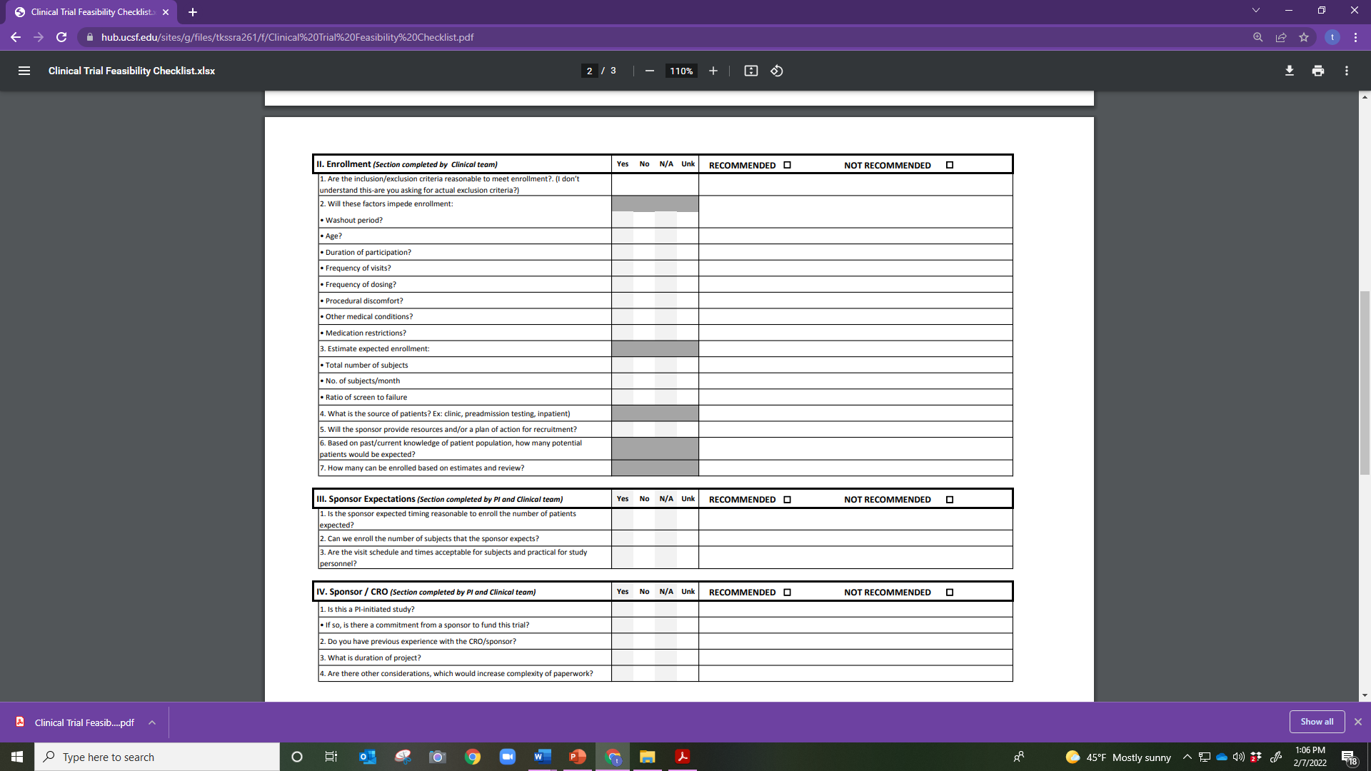

Slide 28
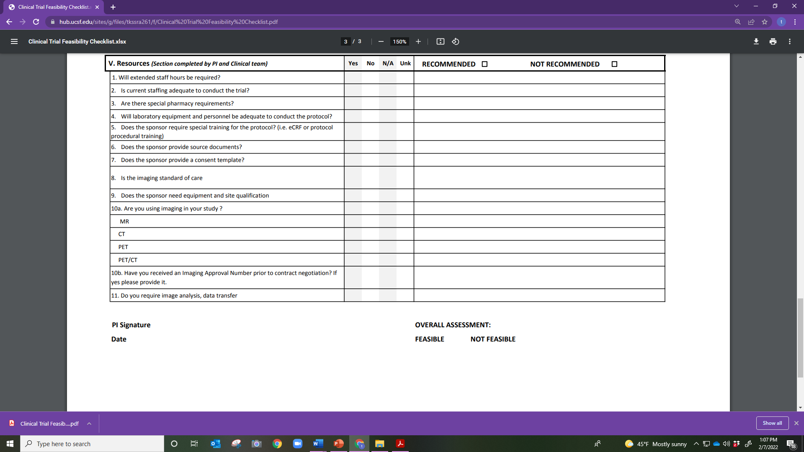

Slide 30
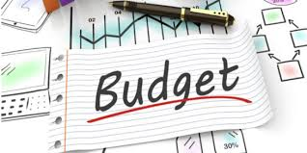

Slide 31
Budget Negotiations
Assessment of the budget:
Are all of the procedures listed/covered in the budget?
What will study start-up cost you/What do you need for a start-up fee
What are the hidden costs depending on the study?
Feasibility assessment
Monitor visits
Recruitment
Re-consenting
Training

Slide 33
Study Team Credentials
Curriculum Vitae/Resumes
Certifications
Licenses
Other documents
FDFs
Training documents

Slide 34
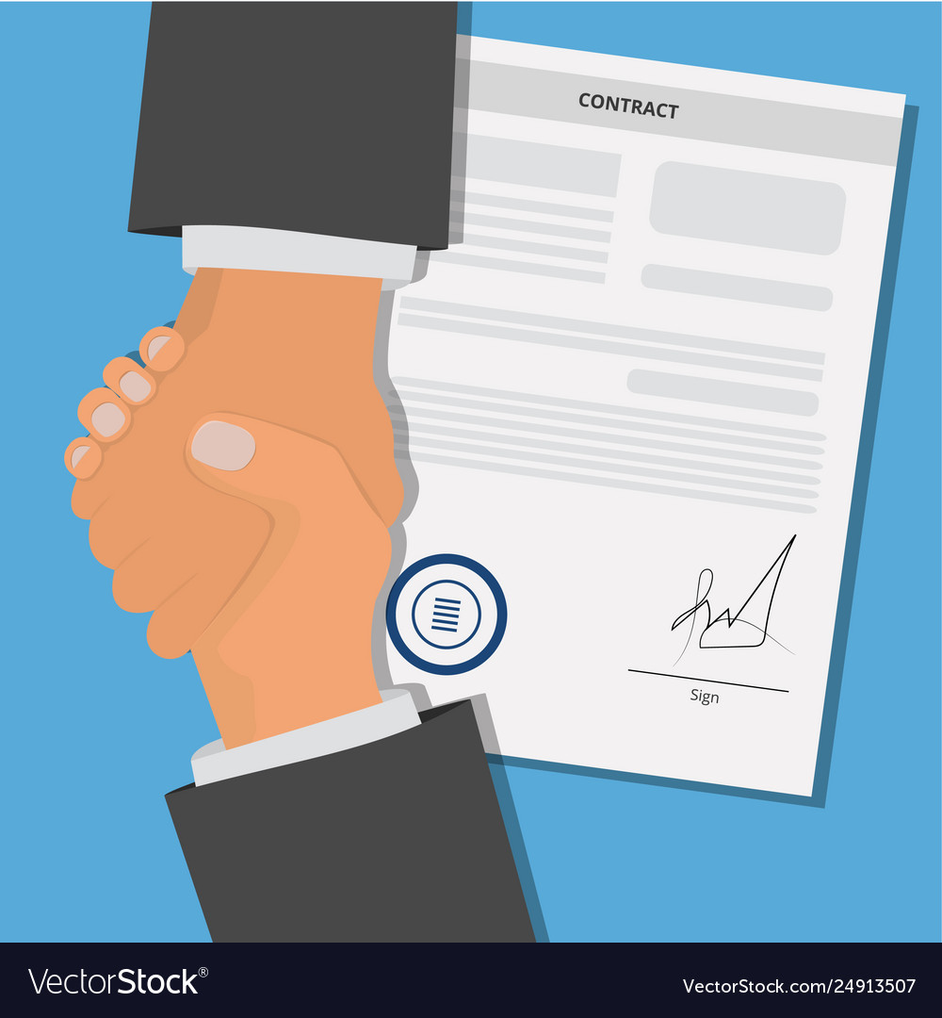

Slide 35
Agreements
Confidentiality Disclosure Agreement (CDA)
Signed before the sponsor will provide the protocol
Clinical Trial Agreement (CTA)
Signed before site initiation

Slide 37
Additional Post-Site Selection Tasks
Prepare and submit IRB application
Prepare and submit other required regulatory/Essential Documents
Essential Documents
1572
CV/Resumes
Licenses
Certifications
Delegation of Authority-Responsibilities outlined
Master log
Screening log
Negotiate Clinical Trial/Study Agreement and Budget
Attend pre-trial initiation visit/training/or investigator meetings
Plan/Provide appropriate training to study team

Slide 39
Documents for the Sponsor
Qualification for PI and study team
Qualification for others conducting study procedures
1572
FDFs
SOPs
Agreements
Approved budget

Slide 40
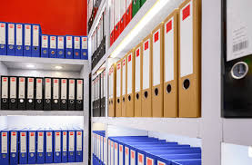

Slide 41
Trial Master File/ Essential Documents
Set up the TMF as soon as documents are received at the site (including emails)
Get organized
Maintain in a secure and confidential manner
Read the protocol to determine the agreed upon time to maintain Essential documents at the site
Will be discussed more in Sessions 9 and 10

Slide 43
Recruitment
Develop a recruitment plan
Create advertising materials, use only IRB approved ones

Slide 44
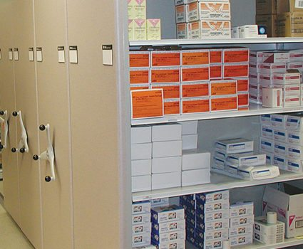

Slide 45
Storage
The study may require storage of the following:
IP
Temperature requirements/Temperature logs
IP associated materials/equipment
Laboratory supplies/kits
Shipping materials
Specimens
Temperature requirements
Time requirements
Shipping requirements
Essential Documents

Slide 46
Part 2: Thursday
SOPs
Training
NDA
Regulatory divisions of the FDA overseeing products

Slide 48
Pre-clinical trials involve human subjects.
True
False

Slide 49
Clinical trials do not involve human subjects.
True
False

Slide 50
A clinical investigation involving an IP drug is not permitted to proceed without the prior written authorization from FDA. FDA shall provide a written determination ___ days after FDA receives the IND or earlier
A. 2
B. 3
C. 15
D. 30

Slide 51
The Principal Investigator must attend the site initiation visit conducted by the Sponsor of the clinical trial.
True
False
Notes:
False

Slide 52
When should the monitor/sponsor representative first review the protocol and schedule of events with the study team?
During the :
A. Initial site visit
B. Site initiation visit
C. Routine monitoring visits
Notes:
2 is the answer

Slide 53
Completed Case Report Forms should be reviewed during the________________.
During the :
A. Initial site visit
B. Site initiation visit
C. Routine monitoring visits
Notes:
3

Slide 54
The best time to begin organizing the TMF is:
A. Upon initiation of the trial
B. Once IRB approval is received
C. When the sponsor sends the site Regulatory Binder/TMF with tabs
D. Upon first receipt of correspondence or documents from the sponsor

Slide 55
In which order does the drug approval process occur?
A. A drug compound is discovered, IND application, animal trials, clinical trial
B. Animal trials, drug compound is discovered, IND application, clinical trials
C. A Drug compound is discovered, animal trials, IND application, clinical trials
D. IND application, drug compound is discovered, animal trials, clinical trials

Slide 56
The ___ between the PI/representative and the sponsor should be executed before the study can be initiated at a site.
A. CTA
B. CDA
C. CDT
D. CTD

