Slide 1
CERTIFICATION EXAM PREPARATION COURSE
SESSION 17:
Monitoring and Auditing

Slide 2
Handout/Reference Sheet/Worksheets:
CAPA reference sheet
Common Findings and Resolution Worksheet
Webinars:
Research 101, session 11
Research 102, session 3

Slide 3
Additional References to Review:
FDA information Sheet: FDA Inspections of Clinical Investigators
https://www.fda.gov/media/75185/download
Steps to Follow when having an FDA Audit: https://www.uth.edu/ctrc/regulatory/fda-inspections.htm

Slide 4
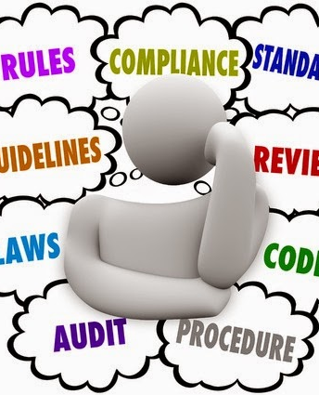
Regulations and Guidance to Follow
Studies should be conducted in compliance with the following according to the type of study is being conducted:
Protocol
Standard Operating procedures, (institutions, departments, sponsors, etc.
ICH GCP E6 (R2)
Federal regulations (21 CFRs)
Institutional Review Board policies and procedures
Institutional requirements
National Institute of Health
Office for Human Research Protections

Slide 5
21 CFR 312 Sponsor Responsibilities
312.50 General responsibilities of sponsors
  Sponsors are responsible for selecting qualified investigators, providing them with the information they need to conduct an investigation properly, ensuring proper monitoring of the investigation(s), ensuring that the investigation(s) is conducted in accordance with the general investigational plan and protocols contained in the IND, maintaining an effective IND with respect to the investigations, and ensuring that FDA and all participating investigators are promptly informed of significant new adverse effects or risks with respect to the drug.
312.53 Selecting investigators and monitors
  (d) Selecting monitors. A sponsor shall select a monitor qualified by training and experience to monitor the progress of the investigation.

Slide 6
21 CFR 312 Sponsor Responsibilities
312.56 Review of ongoing investigations
  The sponsor shall monitor the progress of all clinical investigations being conducted under its IND.
  (b) A sponsor who discovers that an investigator is not complying with the signed agreement (Form FDA-1572), the general investigational plan, or the requirements of this part or other applicable parts shall promptly either secure compliance or discontinue shipments of the investigational new drug to the investigator and end the investigator's participation in the investigation. If the investigator's participation in the investigation is ended, the sponsor shall require that the investigator dispose of or return the investigational drug in accordance with the requirements of § 312.59 and shall notify FDA.

Slide 7
21 CFR 312 Sponsor Responsibilities
312.58 Inspection of sponsor's records and reports
  (a) FDA inspection. A sponsor shall upon request from any properly authorized officer or employee of the Food and Drug Administration, at reasonable times, permit such officer or employee to have access to and copy and verify any records and reports relating to a clinical investigation conducted under this part. Upon written request by FDA, the sponsor shall submit the records or reports (or copies of them) to FDA. The sponsor shall discontinue shipments of the drug to any investigator who has failed to maintain or make available records or reports of the investigation as required by this part.
312.68 Inspection of investigator's records and reports
  An investigator shall upon request from any properly authorized officer or employee of FDA, at reasonable times, permit such officer or employee to have access to, and copy and verify any records or reports made by the investigator pursuant to § 312.62. The investigator is not required to divulge subject names unless the records of particular individuals require a more detailed study of the cases, or unless there is reason to believe that the records do not represent actual case studies, or do not represent actual results obtained.

Slide 8
Audit
ICH GCP E6 (R2)
  1.6 A systematic and independent examination of trial-related activities and documents to determine whether the evaluated trial-related activities were conducted, and the data were recorded, analyzed, and accurately reported according to the protocol, sponsor's standard operating procedures (SOPs), good clinical practice (GCP), and the applicable regulatory requirement(s).

Slide 9
Purpose of Audits
Evaluate the conduct of the trial activities
Verify compliance

Slide 10
Monitoring
ICH GCP E6 (R2)
  The act of overseeing the progress of a clinical trial, and of ensuring that it is conducted, recorded, and reported in accordance with the protocol, standard operating procedures (SOPs), GCP, and the applicable regulatory requirement(s).

Slide 11
Purpose of Monitoring
Protection of the rights, safety and well-being of subjects
Assessment of the conduct/progress of the trial
Evaluation of study compliance
Review of the data for accuracy, completeness, and verifiable from source documents confirming data validity

Slide 12
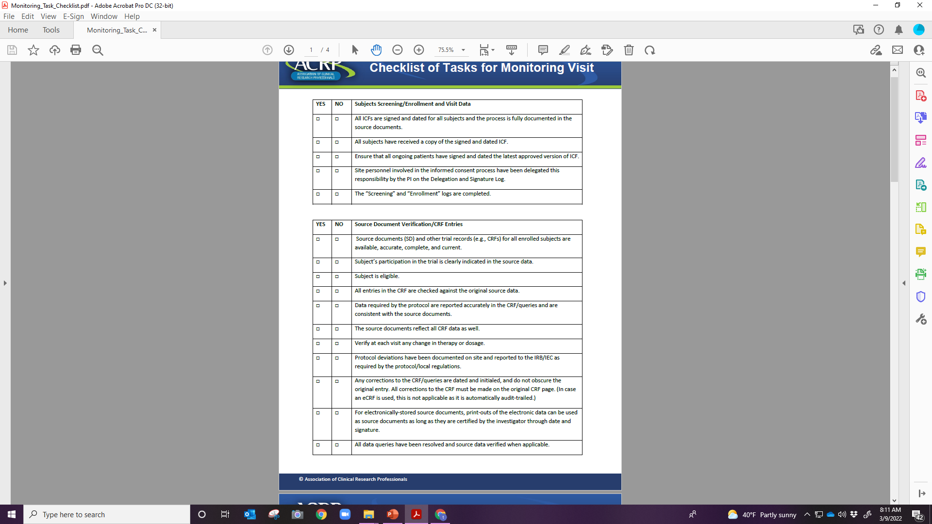

Slide 13
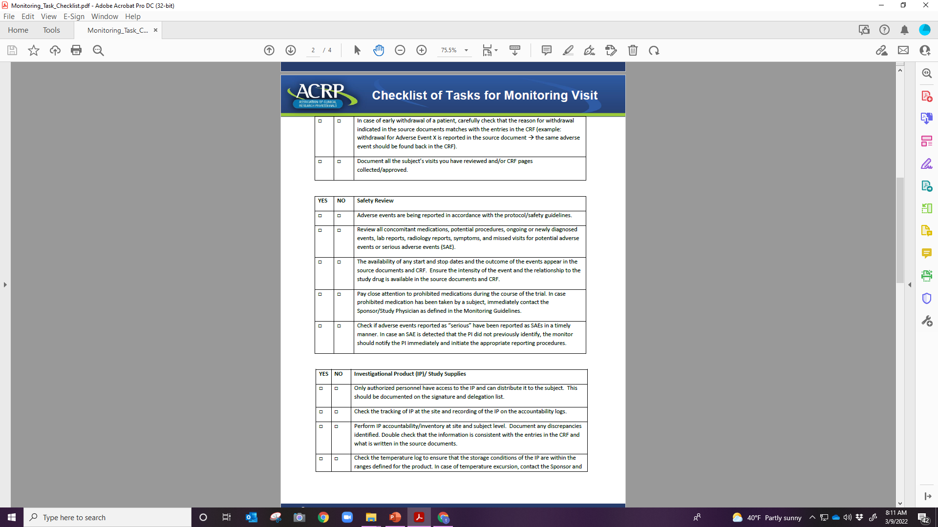

Slide 14
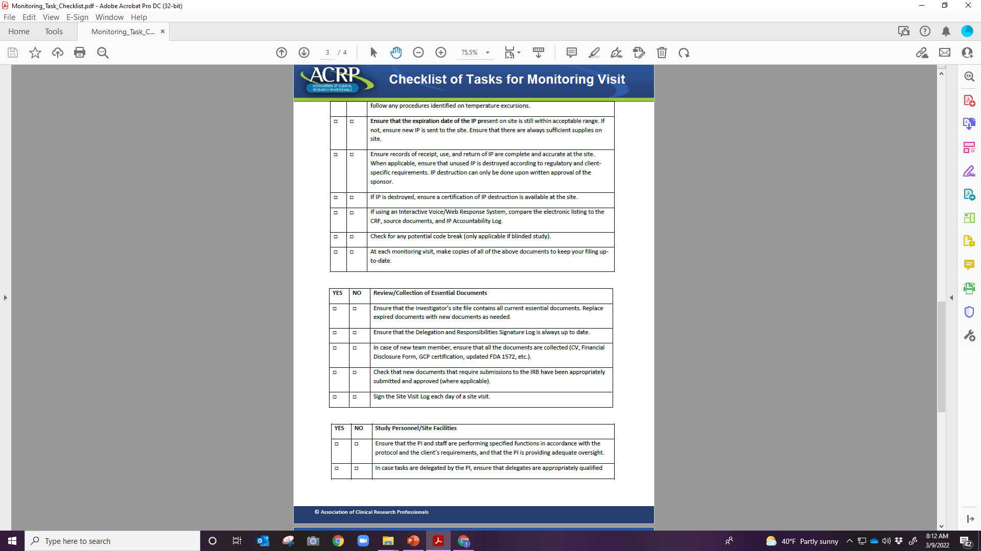

Slide 15
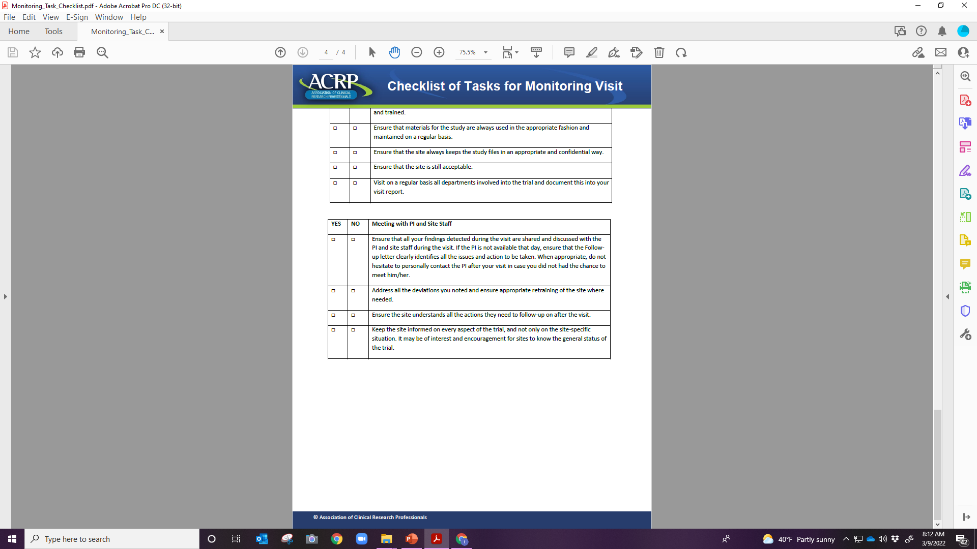

Slide 16
Monitoring vs Auditing
Continuous Process
Controls the quality of the clinical trial
Usually performed by someone who is part of the trial (study team member, Sponsor’s representative, i.e., monitor)
Usually performed during or at the completion of the trial
Assures trial quality
Performed by an independent party (one not associated with the study, i.e., IRB, FDA)

Slide 17
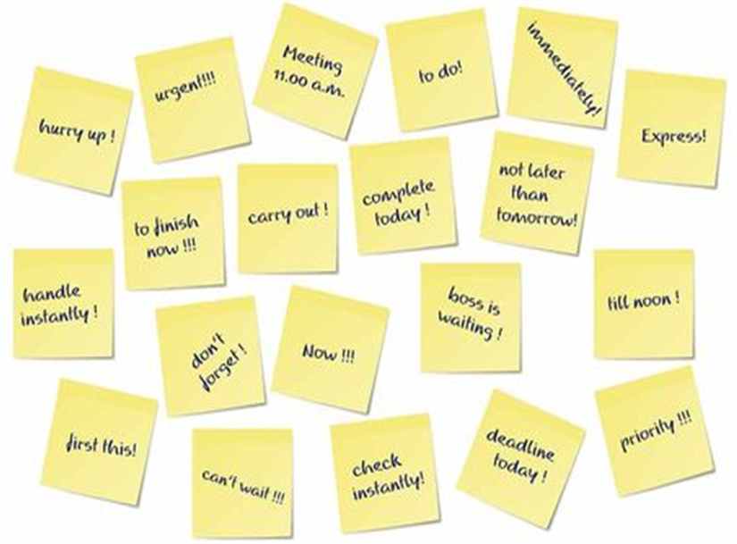
Inevitable, Right?
What Can You Do To Reduce the Amount of Queries/negative findings?

Slide 18
Non-Compliance
Failure (intentional or unintentional) to comply with:
applicable federal regulations,
state or local laws,
the requirements or determinations of the IRB/sponsor/protocol
institutional policy
Non-compliance can result from actions or omissions

Slide 19
Prevention vs Reactive Approach
Ways to prevent issues when conducting research:
PI Oversight
Well-trained research team
Well-written protocol
SOPs/MOPs
Appropriate DOAL
QA/QI system
Mentoring program for junior faculty/team members
Culture that encourages study team members to seek clarification
Adequate monitors/auditors

Slide 20
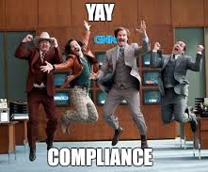
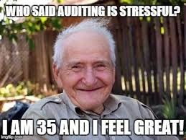
What thoughts/feelings do you have when someone mentions your study is going to be audited/monitored?

Slide 21
Purpose:
Study-specific information is discussed with the PI/study team
Training of the study team
Reassess resources and capabilities of the site to conduct the research study
Site Initiation Visit

Slide 22
Monitoring
Ongoing process conducted before, during, and after the trial
Classified in four distinct types of visits
Pre-initiation
Initiation
Routine/Interim
For cause
Close out

Slide 23
Interim Monitoring Visits
Occurs after the site is initiated and up until the site is closed out
Purpose:
Assess the progress of the trial
Assess the accuracy, completeness and verification of Essential documents/data
ICF, CRFs, source documentation, Regulatory binder, AEs/SAEs, IP accountability
Ensure compliance
Verify subject safety and well-being
Confirm action items from previous visits have been completed

Slide 24
Preparation
Secure
Secure a private/ample/
quiet workspace for the monitor with a phone/ internet connection/
copier
Locate and have
Locate and have available all of the research records/
Essential Documents
Ensure
Ensure all of the action items from the previous monitoring letter has been addressed
Assure
Assure a study team member is available throughout the monitoring visit for questions and collecting of additional information
Schedule
Schedule times for the following:
Meeting with the PI
Visit to the pharmacy and with the pharmacist if IP is stored there
Tour of any facilities if requested by the monitor

Slide 25
How to Ensure a Successful Monitoring Visit
Conduct/
Document knowing someone will be reviewing and will understand what has occurred
Prepare for the Visit
Keep up to date, enter data in a timely manner
Demonstrate flexibility in scheduling dates when possible
Communicate with the Site Staff/Monitor
Complete action items from previous monitoring visits as soon as possible
Answer queries in a timely fashion, preferably within 24 hours

Slide 26
Close Out Visit
Purpose:
To terminate all study procedures at a site
Occurs after study completion or site withdrawal

Slide 27

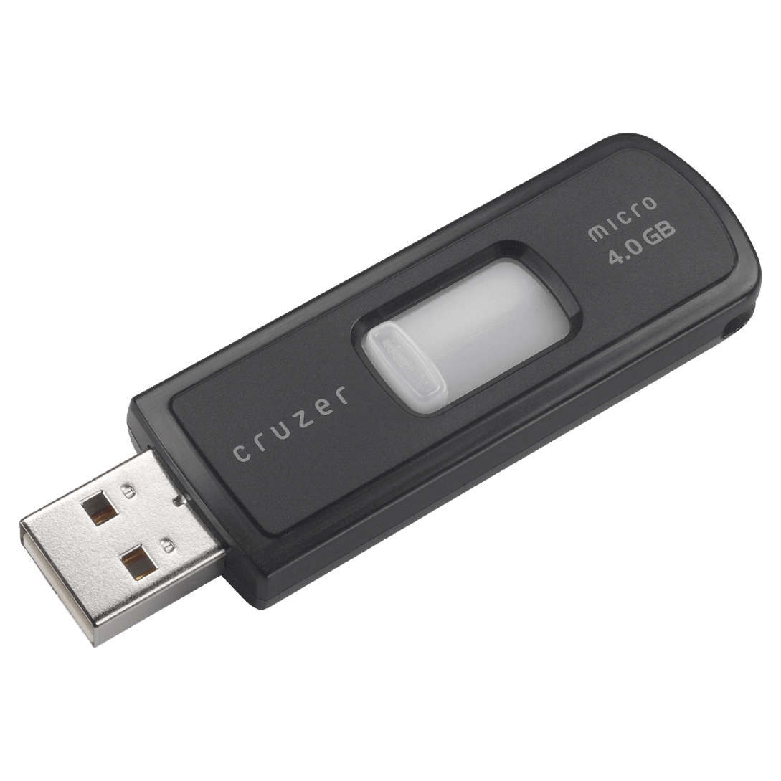

Close-out Visits Include
Signing of the monitoring log
Final data/Essential documents are reviewed/collected by the monitor
IP resolution, return/destruction
Confirmation that AEs/SAEs have been documented in data collection forms and reported appropriately
Confirmation that all lab samples have been shipped, as applicable, and appropriately stored
Confirmation of study record storage location and that PI is aware of applicable record retention policies and possibility of audits by a regulatory agency or other group in future
Submission of the IRB submission for closure of the study

Slide 28

FDA Inspections

Slide 29
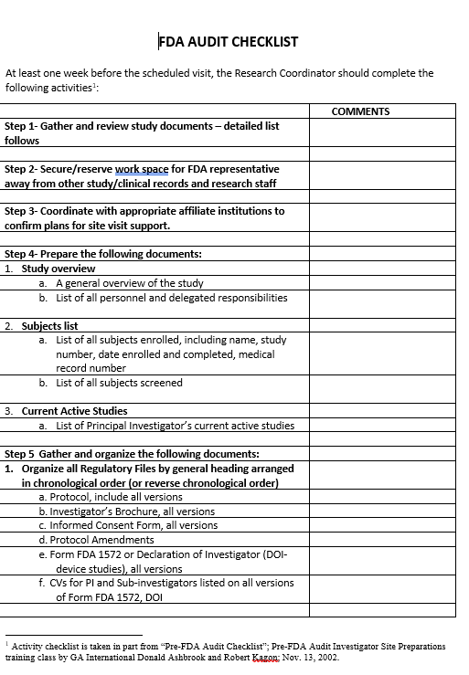
The University of Texas Health Science Center at Houston (UTHealth Houston)Clinical Trials Resource Center (CTRC)

Slide 30
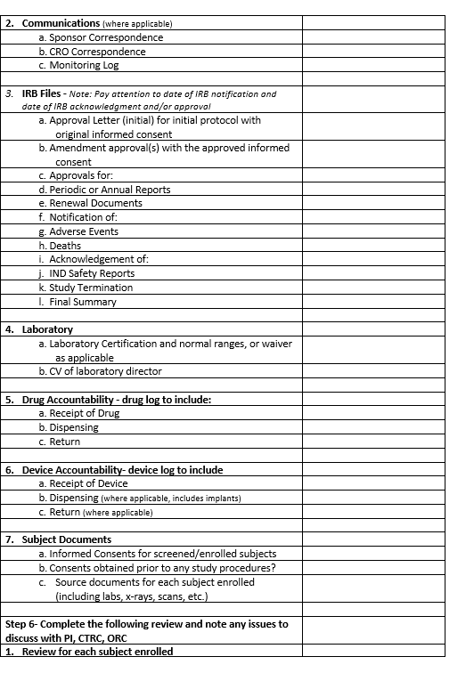

Slide 31
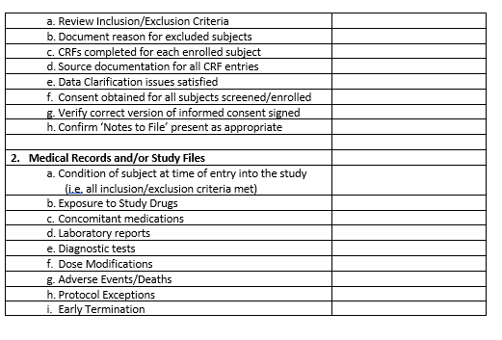

Slide 32
Arrival of Inspector
Notification that the FDA is conducting an inspection at the site for the clinical trial
Have the inspector sign in
Assign an escort for the inspector. This person will walk the inspector to an appropriate meeting room
The inspector will present his/her credentials to verify that they are in order
A Notice of Inspection (482) should be presented by the inspector to the Principal Investigator
The inspector will explain the intended purpose and scope of the inspection

Slide 33
Inspection
Schedule a comfortable work area for the FDA inspector(s) for the duration of the inspection
The room must contain no confidential records, including clinical or research related
The inspector should be accompanied by the escort or designee at all times while in the presence of study related documents, samples, or other confidential information
If the inspector needs to make a phone call and requires some privacy, they should have access to a room with no study related information or public area where they can conduct their business
In general, while an inspector is here in an official capacity, they should not be left alone
The inspector must never have access to any site records not specifically provided by the site representative(s)
Study finances and personnel records are not included in the standard inspection
The Principal Investigator should set aside time each day to talk with the inspector, as well as being available for questions that may arise

Slide 34
When Asked Questions by the Inspector
Escort’s Role
Listen to the question
Answer the question that was asked
Defer to others if you don't know
When possible use documents already provided for support of answers
Stop when the question is fully answered
When you have answered, wait for the next questions
Do not provide additional information once the question is answered
Coordinate all FDA requests and see that the inspector’s questions are answered honestly and completely

Slide 35
How to Answer the FDA Inspector’s Questions
Be concise; answer only the question that is asked, do not elaborate or give additional answers
Be clear when answering to questions, do not guess or speculate
Be confident and convincing
Correct any deficiencies/missing information as soon as possible
Tell the truth
Stay calm
Do not sign affidavits/agreements

Slide 36
Inspection of Documents
Escort the inspector to a private/isolated room away from others
Only provide the inspector the documents they specifically request
The escort will gather the documents requested for review and bring the requested documents to the inspector
When documents are copied for inspectors, maintain a copy for the site or identify each copied document by maintaining an inspection record log
All copies provided should be stamped “Confidential”
The following documents should not be viewed or copied by the inspector: financial, personnel (except for training/qualification records), and internal audits

Slide 37
Exit Interview
Held at the conclusion of the inspection
Attendees: Escort, Principal Investigator, a representative from Institutional Compliance, and other individuals as appropriate should be notified of the time and place and expect to attend
If serious deficiencies have been found during the inspection, an Inspectional Observations form 483 will follow from the regional office, listing the deficiencies
If no deficiencies are found, or the inspector has comments that she or he believes are not serious enough to warrant a 483, no form will be issued
The Principal Investigator will seek to correct any errors in the findings
Both the FDA inspector and Principal Investigator will make sure everything is clear and understood
Observations, comments, and commitments will be noted in the escort inspection notes

Slide 38
Response to FDA 483
The PI or designated shall draft a response to an FDA 483
The written response should include specifics:
Determine if a finding was an oversight/one-time occurrence; or systemic, where a change of procedure is indicated
Delineate corrective actions: including justification of why the proposed response will remediate the issue; and a realistic timeline for correction
If the PI disagrees with an observation: respond factually, providing clear and verifiable evidence
Address each particular observation or finding, point by point
The reply should be sent within two weeks. Keep a copy of the final signed response in your office

Slide 39
Most Common FDA Findings
Failure to:
Conduct the investigator in accordance with the investigator statement or agreement, investigational plan, and applicable regulations
Perform the ICP adequately
Comply to the FDA 1572 requirements
Record/Maintain adequate case history and subject records
Enroll eligible subjects
Provide adequate accountability and disposition records for the investigational product
Protect the rights and safety of clinical trial subjects, specifically failing to obtain informed consent in accordance with 21 CFR Part 50

Slide 40
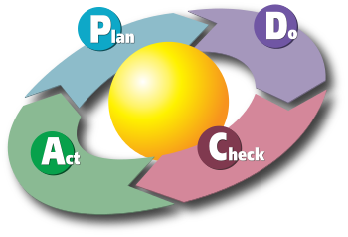
Corrective and Preventive Action
CAPA

Slide 41
What is a CAPA?
Corrective and Preventive Action
CAPA is
a system/process for resolving quality issues and prevention of repeat occurrences

Slide 42
Corrective Action According to the FDA
The FDA indicates that corrective action plans are absolutely necessary to resolve some issues
Eliminate/reduce future problems and non-compliance in clinical investigations
Steps taken to resolve a problem and preventive actions are those actions that keep the problem from recurring
Action/process to eliminate the cause of a detected non-conformity or other undesirable situation

Slide 43
CAPA Process
IDENTIFY
IDENTIFY the issue/event/deviation
EVALUATE
EVALUATE the extent of the issues and ASSESS the risk of harm for subjects
CORRECT
CORRECT the issue: develop REACTIVE steps to correct the immediate problem
UNDERSTAND
UNDERSTAND the issue: IDENTIFY and ANALYZE the underlying cause(s) and extent of the problem(s)

Slide 44
CAPA Process
DETERMINE needed change/actions, PREVENT future issues: be PROACTIVE
DEVELOP/IMPLEMENT the CAPA in a clear and concise manner
COMMUNICATE/REPORT/DISSEMINATE information to appropriate persons/authorities, including training
EVALUATE processes for effectiveness (this is never ending)
CLOSURE of CAPA

Slide 45
Root Cause Analysis (RCA)
A root cause analysis (RCA) is the process of identifying and documenting the root cause and the downstream effect on the causal chain
RCA should focus on identifying underlying problems that contribute to error rather than focusing on mistakes made by individuals

Slide 46
Root Cause Analysis
Develop a root cause analysis as soon as possible after the event/issue has been identified
Collect information from all individuals involved with the event
Review current processes
What happened? Identify the issue/event
Why and how did the issue occur? What were the steps leading up to the event?
Who/what was affected by the issue?
Any risks to the subject(s)/data integrity?
How often did the issue occur?
Are you identifying a trend?
How serious was the event?
Keep asking “who, what when, where, and how” until you reach the root cause
Ask WHY 5 times until it can’t be asked again

Slide 47
From Emory University
CAPAs must be thorough (SMART CAPA)
Specific: Compliant with regulations, addresses the full observation or root cause, accountable to named individual or role
Measurable: Action can be measured to demonstrate whether it is adequate to address root cause
Achievable: Addresses all implicated processes and levels
Realistic: Plan can be carried out given resources, knowledge and expertise
Time-bound: Assigned to a person or role who can accomplish action in a given time period, addresses urgency and criticality

Slide 48
Best Practices
SHOULD BE WRITTEN TO EXPLAIN AN ERROR AND RESOLUTION TO THE ISSUES IN A FORWARD THINKING MANNER
A CAPA SHOULD BE WRITTEN ON DEPARTMENT/
INSTITUTION FORM
SHOULD BE MAINTAINED AS AN ESSENTIAL DOCUMENT IN THE REGULATORY FILE
SHOULD BE SIGNED/DATED BY THE AUTHOR AND THE PI
TAKE RESPONSIBILTY FOR THE ERROR/EVENT/
ISSUE
Make sure to DO WHAT YOU SAY YOU WILL DO
APPROPRIATELY ASSESS CAUSES OF THE PROBLEM
TRAIN STAFF ON NEW PROCESSES
EVALUATE TO ENSURE YOUR CAPA WORKS
DOCUMENT EVERY STEP OF YOUR CAPA

Slide 49


Slide 50

The following statements are true of the FDA 483 form except
A. Notifies the company’s management of objectionable conditions
B. Is presented at the conclusion of an inspection
C. All objectionable conditions that exist are cited on the FDA Form 483 at the conclusion of the inspection
D. All conditions listed on the 483 are discussed at the conclusion of the inspection. Each observation is read and discussed so that there is a full understanding of what the observations are and what they mean

Slide 51
What is the FDA form 482 for?
  A. Notice of Inspection
  B. Findings of Inspection
  C. Declaration of Financial Interests and Arrangements
  D. Certification of Financial Interests and Arrangements

Slide 52
Who is responsible for monitoring the progress of all clinical trial investigations being conducted under its IND?
  A. The Principal Investigator
  B. The Institutional Review Board
  C. The Sponsor
  D. The CRO

Slide 53
Which of the following are necessary elements of a CAPA for repeat deviations?
Re-training for every CAPA
Root cause analysis for every CAPA
System change for every CAPA
D. All of the above
E. A. and B

Slide 54
Monitors are appointed by the _____.
A. Sponsor
B. Principal Investigator
C. FDA
D. CRO

Slide 55
According to ICH GCP, a monitoring report is optional after each trial-site visit or trial-related communication.
True
False

