Slide 1
CERTIFICATION EXAM PREPARATION COURSE
Session 16:
Informed Consent, Part 2

Slide 2

A quick review of last session
Notes:
Part 1 of our sessions for informed consent included the essential elements of the informed consent, the process of obtaining informed consent, OHRP and FDA regulations regarding waiver and alterations of consent, and we discussed some terms like exculpatory language, undue influence and coercion. So if you didn’t join us for that session, it is available on the website. And that websits is in the our study guide.

Slide 3
The Nine Essential Elements of the ICF
Research, Purposes, duration, Procedures and which are experimental
Risks or discomfort
Benefits
Alternative procedures or course of treatment
Confidentiality of research records
For more than minimal risk studies, an explanation as to whether any compensation is available if injury occurs.
Contact
Voluntarism with no penalty
One of the following statement about identifiable private information or biospecimens
Identifiers might be removed and used for future research
Information ever if identifiers are removed will not be used for future research
Notes:
Let’s review the nine essential elements of the ICF

Slide 4
Additional Elements of Informed Consent
Risks if the subject is or may become pregnant
Circumstances under which the subject’s participation may be terminated by the PI
Additional costs to the subject
Consequences of a subject’s decision to withdraw
New findings that may affect willingness to participate
Approximate number of subjects
A statement that the subject’s biospecimens (even if identifiers are removed) may be used for commercial profit and whether the subject will or will not share in this commercial profit;
A statement regarding whether clinically relevant research results, including individual research results, will be disclosed to subjects, and if so, under what conditions; and
For research involving biospecimens, whether the research will (if known) or might include whole genome sequencing (i.e., sequencing of a human germline or somatic specimen with the intent to generate the genome or exome sequence of that specimen).
Notes:
Let’s review the nine additional elements that should be included in the ICF if appropriate.

Slide 5
Under what conditions can an IRB grant a waiver or alteration of the consent process under 45 CFR 46?
The research involves no more than minimal risk to the subjects
The research could not practicably be carried out without the requested waiver or alteration
If the research involves using identifiable private information or identifiable biospecimens, the research could not practicably be carried out without using such information or biospecimens in an identifiable format
The waiver or alteration will not adversely affect the rights and welfare of the subjects
Whenever appropriate, the subjects or legally authorized representatives will be provided with additional pertinent information after participation
Notes:
Let’s review the conditions under OHRS guidelines when the consent process can be altered or waived.
Read the slide.

Slide 6
Under what conditions can an IRB grant a waiver or alteration of the consent process under 21 CFR 50?
21 CFR 50.23: Emergency use of a test article
21 CFR 50.24: Emergency research
21 CFR 50.23: President of the United States can waive informed consent for an investigational drug for a member of the armed forces
Notes:
Let’s review when the FDA can grant waiver or alteration of consent under 21 CFR 50. Read the slide.

Slide 7
Short Forms
The federal regulations at 45 CFR 46.117 (b) (2) and 21 CFR 50.27 (b) (2) permit the use of a short form consent document stating that the required elements of informed consent have been presented to the subject or the subject’s legally authorized representative orally, with a witness present.
The Short Form Consent process is an alternative to using a translated study consent form when the investigator does not have an IRB approved translated consent form. Your institution may have procedures for when a short form may be used.
Notes:
Last session we discussed the process when using the long consent form procedure. Now we need to discuss an alternative to this process and it is called the short consent form.
Derita, will you please go over when a short form may be used.

Slide 8
Short Form Procedure
A short form written informed consent form stating that the elements of informed consent required by §46.116 have been presented orally to the subject or the subject’s legally authorized representative, and that the key information required by §46.116(a)(5)(i) was presented first to the subject, before other information, if any, was provided.
The IRB shall approve a written summary of what is to be said to the subject or the legally authorized representative. When this method is used, there shall be a witness to the oral presentation.
Only the short form itself is to be signed by the subject or the subject's legally authorized representative.
However, the witness shall sign both the short form and a copy of the summary.
The person actually obtaining consent shall sign a copy of the summary.
A copy of the summary shall be given to the subject or the subject’s legally authorized representative, in addition to a copy of the short form.
Notes:
The short form procedure is as follows: The short form written informed consent stating that the elements of informed consnet required by 46.116 have been presented orally. The IRB will approve the summary. Only the short form itself is to be signed by the subject or LAR. The witness shall sign both the short form and a copy of the summary. The person actually obtaining consent shall sign a copy of the summary. A copy of the summary shall be given to the subject or the subjects’ LAR in addition to a copy of the short form.

Slide 9
Short Form Example
You are being asked to participate in a research study.
Before you agree, the investigator must tell you about (i) the purposes, procedures, and duration of the research; (ii) any procedures which are experimental; (iii) any reasonably foreseeable risks, discomforts, and benefits of the research; (iv) any potentially beneficial alternative procedures or treatments; and (v) how confidentiality will be maintained.
Where applicable, the investigator must also tell you about (i) any available compensation or medical treatment if injury occurs; (ii) the possibility of unforeseeable risks; (iii) circumstances when the investigator may halt your participation; (iv) any added costs to you; (v) what happens if you decide to stop participating; (vi) when you will be told about new findings which may affect your willingness to participate; and (vii) how many people will be in the study.
If you agree to participate, you must be given a signed copy of this document and a written summary of the research.
You may contact (name) at (phone number) any time you have questions about the research.
You may contact (name) at (phone number) if you have questions about your rights as a research subject or what to do if you are injured.
Your participation in this research is voluntary, and you will not be penalized or lose benefits if you refuse to participate or decide to stop.
Signing this document means that the research study, including the above information, has been described to you orally, and that you voluntarily agree to participate.
Signature of participant ___________
date___________
Signature of witness ___________
date___________
Notes:
Here is an example of a short form. Read the key elements.
NIH has translated copies of short forms in so many languages that can be downloaded and approved by your IRB. So if you had a person that only spoke Laotian, then this standardized copy of the short form in Laotian could be approved by the IRB. The main consent form could be explained by the translator which could indeed be the witness. The short form would be signed by the subject or LAR and witness. The main consent form would be signed by the witness and the person obtaining the consent.

Slide 10
Short Form Procedure
Both OHRP and FDA
Short form: Signed by Subject or Representative and Witness
Consent summary: Signed by Witness and Person obtaining consent
Copy of the short form and the summary to be given to subject or the representative
Notes:
Both OHRP and FDA have the same requirements for signatures and copies given to subjects. Read the slide.

Slide 11

Assent
    Definition: The expression of approval or agreement. Antonyms: Dissent from; refuse
    Two populations where assent would be obtained:
    Children who have not reached legal age
    Adults with diminished cognitive abilities.
Notes:
We talked about consent in our first session, but we also need to discuss assent. Read the slide.

Slide 12

For Children Who Have Not Reached Legal Age
OHRP and FDA: Assent means a child’s affirmative agreement to participate in research. Mere failure to object, absent affirmative agreement, should not be construed as assent.
Notes:
We discussed the definition of assent in the previous slide, but it is important to know that the mere failure to object does not mean that a subject has agreed to participate. Also, if there is any non-verbal sign of unwillingness to participate, the investigator must take this as a sign of dissent or refusal to enroll.

Slide 13
For Children Who Have Not Reached Legal Age
Permission:
OHRP: the agreement of parent(s) or legal guardian(s) to the participation of their child or ward of the state in research.
FDA: the agreement of parent(s) or guardian to the participation of their child or ward in a clinical investigation.
Notes:
Now we must discuss the concept of Permission. A child gives assent to participate in a research study, a parent gives permission. And permission is defined as: Read the slide.

Slide 14
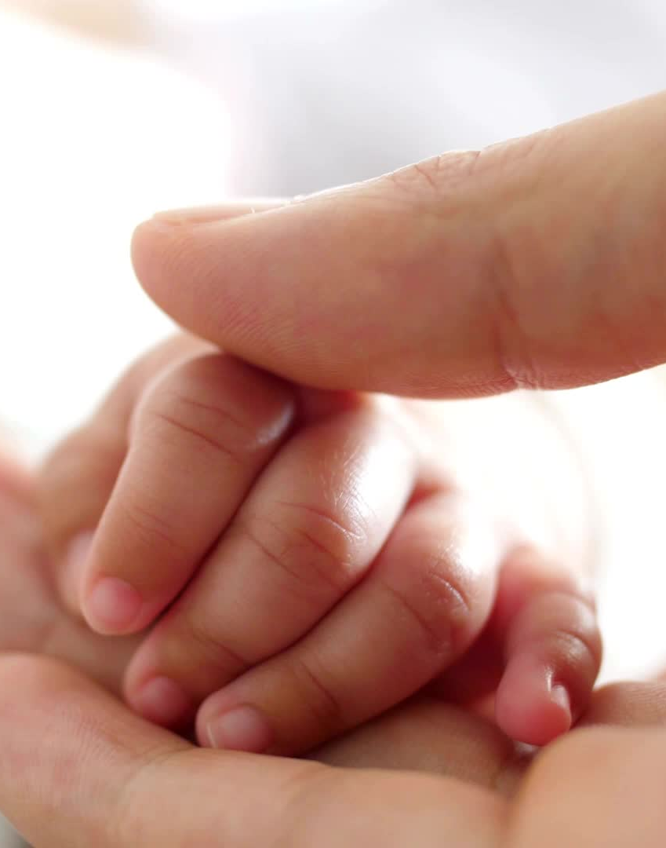
For Children Who Have Not Reached Legal Age
OHRP and FDA: Parent means a child’s biological or adoptive parent.
Notes:
For both OHRP and FDA, parents mean a child’s biological or adoptive parent.

Slide 15
Guardian
45 CFR 46.402(e) and 21 CFR 50.3
Guardian means an individual who is authorized under applicable State or local law to consent on behalf of a child to general medical care.
Notes:
And for both OHRP and FDA, guardian means. Read the slide.

Slide 16
Cognitively Impaired Adults
Dementia or Alzheimer’s disease
Other intellectual disabilities such as mood disorders, schizophrenia, autism
Those who are temporarily unable to make decisions for themselves, such as medical conditions like trauma, care in the intensive care unit, or stroke
Substance abuse
Anorexia
Notes:
So let’s talk about adults who do not have decision-making abilities. Some examples could be: Read the slide.

Slide 17
Legally Authorized Representative
45 CFR 46. 102 (c), Legally authorized representative means an individual or judicial or other body authorized under applicable law to consent on behalf of a prospective subject to the subject’s participation in the procedure(s) involved in the research. If there is no applicable law addressing this issue, legally authorized representative means an individual recognized by institutional policy as acceptable for providing consent in the nonresearch context on behalf of the prospective subject to the subject’s participation in the procedure(s) involved in the research.
FDA 21 CFR 50.3, Legally authorized representative means an individual or judicial or other body authorized under applicable law to consent on behalf of a prospective subject to the subject's participation in the procedure(s) involved in the research.
Notes:
For the cognitively impaired potential subject, a legally authorized representative must give consent for study participation.
Derita, would you read the definitions, please?

Slide 18
45 CFR 46 (OHRP)
Subpart A
Subpart B
Subpart C
Subpart D
Common
Rule
Pregnant Women Human Fetuses, and Neonates
Additional Protections Pertaining to Biomedical and Behavioral Research Involving Prisoners and Subjects Comparison
Additional Protections Pertaining to Biomedical and Behavioral Additional Protections Pertaining to Biomedical and Behavioral Research Involving Prisoners as Subjects
Pertaining to Biomedical and Behavioral Research Involving Prisoners as Subjects
ects
What are they exposed to?
Additional Protections for Children Involved as Subjects in Research
Notes:
Let’s go back a minute and examine the subparts of 45 CFR 46. Part A is the common rule where regulations regarding informed consent and IRB review can be found. OHRP has specific regulations for vulnerable subjects. Part B is for Pregnant Women, Human Fetuses, and Neonates., Part C is for Prisoners, and Part D is for children. For the remainder of this presentation, we are going to look at the criteria regarding their participation in research and then focus on how consent is obtained because the criteria and the consent process go hand-in hand.

Slide 19
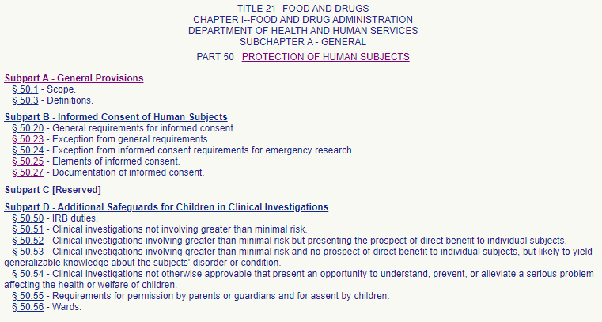
Notes:
And we will review the FDA regulations regarding safeguards of children in clinical investigations. Remember FDA does not have regulations regarding inclusion of pregnant women, human fetuses, and neonates. Take a moment to refresh your memory regarding the FDA subparts.

Slide 20


Notes:
First, let’s talk about Pregnant Women, Human Fetuses, and Neonates.

Slide 21
45 CFR 46 Subpart B
Research involving pregnant women or fetuses
Pregnant women or fetuses may be involved in research if all of the following conditions are met:
(a) Where scientifically appropriate, preclinical studies, including studies on pregnant animals, and clinical studies, including studies on nonpregnant women, have been conducted and provide data for assessing potential risks to pregnant women and fetuses;
(b) The risk to the fetus is caused solely by interventions or procedures that hold out the prospect of direct benefit for the woman or the fetus; or, if there is no such prospect of benefit, the risk to the fetus is not greater than minimal and the purpose of the research is the development of important biomedical knowledge which cannot be obtained by any other means;
Notes:
We are going to cover many regulations going forward. You may have a question on the certification test regarding when pregnant women or fetuses may be involved in research. The first criteria is that preclinical studies must have been done to assess risks. The 2nd is that there is a prospect of direct benefit for the woman or fetus. If there isn’t a prospect of benefit, the research the risk to the fetus is not greater than minimal and the purpose of the research is to find out important biomedical knowledge which can’t be obtained by other means.

Slide 22
45 CFR 46 Subpart B
Research involving pregnant women or fetuses
(c) Any risk is the least possible for achieving the objectives of the research;
(d) If the research holds out the prospect of direct benefit to the pregnant woman, the prospect of a direct benefit both to the pregnant woman and the fetus, or no prospect of benefit for the woman nor the fetus when risk to the fetus is not greater than minimal and the purpose of the research is the development of important biomedical knowledge that cannot be obtained by any other means, her consent is obtained in accord with the informed consent provisions of subpart A.
Notes:
The 3rd criteria is that the risk of the research is the least possible for the objectives of the research. The fourth is that---read the slide.
Remember this part---if the risk to the fetus is not greater than minimal only one consent ----the mother’s is needed.

Slide 23
45 CFR 46 Subpart B
Research involving pregnant women or fetuses
(e) If the research holds out the prospect of direct benefit solely to the fetus then the consent of the pregnant woman and the father is obtained in accord with the informed consent provisions of subpart A, except that the father's consent need not be obtained if he is unable to consent because of unavailability, incompetence, or temporary incapacity or the pregnancy resulted from rape or incest.
(f) Each individual providing consent under paragraph (d) or (e) of this section is fully informed regarding the reasonably foreseeable impact of the research on the fetus or neonate.
Notes:
The 5th criteria is that if the research holds out the prospect of benefit solely to the fetus that consent must be obtained from the mother and the father unless the father is unavailable is incompetent, or has temporary incapacity or the pregnancy resulted from rape or incest.
The last criteria on this slide regarding the research impact on the fetus or neonate is that each individual providing consent is fully informed.

Slide 24
45 CFR 46 Subpart B
Research involving pregnant women or fetuses
(g) For children as defined in §46.402(a) who are pregnant, assent and permission are obtained in accord with the provisions of subpart D;
(h) No inducements, monetary or otherwise, will be offered to terminate a pregnancy;
(i) Individuals engaged in the research will have no part in any decisions as to the timing, method, or procedures used to terminate a pregnancy; and
(j) Individuals engaged in the research will have no part in determining the viability of a neonate.
Notes:
More criteria. Read the slide.

Slide 25
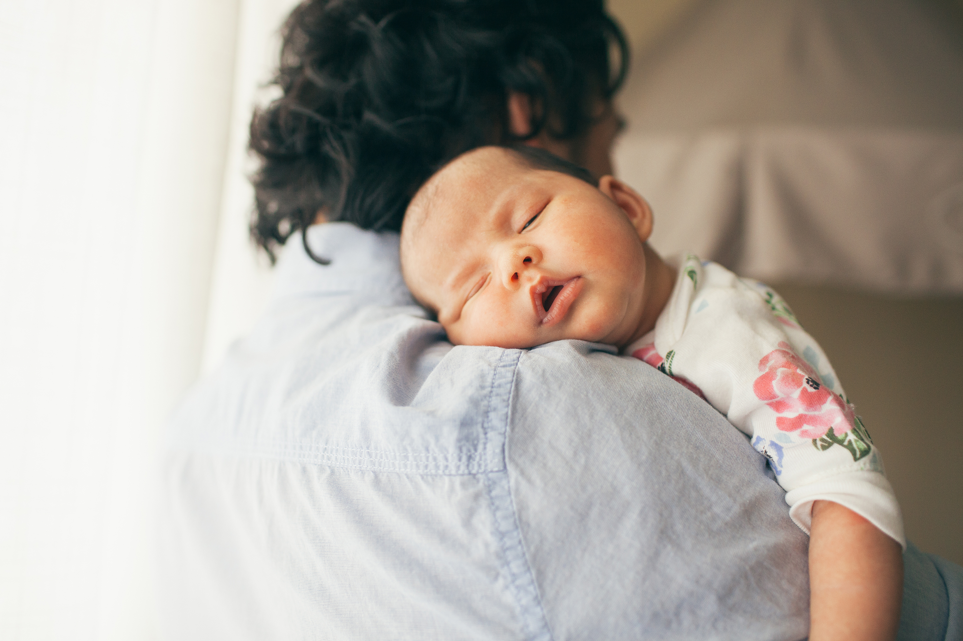
Research involving neonates
Notes:
We will now talk about research in neonates. And we will read more regulations. I promise, we have to do that.

Slide 26
Definitions
Neonate means a newborn.
Viable, as it pertains to the neonate, means being able, after delivery, to survive (given the benefit of available medical therapy) to the point of independently maintaining heartbeat and respiration.
Nonviable neonate means a neonate after delivery that, although living, is not viable.
Notes:
Let’s look at the definitions for a neonate. Derita, will you please go over these?

Slide 27
45 CFR 46 Subpart B
Research involving neonates
Neonates of uncertain viability and nonviable neonates may be involved in research if all of the following conditions are met:
(1) Where scientifically appropriate, preclinical and clinical studies have been conducted and provide data for assessing potential risks to neonates.
(2) Each individual providing consent of this section is fully informed regarding the reasonably foreseeable impact of the research on the neonate.
(3) Individuals engaged in the research will have no part in determining the viability of a neonate.
Notes:
The following criteria have to be met when neonates are involved in research. Read the slide.

Slide 28
45 CFR 46 Subpart B
Research involving neonates of uncertain viability
Until it has been ascertained whether or not a neonate is viable, a neonate may not be involved in research covered by this subpart unless the following additional conditions have been met:
The IRB determines that:
The research holds out the prospect of enhancing the probability of survival of the neonate to the point of viability, and any risk is the least possible for achieving that objective, or
The purpose of the research is the development of important biomedical knowledge which cannot be obtained by other means and there will be no added risk to the neonate resulting from the research
Notes:
Until it has been determined whether or not a neonate is viable, the neonate may not be involved in the research until the IRB determines the research holds the prospect of enhancing the probability of survival of the neonate, the risk is the least possible, and the purpose of the research is for important biomedical knowledge which could not be obtained by other means and there is no added risk to the neonate.

Slide 29
45 CFR 46 Subpart B
Research involving neonates of uncertain viability
The legally effective informed consent of either parent of the neonate or, if neither parent is able to consent because of unavailability, incompetence, or temporary incapacity, the legally effective informed consent of either parent's legally authorized representative is obtained in accord with subpart A except that the consent of the father or his legally authorized representative need not be obtained if the pregnancy resulted from rape or incest.
Notes:
How is informed consent obtained in research involving neonates of uncertain viability? It should be obtained unless there is unavailiabiltiy, incompetetnce or temporary incapacity from either parent. If that is the case, then the Legally Authorized Representative’s consent is sought. The consent of the father or the LAR of the father is not sought if the pregnancy resulted from rape or incest.

Slide 30
45 CFR 46 Subpart B
Research involving neonates of uncertain viability
Nonviable neonates. After delivery nonviable a neonate may not be involved in research covered by this subpart unless all of the following additional conditions are met:
(1) Vital functions of the neonate will not be artificially maintained;
(2) The research will not terminate the heartbeat or respiration of the neonate;
(3) There will be no added risk to the neonate resulting from the research;
(4) The purpose of the research is the development of important biomedical knowledge that cannot be obtained by other means
Notes:
After delivery, a nonviable neonate cannot be involved in research unless the following criteria are met. Vital functions will not be artificially maintained; the research will not terminate the heartbeat, there will be no added risk and there is important biomedical knowledge that can’t be obtained otherwise.

Slide 31
Research involving, after delivery, the placenta, the dead fetus or fetal material
Research involving, after delivery, the placenta; the dead fetus; macerated fetal material; or cells, tissue, or organs excised from a dead fetus, shall be conducted only in accord with any applicable federal, state, or local laws and regulations regarding such activities.
Notes:
Research involving the placenta, the dead fetus, macerated (changes in skin and tissues) fetal material or cells, tissue, or organs that come from a dead fetus shall be conducted in accord with federal state or local laws.

Slide 32
Consent for 45 CFR 46 Subpart B
Research not otherwise approvable which presents an opportunity to understand, prevent, or alleviate a serious problem affecting the health or welfare of pregnant women, fetuses, or neonates.
The Secretary will conduct or fund research that the IRB does not believe meets the requirements of §46.204 or §46.205 only if:
(a) The IRB finds that the research presents a reasonable opportunity to further the understanding, prevention, or alleviation of a serious problem affecting the health or welfare of pregnant women, fetuses or neonates; and
(b) The Secretary, after consultation with a panel of experts in pertinent disciplines (for example: science, medicine, ethics, law) and following opportunity for public review and comment, including a public meeting announced in the FEDERAL REGISTER, has determined either:
(1) That the research in fact satisfies the conditions of §46.204, as applicable; or
(2) The following:
(i) The research presents a reasonable opportunity to further the understanding, prevention, or alleviation of a serious problem affecting the health or welfare of pregnant women, fetuses or neonates;
(ii) The research will be conducted in accord with sound ethical principles; and
(iii) Informed consent will be obtained in accord with the informed consent provisions of subpart A and other applicable subparts of this part.
Notes:
There is always the kind of research that the IRB can’t approve according the previous regulations so the Secretary (of HHS) may approve research after consulting with experts and can verity that the research presents understanding, prevention, or alleviation of a serious problem, the research will be conducted ethically, and informed consent will be obtained.

Slide 33

Notes:
Let’s move on to the regulations concerning prisoners.

Slide 34
45 CFR 46 Subpart C:
Additional duties of the Institutional Review Boards where prisoners are involved
46.306 Permitted research involving prisoners---only if the IRB has certified to the Secretary that it has approved the research and that in the judgement of the Secretary the research solely involves:
Study of the possible causes, effects, and processes of incarceration, and of criminal behavior,
Study of prisons as institutional structures or of prisoners as incarcerated persons
Research on conditions particularly affecting prisoners as a class (for example, vaccine trials and other research on hepatitis which is much more prevalent in prisons than elsewhere;
Research on practices, both innovative and accepted, which have the intent and reasonable probability of improving the health or well-being of the subject.
Notes:
Prisoners can only be involved in research after the Secretary (that means the office of HHS) has approved it.
Read the conditions.

Slide 35
45 CFR 46 Subpart C:
Additional duties of the Institutional Review Boards where prisoners are involved
In addition to all other responsibilities prescribed for Institutional Review Boards under this part, the Board shall review research covered by this subpart and approve such research only if it finds that:
(1) The research under review represents one of the categories of research permissible under §46.306(a)(2) (the criteria on the previous slide)
(2) Any possible advantages accruing to the prisoner through his or her participation in the research, when compared to the general living conditions, medical care, quality of food, amenities and opportunity for earnings in the prison, are not of such a magnitude that his or her ability to weigh the risks of the research against the value of such advantages in the limited choice environment of the prison is impaired;
(3) The risks involved in the research are commensurate with risks that would be accepted by nonprisoner volunteers;
Notes:
If the IRB approves the research and it is OK with HHS, then the IRB must also make sure that there are not advantages for a prisoner to participate in the research--such as improved living conditions, medical care, quality of food, etc. And those advantages would not impair the judgement to participate---in other words. What would this be a considered---not coercion---but Yes, undue influence.

Slide 36
45 CFR 46 Subpart C:
Additional duties of the Institutional Review Boards where prisoners are involved
(4) Procedures for the selection of subjects within the prison are fair to all prisoners and immune from arbitrary intervention by prison authorities or prisoners. Unless the principal investigator provides to the Board justification in writing for following some other procedures, control subjects must be selected randomly from the group of available prisoners who meet the characteristics needed for that particular research project;
(5) The information is presented in language which is understandable to the subject population;
(6) Adequate assurance exists that parole boards will not take into account a prisoner's participation in the research in making decisions regarding parole, and each prisoner is clearly informed in advance that participation in the research will have no effect on his or her parole; and
(7) Where the Board finds there may be a need for follow-up examination or care of participants after the end of their participation, adequate provision has been made for such examination or care, taking into account the varying lengths of individual prisoners' sentences, and for informing participants of this fact.
Notes:
There are Additional considerations for the IRB when approving prisoner research----Selection is fair and control subjects must be selected randomly.
The information is presented in an understandable way.
Parole is not a consideration when a subject agrees to participate.
The consent is in a language that is understandable. An example: One time I reviewed a consent form that continuously talked about the clinical trial. The word “trial” was used hundred of times. So what do you think “trial” means to a prisoner. “Research study’” would have been a more appropriate term to use.
Adequate care will be provided after the study has been completed.

Slide 37

Notes:
The next part of this discussion we will talk about 45 CFR 46 Part D. And 21 CFR 50 Subpart D (the FDA regulations) Research in children.

Slide 38
45 CFR 46 and 21 CDR 50 Subpart D:
Additional Protections for Children Involved as Subjects in Research
45 CFR 46.404 and 21 CFR 50.51-- Research not involving greater than minimal risk.
45 CFR 46.405 and 21 CFR 50.52---Research involving greater than minimal risk but presenting the prospect of direct benefit to the individual subjects.
45 CFR 46.406 and 21 CFR 50.53--- Research involving greater than minimal risk and no prospect of direct benefit to individual subjects, but likely to yield generalizable knowledge about the subject's disorder or condition.
45 CFR 46.407 and 21 CFR 50.54 Research not otherwise approvable which presents an opportunity to understand, prevent, or alleviate a serious problem affecting the health or welfare of children.
Notes:
There are four different kinds of research that is approvable for children to participate in research. 46.404 and 50.51 (the first one at the top. Research not involving greater than minimal risk. Let’s take a minute to refresh our memory regarding the definition of minimal risk. Go to the next slide.
An example of a study like this would be one where growth patterns are observed I children.
The 2nd category is 45 CFR 46.405 and 50.52 which is research greater than minimal risk but presenting the prospect of direct benefit. An example of this kind of study would be a child involved in an investigational drug study to possibly improve control of seizures.
The 3rd kind of study would be described in 45 CFR 46.406 and 21 CFR 50.53. Greater than minimal risk and no prospect of direct benefit. This could be a study about pharmacokinetics or drug levels when multiple blood draws would need to be done over the course of a day. There is no benefit to participating in this study.
And lastly, research not otherwise approval (45 CFR 46.407 and 21 CFR 50.54) but HHS could approve it if there is knowledge to be gained.

Slide 39
Minimal Risk
45 CFR 46
21 CFR 50
Minimal risk means that the probability and magnitude of harm or discomfort anticipated in the research are not greater in and of themselves than those ordinarily encountered in daily life or during the performance of routine physical or psychological examinations or tests.

Slide 40
Assent
The IRB will determine:
The children’s capabilities of providing assent according to ages, maturity and psychological state of the children involved
If the IRB determines that the capability of some or all of the children is so limited and the research holds out a prospect of direct benefit that is important to the health or well-being of the children and is available only in the context of the research, the assent of the children is not a necessary condition for proceeding with the research.
The IRB may waive assent in some cases.
Notes:
The IRB is responsible for determining how assent will be obtained. They look at age, maturity level, and psychological state of children. The Irb may determine that if the capability of some or all of the children is limited and there is the prospect of direct benefit, the IRB may decide that assent is not necessary. The IRB can waive assent altogether in some cases.

Slide 41
45 CFR 46 and 21 CFR 50 Subpart D
Additional Protections for Children Involved as Subjects in Research
45 CFR 46.404 and 21 CFR 50.51: Research not involving greater than minimal risk.
45 CFR 46.405 and 21 CFR 50.52: Research involving greater than minimal risk but presenting the prospect of direct benefit to the individual subjects.
The permission of one parent is sufficient for participation in the research.
Notes:
For 45 CFR 46.404 and 21 CFR 50.1 , which is research not involving greater than minimal risk and for 46.405 and 21 CFR 50.52---research involving greater than minimal risk with the prospect of direct benefit, the permission of only one parent is needed per the federal regulations.

Slide 42
45 CFR 46 and 21 CFR 50 Subpart D
Additional Protections for Children Involved as Subjects in Research
45 CFR 46.406 and 21 CFR 50.53 Research involving greater than minimal risk and no prospect of direct benefit to individual subjects, but likely to yield generalizable knowledge about the subject's disorder or condition.
45 CFR 46.407 and 21 CFR 50.54 Research not otherwise approvable which presents an opportunity to understand, prevent, or alleviate a serious problem affecting the health or welfare of children.
Both parents must give their permission unless one parent is deceased, unknown, incompetent, or not reasonably available, or when only one parent has legal responsibility for the care and custody of the child.
Notes:
For 46.406 and 50.53---Research involving greater than minimal risk but not the prospect of direct benefit and 46.407 and 50.54 Research not otherwise approvable---both parents must give their permission unless one parent is deceased, unknown, incompetent, or not reasonably available or when one parent has legal responsibility or custody of the child.

Slide 43
Summary of Special Protections for Children in Research
Level of risk evaluated
Prospect of direct taken into consideration
Assent
Permission
Notes:
Here is a summary of the special protections for children when participating in research. Risk is evaluated along with prospect of direct benefit. Assent and Permission are attained as part of special protections for children.

Slide 44
45 CFR 46.409 and
21 CFR 50.56
Wards
A person, usually a minor, under the care and control of a guardian appointed by their parents or a court
An adult could be a ward of the courts if in need of protective custody
Notes:
Let’s talk about research with wards. Derita, would you read the definitions, please?

Slide 45
45 CFR 46.409 and
21 CFR 50.56
Wards
Children who are wards of the state or any other agency, institution, or entity can be included in research approved under
45 CFR 46.406 and 21 CFR 50.53 Research involving greater than minimal risk and no prospect of direct benefit to individual subjects,
45 CFR 46.407 and 21 CFR 50.54 Research not otherwise approvable which presents an opportunity to understand, prevent, or alleviate a serious problem affecting the health or welfare of children.
only if such research is:
(1) Related to their status as wards; or
(2) Conducted in schools, camps, hospitals, institutions, or similar settings in which the majority of children involved as subjects are not wards.
Notes:
Wards may participate in 46.404 and 46.405 and the FDA regulations 50.51 and 50.52 with the same protections as other children in those approved research studies. However, there are specific regulations for 46.406 and 46.407 and 50.53 and 50.54 ---research greater than minimal risk without the prospect of benefit and 46.407 ---research not otherwise approvable. Research may be approved in those cases if: Read the slide.

Slide 46
45 CFR 46.409 and
21 CFR 50.56
Wards
If the research is approved under 45 CFR 46.406 or 21 CFR 50.53 or 45 CFR 46.407 or 21 CFR 50.54 of this section, the IRB shall require appointment of an advocate for each child who is a ward, in addition to any other individual acting on behalf of the child as guardian or in loco parentis.
One individual may serve as advocate for more than one child.
The advocate shall be an individual who has the background and experience to act in, and agrees to act in, the best interests of the child for the duration of the child's participation in the research and who is not associated in any way (except in the role as advocate or member of the IRB) with the research, the investigator(s), or the guardian organization.
Notes:
If research is approved under 46.406 or 50.53 or 46.407 or 50.54, then the following is required. : Read the slide.

Slide 47

Test your knowledge

Slide 48
Federal regulations governing informed consent are outlined in the:
A. Code of Federal Regulations Title 21 CFR 54 and Title 45 CFR 46
B. Code of Federal Regulations Title 21 CFR 50 and Title 45 CFR 46.116, 45 CFR 46.117
C. Code of Federal Regulations Title 21 CFR 56 and Title 45 CFR 46 (Subpart B)
D. Code of Federal Regulations Title CFR 312 and Title 45 CFR 46 (Subpart B)

Slide 49

Federal regulations governing informed consent are outlined in the:
A. Code of Federal Regulations Title 21 CFR 54 and Title 45 CFR 46
B. Code of Federal Regulations Title 21 CFR 50 and Title 45 CFR 46.116, 45 CFR 46.117
C. Code of Federal Regulations Title 21 CFR 56 and Title 45 CFR 46 (Subpart B)
D. Code of Federal Regulations Title CFR 312 and Title 45 CFR 46 (Subpart B)

Slide 50
When including certain populations in research, the IRB may request that the investigator provide additional protections for subjects that may present competency issues. Competence refers to a person’s:
A. Desire to enroll in medical research
B. Ability to communicate clearly
C. Legal status regarding decision-making ability
D. Ability to perform basic tasks

Slide 51
When including certain populations in research, the IRB may request that the investigator provide additional protections for subjects that may present competency issues. Competence refers to a person’s:
A. Desire to enroll in medical research
B. Ability to communicate clearly
C. Legal status regarding decision-making ability
D. Ability to perform basic tasks

Slide 52
The date of the subject or the subject’s legally authorized representative signature on the consent document
A. is optional
B. is required under FDA regulations
C. is required under 45 CFR 46
D. both B and C

Slide 53

The date of the subject or the subject’s legally authorized representative signature on the consent document
A. is optional
B. is required under FDA regulations
C. is required under 45 CFR 46
D. both B and C

Slide 54
Who determines whether the child (or children) to be involved in a research study is (are) capable of giving assent to participate?
A. OHRP
B. FDA
C. Both B and C
D. IRB

Slide 55

Who determines whether the child (or children) to be involved in a research study is (are) capable of giving assent to participate?
A. OHRP
B. FDA
C. Both B and C
D. IRB

Slide 56
What concepts form the basis for the “special protection” of children?
A. Level of risk, prospect of direct benefit, IRB approval and assent
B. Level of risk, prospect of direct benefit, assent and permission
C. Level of risk, IRB approval, assent and permission
D. There are no additional protections in the regulations

Slide 57
What concepts form the basis for the “special protection” of children?
A. Level of risk, prospect of direct benefit, IRB approval and assent
B. Level of risk, prospect of direct benefit, assent and permission
C. Level of risk, IRB approval, assent and permission
D. There are no additional protections in the regulations

Slide 58
The FDA considers advertising for study subjects to be
A. Part of the consent process
B. Acceptable only in phase I trials
C. Necessary for all trials
D. Never appropriate with a vulnerable population of subjects
E. Acceptable only in print media

Slide 59

The FDA considers advertising for study subjects to be
A. Part of the consent process
B. Acceptable only in phase I trials
C. Necessary for all trials
D. Never appropriate with a vulnerable population of subjects
E. Acceptable only in print media

Slide 60
The signature of a witness of the standard informed consent document:
A. Is required by federal regulations for research participation
B. Indicates that the witness attests to the information presented
C. Is not required by federal regulations when consent is signed by the subject or the subject’s legally authorized representative
D. Is required by the federal regulations when consent is obtained from a subject’s legally authorized representative

Slide 61
The signature of a witness of the standard informed consent document:
A. Is required by federal regulations for research participation
B. Indicates that the witness attests to the information presented
C. Is not required by federal regulations when consent is signed by the subject or the subject’s legally authorized representative
D. Is required by the federal regulations when consent is obtained from a subject’s legally authorized representative

Slide 62
In a situation where assent of the child is required by the IRB, but the investigator determines with medical advice from the child’s physician that the child is cognitively unable to provide assent, the investigator may waive assent.
True or False.

Slide 63

In a situation where assent of the child is required by the IRB, but the investigator determines with medical advice from the child’s physician that the child is cognitively unable to provide assent, the investigator may waive assent.
True or False.

Slide 64

Questions?

