Slide 1
CERTIFICATION EXAM PREPARATION COURSE
Session 15:
Informed Consent, Part 1

Slide 2
Historical Development of Regulations/Guidance for Informed Consent
1947, Nuremberg Code, Voluntary consent is essential.
1964, Declaration of Helsinki, World Medical Association, Consent should be obtained if at all possible and increased vigilance is needed for vulnerable subjects.
1979, Belmont Report had three core principals, Respect for persons, beneficence and justice. Informed consent is necessary part of showing respect for all persons.
1981 FDA harmonized 21 CFR 50 with OHRP 45 CFR 56, Subpart A. These codes of federal regulations outline requirements for obtaining informed consent.
Notes:
In Session One of our certification review course, Derita outlined the significance of some of the events that led to our federal regulations and guidance regarding human subjects research. I want to review some of those events in this slide and the next one. After World War II the Nuremberg Code of 1947 was developed. One important part of the Code was that voluntary consent is essential. We take that for granted now but at one time in history, humans may not have had that right.
In 1964, the Declaration of Helsinki was created by the World Medical Association. And there was a declaration regarding that the Consent should be obtained if at all possible and increased vigilance is needed for vulnerable subjects. So you can see that there is a trend for honor of self-determination of persons and care for those that do not have the ability for self-determination.
In 1979, after the Tuskegee Syphilis experiment, the Belmont Report was developed. We have talked over and over in these sessions about the three core principals. Respect for persons, beneficence (benefit of research outweighs the risk), and justice (participation in research is an opportunity that should be afforded to all persons and the risk associated with participation should be equally distributed among all persons). In the Belmont Report, the informed consent was deemed a vital part of showing respect for all persons.
In 1981, FDA 21 CFR 50 harmonized (meaning blended, or combined or coordinated) with OHRP 45 CFR 46 Subpart A.
A quick question---what is Subpart A called? ----Yes, the common rule. These two sets of federal regulations outline requirements for obtaining informed consent.

Slide 3
Historical Development of
Regulations/Guidance for Informed Consent (cont.)
1991, The Common Rule, 45 CFR 46, was adopted by many of the governmental agencies. The common rule is the baseline standard of ethics by which any government-funded research in the US is held. Nearly all academic institutions hold their researchers to these standards regardless of funding. The revised common rule was implemented on January 21, 2019.
199I International Conference for Harmonisation Good Clinical Practice [GCP] Freely given informed consent should be obtained from every subject prior to clinical trial participation.
Notes:
In this slide, we will continue with the historical development for informed consent in research.
In 1991, the Common rule, 45 CFR 46 was adopted by many of the governmental agencies. It is a standard of ethics by which federally funded research in the US is held. Most academic institutions uphold these standards for all of their research regardless of the funding source. These regulations were modified in January, of 2019. About 30 years after the first version.
And also in 1991, the International Conference for harmonization Good Clinical practice was formed. Derita has given an entire session on Good Clinical practice. Even though it is not part of the federal regulations, FDA has adopted the principles of good clinical practice and sponsors hold their study sites accountable to the practices. The focus and outcome regarding informed consent in this conference was Freely given informed consent should be obtained from every subject prior to clinical trial participation.

Slide 4
Regulations/Guidance for Informed Consent
Other sources:
FDA Guidance Documents
IRB SOPs
Protocols
Department/Institution policies
State or local laws
Follow the most restrictive policies regarding the informed consent process.
Notes:
There are other sources for obtaining informed consent and they are:
Read the slide.
I will give you an example regarding how informed consent may be more restrictive in state laws. FDA regulations in 21 CFR 50 define a legally authorized representative as an individual or judicial or other body authorized under applicable law to consent on behalf of a prospective subject to the subject's participation in the procedure(s) involved in the research. State laws may actually define who that representative can be. And in Tennessee, there is a hierarchy of descending preference beginning with conservator, guardian, attorney-in-fact, subjects’ spouse and so on and ends with any other adult who is familiar with the subject / patient’s personal values, who is reasonable, available and who is willing to serve as LAR.
You will be tested on the federal guidelines and not institutional, local, or state laws. So remember that when you are studying.

Slide 5
Belmont Report
Consent
=
Respect for persons
Ethical requirement---respect for persons
Ensures the subject is fully and accurately informed
May demonstrates comprehension of the information
Authenticates decision is voluntary
Protect the rights, safety and well-being of subjects
Notes:
Let’s dig deep into the Belmont Report where Consent equals respect for persons. Why is this correct. Respect for persons is an ethical requirement. It ensures that the subject is fully and accurately informed, It may demonstrate comprehension of the information. We don’t know that fully. Some institutions have subjects take a small test. You, however, could use the teach-back method where you can check understanding by asking the subject to state in their own works what they need to know or do about participating in the research study.
The signature on that consent form affirms that the decision is voluntary.
Lastly, the consent form (because it has been IRB approved) protects the rights, safety and well-being of subjects---in part. There are other procedures in study management that protect the rights, safety and well-being of subjects, too, such as Good Clinical Practice guidelines.

Slide 6
Informed Consent Process
It begins with recruitment materials such as flyers, ads, emails.
It continues with the first conversation regarding the study with the potential subject.
Allow ample time for discussion and exchange of information and time for the potential subject to discuss participation with family / friends.
Always allow time for questions.
Document the consent process in the research record.
Notes:
The informed consent process starts with recruitment. Remember, a couple of sessions ago, we talked about recruitment literature and how important it was to provide information that was not coercive or did not contain undue influence. Why, because it is the first encounter a potential subject may have with a research project.
The informed consent process begins with the first conversation. Wherever that may be—in a clinic or on the phone, etc.
The actual sit down and go-over time with the subject should allow ample time for discussion and questions. The potential subject may need to discuss the participation with family and friends, particularly if they will be helping with transportation and study procedures.
The informed consent should be signed but also documented in the research record. And I will give an example of that later on in this presentation.
Remember, the informed consent process is ongoing where affirmation of continued participation is requested by the subject at each encounter. That, too, must be documented in the research record.

Slide 7
General Requirements for Informed Consent
(1) Before involving a human subject in research covered by this policy, an investigator shall obtain the legally effective informed consent of the subject or the subject’s legally authorized representative.
(2) An investigator shall seek informed consent only under circumstances that provide the prospective subject or the legally authorized representative sufficient opportunity to discuss and consider whether or not to participate and that minimize the possibility of coercion or undue influence.
(3) The information that is given to the subject or the legally authorized representative shall be in language understandable to the subject or the legally authorized representative.
(4) The prospective subject or the legally authorized representative must be provided with the information that a reasonable person would want to have in order to make an informed decision about whether to participate, and an opportunity to discuss that information.
Notes:
Here are the general requirements for the informed consent process and these requirements will continue on the next few slides. Number one: The investigator shall obtain the legally effective informed consent before any study procedures begin. 2. There should be opportunity to discuss and consider participation without coercion or undue influence and we will talk about those issues in more detail later. 3. The information should be in a language understandable to the subject or LAR. So that means in the long consent process (normal consent process) and we will discuss the short consent process in part 2 of the Informed Consent session. The consent document needs to be in the subject’s native language. 4 The consent form needs to provide the core information that a reasonable person would want to have in order to make a decision to participate. So what does that actually mean---we will discuss the required elements that need to be included in the informed consent shortly.

Slide 8
General Requirements for Informed Consent
(5) Except for broad consent:
(i) Informed consent must begin with a concise and focused presentation of the key information that is most likely to assist a prospective subject or legally authorized representative in understanding the reasons why one might or might not want to participate in the research. This part of the informed consent must be organized and presented in a way that facilitates comprehension.
(ii) Informed consent as a whole must present information in sufficient detail relating to the research, and must be organized and presented in a way that does not merely provide lists of isolated facts, but rather facilitates the prospective subject’s or legally authorized representative’s understanding of the reasons why one might or might not want to participate.
Notes:
More general requirements. Informed consent must begin with a concise and focused presentation of the key information. So the first part of the consent form must summarize the key points of the study---why—because that will be what subjects receive first. As a subject read pages and pages of consent form, the key information may get lost. That is why it must be at the beginning. The second part is that the information must be presented in a way that will help subjects understand the reasons why he/she may or may not want to participate.
Now lets cover what broad consent means because broad consent does not have to include these two criteria.

Slide 9
Broad Consent
In the revised Common Rule, "broad consent" is an alternative consent process only for the storage, maintenance, and secondary use of identifiable private information or identifiable biospecimens for future, yet-to-be-specified research.
Some institutions are choosing not to use broad consent because tracking has to be done for specimen use.
Notes:
Ask Derita to read the slide.
So what his is saying iw if you have a repository (which is a storage of data or specimens that you may use down the road in future studies but you don’t know how they will be used), you may use a broad consent.

Slide 10
General Requirements for Informed Consent
(6) No informed consent may include any exculpatory language through which the subject or the legally authorized representative is made to waive or appear to waive any of the subject’s legal rights, or releases or appears to release the investigator, the sponsor, the institution, or its agents from liability for negligence.
Notes:
Back to the general requirements of informed consent. And lastly, there must not be any exculpatory language in the consent.

Slide 11
Exculpatory Language
FDA considers exculpatory language to be language that has the general effect of freeing or appearing to free an individual or an entity from malpractice, negligence, blame, fault, or guilt.
Notes:
So let’s talk about exculpatory language.

Slide 12
Exculpatory Language
The following are examples of exculpatory language that would violate compliance and therefore cannot appear in consent forms:
I waive any possibility of compensation, including any right to sue, for injuries that I may receive as a result of participation in this research.
If you suffer a research-related injury, neither the institution nor the investigator can assume financial responsibility or liability for the expenses of treatment for such injury.
In the event that you suffer a research-related injury, your medical expenses will be your responsibility or that of your third party payer.
Notes:
So here are some examples of exculpatory language. Read the slide.
Sometimes legal departments in institutions include language like this and skirt around the regulations but that is not adhering to the federal regulations

Slide 13
Preventing Exculpatory Language
An example of one potential way to explain that a subject's legal right to seek to collect compensation for research-related injuries in certain situations is not being waived is included below.
In the event that you suffer a research-related injury, your medical expenses will be your responsibility or that of your third-party payer, although you are not precluded from seeking to collect compensation for injury related to malpractice, fault, or blame on the part of those involved in the research.
Notes:
Here is a way to use language that is acceptable.

Slide 14
Informed Consent
The process must occur without the possibility of coercion or undue influence.
Notes:
Informed consent must occur without the possibility of coercion or undue influence. What does that mean. We talked about that in our session about recruitment. So let’s talk about how coercion or undue influence looks when enrolling subjects.

Slide 15
Coercion
The practice of persuading someone to do something by using force or threats is coercion.
Examples:
“Ms. Smith, you will not be able to obtain medical care from this clinic if you choose not to participate in this study.”
“Prisoner Jones, you will lose your canteen rights and / or will lose potential parole if you do not participate in a research study.”
Notes:
Read the slide.

Slide 16

Undue Influence
Undue influence, by contrast, often occurs through an offer of an excessive or inappropriate reward or other overture in order to obtain compliance.
Notes:
Read the slide

Slide 17
Undue Influence Examples
An investigator might promise psychology students extra credit if they participate in the research. If that is the only way a student can earn extra credit, then the investigator is unduly influencing potential subjects. If, however, the investigator offers comparable non-research alternatives for earning extra credit, the possibility of undue influence is minimized.
Undue influence also can be subtle. For example, potential subjects might feel obligated to participate in research if their physician is also the investigator, or students might feel pressure to participate in research if everyone else in the class is doing so.
Excessive payments for participation or compensation for time and travel.
Notes:
Read the slide. I think the second example is what we may see often. When a potential subject is in his / her provider’s office and is approached regarding participation in a study. Because the provider is in a position of power as caretaker, the potential subject may feel the need to enroll. Or that they may disappoint the provider if they don’t and …..may be thinking…..how will not enrolling affect my relationship or care in the future.

Slide 18

Test your knowledge

Slide 19
University of California Santa Barbara Policy Statement
1. A subject's participation in research must be completely voluntary.
2. Great care should be taken by investigators to avoid even the appearance of coercion or undue influence when recruiting potential study subjects.
3. For this reason, the Human Subjects Committee (HSC) is required to review and approve all subject recruitment procedures and materials to make sure they do not downplay serious risks, give the impression that participation is mandatory, or emphasize financial inducements.
4. Also, to reduce the potential for real and apparent coercion of study subjects, UCSB discourages investigators from direct solicitation of students in their own classes and employees in their own department.
5. An investigator may recruit students or personnel from their department with general recruitment advertisements (such as a poster hanging in a lounge) or additional safeguards protecting subjects from actual or perceived coercion must be added to the protocol.
Resource: UC Santa Barbara
Notes:
Derita, will you read this scenario, please?

Slide 20
To reduce the potential for coercion or undue influence during recruitment of UCSB-affiliated human research subjects, investigators should:
a. Use general, public recruitment tools (such as posters, fliers and other advertisements) to recruit on and off campus audiences only.
b. Avoid directly approaching or soliciting employees, students or staff in their own classes and departments
c. Require participation by only those employees, students, and staff in their own departments
d. Completely exclude UCSB faculty, students, and staff from participation in research
e. a and b

Slide 21

To reduce the potential for coercion or undue influence during recruitment of UCSB-affiliated human research subjects, investigators should:
a. Use general, public recruitment tools (such as posters, fliers and other advertisements) to recruit on and off campus audiences only.
b. Avoid directly approaching or soliciting employees, students or staff in their own classes and departments
c. Require participation by only those employees, students, and staff in their own departments
d. Completely exclude UCSB faculty, students, and staff from participation in research
e. a and b

Slide 22

Informed Consent Elements
Notes:
We’ve talked thus far about the process of obtaining informed consent. Moving along---the next part of our session will be discussing the parts required in an informed consent documents.

Slide 23
The Nine Essential Elements of the ICF
Research, Purposes, duration, Procedures and which are experimental
Risks or discomfort
Benefits
Alternative procedures or course of treatment
Confidentiality of research records
Notes:
Read the slide

Slide 24
The Nine Essential Elements of the ICF (cont)
For more than minimal risk studies, an explanation as to whether any compensation is available if injury occurs.
Contact
Voluntarism with no penalty
One of the following statement about identifiable private information or biospecimens
Identifiers might be removed and used for future research
Information ever if identifiers are removed will not be used for future research
Notes:
Read the slide

Slide 25
Additional Elements of Informed Consent That May be Included if Pertinent
Risks if the subject is or may become pregnant
Circumstances under which the subject’s participation may be terminated by the PI
Additional costs to the subject
Consequences of a subject’s decision to withdraw
New findings that may affect willingness to participate
Approximate number of subjects
Notes:
Read the slide.

Slide 26
Additional Elements of Informed Consent That May be Included if
Pertinent (cont)
A statement that the subject’s biospecimens (even if identifiers are removed) may be used for commercial profit and whether the subject will or will not share in this commercial profit
A statement regarding whether clinically relevant research results, including individual research results, will be disclosed to subjects, and if so, under what conditions
For research involving biospecimens, whether the research will (if known) or might include whole genome sequencing (i.e., sequencing of a human germline or somatic specimen with the intent to generate the genome or exome sequence of that specimen)
Notes:
Read the slide.

Slide 27
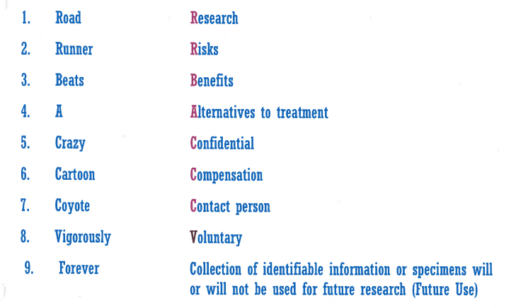
Nine Essential Elements of Informed Consent
Notes:
So here is a way to remember the essential elements of informed consent. We have to think of any way we can to remember these items for the test.

Slide 28
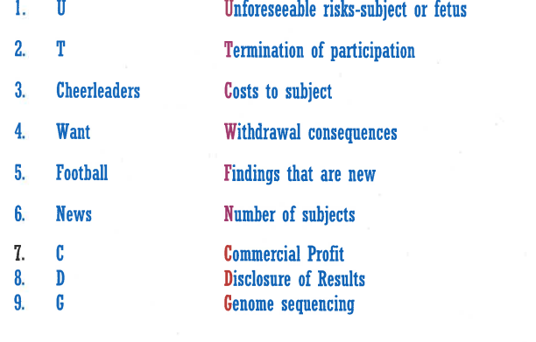
Nine Additional Elements of Informed Consent (as appropriate)
Notes:
Here is a way to remember the additional elements of informed consent

Slide 29
21 CFR 50 vs
45 CFR 46
The Elements of informed consent are virtually identical except:
FDA requires the confidentiality statement to note "the possibility that the FDA may inspect the records”
FDA requires a statement regarding study registry in Clinicaltrials.gov.
Notes:
If we compare 21 CFR 50 (FDA) regulations to those of 45 CFR 46 (OHRP regulations, FDA requires two additional statements.
Read the slide.

Slide 30
Under what conditions can an IRB grant a waiver or alteration of the consent process under 45 CFR 46?
The research involves no more than minimal risk to the subjects
The research could not practicably be carried out without the requested waiver or alteration
If the research involves using identifiable private information or identifiable biospecimens, the research could not practicably be carried out without using such information or biospecimens in an identifiable format
The waiver or alteration will not adversely affect the rights and welfare of the subjects
Whenever appropriate, the subjects or legally authorized representatives will be provided with additional pertinent information after participation
Notes:
Sometimes in research it is not possible to obtain a full written informed consent from a subject. The investigator can request a waiver of consent (meaning not get a consent at all) or an alteration of consent (meaning some part of the consent or some part of the process) needs to be altered to enroll subjects in a study.
For an IRB to allow this under OHRP or 45 CFR 46 rules, the following criteria have to be met. Read the slide.

Slide 31
Under what conditions can an IRB grant a waiver or alteration of the consent process under 21 CFR 50?
21 CFR 50.23: emergency use of a test article:
Life threatening
Informed consent cannot be obtained
Time is not sufficient to obtain consent from the legally authorized representative
There is no alternative treatment
The test article, in the opinion of the investigator is life-saving
Must be validated in writing by a physician who is not participating in the clinical investigation
This Documentation should be submitted to the IRB within 5 working days after use of the test article.
Notes:
When does the FDA allow a waiver or alteration. Three situations exist. The first is emergency use of a test article. The situation has to be: Read the slide.

Slide 32
Under what conditions can an IRB grant a waiver or alteration of the consent process under 21 CFR 50?
21 CFR 50.24 emergency research.
The IRB must review and approve the clinical investigation without requiring informed consent
Obtaining informed consent is not feasible
Because subjects are unable to consent because of their medical condition, the intervention must be administered before the consent from the LAR is feasible. There is not a way to identify prospective subjects likely to become participants in the investigation.
Notes:
The 2nd situation is when there is a study of emergency research described in 21 CFR 50.24. An example of emergency research would be like the following situation. A trauma surgeon wants to compare two different kinds of blood products after trauma to the abdominal area (like a car accident, gun-shot wound or other kind of trauma. The potential subjects come to the ER in an ambulance, the blood product has to be administered immediately and informed consent can’t be obtained because of the timeframe for administering the test article. These criteria must be met before consent can be waived or altered in this situation.
Read the slide.

Slide 33
Under what conditions can an IRB grant a waiver or alteration of the consent process under 21 CFR 50? (cont.)
Participation in the research holds out the prospect of direct benefit
The investigation could not be practicably be carried out without the waiver
The clinical investigation defines the length of potential therapeutic window and obtain the consent from the LAR
The LAR will review the informed consent procedures
Additional protections of the rights and welfare of subjects will be provided, such as, public disclosure, data monitoring committee, a procedure to inform subjects at the earliest feasible opportunity about the clinical investigation.
Notes:
Read the slide. The last criteria is an important one. When emergency research is approved by an IRB, there are often public notices provided in the newspaper to alert the community that this will be going on. Sometimes, a public survey will be conducted to obtain public opinion. Sometimes focus groups of community leaders will be interviewed to determine their feelings regarding the study. Emergency research is well planned out and involves a detailed protocol just like a drug study.

Slide 34
Waiver or Alteration of the Consent Process under 21 CFR 50?
21 CFR 50.23:
There is also a provision under this regulation for the President of the United States to waive prior consent for the administration of an investigational new drug to a member of the armed forces in connection with the member’s participation in a particular military operation.
Notes:
The 3rd situation when Consent can be waived or altered is when the President of the US waives prior consent for an investigational new drug to be administered to a member of the armed forces in connection with that member’s participation in a particular military operation. I can’t give you an example of that situation but it must be a unique situation.

Slide 35
Consent Requirement When the Research Involves Deception
45 CFR 46.104 (d)(3)(iii) If the research involves deceiving the subjects regarding the nature or purposes of the research, this exemption is not applicable unless the subject authorizes the deception through a prospective agreement to participate in research in circumstances in which the subject is informed that he or she will be unaware of or misled regarding the nature or purposes of the research.
Notes:
I want to talk a bit about when research involves deception. An alteration of consent may need to be in place in order for the research outcome to be accurate. This cannot occur unless the subject is told in advance. Read the slide.

Slide 36
Consent requirement when the research involves Deception
Example:
A Principal Investigator wants to observe the facial expressions of students with A+ grade averages when told they did poorly on an exam. In truth, they performed well on the test. Prior to participation in this study, the Principal Investigator must tell the students that they will not know the purpose of the study but will be informed later.
Notes:
An example of deception in research and how the subjects will be informed of the research is as follows.
Read the slide.
After the study, the PI will most likely give the subject an informational sheet that has been approved by the IRB. This sheet will inform subjects of the purpose of the study and the how they were deceived. The subject has the right to allow their data to be included in the study or they may decide to withdraw from the study.

Slide 37
Therapeutic misconception
Therapeutic misconception is a subject’s belief that participating in a clinical trial will be beneficial or “therapeutic”. It is of the utmost ethical principle that patients understand that the therapy during a clinical trial MAY be beneficial but not guaranteed.
Patients desperate for a cure may do anything for hope and this places potential subjects in a vulnerable position of participating in a study without understanding all of the facts about participation.
Notes:
We talked about therapeutic misconception in the session regarding recruitment.
Derita, will you Read the slide, please.
So patients with a diagnosis of cancer, for example, may be willing to enroll in a study thinking that this may be a miracle cure. And it may be---but in the informed consent, it must be stated that the drug or treatment is experimental

Slide 38
Documentation of Informed Consent
Informed consent shall be documented by the use of a written informed consent form approved by the IRB.
The ICF should be signed (including in an electronic format) by the subject or the subject’s legally authorized representative.
A written copy shall be given to the person signing the informed consent form.
Notes:
Documentation of informed consent must occur or as the rule regarding documentation goes------If it is not documented, it didn’t occur. So here are the basics while the subject is in your presence. Read the slide.

Slide 39
Documentation of Informed Consent
Both OHRP and FDA state that informed consent may be either of the following:
(1) A full written informed consent form that meets the requirements.
(2) A short form written informed consent form
Notes:
Both OHRP and FDA state that informed consent my be either of the following. A full written informed consent or a short form. We will cover short forms in Session Two of Informed Consent.

Slide 40
Waiver of Documentation of Informed Consent
45 CFR 46.117
(c)(1) An IRB may waive the requirement for the investigator to obtain a signed informed consent form for some or all subjects if it finds any of the following:
(i) That the only record linking the subject and the research would be the informed consent form and the principal risk would be potential harm resulting from a breach of confidentiality. Each subject (or legally authorized representative) will be asked whether the subject wants documentation linking the subject with the research, and the subject’s wishes will govern;
(ii) That the research presents no more than minimal risk of harm to subjects and involves no procedures for which written consent is normally required outside of the research context; or
(iii) If the subjects or legally authorized representatives are members of a distinct cultural group or community in which signing forms is not the norm, that the research presents no more than minimal risk of harm to subjects and provided there is an appropriate alternative mechanism for documenting that informed consent was obtained.
(2) In cases in which the documentation requirement is waived, the IRB may require the investigator to provide subjects or legally authorized representatives with a written statement regarding the research.
Notes:
Here are the regulations for waiver of documentation or signature of the informed consent process. Here are the circumstances that need to be present for that waiver of documentation of the informed consent. The only record linking the subject and research would be the informed consent and if confidentiality was breached, there is a possibility of harm for the subject. This might be the case when an adult disclosed information about abuse in some form. Think about battered spouses. There is that fear that the battered spouse might be hurt again if the abuser found out about the disclosure. Remember there may be local or state mandated reporting. The research has to be no more than minimal risk---so it could not be a drug study.
Another possibility could be the 3rd circumstance. In some cultures it is offensive to have to sign an agreement. Verbal affirmation is considered the norm. And lastly, the IRB may require that some sort of information sheet regarding the research is given to the subject.

Slide 41
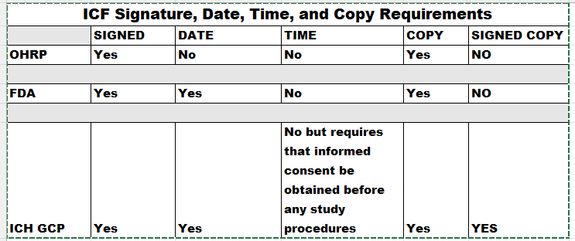
ICF Dates, Times and Copies Comparison
Notes:
Here is a comparison of OHRP, FDA and ICH GCP requirements for signature, DATE, Time and giving the subject a copy of the consent. All three, OHRP, FDA and ICH GCP require a signature on the consent form. OHRP does not require a date. Time is not required for any of the regulations or guidance but ICH requires that informed consent be obtained before any study procedures commence. So adding a time of signature entry will prove, for example, that a lab test was not drawn until after the subject signed the consent form. All three require a copy be given to the subject but only ICH GCP requires that a signed copy by given to the subject. A sidenote. You could be recruiting subjects at a healthfair where a copy machine is not available. A signed copy may not be possible to give to a subject.

Slide 42
What Is Needed After Obtaining Consent?
Original to be maintained with research documents unless approval by IRB to maintain in different manner
Give a copy to subject. Give a signed copy if following ICH GCP E6(R2)
Completion of the ICP documentation
Document and place a copy of the signed ICF in the subject’s medical record (if required)
Document continued desire to participate at each subsequent study visit
Re-Consent if needed
Remember--- IT IS an ONGOING PROCESS.
Notes:
What is needed after obtaining consent. Read the slide.

Slide 43

What to Document regarding the ICP?
Utilize a template for documentation of the process and include:
  Sufficient opportunity to consider participation
    Ample time and opportunity to inquire details of the trial
  ICP conducted without coercion or undue influence
  Subject states understanding of procedures, risks, and benefits
  ICF signed and dated before any study procedures were performed
Notes:
You need to document how the informed consent was obtained.. That includes. Read the slide.

Slide 44
Example of consent documentation
Subject Name: ________________________________
On the _____ day of ________,_______ I discussed the possibility of participating in a clinical research trial for
Protocol __________________IRB #:__________________with the above named subject. The study was explained in
detail including, but not limited to, the contents of the informed consent, purpose of the study, visits and procedures
involved, risks and benefits, alternative treatments, confidentiality, right to withdraw from the study at any time,
treatments provided, arms of the study, and randomization. The subject was encouraged to ask questions. All questions
were answered to the satisfaction of the subject.
The subject was given adequate time to read the informed consent and the opportunity to discuss it. The subject demonstrated
understanding of the informed consent and a copy was given to the subject. The discussion was free of undue influence or coercion.
The informed consent was signed on _____/_____/______ at ______ am/pm prior to any study-related procedures being performed.
If the primary language of the adult subject or LAR; or of the child subject or parent/legal guardian is not English:
Primary language: ____________________________
A translator participated in the informed consent interview.
OR
A translator did not participate in the informed consent interview because the person who obtained consent is fluent
in both English and the primary language.
_______________________________ _______________
Signature of person obtaining consent Date
______________________________ _______________
Signature of PI (if different from above) Date
Notes:
Here is an example of a narrative form of consent documentation.

Slide 45
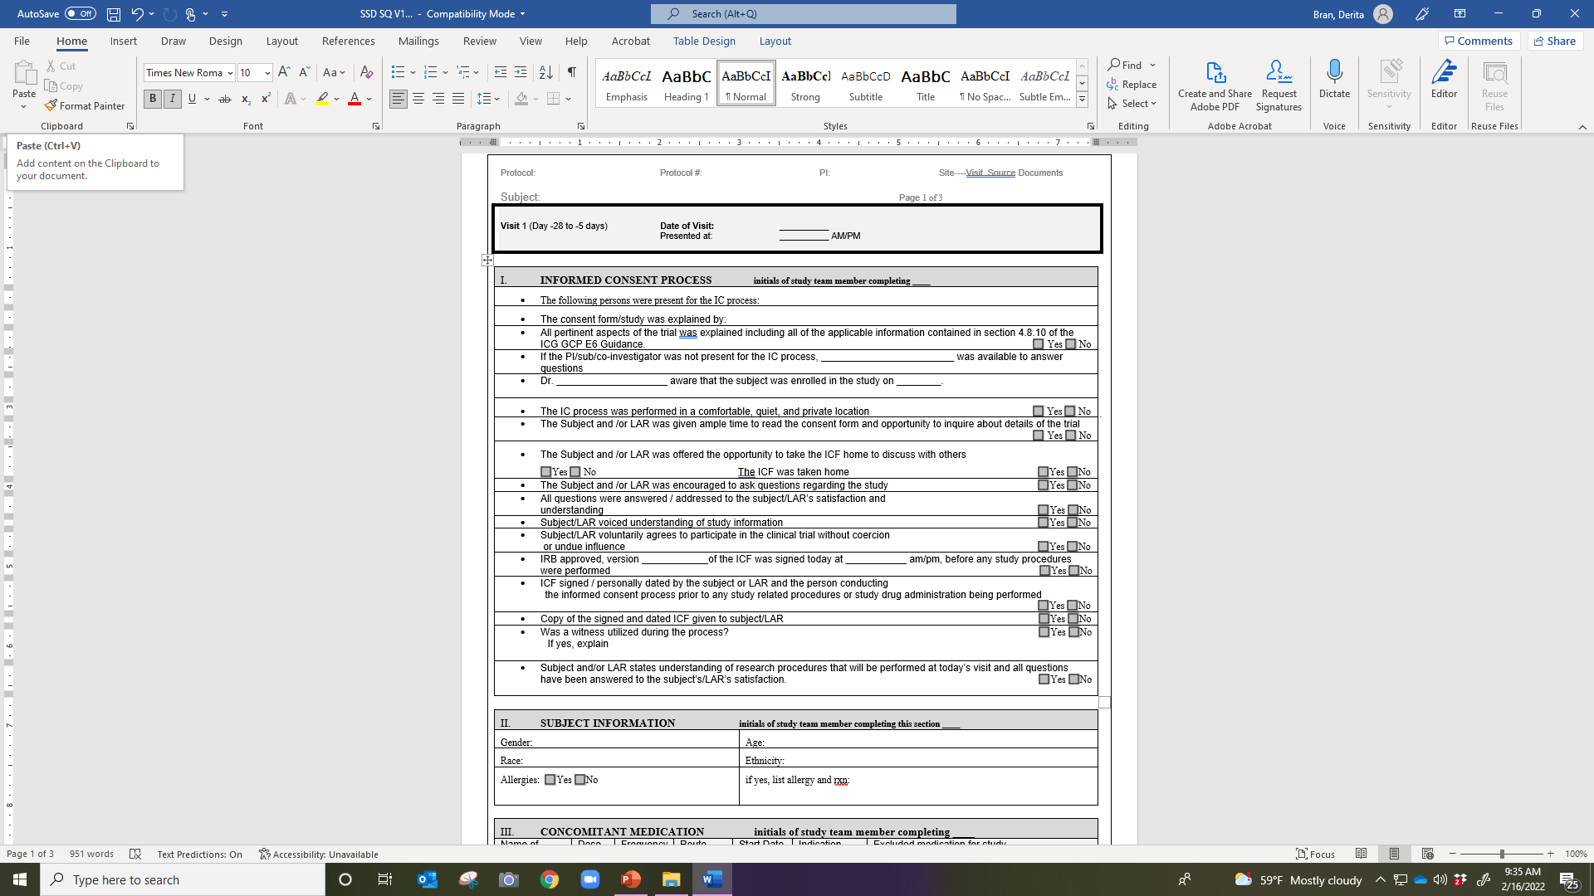
Notes:
Here is an example of a checklist for informed consent documentation.

Slide 46
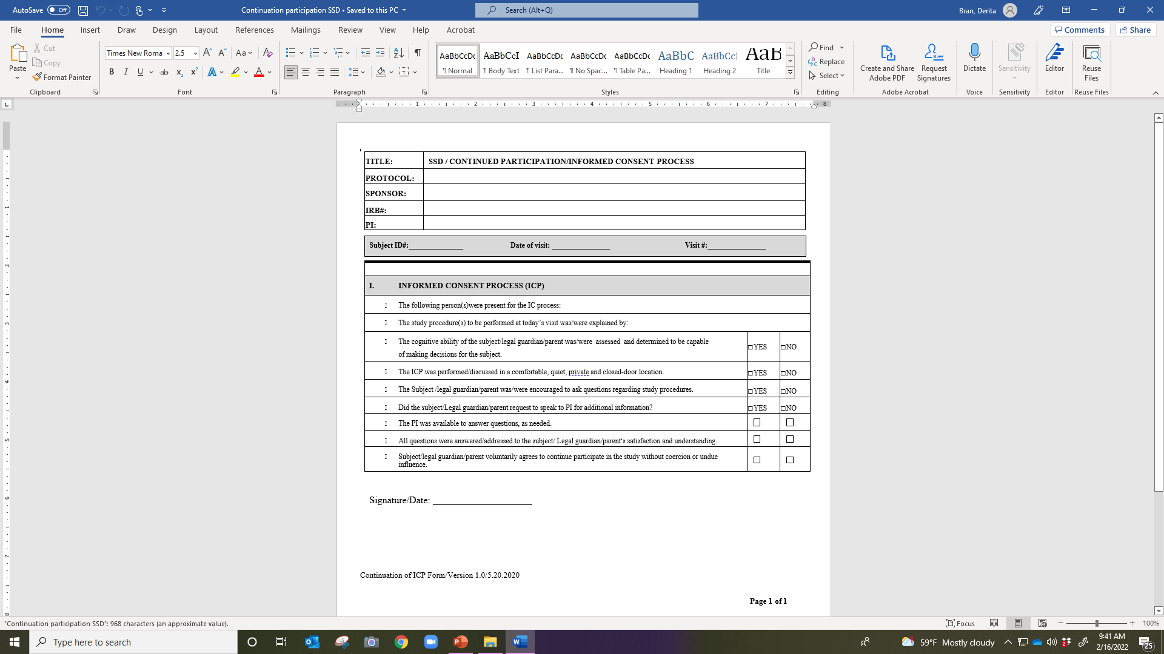
Notes:
Here is an example of a checklist that is used to document continued agreement of a subject to participate in the study. Remember, this needs to be done at each encounter.

Slide 47
Summary-Doing It Right!
Remember:
  Follow the applicable regulations, guidance, and/or SOPs for obtaining consent
  The ICP is conducted to protect the rights, safety, and well-being of subjects
  Ensure that the subject is fully informed and has a good understanding of the research procedures
  Be proactive if mistakes/errors occur, implement the appropriate Corrective and Preventive Action (CAPA)
  The process is on-going
  Take your time and DO IT RIGHT!!
Notes:
In summary, Informed Consent ---the way to do it right. Read the slide.

Slide 48
Test your knowledge

Slide 49
The FDA requires specific elements to be included in an informed consent form?
True or False

Slide 50

The FDA requires specific elements to be included in an informed consent form?
True or False

Slide 51
What date should an investigator write when he failed to sign the consent form on the date section of the consent form.
The date the consent was obtained.
The date he actually signed the consent form.
He should not date it but should explain in the progress notes
None of the above

Slide 52

What date should an investigator write when he failed to sign the consent form on the date section of the consent form.
The date the consent was obtained.
The date he actually signed the consent form.
He should not date it but should explain in the progress notes
None of the above
Notes:
And then a note can be placed in the research file. Remember, the investigator’s signature is not required in the regulations----only the subject’s.

Slide 53
In assessing vulnerability of research subjects the IRB should:
Determine how informed consent should be obtained
Evaluate whether the subjects may be vulnerable to undue influence or coercion.
Determine whether a Legally Authorized Representative may give consent
All of the above

Slide 54

In assessing vulnerability of research subjects the IRB should:
Determine how informed consent should be obtained
Evaluate whether the subjects may be vulnerable to undue influence or coercion.
Determine whether a Legally Authorized Representative may give consent
All of the above

Slide 55
When obtaining informed consent in a provider’s office, coercion and undue influence should be avoided. Undue influences are harder to control because:
A. Subjects are in a dependent relationship with the investigator
B. They always include some benefit for subjects
C. There is an overt threat of harm
D. They are known to the investigator but not the subject.

Slide 56

When obtaining informed consent in a provider’s office, coercion and undue influence should be avoided. Undue influences are harder to control because:
A. Subjects are in a dependent relationship with the investigator
B. They always include some benefit for subjects
C. There is an overt threat of harm
D. They are known to the investigator but not the subject.

Slide 57
If a research study involves more than minimal risks to subjects, a statement regarding compensation and whether any medical treatments are available for potential injury is required.
True or False

Slide 58

If a research study involves more than minimal risks to subjects, a statement regarding compensation and whether any medical treatments are available for potential injury is required.
True or False

Slide 59
The IRB has the authority to require a third party to observe the consent process.
True or False

Slide 60

The IRB has the authority to require a third party to observe the consent process.
True or False

Slide 61
Of the choices listed, which one is an additional element of informed consent?
A. Benefits
B. Compensation
C. Voluntary
D. Consequences of withdrawal
E. Alternatives to participation

Slide 62

Of the choices listed, which one is an additional element of informed consent?
A. Benefits
B. Compensation
C. Voluntary
D. Consequences of withdrawal
E. Alternatives to participation

Slide 63
A potential subject is participating in a consent discussion for enrollment in a randomized placebo controlled drug study. After 2 hours, as the patient is signing the consent form, she says to her companion, “…I will be so glad to get this drug. I hate these disfiguring plaques.” This is an example of
A. Placebo effect
B. Undue influence
C. Clinical Equipoise
D. Therapeutic misconception

Slide 64

A potential subject is participating in a consent discussion for enrollment in a randomized placebo controlled drug study. After 2 hours, as the patient is signing the consent form, she says to her companion, “…I will be so glad to get this drug. I hate these disfiguring plaques.” This is an example of
A. Placebo effect
B. Undue influence
C. Clinical Equipoise
D. Therapeutic misconception

Slide 65
According to 45 CFR 46 (b) revision, the informed consent must contain certain required information. There are:
A. Nine required elements of informed consent
B. Fourteen elements of informed consent
C. There are no required elements
D. Six required elements of informed consent

Slide 66

According to 45 CFR 46 (b) revision, the informed consent must contain certain required information. There are:
A. Nine required elements of informed consent
B. Fourteen elements of informed consent
C. There are no required elements
D. Six required elements of informed consent

Slide 67
Waiver of documentation of informed consent may be used for phone surveys of illegal behaviors, anonymous internet-based survey of sexual practices, and in person interview of rape victims.
True or False

Slide 68

Waiver of documentation of informed consent may be used for phone surveys of illegal behaviors, anonymous internet-based survey of sexual practices, and in person interview of rape victims.
True or False

Slide 69
Waiver of Documentation of Informed Consent
45 CFR 46.117
(c)(1) An IRB may waive the requirement for the investigator to obtain a signed informed consent form for some or all subjects if it finds any of the following:
(i) That the only record linking the subject and the research would be the informed consent form and the principal risk would be potential harm resulting from a breach of confidentiality. Each subject (or legally authorized representative) will be asked whether the subject wants documentation linking the subject with the research, and the subject’s wishes will govern;
(ii) That the research presents no more than minimal risk of harm to subjects and involves no procedures for which written consent is normally required outside of the research context; or
(iii) If the subjects or legally authorized representatives are members of a distinct cultural group or community in which signing forms is not the norm, that the research presents no more than minimal risk of harm to subjects and provided there is an appropriate alternative mechanism for documenting that informed consent was obtained.
(2) In cases in which the documentation requirement is waived, the IRB may require the investigator to provide subjects or legally authorized representatives with a written statement regarding the research.

Slide 70
A waiver of informed consent can be granted in the following minimal risk studies:
Large numbers of subjects are involved and there is not sufficient staff to obtain written informed consent
Records belong to a significant number of subjects who are lost to follow up
Records belong to a significant number of subjects who are deceased.
All of the above

Slide 71

A waiver of informed consent can be granted in the following minimal risk studies:
Large numbers of subjects are involved and there is not sufficient staff to obtain written informed consent
Records belong to a significant number of subjects who are lost to follow up
Records belong to a significant number of subjects who are deceased.
All of the above

Slide 72
Which signatures are required by regulation to be on a full consent form?
The investigator
The subject
The investigator and the subject
A subject and a witness
The investigator, the subject and the person obtaining consent

Slide 73

Which signatures are required by regulation to be on a full consent form?
The investigator
The subject
The investigator and the subject
A subject and a witness
The investigator, the subject and the person obtaining consent

Slide 74

Questions?

