Slide 1
CERTIFICATION EXAM PREPARATION COURSE
Session 14:
Safety and Compliance Reporting

Slide 2

So many terms!
AE or Adverse Event
SAE or Serious Adverse Event
UADE or Unanticipated Adverse Device Effect
SUSAR or Suspected Unexpected Serious Adverse Reaction
Are all Unanticipated Problems?
YES
Notes:
So many terms. AE or Adverse Event. SAE or Serious Adverse Event, UADE or Unanticipated Adverse Device Effect, and SUSAR or Suspected Unexpected Serous Adverse Reaction. These all belong to the greater category of Unanticipated Problems

Slide 3
Examples of Unanticipated Problems
A subject falls while in your clinic
Breach of privacy or confidentiality
Loss of specified temperature of an investigational product
Lab or medication errors that could involve risk to a subject
Subject or family complaint
Suspension or misconduct by an investigator or study staff member
New information that suggests a change to the risk benefit ratio that could affect enrollment
Notes:
Read the slide

Slide 4
Examples of corrective actions or substantive changes that might need to be considered in response to an unanticipated problem include:
changes to the research protocol initiated by the investigator prior to obtaining IRB approval to eliminate apparent immediate hazards to subjects
modification of inclusion or exclusion criteria to mitigate the newly identified risks
implementation of additional procedures for monitoring subjects
suspension of enrollment of new subjects
suspension of research procedures in currently enrolled subjects
modification of informed consent documents to include a description of newly recognized risks
provision of additional information about newly recognized risks to previously enrolled subjects
Notes:
Read the slide
For the first one---changes in the research protocol---If an investigator needs to implement an immediate change, then he/she should do it and then seek IRB approval. Nothing should stand in the way of preventing a hazardous condition.
For the 2nd one---let’s say that it is found that the study drug does not need to be administered to those with declining kidney function. The Sponsor may change the exclusionary criteria to a different, more restrictive glomerular filtration rate, in order to minimize subject risks. Then, in turn, the sixth action, regarding informed consent will be done. The informed consent would be modified and the enrolled subjects would need to be re-consented in order to discuss the new risk associated with kidney function. And then the 7 action, previously enrolled subjects would need to be notified of that risk to kidney function. That might be in the form of a letter sent to those subjects who have completed the study.

Slide 5
What are Adverse Events?
The HHS regulations at 45 CFR part 46 do not define or use the term adverse event
There is not a common definition of this term across government and non-government entities.
In guidance documents, the term adverse event in general is used very broadly and includes any event meeting the following definition on the next slide.
Notes:
Read the slide.
So that is probably why there are so many terms for an adverse event.

Slide 6
What are Adverse Events?
Any untoward or unfavorable medical occurrence in a human subject, including any abnormal sign (for example, abnormal physical exam or laboratory finding), symptom, or disease, temporally associated with the subject’s participation in the research, whether or not considered related to the subject’s participation in the research.
Adverse events encompass both physical and psychological harms. They occur most commonly in the context of biomedical research, although on occasion, they can occur in the context of social and behavioral research.
Notes:
So let’s read the definitions from the FDA guidance documents. Read the slide.
An example of an adverse event with social / behavioral research would be as follows: Let’s say you were administering a survey to a group of adults who had experienced physical abuse as children. Answering questions could trigger memories of that abuse which could in turn cause depression, acute episodes of PTSD or other mental health crises.

Slide 7
Unanticipated Problems Involving Risks to Subjects or Others per OHRP (reportable)
OHRP considers unanticipated problems, in general, to include any incident, experience, or outcome that meets all of the following criteria:
1. unexpected (in terms of nature, severity, or frequency) given (a) the research procedures that are described in the protocol-related documents, such as the IRB-approved research protocol and informed consent document; and (b) the characteristics of the subject population being studied;
2. related or possibly related to participation in the research (in this guidance document, possibly related means there is a reasonable possibility that the incident, experience, or outcome may have been caused by the procedures involved in the research); and
3. suggests that the research places subjects or others at a greater risk of harm (including physical, psychological, economic, or social harm) than was previously known or recognized
Notes:
Read the slide. So an unanticipated problem is not reportable (per federal guidelines) unless it is unexpected, related or possibly related or the research placed subjects or others at a greater risk of harm.

Slide 8
What does expected mean?
(1) The known or foreseeable risk of adverse events associated with the procedures involved in the research that are described in
(a) the protocol-related documents, such as the IRB-approved research protocol, any applicable investigator brochure, and the current IRB-approved informed consent document, and
(b) other relevant sources of information, such as product labeling and package inserts; or
(2) The expected natural progression of any underlying disease, disorder, or condition of the subject(s) experiencing the adverse event and the subject’s predisposing risk factor profile for the adverse event.
Notes:
Let’s breakdown the meaning of expected so that we understand what unexpected it.
So a Pi is studying a new type of insulin for diabetes. It is described in the protocol that the insulin could cause low blood sugar. A subject experiences low blood sugar while in the study---that is expected. It is an adverse event but not reportable.

Slide 9
Examples of Unexpected adverse events
liver failure due to diffuse hepatic necrosis occurring in a subject without any underlying liver disease
Hodgkin’s disease (HD) occurring in a subject without predisposing risk factors for HD would be an unexpected adverse event
In comparison, prolonged severe neutropenia and opportunistic infections occurring in subjects administered an experimental chemotherapy regimen as part of an oncology clinical trial would be examples of expected adverse events if the protocol-related documents described prolonged severe neutropenia and opportunistic infections as common risks for all subjects.
Notes:
Read the slide

Slide 10

What causes adverse events?
Adverse events may be caused by one or more of the following:
the procedures involved in the research;
an underlying disease, disorder, or condition of the subject; or
other circumstances unrelated to either the research or any underlying disease, disorder, or condition of the subject.
Notes:
Read the slide

Slide 11
How would you determine if the adverse event was related or possibly related?
In general, adverse events that are determined to be at least partially caused by the procedures of the research would be considered related to participation in the research.
Adverse events determined to be solely caused by the underlying disease or other circumstances or conditions would be considered unrelated to participation in the research.
For example, for subjects with cancer participating in oncology clinical trials testing chemotherapy drugs, neutropenia and anemia are common adverse events related to participation in the research.
Notes:
Read the slide.

Slide 12
Unanticipated Problems Involving Risks to Subjects or Others per OHRP (reportable)
OHRP considers unanticipated problems, in general, to include any incident, experience, or outcome that meets all of the following criteria:
1. unexpected (in terms of nature, severity, or frequency) given (a) the research procedures that are described in the protocol-related documents, such as the IRB-approved research protocol and informed consent document; and (b) the characteristics of the subject population being studied;
2. related or possibly related to participation in the research (in this guidance document, possibly related means there is a reasonable possibility that the incident, experience, or outcome may have been caused by the procedures involved in the research); and
3. suggests that the research places subjects or others at a greater risk of harm (including physical, psychological, economic, or social harm) than was previously known or recognized
Notes:
Let’s review again. When is an unanticipated problem reportable to OHRP, When it is unexpected, related or possibly related to participation in the research and the last one “suggested that the research places subjects or others at greater risk. So, let’s review what the 3rd criteria is----places subjects at greater harm.

Slide 13
Does the research place subjects or others at a greater risk of harm
The first step is to determine whether the adverse is serious:
results in death;
is life-threatening (places the subject at immediate risk of death from the event as it occurred);
results in inpatient hospitalization or prolongation of existing hospitalization;
results in a persistent or significant disability/incapacity;
results in a congenital anomaly/birth defect; or
based upon appropriate medical judgment, may jeopardize the subject’s health and may require medical or surgical intervention to prevent one of the other outcomes listed in this definition (examples of such events include allergic bronchospasm requiring intensive treatment in the emergency room or at home, blood dyscrasias or convulsions that do not result in inpatient hospitalization, or the development of drug dependency or drug abuse).
Notes:
Read the slide

Slide 14

If the answer to all three questions is yes (unexpected, related, and increases risk), then the adverse event is an unanticipated problem and must be reported to appropriate entities under the HHS regulations at 45 CFR 46.103(a) and 46.103(b)(5).
Report to the IRB.
Notes:
Read the slide.

Slide 15
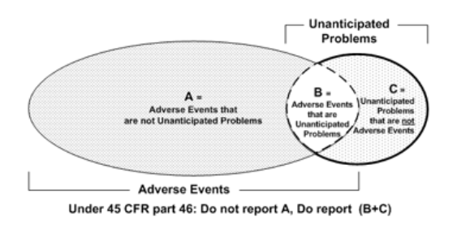
Determining which adverse events are unanticipated problems.
Notes:
Take a look at this diagram. Read the title.
A=Adverse events that are not unanticipated problems so those are not reportable
So the reportable events would be B and C ----ones that the answer to all three questions is yes.
Look at C. Unanticipated problems that are not adverse events. Adverse events usually mean some physical or mental harm. So an example of C would be PI or staff misconduct.

Slide 16
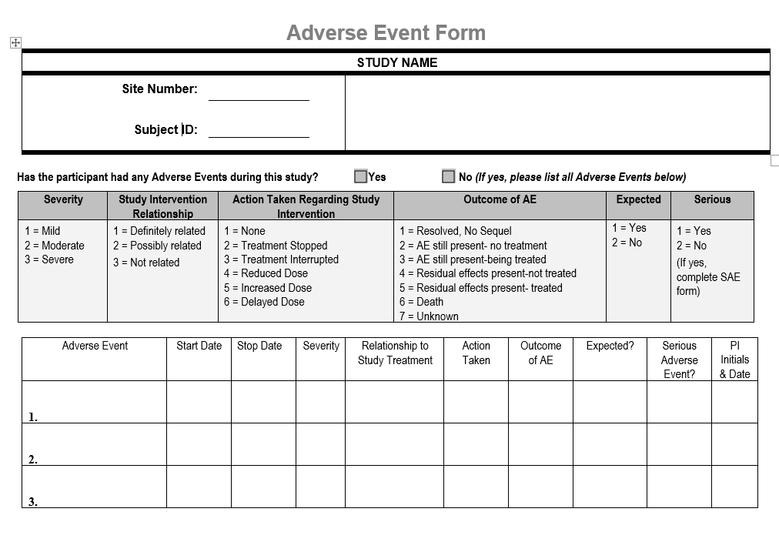
Notes:
Here is an example of an adverse event monitoring log. You can see that it is for each subject. The second column asks whether the event is related. The next to the last column asks if it was expected. The last column asks if it was serious. The action taken regarding study intervention is assessed and seen in the 3rd column. You can see that the action ranges from none to treatment stopped and so on. And you can see the rankings 1-7 of how the outcome of the adverse event is assessed in the 4th column.

Slide 17
Compare “serious” and “severe” as described in the regulations.
Severity is a grading. Adverse Events (AEs) can be classified as mild, moderate or severe. An AE can be severe without being a Serious Adverse Event.
A headache is severe, if it causes intense pain. There are scales like "visual analog scale" that help us assess the severity. On the other hand, a headache is not usually serious (but may be in case of subarachnoid haemorrhage, subdural bleed, even a migraine may temporally fit criteria), unless it also satisfies the criteria for seriousness. Similarly, a severe rash is not likely to be an SAE. However, mild chest pain may result in a day’s hospitalization and thus is an SAE.
Notes:
Let’s compare serious and severe because we have talked about serious adverse events (SAE’s) but we have not talked about Severe adverse events. Derita would you like to read this slide, please?

Slide 18
Does the research place subjects or others at a greater risk of harm
The first step is to determine whether the adverse event is serious:
results in death;
is life-threatening (places the subject at immediate risk of death from the event as it occurred);
results in inpatient hospitalization or prolongation of existing hospitalization;
results in a persistent or significant disability/incapacity;
results in a congenital anomaly/birth defect; or
based upon appropriate medical judgment, may jeopardize the subject’s health and may require medical or surgical intervention to prevent one of the other outcomes listed in this definition (examples of such events include allergic bronchospasm requiring intensive treatment in the emergency room or at home, blood dyscrasias or convulsions that do not result in inpatient hospitalization, or the development of drug dependency or drug abuse).
Notes:
Remember these are the criteria for serious Adverse events.

Slide 19
Classifications of the AE severity often include the following:
Mild: Awareness of signs or symptoms, but easily tolerated and are of minor irritant type causing no loss of time from normal activities. Symptoms do not require therapy or a medical evaluation; signs and symptoms are transient.
Moderate: Events introduce a low level of inconvenience or concern to the participant and may interfere with daily activities, but are usually improved by simple therapeutic measures; moderate experiences may cause some interference with functioning
Severe: Events interrupt the participant’s normal daily activities and generally require systemic drug therapy or other treatment; they are usually incapacitating
Notes:
Severity differs from the serious classification. Here are grades of severity. Read the slide.

Slide 20
Reporting Unanticipated problems to OHRP, the IRB, Appropriate Institutional Officials, the Department or Agency Head (NIH, DOD)
The HHS regulations at 46.103(b)(5) require written procedures for ensuring prompt reporting of unanticipated problems to the IRB, appropriate institutional officials, any supporting department or agency head (or designee), and OHRP.
The purpose of prompt reporting is to ensure that appropriate steps are taken in a timely manner to protect other subjects from avoidable harm.
Notes:
Read the slide.

Slide 21
The regulations do not define prompt.
The appropriate time frame for satisfying the requirement for prompt reporting will vary depending on the specific nature of the unanticipated problem, the nature of the research associated with the problem, and the entity to which reports are to be submitted.
For example, an unanticipated problem that resulted in a subject’s death or was potentially life-threatening generally should be reported to the IRB within a shorter time frame than other unanticipated problems that were not life-threatening.
Notes:
So here is problem ---why do they do this? The regulations don’t define prompt. The appropriate time from depends on the nature of the unanticipated problem. For example, a subject’s death should be reported within a shorter time frame than something not life-threatening.

Slide 22

OHRP Recommended timelines to satisfy the requirement for prompt reporting:
Unanticipated problems that are serious adverse events should be reported to the IRB within 1 week of the investigator becoming aware of the event.
Any other unanticipated problem should be reported to the IRB within 2 weeks of the investigator becoming aware of the problem.
All unanticipated problems should be reported to appropriate institutional officials (as required by an institution’s written reporting procedures), the supporting agency head (or designee), and OHRP within one month of the IRB’s receipt of the report of the problem from the investigator.
Notes:
Read the slide.

Slide 23
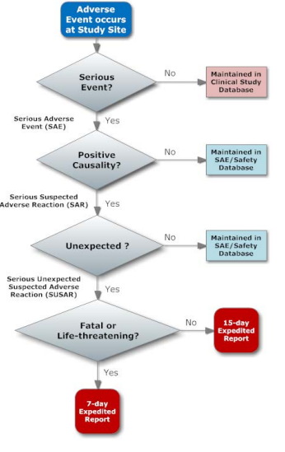
Notes:
Here is a great diagram that shows regarding reportable unexpected problems and their reporting.

Slide 24
Internal vs. External Adverse Events
External adverse event: From the perspective of one particular institution engaged in a multicenter clinical trial, external adverse events are those adverse events experienced by subjects enrolled by investigators at other institutions engaged in the clinical trial.
Internal adverse event: From the perspective of one particular institution engaged in a multicenter clinical trial, internal adverse events are those adverse events experienced by subjects enrolled by the investigator(s) at that institution. In the context of a single-center clinical trial, all adverse events would be considered internal adverse events.
Notes:
We also need to discuss internal vs external adverse events. If you are involved in a multi-center trial, you will most likely receive adverse event reports from other sites which are “External adverse events”. An Internal adverse event is one that occurs at the local site.

Slide 25

Test your knowledge

Slide 26
A subject is enrolled in a Phase II study where an investigational drug for arthritis is being studied. The informed consent includes potential risks associated with the study. Gastrointestinal bleeding is one of the potential risks associated with taking the study drug.
After four weeks of administration of the medication, the subject calls the study site and reports blood in the stool. The blood does not occur daily. The subject has no other reported side effects.
Is this a reportable adverse event?
Yes
No

Slide 27


A subject is enrolled in a Phase II study where a investigational drug for arthritis is being studied. The informed consent includes potential risks associated with the study. Gastrointestinal bleeding is associated with taking the study drug.
After four weeks of administration of the medication, the subject calls the study site and reports blood in the stool. The blood does not occur daily. The subject has no other reported side effects.
Is this a reportable adverse event?
Yes
No
Why:
1. unexpected? No
2. related? Yes
3. suggests that the research places subjects or others at a greater risk of harm ? No
Even though the adverse event is not reportable, appropriate follow-up should occur to assess the bleeding.

Slide 28
Notes:
Remember this monitoring form. This needs to be completed for that subject and follow-up needs to be done. I participated in a study once for sunscreen with varying Sun protection factors.
If you ever have the chance to be a subject in a research study, please participate---you will gain an understanding and perspective from study participation that is invaluable. So in this study using the sunscreen I that I was randomized to, I got a sunburn and I would describe the severity as moderate. It was definitely related to study participation. It was a 3 hour study, so there was no action taken. But the study team followed –up with me a couple of weeks later to make sure that I was OK and had no problems.

Slide 29
A local investigator is conducting a medical record review of the signs and symptoms of anxiety and depression in chronic disease states. This is a collaborative study among several investigators at three universities. The local investigator discovers that the transfer of data to the data analyst at another site was not done in a secure method.
Is this a reportable adverse event?
Yes
No

Slide 30

A local investigator is conducting a medical record review of the signs and symptoms of anxiety and depression in chronic disease states. This is a collaborative study among several investigators at three universities but is not externally funded. The local investigator discovers that the transfer of data to the data analyst at another site was not done in a secure method.
Is this a reportable adverse event? Yes
Why:
1. unexpected? Yes
2. related? Yes
3. suggests that the research places subjects or others at a greater risk of harm ? Yes
The local investigator should report this to the IRB and to the Privacy Board at the institution where he / she works. Those two entities will determine how to proceed with other reporting.

Slide 31

An adverse event that is severe: a. Is always classified as serious b. Is never classified as serious c. May not meet the definition of serious d. Should be submitted to the sponsor within 24 hours e. Is always classified as related

Slide 32

An adverse event that is severe: a. Is always classified as serious b. Is never classified as serious c. May not meet the definition of serious d. Should be submitted to the sponsor within 24 hours e. Is always classified as related

Slide 33
Does the research place subjects or others at a greater risk of harm
The first step is to determine whether the adverse event is serious:
results in death;
is life-threatening (places the subject at immediate risk of death from the event as it occurred);
results in inpatient hospitalization or prolongation of existing hospitalization;
results in a persistent or significant disability/incapacity;
results in a congenital anomaly/birth defect; or
based upon appropriate medical judgment, may jeopardize the subject’s health and may require medical or surgical intervention to prevent one of the other outcomes listed in this definition (examples of such events include allergic bronchospasm requiring intensive treatment in the emergency room or at home, blood dyscrasias or convulsions that do not result in inpatient hospitalization, or the development of drug dependency or drug abuse).
Notes:
Remember these are the criteria for serious Adverse events. Remember a headache may be severe but it may not be serious.

Slide 34
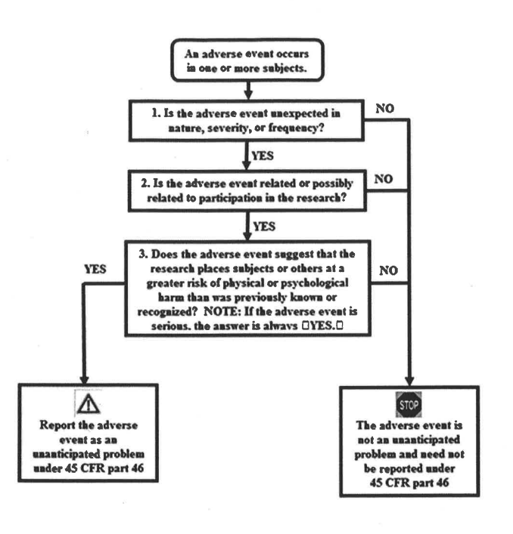
Notes:
Let’s review the flow of adverse event reporting again.

Slide 35
For an IND: Investigators are Required to Report
Adverse events according to IRB and sponsor policies.
Notes:
Let’s change the focus to FDA reporting. Remember IND stands for Investigational New Drug and we find those regulations at 21 CFR 312.

Slide 36
For an IND:
Sponsors are Required to Report
The sponsor must submit each IND safety report in a narrative format or on FDA Form 3500A or in an electronic format that FDA can process, review, and archive.
If the IND is not in an electronic format, other means of rapid communication (e.g., telephone, fax, email) may be used.
Initial reporting:
Unexpected serious suspected adverse reactions must be reported to FDA as soon as possible but no later than within 15 calendar days following the sponsor’s initial receipt of the information.
Unexpected fatal or life-threatening suspected adverse reactions must be reported to FDA as soon as possible but no later than 7 calendar days following the sponsor’s initial receipt of the information.
Follow-up reporting:
As soon as the information is available but no later than 15 calendar days after the sponsor receives the information.
Notes:
For an IND sponsors are required to report in a narrative format or on an FDA Form 3500 A or some other format that the FDA can review.
And that can be by telephone, fax or email if the IND is not in an electronic format.
Unexpected serious suspected adverse reactions should be reported ASAP but no later than within 15 calendar days of initial receipt.
Unexpected fatal or life threatening suspected adverse reaction should be reported ASAP but no later than 7 calendar days following receipt.
Follow up--- no later than 15 calendars days after the sponsor receives the information.

Slide 37
For an IDE: Investigators are Required to Report
The investigator must submit to the sponsor and the reviewing IRB a report of any unanticipated adverse device effect as soon as possible but no later than 10 working days after the investigator first learns of the effect.
Notes:
For an IDE (Investigational Device Exemption----which is the parallel to an Investigational New Drug) at 21 CFR 812. The investigator must report to the sponsor and IRB ASAP but no later than 10 working days after the investigator learns of the adverse effect.

Slide 38
For an IDE:
Sponsors are Required to Report
The sponsor must report the results of an evaluation of an unanticipated adverse device effect to FDA and all reviewing IRBs and investigators within 10 working days after the sponsor first receives notice of the adverse effect.
Notes:
Sponsors are required to report unanticipated adverse device effects to the IDA and all IRB’s and investigators within 10 working days after first receipt of the effect.

Slide 39

MedWatch
MedWatch is the FDA’s medical product safety reporting program for health professionals, patients and consumers.
Notes:
So how are adverse effects reported. Through MedWatch. Read the slide.

Slide 40
MedWatch receives reports from the public and when appropriate, publishes safety alerts for FDA-regulated products such as:
Prescription and over-the-counter medicines
Biologics such as blood components, blood/plasma derivatives and gene therapies.
Medical devices such as hearing aids breast pumps, and pacemakers.
Combination products such as pre-filled drug syringes, metered-dose inhalers and nasal sprays.
Special nutritional products such as dietary supplements, medical foods and infant formulas.
Cosmetics such as moisturizers, makeup, shampoos, hair dyes and tattoos.
Food such as beverages and ingredients added to foods.
Notes:
Read the slide

Slide 41

What form is used for MedWatch reporting?
Voluntary?
Reporting can be done through the online reporting portal or by downloading, completing and then submitting FDA Form 3500 (health professional) or 3500B (consumer/patient) to MedWatch:The FDA Safety Information and Adverse Event Reporting Program.
Mandatory?
FDA Form 3500 A is used for mandatory reporting by IND reporters, manufacturers, distributors, importers, user facilities personnel.
Notes:
What form is used for MedWatch reports. If it is voluntary, 3500 is used by health professionals and 3500 B is used for consumers and patients. For Mandatory reporting, 3500 A is used for IND and IDE reports.

Slide 42

21 CFR 54
Financial Disclosure
Notes:
Let’s switch topics and move onto 21 CFR 54, the FDA Financial Disclosure Forms

Slide 43

21 CFR 54
Financial Disclosure
One potential source of bias in clinical studies is a financial interest of the clinical investigator:
in the outcome of the study because of the way payment is arranged (e.g., a royalty) or
because the investigator has a proprietary interest in the product (e.g., a patent) or
because the investigator has an equity interest in the sponsor of the covered study (such as stock)
Notes:
21 CFR 54 is used for financial disclosure because financial interests of a clinical investigator or study staff may be a source or bias. And here is how, it can be in the form of : Read the slide
So the applicant or the sponsor is required to submit the Financial Disclosure forms to the FDA.

Slide 44
21 CFR 54
Financial Disclosure
“Applicant” means the party who submits a marketing application to FDA for approval of a drug, device or biologic product or who submits a reclassification petition. The applicant is responsible for submitting the required certification and disclosure statements.
Notes:
In the 21 CFR 54 financial disclosure form, we must understand the definition of the Applicant. Derita will you read this definition, please?
So in the case of a sponsored study, the sponsor is the applicant. In the case of an investigator / sponsor (an investigator who holds the IND and is conducting the study), the investigator is the applicant.
So the applicant or the sponsor is required to submit the Financial Disclosure forms to the FDA.

Slide 45
Financial interest, arrangement and payments that must be disclosed.
The dollar amounts that trigger reporting are the combined financial interests of the investigator, spouse, and dependent children.
Notes:
This is a very important concept to remember and may be a test question. Any question that is asked on a form regarding dollar amounts is the combined amount of the investigator, spouse and dependent children.

Slide 46
Required reporting
1. Any compensation made to the investigator by any sponsor of the covered clinical study in which the value of compensation could be affected by study outcome.
2. A proprietary interest in the tested product including, but not limited to, a patent, trademark, copyright or licensing agreement.
3. Any equity interest in any sponsor of the covered clinical study, i.e., any ownership interest, stock options, or other financial interest whose value cannot be readily determined through reference to public prices. The requirement applies to interests held during the time the clinical investigator is carrying out the study and for one year following completion of the study.
4. Any equity interest in any sponsor of the covered study if the sponsor is a publicly held company and the interest exceeds $50,000 in value. The requirement applies to interests held during the time the clinical investigator is carrying out the study and for one year following completion of the study.
5. Significant payments of other sorts (SPOOS) are payments that have a cumulative monetary value of $25,000 or more and are made by any sponsor of a covered study to the investigator or the investigator’s institution during the time the clinical investigator is carrying out the study and for one year following completion of the study. This would include payments that support activities of the investigator (e.g., a grant to the investigator or to the institution to fund the investigator’s ongoing research or compensation in the form of equipment), exclusive of the costs of conducting the clinical study or other clinical studies, or to provide other reimbursements such as retainers for ongoing consultation or honoraria. See Section IV, Questions C.4, C.5, and C.6 for additional information on SPOOS.
Notes:
These are the things that have to be reported in the 3455 form. Read the slide.
These items must be reported for one year following completion of the study.

Slide 47
FORM 3454 Certification
For any clinical investigator who has no disclosable financial interests in or arrangements with any sponsor of the covered clinical study.
Notes:
Read the slide

Slide 48
FORM 3455
Disclosure
For each clinical investigator who, or whose spouse or dependent child, had disclosable financial interests in and/or arrangements with any sponsor of the covered clinical study.
Notes:
Read the slide

Slide 49
3454 (Certification) vs 3455 (Disclosure)
FORM FDA 3454
FORM FDA 3455
Notes:
Let’s take a look at both of these forms.

Slide 50
Financial forms reporting and record keeping
To whom does the investigator submit the required financial information?
The clinical investigator shall provide to the sponsor of the covered study sufficient accurate financial information to allow the sponsor to submit complete and accurate certification or disclosure statements as required.
When is the investigator required to provide updated information?
The investigator shall promptly update this information if any relevant changes occur in the course of the investigation or for 1 year following completion of the study.
What are the recordkeeping and retention requirements?
For any application submitted for a covered product, an applicant shall retain records for 2 years after the date of approval of the application.
Notes:
So let’s review. The investigator must submit financial information to the sponsor through the disclosure statement.
The investigator must provide this information and any changes for one year following completion of the study.
The applicant (the sponsor or the sponsor / investigator) must retain records for two years after marketing approval.

Slide 51

Clinicaltrials.gov
Notes:
The last subject we are going to cover today is clinicaltrials.gov

Slide 52

ClinicalTrials.gov
is a database of privately and publicly funded clinical studies conducted around the world.
Notes:
Read the slide.

Slide 53
Clinicaltrials.gov
Protocol Registration is required to make study information publicly available to:
Facilitate enrollment in clinical trials
Allow tracking of study progress
Provide dissemination of study findings
Ensure access to peer-reviewed journals for publication of research outcomes
Protocol Registration is required by:
Food and Drug Administration Amendments Act 2007 (FDAAA)
National Institutes of Health (NIH)
International Committee of Medical Journal Editors (ICMJE)
Center for Medicare and Medicaid (CMS)
Notes:
Read the slide

Slide 54
Clinicaltrials.gov
International Committee of Medical Journal Editors (ICMJE) requires protocol registration of interventional clinical studies to include studies of any intervention type, phase, or geographic location BEFORE enrollment of first subject.
Not all studies meet the definition of a clinical trial per clinicaltrials.gov. Determine if your study is an Applicable Clinical Trial that should be registered.
Notes:
These are very important facts to know about clinicaltrials.gov. An investigator may not be able to publish if he/she or the sponsor does not register the clinical trial with clinicaltrials.gov. And that registration has to occur before enrollment of the first subject.
The second point is that there is a specific definition for “clinical trial” so just because you have a research study that involves human subjects, it may not need to be registered in clinicaltrials.gov because it does not meet their definition.

Slide 55
Test your knowledge

Slide 56
Significant equity interest refers to ownership interests, stock options or other financial interests whose value cannot be readily determined through reference to public interest or any equity interest of $25,000 or more.
True or False?

Slide 57

Significant equity interest refers to ownership interests, stock options or other financial interests whose value cannot be readily determined through reference to public interest or any equity interest of $25,000 or more.
True or False?
It is any amount—the key statement is “whose value cannot be readily determined”.

Slide 58

How long does an investigator have to report equity interests to a sponsoring company of the covered study?
a. One year after completion of the study
b. Two years after completion of the
study
c. As long as the investigator has a working relationship with the sponsor
d. b and c

Slide 59

How long does an investigator have to report equity interests in a sponsoring company of the covered study?
a. One year after completion of the study
b. Two years after completion of the
study
c. As long as the investigator has a working relationship with the sponsor
d. b and c

Slide 60
Who is responsible for determining that an adverse event is reported to the FDA?
A. The Investigator
B. The Sponsor
C. The IRB
D. All of the above

Slide 61
Who is responsible for determining that an adverse event is reported to the FDA?
A. The Investigator
B. The Sponsor
C. The IRB
D. All of the above

Slide 62
An investigator has a financial interest in the research of a promising new drug she is studying. Under the regulations, she must submit FDA form 3455 to the Sponsor when the marketing application is submitted?
True or False

Slide 63

An investigator has a financial interest in the research of a promising new drug she is studying. Under the regulations, she must submit FDA form 3455 to the Sponsor when the marketing application is submitted?
True or False
False. The Form 3455 must be submitted at the time of the IND in order to minimize or prevent bias in the investigation.

Slide 64
If associated with the use of a study drug, within what time frame must the FDA be notified via a written report about a serious and unexpected adverse event that is not fatal or life threatening?
7 calendar days
15 calendar days
10 working days
24 hours of sponsor notification

Slide 65

If associated with the use of a study drug, within what time frame must the FDA be notified via a written report about a serious and unexpected adverse event that is not fatal or life threatening?
7 calendar days
15 calendar days
10 working days
24 hours of sponsor notification

Slide 66
How should the incarceration of a study participant while enrolled in a research study be reported?
Unanticipated Problem
Serious Adverse Event
Suspected adverse experience
None of the above

Slide 67

How should the incarceration of a study participant while enrolled in a research study be reported?
Unanticipated Problem
Serious Adverse Event
Suspected adverse experience
None of the above
Incarceration should be reported to the IRB who will then report it to OHRP

Slide 68
Under 21 CFR 54, a clinical investigator is defined as:
Any researcher who is directly involved in the treatment or evaluation of subjects
The spouse and depended child of each investigator
Any listed sub-investigator who is directly involved in the treatment or evaluation of subjects
a and b
a and c
a, b, and c

Slide 69

Under 21 CFR 54, a clinical investigator is defined as:
Any researcher who is directly involved in the treatment or evaluation of subjects
The spouse and depended child of each investigator
Any listed sub-investigator who is directly involved in the treatment or evaluation of subjects
a and b
a and c
a, b, and c

Slide 70
21 CFR 54 Clinical Investigator
Clinical investigator means only a listed or identified investigator or subinvestigator who is directly involved in the treatment or evaluation of research subjects. The term also includes the spouse and each dependent child of the investigator.rials.gov is a database of privately and publicly funded clinical studies conducted around the world.

Slide 71

Questions?

