Slide 1
CERTIFICATION EXAM PREPARATION COURSE
SESSION 12:
21 CFR 312, 21 CFR 812, 21 CFR 814

Slide 2
21 CFR 312
Investigational New Drug Application (IND)
Notes:
The first part of our session will focus on 21 CFR 312 where you will find the FDA regulations regarding the Investigational New Drug Application (IND).

Slide 3
21 CFR 312
CFR - Code of Federal Regulations Title 21 (fda.gov)
Notes:
Let’s take an overview of 21 CFR 312.

Slide 4
Definitions
Clinical investigation means any experiment in which a drug is administered or dispensed to, or used involving, one or more human subjects. For the purposes of this part, an experiment is any use of a drug except for the use of a marketed drug in the course of medical practice.
Contract research organization means a person that assumes, as an independent contractor with the sponsor, one or more of the obligations of a sponsor, e.g., design of a protocol, selection or monitoring of investigations, evaluation of reports, and preparation of materials to be submitted to the Food and Drug Administration.
Notes:
For you to totally understand these regulation we have to cover definitions because you need to know these terms for your exam. Derita, will you read these definitions.
Clinical investigation in 21 CFR 312 is used interchangeably with the term “research”.

Slide 5
Definitions
Investigational new drug means a new drug or biological drug that is used in a clinical investigation. The term also includes a biological product that is used in vitro for diagnostic purposes. The terms "investigational drug" and "investigational new drug" are deemed to be synonymous.
Investigator means an individual who actually conducts a clinical investigation (i.e. , under whose immediate direction the drug is administered or dispensed to a subject). In the event an investigation is conducted by a team of individuals, the investigator is the responsible leader of the team. "Subinvestigator" includes any other individual member of that team.
Notes:
Margaret read the definition.
So in this definition, subinvestigator can mean another clinician on the study, a study coordinator, or a clinical research associate.

Slide 6
Definitions
IND is the abbreviation of Investigational New Drug, which refers to the approval of clinical research of new drugs.
NDA is the abbreviation of New Drug Application, which refers to the stage of application for registration and marketing of a new drug after clinical trials.
ANDA is the abbreviation of Abbreviated New Drug Application, that is, generic drug NDA declaration. Generic drugs are copies of innovative drugs
Notes:
Derita, will you please read these definitions.

Slide 7
Definitions
Sponsor means a person who takes responsibility for and initiates a clinical investigation. The sponsor may be an individual or pharmaceutical company, governmental agency, academic institution, private organization, or other organization. The sponsor does not actually conduct the investigation unless the sponsor is a sponsor-investigator.
Sponsor-Investigator means an individual who both initiates and conducts an investigation, and under whose immediate direction the investigational drug is administered or dispensed. The term does not include any person other than an individual. The requirements applicable to a sponsor-investigator under this part include both those applicable to an investigator and a sponsor.
Notes:
Margaret to read.
So in a sponsor—investigator trial—the investigator is responsible for all aspects of the study. An example of a sponsor-investigator trial would be like this one. A physician works closely with the pharmacy in developing a dermatological cream that may have benefit to psoriasis patients. The compounds have been tested in animals and have been proven to be safe. She would like to conduct a Phase I trial to determine safety in healthy volunteers. This clinician would need to file an investigational new drug application with the FDA.
Another example would be like the following: A pulmonologist would like to study an inhaler that has been approved for use in adults. There are no clinical trials to study this inhaler in teens ages 13 to 18. He will need to submit an IND.

Slide 8
Definitions
45 CFR 46
Human subject means a living individual about whom an investigator (whether professional or student) conducting research obtains (1) data through intervention or interaction with the individual, or (2) identifiable private information.
21 CFR 50
Human subject means an individual who is or becomes a participant in research, either as a recipient of the test article or as a control. A subject may be either a healthy human or a patient.
21 CFR 312
Subject means a human who participates in an investigation, either as a recipient of the investigational new drug or as a control. A subject may be a healthy human or a patient with a disease.
Notes:
I want us to stop at this point and review what the definitions are for human subjects----what we have learned thus far and how they differ with the definition in 21 CFR 312. Derita, would you like to read these definitions.

Slide 9
Form 1571
Form 1571---Investigational New Drug Application (IND)
FORM FDA 1571
Notes:
One of the major parts of 21 CFR 312 is the description of FDA Form 1571 Investigational New Drug Application. So let’s take a look at what that form involves.

Slide 10

When can a sponsor start a study?
An IND application may go into effect:
30 days after FDA receives the application, unless FDA notifies the sponsor that the investigations described in the application are subject to a Clinical Hold; or
on earlier notification by FDA that the clinical investigations in the IND may begin.
Once the IND is submitted, the sponsor must wait 30 calendar days before initiating any clinical trials. During this time, FDA has an opportunity to review the IND for safety to assure that research subjects will not be subjected to unreasonable risk.
Notes:
This will most likely be a test question on your exam. So know these timeframes. Read the slide.

Slide 11
When can an investigator receive investigational drug?
New investigator. A sponsor shall submit a protocol amendment when a new investigator is added to carry out a previously submitted protocol.
The sponsor shall notify FDA of the new investigator within 30 days of the investigator being added.
Once the investigator is added to the study, the investigational drug may be shipped to the investigator and the investigator may begin participating in the study.
Notes:
Read the slide
This will probably be a test question, too.

Slide 12

Clinical Hold
A clinical hold is an order issued by FDA to the sponsor of an IND application to delay a proposed clinical investigation or to suspend an ongoing investigation.
All or some of the investigations conducted under an IND application may be placed on clinical hold.
Notes:
What is a clinical hold---Read the slide. Basically, it means your study can not proceed until further notice from the FDA.

Slide 13
Definitions for Treatment Use of Investigational Drugs
Treatment IND
The treatment IND [21 CFR 312.34 and 312.35] is a mechanism for providing eligible subjects with investigational drugs for the treatment of serious and life-threatening illnesses for which there are no satisfactory alternative treatments.
Parallel Track
It provides an administrative system that expands the availability of drugs for treating AIDS/HIV. These studies require prospective IRB review and informed consent.
Emergency Use IND
The need for an investigational drug may arise in an emergency situation that does not allow time for submission of an IND in the usual manner. In such cases, FDA may authorize shipment of the drug for a specified use [21 CFR 312.36].
Notes:
There are certain situations when a investigational drug may be used to treat a patient and the patient is not a subject enrolled in a clinical investigation. The treatment IND [21 CFR 312.34 and 312.35] is a mechanism for providing eligible subjects with investigational drugs for the treatment of serious and life-threatening illnesses for which there are no satisfactory alternative treatments. A treatment IND may be granted after sufficient data have been collected to show that the drug "may be effective" and does not have unreasonable risks. Because data related to safety and side effects are collected, treatment INDs also serve to expand the body of knowledge about the drug. I want to give you an example of this situation. Let’s say that the dermatologist that we discussed previously has an 11 year-old with severe psoriasis and the disease has not been responsive to any other medication. A drug is under investigation with adults. The treating physician may submit a single treatment IND to the FDA / sponsor and request use of that drug for that patient or maybe, even a group of patients.
Another treatment use of a investigational drug is considered to be the Parallel track-----read the slide.
The need for an investigational drug may arise in an emergency situation that does not allow time for submission of an IND in the usual manner. In such cases, FDA may authorize shipment of the drug for a specified use [21 CFR 312.36]. Such authorization is usually conditioned upon the sponsor filing an appropriate application as soon as practicable. Prospective IRB review is required unless the conditions for exemption are met [21 CFR 56.104(c) and 56.102(d)]. Informed consent is required unless the conditions for exception are met [21 CFR 50.23].
An example of an Emergency Use IND: Let’s say that an infectious disease physician has run out of antibiotic options for a patient with sepsis. There is currently an investigational drug that is in clinical trials but not FDA approved. That physician may request an emergency use IND for use of that investigational drug in that patient. The IRB will usually want a follow-up report of the condition of the patients and whether or not the use of the investigational drug was effective.

Slide 14

Form 1572
Form 1572---Statement of Investigator
FDA-1572_508_R6_FINAL (6).pdf
Notes:
So along with a Form 1571 covered in 21 CFR 312, this form is addressed, also. Form 1572 is the Statement of Investigator. It has two purposes: (1) to provide the sponsor with information about the investigator’s qualifications and the clinical site that will enable the sponsor to establish and document that the investigator is qualified and the site is an appropriate location at which to conduct the clinical investigation. And (2) to inform the investigator of his/her obligations and obtain the investigator’s commitment to follow FDA regulations

Slide 15

When and where is the 1572 submitted?
A 1572 must be completed by the investigator before the investigator is allowed to participate in the clinical investigation.
The 1572 is submitted to the sponsor.
The sponsor may or may not submit the form to the FDA. The sponsor is not required to submit the form to the FDA but must keep them on file.
Notes:
Read the slide

Slide 16
Orphan Drug Regulations:
21 CFR 316
These regulations provide procedures to encourage and facilitate the development of drugs for rare diseases or conditions (200,000 or less persons in the US).
Notes:
Another kind of drug regulation is orphan drug status. These regulations provide procedures to encourage and facilitate the development of drugs for rare diseases or conditions (200,000 or less persons in the US).

Slide 17

Test your knowledge

Slide 18
Scenario
FDA approved product “A” is marketed in a liquid form for the prevention of refractory seizures in patients 12 and older. Based on a report in the literature, an investigator wants to conduct an open-label study to demonstrate efficacy in children ages 4-11 who have documented seizure history.

Slide 19
Question 1:
Approved drugs that are used in a research study are governed by: a. Common rule b. FDA regulations c. 21 CFR 812 d. DHHS

Slide 20
Question 1 answer:
Approved drugs that are used in a research study are governed by: a. Common rule b. FDA regulations c. 21 CFR 812 d. DHHS

Slide 21
Question 2:
The study requires a new IND to proceed with the study to include this new population.
True or False

Slide 22

Question 2 answer:
The study requires a new IND to proceed with the study to include this new population.
True or False
It depends. Let’s look at why.

Slide 23
A clinical investigation of a marketed drug is exempt from the IND requirements if all of the following criteria for an exemption in § 312.2(b) are met:

Slide 24
Criteria for Marketed Drug Exemption from IND Requirements
• The drug product is lawfully marketed in the United States.
• The investigation is not intended to be reported to FDA as a well-controlled study in support of a new indication and there is no intent to use it to support any other significant change in the labeling of the drug.
• In the case of a prescription drug, the investigation is not intended to support a significant change in the advertising for the drug.
Notes:
You have to answer “Yes” to the following questions for an exemption from submitting an IND. Read the slide

Slide 25
Criteria for Marketed Drug Exemption from IND Requirements (cont.)
• The investigation does not involve a route of administration, dose, patient population, or other factor that significantly increases the risk (or decreases the acceptability of the risk) associated with the use of the drug product (21 CFR 312.2(b)(1)(iii)).
• The investigation is conducted in compliance with the requirements for review by an IRB (21 CFR part 56) and with the requirements for informed consent (21 CFR part 50).
• The investigation is conducted in compliance with the requirements of § 312.7 (i.e., the investigation is not intended to promote or commercialize the drug product).
Notes:
Read the slide.

Slide 26

Question 2 answer:
The study requires a new IND to proceed with the study to include this new population.
True or False.
The investigation would be conducted in a new population.
Notes:
Let’s go back to our question. The answer is true. The investigation would be conducted in a new population so it would require and IND.

Slide 27
Question 3:
When reviewing this protocol the IRB may: a. determine the level of risk to the subjects b. engage a pediatric neurologist as a consultant c. determine when assent is required and how it is to be documented d. a and b only e. a, b, and c f. none of the above

Slide 28

Question 3:
When reviewing this protocol the IRB may: a. determine the level of risk to the subjects b. engage a pediatric neurologist as a consultant c. determine when assent is required and how it is to be documented d. a and b only e. a, b, and c f. none of the above

Slide 29
21 CFR 812
21 Part 812:
Investigational Device Exemptions (IDE)
Notes:
We are going to move forward and talk about Investigational Device Exemptions (IDE) which are in the FDA regulations under 21 CFR 812. To me, even after 8 years working in the IRB, I believe these are the most difficult regulations to understand. I think it is because there are many parts to device regulations. I have tried to make this presentation as easy to understand as possible.

Slide 30
Classification of devices
The Food and Drug Administration (FDA) has established classifications for approximately 1,700 different generic types of devices and grouped them into 16 medical specialties referred to as panels.
Each of these generic types of devices is assigned to one of three regulatory classes based on the level of control necessary to assure the safety and effectiveness of the device.
The three classes are divided into Class I, Class II, and Class III devices.
Notes:
Under FDA regulations devices are divided into 3 classes. Read the slide.

Slide 31
Classifications of Devices and Risk
Classification is risk based, that is, the risk the device poses to the patient and/or the user is a major factor in the class it is assigned.
Class I includes devices with the lowest risk and Class III includes those with the greatest risk.
Notes:
Read the slide

Slide 32
Device Class and Regulatory Controls
1. Class I General Controls
With Exemptions
Without Exemptions
2. Class II General Controls and Special Controls
With Exemptions
Without Exemptions
3. Class III General Controls and Premarket Approval
Notes:
The devices are categorized according to their manufacturing controls and whether exemptions to these controls are allowed or not. So you see that the controls are less flexible with the higher risk Class III category.

Slide 33
Examples of Class I Devices
Electric Toothbrush
Tongue Depressor
Oxygen Mask
Reusable Surgical Scalpel
Bandages
Hospital Beds
Non-electric wheelchair
Notes:
Read the slide.

Slide 34
Examples of Class II Devices
Catheters
Blood Pressure Cuffs
Pregnancy Test Kits
Syringes
Blood Transfusion Kits
Contact Lenses
Surgical Gloves
Absorbable Sutures

Slide 35
Examples of Class III Devices
Breast implants
Pacemakers
Defibrillators
High-frequency ventilators
Cochlear implants
Fetal blood sampling monitors
Implanted prosthetics
Notes:
Read the slide

Slide 36
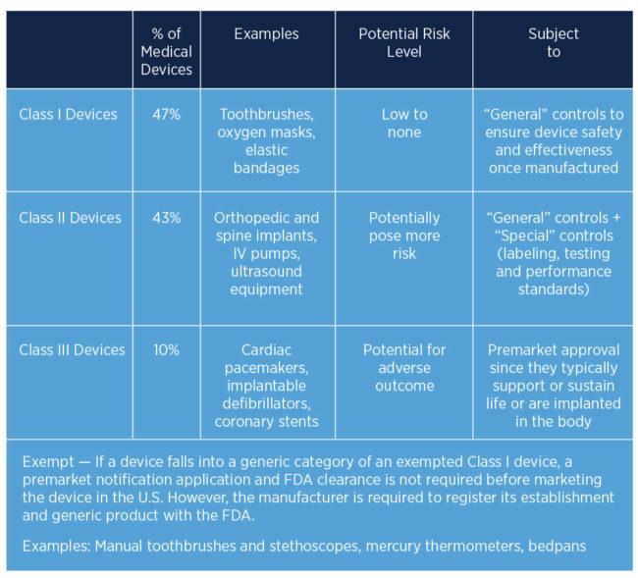
Notes:
You can see that Class 1 devices make up the majority of devices on the market. It is kind of interesting that a bandage is considered a device but it is. . You can also see the the potential risk level for Class 1 devices are low and Class III devices have a potential for an adverse outcome.

Slide 37
21 CF
CFR - Code of Federal Regulations Title 21 (fda.gov)
21 CFR 812
Notes:
Let’s take an overview of 21 CFR 812. So these regulations are structured similarly to the regulations in 312.

Slide 38
Definitions
Investigational Device Exemption (IDE)
IDE refers to the regulations under 21 CFR 812. An approved IDE means that the IRB (and FDA for significant risk devices) has approved the sponsor’s study application and all the requirements under 21 CFR 812 are met.
Premarket Approval (PMA)
A premarket approval means any premarket approval application for a Class III medical device, including all information submitted with or incorporated by reference therein. (21 CFR 814.3)
Premarket Notification [PMN or 510(k)]
510(k) refers to the type of submission to FDA described under 21 CFR 807 Subpart E in which the applicant must establish that their device is substantially equivalent to a legally marketed device. This type of submission is used for most Class II devices and some Class I devices.
Notes:
Derita, will you please go over these definitions?
Investigational Device Exemption-----this is the parallel to an Investigational New Drug Application. Exemption in this term does not refer being exempt from the FDA regulations. It means “exempt” from marketing guidelines across state lines. That is a bit confusing but remember that. On the next slide we will go deeper into the Premarket notification process.

Slide 39
Predicate Device
Predicate device: A Premarket Notification [510(k)] is a premarketing submission made to FDA to demonstrate that the device to be marketed is safe and effective by proving substantial equivalence (SE) to a legally marketed device (predicate device) that is not subject to Premarket Approval (PMA). ... The legally marketed device(s) to which equivalence is drawn is known as the predicate device(s).
Notes:
Read the slide.
What this means is that if a device manufacturer has made a modification to a previously approved similar (predicate device), the manufacturer only needs to submit a 510(k) application. For example, a bandaid has been approved by the FDA. The manufacturer changes the shape of the bandaid. A substantial change has not been made to the predicate device. However, if the bandaid now includes a antimicrobial, the Premarket Approval process (IDE) may need to be completed.
Premarket Notification means---OK FDA, We sending you notification that we are going to market a device that has a predicate (similar previously approved version).
Premarket Approval means----OK FDA, we need to go through the process of submitting an IDE.
In the previous slide we looked at the definition for a Premarket notification. What this means is that if a device manufacturer has made a modification to a previously approved similar (predicate device), the manufacturer only need to submit a 510 (k) application.

Slide 40
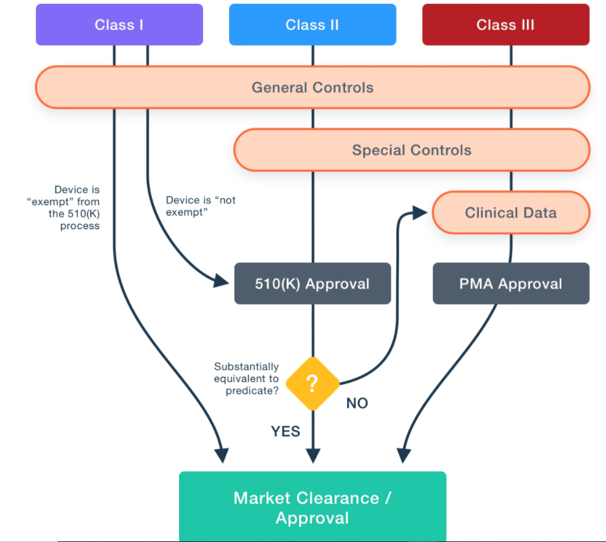
Resource: Sierra Labs
Notes:
Let’s look at this diagram which demonstrates the route to approval of a device. You can see that Class I, II and II devices have general controls, Class II and Class II have Special Controls and Class III which are the devices with the highest risk of outcomes need clinical data and a Premarket Approval before they can be marketed for use. A class 1 and Class II device may be able to receive a 510(k) (I don’t know what that stands for) if the device has a substantially equivalent previous or predicate device. If there is no substantial or previous device then there is a need to collect clinical data through a Premarket approval process (a clinical trial).

Slide 41
Definitions
Investigational device means a device, including a transitional device, that is the object of an investigation.
Significant risk (SR) device means an investigational device that:
(1) Is intended as an implant and presents a potential for serious risk to the health, safety, or welfare of a subject;
(2) Is purported or represented to be for a use in supporting or sustaining human life and presents a potential for serious risk to the health, safety, or welfare of a subject;
(3) Is for a use of substantial importance in diagnosing, curing, mitigating, or treating disease, or otherwise preventing impairment of human health and presents a potential for serious risk to the health, safety, or welfare of a subject; or
(4) Otherwise presents a potential for serious risk to the health, safety, or welfare of a subject.
Notes:
More definitions but they are important to understand. Devices in addition to Classes 1 – III are further categorized into Significant risk of non-significant risk. Read the slide

Slide 42
Definitions
What is a Nonsignificant Risk Device (NSR)?
An NSR device is one that does not meet the definition for a Significant Risk (SR) device.
Notes:
Read the slide. The Classes of devices (I through III) differ from significant and non-significant risk device definitions.

Slide 43
Who Decides Whether A Device Study is SR or NSR?
Sponsors are responsible for making the initial risk determination and presenting it to the IRB.
FDA is also available to help the sponsor, clinical investigator, and IRB in making the risk determination.
Unless FDA has already made a risk determination for the study, the IRB must review the sponsor's SR or NSR determination for every investigational medical device study reviewed and modify the determination if the IRB disagrees with the sponsor.
If FDA has already made the SR or NSR determination for the study, the agency's determination is final. FDA is available to help the IRB when making its risk determination.
Notes:
So let’s say that it is determined that a device has to go through Premarketing approval which means going through the IDE (potential Clinical Trial) process. Sponsors are responsible for making the initial risk determination of SR or NSR. Read the rest of the slide.

Slide 44
What are the Major Differences Between SR And NSR Device Studies
The major differences between SR and NSR studies are in the IDE approval process and in the sponsor’s record keeping and reporting requirements.
Significant Risk (SR) Device Studies must follow all the IDE regulations at 21 CFR 812.
SR device studies must have an IDE application approved by FDA before they may proceed.
Notes:
So why is the distinction of significant or non-significant determination important. Read the slide.

Slide 45
Nonsignificant Risk Device Studies
NSR device studies must follow the abbreviated requirements at 21 CFR 812.2(b).
These abbreviated requirements address labeling, IRB approval, informed consent, monitoring, records, reports, and prohibition against promotion. However, there is no need to make progress reports or final reports to FDA.
NSR device studies do not have to have an IDE application approved by FDA. • Sponsors and IRBs do not have to report the IRB approval of an NSR device study to FDA. This means that an IRB may approve an NSR device study and an investigator may conduct the study without FDA knowing about it.
An IRB’s NSR determination is important because the IRB serves as the FDA’s surrogate for review, approval, and continuing review of the NSR device studies. An NSR device study may start at the institution as soon as the IRB reviews and approves the study and without prior approval by FDA.
Notes:
Read the slide.

Slide 46
Resource: Sierra Labs
Notes:
Let’s go back and look at this diagram again. A class I may or may not go through the 510(k) process where there is a substantially equivalent previous device. So Class II devices are most likely to undergo a 510 K approval process in order to market. Class II devices almost always go through the PreMarket approval Process (IDE process).

Slide 47
510(k) Clearance
Section 510(k) of the Food, Drug and Cosmetic Act requires device manufacturers who must register, to notify FDA of their intent to market a medical device at least 90 days in advance. This is known as Premarket Notification - also called PMN or 510(k).
This allows FDA to determine whether the device is equivalent to a device already placed into one of the three classification categories. Thus, "new" devices (not in commercial distribution prior to May 28, 1976) that have not been classified can be properly identified.
Specifically, medical device manufacturers are required to submit a premarket notification if they intend to introduce a device into commercial distribution for the first time or reintroduce a device that will be significantly changed or modified to the extent that its safety or effectiveness could be affected. Such change or modification could relate to the design, material, chemical composition, energy source, manufacturing process, or intended use.
Notes:
Read the slide.

Slide 48
Device Class and Type of Submission
The class to which your device is assigned determines, among other things, the type of premarketing submission/application required for FDA clearance to market.
If your device is classified as Class I or II, and if it is not exempt, a 510k will be required for marketing.
For Class III devices, a premarket approval application (PMA) will be required unless your device is a pre-amendments device (on the market prior to the passage of the medical device amendments in 1976, or substantially equivalent to such a device) and PMA's have not been called for. In that case, a 510k will be the route to market.
Notes:
So as a review. …. Read the slide.

Slide 49
21 CFR 814
FDA Premarket Approval (PMA)
eCFR :: 21 CFR Part 814 -- Premarket Approval of Medical Devices
Notes:
Two major parts of 21 CFR 814 are the Premarket Approval (PMA) and the Humanitarian Use Device regulations. First, we will discuss the PMA. Let’s take a look.

Slide 50
HUMANITARIAN USE DEVICES (HUD)
21 CFR 814
Subpart H
Notes:
The next type of device submission we are going to discuss is the Humanitarian Use Device regulations at 21 CFR 814

Slide 51
HUD DEFINITION
21 CFR 814
Subpart H
A HUMANITARIAN USE DEVICE (HUD) IS A MEDICAL DEVICE INTENDED TO BENEFIT PATIENTS IN THE TREATMENT OR DIAGNOSIS OF A DISEASE OR CONDITION THAT AFFECTS OR IS MANIFESTED IN FEWER THAN 8,000 INDIVIDUALS IN THE UNITED STATES PER YEAR.
8
Subpart H
Notes:
Read the slide. An HUD is the parallel to the Orphan Drug Status under the 21 CFR 312 Drug regulations. Both provide new drugs / devices for persons with rare diseases or conditions.

Slide 52
Features Of a Humanitarian Device Exemption (HDE)
AN HDE AUTHORIZES THE HOLDER TO MARKET THE DEVICE
THE APPLICANT MUST ESTABLISH SAFETY OF THE DEVICE, BUT NOT ITS EFFECTIVENESS
AN HDE IS ISSUED ONLY IF A COMPARABLE DEVICE IS NOT MARKETED
USE OF THE HUD UNDER AN HDE IS NOT HUMAN RESEARCH
THE FACILITY IN WHICH IT IS USED MUST HAVE AN IRB AND ITS USE MUST BE REVIEWED BY AN IRB
Notes:
Read the Slide. Read the
Remember IDE is an Investigational Device Exemption and an HDE is a Humanitarian Device Exemption.

Slide 53
Test your knowledge

Slide 54
Question 1:
What is the parallel for an IND (Investigational New Drug) application: a. An Investigational Device Exemption b. A Humanitarian Use Device

Slide 55

Question 1 answer:
What is the parallel for an IND (Investigational New Drug) application for the following: a. An Investigational Device----
IDE (Investigational Device Exemption) b. A Humanitarian Use Device
HDE (Humanitarian Device Exemption)

Slide 56
Question 2:
An example of a combination product is a. Intraocular lens b. Insulin inhaler c. Foley catheter d. none of the above

Slide 57

Question 2 answer:
An example of a combination product is a. Intraocular lens b. Insulin inhaler c. Foley catheter d. none of the above

Slide 58
Combination Products
Combination products are therapeutic and diagnostic products that combine drugs, devices, and/or biological products.
Combination products are typically marketed under a marketing authorization type associated with the constituent part that provides the primary mode of action (PMOA) for the combination product, for example:
a new drug application (NDA) or abbreviated new drug application (ANDA)
premarket notification (“510(k)”) if it has a device PMOA
A single marketing application is generally sufficient for a combination product.
Notes:
We didn’t talk about combination products so here some information describing a combination product. Read the slide

Slide 59
Question 3:
21 CFR 814 regulates the: a. Investigational Device Exemption b. Financial disclosures of Investigators c. Investigational New Drug Application d. Premarket Approval Application.

Slide 60

Question 3:
21 CFR 814 regulates the: a. Investigational Device Exemption b. Financial disclosures of Investigators c. Investigational New Drug Application d. Premarket Approval Application.

Slide 61

Questions?

