Slide 1
CERTIFICATION EXAM PREPARATION COURSE
SESSION 11:
Investigational Product

Slide 2
Handouts/Reference sheets/Worksheets:
NIH IP Accountability Tool Summary Sheet
IP Accountability Reference Sheet
Webinars:
Research 101, session 10

Slide 3
FDA’s CFR Definition of an Investigational New Drug
"...a new drug or biological drug that is used in a clinical investigation." In the U.S. Food and Drug Administration (FDA) regulations, an investigational new drug is any substance (such as a drug, vaccine or other biological product) for which FDA approval is being sought
A drug may be considered “new” even if it has been in use for years if a change is proposed in its use, formulation, route of administration, use in patient population where risk would be increased, or packaging

Slide 4
FDA’s Definition of an Investigational Device
Means a device, including a transitional device, that is the object of an investigation

Slide 5
ICH GCP’s Definition an Investigational Product
“A pharmaceutical form of an active ingredient or placebo being tested or used as a reference in a clinical trial” (ICH GCP 1.33).
This may include a marketed product that is being used in a different form than the one it was approved for, or a marketed product being used for an unapproved or new indication.

Slide 6
Investigational Product
Includes the following being studied in a clinical trial:
Drug
Device
Biologic

Slide 7
Investigational Product Accountability

Slide 8
Purpose of IP Accountability
Inventory records document that IP was used only for study participants in accordance with the approved protocol
Ensure study participants:
receive the correct IP
are in compliance with the protocol

Slide 9
Why is IP Accountability Needed?
Subject safety
Documents the handling of the IP
Identifies subjects who have received the IP/Ensure study participants receive the correct IP
Document compliance with the protocol
Verify data integrity

Slide 10
IP Accountability
Process
PROCESS includes:
Receipt
Storage
Distribution
Return/Destruction
Compliance

Slide 11
Regulations
21 CFR 312
21 CFR 812
ICH GCP E6 (R2)

Slide 12
21 CFR 312 Subpart D
312.57 Recordkeeping and record retention
312.59 Disposition of unused supply of investigational drug
312.57 A sponsor shall maintain adequate records showing the receipt, shipment, or other disposition of the investigational drug. These records are required to include, as appropriate, the name of the investigator to whom the drug is shipped, and the date, quantity, and batch or code mark of each such shipment
312.59 The sponsor shall assure the return of all unused supplies of the investigational drug from each individual investigator whose participation in the investigation is discontinued or terminated. The sponsor may authorize alternative disposition of unused supplies of the investigational drug provided this alternative disposition does not expose humans to risks from the drug. The sponsor shall maintain written records of any disposition of the drug in accordance with 312.57

Slide 13
21 CFR 312 Subpart D
312.61 Control of the Investigational Drug
An investigator shall administer the drug only to subjects under the investigator's personal supervision or under the supervision of a sub-investigator responsible to the investigator. The investigator shall not supply the investigational drug to any person not authorized under this part to receive it
312.62 Investigator Recordkeeping and Record Retention
Disposition of the drug: An investigator is required to maintain adequate records of the disposition of the drug, including dates, quantity, and use by subjects. If the investigation is terminated, suspended, discontinued, or completed, the investigator shall return the unused supplies of the drug to the sponsor, or otherwise provide for disposition of the unused supplies of the drug under § 312.59

Slide 14
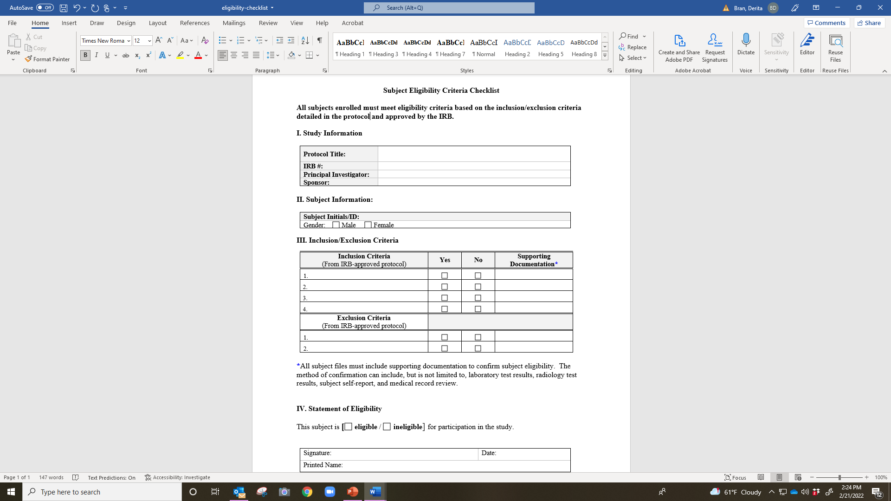

Slide 15
21 CFR 312 Subpart D
312.69 Handling of Controlled Substances
If the investigational drug is subject to the Controlled Substances Act, the investigator shall take adequate precautions, including storage of the investigational drug in a securely locked, substantially constructed cabinet, or other securely locked, substantially constructed enclosure, access to which is limited, to prevent theft or diversion of the substance into illegal channels of distribution

Slide 16
ICH GCP E6 (R2)
4.6 Investigational Product(s)
  4.6.1 Responsibility for investigational product(s) accountability at the trial site(s) rests with the investigator/institution
  4.6.2 Where allowed/required, the investigator/institution may/should assign some or all of the investigator’s/institution’s duties for investigational product(s) accountability at the trial site(s) to an appropriate pharmacist or another appropriate individual who is under the supervision of the investigator/institution
  4.6.3 The investigator/institution and/or a pharmacist or other appropriate individual, who is designated by the investigator/institution, should maintain records of the product’s delivery to the trial site, the inventory at the site, the use by each subject, and the return to the sponsor or alternative disposition of unused product(s). These records should include dates, quantities, batch/serial numbers, expiration dates (if applicable), and the unique code numbers assigned to the investigational product(s) and trial subjects. Investigators should maintain records that document adequately that the subjects were provided the doses specified by the protocol and reconcile all investigational product(s) received from the sponsor

Slide 17
ICH GCP E6 (R2)
4.6.4 The investigational product(s) should be stored as specified by the sponsor (see sections 5.13.2 and 5.14.3) and in accordance with applicable regulatory requirement(s)
4.6.5 The investigator should ensure that the investigational product(s) are used only in accordance with the approved protocol
4.6.6 The investigator, or a person designated by the investigator/institution, should explain the correct use of the investigational product(s) to each subject and should check, at intervals appropriate for the trial, that each subject is following the instructions properly

Slide 18
ICH GCP E6 (R2)
4.7 Randomization Procedures and Unblinding
The investigator should follow the trial’s randomization procedures, if any, and should ensure that the code is broken only in accordance with the protocol. If the trial is blinded, the investigator should promptly document and explain to the sponsor any premature unblinding (e.g., accidental unblinding, unblinding due to a serious adverse event) of the investigational product(s)

Slide 19
ICH GCP E6 (R2)
Essential Documents Section 8

Slide 20
Essential Documents Section 8
8.2.14 INSTRUCTIONS FOR HANDLING OF INVESTIGATIONAL PRODUCT(S) AND TRIALRELATED MATERIALS (if not included in protocol or Investigator’s Brochure) To document instructions needed to ensure proper storage, packaging, dispensing, and disposition of investigational product(s) and trialrelated materials
8.2.15 SHIPPING RECORDS FOR INVESTIGATIONAL PRODUCT(S) AND TRIAL-RELATED MATERIALS To document shipment dates, batch numbers and method of shipment of investigational product(s) and trialrelated materials. Allows tracking of product batch, review of shipping conditions, and accountability
8.2.17 DECODING PROCEDURES FOR BLINDED TRIALS To document how, in case of an emergency, identity of blinded investigational product can be revealed without breaking the blind for the remaining subjects’ treatment
8.2.18 MASTER RANDOMIZATION LIST To document method for randomization of trial population

Slide 21
8.3 During the Clinical Conduct of the Trial
8.3.1 INVESTIGATOR’S BROCHURE UPDATES To document that investigator is informed in a timely manner of relevant information as it becomes available
8.3.8 DOCUMENTATION OF INVESTIGATIONAL PRODUCT(S) AND TRIAL-RELATED MATERIALS SHIPMENT
8.3.23 INVESTIGATION PRODUCTS ACCOUNTABILITY AT THE SITE To document that investigational product(s) have been used according to the protocol

Slide 22
8.4 After Completion or Termination of the Trial
8.4.1 INVESTIGATIONAL PRODUCT(S) ACCOUNTABILITY AT SITE To document that the investigational product(s) have been used according to the protocol. To document the final accounting of investigational product(s) received at the site, dispensed to subjects, returned by the subjects, and returned to sponsor
8.4.2 DOCUMENTATION OF INVESTIGATIONAL PRODUCT DESTRUCTION To document destruction of unused investigational products by sponsor or at site
8.4.6 TREATMENT ALLOCATION AND DECODING DOCUMENTATION Returned to sponsor to document any decoding that may have occurred

Slide 23
Who is Responsible for IP Accountability?
Investigator
Qualified study team members that have been delegated this task
Sponsor/CRO
Pharmacist

Slide 24
Results of Poor IP Accountability
Subject may incur a safety risk
Loss of data/data integrity
Negative monitoring/auditing reports
Sponsor may place a “hold” on the study if non-compliance is severe

Slide 25
Documentation of the IP
Records/Essential Documents:
  Receipt of the IP at the study site
  Secured location of IP (locked/limited access)
  Dispensing records
  Return of IP from subject
  Subject Compliance
  Return to sponsor/CRO
  Destruction
  Storage
  Expiration dates
  Inventory
  Temperature logs/excursions

Slide 26
Documentation of the Receipt of the IP at the Site
Name of person receiving IP (qualified delegated personnel)
Date of receipt
Name of IP
Lot #, expiration date, Batch/serial information/unique code (all that are applicable)
Dosage
Expiration date
Quantity

Slide 27
What to Document When Dispensing IP
Subject ID
Name identifier of IP
Lot #, expiration date, Batch/serial information/unique code (all that are applicable)
Dose
Date dispensed
Quantity
Name of the person dispensing
Subject instructions/education

Slide 28
What to Document When the Subject Returns IP
Name of medication
Lot #, expiration date, Batch/serial information/unique code (all that are applicable)
Dose
Date returned
Quantity returned
Name of the person receiving
Compliance

Slide 29
What to Document When Destroying/Returning IP
Name of medication
Lot #, expiration date, Batch/serial information/unique code (all that are applicable)
Dose
Date destroyed
Quantity destroyed
Means of destruction
Name/title/signature of the person destroying
Name/title/signature of at least one witness

Slide 30
Documents to be Maintained
Investigational brochure, package insert, or device manual, all versions
Sample of product label
Documentation of study product shipment/receipt/dispensing/return/disposal
Include dates, quantities, batch/serial #/lot #s/unique codes, expiration dates
Instructions for IP handling
Randomization instructions, if applicable
Temperature log, when applicable
Storage/maintenance instructions
Unblinding procedures, as applicable
Subject IP accountability/compliance
Calibration of all equipment, ie. Freezers/refrigerators
Delegation of Authority log

Slide 31
IP Accountability Log

Slide 32
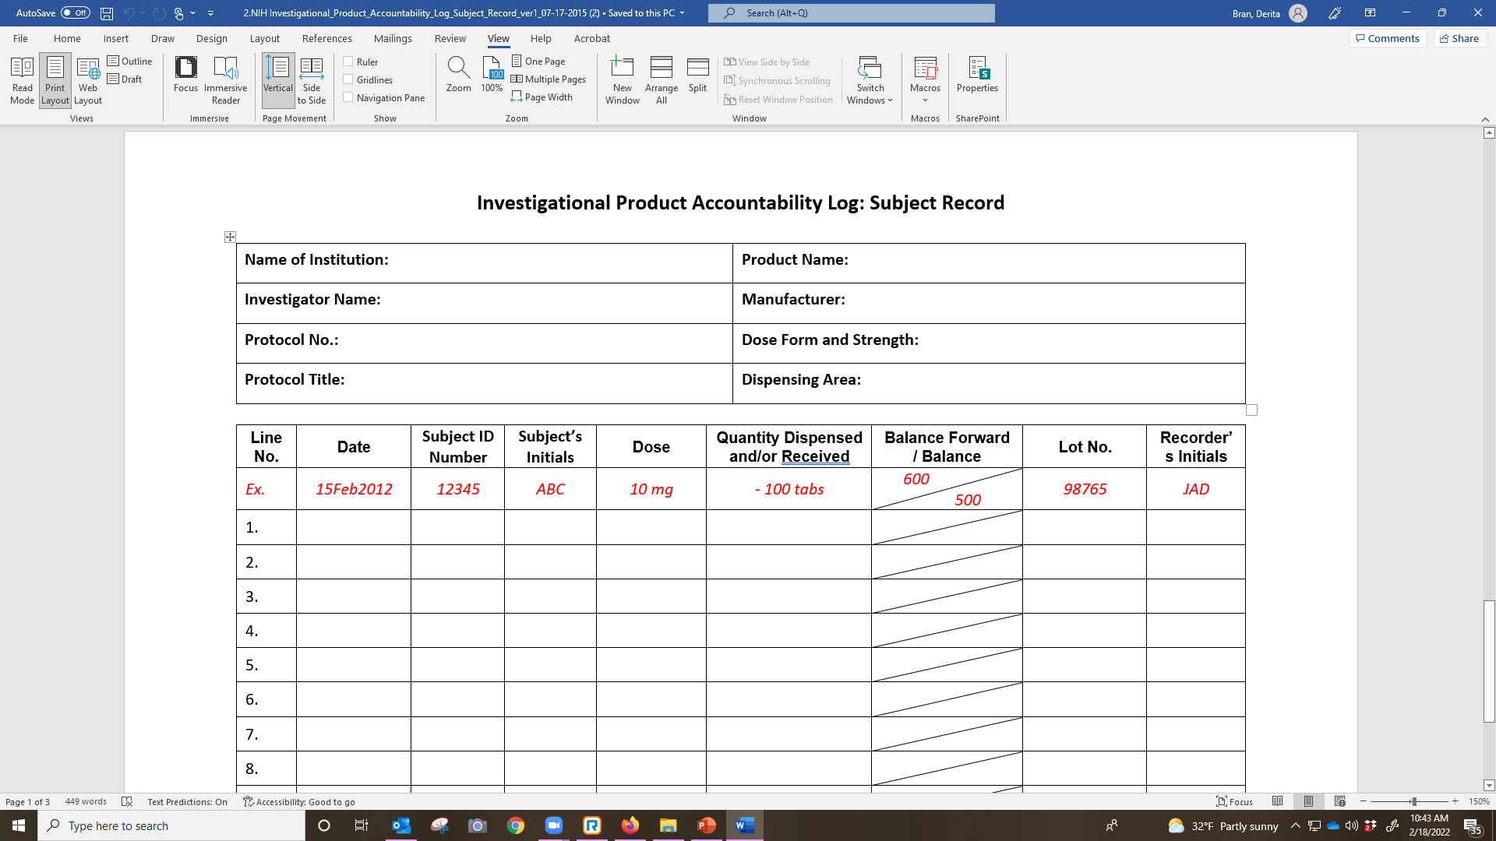

Slide 33
Best Practices
Complete the log as study product is received dispensed/returned/destroyed
Follow ALCOA-C
Number each page of the IP accountability records
Store pages in reverse chronological order
Identify the final page of the log at the close-out of the study

Slide 34
Charging for IPs
Charging for Investigational Medical Devices and Radiological Health Products
The Investigational Device Exemption (IDE) regulations allow sponsors to charge for an investigational device, however, the charge should not exceed an amount necessary to recover the costs of manufacture, research, development, and handling of the investigational device [21 CFR 812.7(b)]. A sponsor justifies the proposed charges for the device in the IDE application, states the amount to be charged, and explains why the charge does not constitute commercialization [21 CFR 812.20(b)(8)]. FDA generally allows sponsors to charge investigators for investigational devices, and this cost usually is passed on to the subjects.
Charging for Investigational Drugs and Biologics
On August 13, 2009, FDA issued 21 CFR Part 312 and 316 Charging for Investigational Drugs Under an Investigational New Drug Application; Expanded Access to Investigational Drugs for Treatment Use; Final Rules. These rules address clinical studies conducted under an IND as well as treatment protocols and treatment INDs. These rules and the accompanying preamble are available at http://edocket.access.gpo.gov/2009/pdf/E9-19004.pdf

Slide 35


Slide 36

Who should explain the correct use of IP to a subject and how often?
A. Any qualified member of the study team, as needed
B. PI and pharmacist, every visit
C. Any qualified member of the study team that has been delegated the task, before and during the conduct of the study often and as needed
D. PI and Pharmacist, as needed
Notes:
A qualified study team member. Should go over instruction and compliance at each visit

Slide 37
When should IP accountability be performed?
A. Before, during, and at the closure/termination of the study
B. Before, during, and at the closure/termination of the study and at each study and monitoring visit
C. Before, during, and at the closure/termination of the study and at designated interval times as required by the pharmacist
D. Before, during, and at the closure/termination of the study and at monitoring visits

Slide 38
A 1572 is a contract between
A. The PI and the sponsor
B. The PI and the CRO
C. The PI and the FDA
D. The PI and the IRB

Slide 39
According to FDA CFRs, the Investigator’s Brochure (IB)must be created by the _____ and provided to the ____.
A. Investigator, Sponsor
B. CRO, Sponsor
C. Sponsor, IRB/IEC
D. Sponsor, Investigator

Slide 40
Which of these statements is not part of the 1572 PI commitment?
A. I agree to conduct the study(ies) in accordance with the relevant, current protocol(s) and will only make changes in a protocol after notifying the sponsor, except when necessary to protect the safety, rights, or welfare of subjects.
B. I agree to personally conduct or supervise the described investigation(s).
C. I agree to inform any patients, or any persons used as controls, that the drugs are being used for investigational purposes and I will ensure that the requirements relating to obtaining informed consent in 21 CFR Part 50 and institutional review board (IRB) review and approval in 21 CFR Part 56 are met.
D. I agree to report to the sponsor adverse experiences that occur in the course of the investigation(s) in accordance with 21 CFR 312.64.
E. I have read and understand the information in the investigator’s brochure, including the potential risks and side effects of the drug. I agree to ensure that all associates, colleagues, and employees assisting in the conduct of the study(ies) are informed about their obligations in meeting the above commitments.
F. I agree to maintain adequate and accurate records in accordance with 21 CFR 312.62 and to make those records available for inspection in accordance with 21 CFR 312.68.
G. I will ensure that an IRB that complies with the requirements of 21 CFR Part 56 will be responsible for the initial and continuing review and approval of the clinical investigation.
H. I also agree to promptly report to the IRB all changes in the research activity and all unanticipated problems involving risks to human subjects or others. Additionally, I will not make any changes in the research without IRB approval, except where necessary to eliminate apparent immediate hazards to human subjects.
I. I agree to comply with all other requirements regarding the obligations of clinical investigators and all other pertinent requirements in 21 CFR Part 312.

Slide 41
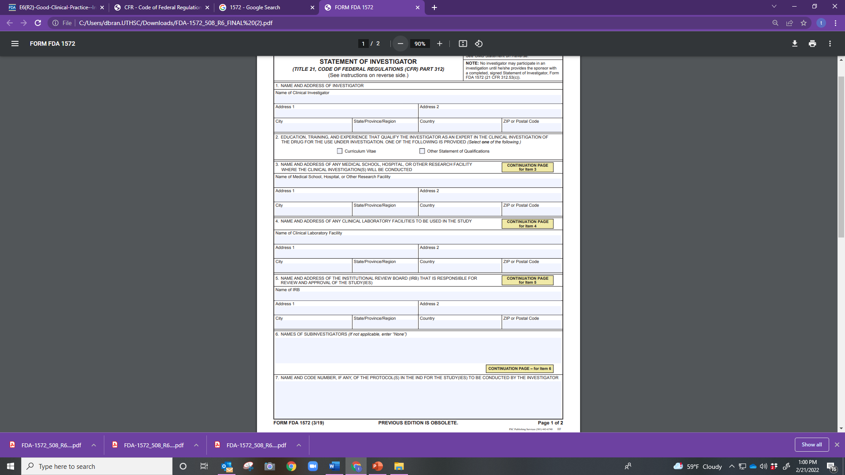

Slide 42
