Slide 1
CERTIFICATION EXAM PREPARATION COURSE
SESSION 10:
Essential Documents: Part 2

Slide 2
Handouts/Reference sheets/Worksheets:
Good Documentation Best Practices
List of Essential Documents
Regulatory Binder Best Practices
Regulatory Binder Set-up
Essential Documents Reference Sheet
Regulatory Binder Tabs/Documents Worksheet
Webinars:
Research 101, session 7
Research 102, session 8
Research 102, session 4

Slide 3
ICH GCP E6 (R2) Section 8.3
During the Clinical Trial

Slide 4
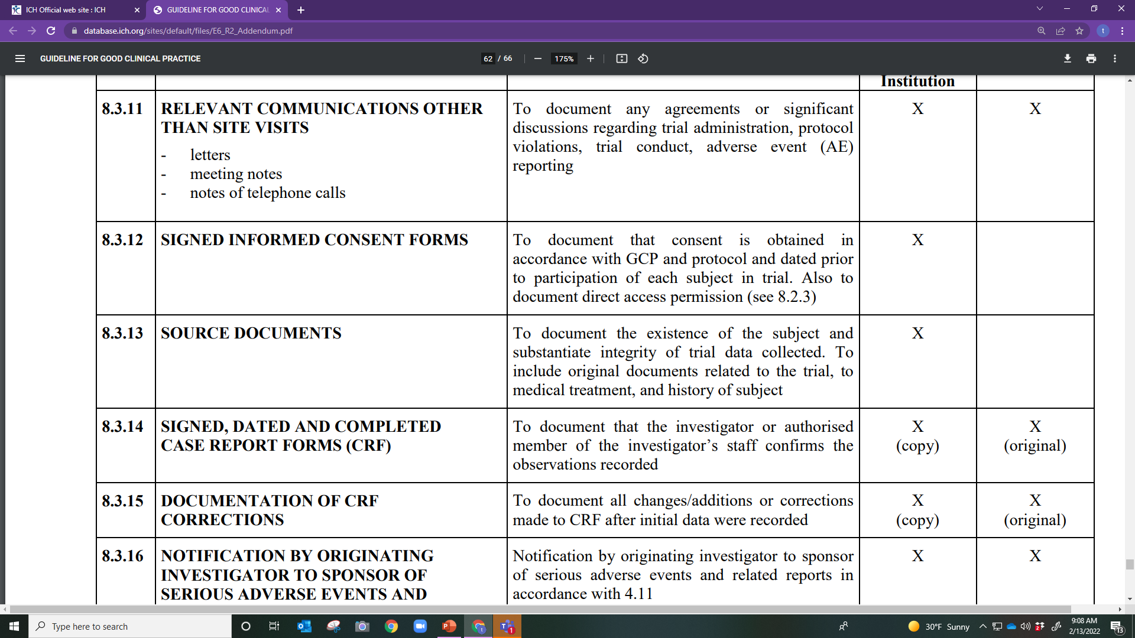

Slide 5
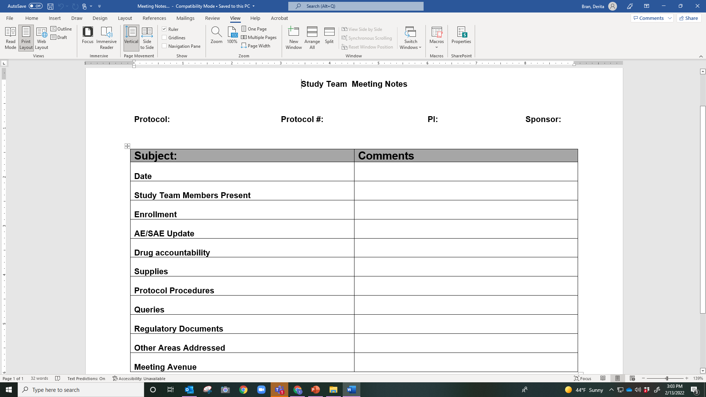

Slide 6
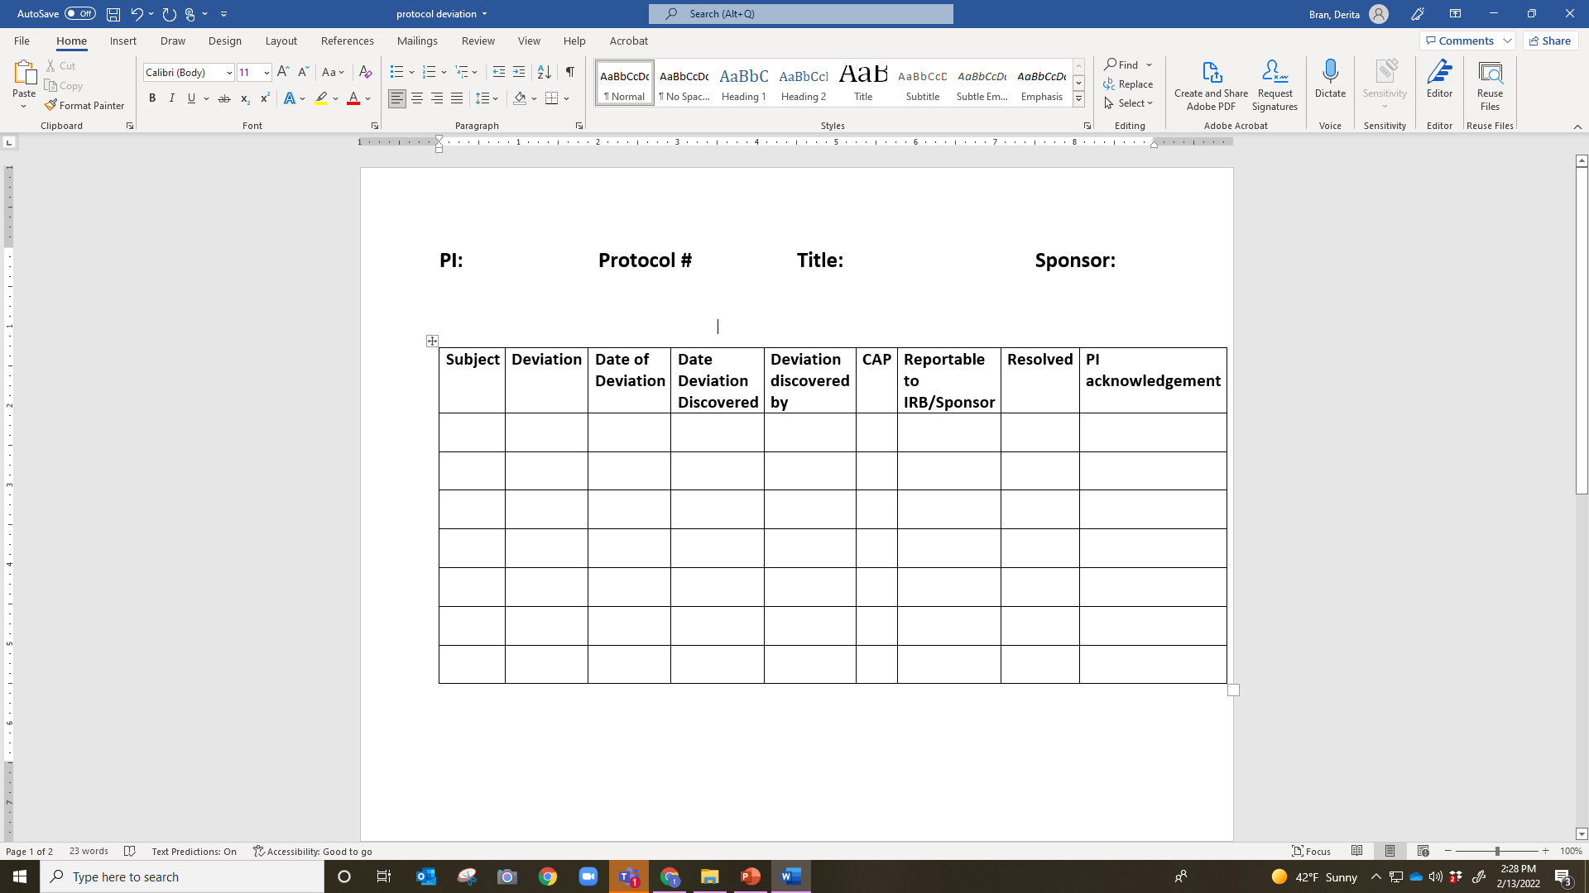

Slide 7
Protocol Deviations
Purpose: Documentation of non-compliance with the protocol
Best Practices:
Maintain a protocol deviation log
Documentation/memo/Corrective Action Preventive Action (CAPA), as applicable for each deviation
Record events a soon as possible after the event
Follow ALCOA-C

Slide 8
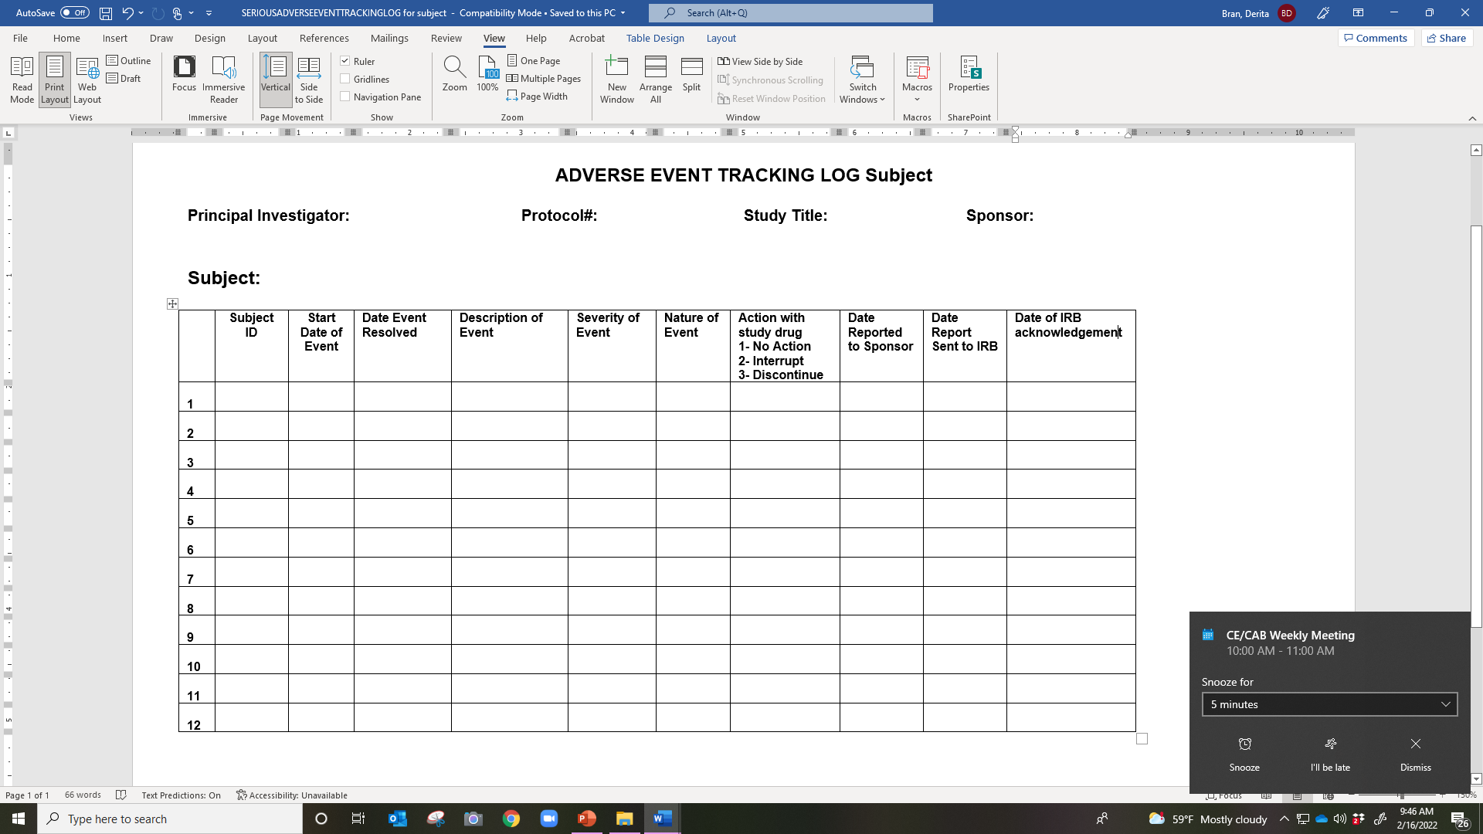

Slide 10
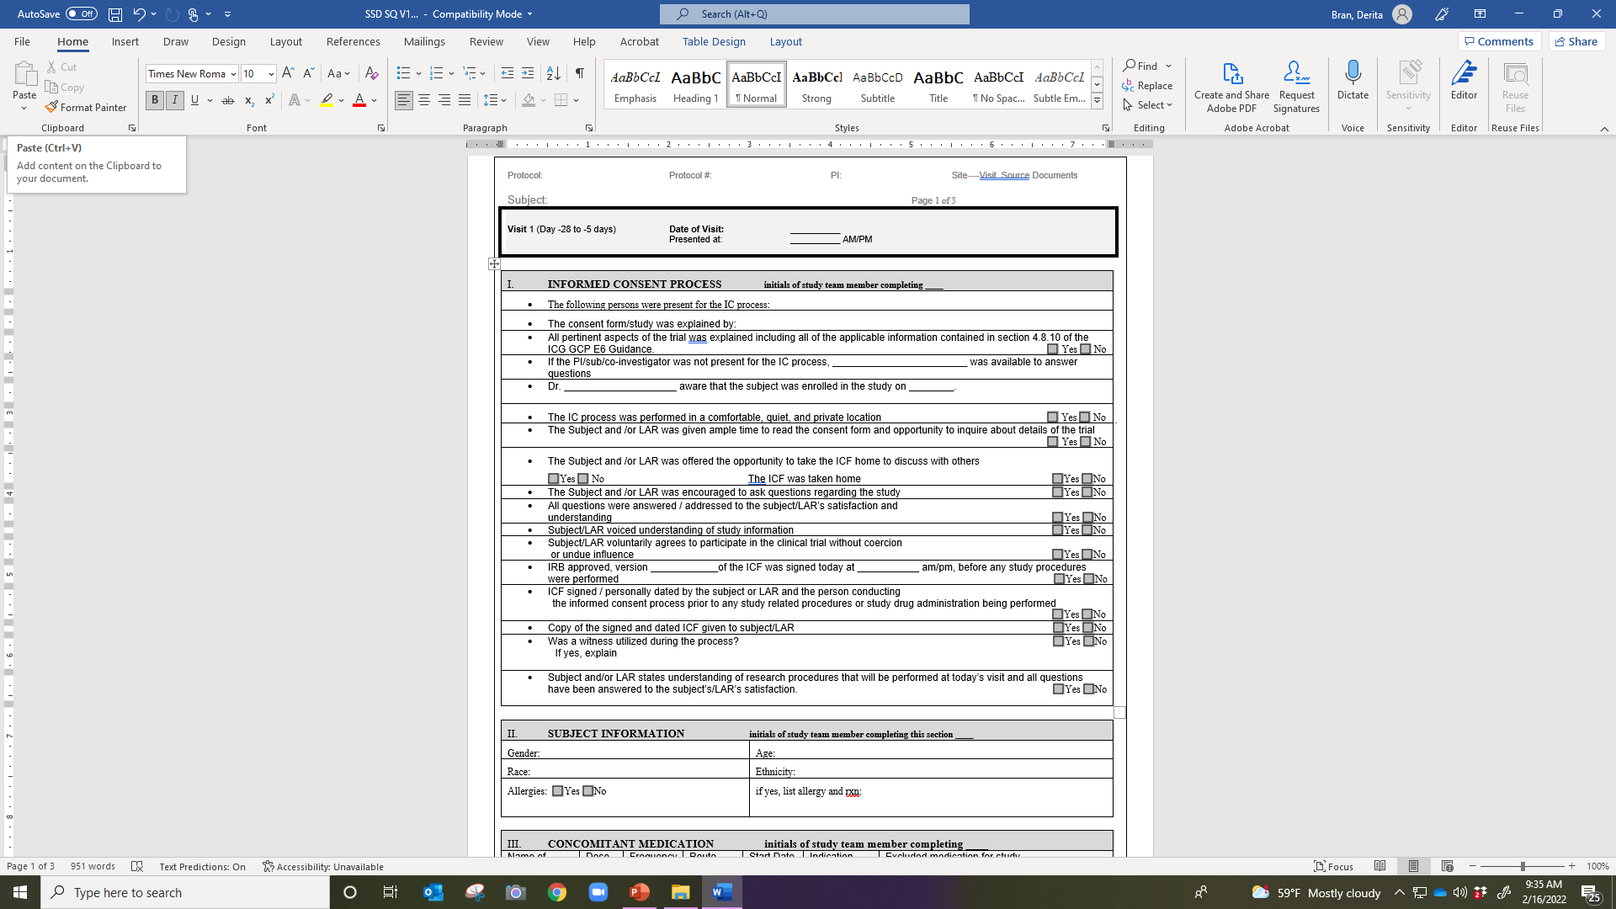

Slide 11
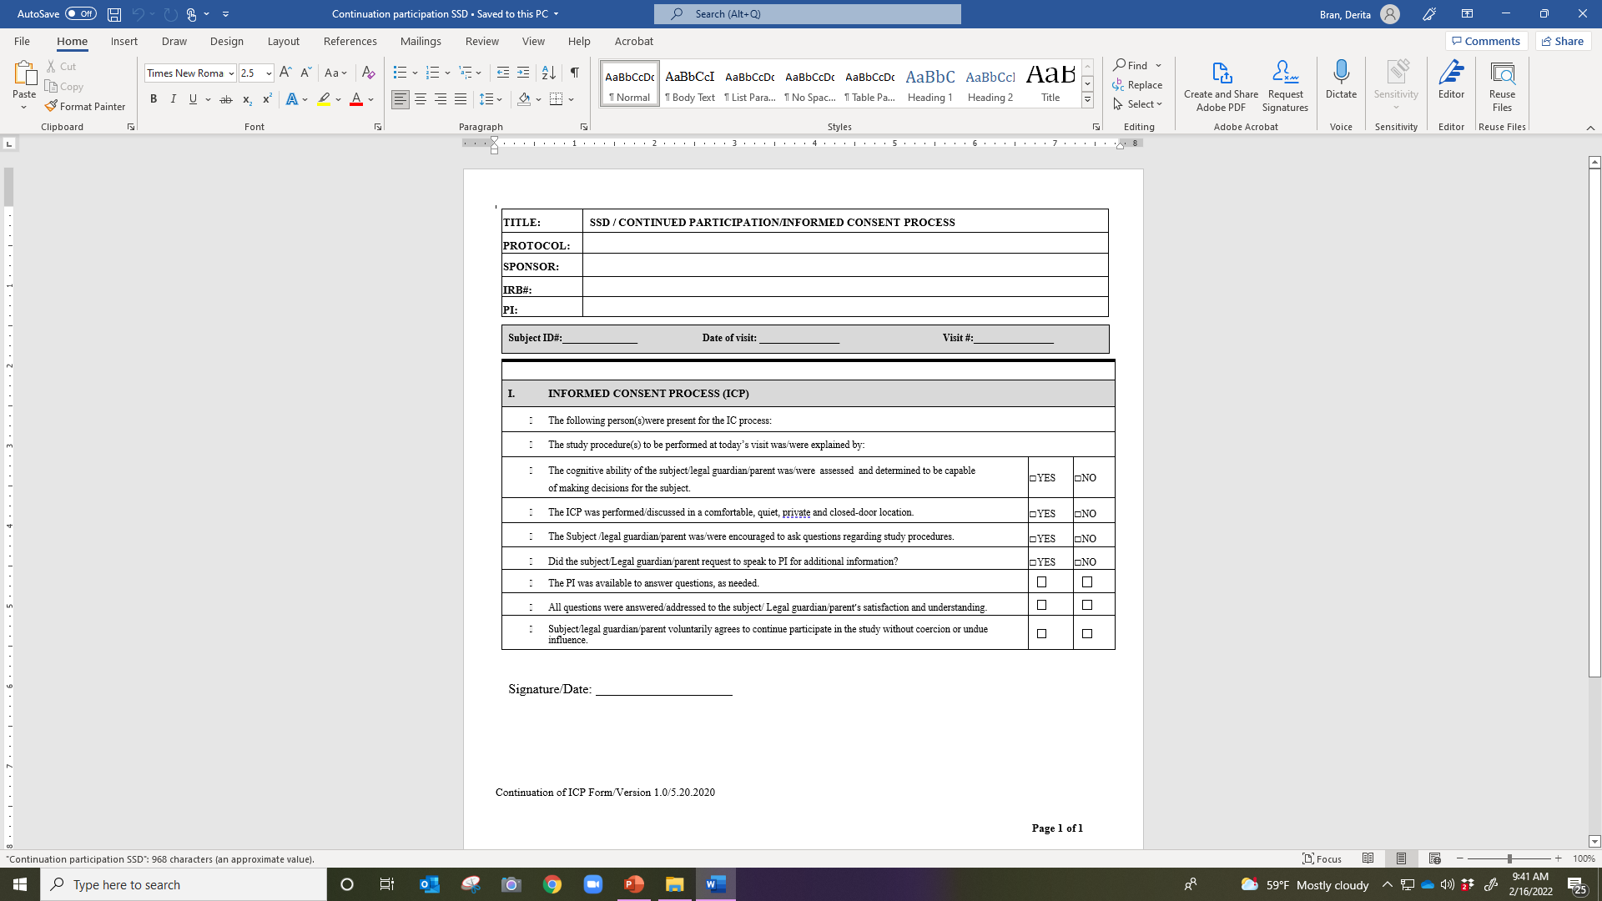

Slide 13
Source Documents
1.52 Source Document Original documents, data, and records
hospital records
clinical and office charts
laboratory notes, memoranda
subjects’ diaries
evaluation checklists
pharmacy records
recorded data from automated instruments
copies or transcriptions certified after verification as being accurate copies
x-rays
subject files

Slide 14
Site Source Documents (SSDs)/Study Visit Worksheets
Created by the site/ occasionally the sponsor
Protocol specific worksheets for each study visit
Includes procedures that need to be performed at each visit
All worksheets should include the following information:
Subject/Protocol identifiers
Visit number/Date of visit
Subject’s desire to participate/continue participation
IP accountability
Adverse events assessment
Study procedures to be performed
Additional information needed to document “the entire study” of the visit

Slide 15
Examples of Site Source Documents
Concomitant Medication Form
Study Visits Worksheets
Study logs
Documentation of the ICP
Initial and
Continuation

Slide 16
Concomitant Medication Form

Slide 18
CRFs Best Practices
All completed CRFs should be maintained as essential documents
CRFs should be dated/signed by the study team member completing the form (ALCOA-C)
Data reported on the CRF should be consistent with the source documents
Any change or correction to a CRF should be dated, initialed, and explained (if necessary) and should not obscure the original entry
Usually the PI reviews/signs off on the completed CRFs or documents

Slide 20
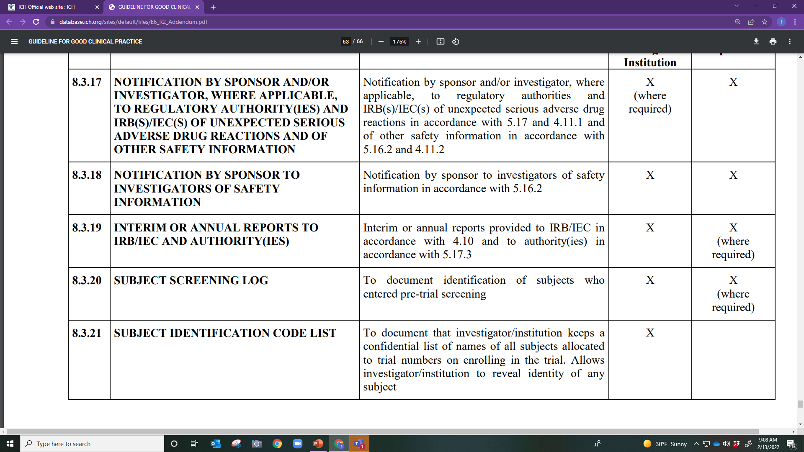

Slide 21
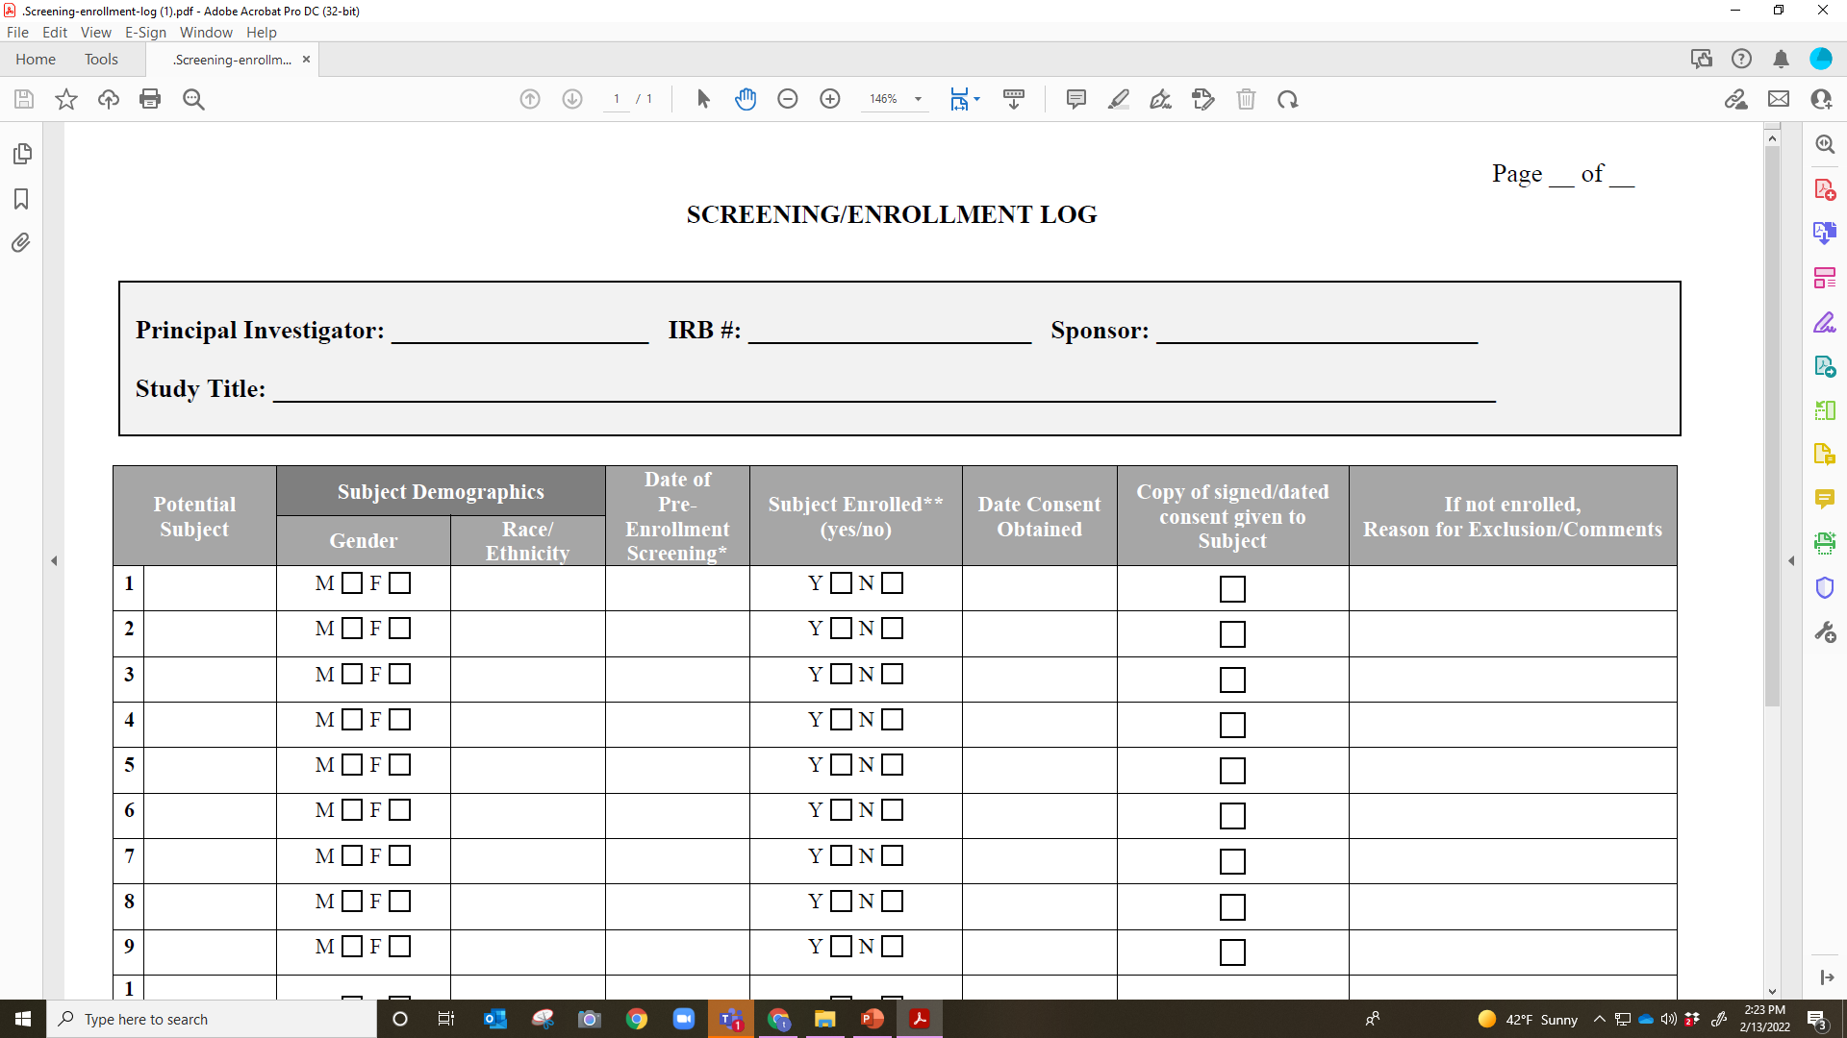
UTHSC IRB created form

Slide 23
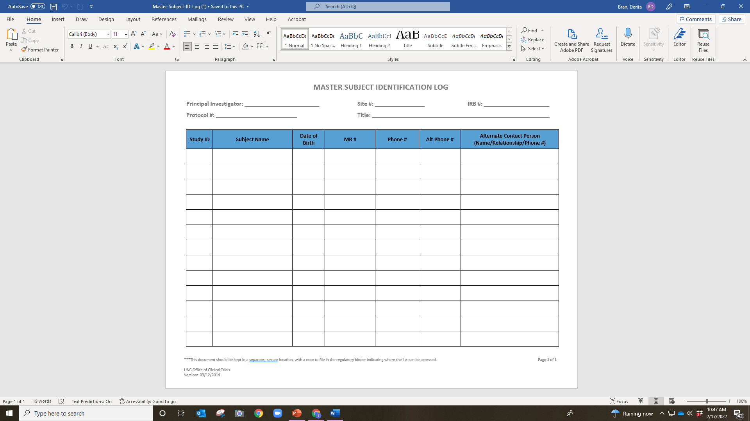

Slide 24
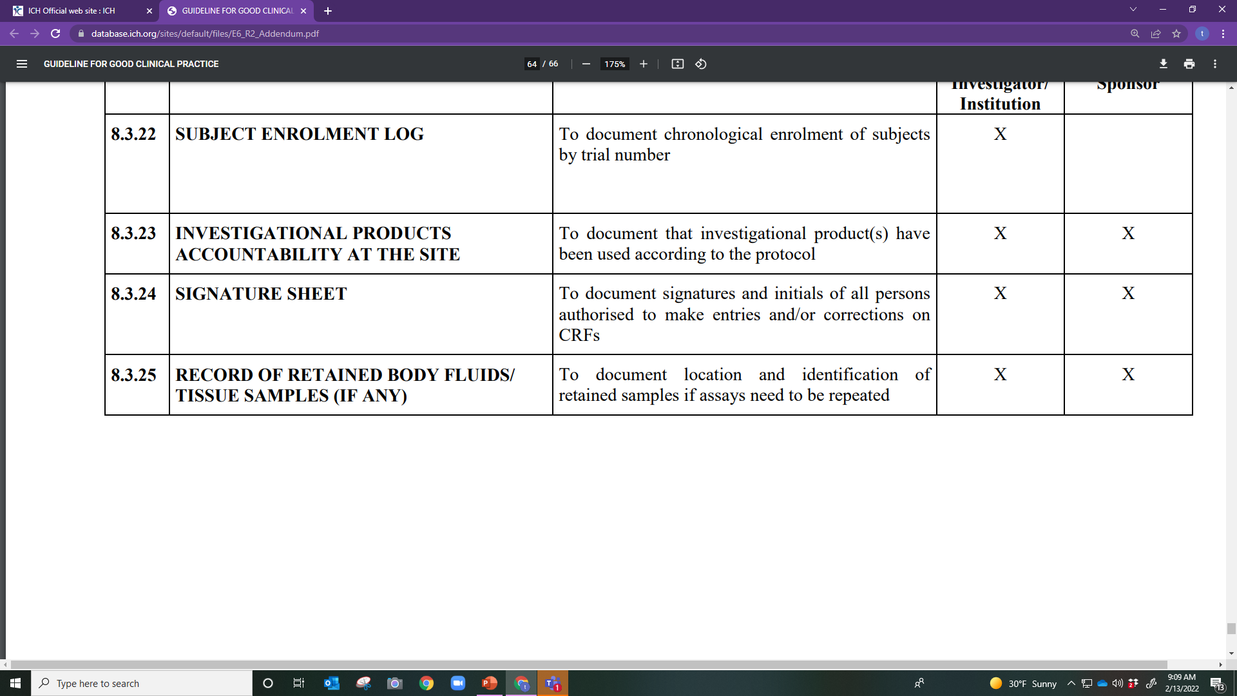

Slide 25
DOAL
Identifies the Key Study Personnel (KSP) in the study
Matches the KSP to their signature and initials
Documents the delegated task of each KSP
Documents the timeline of the study team members work on the study

Slide 26
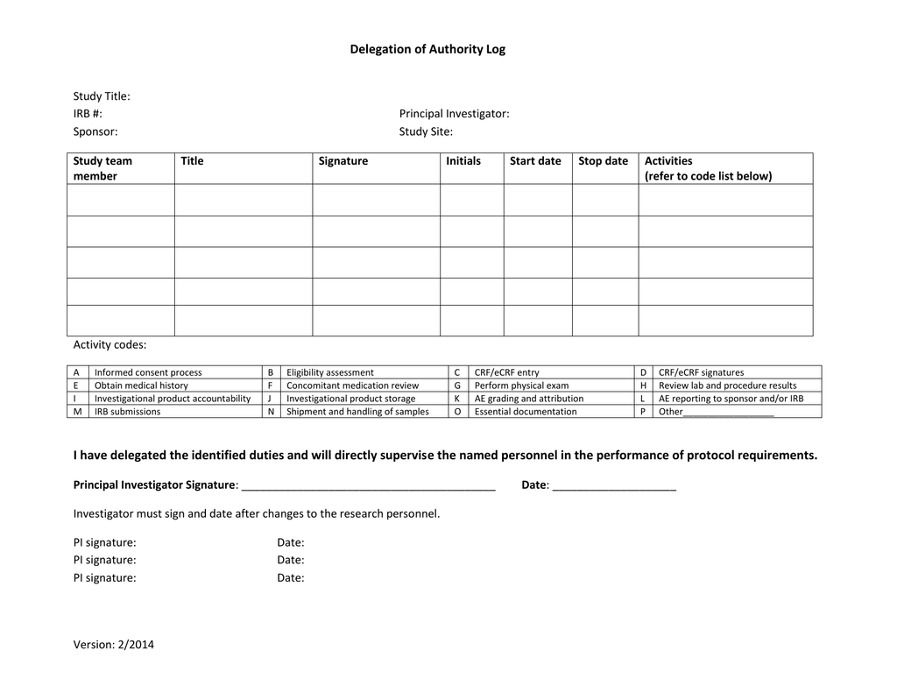

Slide 27
Best Practices for the DOAL
This document must remain current at all times
Should be completed before/at the time the study is initiated
The PI must initial and date any changes that are made throughout the life of the study
He/she must also sign this form at the closure

Slide 29
Specimen Tracking Log
Purpose:
Provides a means to tracks specimens/samples collected as study procedures
Types of samples to track:
Specimen Tracking Log
Retained tissue log
Documents to maintain
Shipping/Receipt/Maintenance documentation
Storage temperature logs

Slide 30
ICH GCP E6 (R2) Section 8.4
After completion or termination of the trial

Slide 31
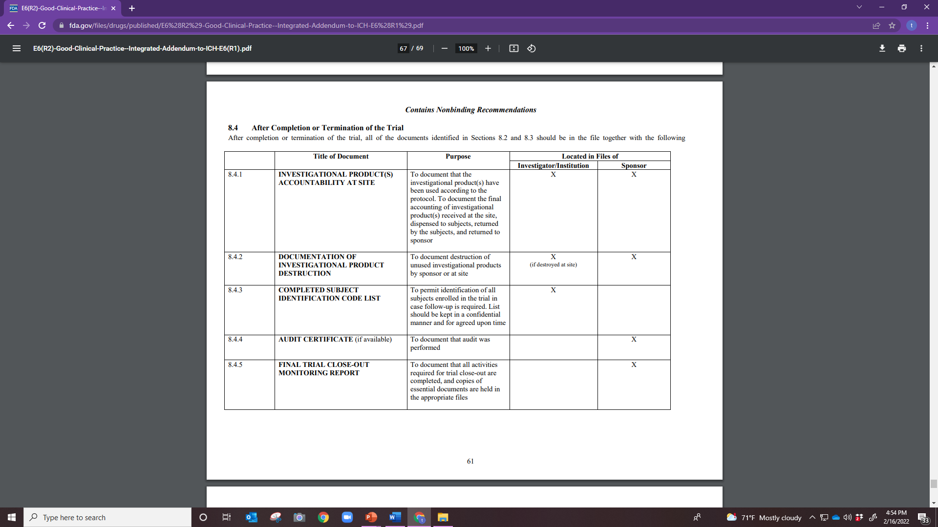

Slide 32
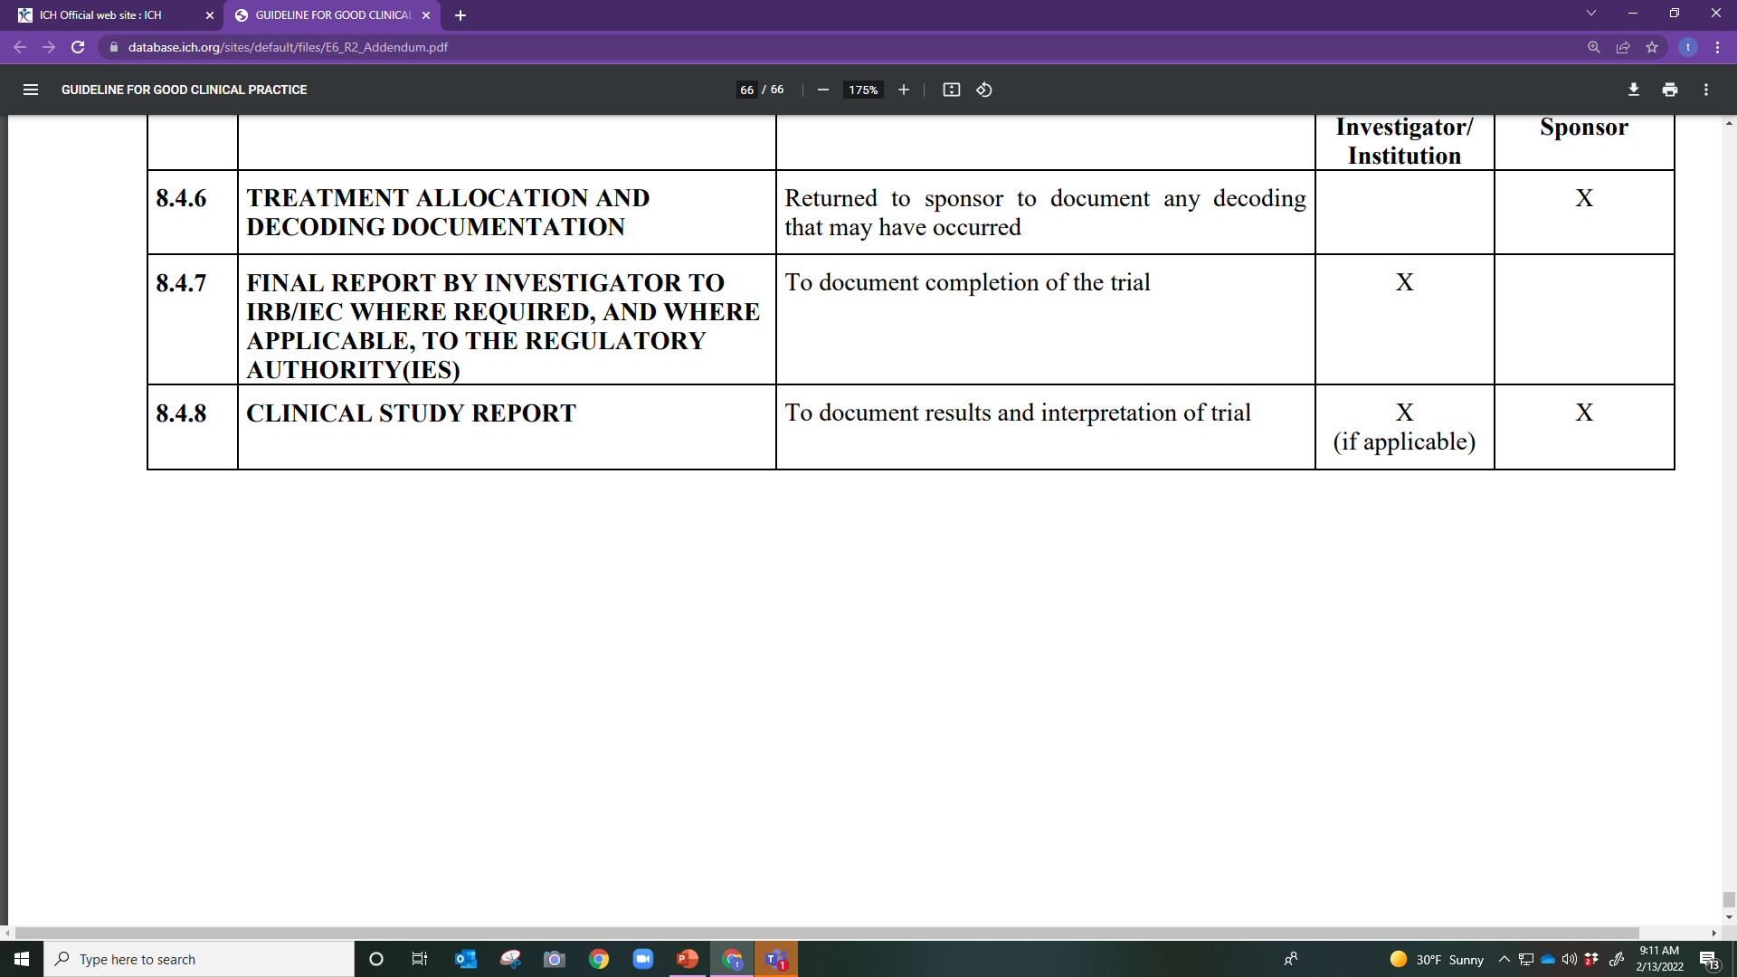

Slide 33
This Photo by Unknown Author is licensed under CC BY-SA

Slide 34
Best Practices for Maintaining Essential Documents
GET ORGANIZED
Create process for maintenance of the Essential documents (Reg binder, etc.)
List of tasks to complete
Checklists/Logs
Don’t procrastinate
Keep up to date/keep audit ready
Prompt reporting
“Real time” documenting
ALCOA-C

Slide 35
Good Documentation Practice
What is not documented---Was not done!
Document what was done AND what was not done
Include reason for any missed information
Use black or dark blue ink
Do not back or future date and entries
Create and maintain documents
Assure documentation is ALCOA-C compliant
SLIDE rule for errors
Be thorough and timely when documenting
Perform quality checks
Be Proactive when finding errors or omissions

Slide 36
How Can Documentation/ Essential Documents be Improved?
Creation of site source documents per protocol
Adequate training per protocol
Delegation of this duty regarding adequate documentation
Follow ALCOA-C
Monitoring for accurate and complete documentation by study staff
Commitment to best documentation practices
Oversight/Internal QA process
Seek resources to increase knowledge
Make sure the documentation tells the entire story

Slide 37
Purpose of Essential Documents
Compliance:
Demonstrates compliance with Regulations and Good Clinical Practice (GCP)
Validates adherence to high standards of research practices and human subject protection
Record Keeping:
Provides an organizational framework for study specific essential documents
Organization and Access:
Allows easy access to study documents with minimal effort
Permits evaluation of the conduct of the study and assists to determine the quality of the data

Slide 39
Tasks that may be delegated by the Principal Investigator to the Coordinator (non nurse) may include the following:
A. Obtaining Informed Consent
B. Assessment of AEs (severity and causality)
C. Physical exam assessments
D. All of the above

Slide 40
The purpose of the delegation log is to
A. Ensure study team members are delegated tasks
B. Identify study team members to which study tasks/procedures have been delegated to by the sponsor
C. Ensure the PI identifies qualified study team members to perform specific study tasks as delegated by himself/herself
D. All of the above

Slide 41
Source documents for a research clinical trials may include which of the following documents?
A. Lab results, x-rays, and Ultrasound results
B. Vital signs first recorded on a sticky note
C. Clinic records, Medical records
D. A. and C.
E. All of the above
F. None of the above

Slide 42
Data recorded on the CRFs should be consistent with the source documents.
True
False

Slide 43
In order for a sponsor to transfer their obligations to a CRO, which of the following must occur?
A. There must be a written agreement between the parties
B. The agreement must outline which obligations have been transferred to the CRO
C. The delegated tasks are then the responsibility of the CRO only
D. A. and C.
E. A. and B.
F. All of the above

Slide 44
The purpose of the site qualification visit is to assess the site for the current infrastructure needed to perform the study.
True
False

Slide 45
A PI can delegate his/her protocol tasks onto a _____ study team member and this delegation will be recorded on a _____.
A. Any, Signature log
B. Qualified, DOAL
C. Qualified, master log
D. Any, Enrollment log

Slide 46
One main purpose of source documents is to document the enrollment of subjects, confirm study procedures were performed and validate the data collected
True
False

Slide 47
In order for the PI/study team to know the most information regarding the study and procedures, they should read the
A. Protocol synopsis
B. Protocol
C. Investigator Brochure

