Slide 1
CERTIFICATION EXAM PREPARATION COURSE
SESSION 1:
Historical Events, Evolution of Regulations,
and Phases and Types of Studies

Slide 2
Part 1 of Session 1:
Historical Events, Evolution of Regulations

Slide 3
Handouts:
Timeline of Research Events
Historical Events and the Resulting Regulation/Guidance Worksheet
Matching Worksheet

Slide 4
Timeline
1887 NIH founded
1906 FDA Pure Food and Drug Act
1932-1972 The Tuskegee Syphilis Study
1937 Elixir Sulfanilamide Disaster
1938 Federal Food, Drug, and Cosmetic Act
1936-1945 Nazi Experiments
1946 Nuremberg Doctor’s Trial
1947 The Nuremberg Code

Slide 5
1953 First US Federal Policy for Protection of Human Subjects
1962 Kefauver-Harris Drug Amendment
1964 World Medical Association, Helsinki Declaration
1974 Congress passes the National Research Act
1976 Medical Device Amendment
1979 The Belmont Report
1981 FDA Regulations Title 21

Slide 6
1989 Office of Scientific Integrity and the Office of Scientific Integrity Review
1989 Responsible Conduct of Research Training
1990 International Conference on Harmonization Guidelines
1990 The Safe Medical Devices Act
1991 The Common Rule
1992 Office of Scientific Integrity and the Office of Scientific Integrity Review
1993 MedWatch

Slide 7
1996 HIPAA
1996 The World Health Organization Guidelines for Good Clinical Practice
1999 The NIH and the OHRP required training
2004 Secretary’s Advisory Committee on Human research Protection
2017 Revisions to Common Rule
Revisions to ICH GCP E6

Slide 8
Ethics
A system of moral principles that govern a person's behavior or how an activity is conducted
Dealing with what is good and bad, and with moral duty and obligation
The basic concepts and fundamental principles of decent human conduct
Based on a person’s own values
Standards of right and wrong that recommend what humans should do, usually in terms of :
rights, obligations, benefits to society, fairness, or specific virtues

Slide 9
Nuremberg Code
Belmont Report
Declaration of Helsinki

Slide 10
Nuremburg Code 1947
Informed consent is essential
Qualified researchers must use appropriate research design
Must have a favorable risk/ benefit ratio(minimization of risk)
Voluntary participation
Participants must have the ability to terminate their participation at any time
10 ethical principles: https://history.nih.gov/display/
history/Nuremberg+Code

Slide 11
GCP guidelines
Have their roots in the Nuremburg Code

Slide 12
The Declaration of Helsinki
The well-being of the subject should take precedence over the interests of science and society
Respect for persons and the welfare of animals
Consent should be in writing
Protection of the subjects, special protection for vulnerable populations
Use caution if participant is in dependent relationship with researcher
Limited use of placebo, especially if treatment is available
Greater access to benefit once research is concluded
Medical research is justified only if there is likelihood that the research populations stand to benefit from the results of the research
Negative as well as positive results should be published or made publically available

Slide 13
Belmont Report
Individuals should consent to participate in studies
Protection for those who cannot give their consent, such as children, people with diminished abilities, and prisoners
Participation in research should:
prevent harm
minimize risks
maximize possible benefits.
Fairness in procedures for selecting participants
Ethical Principles and Guidelines for the Protection of Human Subjects of Research

Slide 14
Belmont Report
Respect for persons
Beneficence
Justice

Slide 15
Respect for Persons
  Choices of autonomous individuals should be respected
  People incapable of making their own choices should be protected
  Voluntary subjects need adequate information for decision-making
  Respect for person during the ICP is provided when adequate standards for informed consent are satisfied:
  Information
  Comprehension
  voluntariness

Slide 16
Beneficence
  Protect from harm
  Be aware of various potential harms
  Participation in research is associated with a favorable balance of potential benefits and harms
  Maximize possible benefits, minimize potential harm
  We must treat persons in an ethical manner not only respecting their decisions and protecting them from harm, but also making efforts to secure their well-being

Slide 17
Justice
  Fair and unbiased selection of subjects
  Equal treatment of people
  Participation in research is associated with a favorable balance of potential benefits and harms
  May not exploit or exclude vulnerable individuals who may benefit without good reason
  Favorable distribution of burdens and benefits

Slide 18
Principles of Belmont Report | Meaning | Practice
Respect for Persons Beneficence Justice | Each person has individual rights Provide benefit, protect from harm, limit risk Equitable selection of subjects | Obtain informed consent, protect privacy, maintain confidentiality Risk-benefit assessment made Standard procedures used Includes all groups that may benefit but does not single out one group

Slide 19
Part 2 of Session 1:
Phases and Types of Studies

Slide 20
Handouts:
Phases and Types of Studies/Graphics
Phases of Clinical Trial Chart
Blinding and Randomization
Process of Drug Development Handouts

Slide 21
What is a Clinical Study?
A clinical study involves research using human volunteers (also called participants/subjects) that is intended to add to medical knowledge
There are two main types of clinical studies:
interventional studies
observational studies

Slide 22
Purpose
Evaluates a medical, surgical, or behavioral intervention
Primary way to discover if a new treatment/device is safe and effective in people
To learn if a new treatment is more effective and/or has less harmful side effects than the standard treatment
Find ways to prevent a health problem
May also look at how to make life better for people living with a life-threatening disease or a chronic health problem

Slide 23
Categories of Clinical Trials
Interventional
Observational

Slide 24
Interventional Clinical Trials
Test the safety and effectiveness of a candidate drug, therapy or experimental treatment
Classifications:
Treatment Research
Prevention Research
Diagnostic Research
Screening Research
Quality of Life Research
Genetic studies
Epidemiological studies

Slide 25
Observational Clinical Trials
Do not test drugs or treatments
Researchers observe participants by monitoring their health over a period of time
Provide researchers with data that advances our understanding of certain diseases and how to treat the disease
Assess health outcomes in groups of participants
Participants may receive interventions (which can include medical products such as drugs or devices) or procedures as part of their routine medical care

Slide 26
Types of Study Designs
CASE-CONTROL STUDY
COHORT STUDY
CROSSOVER STUDY
DOUBLE-BLIND CLINICAL TRIAL
EXPERIMENTAL STUDY
FEASIBILITY STUDY
LONGITUDINAL STUDIES
MULTICENTER CLINICAL TRIAL
OBSERVATIONAL STUDY
PILOT STUDY
PROSPECTIVE STUDY
RETROSPECTIVE STUDY
SINGLE-BLIND CLINICAL TRIAL
UNICENTER/SINGLE SITE CLINICAL TRIAL

Slide 27
Phases of Studies
Phase 0
Phase 1
Phase2
Phase3
Phase 4

Slide 28
Phase 0
Aren’t widely used
Studies are very small, often with fewer than 15 people
Purpose is to help speed up and streamline the drug approval process
Only a few small doses of a new drug in a few people, given for a short period of time
Drug doses are low, there’s also less risk to those in the trial
Almost no chance the people in phase 0 trials will benefit, benefit will be for other people in the future
Not a required part of testing a new drug

Slide 29
Phase 1
Usually, the first that involve people for a new drug
Small group of often healthy people (20 to 80)
Emphasis is on safety: assess side effects and to determine the best/highest/route for the drug
Controlled, closely monitored trials
Performed to determine the metabolism and pharmacologic actions of the drug in humans
High risk to benefit ratio
Phase 1 oncology trials are likely to enroll subjects who have failed standard therapy
Placebos (inactive treatments) are not used in phase I trials

Slide 30
Phase 2
The emphasis is on effectiveness and side effects
Purpose is to determine the right dosage and effectiveness in treating a particular disease/condition
Enrolls hundreds of subjects and can last several years
Determine the common short-term side effects and risks associate with the drug
Focus is to determine if the intervention is more effective than standard alternatives
Normally involves assigning participants to different treatment groups, where each group can receive different doses or delivery of the treatment
Usually, there is a “control group”
The health of the group(s) of patients who received the different types of treatment is compared to the control groups

Slide 31
Phase 3
Primarily focuses on determining whether the treatment would be safe and effective for a wide variety of people
The number of subjects usually ranges from several hundred to about 3,000 people
The plan normally involves assigning participants to treatment or control groups
If the FDA agrees that the trial results are positive, it will approve the experimental drug or device
Are often conducted in many places across the country (or even around the world) at the same time
Placebos may be used in some phase III studies, but they’re never used alone if there’s a treatment available that works
Sometimes, a patient who is randomly assigned to the placebo for part of the study will at some point be offered the standard treatment as well

Slide 32
Phase 4
After approval by the FDA and manufacturing of the drug for a long period of time in diverse populations
May involve thousands of people
To obtain further information about the risks, benefits, safety, and long-term effects, or to test the product in special patient populations
Most likely to use a drug registry
Detection of rare side effects and those associated with chronic/long-term use of the drug
May also look at other aspects of the treatment, such as quality of life or cost effectiveness
Sometimes, the side effects of a drug may not become clear until more people have taken it over a longer period of time.

Slide 33
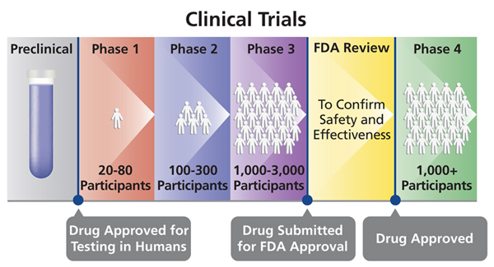

Slide 34
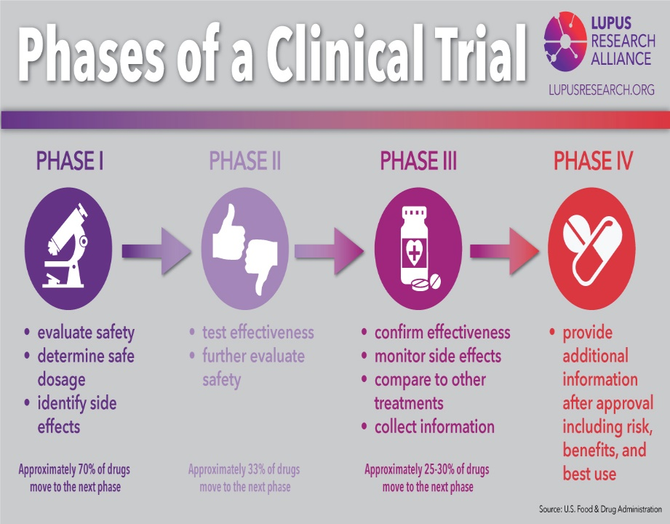

Slide 35
Phase | Population | Study Design | Focus | Duration of treatment
0 | 1-15 people Aren’t widely used | Sub-therapeutic dose | No safety or efficacy parameters | Single/micro dose Drug is given for a short time
1 | Usually 20-80 healthy people Normal volunteers | Dose escalation to establish maximum tolerated dose | Safety and tolerability to determine the metabolism and pharmacologic actions | Short term, usually less than 30 days
2 | 200-300 volunteers with a targeted disease | Well-controlled, strict inclusion/exclusion criteria, most rigid study design, comparison between placebo and active controls | Comparison study, looking for effectiveness, efficacy, and safety (assess side effects) Determine the correct dose and effectiveness in treating a particular disease | Short term, usually less than 1 year, but can last several years
3 | Several Hundred to several thousand | Eligibility is looser than Phase 2, multi-centered trials | Safety and efficacy, risk/benefit analysis, safety profiles Investigational vs placebo | Parallel, anticipated treatment Could last for years Often conducted in many places at the same time
4 | All people on the treatment | Usually no study | Safety in large groups, patient satisfaction, additional safety data | Ongoing after FDA approval

Slide 36
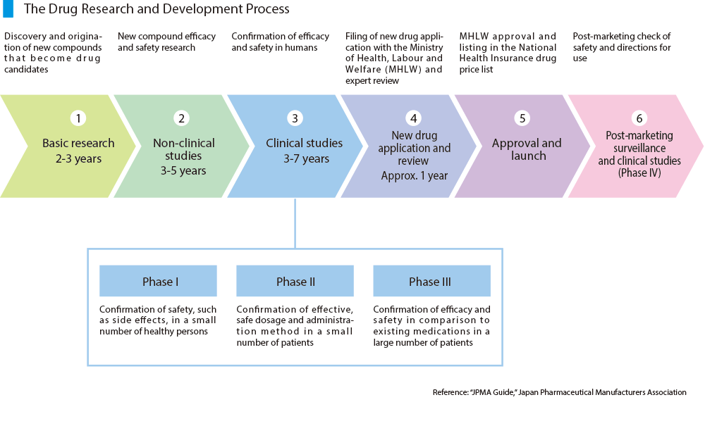

Slide 37


Slide 38

Clinical trials which usually involve an intervention such as medication, psychotherapy, new devices, or new approaches to surgery or radiation therapy is called __________.
A. Diagnostic Research
B. Treatment Research
C. Screening Research
D. Quality of Life Research
Notes:
Treatment research

Slide 39
The Belmont Report was created as part of the _____________________.
National Research Act of 1974
National Research Commission of 1974
National Research Act of 1977
National Research Commission of 1977

Slide 40
The Declaration of Helsinki was created by the
a. World Health Organization
b. World Medical Association
c. World Health Association
d. World medical Organization
Notes:
B

Slide 41
Observational Clinical Trials:
Provide researchers with data that advances our understanding of certain diseases and how to treat the disease
B. Assess health outcomes in groups of participants
C. Participants may receive interventions (which can include medical products such as drugs or devices) or procedures as part of their routine medical care
D. A and B
E. All of the above

Slide 42
In which order does the drug development process follow?
A. Confirmation of drug efficacy and safety in humans, discovery of a new compound, approval and manufacturing, drug is marketed
B. Discovery of a new compound, confirmation of drug efficacy and safety in humans, approval and manufacturing, drug is marketed
C. Discovery of a new compound, approval and manufacturing, Confirmation of drug efficacy and safety in humans, drug is marketed

Slide 43
GCPs have their roots in the __________.
Belmont Report
B. Declaration of Helsinki
C. Nuremburg Code
D. ICH GCP E6 (R2)

Slide 44
The Declaration of Helsinki is the oldest ethical framework for researchers.
True
False
Notes:
False, Nuremberg

Slide 45
The influencer for the Belmont Report was the _______________.
Nuremberg war crimes
b. The Guatemala study
c. The Tuskegee study
d. The Willowbrook study
Notes:
a

Slide 46
According to the Declaration of Helsinki, which of the
following is not included when addressing the
Informed Consent Process?
Participation must be voluntary
Refusal to participate should not affect the patient-physician relationship
Consultation with others is necessary
d. Information regarding payment for participation should be included

Slide 47

Please email Derita or Margaret

