Slide 1
Navigating Federal Life Science Funding
November 13, 2024
Dr. Travis Taylor
Vice President, Life Sciences
travis@strategicmi.com

Slide 2
LEARNING OBJECTIVES
Participants will:
Understand best practices for engaging with life science/health Federal funders and how to best position themselves for success
Understand funding initiatives related to life science R&D and the priorities of Federal funding agencies
DOD
ARPA-H

Slide 3
PRESIDENT’S FY25 BUDGET REQUEST
Department of Defense
$849B total with $143B for Research and Development
National Institutes of Health
$48.3B base funding
$260M increase for diabetes
$1.48B new mandatory funding for Cancer Moonshot in FY25 and FY26
$2.7B in new mandatory biodefense research
Advanced Research Project Agency for Health (ARPA-H)
$1.5B level is maintained
National Science Foundation (NSF)
$10.2B total budget
Technology, Innovation, and Partnerships (TIP) Directorate budget is $900M
$205M of TIP Directorate budget is for Regional Innovation Program

Slide 4
BUILD A FUNDING STRATEGY
How do I get from Point A to Point B? Do I need strong preliminary data?
Inflation impacts life science and medical research disproportionately, so research funding dollars may decrease in the real world
What funds can be leveraged from various Federal government agencies?
If research is more advanced, does it benefit from preclinical services provided by the NIH?
Is the research meaningful to the Department of Defense?
You can’t “double dip,” but you can submit similar proposals with non-overlapping specific aims to multiple Federal funders.
Can I spin this out as a company? Funders MUST spend 3.2% of budget on SBIRs

Slide 5
The Dreaded Development Pipeline
IND
NDA/BLA
Basic
Research
Pre-Clinical
Clinical
Trials
Approval
Manufacture
Procurement
Hit-to-Lead
Non-Dilutive Funding
Funding Needed
The Funding Conundrum

Slide 6
The Dreaded Development Pipeline
IND
NDA/BLA
Basic
Research
Pre-Clinical
Clinical
Trials
Approval
Manufacture
Procurement
Hit-to-Lead
NIH/NSF grants
SBIRs (small dollars, early)
NIH Preclinical Services
NIH Contract Awards
BARDA (Phase 2 and beyond)
CARB-X (HTL to Phase 1)
DRIVe (earlier stage than BARDA)
ASPR IBMSC (manufacture)
ARPA-H (broad funding mechanisms)
DOD JWMRP
DOD CDMRP (broad funding mechanisms)

Slide 7
HHS SBIR AWARDS by STATE in 2023
California: 263
Massachusetts: 126
North Carolina: 75
New York: 63
Maryland: 53
Texas: 47
Pennsylvania: 41
Virginia: 40
Washington: 35
*Data pulled from SBIR.gov for HHS SBIR awards

Slide 8
BEST PRACTICES FOR ENGAGEMENT
COMMUNICATION IS KEY!
Talk to the program officer and develop a relationship
Understand the priorities and requirements of the office and any open solicitations
Demonstrate how your research is relevant and aligns with mission/objectives
Send a slide deck attached to the meeting request if possible
Have a clear “ask” slide in your presentation. What do you want?
If you receive a rejection, discuss with the program officer what might be done better. Review the Summary Statement (NIH).

Slide 9
BEST PRACTICES FOR ENGAGEMENT
For more advanced research, be able to describe your development pathway. Where are you? Where do you want to go? Hit to Lead? Bread board? Pre-IND? IND-enabling studies? Manufacturing?
Know your Technology Readiness Level (TRL)
Have a real solution to discuss. Avoid “tell me what to do” discussions.
Have a reasonable timeline for development activities clearly shown on a Gantt chart
Be able to cogently describe your regulatory pathway and any FDA discussions to date

Slide 10
BEST PRACTICES FOR ENGAGEMENT
Search both SAM.gov and GRANTS.gov for opportunities
Know the lingo (BAA, RFA, RFP, RFQ, RFI)
Is the award a Cooperative Agreement, Grant, or Contract?
Don’t submit unsolicited proposals to generic BAAs without talking to the Program Officer
Will partners or collaborators increase likelihood of success?
If applying to a DOD solicitation, will a DOD partner help?
FOLLOW INSTRUCTIONS for submissions

Slide 11
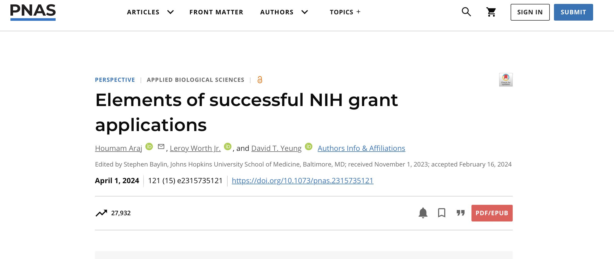
PEER REVIEW TIPS
SOURCE: Proceedings of the National Academy of Sciences, April 1, 2024

Slide 12
NATIONAL INSTITUTES OF HEALTH
SBIR and STTR Opportunities
Technical and Business Assistance (TABA) funding to identify and address product development needs ($6k/yr for Phase I and $50k across all years for Phase II)
Commercialization Enhancement Programs (mentoring and business programs)
NIH Contract SBIR Opportunities (use the eCPS system for submission)
National Institute of Allergy and Infectious Diseases Applicant Assistance Program
One-on-one advisor to help with SBIR application process
Must fit NIAID’s High-Priority Areas of Interest list
Encourages participation from small businesses that are owned or operated by individuals who are traditionally underrepresented in biomedical sciences
Check upcoming Council-approved topic lists (NIAID’s list) to anticipate future funding opportunities
Be a reviewer at the NIH to learn the process first-hand. Special Emphasis Panels (SEPs) are the easiest reviews to join as they are one off meetings for specific funding opportunities

Slide 13
BIOMEDICAL ADVANCED RESEARCH AND DEVELOPMENT AUTHORITY (BARDA)
BARDA solicitation supports ADVANCED R&D for Chemical, Biological, Radiological, Nuclear (CBRN) threat countermeasures
Antimicrobials (biologics, small molecule, host-directed countermeasures, phage, microbiome)
Emerging infectious diseases
Detection and Diagnostics
Chemical and radiation exposures (repurposing of existing drugs)
DRIVe solicitation supports earlier stage R&D
Combatting Antibiotic-Resistant Bacteria (CARB-X)
Submit TechWatch request if you have relevant technology at the appropriate development stage (Phase 2 clinical trials usually)
You MUST align with one of the AREAS OF INTEREST (AoI) in the BAA
Do NOT submit unsolicited proposals

Slide 14
ADVANCED RESEARCH PROJECTS AGENGY FOR HEALTH (ARPA-H)
ARPA-H has three Hubs:
The main office location located near Washington DC
Customer Experience Hub (user testing of ARPA-H projects) in Dallas TX
Investor Catalyst (help get projects to market) in Cambridge MA
DARPA model for innovation and project selection (Heilmeier Catechism)
Recent Solicitations:
Engineering Immune Cells in the Body (EMBODY)
Lymphatic Imaging, Genomics, and Phenotyping Technologies (LIGHT)
Personalized Regenerative Immunocompetent Nanotechnology Tissue (PRINT)
Sprint for Women’s Health
Opening new solicitations almost monthly, check the website frequently
Short windows for submissions

Slide 15
BIOECONOMY EXECUTIVE ORDER
Executive Order on Advancing Biotechnology and Biomanufacturing Innovation for a Sustainable, Safe, and Secure American Bioeconomy:
Bolster federal investment in key research and development areas of biotechnology and biomanufacturing
Improve and expand domestic biomanufacturing production capacity and processes
Biotechnology and biomanufacturing workforce training
Regulatory streamlining and clarification
COVID highlighted issues with our supply chain and dependence on foreign sources
Calls for investment in domestic biomanufacturing (not just limited to pharmaceuticals)
Need more resilient supply chains
Need innovation to bring key manufacturing back to the US (how to make it cheaper?)
Will require significant investment in workforce development and training

Slide 16
WOMEN’S HEALTH EXECUTIVE ORDER
March 2024: “Executive Order on Advancing Women’s Health Research and Innovation”
Integrate Women’s Health Research in Federal Research Programs
Prioritize Federal Investments in Women’s Health Research
Galvanize Research on Women’s Midlife Health (menopause and perimenopause research)
Assess Unmet Needs to Support Women’s Health Research
Invest in Research in a Wide Range of Women’s Health Issues (endometriosis, rheumatoid arthritis, chronic fatigue)
Create a Comprehensive Research Agenda on Menopause
Call for New Proposals for Emerging Women’s Health Issues (National Science Foundation)
Increase Research on How Environmental Factors Affect Women’s Health (EPA, endocrine disruption, toxin exposure
Create a Dedicated, One-Stop Shop for NIH Funding Opportunities on Women’s Health
Accelerate Transformative Research an Development in Women’s Health (ARPA-H)
Maternal Health Outcomes

Slide 17
DOD MEDICAL TECHNOLOGY PRIORITIES
Next major war will be with peer or near-peer adversaries (look at the injuries and issues in Ukraine)
Multi-Domain Operations/Large-Scale Combat Operations (MDO/LSCO)
Will not have air superiority to evacuate injured Warfighters, will need prolonged field care (>72 hrs)
How do we stabilize and transport the wounded?
Major research priorities:
Combat Casualty Care (blood/fluids, stabilization, hemostasis, preserve tissue, eye injuries)
Operational Medicine (injury prevention/reduction, resilience, physiological/psychological health)
Battlefield Wound Care (infection, tissue preservation, scarring)
Regenerative Medicine (volumetric muscle loss, vision, hearing, nerve)
Ruggedization and Miniaturization of Equipment (make things ”harder,” smaller, and use less power)
Training (innovative teaching methods, virtual)
Automation and simplification of complex procedures
How do we deal with pain and reduce the use of opioids?
What physical or mental support services are needed to get wounded Warfighters back to duty?
Traumatic Brain Injury (TBI)
Post-Traumatic Stress Disorder (PTSD) and Depression/Suicide

Slide 18
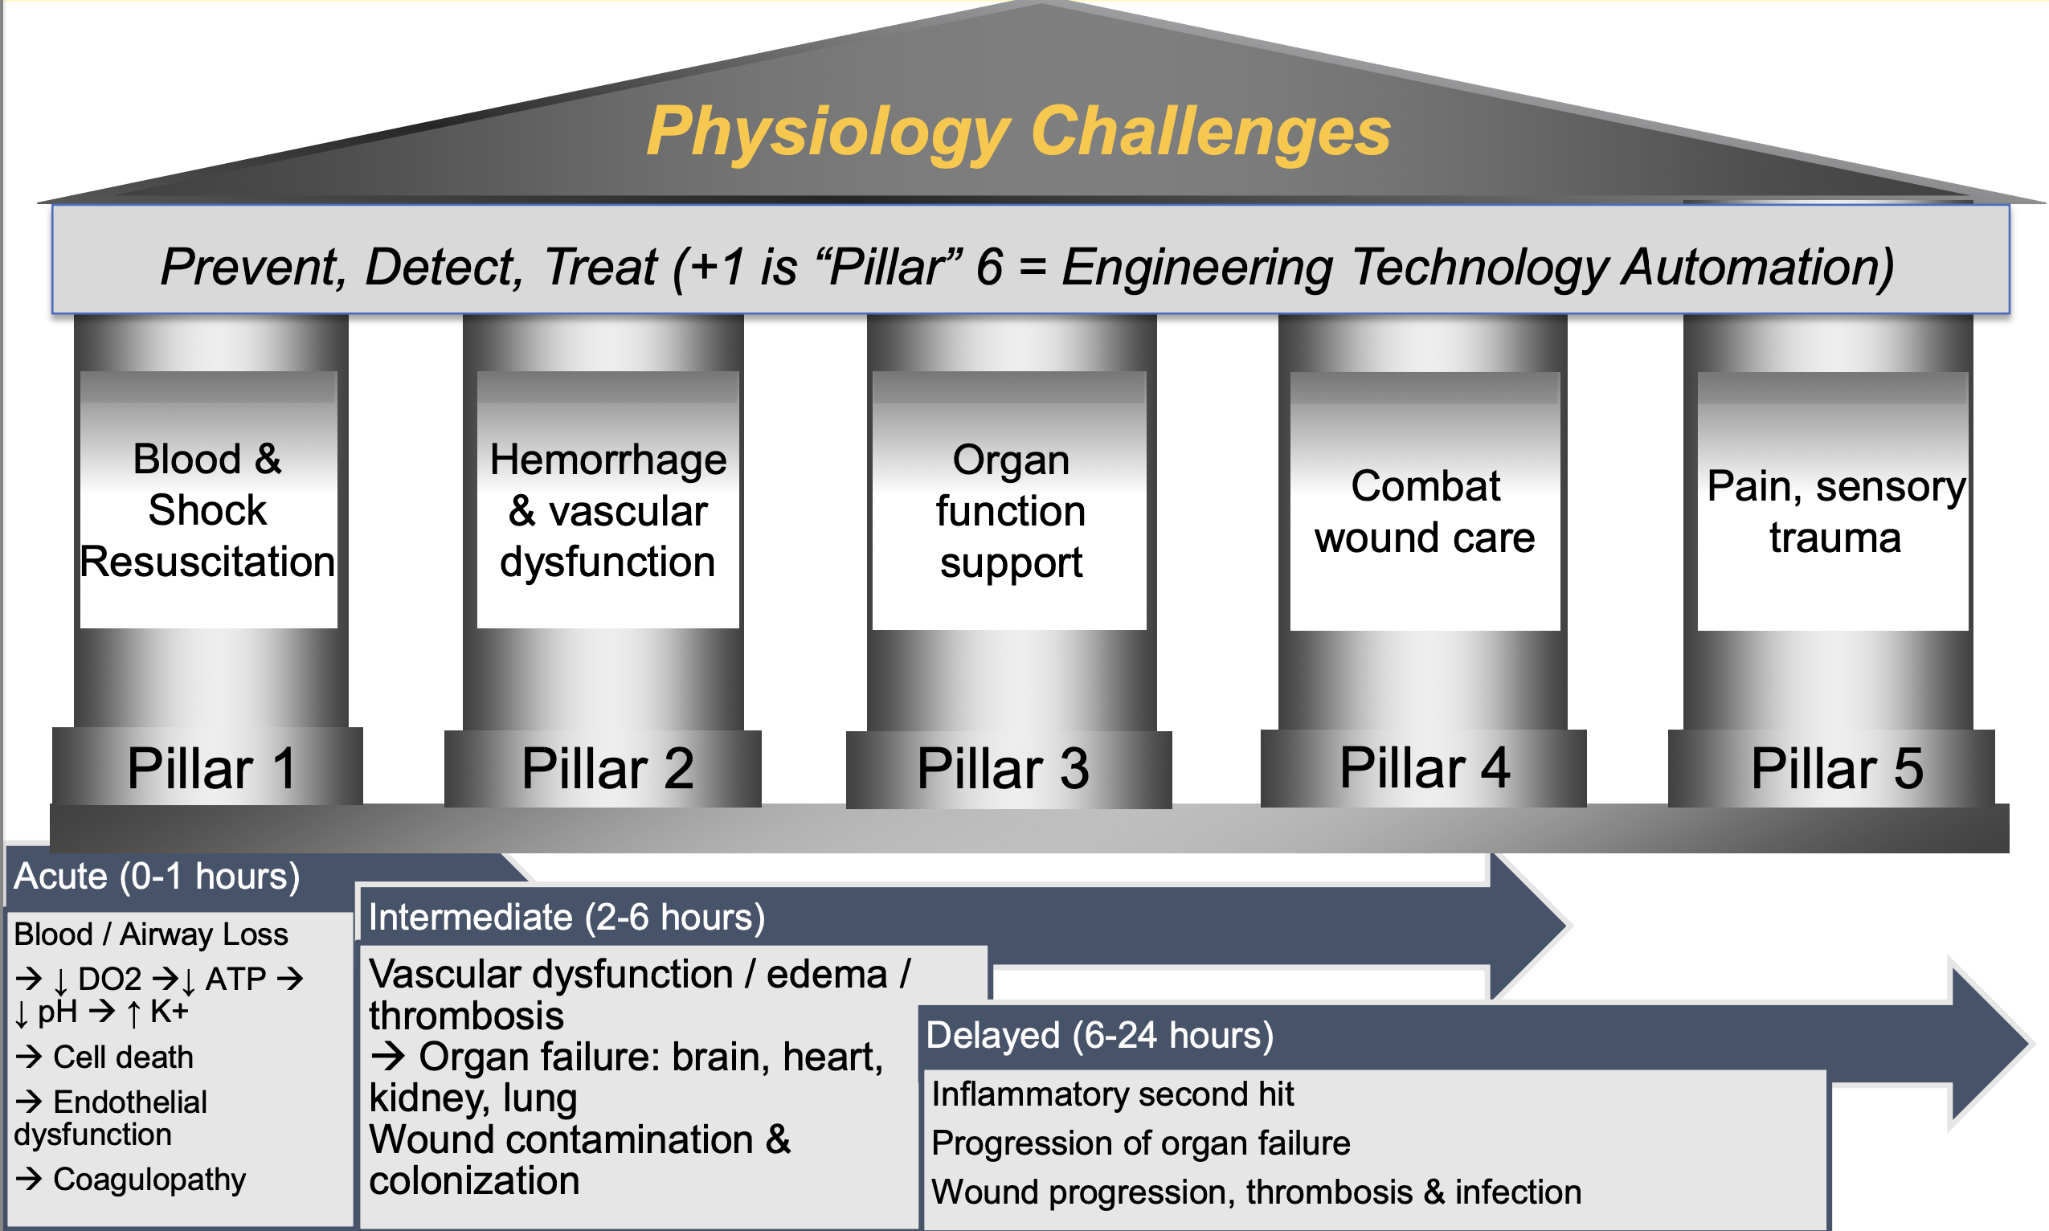
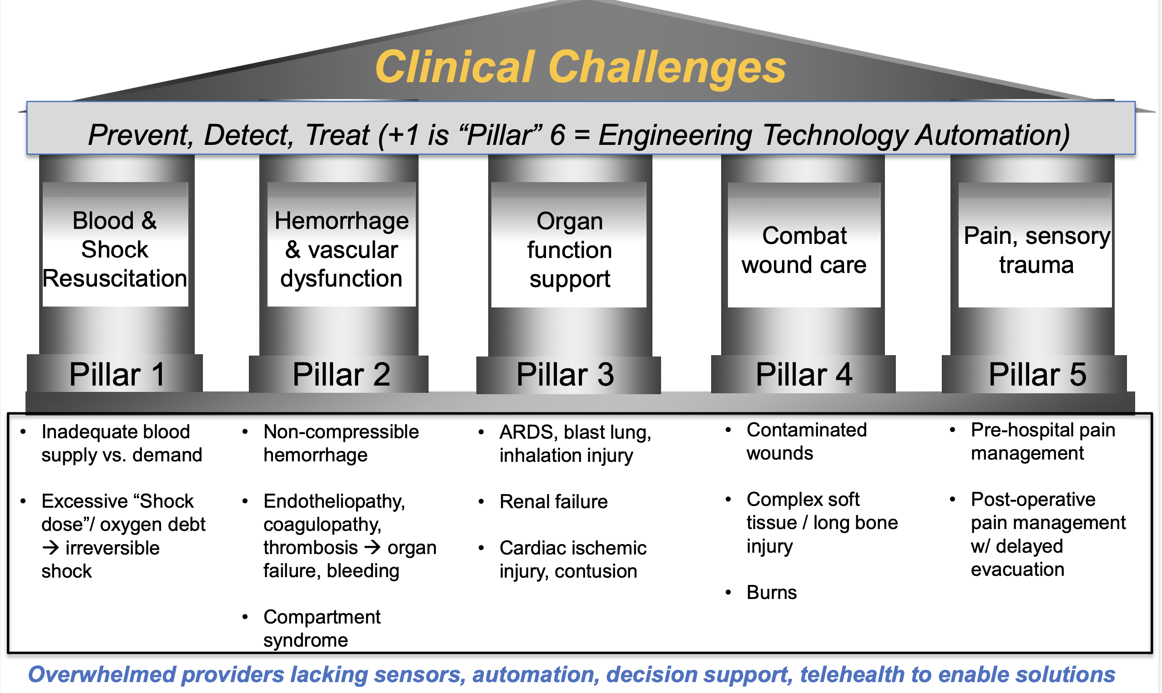
DOD MEDICAL TECHNOLOGY PRIORITIES
Source: COL Andrew P. Cap, MD, PHD, Director of Research, USAISR

Slide 19
DOD MEDICAL TECHNOLOGY PRIORITIES
Technologies can include biologics, small molecules, immunoprophylaxis, host-directed therapeutics
MIDRP isn’t interested in influenza or most bacterial biodefense agents (anthrax, plague)
SOURCE: Nov, 2022 presentation by COL Stuart Tyner, MIDRP

Slide 20
DEPARTMENT OF DEFENSE (DOD)
Who am I talking to? Funder or research partner? Potential research partners and collaborators include:
US Army Institute of Surgical Research (USAISR)
Walter Reed Army Institute of Research (WRAIR)
US Army Medical Research Institute of Infectious Diseases (USAMRIID)
Uniformed Services University of the Health Sciences (USUHS)
VA Hospitals (VA hospitals can be tricky as partners)
Third party research organizations like the Geneva Foundation that focus on military health issues
Navy medical labs and facilities (NMRC, NHRC)
Do we need to establish a Cooperative Research and Development Agreement (CRADA) to formalize partnership?
Submit new ideas to USAMRDC via the New Products and Ideas (NPI) portal to request a meeting
Attend the annual Military Health Sciences Research Symposium (MHSRS) to meet program managers
DOD invests because it wants to procure products: 1) is it safe? and 2) does it work?

Slide 21
DEPARTMENT OF DEFENSE (DOD)
Non-exhaustive list of DOD offices that fund health-related research:
US Army Medical Research and Development Command (MRDC)
Combat Casualty Care Research Program (CCCRP)
Military Operational Medicine Research Program (MOMRP)
Military Infectious Disease Research Program (MIDRP)
Blast Injury Coordinating Office
Medical Chemical Biological Defense Research
US Army Medical Materiel Development Activity (USAMMDA)
Defense Health Agency (DHA)
Congressionally Directed Medical Research Program (CDMRP)
Joint Warfighter Medical Research Program (JWMRP)
Defense Threat Reduction Agency (DTRA) Research and Development Directorate (BAA link)
Air Force AFWERX SBIR/STTR Portal
Office of Naval Research (ONR) Division 341: Human and Engineered Systems
Defense Advanced Research Projects Agency (DARPA) Biological Technologies Office (BTO) (BAA link)
Other Transactional Authorities: Medical Technology Enterprise Consortium (MTEC)
Service labs (AFRL, DEVCOM ARL, etc)
Defense Advanced Research Projects Agency (DARPA Connect)

Slide 22
CONGRESSIONALLY DIRECTED MEDICAL RESEARCH PROGRAM (CDMRP)
CDMRP currently has multiple open funding solicitations (subscribe online for specific program notifications)
Congress adds money to the DOD budget each year and funding/topics can vary from year-to-year
Each program is open only once a year and timing varies based upon annual appropriations schedule
Two-stage peer review process that includes technical experts and consumers
Must score well both technically and programmatically (portfolio balance): There is no “pay line”
Programs “align with vision of transforming healthcare to Service Members, Veterans, and the American public”
Programs can fund a wide range of activities from discovery stage through clinical trials using different award mechanisms
Some programs have two-stage submission process that has a short pre-proposal and invitation to full proposal
CDMRP programs use the eBRAP system for submissions
It helps to have DOD collaborators or partners on the team

Slide 23
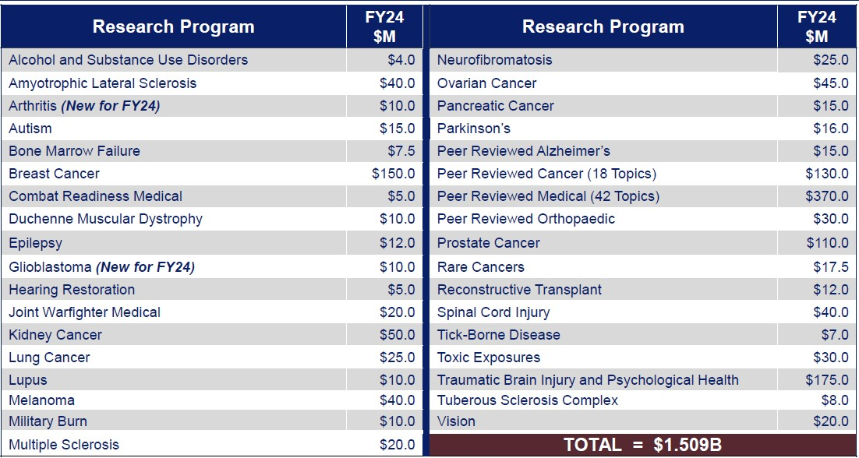
CONGRESSIONALLY DIRECTED MEDICAL RESEARCH PROGRAM (CDMRP)

Slide 24
CONGRESSIONALLY DIRECTED MEDICAL RESEARCH PROGRAM (CDMRP)

Slide 25
CONGRESSIONALLY DIRECTED MEDICAL RESEARCH PROGRAM (CDMRP)

Slide 26
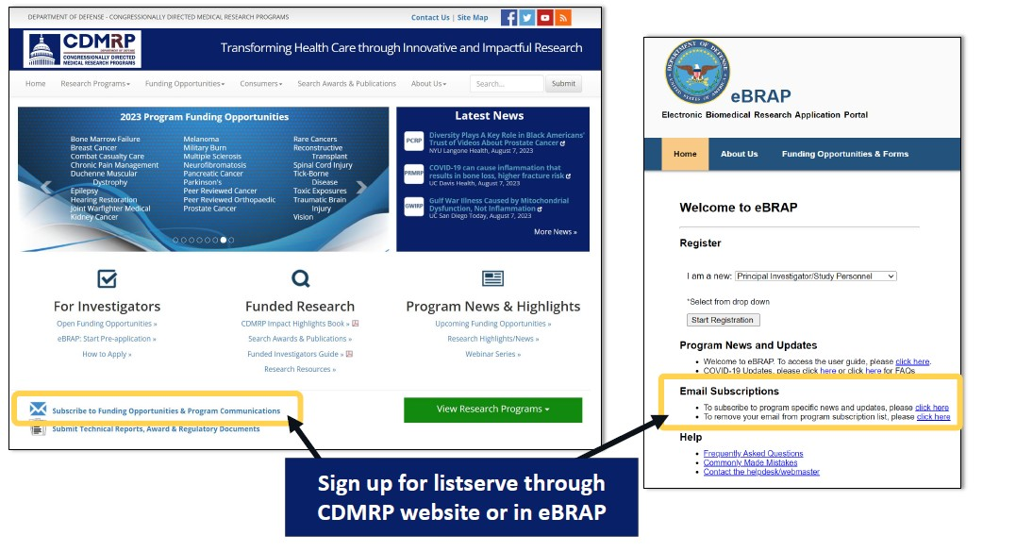
CONGRESSIONALLY DIRECTED MEDICAL RESEARCH PROGRAM (CDMRP)
https://cdmrp.health.mil/

Slide 27
CDMRP Funding Mechanisms
BASIC RESEARCH
Discovery Award (small, no preliminary data)
Investigator-Initiated Research Award (similar to NIH R01, validation)
TRANSLATIONAL RESEARCH
Impact Award (strong in vivo data required)
Technology/Therapeutic Development Award (IDE/IND enabling studies)
CLINICAL RESEARCH
Clinical Trial Award
Lifestyle Behavioral Health Intervention Research Award (patient focused)

Slide 28
QUESTIONS?
Travis Taylor: travis@strategicmi.com

