Slide 1


The Pursuit of Extramural Funding: How the Office of Research Development Can Help You

Slide 2
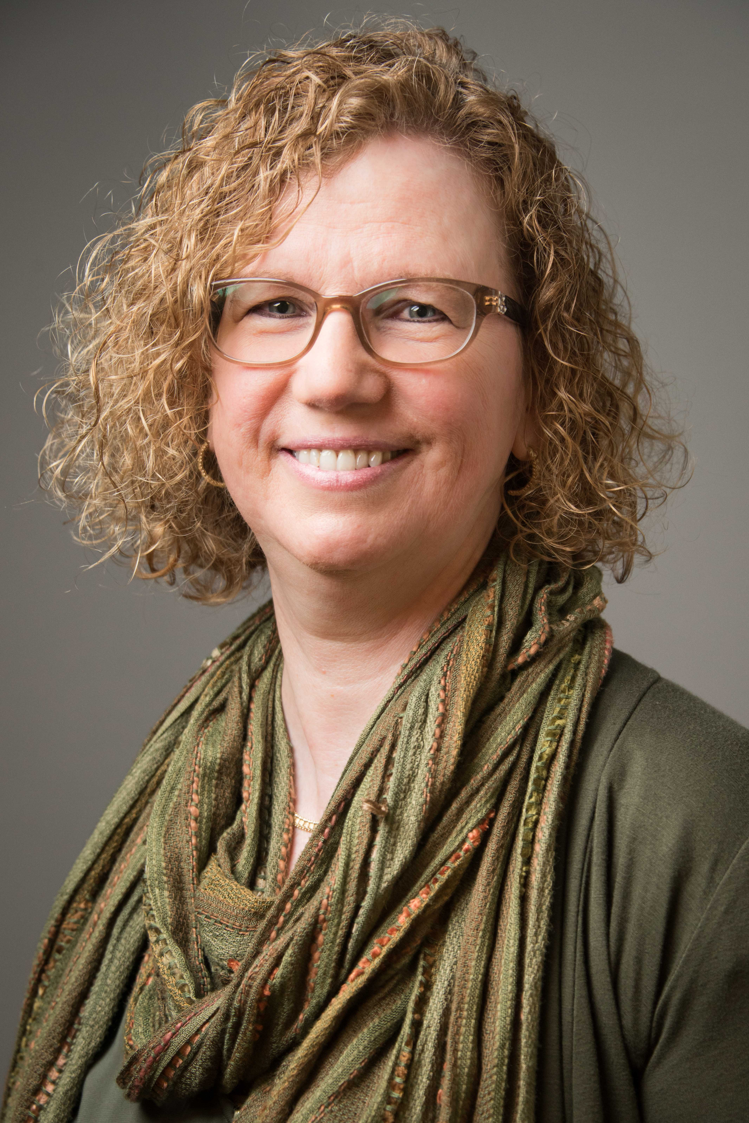

Who we are and what we do
Lisa Youngentob - DIRECtor
CORNET Award program and CORNET-related events
Bridge Funding
New Grant Support
Limited submission process
Distribute funding opportunities to the campus
Point of contact for setting up services with external grant consultants, Hanover Research
Track Office of Research resources
Office of Research events (workshops, seminars, symposiums and conferences)
Yes, I’m the one who sends you all of the emails in the middle of the night!

Slide 3
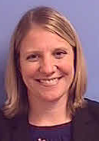
Who we are and what we do
Jamie Whartenby - Administrative Specialist III
Conducts one-on-one consultations with investigators to assist in identifying relevant external funding opportunities by introducing and training on use of Funding Institutional (FI)
Identifies open/upcoming funding opportunities and limited submissions
Pre-reviews submissions from InfoReady Review (IRR)
Maintains O of R resource tracking spreadsheets
Event planning
IT whiz

Slide 4


Office of research development - MISSION
In keeping with the Office of Research’s vision of UTHSC becoming a world-class, interdisciplinary and research-intensive health science center, the Office of Research Development aims to assist in the pursuit of this goal by:
  Providing targeted funding opportunities to research faculty
  Establishing and enhancing collaborations within and beyond UTHSC
  Offering proposal development services and resources to maximize competitiveness of grant applications and scientific manuscripts

Slide 5

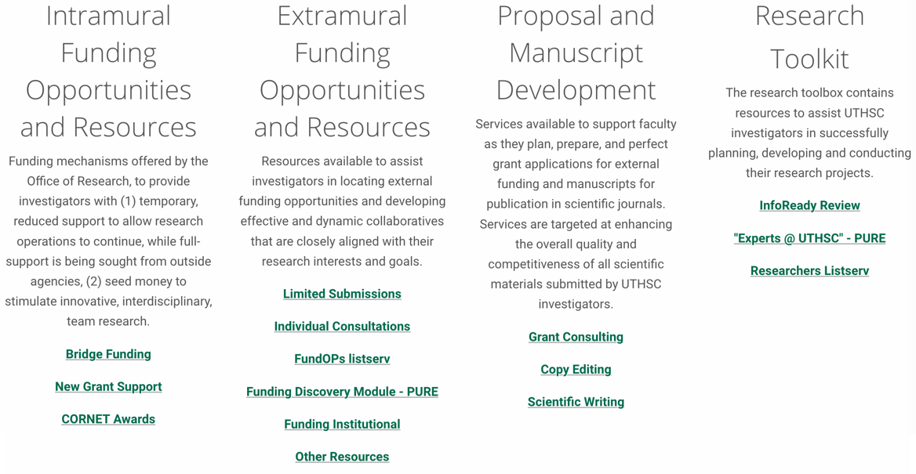
Where to find us on the web
http://www.uthsc.edu/
Notes:
Hot link http://www.uthsc.edu/

Slide 6

Intramural Funding Opportunities and Resources
Interim funding mechanisms offered by the Office of Research which offers:
  temporary, reduced support to allow research operations to continue, while full-support is being sought from outside agencies
      Bridge Funding
      New Grant Support
  seed money to stimulate innovative, inter-disciplinary, team research
      CORNET Awards

Slide 7


Bridge Funding (BF)
Intramural, competition-based program
Interim funding to UTHSC faculty whose renewal application for an expiring grant was not funded
Provides temporary, reduced support
Allows retention of key personnel and continued laboratory or research operations, while full-support is being sought from outside agencies
Funding information:
  Up to $75,000 total for R01s (or equivalent)
  Award money can be used for up to two years
Notes:
Add Hot link http://www.uthsc.edu/research/development/intramural-funding/index.php

Slide 8


Bridge Funding (BF) - eligibility
Eligible:
  Lapsed grant was funded by a national funding for at least three consecutive years
  Competitive renewal application was submitted during the final year of the extramural funding cycle (or no-cost extension)
  Competitive renewal application was not funded
  Funding application was a direct continuation of the previously funded grant
          Not eligible:
            Adjunct faculty
            Non-renewable grants such as R21s or R03s
            Previously funded grants that ran out without a notice of non-continuation of funding

Slide 9

Bridge Funding (BF) - eligibility
Budget Limitations:
  No faculty salaries
  No graduate student stipends (if supported by the graduate college)
  No large equipment purchases
  Travel with a limitation of $1,500 is allowed for attending a national scientific conference
If there is a question as to your unfunded grant’s eligibility, contact ORD

Slide 10

New Grant Support (NGS)
Internal, competition-based program
Interim funding to UTHSC investigators who’s new grant submission was scored, but not funded
Allows investigators to continue their research activities so they can
    address reviewer’s concerns
    collect additional data
    strengthen their unfunded grant
Funding information:
    Up to $20,000 for R15s and R21s (or equivalent) and up to $30,000 for R01s (or equivalent)
    Award money can be used for up to two years
Notes:
Add hot link http://www.uthsc.edu/research/development/intramural-funding/index.php

Slide 11


New Grant Support (NGS) - eligibility
Eligible Principal Investigators (PIs) are those whose:
  New R01, R15 or R21 (or equivalent) grant was scored, but not funded
  Scored grant was reviewed within the previous six months of the NGS deadline
  Scored grant was an A0 or A1 submission
Not eligible:
  Adjunct faculty
  Unscored grants
  Grants reviewed more than 6 months prior to NGS deadline
  Continuation/competitive renewal grants (these grants are eligible for Bridge Support)

Slide 12

New Grant Support (NGS) - eligibility
Budget Limitations:
  No faculty salaries
  No graduate student stipends (if supported by the graduate college)
  No travel
  No large equipment purchases
If there is a question as to your unfunded grant’s eligibility, contact Lisa Youngentob in ORD

Slide 13

BRIdge funding/new grant support - applying
Three deadlines/year
  January 31st
  April 30th
  August 31st
      Apply via the UTHSC InfoReady Review Portal
      Guidelines and Checklist found on webpage

Slide 14
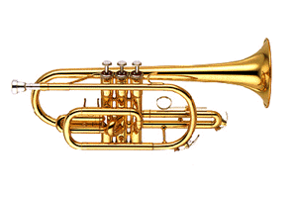
CORNET Awards
COLLABORATIVE RESEARCH NETWORK
(CORNET) AWARDS
Provide seed money to stimulate innovative, interdisciplinary, team-based research, which will give rise to future extramural funding
Designed to promote new lines of research among newly created research teams in response to a specific CORNET announcement
Not intended as bridging funds or a mechanism to extend ongoing funded research
Notes:
Add hot link http://www.uthsc.edu/research/development/intramural-funding/index.php

Slide 15

CORNET AWARDS – eligibility
Eligibility:
  Open to faculty on all UTHSC campuses (adjunct faculty not eligible)
  Each proposal must include, at minimum, one faculty member from each collaborative unit
Guidelines:
  Outlined on each RFA
  To apply, PIs are not required to have institutional approvals for research involving human subjects, animals, biohazards, etc., but awardees must submit notification of compliance approval prior to release of CORNET funding

Slide 16
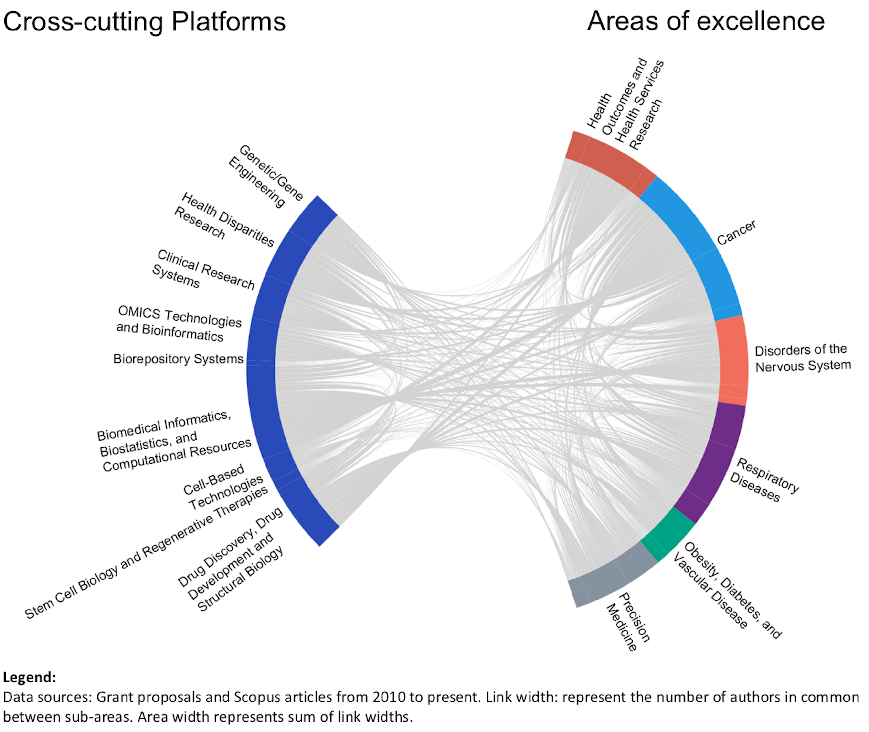
CORNET Awards – FOCUS areas
Aiming to create a CORNET collaborative to encompass each of the six areas of Excellence described in the Operational Strategic Plan for Research.
To date, we have funded CORNETs in Cancer, Substance Abuse, Regenerative Medicine, Drug Discovery and Development, Health Disparities Research, Vascular Disease, Diabetes, and Epidemiology.

Slide 17

CORNET Awards – internal collaboratives
Cross-college
Stimulate interdisciplinary research among UTHSC faculty from different UTHSC colleges
  2016: 47 applications, 9 funded
  2017: 41 applications, 6 funded
Clinical
Stimulate research productivity among UTHSC faculty members who function primarily as clinicians (Physicians, Dentists, Clinical Psychologists, RNs, Physical and Occupational Therapists, Clinical Pharmacists, etc.)
  2017: 29 applications, 4 funded

Slide 18

CORNET Awards – state-wide collaboratives
Cross-System
Creating collaborations between faculty from multiple University of Tennessee System institutions
  UT CORNET Awards in Cancer
      2017: 20 applications, 3 funded

Slide 19

CORNET Awards – regional collaboratives
Facilitating team research between faculty from UTHSC and other Mid-South universities
  2016 - UTHSC/University of Arkansas for Medical Sciences - Substance Abuse
    1 application, 1 funded
  2017 - UTHSC/University of Arkansas for Medical Sciences - Cancer
    10 applications, 4 funded
  2018 - UTHSC/University of Mississippi Medical Center/Tulane University - Health Disparities
    11 applications, 2 funded

Slide 20

CORNET Awards – global collaboratives
Pairing faculty from UTHSC and international universities/hospitals
  2017 - UTHSC/Harbin Medical University (China) - Cancer, Vascular Disease, Diabetes, and Epidemiology
      7 applications, 3 funded
  2018 - UTHSC/West China Hospital/Sichuan University (China)- Regenerative Medicine
      4 applications, 2 funded
  2018 – UTHSC/Ghana Health Services, Korle-Bu Teaching Hospital, H3Africa/UMC Utrecht, the Netherlands - Preeclampsia
      1 application, 1 funded

Slide 21

CORNET Awards –
Industry collaboratives
Build research relationships between UTHSC faculty and industry partners. Aimed not only at acquiring extramural funding but also spin-offs, patents, and IP
  2017 – UTHSC/UTRF/Southern Research (Birmingham, AL) – Drug Discovery and Development
    Aims to launch drug discovery programs that are based on new and unique biology of disease that will fill significant unmet medical needs.
    12 submitted, 2 funded

Slide 22

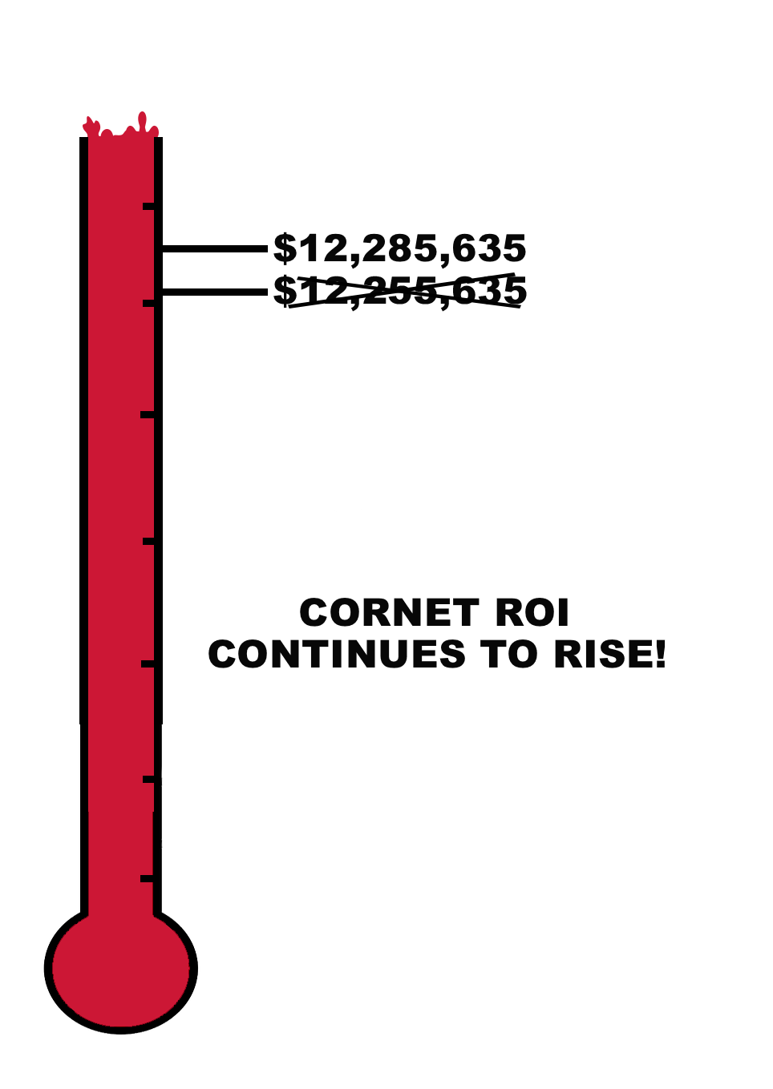


CORNET Awards -
A Successful Seed Grant Program
Since the inception of the CORNET program in 2016:
    43 CORNETs awarded
    $2M ($2,375,478)
    awarded from all
    partnering institutions
    $1.5M ($1,559,555)
    awarded from
    UTHSC Office of Research
    14 extramurally funded grants stemming
    from CORNET work,
    worth $12 M ($12,285,635)
8-fold
(7.88)
Return on Investment

Slide 23

Extramural Funding Opportunities and Resources – Limited submissions
Grants, awards and fellowships that limit the number of proposals that can be submitted from one institution
ORD conducts internal competition to choose the most competitive proposal
Only selected UTHSC nominee is allowed to submit to the funding agency
Notes:
Hot link http://www.uthsc.edu/research/development/extramural-funding/limited-submissions.php

Slide 24
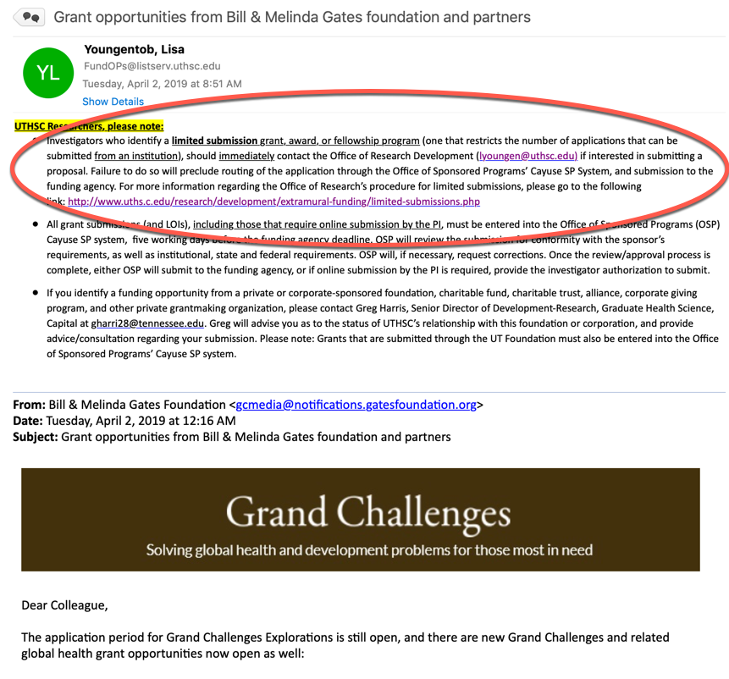
Limited submissions - announcements
UTHSC Researchers, please note:
  Investigators who identify a limited submission grant, award, or fellowship program (one that restricts the number of applications that can be submitted from an institution), should immediately contact the Office of Research Development (lyoungen@uthsc.edu) if interested in submitting a proposal. Failure to do so will preclude routing of the application through the Office of Sponsored Programs’ Cayuse SP System, and submission to the funding agency. For more information regarding the Office of Research’s procedure for limited submissions, please go to the following link: http://www.uths.c.edu/research/development/extramural-funding/limited-submissions.php

Slide 25
Limited submissions - Process
Eligible proposals move on to internal review committee
Submit pre- proposal via IRR
VCR chooses nominee based on reviews
Nominee enters full proposal into Cayuse SP 5 days before funding
agency deadline
ORD notifies all applicants of submission outcome

Slide 26
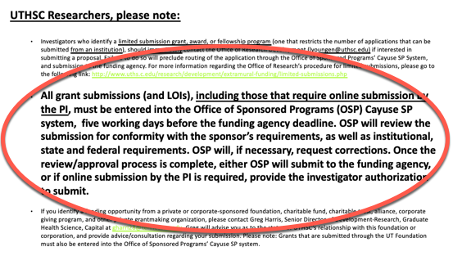
Limited submissions - Process

Slide 27

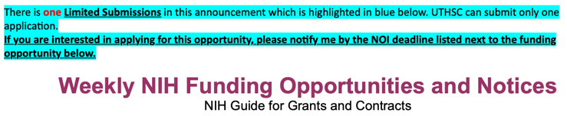
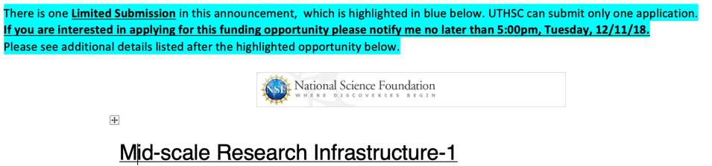
Limited submissions - announcements
Once a limited submission opportunity has been identified, ORD will do one of the following:
Distribute a limited submission
  e-blast announcement to the
  FundOPs and Faculty listservs
Most NIH limited submissions
  are announced via the Friday
  NIH Funding Opportunities and
  Notices eblast sent out only to the
  FundOPs listserv
  These limited submissions require a Notice of Interest (NOI) email to be sent to ORD by a specific date
  Only those who respond with a NOI before the deadline will be able to participate in the internal competition
Most NSF limited submissions will be
  announced in the same manner
  as the NIH announcements

Slide 28
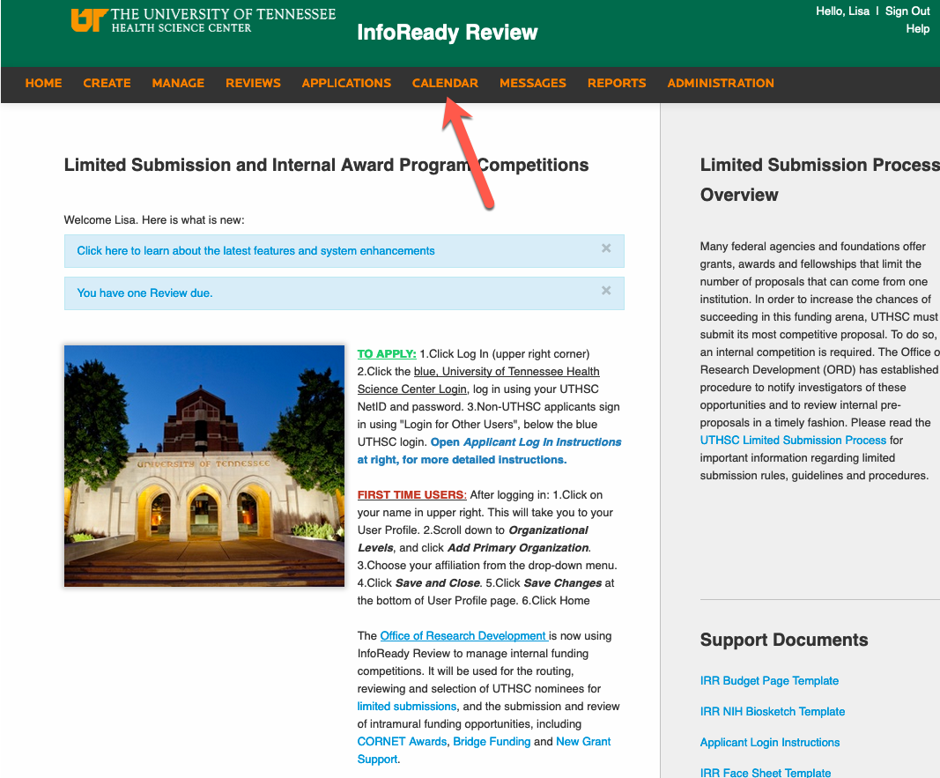
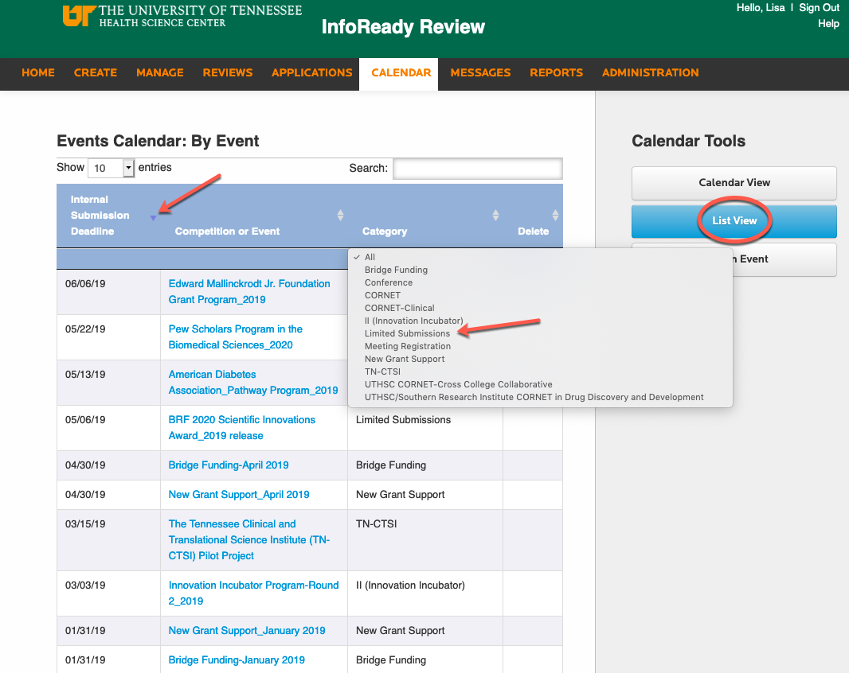
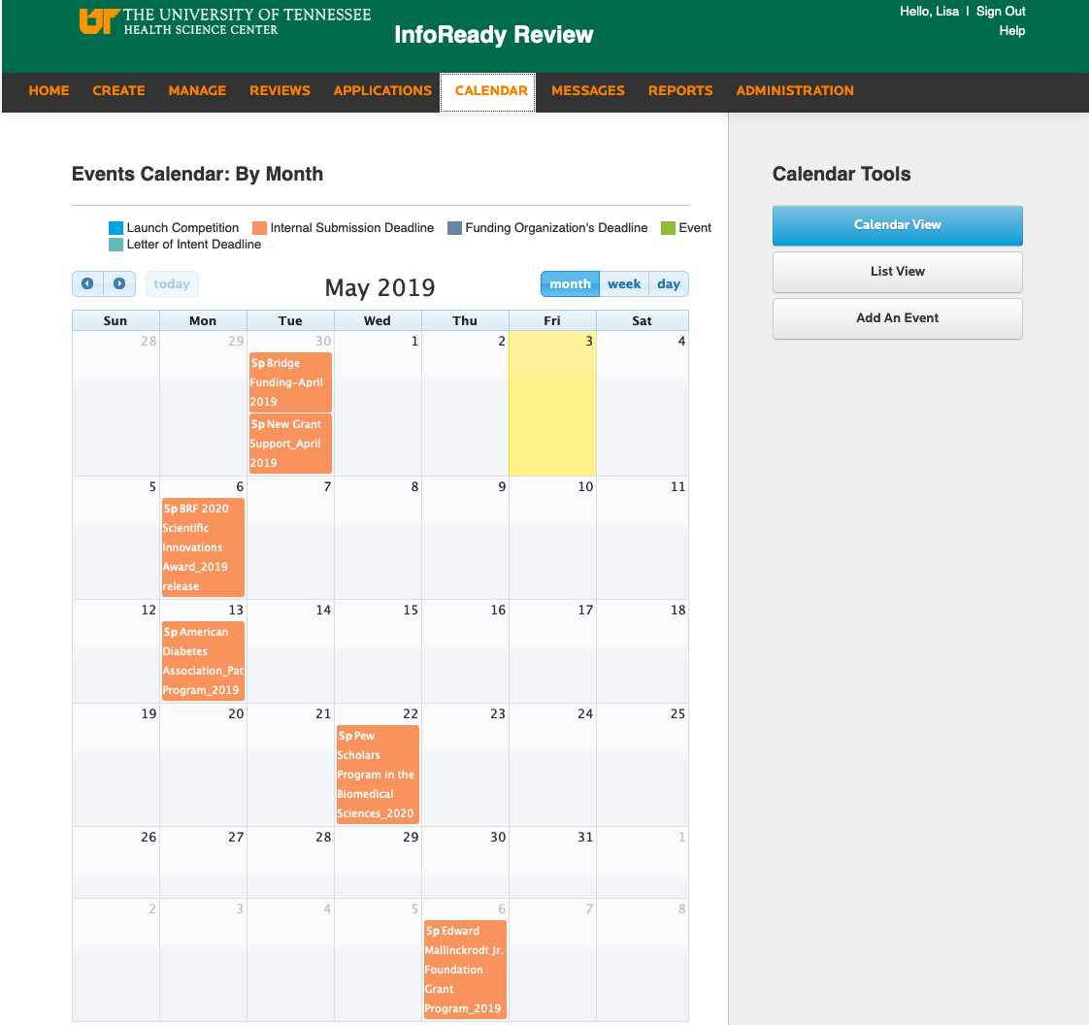
Limited submissions - announcements
  InfoReady Review homepage has all active limited submissions, and a calendar (and searchable listing) of past limited submissions
Notes:
Add hot link https://uthsc.infoready4.com

Slide 29


Extramural Funding Opportunities - Funding institutional (FI)*
Searchable database of funding opportunities, funders, and awarded grants, taken from a wide range of governmental and private sources
Faculty, students and staff can use FI to:
  Search for funding opportunities
  Find new sources of external grant income
  Identify potential collaborators and find investigators that are securing grants in their field of interest
  Survey funding trends
  Set up alerts to be notified automatically of new funding opportunities
*The UTHSC Office of Alumni Affairs and Development has generously made this product available to the UTHSC campus

Slide 30
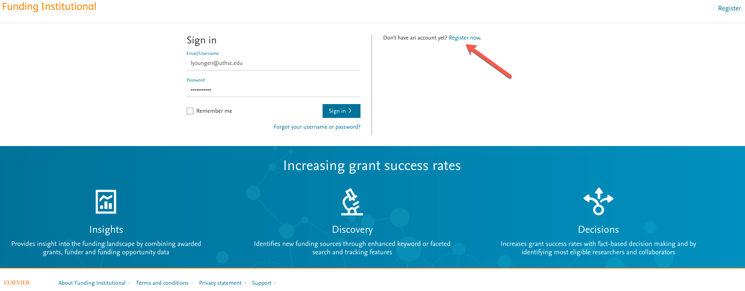
Funding institutional (FI)* - account set up
FI does not support SSO, so you will need to create an account at https://www.fundinginstitutional.com/login
*The UTHSC Office of Alumni Affairs and Development has generously made this product available to the UTHSC campus
Notes:
Add hot link https://www.fundinginstitutional.com/login

Slide 31

Funding institutional (FI)* – training and informational resources
Jamie is available for one-on-one consultations to introduce and train investigators on how to use FI
ORD Quick Tips and Tricks flyer: http://uthsc.edu/research/development/extramural-funding/documents/funding-institutional-v2-online-version.pdf
Link to Users Manual and Quick Search Tips Guide: https://www.fundinginstitutional.com/static/rev0/scripts/files/UserManual.pdf
FI Webinar: “Introducing Funding Institutional”: https://www.brighttalk.com/webcast/13819/287481?utm_source=Elsevier&utm_medium=brighttalk&utm_campaign=287481
Website: https://www.elsevier.com/solutions/funding-institutional
*The UTHSC Office of Alumni Affairs and Development has generously made this product available to the UTHSC campus

Slide 32
Extramural Funding Opportunities -
OTHER sources
Investigators in search of funding opportunities in areas of special interest can set up individual consultations with Jamie in ORD
FundOPs listserv
  alerts for active intramural grants that are supported by the Office of Research, and extramural research funding announcements as they are made available to the Office of Research Development
Sign up for funding agency newsletters/funding announcements

Slide 33

Proposal Development - grant consultant
Hanover Research
Helps to strengthen competitive grant proposals to federal agencies such as NIH and NSF as well as grants to foundations
Work with faculty by providing reviews that underscore key insights into funder priorities and recommendations for improvement
Services - detailed descriptions on website Consultation
  Proposal Review Services
  Grantsmanship Training and Workshops
Notes:
Add hot link http://www.uthsc.edu/research/development/proposal-manuscript-development/grant-consulting.php

Slide 34
Hanover research - grant consultant
What you need to know:
Services are free of charge to investigators
Lead time for services is 2 weeks
Up to two waves of review from a Grants Consultant for each proposal
Requests for services go through Lisa via email
All requests for services must be accompanied by Proposal Summary Form found on ORD website
Hanover is a grant consulting firm, they:
  Do provide grantsmanship services
  Do assist in making a proposals more persuasive
  Do make suggestions so proposal is better aligned with funder guidelines and priorities
  Do outline opportunities for shaping a more competitive proposal
  Do not review your science. Consultants read proposals as non-experts, in the same way as NIH reviewers.

Slide 35

Hanover research – grantsmanship training and workshops
Each year, Hanover provides:
  one on-site training that lasts two full days
    (includes one-on-one consultations to faculty)
    February 2019: On-site Grantsmanship Workshop -
      Hanover Grants Consultant, Dr. Sarah Ott
  two training webinars
    December 2018: Webinar -
      Hanover Grants Consultant, Dr. Steven Jax
    June 2019: Webinar - Sarah will be announcing soon
      All training resources (recordings and Power Points) can be found on ORD website
Notes:
Add hot link http://www.uthsc.edu/research/development/proposal-manuscript-development/grant-consulting.php

Slide 36
Proposal Development - scientific writing
Office of Scientific Writing
(Director) and Patti Smith, MPH (20% effort)
Provide both scientific writing and copy editing services
  Scientific writing sharpens the language so that the proposal or manuscript presents all of the science and specific aims of one’s research in a compelling manner, while being easy to read by reviewers. It is a more detailed editing job that will result in suggested revisions in formatting, overall organization of the manuscript or proposal, even suggestions about how to best present the scientific content.
  Copy editing, the proposal or manuscript will be checked for typos, missing words, grammar, etc. – but the scientific content and structure of the manuscript will not be subject to revision.
Status of Director search
Interim Policies-until a new Director is in place:
  Using outside consultants for both copy editing and scientific writing
  Send all scientific writing and copy editing requests to Lisa with form found on OSW website
Notes:
Add hot link http://www.uthsc.edu/research/scientific-writing/index.php

Slide 37
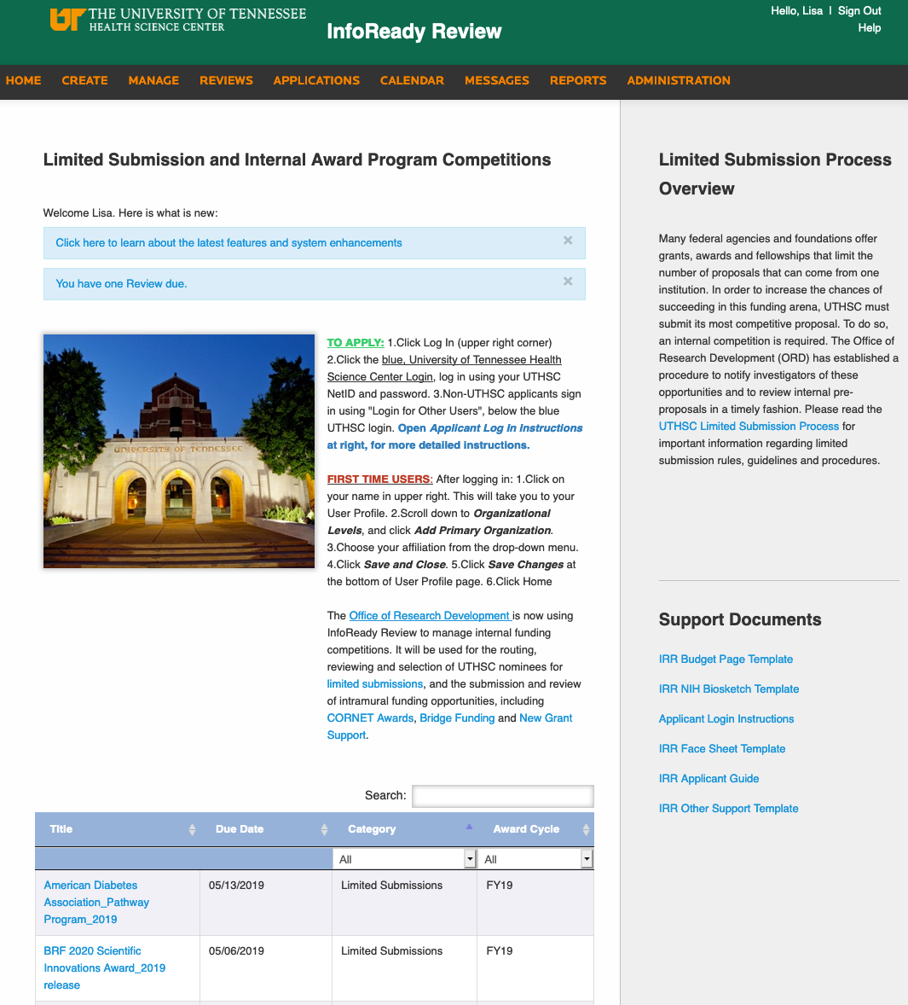
Toolbox – infoready review (IRR)
ORD uses IRR to manage internal funding competitions
  Routing, reviewing and selection of UTHSC nominees for limited submissions
  Submission and review of intramural funding opportunities, (CORNET Awards, Bridge Funding and New Grant Support)
Future uses:
  Hanover consultation requests
  Scheduling one-on-one meetings for Hanover grant consultant during on-site visit
  Considering for copy editing/scientific writing requests when new OSW Director comes on board
Notes:
Add hot link https://uthsc.infoready4.com

Slide 38
InfoReady Review- getting started
Create an account- directions on ORD webpage and IRR webpage
How to apply to a competition- directions on ORD webpage, IRR homepage, and bottom of all competition announcement
What you need to know as an applicant
    an automated confirmation email will be sent from IRR within 5 minutes of submitting your application. If you do not receive this email, please contact Lisa Youngentob
    Templates for Face Sheet, Budget Page, NIH-Style Biosketch, and Other Support can be downloaded from the IRR home page
    Enter all required information in fields that are marked with an asterisk (*). You will not be able to submit your application without filling out all asterisk marked fields.
Notes:
Add hot link http://www.uthsc.edu/research/development/infoready-review.php

Slide 39
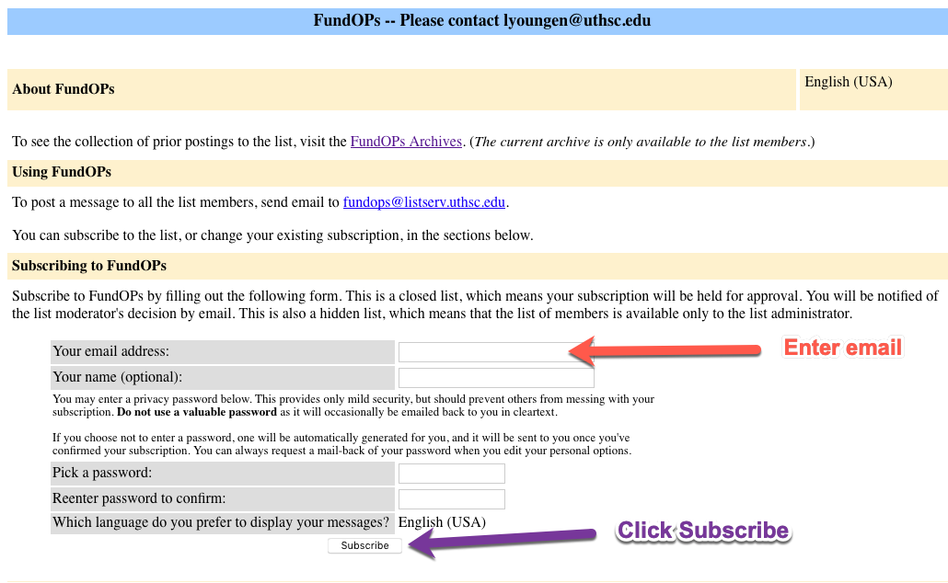
TOOLBOX – Listservs serving the
Research Community
Active intramural grants supported by the Office of Research
Extramural research funding announcements as they are made available to the Office of Research Development.
Subscribe to FundOps listserv
http://uthsc.edu/research/development/extramural-funding/fundops-listserv.php
FundOPs listserv
Notes:
Add hot link http://uthsc.edu/research/development/extramural-funding/fundops-listserv.php

Slide 40
Toolbox – Listservs serving the Research Community
  Researchers listserv:
  Office of Research’s mailing list
  geared toward all UTHSC Research Faculty, Post Docs, and Graduate Students
  Announcement of research-related events, workshops, opportunities, news, etc.
  Subscribe to Researchers listserv
  http://uthsc.edu/research/development/researchers-listserv.php
Notes:
Add hot link http://uthsc.edu/research/development/researchers-listserv.php

Slide 41

TOOLBOX – Enhance Collaborations with Experts @ uthsc
https://uthsc.pure.elsevier.com/
Notes:
Add hot link https://uthsc.pure.elsevier.com/

Slide 42
What can you do?
Create an account in Funding Institutional https://www.fundinginstitutional.com/login?routeTo=https%3A%2F%2Fwww.fundinginstitutional.com%2F
Create an account in InfoReady Review https://uthsc.infoready4.com/#homePage
Subscribe to Researchers listserv http://listserv.uthsc.edu/mailman/listinfo/researchers
Subscribe to FundOps listserv http://listserv.uthsc.edu/mailman/listinfo/fundops
Find collaborators at Experts @ UTHSC https://uthsc.pure.elsevier.com/
Attend Office of Research Events/seminars (VCR Distinguished Lecture Series, Hot Topics, LEADS lectures, HSE webinars) https://www.uthsc.edu/research/about/events/
Attend Office of Research Fair on August 14th, 2019
Read the Operational Strategic Plan for Research https://www.uthsc.edu/research/about/reports-and-publications/documents/operational-strategic-plan-for-research-8-22-16-final.pdf
Respond to ORD surveys and inquiries-this helps us improve services and track outcomes, allowing programs to continue

Slide 43
OFFICE OF RESEARCH DEVELOPMENT – contact us
        Lisa Youngentob
        Director
        lyoungen@uthsc.edu | 448-1277
        Jamie Whartenby
      Administrative Specialist III
        jwharten@uthsc.edu | 448-5296
http://www.uthsc.edu/research/development/
910 Madison Ave, Suite 608

Slide 44

Questions?

