Slide 1
Research 102 sponsored by

Slide 2
Conflict of Interest Disclosure
Conflicts of Interest
A Conflict of Interest occurs when an individual has an opportunity to affect educational content about healthcare products or services of a commercial interest with which she/he has a financial relationship.
There is no conflict of interest for this presentation.
Commercial Support
No commercial support for this seminar
Non-Endorsement of Products
Non-applicable

Slide 3
Subject Recruitment
Objectives
Define three goals of subject recruitment program
Describe the advantages and disadvantages of traditional and digital strategies employed in a recruitment program

Slide 4
Problems with Recruitment Programs
60%¹ to 86%² of clinical trials don’t meet enrollment goals ¹ Puffer s, et al. Recruitment difficulties in randomized controlled trials. 2003 ² R&D Leadership Summit, Getz, Drug Development: Economic and Operating Realities
Overpromise and under-deliver
Without subjects, research is stalled

Slide 5
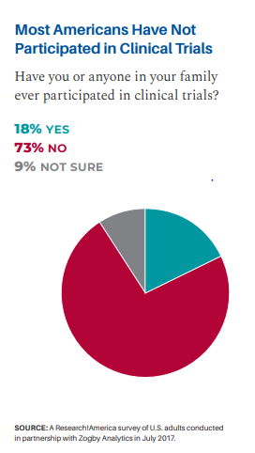

Slide 6
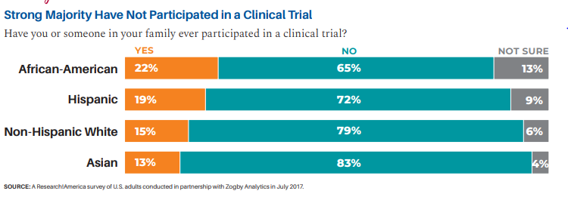

Slide 7
Recruitment is the first phase of the informed consent process.
Recruitment is a PROGRAM comprised of personnel,tools, phone scripts, dialogue, consent forms,…

Slide 8
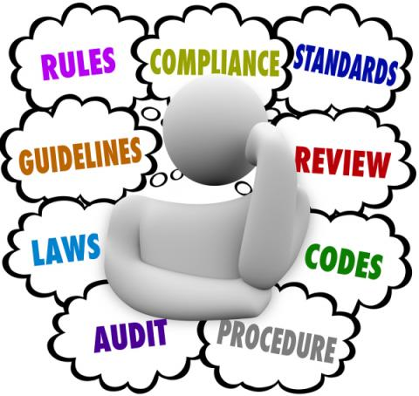
IRB Approval is Foundation for Recruitment Program
Complies with Federal Codes for subject protection
Reflects protocol/consent content
Avoids pressure
No prejudice to care or performance
Doesn’t state a favorable outcome
“Therapeutic Misconception”

Slide 9
“Recruitment involves attracting and selecting suitable candidates for a project.” University of South Carolina
Recruitment Goals:
Attract interested participants, “get the word out”
Inform participants about the study
Enroll eligible participants

Slide 10
Traditional Recruitment Methods
Direct recruitment-face to face, phone, letter
Chart or database reviews
Flyers, posters, table tents, brochures
Ads-newspaper, radio
Networking-neuro, ortho, AARP, Runner’s clubs,…
Referrals, word of mouth
Contact with past participants

Slide 11
Traditional Methods
Advantages
Disadvantages
Inexpensive
Raise awareness of study
Target a specific audience
Reach a broad population
Allows for subject to consider at their pace
Help gain access to interested subjects, i.e. “my friend said…”
“Out of sight, out of mind”
May be too much information to recall
Conflict with clinical care
Can be intrusive or unwanted
System to replace damaged, missing or outdated materials
Can be labor intensive, i.e. sending/tracking correspondence

Slide 12
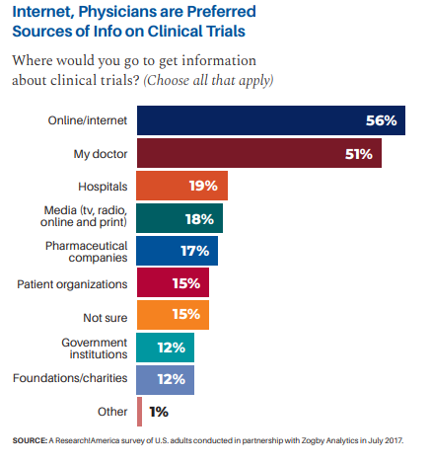

Slide 13
Digital Recruitment Methods
Email communication
Facebook, YouTube, Twitter
Google search engines
Website links
CTN2.org
Researchmatch.org
Clinicaltrials.gov

Slide 16
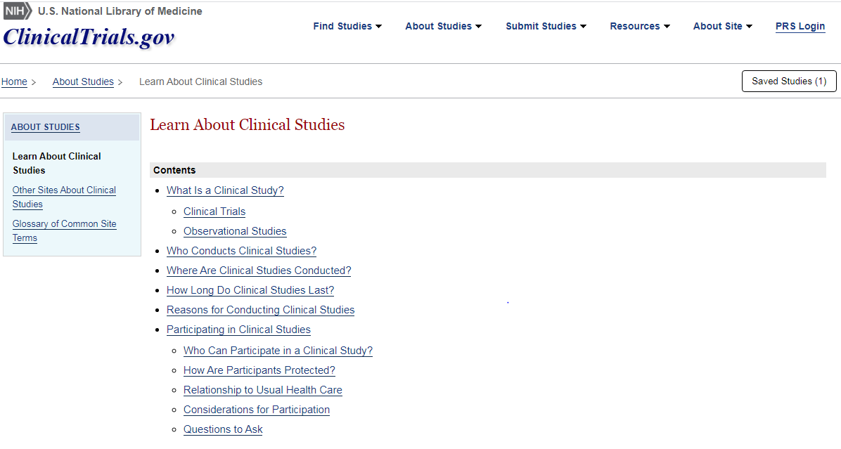

Slide 17
Digital or Network Methods
Advantages
Disadvantages
Increase your reach
Broad audience
Target a region or interest
Update the information quickly
Can be interactive
Social media is omnipresent, “The Source”
Consideration at subject’s pace
Cost considerations
Quality of interested participants
Time intensive
Monitor activity on platforms
Follow up on interested subjects
Technology problems
Overcrowded platforms

Slide 18
Tailoring a Recruitment Tool to your Study Design
Visual Design
Attention getting headline
Engaging image that resonates with the target audience
Format content for readability
Include lay language
Communicate how to obtain more information
Include a snapshot of I/E and study procedures
Network with other professionals
Include mandatory IRB details
Reference: University of Florida Clinical and Translational Science Institute

Slide 21
“Make sure that the study fits the subject and that the subject fits the study”

Slide 22
Recruitment and Retention
Enable subjects to feel like they are joining the research team.
Keep subjects engaged over time.
Try to make the study experience positive.
Create consent forms that are easy to understand.
Match the subject’s interest with the study design.

Slide 23
Enroll interested, informed, qualified subjects
Pace of enrollment
Retain subjects to end of study

Slide 24
Reformulate
Assess
Evaluate
Implement
Plan

Slide 25
Questions?
Thank you!

