Slide 1
Research 101 sponsored by

Slide 2
Conflict of Interest Disclosure
Conflicts of Interest
A Conflict of Interest occurs when an individual has an opportunity to affect educational content about healthcare products or services of a commercial interest with which she/he has a financial relationship.
There is no conflict of interest for this presentation.
Commercial Support
No commercial support for this seminar
Non-Endorsement of Products
Non-applicable

Slide 3
Event Reporting
Adverse Events, Serious Adverse Events, and Protocol Deviations

Slide 4
Adverse Events

Slide 5
What is an Adverse Event (AE)?
“Any untoward or unfavorable medical occurrence in a human subject, including any abnormal sign (for example, abnormal physical exam or laboratory finding), symptom, or disease, temporally associated with the subject’s participation in the research, whether or not considered related to the subject’s participation in the research.” (OHRP Guidance, Jan. 2007)
“Any untoward medical occurrence associated with the use of a drug in humans, whether or not considered drug related.” (21 CFR 312.32 (a))
“Any untoward medical occurrence in a patient or clinical investigation subject administered a pharmaceutical product and which does not necessarily have a causal relationship with this treatment... any unfavorable or unintended sign... symptom, or disease temporally associated with the use of a medicinal product, whether or not considered related to the medicinal product.” (ICH E2A and E6)
Notes:
By signing the 1572, the investigator also commits to reporting adverse events to the sponsor that occur during the course of a trial, in accordance with 21 CFR 312.64: Safety reports.
Any untoward medical occurrence
Any change in health or worsening of baseline conditions
Baseline neuropathy, but has increased in severity while on trial
New symptom
An accident
New diagnosis
The event does not have to be related to the trial treatment

Slide 6
Examples of AEs
Hypertension
Nausea
Vomiting
Rash
Anxiety
Delayed wound healing

Slide 7
Why is AE Reporting Important?
Safety
Safety
Safety
Safety
Notes:
Principle measure of safety of a new product!
We are developing the toxicity profile of a new product
What is the ultimate goal of clinical trials?
Development of better drugs that can improve patient outcomes and quality of life
The reporting of AEs is a major focal point in a clinical trial
Despite all of the paperwork that needs to be done, AE reports are a necessary and integral part of any trial

Slide 8
When does AE Collection Start?
Refer to the protocol
AEs and SAEs collected from the time ICF signed until safety visit
AEs must be followed up until resolution
AEs not resolved at End of study – “ongoing”

Slide 9
Sources of Information for AEs
Volunteered by the participant
Discovered by indirect questioning
Detected by physical examination
Laboratory tests
Diagnostics
(CT scan, EKG, etc.)
Patient Reported Outcomes
Notes:
Volunteered by participant, patient, or guardian (spouse, friend)
Patient reported outcomes – ePROs can often be reviewed on the device or on a website

Slide 10
Information Needed about the AE
Assessment
Start & Stop Date
Intensity
Precipitating Factors
Treatment
Response to Treatment
Severity
Mild, Moderate, Severe
In Oncology, a grading system is used
CTCAE
Based on signs & symptoms
Based on effect on daily activities
Refer to the protocol for specific requirements (may only want Grades 2-5 reported)
Notes:
CTCAE: Fundamentally intended to an agreed upon terminology for the designation, reporting, and grading of AEs that occur in Oncology research

Slide 11
Information Needed about the AE
Is it Serious?
Causality / Attribution
Assesses whether there is a reasonable possibility that the drug caused the event
Determination is made by the PI with input of study team
Sponsor determines how to rate
Yes / No
Definite, Probable, Possible, Unlikely, Unrelated
Questions that may be helpful in determining attribution
Has the AE occurred before in this study?
Is the AE reasonably temporally related to the intervention?
Does the AE improve or disappear when the intervention is discontinued? What happens on re-test? Does the AE reappear? At the same severity? At the same time point?
Are there any other potential causes for the AE?
Notes:
Definite: Clearly related to
Probable: Likely related to
Possible: May be related to
Unlikely: Doubtfully related to
Unrelated: Clearly not related to

Slide 12
Information Needed about the AE
Actions taken
Alteration in IP (ex. Dose decreased, held, or discontinued)
Concomitant Medication
Concomitant Procedure
Hospitalization
Discontinued from the study
Outcome
Resolved / Resolved
Not Recovered / Resolved
Change in Severity
Death from AE
Death from Other Cause
Notes:
Definite: Clearly related to
Probable: Likely related to
Possible: May be related to
Unlikely: Doubtfully related to
Unrelated: Clearly not related to

Slide 13
Documentation of AEs
Source document completed during patient visit
Note to file
Supporting documentation as needed
Adverse Event Log
Serious Adverse Event Form
Notes:
NTF – to provide additional information via a short narrative about the AE
Supporting documentation – Copy of lab value that is abnormal
Adverse Event Log – to track ALL AEs that happen throughout the course of the subject’s participation
Serious Adverse Event Form – Can be paper or a part of the EDC

Slide 14
AE Assessment: Source Document
General: Fever / Fatigue / Wt Loss / Alopecia / Other ____________________________________________________________
Eyes: Vision Changes ______________________________________________________________________________________
ENT: Mucositis / Tinnitus / Difficulty Swallowing / Other __________________________________________________________
Resp: Dyspnea / Cough (productive or non-productive) / Other ____________________________________________________
Cardiac: Chest Pain (cardiac or non-cardiac) / Palpitations / Edema / Other __________________________________________
GI: N / V / Constipation / Diarrhea / Bloating / Appetite Changes / Other ____________________________________________
MS: Joint Swelling (arthritis type pain) / Other Pain ______________________________________________________________
GU: Difficult Urination / Painful Urination / Other _______________________________________________________________
Endocrine: Hot Flashes / Night Sweats / Other _________________________________________________________________
Skin: Pruritus / Rash _______ / Wounds ______ / Jaundice / Other _________________________________________________
Psych: Anxiety / Depression / Insomnia / Other _________________________________________________________________
Heme/Lymph: Bleeding / Bruising / Swollen LN / Other __________________________________________________________
Neuro: Dizziness / HA / Seizures / Syncope / Neuropathy _________________________________________________________
Other: __________________________________________________________________________________________________

Slide 15
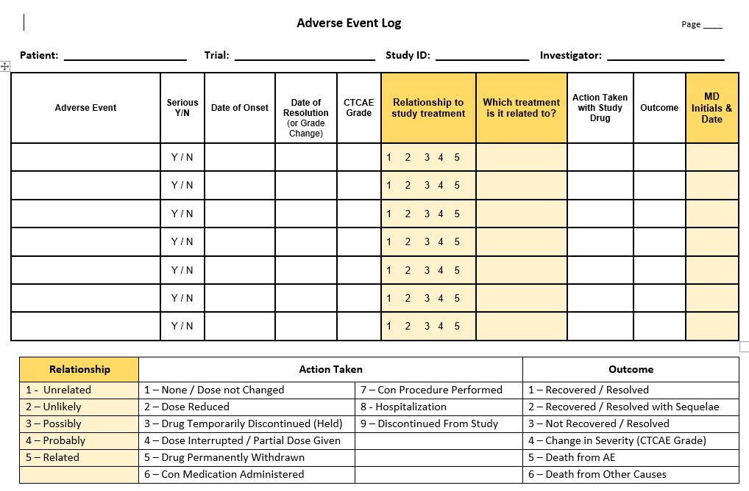
Notes:
CHANGE IN SEVERITY REQUIRES A NEW ENTRY
If an ongoing AE worsens or improves in its severity or its relationship to the study drug changes, a new AE entry for the event should be entered on the CRF.

Slide 16
Examples
A participant who has just given informed consent and completed screening assessments but has not been randomized yet. The participant leaves the study visit and then gets in a car accident on the way home.
A patient becomes pregnant while on trial.
Notes:
Pregnancy is NOT an AE
All pregnancies during the course of a clinical trial must be reported
Follow protocol/sponsor guidance

Slide 17
Challenges with AE Reporting
Protocols are complex and often involve multiple drugs and/or therapeutic modalities.
A patient’s prior therapies can affect the occurrence and/or severity of an AE.
Many patients have complex presentation of their disease with many baseline signs and symptoms.
Concurrent medical conditions and/or medications can affect the occurrence and/or severity of an AE.

Slide 18
Serious Adverse Events

Slide 19
What is a Serious Adverse Event (SAE)?
Results in death
Is life threatening
Requires hospitalization or prolongation of existing hospitalization
Results in persistent or significant disability or incapacity
Is a congenital anomaly or birth defect
Based upon appropriate medical judgment, may jeopardize the subject’s health and may require medical or surgical intervention to prevent one of the other outcomes listed in this definition
https://www.fda.gov/media/79394/download
Notes:
What is life threatening?
The subject was at risk of death at the time of the event
It does not refer to an event which hypothetically might have caused death if it were more severe
The determination of whether an adverse event is life threatening can be based on the opinion of either the investigator or sponsor.
SEVERITY is not the same as SERIOUS
Serious is based on outcome and is a factor in determining reportability e.g.: subject hospitalized as result of event
Severity refers to the intensity of the experience e.g.: CTCAE grade 3 events

Slide 20
SAE Reporting Timelines
Refer to the protocol
Normally within 24 hours of site awareness of the event
For the initial submission, submit what you have:
Most recent clinical evaluation, baseline history and physical
Provide a summary of the event and treatment to date
When additional information becomes available – amend the report
Follow-up reports are submitted until SAE resolves -- even after the study has ended, the follow-up period has ended, or the patient has been removed from trial
Notes:
Some events that initially appear to meet expedited reporting requirements may be excluded from expedited reporting as per the protocol.

Slide 21
Information Needed about the SAE
Event term
Subject demographics
Study agent (dates given, dose, route of administration)
Causality
Medical history
Concomitant medications
Pertinent labs and diagnostics
When needed to explain the experience
When needed to support the diagnosis
Notes:
FDA is looking for an attribution as it relates to an investigational drug/product
IRB is looking for an attribution as it relates to the research
Sponsors may use either one or a combination
This means that an event that is to be reported to a Sponsor may not necessarily be reported to the IRB.

Slide 22
Information Needed about the SAE
Narrative summary of occurrence
Most important part
Provides the background information necessary to assess the event and supports the Investigator’s attribution
Information that helps to describe the event(s)
Information that puts the event in perspective
Include recent events that may be a contributing factor
Investigator’s signature
Notes:
All information captured, must have source documentation

Slide 23
When is a SAE Reported to the IRB?
In 2009, FDA issued a guidance on AE reporting to IRBs Improving Human Subject Protection that makes recommendations on the types of adverse event information that should be reported to an IRB
Investigators are required to promptly report “to the IRB … all unanticipated problems involving risk to human subjects or others,” including adverse events that should be considered unanticipated problems (21 CFR 312.66).

Slide 24
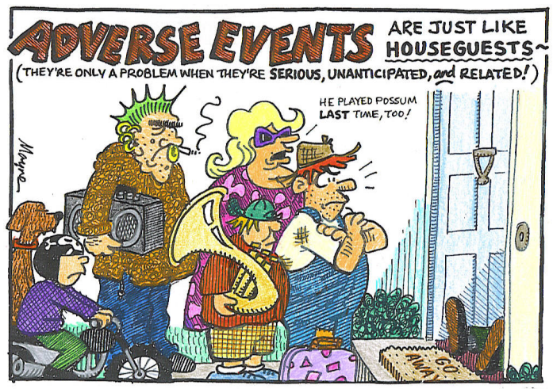
What is an Unanticipated Problem?
Unexpected in terms of nature, severity, or frequency, given
the research procedures that are described in the protocol-related documents
the characteristics of the subject population being studied
Related or possibly related to a subject’s participation in the research; AND
Suggests that the research places subjects or others at a greater risk of harm (including physical, psychological, economic, or social harm) related to the research than was previously known or recognized.”
OHRP Guidance on UPs and AEs, Jan. 15, 2007
Notes:
Most AEs are not unanticipated problems

Slide 25
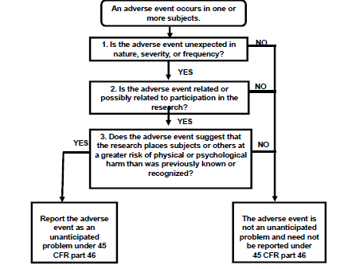
Do I Report the SAE to the IRB?
Notes:
Expected AEs
Reported in previous or pre-clinical trials
Described in IB
Unexpected AEs
Not previously observed
Not consistent with information in IB
For example, under this definition, hepatic necrosis would be unexpected (by virtue of greater severity) if the investigator brochure referred only to elevated hepatic enzymes or hepatitis.

Slide 26
Common Problems with SAE Reporting
Person(s) assessing event is not qualified to do so (not on study protocol, insufficient or no medical training, no licensing… etc.)
Events not appropriately documented
Reporting timeframe requirements not met
Protocol-specified study procedures not followed

Slide 27
Protocol Deviations

Slide 28
ICH GCP Regulations
4.5.1: Investigator should conduct the trial in compliance with the protocol agreed to and approved by an IRB
4.5.2: Investigator should not implement any changes or deviations from the protocol unless agreed to by the IRB, sponsor, etc. except when necessary to eliminate immediate hazards to trial subjects, or when the changes are administrative or logistical
5.20.2: If the monitoring and/or auditing identifies serious and/or persistent noncompliance on the part of an investigator/institution, the sponsor should terminate the investigator’s/institution’s participation in the trial.
5.20.2: The sponsor must view protocol non-compliance as a ‘violation’ of agreed responsibilities.

Slide 29
Why is Protocol Adherence Important?
Strict adherence to the protocol is more likely to:
Protect human subjects
Preserve the integrity of the data and research
Notes:
The reality is that within clinical trials, protocol deviations do happen, despite best efforts.
However, not all have the same level of impact on study results or patient well-being.

Slide 30
Protocol Deviations (PDs)
A protocol deviation occurs when the activities during a study diverge from the IRB approved protocol
Examples
Not obtaining a weight during a visit
Failing to collect a lab
Targeted physical exam documented instead of complete PE
CT scan performed outside of window

Slide 31
Protocol Violations
A protocol violation occurs when there is a protocol deviation that also:
Reduces the quality or completeness of the data
Impacts a subject’s safety, rights, or welfare
Affects the scientific integrity
Examples
Inadequate informed consent
Enrollment of subjects not meeting the inclusion /exclusion criteria
Initiation of study procedure prior to completion of informed consent
Improper breaking of the blinding of the study
Falsification of records
Frequent minor deviations
Failure to withdraw a subject meeting withdrawal criteria
Notes:
Also called major deviations

Slide 32
Who Discovers Deviations/Violations?
Study Team
Monitor
Auditor
Participant

Slide 33
Reporting Deviations
Description of the deviation
Reasons why it occurred
Corrective and preventive actions taken in response

Slide 34
Preventing Deviations
Review and understand protocol
Identify any procedures in the protocol that differ from standard practice at your establishment
Use well-designed study-specific source documents
Review and understand protocol
Identify any procedures in the protocol that differ from standard practice
Thoroughly train study staff
Study initiation meetings
Is the staff who are conducting the procedures credentialed?
Carefully review amendments
Use the correct version of the protocol

