Slide 1
Research 101 sponsored by

Slide 2
Disclaimer
Conflicts of Interest
A Conflict of Interest occurs when an individual has an opportunity to affect educational content about healthcare products or services of a commercial interest with which she/he has a financial relationship.
There is no conflict of interest for this presentation.
Commercial Support
No commercial support for this seminar
Non-Endorsement of Products
Non-applicable

Slide 3
Regulatory and Essential Documents Record-Keeping
Carol Hendrix, MSN, RN, CCRC
Manager, BIG Initiative
UTHSC
Derita Bran MSN, RN, CCRC
Program Director
TN-CTSI

Slide 4
Regulations/Guidance for Essential Documents
ICH GCP E6 (R2)
https://www.fda.gov/media/93884/download
21CRFs
https://www.accessdata.fda.gov/scripts/cdrh/cfdocs/cfcfr/cfrsearch.cfm
45CFR46
https://www.hhs.gov/ohrp/regulations-and-policy

Slide 5
Essential Documents
From ICH GCP E6 (R2):
Documents which individually and collectively permit evaluation of the conduct of a trial and the quality of the data produced
Serve :
to demonstrate the compliance of the investigator, sponsor and monitor with the standards of Good Clinical Practice and with all applicable regulatory requirements
a number of other important purposes:
Filing essential documents at the investigator/institution and sponsor sites in a timely manner can greatly assist in the successful management of a trial by the investigator, sponsor and monitor
These documents are also the ones which are usually audited by the sponsor’s independent audit function and inspected by the regulatory authority(ies) as part of the process to confirm the validity of the trial conduct and the integrity of data collected

Slide 6
ICH GCP E6 (R2) Section 8
ESSENTIAL DOCUMENTS FOR THE CONDUCT OF A CLINICAL TRIAL
The various documents are grouped in three sections according to the stage of the trial during which they will normally be generated:
1) before the clinical phase of the trial commences
2) during the clinical conduct of the trial
3) after completion or termination of the trial.
A description is given of the purpose of each document, and whether it should be filed in either the investigator/institution or sponsor files, or both. It is acceptable to combine some of the documents, provided the individual elements are readily identifiable.

Slide 7
Essential Document Maintenance
Essential Documents master file should be established at the beginning of the trial
both at the investigator/institution’s site and with sponsor, as applicable
Any or all of the documents maintained as part of your research are subject to, and should be available for, audit/monitoring by the following:
Sponsor
Regulatory authority(ies)
IRB/IEC
Institution
Department

Slide 8
Essential Documents
What Essential Documents must be maintained?
How are Essential Documents maintained?
Most Essential Documents are maintained in a Regulatory Binder/File
What is a Regulatory Binder?

Slide 9
What is a Regulatory Binder?
Electronic/paper/combination file that contains:
Study specific information
Study essential documents
Regulatory documents

Slide 10
Regulatory Binder
Purpose:
Compliance:
Demonstrates compliance with Regulations and Good Clinical Practice (GCP)
Validates adherence to high standards of research practices and human subject protection
Record Keeping:
Provides an organizational framework for study specific essential documents
Organization and Access:
Allows easy access to study documents with minimal effort
Permits evaluation of the conduct of the study and assists to determine the quality of the data

Slide 11
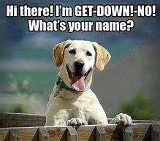

Slide 12
Regulatory Binder Names
Regulatory Binder (RB)
Reg Binder
Investigator Binder
Investigational Site File (ISF)
Study Binder
Master Trial File (MTF)
Study Administrative Binder
Regulatory Files
Study File
Trial Master File (TMF)

Slide 13
Labeling the RB
If Paper documents:
Title
Number the binders if more than 1 (ex. 1 of 3)
PI name
Protocol Name/identifier
IRB#
Sponsor
If electronic documents:
Folder on your computer
Tabs under the folder as you would in a paper Regulatory Binder

Slide 14
Responsibility
It may involve many different research study team members!
Key Study Personnel (KSPs)
Principal Investigator (PI) is ultimately responsible, but most often this task is delegated to other members of the study team
Investigators
Clinical Research Coordinators
Research Associates/Assistants
Clinical Research Associates (Monitors)
Data Managers
Regulatory Affairs staff
Other study team members

Slide 15
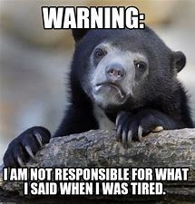

Slide 16
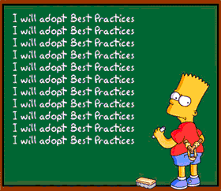
Best Practices:
Maintenance
Organization
Storage

Slide 17
Maintenance
Establish the RB/Electronic File Folder(s) at the beginning of the study
Keep the binder/files current, up-to-date, and organized
Subject specific information/documents are usually maintained separately from the Regulatory Binder/Electronic documents in subject specific research records
Do not destroy/delete earlier versions of essential documents

Slide 19
Organization
Store items in reverse chronological order if in paper binder
Organize the electronic file by dates
Customize the binder/electronic files to the needs of the specific protocol
Order the sections/electronic folders to facilitate easy referencing
If paper RB, file sections that most referenced in the front of the binder
If Industry sponsored trials, the sponsor may have a template for the paper binder to be used

Slide 20
Storage
Store the binder in a safe and secure location at the investigator’s site if paper RB
If electronic files, ensure the files are password protected
Documents not stored in the RB should have a note (NTF)/memo indicating the location of where the documents will be maintained outside of the paper RB
Maintain subject confidentiality
It is suggested the following be maintained outside of the paper RB:
Signed ICFs
Test results
Completed CRFs
Screening/Enrollment log
Master Log
Contracts/budget/study financial records

Slide 22
Table of Contents
Current Protocol
Current Consent Form
IRB Documents
Study Team Credentials
IP Brochure/Manual
DOA/DOR
Case Report Forms
Training
Documents
IP Information and Accountability
Correspondence
Screening/
Enrollment log
Master Log
Laboratory Documents
Specimen Tracking Log
Protocol Deviation log
Note to Files
Monitoring Visits and Reports
AE/SAE Logs/Documents
Source Documents
Legal/Financial Documents

Slide 23
Protocol
Most updated, current IRB approved protocol version
*Prior versions behind, in order
PI signature page of the protocol:
PI has read and is familiar with protocol
Understands procedures
Proves oversight
Protocol Summary documents of changes if this is an amended version
*Consider using a protocol version log to track changes

Slide 24
Informed Consent Form (ICF)
Most current IRB approved ICF (and all prior versions)
Consider creating a protocol version log
Make sure that the study team has the most updated, IRB approved ICF available for their use
Print directly from your IRB portal (such as iMedris)
Don’t print off too many
Keep track of new versions, destroy old versions
Reconsent as needed

Slide 25
Signed ICFs
We do not recommend the storage of signed ICFs in the RB
Store in the participant’s research record
For high volume, one-visit studies, consider storing multiple participants’ research records in several large binders

Slide 26
Institutional Review Board (IRB)
Purpose:
This section is maintained to document that the trial has obtained IRB/IEC approval and can be conducted
The documents in this section can also help to identify the current version of IRB approved documents

Slide 27
IRB Documents to Include
IRB Membership Roster
Maintain from date of first submission to close out of the study (all IRB boards)
IRB Federal Wide Assurance (FWA)
IRB SOPs that may be applicable to your study or that the sponsor requires (ICF, AE submission)
Certificate of Confidentiality, if applicable

Slide 28
IRB Documents cont’d
IRB Submissions
Initial Application
Ongoing / Continuing Review
Revision
Amendment
Termination / Closure
Including all versions of the following:
Protocol with signature page
ICF
Blank CRFs (if required) – also diaries and questionnaires
Recruitment materials (flyers, posters, gifts)
Participant educational brochures / study informational materials / Video recordings / Gifts

Slide 29
IRB Documents cont’d
Reportable Safety Events
PD (protocol deviations)
UP (unanticipated problems)
SAEs (serious adverse events)
Data Safety Monitoring Board Reports
New information that the sponsor wants reported
Helpful Tips:
Create a submission packet with the approval clipped to the top
Use colored paper identifying various types of submissions
Make sure the submission and approval dates are clearly visible
Include a summary of changes submitted if applicable
Create an IRB submission log to help keep track if desired

Slide 30
IRB Documents cont’d
Correspondence with the IRB
Approval letters
Proviso letters
PI responses to IRB
IRB notices of upcoming expiration dates
Request for corrected IRB letter
IRB stamped approved documents
Maintain IRB documents outside of the
IRB portal (ie. iMedris)

Slide 31
Study Team Credentials
Curriculum vitae (CVs) / resume / bio sketch for the Principal Investigator, other investigator(s) and key study personnel (KSP) for the study
Financial Disclosure Forms and Conflict of interest forms
Clinical professional licensure/certification (dental, medical, nursing, pharmacy, etc.) for all KSP; Specialty training needed for study procedures
Training documents (Human Subject Protection, CITI, Good Clinical Practice, protocol, etc.)

Slide 32
Study Team Credentials Best Practices
Maintain these credentials throughout the KSP’s participation in the study (and some studies require 2 years post study)
The KSPs’ credentials should be maintained at the time (or before) their study participation to the end of their participation in the study (These dates should be in alliance with the Delegation of Authority log)
CV/Resumes should be current/signed/dated – industry standard is that these are updated and signed every 2 years
You can maintain in paper format or electronically or both, but they must be easily accessible and current
Maintaining current credentials is challenging! Find a process that works for you

Slide 34
Training Documents
Human Subject Protection
ICH GCP E6 (R2)
FDA regulations
45CFR46
Declaration of Helsinki/Nuremburg Code/Belmont Report
Institution specific training
Protocol/procedures/IP
In-services
Study related meetings
IATA/Biohazard
SOPs/MOPs
Site Initiation Visit

Slide 35
Delegation Log
Additional names:
Delegation of Authority Log (DOAL)
Delegation of Authority (DOA)
Delegation of Responsibility Log
Signature Log

Slide 36
DOA/DOAL/DOR
Purpose:
Identifies the KSP involved in the study
Matches KSP’s name to handwriting/initials
Documents the delegated task(s) that have been assigned by the PI to the KSPs, ensure KSP is qualified to perform the delegated task
Documents the timeline of an individual’s participation in the study

Slide 37
DOA/DOAL/DOR
Best Practices:
This document must remain current at all times
Should be completed before/at the time the study is initiated/throughout the conduct of the study and at closure
The PI must initial and date any changes that are made throughout the life of the study
He/she must also sign this form at the closure of the study

Slide 38
Subject /Participant Logs
Purpose:
Documentation of the individuals approached/screened and/or enrolled in the study
Screening/Enrollment
Master log
*Your sponsor may have other names for these logs

Slide 39
Subject /Participant Logs cont’d
Storage:
Reg binder – for studies with fewer participants
Separate binder – for studies with many participants, when you need frequent access

Slide 40
Screening/Enrollment Log
Purpose:
Provides a comprehensive, accurate list of patients that have been approached/screened to determine eligibility
What is eligibility? Desire to participate + meets inclusion/exclusion criteria
To record the consent of all subjects wanting to participate and meeting eligibility criteria
Documents reason for screen fail or why they were not enrolled

Slide 41
Subject Logs: Best Practices
This log should contain no identifying information / No PHI
Number each potential subject chronologically as a separate entry and number each page (1/3, 2/3, 3/3, etc.)
At the conclusion of the study, identify the final page of the log
Maintains the status of the subject’s participation (withdrawal/termination/completed the study)

Slide 42
Master Log
Purpose:
Subject Identification Code List
Confidential list of PHI (name, DOB, address, phone numbers, email, etc.)
Need a way to contact participants for future concerns

Slide 43
Case Report Forms (CRFs)
Purpose:
Documentation of protocol required data or information for each study participant
Facilitation of data collection and entry

Slide 44
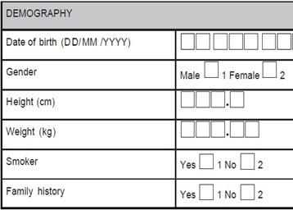
Blank Case Report Forms (CRFs)
A blank copy of all CRFs should be maintained in the reg binder
Completed CRFs should be filed in each participant’s research record
CRFs may include:
Data collection sheets
Questionnaires
Worksheets

Slide 45
CRFs:Best Practices
All completed CRFs should be maintained as essential documents
CRFs should be dated/signed by the study team member completing the form (ALCOA-C)
Data reported on the CRF should be consistent with the source documents
Any change or correction to a CRF should be dated, initialed, and explained (if necessary) and should not obscure the original entry
Usually the PI reviews/signs off on the completed CRFs or documents

Slide 46
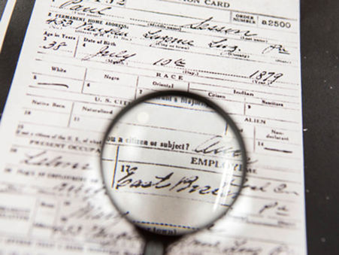
Source Documents
“Source documents are original documents, data, or records … that relate to the medical treatment and the history of the participant, and from which study data are obtained.” ​ gcp.nidatraining.org​
​
Storage locations:​
Patient/Subject’s medical records​
Subject’s research record​
RB, for a small amount of participants

Slide 47
Investigational Product (IP)
Purpose:
Documentation of the receipt and maintenance of the IP
Documents to be maintained:
Investigational brochure, package insert, or device manual, all versions
Sample of product label
Documentation of study product shipment/receipt/dispensing/return/disposal
IP log to Include dates, quantities, batch/serial #, expiration dates
Documentation pertaining to disposable drug temperature monitoring devices

Slide 48
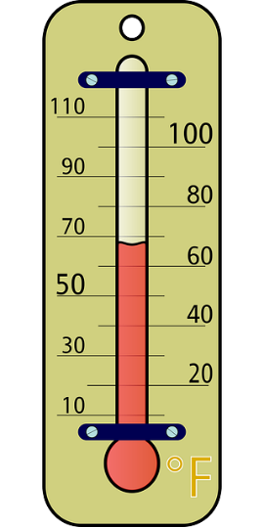
Investigational Product cont’d
Documents to be maintained:
Instructions for IP handling
Randomization instructions, if applicable
Unblinding procedures, as applicable
Temperature log, when applicable
Travel temp documentation, if applicable
Storage/maintenance instructions

Slide 49
Laboratory/Testing Center Documents
Purpose:
Documentation of the normal ranges for the laboratory tests / procedures / laboratory’s credentials as being a qualified lab to test specimens collected for the study
Documents to be maintained:
Copy of laboratory certification and accreditations (CAP, CLIA, State License)
Laboratory normal reference ranges/values for procedures included in the protocol
Certification of analysis/reliability of tests performed, when requested
Copy of Laboratory/Testing Center’s Director’s license and CV (current within 2 years)

Slide 50
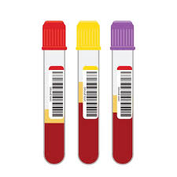
Specimen Tracking
Purpose:
Provides a means to tracks specimens/samples collected as study procedures
Types of samples to track:
Specimen Tracking Log
Retained tissue log
Consider transport log, if applicable
Documents to maintain
Shipping/Receipt/Maintenance documentation
Storage temperature logs

Slide 51
Equipment Logs
Must prove ongoing accuracy of department equipment used to collect or create data:
Calibration documentation, manuals, repairs
Centrifuge
Refrigerators
Freezers
Associated alarm systems with fridge and freezer
VS monitoring (BP, Pulse, Temp, oximetry, EKG)
Scales
Room and Refrigerator thermometer, hygrometer

Slide 52
AEs/SAEs
Purpose:
Documentation of side effects/adverse events (AEs)/serious adverse events (SAEs)/unexpected adverse events experienced by a subject

Slide 53
AEs/SAEs/Unanticipated Problems
Maintain the following:
Log for each subject, if applicable
Log for study
Forms/CAPAs
Correspondence, copies and acknowledgement of reports of internal AEs
External reports to IRB, Sponsor, regulatory authorities
IND Safety Reports

Slide 54
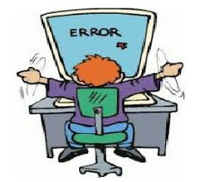
Protocol Deviations
Purpose:
Documentation of non-compliance with the protocol
Best Practices:
Maintain a protocol deviation log
Documentation/memo/Corrective Action Preventive Action (CAPA), as applicable for each deviation
Record events as soon as possible after the event, ALCOA-C

Slide 55
Monitoring Visits
Documentation of the monitoring visit/visit type/ results of visit(s)/findings(s)
Maintain the following in this section:
Monitoring reports/letters/Correspondence
Monitoring Log:
Each Visit should be documented by the monitor and a study team member by dating and signing the log
The reason for each visit should also be documented on the log
Pre-study visit, site initiation, routine visits, close-out visit, etc.

Slide 56
Correspondence
Purpose
To record discussions/ correspondence that are significant to the conduct of the study resulting in a complete and accurate audit trail
Types of Correspondence (emails/faxes/letters/electronic documents, meeting notes, phone calls) to maintain from:
Sponsor
Contract Research Organization (CROs)
Monitor
IRB (prefer to keep this correspondence with the IRB section)
Study Team
Subjects
Correspondence regarding individual subjects should/may be maintained with their research records

Slide 57
Legal/Financial Documents
FDA documents
Contracts
Budgets
Subject payments
Letter of Understanding/Confidentiality Agreement
Data Sharing Agreement
Material Transfer Agreement
Signed agreements between parties (i.e., sponsor/CRO/Institution investigators)

Slide 58
Memo to Document Events (aka NTF)
Purpose:
To document the reason for missing/delayed/incorrect information/any discrepancies
To document the corrective action taken/resolution of discrepancies
To document the location of documents stored outside of the RB
To provide additional information or clarification
Documentation of events should include the following:
Signature of the author and the date created and the PI (when applicable)
Description of the event (who, what, where, when, how, why)
Actions taken to resolve the issue
Any necessary CAPA
Pertinent information to provide clarification of an event

Slide 59
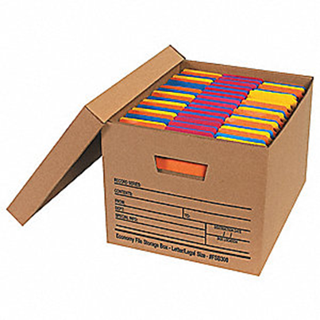
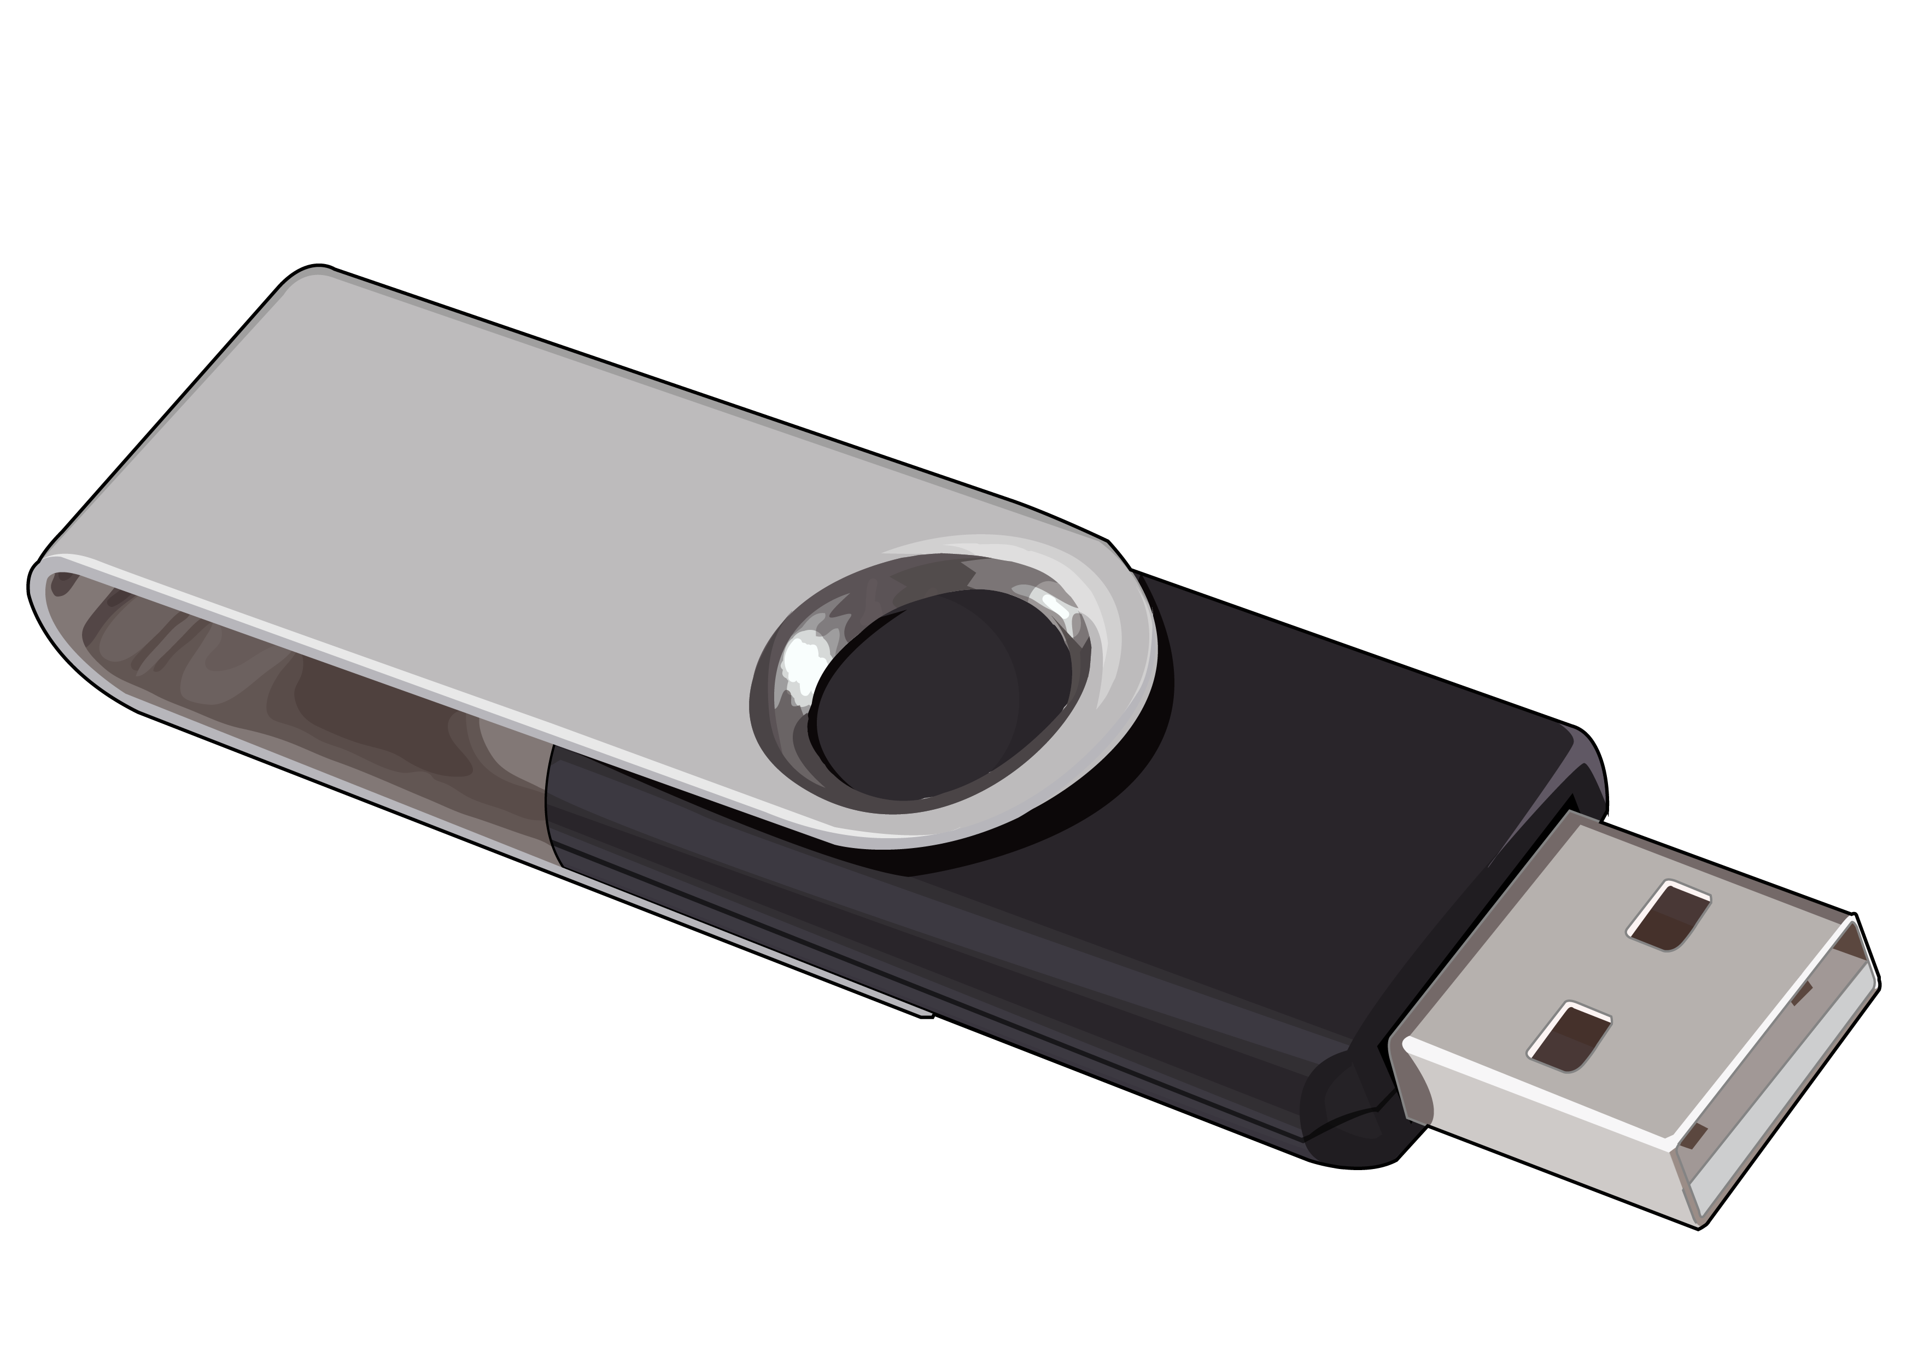
Long Term Storage
Make sure you have allowed for this in your budget
Store on site if possible
If location changes, let sponsor know
Temp, humidity controlled
When storing CDs or flash drives be be sure to check with your institution regarding safe storage of these items."
CURRENT SOPs with that particular study – both departmental and IRB
How to:
Remove hard binder, divider pages, plastic sleeves
Rubber band horizontal and vertical
Place in labeled, expandable folder, store in binder order
Label storage boxes appropriately according to institution

Slide 60
Conclusion
The RB should:
Organized in a logical manner
Located in a central location and accessible to the appropriate study team members
Be maintained in a current state at all times in paper / electronic / or combination of both formats
Store securely until deemed appropriate to destroy

Slide 61
Carol Hendrix MSN, RN, CCRC chendrix@uthsc.edu
Derita Bran MSN, RN, CCRC dbran@uthsc.edu

