Slide 1
Research 101 sponsored by

Slide 2
Disclaimer
Conflicts of Interest
A Conflict of Interest occurs when an individual has an opportunity to affect educational content about healthcare products or services of a commercial interest with which she/he has a financial relationship.
There is no conflict of interest for this presentation.
Commercial Support
No commercial support for this seminar
Non-Endorsement of Products
Non-applicable

Slide 3
Roles and Responsibilities of the Investigator and Study Team
Derita Bran, MSN, RN, CCRC
Program Director, TN-CTSI

Slide 4
List of Abbreviations
AE- Adverse Event
ALCOA-C – Attributable, Legible, Contemporaneous, Original, Accurate, and Complete
CFR- Code of Federal Regulations
DOAL-Delegation of Authority Log
ICH GCP- International Council For Harmonization Good Clinical Practice
I/E- Inclusion/Exclusion criteria
IP- Investigational Product
IRB- Institutional Review Board
IEC- Independent Ethics Committee
OHRP- Office of Human Research Protection
PI- Principal Investigator
SAE- Serious Adverse Event

Slide 5
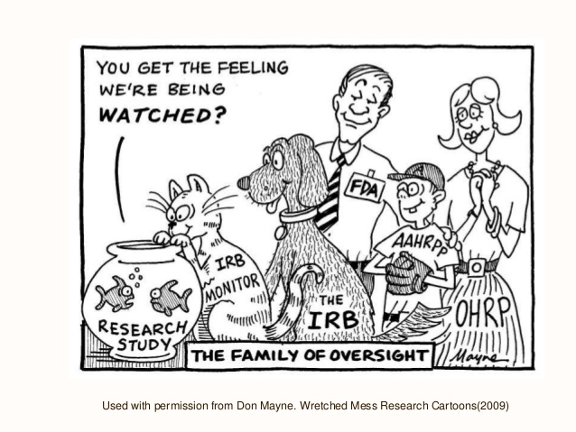
Regulations and Guidance
21 CFR Part 11, 50, 54, 56, 312, 812
45 CFR 46
ICH GCP E6 (R2)guidance
FDA information Sheets
OHRP
Belmont Report
Nuremburg Code
Declaration of Helsinki
IRB/IEC
Protocol
Institutional and Departmental policies and procedures
ALCOA-C

Slide 6
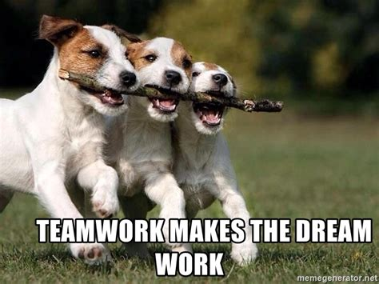
Research Study Team
Who can be a Member?
PI
Other investigators
Coordinators
Data specialists
Statisticians
Regulatory Coordinator
Other key personnel

Slide 7
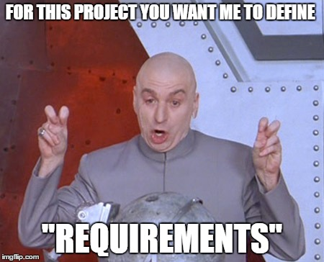
Research Study Team
Requirements to be a study team member:
Appropriate and adequate skill set to perform delegated tasks
Training
Protocol compliance
Regulation and Guidance compliance

Slide 8
Investigator Commitments
Ability to recruit in sufficient numbers and in timeframe given
Sufficient time to complete his/her duties for the study
Be well-informed about the protocol, the IP, and study responsibilities
Knowledgeable regarding regs and guidance
Ensure the integrity of the data collected and reported
Have adequate resources to conduct the study
Protocol compliance
Notes:
Protocol feasibility. Assessed at different levels to determine if study is a good fit for the site
Assessed for adequate personnel, correct access to facilities and 3rd facilities (CT, lab, path, surgery)
Have to dedicate research time for the study

Slide 9
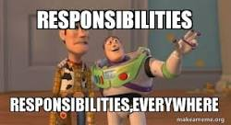

Slide 10
Principal Investigator’s Overall Responsibility
Ultimately responsible for all activities associated with the conduct of a research project, (even when tasks are delegated)
Qualified by education, training, and/or experience
Adherence to the FDA Regs, ICH GCPs, ethical principles, state and local laws/ policies, and Protocol
Supervision of a clinical study in which some study tasks are delegated to employees or colleagues of the investigator or other third parties
Protecting the rights, safety, and welfare of the study subjects
Notes:
Overall responsibilities
PI is responsible for the management and integrity of the design, conduct, and reporting of the research project, for managing, and monitoring
Oversight of compliance

Slide 11
PI General Responsibilities
Conduct research in an ethical manner
Conduct research that contributes to generalizable knowledge while protecting the rights and welfare of human subjects
Ensure that a clinical investigation is conducted according to the signed investigator statement (1572) and/or investigational plan (protocol), as applicable
Personally conduct or supervise the trial as written in the clinical protocol
Disclosure of conflicts of interest
Controlling IP under investigation, including accountability / understand the IP, including the potential risk and side effects (SEs)
Notes:
Adequate records include IP accountability, accurate case histories that record all observations, safety reports, signing labs, assessing AEs and SAEs

Slide 12
PI General Responsibilities cont’d
Ensure adequate infrastructure and resources to conduct the study efficiently
Delegation of study-related tasks to employees/study staff, colleagues, or other third parties
Ensure that all study team members are informed about their duties and obligations
Maintaining adequate records
Ensuring IRB review, approval, compliance and reporting requirements are met
Willing to comply with applicable regulations and be prepared for audits and monitoring

Slide 13
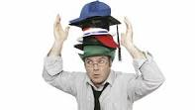
Responsibility of the Study Team
As a member of the research study team, we may wear many hats in order to fulfill our responsibilities to the PI and for the study

Slide 14
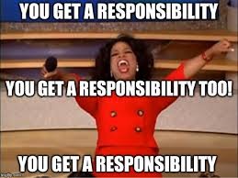

Slide 15
Responsibilities of Research Staff
Must be qualified by education, experience, and/or training to perform tasks delegated by the PI
Subject advocate-Protection of the subject’s rights, well-being, and safety
Protocol compliance
Management of the study
Maintain study records/documentation/data entry
Communicator among study team
Coordination of the study team
IRB Submissions
*Depends on the role of the study team member*

Slide 16
Responsibilities of Research Staff cont’d
Conduct study procedures per protocol
Follow ethical principles
Certified in Human Subject Protection
Adhere to regulations, policies, and guidance
Ongoing training/educator
Identify barriers and resolutions
Contract/budget negotiations

Slide 17
Rate Principle
Accountability
Transparency
C
Connecting
Rapport
Empowerment
Rate Principle: Creation of the network of Dedicated Enrollment Sites, a core component of the Veterans Administration (VA) Cooperative Studies Program

Slide 18
Delegating Tasks
Delegate tasks to those who are qualified by education, training, and experience to perform the task
Provide adequate supervision of those to whom tasks are delegated
Provide appropriate training for study staff
Even if tasks are delegated, it is the PI/s responsibility to ensure that all study-related responsibilities are appropriately fulfilled
The PI retains the ultimate responsibility for the conduct of the trial even when delegating tasks
DOAL form

Slide 19
Inappropriate Delegation to the Study Team
Screening evaluations, including obtaining medical histories and assessment of I/E criteria
Physical Exams
Evaluation of AEs and SAEs
Obtaining informed consent
Inappropriate delegated tasks (too many, not qualified to perform)

Slide 20
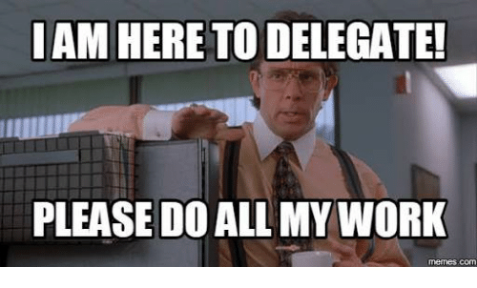

Slide 21
Protocol Compliance
Conduct the study/trial in compliance with the protocol
Document and explain all deviations
Deviation from the protocol should only occur to eliminate an immediate hazard to a subject and requires immediate reporting to:
PI
IRB (as applicable)
Sponsor (as applicable)
Any other regulatory authorities (as applicable)

Slide 22
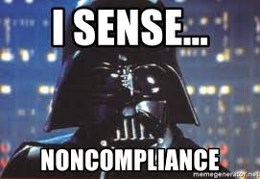

Slide 23
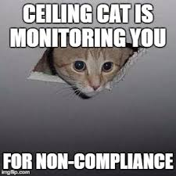
Common Non-Compliance Findings
Insufficient evidence of investigator oversight/involvement
Failure to adhere to the protocol procedures
Inadequate source documentation
Changes made to the original records without an audit trail
IP accountability issues
Reporting deficiencies

Slide 24
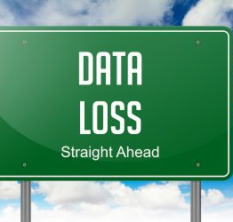
Consequences of Non-Compliance
Loss of data
Professional reputation for the investigator, you, and the institution
Subject safety

Slide 25
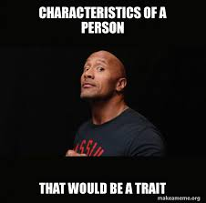

Slide 26
Research Coordinator/Study Team Characteristics/Traits

Slide 27
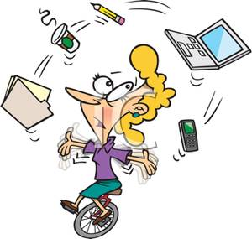
Characteristics/Traits:
Ethical/Caring personality for subjects/Protector of subjects
Multi-tasker
Customer service skills
Leadership skills
Independent worker
Competent/knowledgeable
Organization skills
Detailed oriented/ Efficient documentation
Effective communicator/ good interpersonal skills
Collaborator/team player
Prioritizing skills/time management skills

Slide 28
Characteristics cont’d
Trustworthy
Dependable
Active listener
Critical thinking skills/Problem solver/conflict resolution skills
Flexible/adaptable
Coachable
Teacher/Serve as a resource to other researchers/ Mentor
Motivated
Technology savvy
Creative
Patient attitude
Can do attitude

Slide 29
Research= Being:
Responsible
Ethical
Subject protector
Efficient
Attentive
Caring
Honest
ACRP article: https://acrpnet.org/2018/08/14/the-anatomy-of-a-great-clinical-research-coordinator/

Slide 30
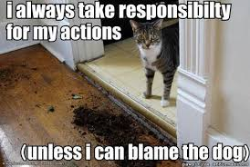

Slide 31
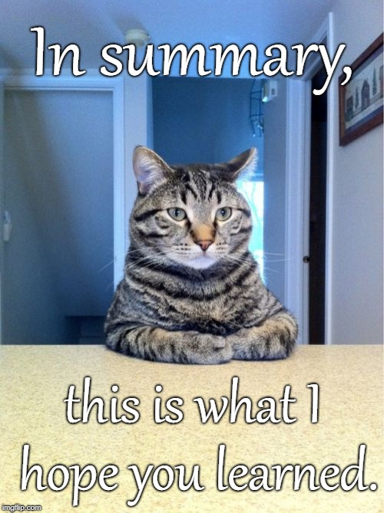
Adhere to the Protocol unless there is a safety issue for the subject
Comply to regulations, policies, procedures, and guidance
Perform tasks delegated by the PI that you are qualified to conduct
Protect subjects
Act as a team and perform the study according to above bullet points and your study will be SUCCESSFUL

