Slide 1
Research 101
sponsored by

Slide 2
Conflict of Interest Disclosure
Conflicts of Interest
A Conflict of Interest occurs when an individual has an opportunity to affect educational content about healthcare products or services of a commercial interest with which she/he has a financial relationship.
There is no conflict of interest for this presentation.
Commercial Support
No commercial support for this seminar
Non-Endorsement of Products
Non-applicable

Slide 3
Standard Operating Procedures (SOPs)
Dr. Marie Jackson

Slide 4
Standard Work Video https://www.bing.com/videos/search?q=I+Love+Lucy+Chocolate&&view=detail&mid=14D5BB9E304AA4182D3B14D5BB9E304AA4182D3B&&FORM=VDRVRV

Slide 5
Definition of SOPs
A standard operating procedure is
a set of step-by-step instructions compiled by an organization
to help staff carry out complex, routine operations.
https://en.wikipedia.org/wiki/Standard_operating_procedure

Slide 6
Purpose of SOPs
SOPs aim to achieve efficiency, quality output and uniformity
of performance, while reducing miscommunication and failing to comply with industry regulations.

Slide 8
Benefits of SOPs
Provides the framework for a well-controlled, compliant clinical trial by ensures the integrity of the data collected
Ensures you meet regulations
Excellent training resource for new team members
Offers opportunity to examine and improve processes
Promotes accountability for team members
Think of an SOP like a recipe for clinical trials
operations at your site

Slide 9
How to Begin
Assemble teams
An upstream, downstream, and outside
Set clear goals and timelines
Gather applicable literature regarding regulations, review and record
Create a list of procedures to be included
Discuss the procedures/steps/any foreseeable issues
Identify the Owner-(this is usually the most senior leader in unit)
E6(R2) Good Clinical Practice: Integrated Addendum to ICH E6(R1)
Guidance for Industry

Slide 10
Create a Standard Template
Title
Section headers
Purpose
Definition
Scope/Responsible individuals
Background
Procedures
Reference to applicable guidance and regulations
Signature of approving authoritative person/date
Page numbers
Attachments/Appendix
History of Change
Date of :
Version
Initial approval
Effective date
Revision

Slide 12
Begin Writing
Buddy
Chuck
Paper and Pen Write Page 1
WHO writes SOP?
Sue
Determine the following:
Final Approver, review and sign
Step 1
Who knows the details in the process?
Enter Page 1 into computer
Lean Six Sigma Writing Flow Cell Concept
Who performs the task(s)?
Robin
Michelle
Add graphs, checklists, resources, format, page numbers
Department directors
Quality Review check and edit
Quality department staff

Slide 13
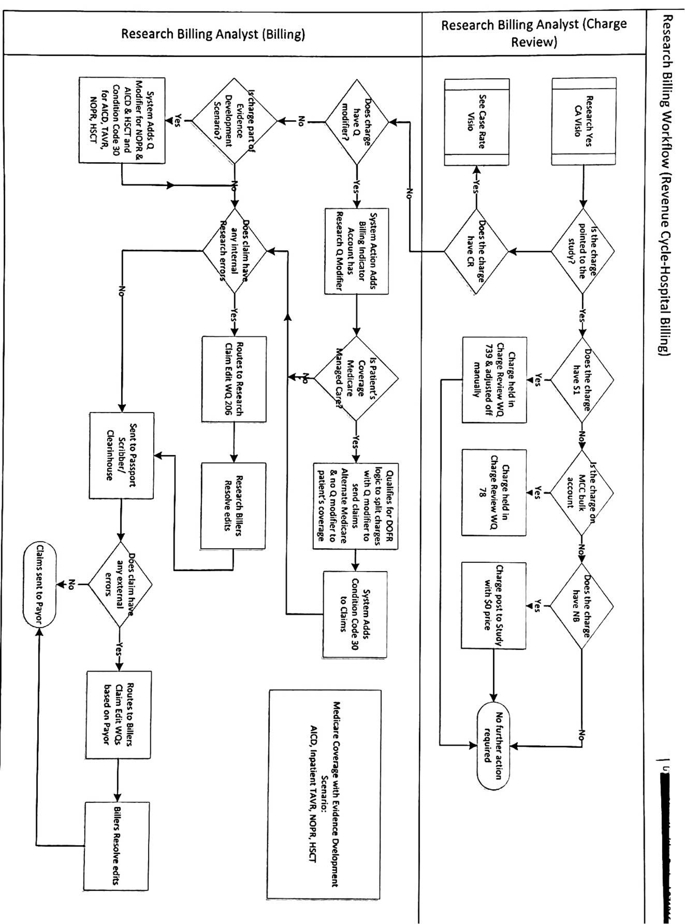
Example of Workflow within SOP

Slide 14
TIPS for Creating SOPs
First, SOP on SOP and include a glossary of terms
Definitions, numbering, standard format, sections, training, revision…
Be comprised of short, concise, active sentences
Include adequate details to clearly guide research staff to conduct a procedure
Contain a specific aim and written in a general format that can be easily followed by a broad audience
Demonstrate compliance with regulations and guidance
List tasks in the correct order to be conducted

Slide 15
Does it Work?
Test the SOP- does it actually work as written?
Can a team member successfully perform the process unsupervised?

Slide 16
Approval Process
Establish the approval process by determining who will review and make the decision to approve
The author of the SOP will sign
The department head that has been designated to approve the SOP will also sign the form
A responsible party will also be assigned the task for revisions/reviews and maintain a master list of SOPs

Slide 17
Distribution/Training
Distribution, education and training on new departmental SOPs should be consistent
Notify study team that there is a new SOP
Place the signed original copy in an SOP binder/electronic folder
Keep the paper/electronic original in a secure location
Choose the best training approach for the SOP
Document the date each research staff has been appropriately trained and deemed competent to perform the SOP
Train new staff on all SOPs when they join the study team
Consistently monitor members of the study team to ensure they are following SOP procedures
Provide refresher training at regular intervals-annual required trainings
Train and Re-Train!

Slide 18
Implementation
After the study team has had adequate training the SOP can be implemented
Notify the team member the SOP is effective and should be implemented
Document the date the SOP became effective
Reassess the SOP process/procedures a few days after the implementation to ensure all procedures can be implemented without any errors/revisions/issues

Slide 19
Review of SOPs
When should a review be performed?
At least an annually
Regular intervals as needed to reassess applicability of procedures
When trends of noncompliance occur
In response to a monitoring/audit finding
After a reporting of issues by the study teams or other involved parties
Why should reviews be performed?
To ensure the procedures still apply
Review to assess if any content/procedures require updating
Who should conduct the review?
SOP owners, study team members, and approval authorities

Slide 20
What to Consider When Reviewing SOPs
IF IT HAS BEEN AWHILE SINCE
ARE THE PURPOSE AND INSTRUCTIONS OF YOUR SOP CLEAR AND CONCISE (I.E. DO SOME OF THE INSTRUCTIONS ALLOW TOO MUCH ROOM FOR INTERPRETATION)?
IF YOU ARE SEEING NONCOMPLIANCE WITH SOPS, WHAT LANGUAGE NEEDS TO
BE UPDATED OR REMOVED (I.E. PROVIDING MORE DEFINED TIMELINES FOR DELIVERABLES)?
YOU HAVE UPDATED YOUR
STANDARD OPERATING
PROCEDURES, HERE ARE A
FEW IMPORTANT QUESTIONS
TO CONSIDER:
HAVE THERE BEEN ANY POLICY CHANGES (I.E. UPDATED REGULATORY REQUIREMENTS IN A CERTAIN REGION)?
DO THE PROCEDURES WORK WELL TOGETHER, OR IS THERE DUPLICATION AMONG DIFFERENT PROCEDURES? OR MAYBE WORSE, ARE THERE
CONFLICTING REQUIREMENTS?

Slide 21
Revising & Archiving
Revision occurs when:
Deviations occur that require a procedure/SOP to be revised
Regulations, guidance, or policies change
Revision process:
A designated member of the study team manages this process
Create audit trails, use track changes
Archiving:
Old versions need to be archived when SOPs are updated
Keep all signed originals in the SOP binder/folder (electronic or paper)
Label superseded versions as “Archived”
Remove superseded versions from circulation

Slide 22
Master Tracking List of the SOPs
Reference
Version
Title
Associated Document(s)
•Informed Consent Form
•Participant Information Sheet (PIS) Guide
•Study Withdrawal Form
SOP-QA-9 V2
Receiving Informed Consent
SOP-QA-17 V1
Project Committees
SOP-QA-19 V4
Amendments
•Amendment Log
•Emergency Unblinding Form
•IP Order Form
•Temperature Monitoring Log
•Drug accountability log
SOP-QA-15* V3
Drug Accountability

Slide 23
List of SOPs that Research Teams May Need to Have:
1. SOPs process for SOPs
2. Responsibilities of the Research Team
3. Screening, Recruitment, Enrollment, and Retention of Participants
4. Informed Consent Process
5. Essential Documents and Recordkeeping
6. IRB Submissions: Initial, Revision, Continuing Review, and Closure
7. Event Reporting (AE, PD, UP)
8. Clinical Research Billing and Coverage Analysis
9. IP Accountability, Storage, Transportation, Shipping, Destruction
10. Monitoring and Auditing
11. Study Closure
12. Emergency/Disasters (COVID)
What SOPs are needed?
How many SOPs are we talking about?

Slide 24
Common Errors

Slide 25
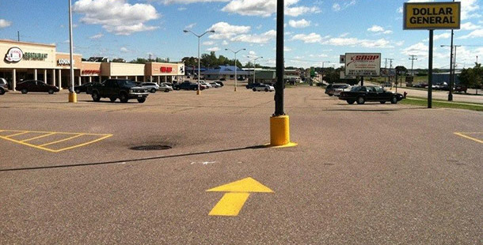
Not updating SOPs as needed

Slide 26
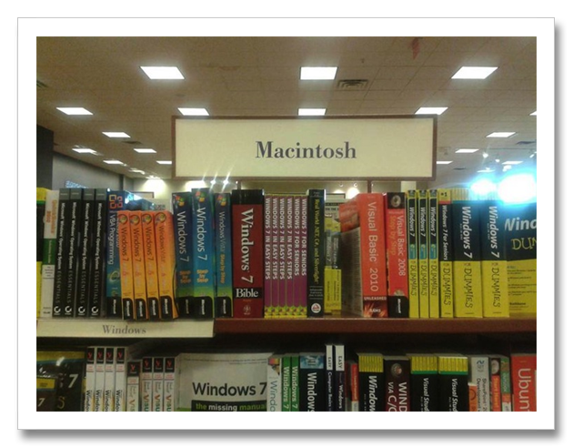
Not documenting training

Slide 27
Not properly distributing

Slide 28
Not versioning or including an effective date

Slide 29
Making SOPs too detailed

Slide 30
Writing the procedures
in a manner that can not be followed

Slide 31
Failure to train the team especially when the SOP is revised

Slide 32
Implementing a new SOP or a revision BEFORE training

Slide 33
FDA will issue a 483 if you are not following your own SOPs

Slide 34
“Making the simple complicated is commonplace;
making the complicated simple, awesomely simple,
that’s creativity”.
-Charles Mingus

