Slide 1
Research 101 sponsored by

Slide 2
Conflict of Interest Disclosure
Conflicts of Interest
A Conflict of Interest occurs when an individual has an opportunity to affect educational content about healthcare products or services of a commercial interest with which she/he has a financial relationship.
There is no conflict of interest for this presentation.
Commercial Support
No commercial support for this seminar
Non-Endorsement of Products
Non-applicable

Slide 3
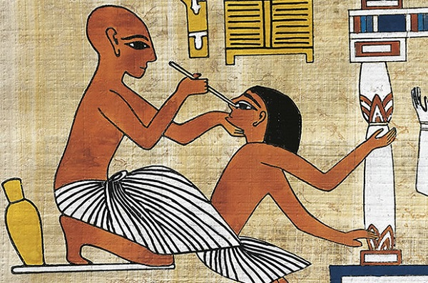
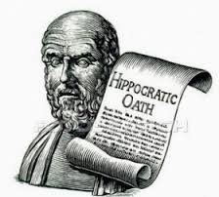
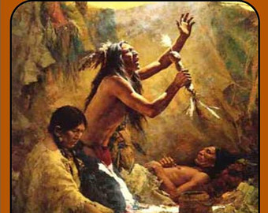
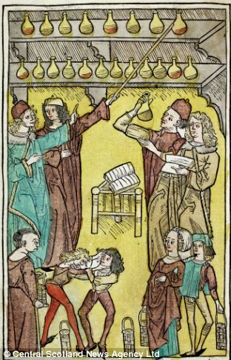
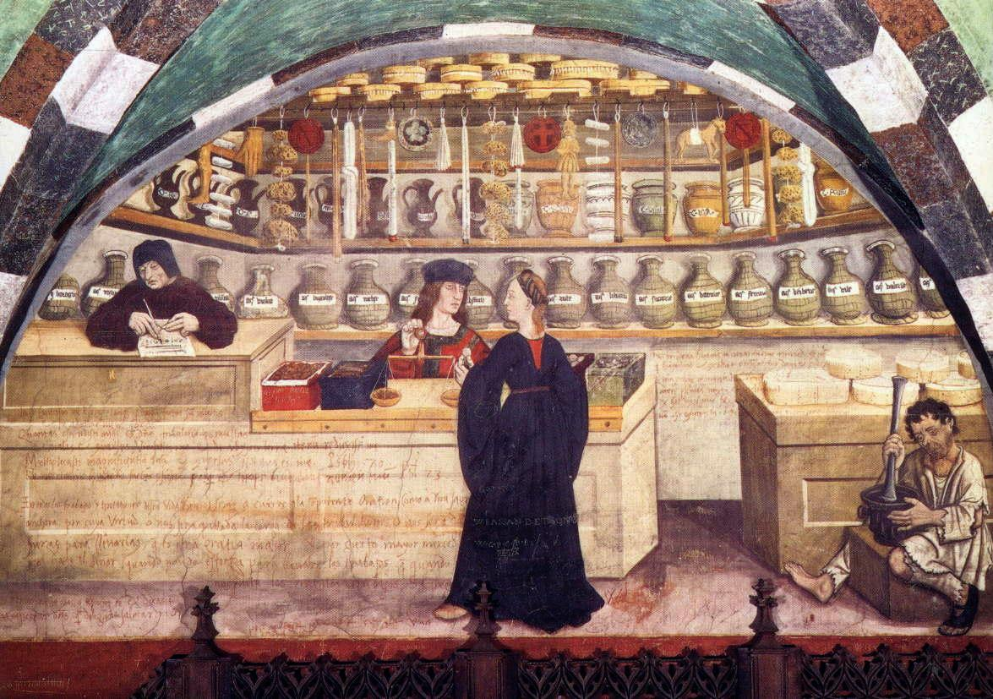
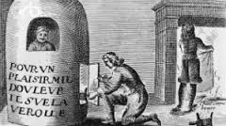
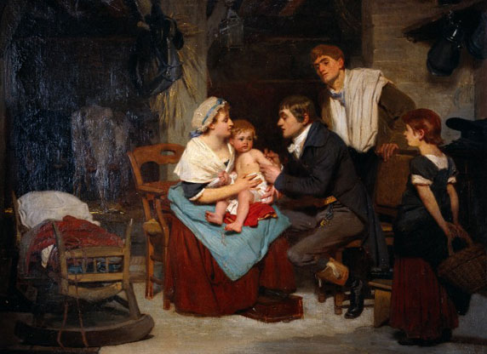
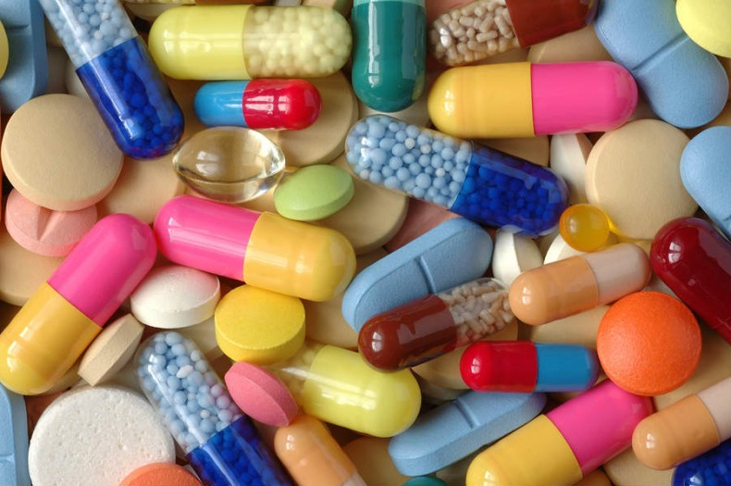
Destination Clinical Research 2020
An Abbreviated Trip through History
Research 101
May 21, 2020
Janie Gardner, MS, CCRP, CIM
Clinical Research Education
Notes:
History – looks back at events that shaped our current practices
Ancient Egyptians performing cataract surgery
Observing the color of Urine
A man who has contracted Syphilis is treated by baking in an oven for 30 days while breathing mercury fumes, a 16th Century treatment. This treatment often led to death due to heart failure, dehydration and suffocation.
Many advances were the result of “War Medicine”
Many advances in treatment arose out of the need to treat disease and injury, to improve health and prevent the spread of disease .
In many early battles, on land and sea, more men died of disease than battle wounds.
Early in human history, most diseases and/ or injuries were spread through
Travel -- Military campaigns, exploration and trade routes
Example: Seige of Caffa
Poor sanitation – crowded barracks, contaminated water supplies
Example: 1918 Influenza Pandemic
Famine – poor general health of soldiers and civilians alike
Example: Land and Sea Scurvy
Battle injuries –Blood loss and infection due to swords, spears and arrows – later gunshot wounds
3

Slide 4
Key Points
The Science - Clinical Trial Study Design
The Ethics - Protection of Human Subjects
U.S. Regulations and Guidance ---Study Conduct
Objectives:
Recognize the events in history that led to the drafting of ethical and regulatory guidelines for clinical research in the U.S.
Explain the major provisions of the national Research Act of 1974 -
Include the impact on the ethical and regulatory considerations for
clinical studies.
Notes:
4

Slide 5
Clinical Research
is
Research involving Humans
To examine physical, mental and/ or behavioral attributes of an individual or group of people
To collect information that contributes to our collective memory and general knowledge about individuals and groups of people
Notes:
Information that becomes part of our collective memory
Generalizable knowledge that can be accessed for future studies-
5

Slide 6
Clinical Trials
A special type of Clinical Research that evaluate the effects of an intervention on biomedical or health –related outcomes.
The function of the controlled clinical trial is not the "discovery" of a new drug or therapy.
The function of the formal controlled clinical trial is to separate the relative handful of discoveries which prove to be true advances in therapy from a legion of false leads and unverifiable clinical impressions, and to delineate in a scientific way the extent of and the limitations which attend the effectiveness of drugs.”
William Thomas Beaver, MD
PHARMA v. Robert Finch and Herbert Ley
1969
Notes:
Very appropriate description of clinical trials
William Beaver was a clinical pharmacologist at Georgetown University who is credited with
later drafting the initial regulations defining "adequate and controlled" clinical studies.
The was a case brought against the FDA Secretary ( Ley) and (Finch) Secretary of DHEW and contesting findings that resulted in 7 drug products of the Upjohn company – based on insufficient evidence of effectiveness under the conditions or use prescribed or suggested in the labeling.
1962 amendment expanded the FDA’s role and initiated re-review of previously approved drug products.
To meet new standard of effectiveness.
US District Court – District of Delaware
Finch – Secretary of DHEW and Ley Commissioner of the FDA
6

Slide 7
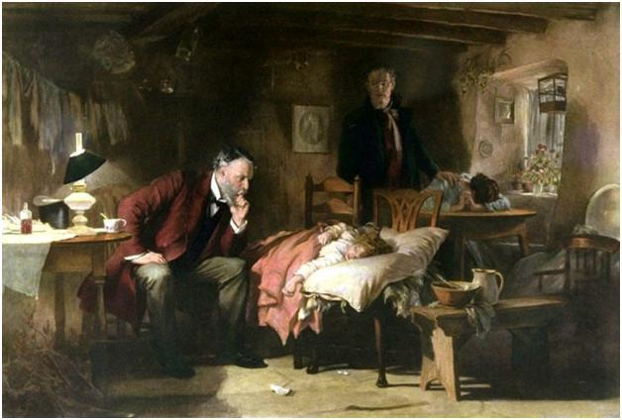
Contributions to the
“The Science”
Study Design
Notes:
7

Slide 8
These early physician /investigators through their
Curiosity,
Observation and
Documentation
pioneered a rigorous research method for new treatments
Notes:
In the following seminal events describe involve military physicians or surgeons
Pare , Lind, Hopkins and Hill were key players in establishing new processes and new treatments to preserve life and reduce suffering.
Attributes we find in good researchers today!!!
8

Slide 9
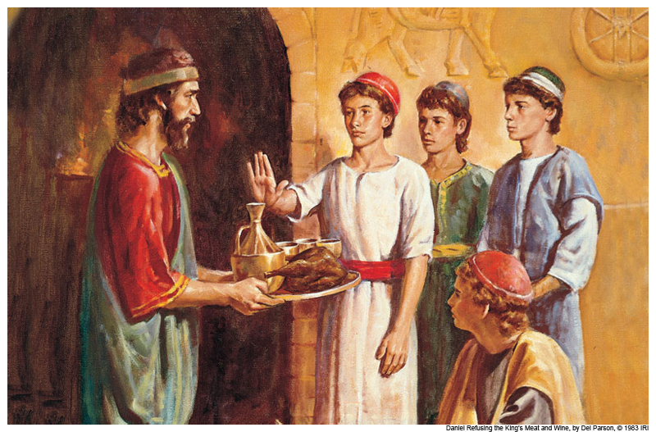
First Documented Clinical Study
Problem: Daniel and his friends cannot eat the food
ordered by the king
(Daniel 1:5-16).
Notes:
605 – 562 BC
King Nebuchadnezzar's court and Daniel’s diet study
Daniel had been brought to the kings court as a war prisoners from Jerusalem ( defeated by Neb)
Due to their faith, Daniel and his friends were forbidden to eat the meat and wine diet ordered by the king.
Daniel asked that he and his friends be allowed to eat vegetables (beans) and water for 10 days and if they did not appear healthy they would comply with the kings order.
At the end of ten days it was seen that they were better in appearance and fatter in flesh than all the youths who ate the king's rich food. So the steward took away their rich food and the wine they were to drink and gave them vegetables.
First time an uncontrolled human experiment guided a decision about public health.
Importance of publication
9

Slide 10
First Novel Therapy
Problem: Gunshot wounds
(Guns used in battle for the first time in 16th century)
Notes:
Gunpowder felt to be poison that could be neutralized cauterization with boiling oil
Treatment worse than the injury in many cases
10

Slide 11
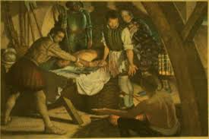
First Novel Therapy
Ambroise Pare
1537
Siege of Turin
Notes:
Curative trial
Pare ran out of oil to boil and remembered an ancient Arabic recipe for a poultice of egg yolks, oil of roses and turpentine oils.
Soothed the wound and had some pain relief ( oil of turpentine) and anti-inflammatory properties (egg yolks) and antiseptic and coagulation (oil of Roses)
Soldiers treated with the poultice were much improved the next morning and were far better off than the ones treated with the boiling oil.
Documented in his diaries.
11

Slide 12
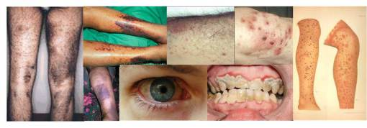
First Controlled Clinical Trial
Problem: Sea Scurvy
James Lind
1747
Notes:
Diet consisted of dried salted meats and dried beans, beer/ale
Scurvy
Affected sailors, pirates and passengers alike
Early symptoms were lethargy and malaise edema and anemia
Later bleeding , petechial hemorrhage, poor wound healing, tooth loss and
Death
High costs to the Royal Navy
Crews of ships on long voyages or in battle could lose as many as 78% of their number to Scurvy
12

Slide 13
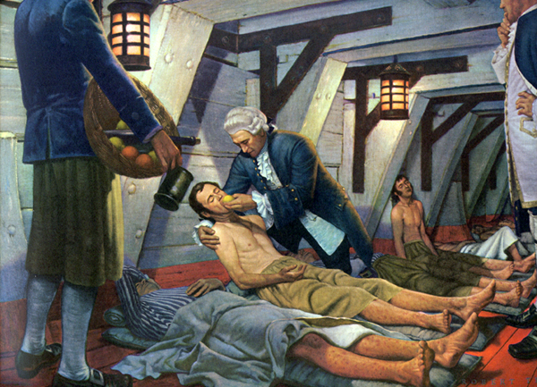
First Controlled Clinical Trial
Lind’s Experiment
Twelve sailors with same symptoms of Scurvy
Each pair received one of the following interventions
Quart of cider a day
25 drops vitriol 3x a day
2 spoons of vinegar 3x a day
Half pint of sea water a day
Paste of garlic, mustard seed, dried radish and myrrh
An orange and two lemons
Notes:
Although the benefits of citrus had been know for centuries, Lind’s study confirmed the addition of citrus fruit to the diet as superior to other remedies.
All were treated the same except for the tx
A common laxative
Vitriol is sulfuric acid
Published his finding on scurvy in a treatise in 1753
Navy did not adopt the changes for another 42 years
13

Slide 14
Notes:
Thus, the relevant question when assessing a treatment is not "does the treatment work?" but "does the treatment work better than a placebo treatment, or no treatment at all?“
The purpose of the placebo group is to account for the placebo effect, that is, effects from treatment that do not depend on the treatment itself.
Such factors include knowing one is receiving a treatment, attention from health care professionals, and the expectations of a treatment's effectiveness by those running the research study. Without a placebo group to compare against, it is not possible to know whether the treatment itself had any effect.
Adam Flint is credited with first documented use of placebo in a US clinical trial – 1863
He treated 13 patients suffering from rheumatism with an herbal extract which was advised instead of an established remedy – found that there was no difference in response to therapy in 12 of the 13 patients.
14

Slide 15
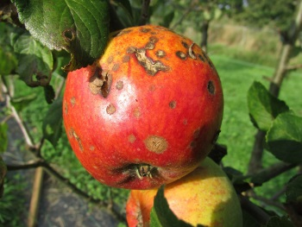
First Double Blind Controlled Clinical Trial
Problem : The Common cold
British Medical Research Council- 1943 – 44
Multi-center study to compare Patulin to placebo.
Patulin a fungal metabolite (mycotoxin) from rotting apples
(Penicillium patulum) was compared to placebo
W. A. Hopkins, M.D.
Bradford Hill, M.D.
Army and Navy Trials
“An Apple a Day…”
Notes:
Penicillin found to be effective against gram positive bacteria – Staph and strep
Surgeon Commander in the Royal Navy
Pilot trials ( small trials)
Importance of the common cold –
British Medial Research Council
Multicenter trial – involving patients diagnosed with the common cold.
There were two test groups and two placebo groups
Subjects received an unmarked vial of nose drops by a method called “rotation”-
Patient 1 – assigned to group1--- patient 2 – to group 2 ----- patient 5 assigned to group 1 patient 6 assigned to group 2 etc.
The identification of the patulin and placebo vials was masked to the researchers and the patients.
Ran a tsp. of solution into each nostril 3 x a day.
Study was recognized for it methodology and was the model for the next study of pulmonary tuberculosis
…by studying sufficiently large numbers of patients, ensuring unbiased allocation to drug or placebo controls, and by developing a simple, standard way of recording symptoms.
15

Slide 16
First Randomized, Double -blind
Controlled Clinical Trial
1948
Problem: Penicillin ineffective against Pulmonary Tuberculosis
… tuberculosis was the most important cause of death ( 50% mortality)
of young adults in Europe and North America.
Study was to measure the efficacy of Streptomycin to treat Pulmonary tuberculosis
Bradford Hill, M. D. Phillip D’Arcy Hart
Notes:
1926 in Detroit
First to conduct a clinical trial using randomization J. Burns Anderson – assigned 24 patient to 2 groups by flipping a coin. used to be thought^{[20]} that the first-ever randomized clinical trial was the trial^{[21]} conducted by the Medical Research Council (MRC) in 1948 into the efficacy of streptomycin in the treatment of pulmonary tuberculosis. In this trial, there were two test groups:
those "treated by streptomycin and bed-rest", and
those "[treated] by bed-rest alone" (the control group).
What made this trial novel was that the subjects were randomly allocated to their test groups. The up-to-that-time practice was to allocate subjects alternately to each group, based on the order in which they presented for treatment. This practice could be biased, because those admitting each patient knew to which group that patient would be allocated (and so the decision to admit or not admit a specific patient might be influenced by the experimenter's knowledge of the nature of their illness, and their knowledge of the group to which they would occupy).
Randomized, double bind controlled trial is still considered the gold standard for todays clinical investigations.
Hill – statistician
Hart – Director of the TB research unit at the MRC ( study team of the Patulin study)
Official recognition goes to Hill for his randomization design (First to use “proper” randomization techniques)
Envelopes were held in a central area and were distributed alternately to the subject according to the site where he was to be treated.
Both Groups received Standard care – bed rest
S = Streptomycin + Bed rest
C= Control (bed rest)
After 4 months of treatment – the streptomycin group started to show an acquired resistance to the drug.
16

Slide 17
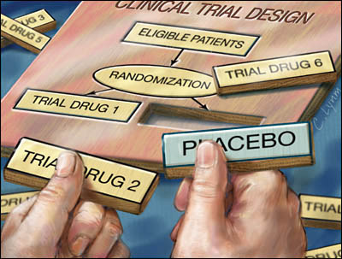
The randomized, double bind controlled trial is still considered the gold standard for today’s clinical investigations.
Notes:
17

Slide 18
The Ethics
Protecting Human Subjects
Notes:
18

Slide 19
“The Ethics”
Protection of Human Subjects
In the previous examples “patients/subjects” were not informed that they were involved in experimental treatments.
Prior to the twentieth century, research ethics were primarily governed by physicians’ conscience and professional codes of conduct.
Patients expected that the treatment or intervention was for therapeutic purposes
Notes:
In general, patients/subjects believed that their physician always acted in their best interest.
And in reality most practitioners were acting in the best interest of their patients – just that at the time most therapy was experimental.
19

Slide 20
Early U.S. Court Cases
Carpenter V. Blake
1871
Earliest significant contribution to human subject protections
The Carpenter court held that a doctor who departs from the usual, established method of treatment is liable for any resulting problems.
Fortner v. Koch
1935
For the first time, the court recognized that some human experimentation must be permitted – specifically , Therapeutic Research, experiments that could potentially benefit the patient.
The court imposed two important limits on such experimentation, namely that the subject must consent and that the procedure not deviate too much from established practice.
Notes:
Earliest significant contribution to U.S. ethics of conducting human research – justice system
Prior to this case, most issues were regarded as either battery or negligence in the practice of medicine.
Carpenter V. Blake -----1871 -----U.S. Court Case
The patient sued her physician for negligence and malpractice in the setting and treatment of a dislocated arm.
The physician defended his actions by claiming that his unusual treatment method was not negligence but rather a new type of treatment.
Effect
Discouraged physician’s pursuing novel treatments.
Fortner v. Koch 1935
Court acknowledged that if medicine and surgery are to progress – some research must be allowed –
But only with the consent of the patient /or those responsible for him and that the experiment could not vary too far from accepted practice.
Also was specific to therapeutic research – those experiments that provided a potential for benefit to the patient
Introduced the concept of the Risk/Benefit analysis .
Of interest – concurrently with these civil decisions -----the practice of “War Medicine” pushed the military to adopt consent requirements.
Military needed to find treatments for diseases and injury affecting troops during wartime.
Walter Reed is credited with creating the first written informed consent (1897) document to study Yellow Fever that decimated troops in the Spanish- American War and the occupation of Cuba afterwards. Informed consent became a requirement in the Department of the Army in 1925 and of the Navy in 1932.
How often this requirement was met at the time is unclear and in some later cases –– absolutely ignored – for the “greater good”
Human Research in the US did not become widespread until the early 1940’s – however very common in Europe
20

Slide 21
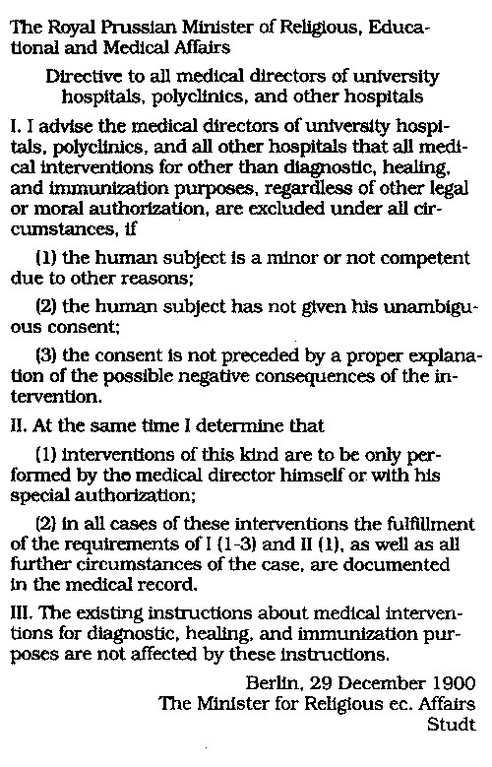
In the meantime – in Europe
The Berlin Code of Ethics
1900
“Prussian Standards”
First regulations by a state authority for human experimentation
Became a part of physician employment contracts
Binding under German law
Notes:
Biomedical research in Germany between 1900 and 1930 was considered the most advanced of its day, not only in relation to progress made in several disciplines but also because of the ethical standards, regulations, and laws in place to protect the subjects of research
In 1900 the Kingdom of Prussia established the Berlin Code of Ethics (also known as the Prussian Standards), a series of ethical rules regarding human experiments to test new treatments. Mostly as a result of Albert Neisser’s syphilis experiments on prostitutes that gave them the disease and infected hundreds of others that cause a great public outrage.
21

Slide 22
Guidelines for New Therapy and Human Experimentation'
“Reich Instructions”
1931
Expanded on the Berlin Code of Ethics
No experimentation on patients who were poor or socially disadvantaged.
Proportionality of risk and benefit must be respected, and
that experiments should first be done in animals.
Experimentation with dying persons not permissible, and
Made the head of the institution personally and professionally responsible for
the design, implementation and review of human experimentation
Notes:
Issued by German Ministry of Interior In 1931
In addition to the Prussian instruction requirements – no minors, no incompetents, no one without their express consent and not without explaining the disadvantages (Risks)of the intervention
So how did German physicians go from this advanced ethical system for protections of human subjects to the experiment in the concentration camps.
22

Slide 23
The earlier human protection directives were reversed and laws were passed to control reproduction and achieve racial cleansing. 1) Sterilization Act of 1933 Protect the Hereditary Health of the German People 2) Reich Citizenship law 3) Nuremberg Laws of 1935 Safeguard Marital Health
Rise of Adolf Hitler and the Third Reich
1933
Notes:
Ensure the purity of the Aryan Race – obsessed with eugenics
Sterilized 400,000 people with congenital mental retardation, schizophrenia, manic-depressive psychosis, hereditary epilepsy, hereditary chorea (Huntington disease), congenital blindness or deafness, etc. Included Dangerous Criminals
Eugenics A science/practice that deals with the improvement of hereditary qualities of a race or breed. (as by control of human mating) Reich Citizenship law – stated that only those people of German blood could be citizens –
all others were classed as state subjects without civil or citizen rights. ( Jews, Romanis and Blacks)
Nuremberg Laws
Included the Law for Protection of German Blood and German Honour forbade marriages between Germans and Jews
Forces Jews and other out of Germany – when the Jews had no where to flee – Hitler decided to exterminate them – Holocaust
23

Slide 24
Euthanasia Program
“life unworthy of life”
1939
This program authorized doctors to identify and destroy those who were “undesirable” in the population.
In Berlin, a state organization was formed, which allowed doctors to examine hospital and clinic records.
Between 1939 and 1941, doctors sentenced 70,000-100,000 Germans to death through their experiments in “perfecting methods of group killings”
Public forced a shut down of the domestic euthanasia program – Hitler set up the death camps
Notes:
These three laws allowed Nazi doctors to determine which citizens would survive, marry, and reproduce
Nazi Germany designated the incurable /undesirables
(mentally retarded, habitual criminals, the physically handicapped, patients with chronic diseases, as those less valuable members of society ) as “life unworthy of life”, and they could be legitimately sacrificed to improve life for the majority of the population.
Particularly Jews, the Romani and blacks
Unlimited funding – unlimited pool of subjects
24

Slide 25
Nazi Doctors’ Trial 1946 U.S.A. V. Karl Brandt, et al
Prosecution of 23 doctors and administrators participating in war crimes and crimes against humanity in the form of medical experiments and medical procedures inflicted on prisoners and civilians without their consent
The specific crimes charged included more than twelve series of medical experiments concerning the effects of and treatments for high altitude conditions, freezing, malaria, poison gas, sulfanilamide, bone, muscle, and nerve regeneration, bone transplantation, saltwater consumption, epidemic jaundice, sterilization, typhus, poisons, and incendiary bombs.
Notes:
December 9, 1946, an American military tribunal opened criminal proceedings against 23 leading German physicians and administrators for their willing participation in war crimes and crimes against humanity. Among the charges were that German Physicians conducted medical experiments on thousands of concentration camp prisoners without their consent. Most of the participants of these experiments died or were permanently crippled as a result.
Experiments to improve survival chance of the German troops such as
Experiments for treatment of injuries and diseases that affected the military and others – Typhus, hepatitis, venereal disease,
poison gases, cholera, burns
Experiments for racial hygiene – sterilization
Physician defense – that the prisoner were less than human – did not have the moral obligation to act in their best interest
25

Slide 26
“Permissible Medical Experiments”
(Nuremberg Code)
Considered the basic text of Modern
medical ethics for human experimentation
First INTERNATIONAL document that advocated for informed consent and voluntary participation and imposed limits on how experiments could be
conducted.
Compliance and enforcement left to the investigator
Notes:
These 10 principles – were part of the final judgment of the Doctor’s Trials.
The Nuremberg Code was a monumental first step in the effort to regulate research on humans and would
soon influence many professional organizations and governments who were beginning to contemplate similar
regulation.
One of those organizations was the World Medical Association.
26

Slide 27
Nuremberg Code
#1 The voluntary consent of the human subject is absolutely essential
The experiment should aim at positive results for society that cannot be procured in some
other way.
It should be based on previous knowledge (like, an expectation derived from animal experiments) that justifies the experiment.
The experiment should be set up in a way that avoids unnecessary physical and mental suffering and injuries.
It should not be conducted when there is any reason to believe that it implies a risk of death or disabling injury.
The risks of the experiment should be in proportion to (that is, not exceed) the expected humanitarian benefits.
Preparations and facilities must be provided that adequately protect the subjects against
the experiment’s risks.
8. The experiment should be conducted only by scientifically qualified persons.
The human subjects must be free to immediately quit the experiment at any point when
they feel physically or mentally unable to go on.
10. Likewise, the medical staff must stop the experiment at any point when they observe that
continuation would be dangerous.
Notes:
Part of the Judgement
Consider correlation between the Reich Code of Ethics (1931) and the Nuremberg code (1947)
Nuremberg added conditions under which the experiment can be conducted.
27

Slide 28
Post Nuremberg ---1947 – 1974
Novel therapies and experiments continued to be performed on unsuspecting US populations by researchers without consent including those populations that we would now consider “vulnerable”.
Pregnant Women
Children
Mentally disabled
Prisoners
Military personnel
Elderly
Terminally ill
Infants
Especially egregious were the experiments on the US population and military by the Atomic Energy Commission.
Notes:
Hepatitis, Herpes, Malaria, chemical agents, poison gases and mind altering drugs.
Conducted numerous Radiation Experiments – 1944 – 1974 PLUTONIUM FILES
University of Iowa investigators gave pregnant women radioactive iodine and to newborns to measure thyroid uptake
Walter E. Fernald State School in Massachusetts, 73 mentally disabled children were fed oatmeal
containing radioactive calcium and other radioisotopes, in order to track "how nutrients were digested".
Researchers at the University of Rochester injected uranium into six people to study how much uranium their kidneys could tolerate before becoming damaged
University of Chicago, patients were injected with plutonium and six employees were given water contaminated with plutonium to drink.
Researchers at Vanderbilt University gave 829 pregnant mothers in Tennessee what they were told were "vitamin drinks" that would improve the health of their babies. The mixtures contained radioactive iron and the researchers were determining how fast the radioisotope crossed into the placenta.
Researchers at the Johns Hopkins Hospital inserted radium rods into the noses of 582 Baltimore, Maryland schoolchildren as an alternative to adenoidectomy.
28

Slide 29
First Federal Policy for Protection of Human Subjects
1953
The first U.S. Federal policy for the protection of human subjects was put into place for research conducted at the Clinical Center, NIH.
This system is the model for the current IRB system.
NIH Policy
1966
It required prospective review of human subjects research, taking into account the rights and welfare of the subjects involved, the appropriateness of the methods used to secure informed consent, and the risks and potential benefits of the research.
Notes:
This policy provided a mechanism for prospective review of proposed research by individuals having no direct involvement or intellectual investment in the research.
This 1966 version was codified as 45 CFR 46 under the Nation Research Act in 1974
It was hoped that this 1966 policy would be adopted by other institutions and agencies – it was not .
In fact a study by the Law –Medicine institute in 1960 found in a three year study --- out of 52 clinical research practices polled --only 9 had any formal guidelines for clinical researchers - and that investigators wanted to directly oversee research
29

Slide 30
Declaration of Helsinki
1964
Many in the medical community saw the Nuremberg Code as imposing strict legal obligation on Doctors.
World Medical Association prepared recommendations as a guide to every physician in biomedical research involving human subjects.
Informed consent requirement based on whether the research was considered Therapeutic or Non-therapeutic.
Notes:
Another major ethical contribution to biomedical research
Attempt by the physicians to self regulate
Incorporated the principles of Nuremberg and expanded on it
Required independent committee review
Allowed surrogate consent
DoH is Considered a “Living Document” and has been revised 9 times
30

Slide 31
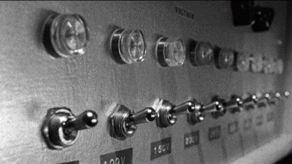
Obedience to Authority Study
Stanley Milgram
Yale University
Deception in Research
Notes:
1963 published
When and how Deception in research could be ethically used – affect IRB review criteria and Informed consent
31

Slide 32
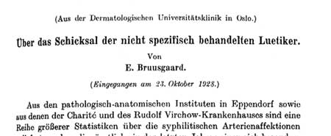
"Tuskegee Study of Untreated Syphilis
in the Negro Male”
1932- 1972
Based on finding of the Oslo Study of the natural history of 2000 cases of untreated syphilis 1890 – 1910 and follow up 1921 – 1928
Notes:
Pandemic in 1495 in Europe and Asia – spread by troops – more virulent form than today – called the Great Pox
Bulbous and Macular papular rash and sores of the secondary stage.
Treatments consisted on burning sores with hot irons –
ointments, potions and fumigations with mercury as the major ingredient
Bake the patient in a hot oven – 30 days – calomel under the chair and patient breathed the fumes –
To initiate salivation – which according to Galen would purify blood and
gas – as in fumigation
Calomel – mercuric chloride – administered in a cream , a tonic ---- fumigation
Oslo study patient with primar y and secondary syphilis – protected the community by keeping patient in hospital until symptom free – 1 -1 2month usually-
Goal to measure occurrence of relapse – morbity and mortality from other causes – effects on life expectancy – neuro- syphilis in whites and ?Cardio syphilis in Blacks
Toliver Clark – the head of the PHS at the time – credited with the starting the study – originally designed it to be observational period for 6 – 9 months and then follow with a treatment phase. Disagreed with the plan to conduct a long term study.
Retired one year after the study began.
32

Slide 33
National Research Act
1974
Three major provisions
Office of Protection from Research Risks (OPRR) in the NIH
2. Promulgated 45 CFR 46 Public Welfare Regulations for the Protection of Human Subjects
National Commission for the Protection of Human Subjects of Biomedical and Behavioral Research*
- Belmont Report: Ethical Principles and Guidelines for the Protection of Human Subjects of Research
Notes:
Numerous research improprieties between 1950 and 1974 in the United States prompted Congressional deliberations about human-subject-research oversight. Some of these research projects were described in Henry Beecher’s examples of “unethical or questionable ethical studies” published in 1966 and the public outrage and political embarrassment of the PHS Syphilis Study expose among other
Resulted in the National Research Act of 1974.
National Research Act also published the NIH’s policy for protecting human subjects as law in Public Welfare CFR Title 45 Part 46
Protection of Human Subjects
National Research Act required DHEW to adopt the 1966 NIH policy for protecting human subjects as part of the public welfare regulations.
The 1974 regulations at 45 CFR 46 were amended and re-issued in 1981 with provision that they only applied to federally funded research
Principles of Belmont – Respect for Persons----Beneficence ------Justice
In 2000 NIH mandated human protections training for all staff engaged in clinical research activities.
33

Slide 34
45 CFR 46
Public Welfare
Protection of Human Subjects
National Research Act required DHEW to adopt the 1966 NIH policy for protecting human subjects as part of the public welfare regulations.
The 1974 regulations at 45 CFR 46 were amended and re-issued in 1981 with provision that they only applied to federally funded research
Oversight of federally funded human research was assigned to
Office of Protection from Research Risks in the NIH
1991
45 CFR 46 subpart A was adopted by 17 federal agencies – called the “Common Rule”
Notes:
At this time the FDA adopted these regulations and they are codified in 21CFR 50 and 56- but applied to all FDA regulated investigations.
!991 45CFR 46 adopted by 16 - 17 federal agenices --- called the “Common Rule”
34

Slide 35
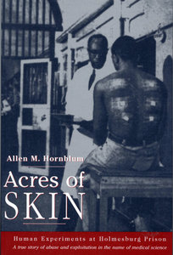
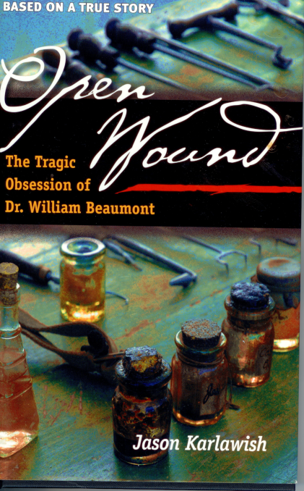
Notes:
35

Slide 36
Regulations and Guidance
Notes:
36

Slide 37
Good Clinical Practice
Is comprised of the FDA Regulations and guidance documents, the ICH guidelines for good clinical practice and ethical codes of conduct in clinical trials such as the Declaration of Helsinki and the Belmont Report
Is a standard for the design, conduct, performance, monitoring, recording, analysis and reporting of clinical trials
Ensures the rights, safety and welfare of subjects are protected and the integrity of the study data is maintained
Notes:
37

Slide 38
Good Clinical Practice in Clinical Trials
Concurrent to the drafting of ethical guidelines and regulations , authorities began to recognize the need for controlling medical therapies early in the 20th Century
Predecessor office to the current Food and Drug Administration (FDA) was the Chemistry Division, a scientific department, in the Department of Agriculture established in 1862.
Major function was to test pesticides and other agricultural products
(included preservatives in foodstuffs)
Notes:
F
Although it was not known by its present name until 1930, FDA’s modern regulatory functions began with the passage of the 1906 Pure Food and Drugs Act, a law a quarter-century in the making that prohibited interstate commerce in adulterated and misbranded food and drugs--had been the driving force behind this law and headed its enforcement in the early years, providing basic elements of protection that consumers had never known before that time.
and drugs and the need for testing drugs in clinical trials increased.
38

Slide 39
FDA consumer oversight function of food and drug products began in 1906
The role of the FDA as a consumer protection agency has evolved and expanded
“FDA is responsible for protecting the public health by assuring the safety, efficacy, and security of human and veterinary drugs, biological products, medical devices, our nation’s food supply, cosmetics, and products that emit radiation.”
Notes:
39

Slide 40
Turn of the Century in the United States
1900
“Adulterated Foods”
“Patent Medicines” trade
Publication of “The Jungle”
Notes:
Advertising of patent medicines
Samuel Hopkins Adams published a series of articles exposing fraud in the patent medicine industry in an expose for Collier ’s magazine. Adams’ articles horrified the public and shook the bill’s opponents. Adding further momentum behind the forces of reform, the American Medical Association took a public stand calling for federal regulation of food and drugs
Upton Sinclair’s a graphic account of hideously unsanitary conditions in the meat-packing industry. Public focused on the 15 pages of the book that described grotesquely unsanitary processing practices of the meat packing industry. In those few pages Sinclair had catalogued a horrifying litany of industry misdeeds, including workers falling into processing vats, children drinking milk tainted with formaldehyde, and spoiled meat routinely concealed through chemical adulteration or mixing with fresh meat.
40

Slide 41
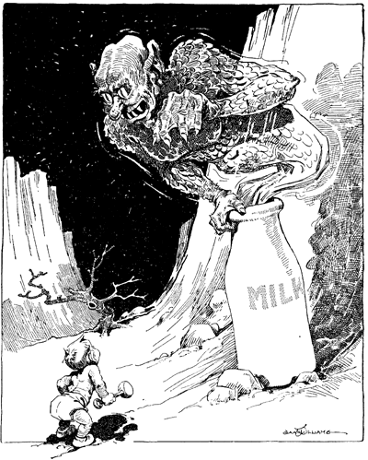
Adulterated Foods
Chemistry Division, Department of Agriculture
“…investigate the character of food preservatives, coloring matters, and other substances added to foods, to determine their relation to digestion and to health, and to establish the principles which should guide their use."
Common Additives/ Preservatives
Borax
Copper Sulfate
Sulfuric Acid
Potassium Nitrite
Benzoic Acid
Alum
Formalin
Notes:
Urbanization – shipping food to consumer required preserving food in some way—
The most serious adulteration of milk--especially for children--was the use of formaldehyde as a preservative. As early as July 1899, the Indianapolis News reported prosecutions of dairymen who added formaldehyde to milk. Many children--including infants at the Indianapolis Orphans Home--died from contaminated milk
Harvey Wiley set up experiments
Table Trials 1902 - 1907
Bureau of Chemistry
Harvey Wiley – Father of the FDA
The goal of the Poison Squad was simple: they were tasked with trying some of the most commonly used food additives in order to determine their effects. During each of the poison squads trials, the members would eat steadily increasing amounts of each additive, carefully tracking the I
impact that it had on their bodies.
Borax - made meat look fresher longer
Copper Sulfate – made peas look greener
Sulfuric acid –acidify product to inhibit bacteria ( spoilage)
Formaldehyde – milk
41
The Food and Drug Administration is the oldest comprehensive consumer protection agency in the U. S. federal government. Since 1848 the federal government has used chemical analysis to monitor the safety of agricultural products -- a responsibility inherited by the Department of Agriculture in 1862 and by later by the FDA.

Slide 42
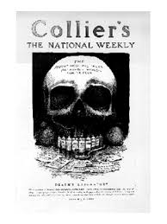
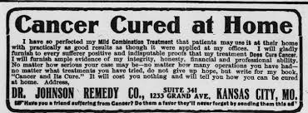
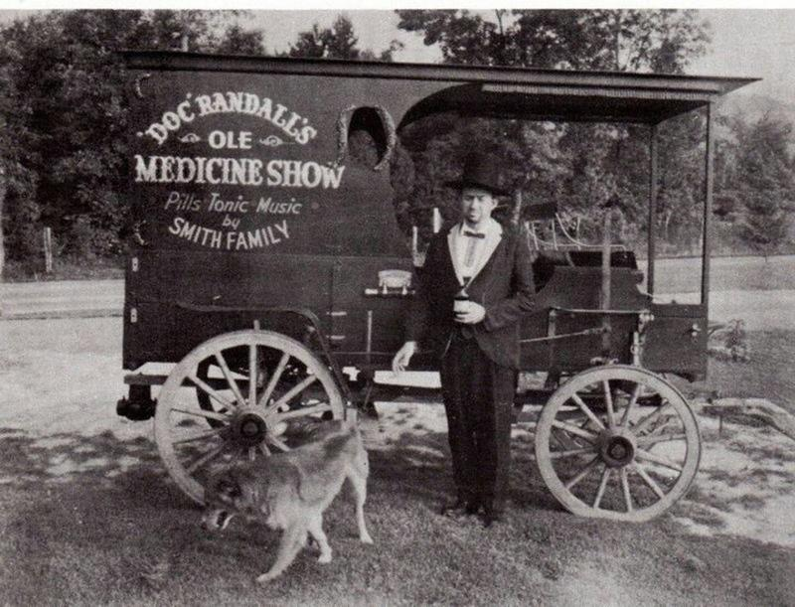
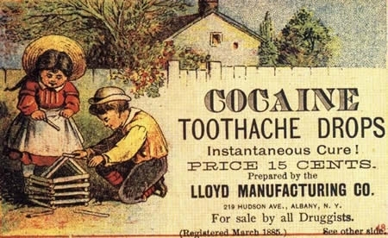
The Patent Medicine Trade
Outrageous Advertising
“Secret” Ingredients
Notes:
any claim could be made for any remedy. Any ingredient, even if lethal or addictive, could be put into a bottle and legally sold, without that ingredient being listed on the label.
Samuel Hopkins Adams, who had a background both as a crime reporter and a medical reporter, wrote a series of articles published in 1905-1906 by Colliers Magazine, exposing the patent medicine industry as "The Great American Fraud." "
Containing opium, alcohol, hemlock oil AND chloroform, Dr. Thomas’ Eclectric Oil advertised that it would positively cure toothache, earache, lameness, deafness and burns
Victory V throat lozenges – cannabis and chloroform
Coca Wine – Cocaine and alcohol – later became coca cola
42

Slide 43
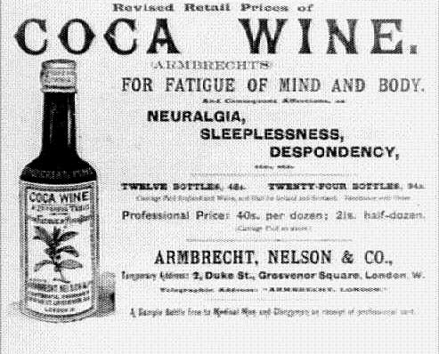
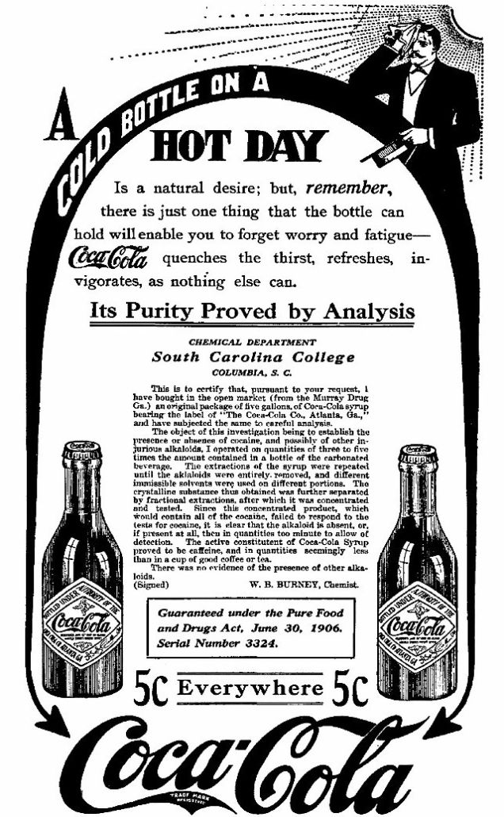
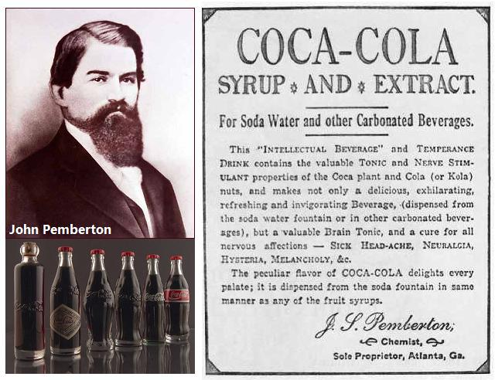
Notes:
Patent medicine drugs were usually created from a mixture of vegetable compound with alcohol, morphine, opium, or cocaine.
43

Slide 44
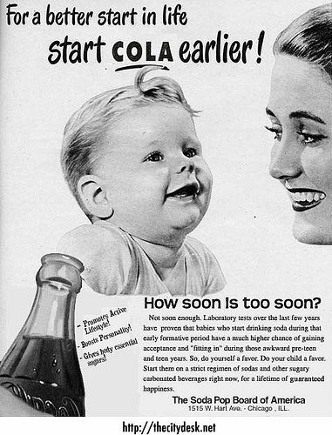
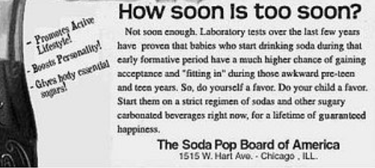
“Brain Tonic”
Notes:
44

Slide 45
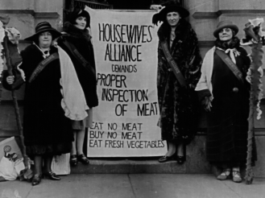
The Jungle
Sinclair wrote how diseased, rotten, and contaminated meat products were processed, doctored by chemicals, and mislabeled for sale to the public.
…how workers would process dead, injured and diseased animals after regular hours when no meat inspectors were around – or paid them off
Notes:
Public reaction was a major contributor to the signing of the 1906 food safety law
Meat inspection act of 1906 was signed the same day!
P
45

Slide 46
The Pure Food and Drug Law of 1906
LANDMARK LEGISLATION
The federal government assumed permanent and comprehensive ( law enforcement) responsibility for the health and safety of the American food and drug supply for the first time.
First U.S. Consumer Protection law of the 20th Century
Notes:
The Department grew and was renamed the Bureau of Chemistry in 1901 .
Its mission changed to law enforcement after the passage of the Pure Food and Drug Law of 1906
Congress created the FDA to protect the public from unsafe drugs. The first act authorizing the FDA to regulate the drug market was the FederalFood and Drug Act of 1906.
This act authorized the FDA to recall a misbranded or adulterated drug only after the drug manufacturer had introduced the drug into the stream of commerce.
The statute for the first time regulated food and drugs that moved in interstate commerce and forbade the manufacture, sale or transportation of poisonous patent medicines. It arose in the wake of exposés by such muckrakers as Upton Sinclair and Samuel Hopkins Adams
After 1906, legislation progressively demanded greater accountability for marketing food and drugs and the need for testing drugs in clinical trials increased.
46

Slide 47
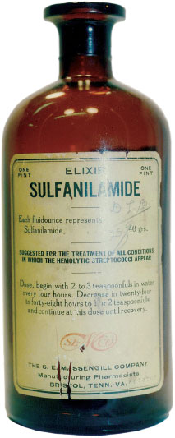
Sulfanilamide Disaster
1937
“…to realize that six human beings, all of them my patients, one of them my best friend, are dead because they took medicine that I prescribed for them innocently, and to realize that that medicine which I had used for years in such cases suddenly had become a deadly poison in its newest and most modern form, as recommended by a great and reputable pharmaceutical firm in Tennessee: well, that realization has given me such days and nights of mental and spiritual agony as I did not believe a human being could undergo and survive”
A.S. Calhoun, MD
Notes:
Sulfanilamide, a drug used to treat streptococcal infections, had been shown to have dramatic curative effects and had been used safely for some time in tablet and powder form. In June 1937, however, a salesman for the S.E. Massengill Co., in Bristol, Tenn., reported a demand in the southern states for the drug in liquid form. The company's chief chemist and pharmacist, Harold Cole Watkins, experimented and found that sulfanilamide would dissolve in diethylene glycol. The company control lab tested the mixture for flavor, appearance, and fragrance and found it satisfactory. Immediately, the company compounded a quantity of the elixir and sent shipments--633 of them--all over the country.
The new formulation had not been tested for toxicity. At the time the food and drugs law did not require that safety studies be done on new drugs. Selling toxic drugs was, undoubtedly, bad for business and could damage a firm's reputation, but it was not illegal. Because no pharmacological studies had been done on the new sulfanilamide preparation, Watkins failed to note one characteristic of the solution. Diethylene glycol, a chemical normally used as an antifreeze, is a deadly poison.
Misbranded gave the FDA authority to recall elixir must contain alcohol and misbranded – no information that the formulation contained diethtylene glycol
47

Slide 48
Food, Drug and Cosmetic Act of 1938
The only remedy for such a situation ( Sulfanilamide Disaster) is the enactment by Congress of an adequate and comprehensive national Food and Drugs Act which will require that all medicines placed upon the market shall be safe to use under the directions for use. ...“
Required
“substantial” evidence that a new drug was safe for use
and be reported to the FDA*
Required a FDA approval of new drug for market
*Doesn’t specifically require animal testing in the law: however animal testing has become the default standard for the FDA and the agency will generally ask for toxicity test results using at least two species of animals
Notes:
A bill was introduced in the U.S. Senate in 1933 to overhaul the 1906 drug law. But congressional action stalled.
Revised legislation wasn't passed until 107 people died from a poisonous ingredient in Elixir Sulfanilamide.
The S.E. Massengill Co. of Bristol, Tenn., had been marketing the product, which was the chemical relative of antifreeze now used in automobiles. Congress passed the Federal Food, Drug, and Cosmetic (FD&C) Act of 1938 with new provisions. President Roosevelt signed it into law on June 25, 1938.
For the first time, manufacturers were required to show that a drug was safe before it could be marketed. Required a pre-market approval --------Manufacturers had to submit an new drug application to the FDA before marketing a drug. New teeth in the labeling and additive laws – required manufacturers to prove safety
Neither the federal Food, Drug, and Cosmetic Act nor FDA regulations require animal testing of pharmaceuticals. However, animal safety testing has become the default standard for the FDA, and the FDA industry guidance for preclinical drug testing states that the agency will “generally ask” for toxicity test results using at least two species of animals. Thus drug companies reasonably expect that the FDA will prefer animal safety tests for many safety endpoints.
48

Slide 49
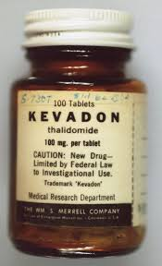
Thalidomide Tragedy
1957 – 1961
Synthesized in Germany and marketed over the counter in 1957 as a sedative under the trade name Kevadon.
Distributed in 46 countries -------wildly popular as the only
non-barbiturate sedative available
An Australian obstetrician discovered that the drug also
alleviated morning sickness. He started recommending this off-label use of the drug to his pregnant patients, setting a worldwide trend.
Notes:
By 1960 it was distributed to 46 countries – wildly popular as the only non- barbiturate sedative available –
Application to marke in nUsa submitted in 19060
By 1961 – physician were beginning to draw a correlation between
Thalidomide and birth defects
Within the sensitive period from day 35 to day 49 there is the following sequence:
Absence of ears and deafness: 35th - 37th day
Absence of arms: 39th - 41st day
Phocomelia with 3 fingers: 43rd - 44th day
Thumbs with 3 joints: 46th - 48th day.
If thalidomide has been taken throughout the sensitive period, the consequence may be severe defects of ears, arms and legs and of internal malformations, which often led to early death.
About 40 per cent of thalidomide victims died before their first birthday.
49

Slide 50
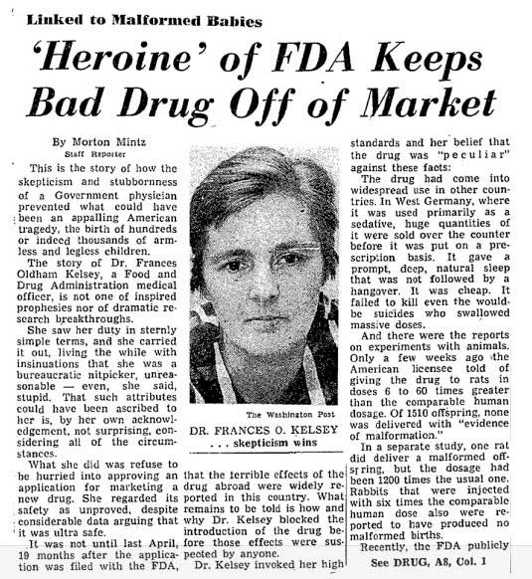
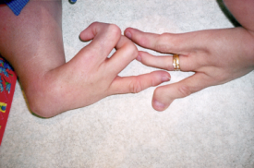
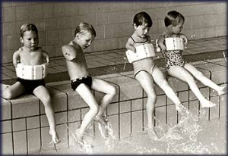
Thalidomide Tragedy
In 1960 the FDA was petitioned to approve distribution in the US.
Dr. Francis Kelsy held up the application for over a year –by then reports of the birth defects were being associated with Thalidomide use.
Notes:
September 1960, -
New Drug Application was submitted to the FDA
October 1960 --Kevadon Clinical Trials were started
The drug interfered with the babies' normal development, including
Deafness and blindness
Phocomelia - shortened, absent, or flipper-like limbs
Malformed hearts, bowel, etc.
Though never marketed in the US – it is estimated that more than 2.5 million doses of Kevadon were given to more than 20,000 patients as part of the trial.
Pulled off the INTERNATIONAL market in 1962.
50

Slide 51
Kefauver – Harris Amendment to the
Food Drug and Cosmetic Act
1962
For a new drug application: the amendment
Required Manufacturers to provide substantial proof of “Efficacy” through well controlled clinical trials
Codified the informed consent requirement
Set the rules for investigations
Required the FDA specifically approve marketing applications
Required adverse events be reported
Laid the ground work for the New Drug Regulations
Notes:
in addition to safety evaluations; the amendment
Required Manufacturers to provide substantial proof of “Efficacy” through well controlled clinical trials
The Kefauver-Harris Amendment laid the groundwork for modern drug approvals. Ultimately, FDA established an evidence-based model for drug evaluation decisions that stands as the global standard.
51

Slide 52
Investigational Drug Regulations
1963
21 CFR 312
IND Application Regulations
21 CFR 314
New Drug Application
for market approval
Notes:
The FDA published the investigational new drug application (IND) regulations on January 8, 1963,
First Investigational Drug Regs., and the new drug application (NDA) regulations on June 20, 1963,
The IND regulations set forth the information that the FDA requires of the drug sponsor prior to commencement of drug testing on humans.
Set up the pre-clinical testing requirements and the phases of clinical trials
The sponsor must also set forth the exact nature of the trials, the names and qualifications of the investigators
performing the research, the expected results of the trials, and the expected duration of
the trials.
52

Slide 53
Many other amendments through the years (24) 1951 Durham Humphrey Act 1976 Medical Device Amendments 1983 Orphan Drug Act 1992 Prescription Drug User Fee Act 2003 Pediatric Research Equity Act
Food Drug and Cosmetic Act
Notes:
53

Slide 54
1981 FDA and OHRP regulations were harmonized to the extent allowed by statute. 1991 45 CFR 46 Subpart adopted as the “Common Rule”
Helpful to Remember!
OHRP has regulatory oversight clinical research funded or supported by the federal government. (45 CFR 46)
FDA has regulatory oversight of clinical investigations of FDA regulated products regardless of the source of funding.
21 CFR 11, 50, 54, 56, 312, 314, 812, 814
Notes:
54

Slide 55
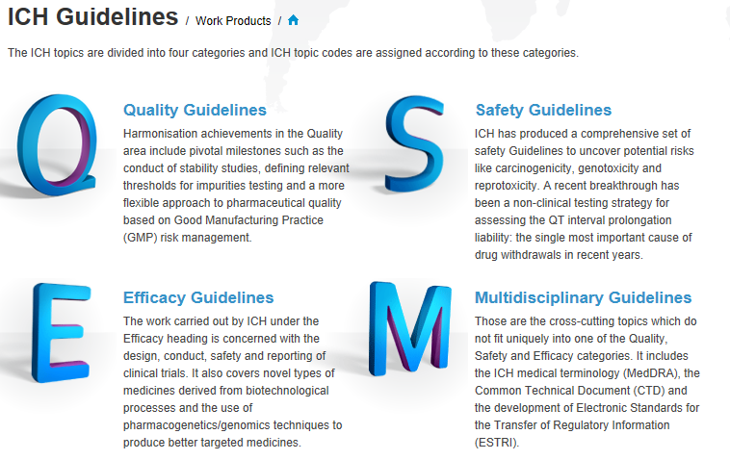
International Conference on Harmonization Guidance Documents
1996
Notes:
Japan , US and EU 1996
Efficacy guidelines mostly used for clinical research staff involved at the study site
19
Efficacy Guidelines
E1 Clinical Safety for Drugs used in Long-Term Treatment
E2 Pharmacovigilance
E3 Clinical Study Reports
E4 Dose-Response Studies
E5 Ethnic Factors
E6 Good Clinical Practice
E7 Clinical Trials in Geriatric Population
E8 General Considerations for Clinical Trials
E9 Statistical Principles for Clinical TrialsStep 1
E10 Choice of Control Group in Clinical Trials
E11 Clinical Trials in Pediatric Population
E12 Clinical Evaluation by Therapeutic Category
E14 Clinical Evaluation
E15 Definitions in Pharmacogenetics / Pharmacogenomics
E16 Qualification of Genomic Biomarkers
E17 Multi-Regional Clinical Trials
E18 Genomic Sampling Methodologies
Cross-cutting Topics
chapters
55

Slide 56
Efficacy (E) - 20 Guidelines Concerned with the design, conduct, safety and reporting of clinical trials. E8 GENERAL CONSIDERATIONS FOR CLINCIAL TRIALS The Guideline provides an introduction to clinical development, quality design of clinical studies and a focus on those factors critical to the quality of the studies. E6 (R2) GOOD CLINCIAL PRACTICE Outlines expectations of all participants in the conduct of clinical trials, including investigators, monitors, sponsors and IRBs. GCP E6 covers aspects of monitoring, reporting and archiving of clinical trials, and incorporates addenda on Essential Documents and on the Investigator's Brochure. The revised guidance updates and improves approaches to clinical trail design, conduct, oversight, recording and reporting including standards regarding electronic records and essential documents. E2 PHARMACOVIGILANCE E2A – Clinical Safety Data management: Definitions and Standards for Expedited Reporting
International Conference on Harmonization Guidance Documents
Notes:
56

Slide 58
Notes:
58

Slide 59
Useful Resources
Nuremburg Code
Declaration of Helsinki
Belmont Report
https://www.hhs.gov/ohrp/international/ethical-codes-and-research-standards/index.html
Compare OHRP and FDA regulations
https://www.fda.gov/science-research/good-clinical-practice-educational-materials/
comparison-fda-and-hhs-human-subject-protection-regulations
Milestones in FDA History
https://www.fda.gov/about-fda/fdas-evolving-regulatory-powers/milestones-us-food-and-drug-law- history
Notes:
59
.
Flint, A., "A Contribution Toward the Natural History of Articular Rheumatism, Consisting of a Report of Thirteen Cases Treated Solely with Palliative Measures", American Journal of the Medical Sciences, Vol.46, (July 1863), pp.17–36.

