Slide 1
COVID-19 Pandemic Response:
The role of public health nursing leadership at the local level
Alisa R. Haushalter, DNP, RN, PHNA-BC
Director, Shelby County Health Department
Associate Professor, UTHSC College of Nursing
President Elect, Tennessee Public Health Association

Slide 2
No Disclaimers
No Conflicts of Interest

Slide 3
Acknowledgements
Staff
Elected officials
Memphis Shelby County Joint Task Force
Healthcare partners
Safety net partners
Business community
Academic partners
Community at large
Tennessee Department of Health
Centers for Disease Control and Prevention
Craig Stotts, DrPH, RN

Slide 4
Objectives
At the completion of this presentation you will have an increased awareness of:
the role of public health at the local level in Tennessee
the role of a nurse leader within a local public health setting
the manifestation of the role during the COVID-19 Pandemic

Slide 5



Foundation: IOM Reports
2010
2015
Coming soon: FON 2020-2030
The IOM (Institute of Medicine) is now known as the
NAM (National Academy of Medicine).
Notes:
The Campaign launched on the heels of the release of a 2010 landmark Institute of Medicine Study, called The Future of Nursing: Leading Change, Advancing Health, which stated that nurses must help to lead and shape health system transformation.
The 2010 report, along with a follow up report released in 2015, offered specific recommendations to transform health and health care through nursing so all Americans have access to high-quality care, with nurses contributing to the full extent of their capabilities.
Using the IOM reports as our roadmap, the Campaign is building on the strengths of nursing to create a healthier America. Driving our work is a belief that everyone in America deserves to live the healthiest life possible and that nurses are vital to building a healthier nation.
*You may know the IOM was recently renamed the National Academy of Medicine.
Nurses and their partners participated in “listening sessions” to inform the 2020-2030 report, including partners in TN, MO and AR

Slide 6



IOM Report – Too Important to Sit on a Shelf
Future of Nursing: Campaign for Action
      Focus Areas
      Transforming Nursing Education
      Promoting Nursing Leadership
      Increasing Diversity
      Collecting Workforce Data
      Fostering Interprofessional Collaboration
      Building Healthier Communities
      Action….
      State Action Coalitions

Slide 7

What is Public Health ?
https://youtu.be/XkSnp9jQYSc

Slide 8

What is Public Health
Public health is the science of protecting and improving the health of families and communities through promotion of healthy lifestyles, research for disease and injury prevention and detection and control of infectious diseases.
https://www.apha.org/what-is-public-health

Slide 9
Core Functions of Public Health
Assessment
Policy Development
Assurance

Slide 10
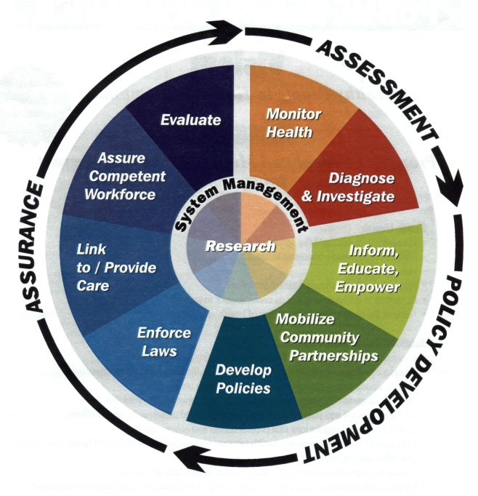
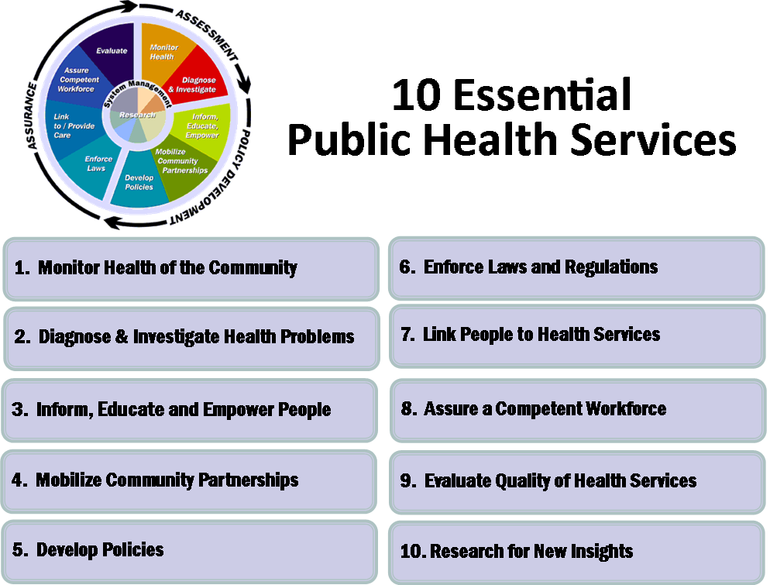
https://www.cdc.gov/publichealthgateway/publichealthservices/essentialhealthservices.html

Slide 11

Ten Great Public Health Achievements in the 20th Century
Immunizations
Motor-Vehicle Safety
Workplace Safety
Control of Infectious Diseases
Declines in Deaths from Heart Disease and Stroke
Safer and Healthier Foods
Healthier Mothers and Babies
Family Planning
Fluoridation of Drinking Water
Tobacco as a Health Hazard
http://www.cdc.gov/about/history/tengpha.htm
Notes:
Public health is credited with adding 25 years to the life expectancy of people in the United States in this century. Yet, ask the average person what public health is and their reply might be limited to: "healthcare for low-income families." CDC's Ten Great Public Health Achievements in the 20th Century was created to remind us of how far we've come, how we got here, and exactly what public health is: the active protection of our nation's health and safety, credible information to enhance health decisions, and partnerships with local minorities and organizations to promote good health.

Slide 12


Public Health Professionals and
Clinical Professionals
Nurses
Epidemiologists
Environmental Health Scientists
Dentists
Dental Hygienists
Health Services Administrators
Health Educators
Inspectors
Nutritionists
Social Workers
Doctors
Physician Assistants
Biostatisticians
Physical Therapists
Occupational Therapists
Pharmacists
Laboratory Professionals

Slide 13
What is Public Health Nursing
Public health nursing is the practice of promoting and protecting the health of populations using knowledge from nursing, social, and public health sciences. It focuses on improving the health of populations.
https://www.apha.org/~/media/files/pdf/membergroups/phn/nursingdefinition.ashx
Notes:
Public Health Nursing – “The practice of promoting and protecting the health of populations using knowledge from nursing, social, and public health sciences. Public health nursing is a specialty practice within nursing and public health. It focuses on improving population health by emphasizing prevention and attending to multiple determinants of health. Often used interchangeably with community health nursing, this nursing practice includes advocacy, policy development, and planning, which addresses issues of social justice” (APHA PHN, 2013).
Public Health Nursing Diagnosis – Is the use of the nursing process within the context of placing the community or a population at the center of public health nursing practice. The focus shifts from an individual client to individuals, families, groups, the community, or population.
Key characteristics of practice include: 1) a focus on the health needs of an entire population, including inequities and the unique needs of sub-populations; 2) assessment of population health using a comprehensive, systematic approach; 3) attention to multiple determinants of health; 4) an emphasis on primary prevention; and 5) application of interventions at all levels—individuals, families, communities, and the systems that impact their health.4

Slide 14

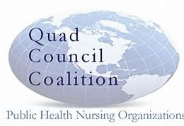
Scope of Practice
ANA Scope and Standards
Quad Council Competencies
Public Health Core Competencies
Tennessee State Statute
Shelby County Regulations
Chief Health Strategist

Slide 15
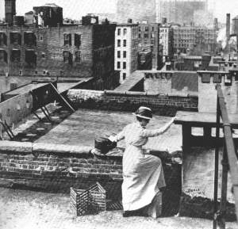
Notes:
Since Lillian Wald started the Henry Street Settlement, public health nurses – district nurses – have been on the forefront of serving the public where they live, learn and work.

Slide 16
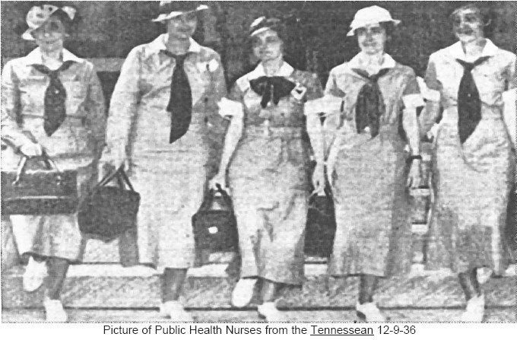
Notes:
Public health nurses go into the field to address the social determinants and to create conditions for all people to achieve their fullest potential.

Slide 17
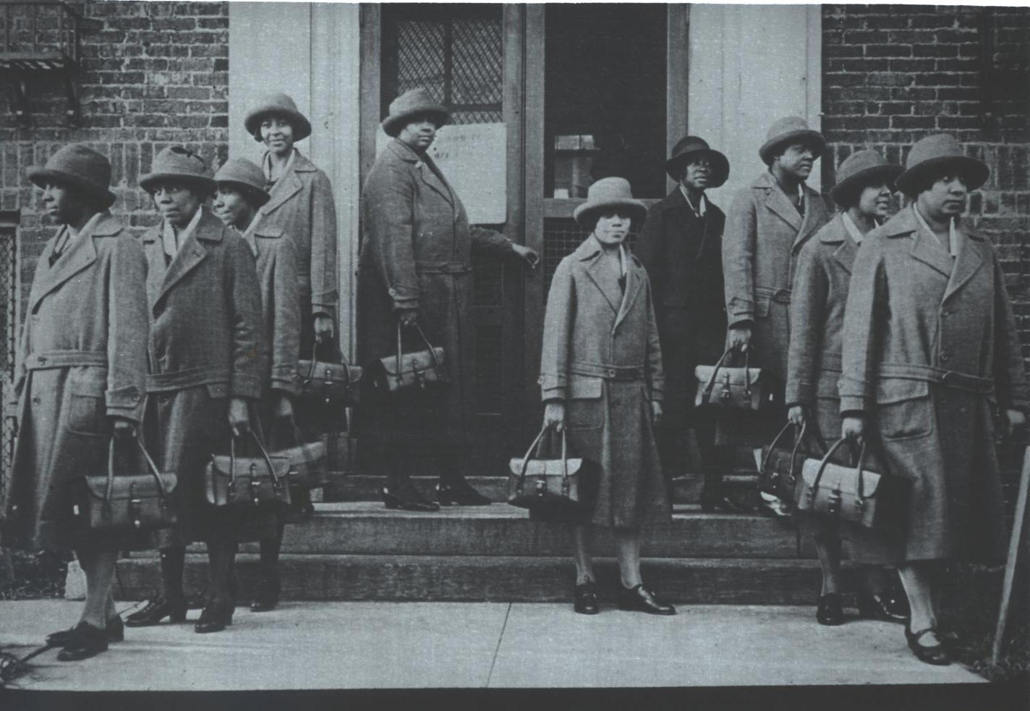
Notes:
PHNs have gone out to serve their communities, providing services during many of our most challenging epidemics and crises.

Slide 18
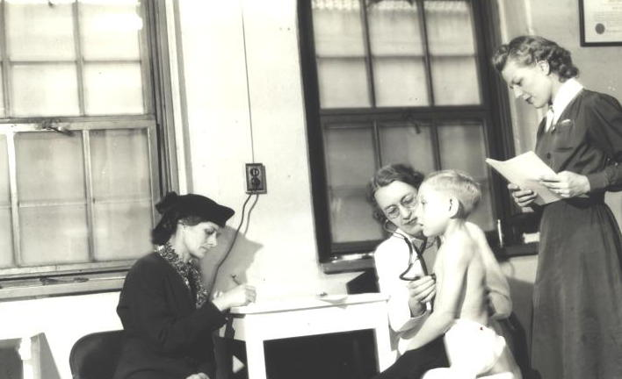
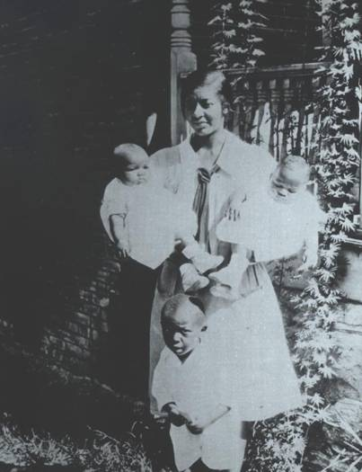
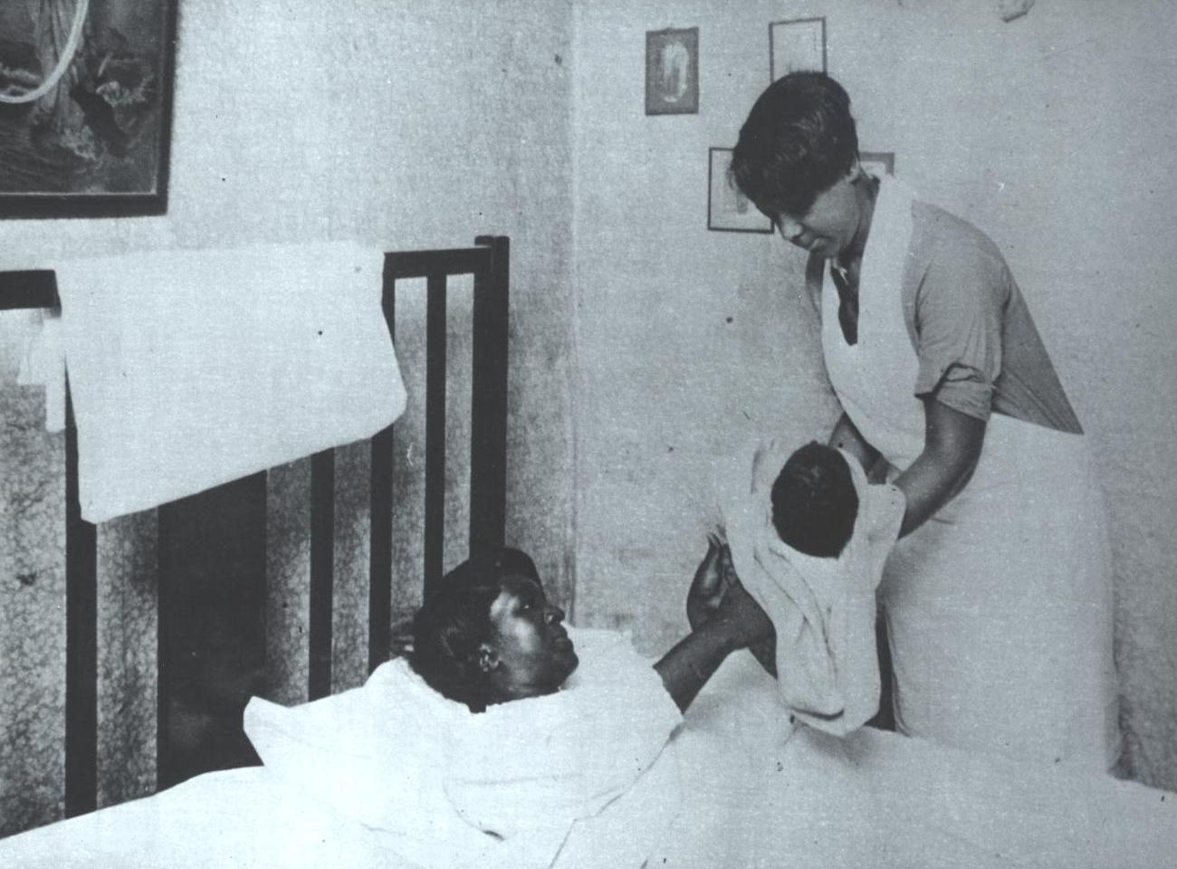
Notes:
PHNs have focused on improving maternal child health outcomes.

Slide 19
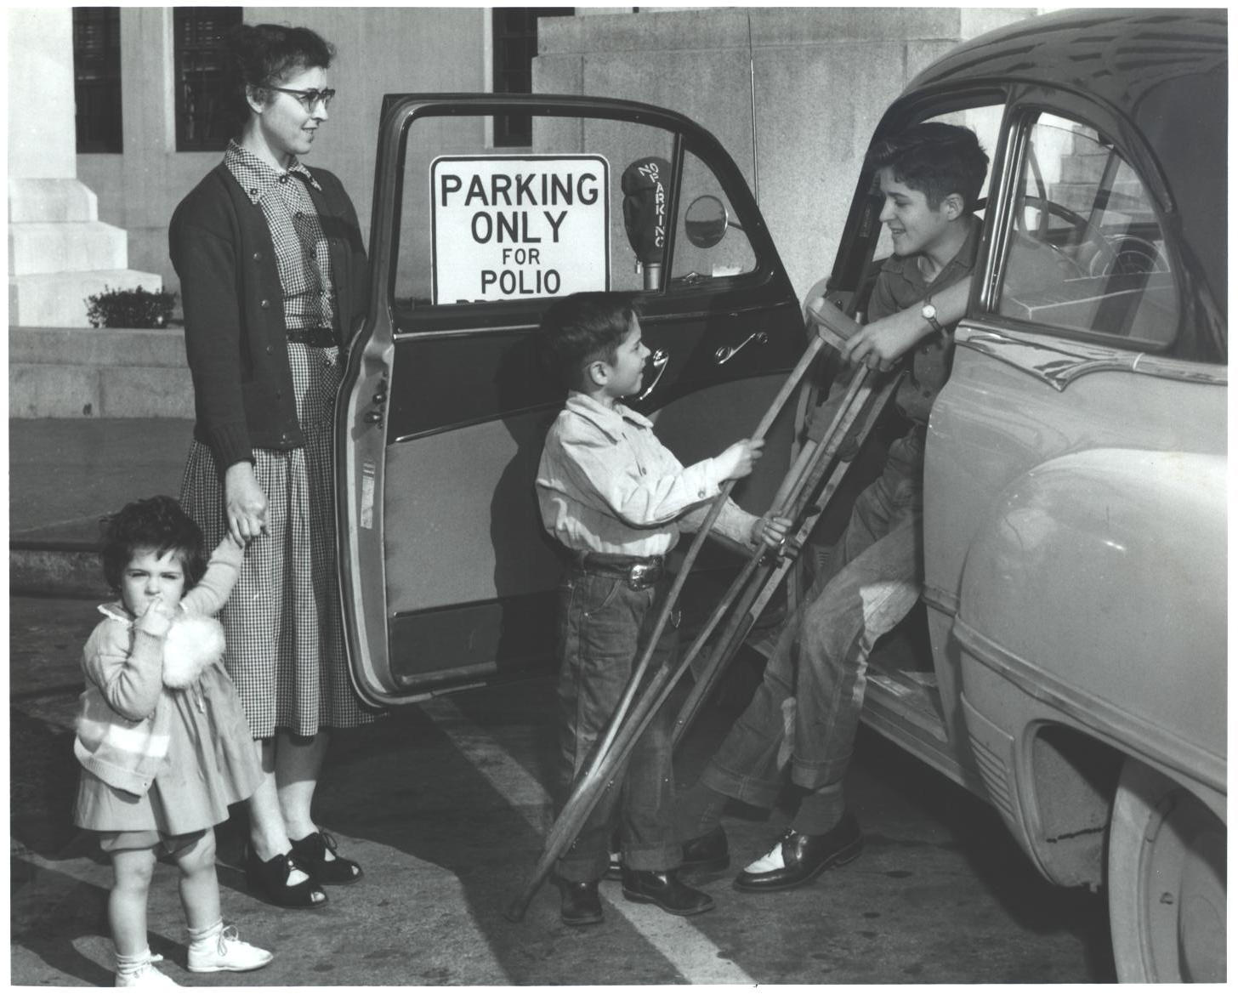
Notes:
Fought polio.

Slide 20
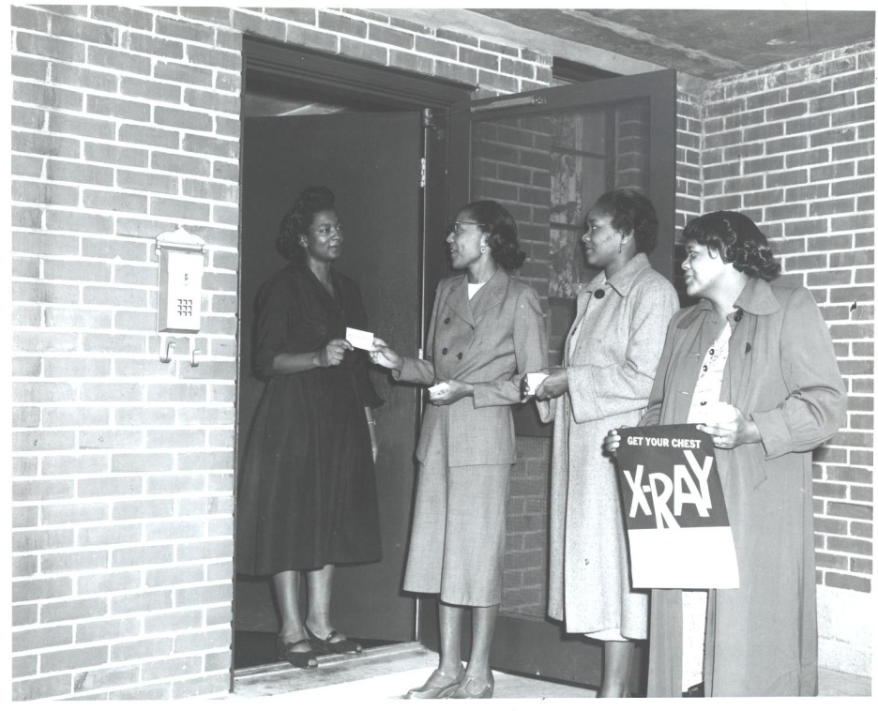
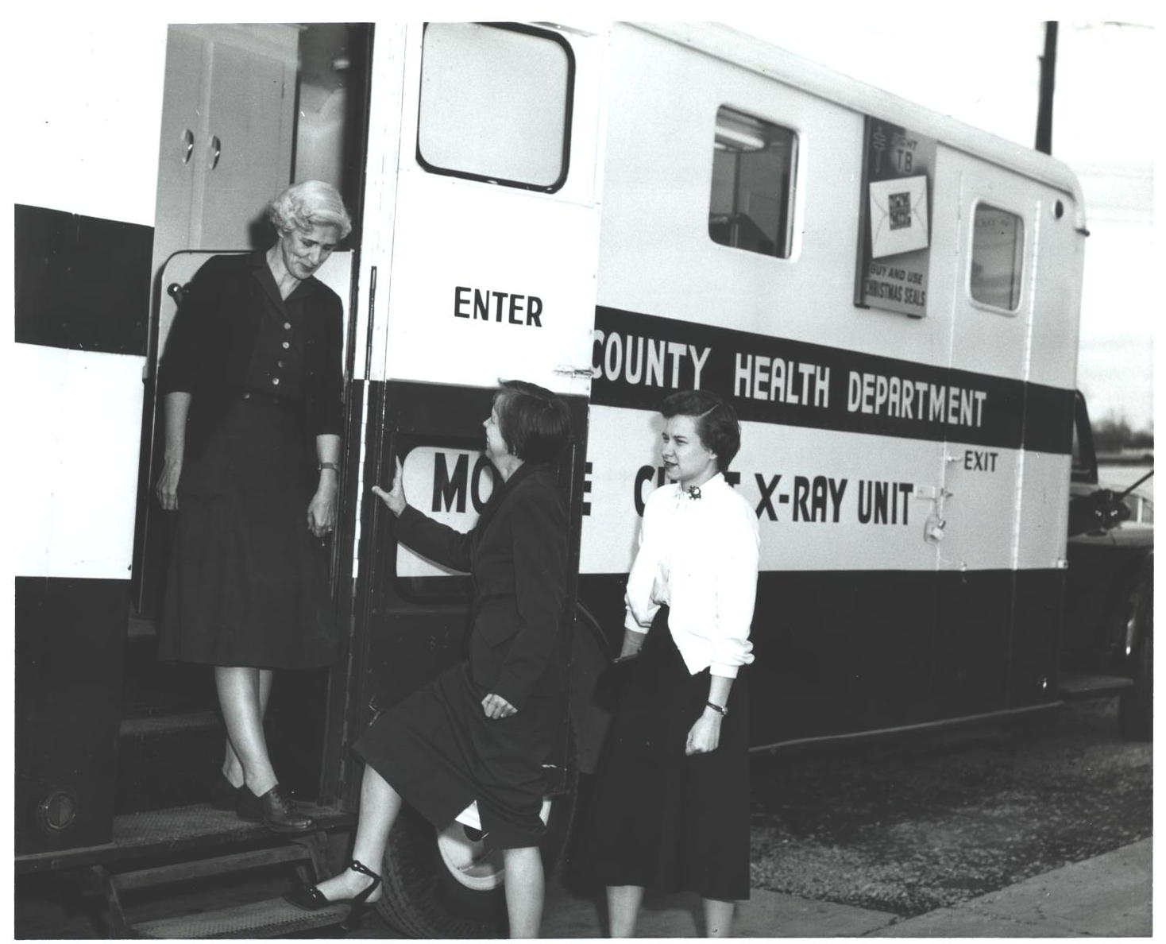
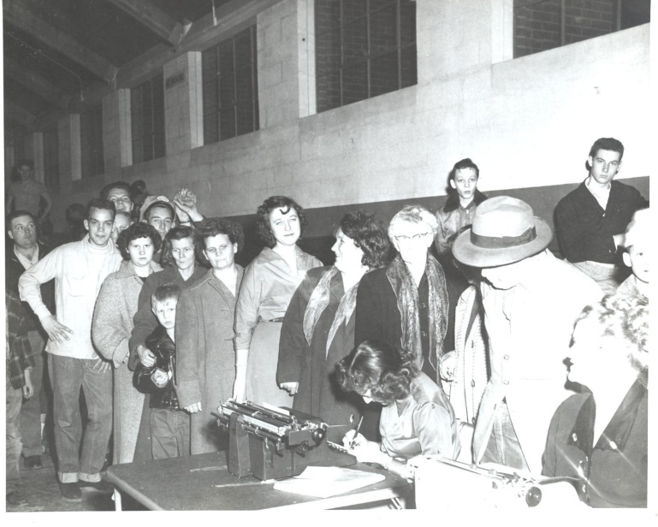
Notes:
Radically reduced the impact of tuberculosis in the United States.

Slide 21
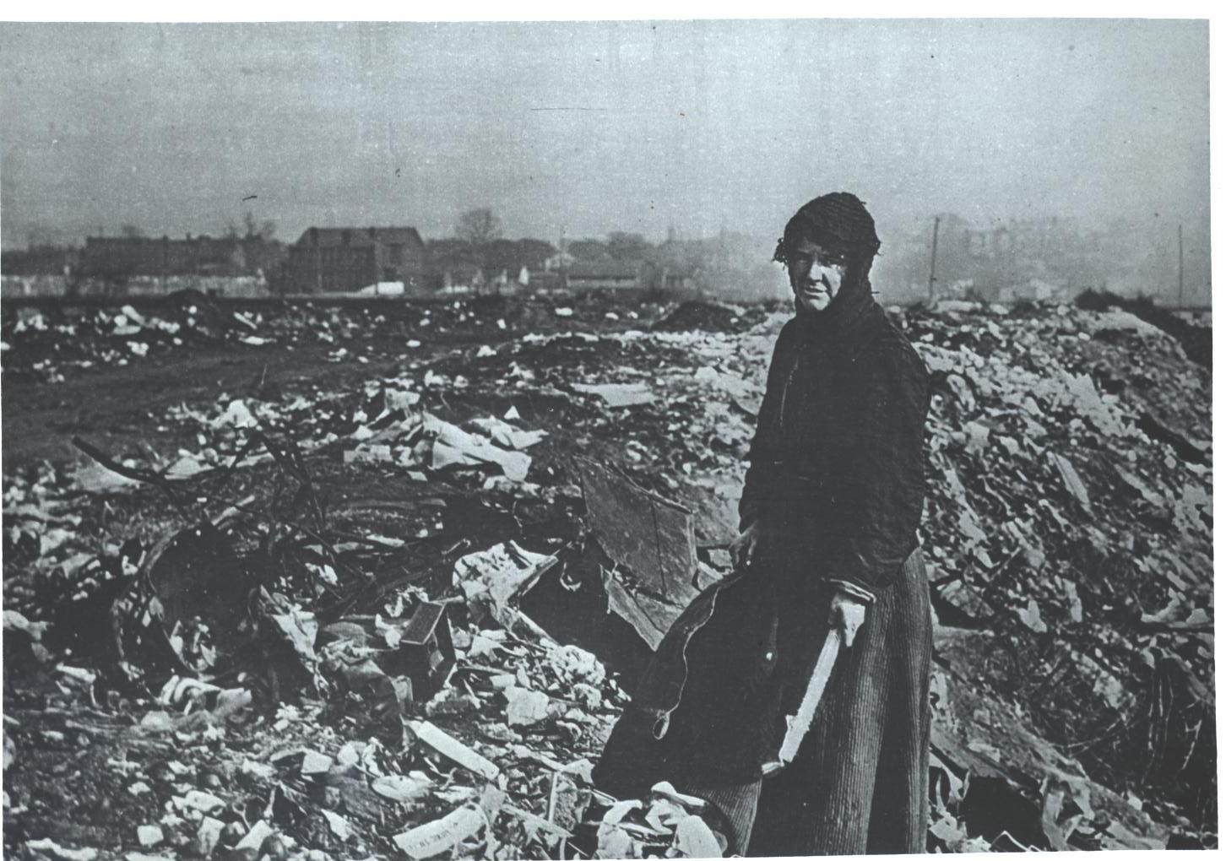
Notes:
Most importantly, PHNs have focused their interventions on data driven solutions to change the basic conditions that contribute to health and well-being.
The root of public health is social justice.

Slide 22


Factors that Affect Health
Examples
Smallest
Impact
Eat healthy, be physically active
Counseling
& Education
Rx for high blood pressure, high cholesterol, diabetes
Clinical
Interventions
Immunizations, brief intervention, cessation treatment, colonoscopy
Long-lasting
Protective Interventions
Fluoridation, 0g trans fat, iodization, smoke-free laws, tobacco tax
Changing the Context
to make individuals’ default
decisions healthy
Largest
Impact
Poverty, education, housing, inequality
Socioeconomic Factors
Notes:
Frieden Pyramid
On this pyramid, PHNs focus on the lower rungs of the pyramid.
As noted earlier, there are key foci of the public health leader, including nurse leader.
Strategy Development
Assessment
Assurance, and
Policy Development

Slide 23
STRATEGY DEVELOPMENT

Slide 24
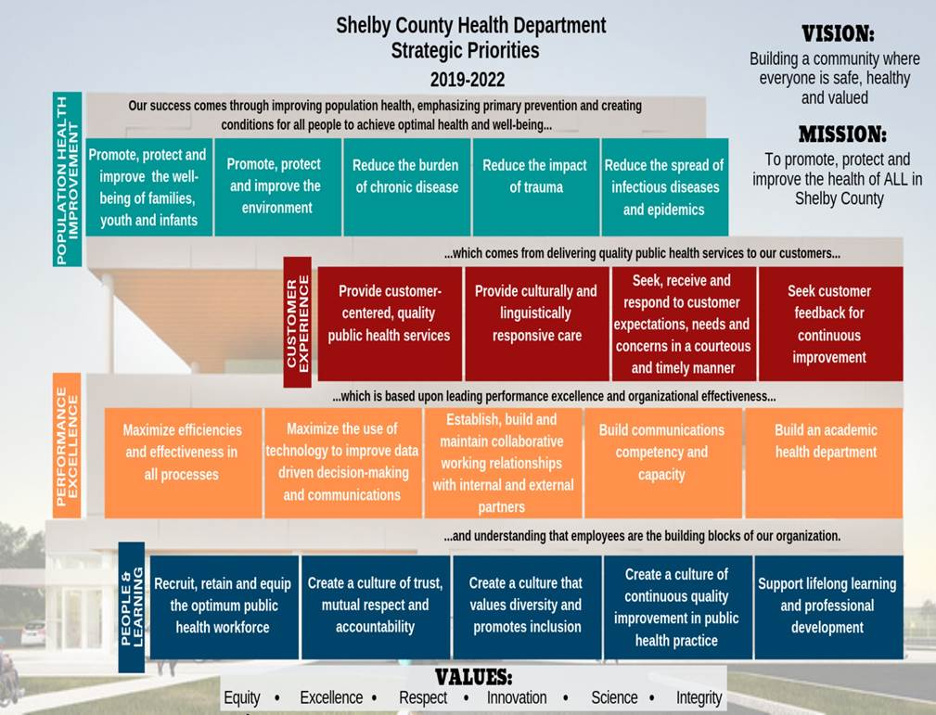


Slide 25
Memphis and Shelby County COVID19 -
Pandemic Priorities
Preservation of Life / Mitigation of Spread
Continuity of Government – Public Safety and Order
Preservation of Systems
  Commercial, Business, Non-Profit
  Critical Infrastructure
Crisis stabilization – regression of disease
Transition to Pre-incident conditions

Slide 26
Memphis and Shelby County COVID19 -
Pandemic Priorities
Getting children back to school
Getting people back to work
Reducing the impact on vulnerable populations
  Residents of congregate settings
  Seniors
  Geographic hotspots

Slide 27
Public Health Strategies
Surveillance
  Syndromic Surveillance
Case Finding
  Early Detection
  Early Diagnosis
  Early Reporting
  Prompt, Appropriate Medical Care
  Isolation
  Testing
    Access
    Equity

Slide 28
Public Health Strategies
Contact Investigation/Tracing
  Timely Investigation
  Timely quarantine
  Adherence to quarantine
  Prioritize high risk settings/roles

Slide 29
Public Health Strategies
Social Distancing
  Policies and Practices to Reduce Community Exposure
    Executive Orders/Health Directive
    Education/Social Marketing Campaign
    Use of Masks
    Emphasis on Vulnerable Populations
  Policies and Practices to Reduce Workplace Exposure
    Organizational Policies and Practices
    Screening
    Exclusion

Slide 30
Public Health Strategies
Appropriate Medical Management
  Predict, Plan and Prepare for a Surge
  Manage Surge
  Address Staffing Issues
  Seeking and Receiving Appropriate Level of Care
    Stay at Home Care
    Primary Care
    Hospital-based Care

Slide 31
ASSSESSMENT

Slide 32
Cumulative total number of COVID-19 cases in
Shelby County as of 6/24/20

Slide 33
COVID-19 Cases in Shelby County by
Specimen Collection Date as of 6/24/20

Slide 34
COVID-19 Testing Positivity Rate as of 6/24/20

Slide 35
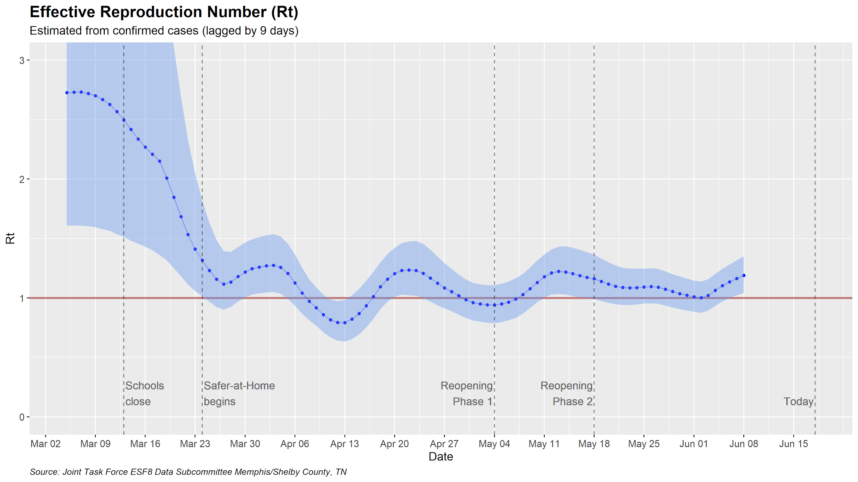
Smoothed
Rt by Period*
Pre-SaH: 2.82
SaH: 1.04
Reopen 1: 1.08
Reopen 2: 1.11
*Robust average of unsmoothed Rt

Slide 36
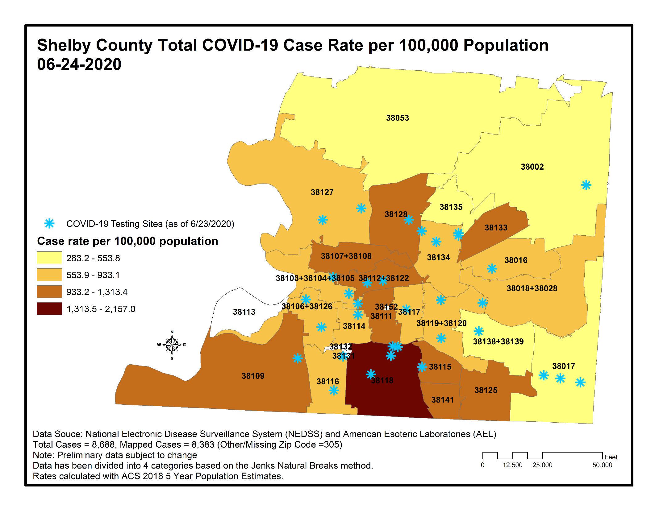

Slide 37
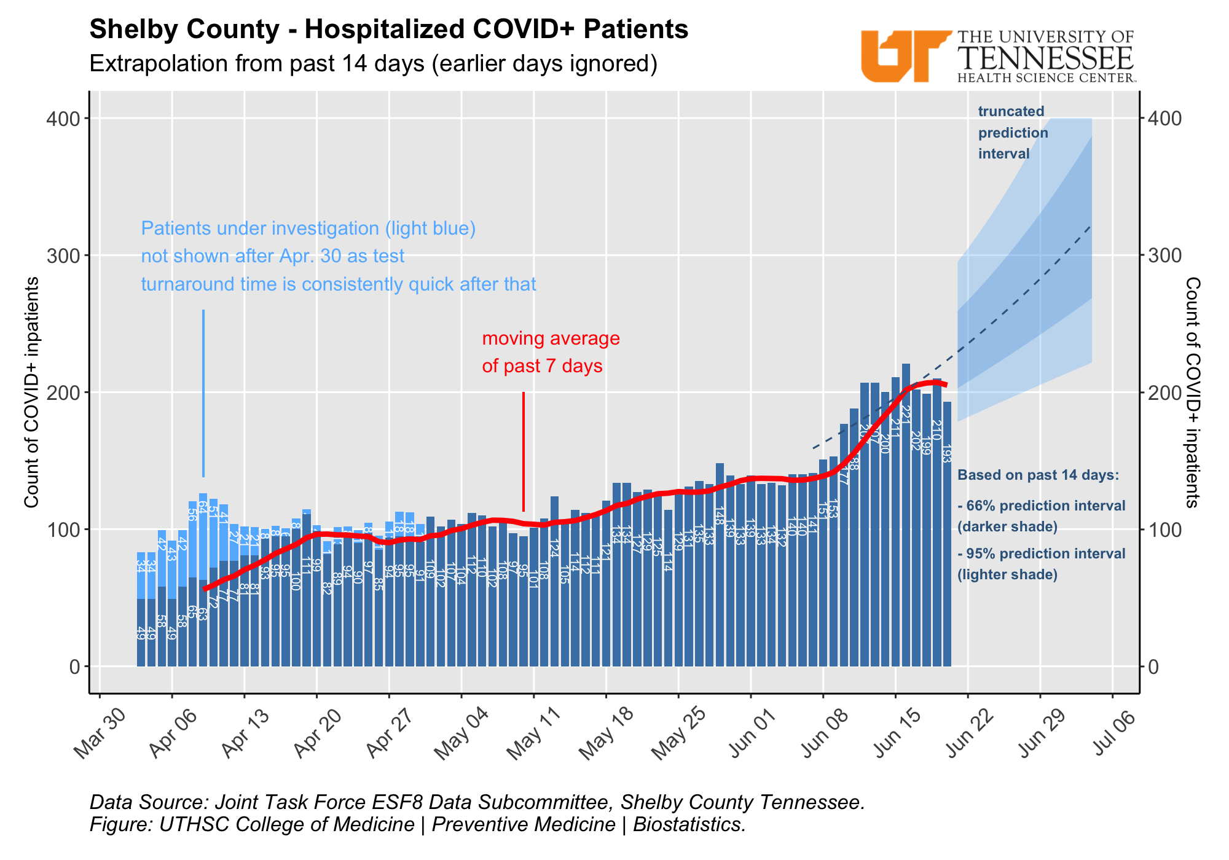

Slide 38
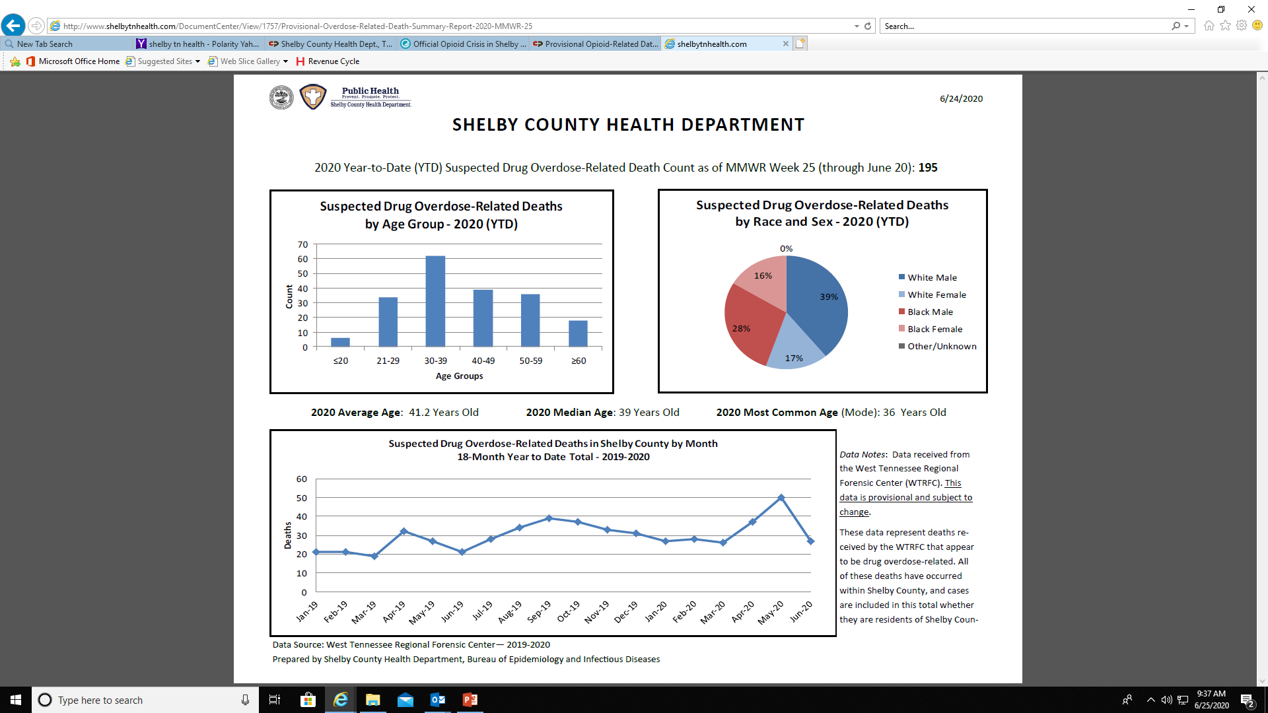

Slide 39
ASSURANCE

Slide 40
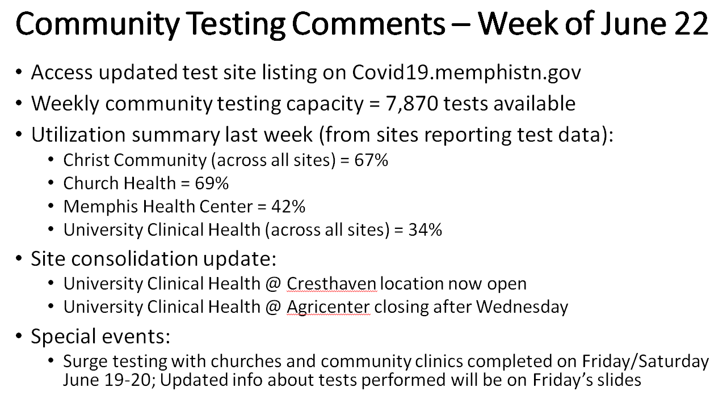

Slide 41
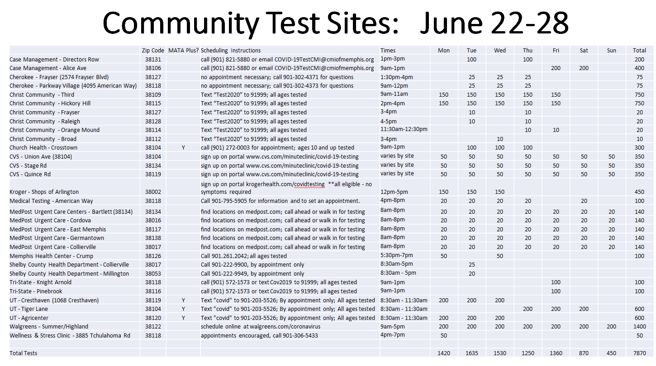

Slide 42
POLICY DEVELOPMENT

Slide 43
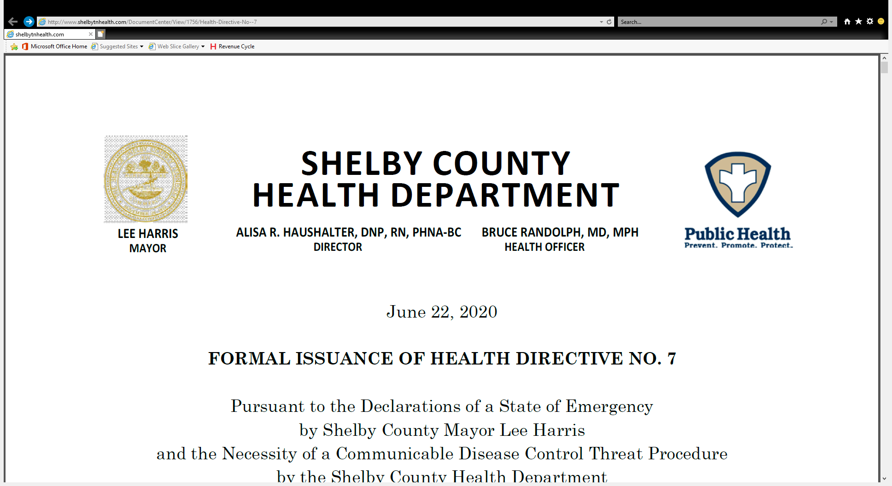

Slide 44


Slide 45
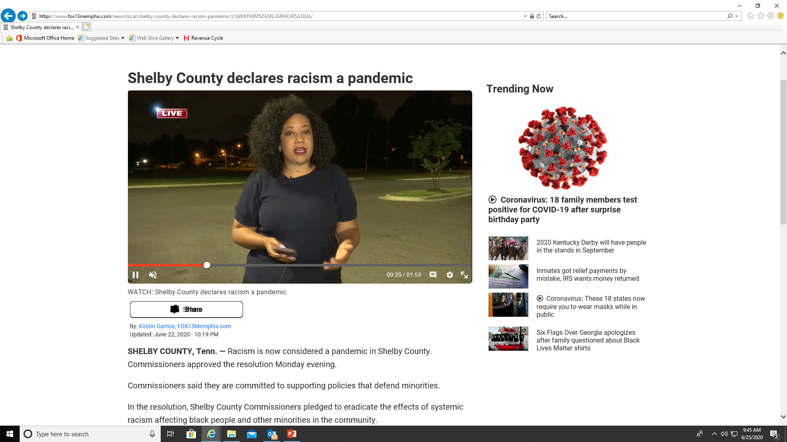

Slide 46




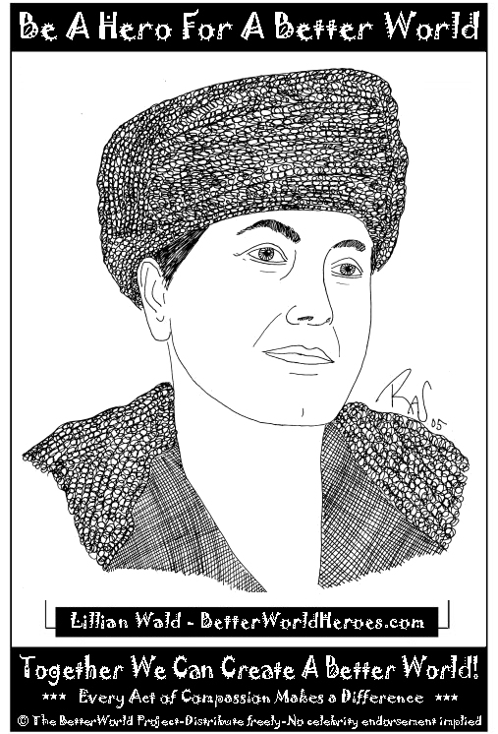
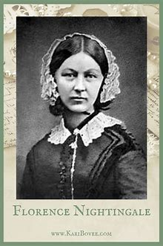
Notes:
While 2020 may not be the year that many of us had planned for, it is unprecedented and it will recorded in history for many reasons including the COVID-19 Pandemic.
As we reflect on the role of nurses during the Year of the Nurse, it is important that we recognize the contributions of our colleagues – our sisters and brothers on the frontline.
It is equally important, however, that we elevate our voices, tell our stories and advocate for nurses – in all specialties – to practice to the fullest extent of their license.
Thank-you.

Slide 47
https://www.apha.org/what-is-public-health
https://www.apha.org/-/media/files/pdf/membergroups/phn/nursingdefinition.ashx?la=en&hash=331DBEC4B79E0C0B8C644BF2BEA571249F8717A0
http://www.quadcouncilphn.org/wp-content/uploads/2016/03/2015_RESOLVE-Community-Chief-Health-Strategist.pdf
http://www.quadcouncilphn.org/

Slide 48
https://www.naccho.org/uploads/downloadable-resources/15-11-LHD-as-Community-Chief-Health-Strategist.pdf
http://shelbytnhealth.com/
Photos – personal collection, Davidson County Archives PHN Collection

