Slide 1
Test Taking Strategies in nursing
Showing what you know on the exam
Christie Cavallo, MSN, RN-BSN Instructor
College of Nursing, UTHSC
Keri Snyder, Student Academic Support Services and Inclusion

Slide 2
Factors that can impact learning
Knowledge
Review strategies
Reading rate
Anxiety
Time management
Test-taking strategies & pace
Physical, emotional health

Slide 3
Reading Rate & Vocabulary
Vocabulary Enhancers
Reading Rate
Examples, definitions, activities
Vocabulary Builder
Magoosh
SASSI computer lab
Learning resources and speed reader programs
Acceleread
Spreeder
https://www.lumosity.com

Slide 4
Time Management
Remember: There isn’t time to do EVERYTHING
What’s most important?
Be selfish with your time
Is it a good use of your time? Is it worth it?
Try not to multitask too much
Go through the material that you can get through the fastest
Set time limits and stick to them
Move on even if you don’t accomplish everything
Keep a running list of things to review on the weekend
Be flexible but realistic
Unexpected things happen
Give it a chance

Slide 5
Anxiety, Emotional, Physical Health
Eating, sleeping, exercise
Meet with an Educational Specialist
Try new strategies
Think out loud
Your support network
Talk to someone
Counseling Services
University Health Services
Student Assistance Program (SAP)
JED (online mental health resources)

Slide 6
Review Strategies
Yesterday—Review what you covered yesterday
Today—Review what you covered today
Tomorrow—Preview what you’re going to cover tomorrow

Slide 7
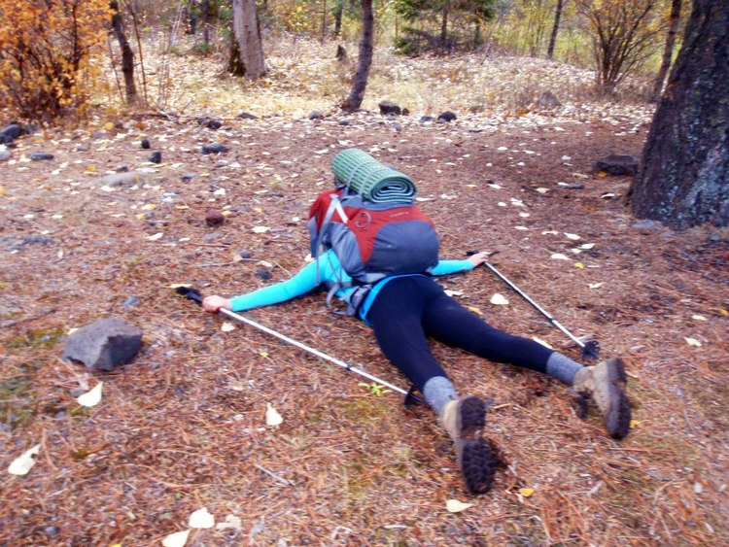
Strategies
While the strategies that got you here worked, they may need to be adjusted to fit this environment.
Test taking, time management, study skills, etc.
The lightweight day pack that you trained with is a walk in the park compared to the 50lb pack now on your back.
Be open to making adjustments that will improve your ability to thrive in this environment.

Slide 8
Past, Present, future
Past
Old Tricks
What worked before?
Memorization
Reviewing
Notecards
Only using 1 resource
Not opening a book
Last minute/not studying
Longest Answer is correct
Find an word in the answers that matches the stem
Don’t choose A or 1 often, it’s not usually correct
Choose “All of the above” or “None of the above”
A positive choice is more likely than a negative choice
Come up with the answer in your head before you answer
NOPE, Doesn’t work in nursing questions!!!

Slide 9
Past, Present, future
Present | Future
What’s working now? Are the same approaches working? → How do you know? What do you need to change? → Have you been doing practice questions? | What can you do to go higher? Try a new approach Practice questions Fine tuning Time management Asking the experts → SASSI, CON Learning Navigator, Faculty → Tutors, Peers

Slide 10
Anatomy of a nursing question
Stem-Question
Distractors-Answers
NCLEX is…
Multiple choice
Timed
Application and analysis….not regurgitation of memorization

Slide 11
Tip #1
Avoid asking forbidden words…
“Well, what if…”

Slide 12
Example Question
A hospitalized patient has a fever of 102.4 F orally and is exhibiting chills, warm, flushed skin and lethargy. Which action by the nurse is correct?
Administer acetaminophen (Tylenol) 500 mg x 2 tablets
Apply a warm, dry cloth to patient's axillary areas
Call the patient’s family to the hospital
Ask the patient if they have had anything to eat

Slide 13
Tip #2
Focus first on only the information in the question (stem)
What is the question asking???

Slide 14
EXAMPLE QUESTION
A patient was driving the wrong way on a one way street when he hit a car going 60 mph. He has a comminuted fracture to his right tibia and fibia. Surgery was preformed by Dr. Bones on July 23, 2018. He has requested a hamburger for lunch. The nurse is teaching a client in skeletal leg traction about measures to increase bed mobility. Which item would be most helpful for this patient?
Crutches
Fracture bedpan
Overhead trapeze
Walker

Slide 15
TIP #3
Look for strategic words…
Initial, first, priority,
(all answers are correct, one is first)

Slide 16
Example Question
The nurse is caring for a patient with a diagnosis of heart failure who suddenly complains of shortness of breath. The nurse should take which immediate action?
Administer oxygen to the client
Elevates the head of the patient’s bed
Calls the health care provider (HCP)
Prepares to administer furosemide (Lasix)
If experiencing anxiety or are thrown off, focus on the first word. It helps get you grounded.
Administer
Elevates
Calls
Prepares

Slide 17
TIP #4
In multiple choice questions that are select all that apply
Read every choice before answering
Ask if each option is an answer to what the question is asking
(basically a knowledge question)

Slide 18
Example Question
The nurse is caring for a client who just returned from the recovery room after undergoing abdominal surgery. Which symptom(s) indicate hypovolemia (select all that apply)?
Lethargy
Increased pulse rate
Increase urinary output
Fever
Hypotension

Slide 19
Tip #5
When choosing an answer…
First eliminate the wrong answers

Slide 20
Example question
The nurse provides medication instructions to a patient about digoxin (Lanoxin). Which statement by the patient indicates an understanding of the adverse effects?
“Blurred vision is expected.”
“If I am nauseated, I should just drink liquids.”
“This medication may cause headache and weakness.”
“I should check my pulse before I take the medication.”

Slide 21
Review of test taking strategies
Cover the answers
Read the LAST sentence first, if needed read the last two sentences.
What is the question asking?
Look for strategic words
Predict the answer OR brainstorm what you do know based on what you know is incorrect based on the question?
Don’t get hung up on words that you do not know

Slide 22
Question Analysis- Think about why a question was missed
Misread
Words skipped, words read incorrectly (ie. Independent/dependent)
Words in the question that you didn’t know
Misinterpreted
Did you go to “what ifs“?
Thought about extraneous information and not the question
Missed a strategic word
Gave up too quickly
If you spent one more minute on the question would you have gotten it correct?
Did not know the information needed to problem solve
Knowledge deficits?
Are you changing your answer?

Slide 23
Strategic Learning
Desired outcome: Your grade matching the amount of effort that you put into your studying.
Be strategic in your studying/time management
Do what’s worked and integrate different strategies
Use practice questions
Seek assistance
Long-term learning; building upon knowledge

Slide 24
Practice Questions- Why are they useful?
Use them early, not later
Identify gaps in knowledge
Provides practice in applying, analyzing, and evaluating problems
Template for integrating the material and thinking like a nurse
Makes the material stick

Slide 25
Self Evaluation- Strategies to be mindful of before you begin your exam
Keep pace
Limited time on each question
Make a guess and move on
Practice timing yourself
Go with your gut
You know this!
What is your intuition?
Don’t change your answer unless you can bet on it
Practice questions can help build confidence
Don’t forget to breathe!
Helps with anxiety
Be a friend
Fear is contagious!
Before the test
Do 3-5 questions that you know the morning of as a warm up (not material that you are unsure of)
After your first assessment
Reflect on what went well
If you did not finish on time, felt rushed, didn’t sleep the night before reach out to resources early so that you can strategically approach the next exam

Slide 26
Need Help?
Counseling Services | Care Navigator | SASSI
SASSI 8 South Dunlap Street, Room BB9 Memphis, TN 38163 SASSI 901-448-5056 Or UHS 910 Madison, 9th Floor Or SAP 1-800-327-2255 Schedule an appointment online uthsc.edu/sassi | Contact Rachel Bolick: uthsc.edu/care-concern careteam@uthsc.edu (901)448-2344 SASSI GEB BB9 uthsc.edu/care-team | 8 South Dunlap Street, Room BB9 Memphis, TN 38163 SASSI 901-448-5056 sassi@uthsc.edu Schedule an appointment online uthsc.edu/sassi
After Hours Mental Health Emergency - (901) 541-5654 or
Suicide Prevention Lifelines: 1-800-273-8255 (TALK)
Here you can speak to a counselor about mental health issues or share a care concern after hours

Slide 27
References
Silvestri, L. A. (2014). Saunder’s comprehensive review for the NCLEX-RN examination. (6th ed). St. Louis, MO:Elsevier

