Slide 1
Therapeutic Plasma Exchange:
indications in Nephrology
M. Colleen Hastings, MD
Nephrology Grand Rounds
October 4, 2011

Slide 2
Outline
Overview of plasmapheresis procedure
Potential indications
  Goodpasture’s Syndrome
  Thrombotic Thrombocytopenic Purpura
  Cryoglobulinemia
  Multiple Myeloma
  ANCA Disease
Complications of plasmapheresis

Slide 3
Therapeutic Plasma Exchange (PEX)
Synonomous with the term “plasmapheresis”
Apheresis → “taking away”
Designed for removal of large molecular weight substances (≥15,000 d)
  Autoantibodies
  Immune complexes
  Cryoglobulins
  Myeloma light chains
  Endotoxin
  Cholesterol-containing lipoproteins
Designed for removal of substances with a long half life
Designed for removal of substances that are acutely toxic and resistant to conventional therapy
Kaplan. AJKD. 52:1180-1196, 2008.

Slide 4
PEX Procedure
Typical goal is to exchange 1 to 1.5 times the estimated plasma volume per treatment
Will lower plasma macromolecule (eg. immunoglobulin) level by 60 to 70%
Plasma volume (in L) is estimated by (0.065*wt in kg)*(1-hct)
For a 60 kg person with a hct of 30, the plasma volume is about 2.7 L
Kaplan. Trans Am Soc Artif Intern Organs. 36:M597-M599; 1990.

Slide 5
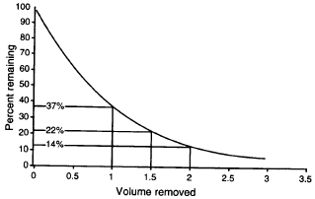
Percentage initial plasma remaining per exchange volume
Pediatric Dialysis. 629-648, 2004.

Slide 6
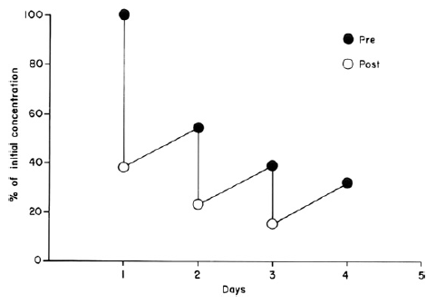
IgG removal with PEX
Kaplan. AJKD. 52:1180-1196, 2008.

Slide 7
PEX procedure – Access
  Generally requires placement of vascath or permcath
  Can be performed via AVF/AVG
Brenner and Rector’s The Kidney, 8th ed. 2071-2080, 2007.

Slide 8
PEX procedure – Anticoagulation
Acid-citrate-dextrose solution
  continuous infusion
  adjusted according to blood flow (1:10 to 1:25)
  requires concurrent calcium gluconate infusion
Heparin
  used alone or in combination with citrate infusion
  40 units/kg bolus then 20 units/kg hour
Brenner and Rector’s The Kidney, 8th ed. 2071-2080, 2007.

Slide 9

PEX procedure –
Replacement Fluids
5% Albumin
  Most commonly used
  Generally combined with NS on a 50:50 (vol%) basis
  Contains sodium 145 $±$ 15 mEq/L but potassium <2 meq/L
  No risk of viral transmission
  Low risk of anaphylactic reactions
  Associated with depletion coagulopathy
    PT increases by 30% and PTT by 100% after single PE
    Can correct using FFP at end of procedure
  Immunoglobulin depletion
    Single 1 plasma volume exchange reduces immunoglobulin levels by 60%
    Can correct using single infusion of IVIG
Kaplan. AJKD. 52:1180-1196, 2008.

Slide 10
PEX procedure –
Replacement Fluids
Fresh Frozen Plasma
  Does not cause postpheresis coagulopathy or immunoglobulin depletion
  Risk of anaphylactoid reactions
      May pre-treat with diphenhydramine
      Epinephrine (1:1000) may be necessary for SC injections
  Citrate toxicity (14% citrate by volume) leading to hypocalcemia and metabolic acidosis
  Risk of viral transmission
    3L of FFP is obtained from 10 to 15 donors
Kaplan. AJKD. 52:1180-1196, 2008.

Slide 11
Brenner and Rector’s The Kidney, 8th ed. 2071-2080, 2007.

Slide 12
Brenner and Rector’s The Kidney, 8th ed. 2071-2080, 2007.

Slide 13
PEX versus Hemodialysis
 | PEX | Hemodialysis
Target for removal | Ab, proteins | Electrolytes, free water
Separation technique | Centrifugation | Semipermeable membrane
Extracorporeal volume | 250-500 ml | 80-350 ml
Indication | Autoimmune or metabolic disease | Renal failure or toxin removal
Treatment of fluid overload | Limited | Effective
Treat coagulopathy | Yes | No
Treat electrolyte imbalance | No | Yes
Pediatric Dialysis. 629-648, 2004.

Slide 14
Scoring system for indications for PEX
Initially developed by the American Medical Association Council on Scientific Affairs in 1985
Revised in June 2007 by the American Society for Apheresis
I: Standard therapy, acceptable but not mandatory
II: Available evidence tends to favor efficacy: conventional therapy usually tried first
III: Inadequately tested at this time
IV: No demonstrated value in controlled trials
Kaplan. AJKD. 52:1180-1196, 2008.

Slide 15
Efficacy of PEX
Indication | 2007 Rating
Goodpasture’s syndrome | I
Thrombotic thrombocytopenic purpura | I
Cryoglobulinemia | I
Renal allograft rejection | II
Removal of cytotoxic Ab in transplant transplant candidate | II
Recurrent FSGS post transplant | III
Rapidly progressive glomerulonephritis | III
Multiple myeloma, cast nephropathy | III
Hemolytic uremic syndrome | III-IV
Szczepiorkowski et al. J Clin Apher. 22:106-175; 2007.

Slide 16
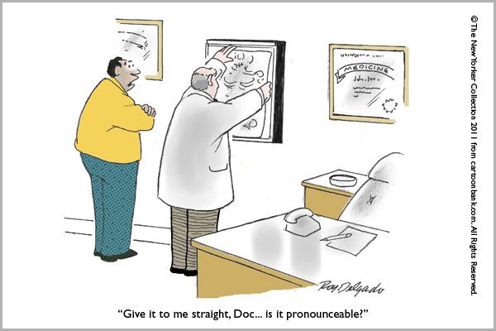

Slide 17
Goodpasture’s Syndrome
Hemoptysis (generally in smokers)
Sudden decrease in hemoglobin
Pallor
Cough
Fever
Dyspnea
Hematuria
Non-nephrotic proteinuria
Red cell casts
I
Hudson et al. N Engl J Med. 348:2543-2556; 2003.
Notes:
Goodpasture’s syndrome occurs primarily in young
men in their late 20s and in men and women over
60 years of age.28 In the younger age group, the
disease is usually eruptive, with hemoptysis, a sudden
decrease in the hemoglobin level, pallor, cough,
fever, dyspnea, hematuria, non-nephrotic proteinuria,
and red-cell casts. Chest radiography shows
diffuse alveolar infiltrates. Hemoptysis is largely
confined to smokers.117 Goodpasture’s syndrome is
generally detected earlier in patients who present
with lung hemorrhage, and such patients may do
better than those who present with silent renal injury
alone. Presentation with oliguria is a particularly
bad sign.133,134
The prognosis at presentation is worse if there is
oliguria, advanced fibrosis or more than 50 percent
crescents on renal biopsy, a serum creatinine
concentration of more than 5.7 mg per deciliter
(500 μmol per liter), or a need for dialysis.134 Most
patients with advanced disease do not have a response
to plasmapheresis or immunosuppression.
Patients with end-stage kidney disease who present
with hemoptysis, however, should be treated for
lung hemorrhage, which does respond to plasmapheresis.
133 Patients who have the fewest features
known to predict a poor outcome typically have a
response when given 8 to 10 treatments with plasmapheresis
during the first two weeks, accompanied
by oral prednisone and cyclophosphamide
therapy. Although the evidence is largely experiential,
those who have a response to treatment involving
an enduring absence of anti–glomerular basement
membrane antibodies can have their dose of
prednisone tapered after a few months, while continuing
to receive cyclophosphamide for varying
periods of up to a year. Kidney transplantation is
possible, but because there is a risk of recurrence,
experience has suggested that patients should wait
for six months — and certainly until anti–glomerular
basement membrane antibodies are undetectable
in serum.124

Slide 18
Goodpasture’s syndrome
Occurs primarily in young men in their late 20s and in men and women over the age of 60 years
In the younger group, onset tends to be rapid or “eruptive”
Chest x-ray classically shows diffuse alveolar hemorrhage
Generally detected earlier in patients with pulmonary manifestations
I
Hudson et al. N Engl J Med. 348:2543-2556; 2003.

Slide 19
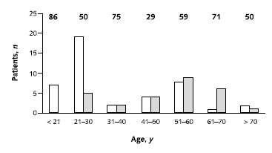
Incidence of pulmonary hemorrhage
Pulmonary hemorrhage
Percent male
No pulmonary hemorrhage
I
Levy et al. Ann Intern Med. 134:1033-1042; 2001.
Notes:
White bars represent patients with pulmonary hemorrhage, and gray bars
represent patients without pulmonary hemorrhage. The numbers above
the bars represent the proportion of men in each age group. Younger
patients (mostly men) tend to present with pulmonary hemorrhage.

Slide 20
Pathogenesis
I
Hudson et al. N Engl J Med. 348:2543-2556; 2003.

Slide 21
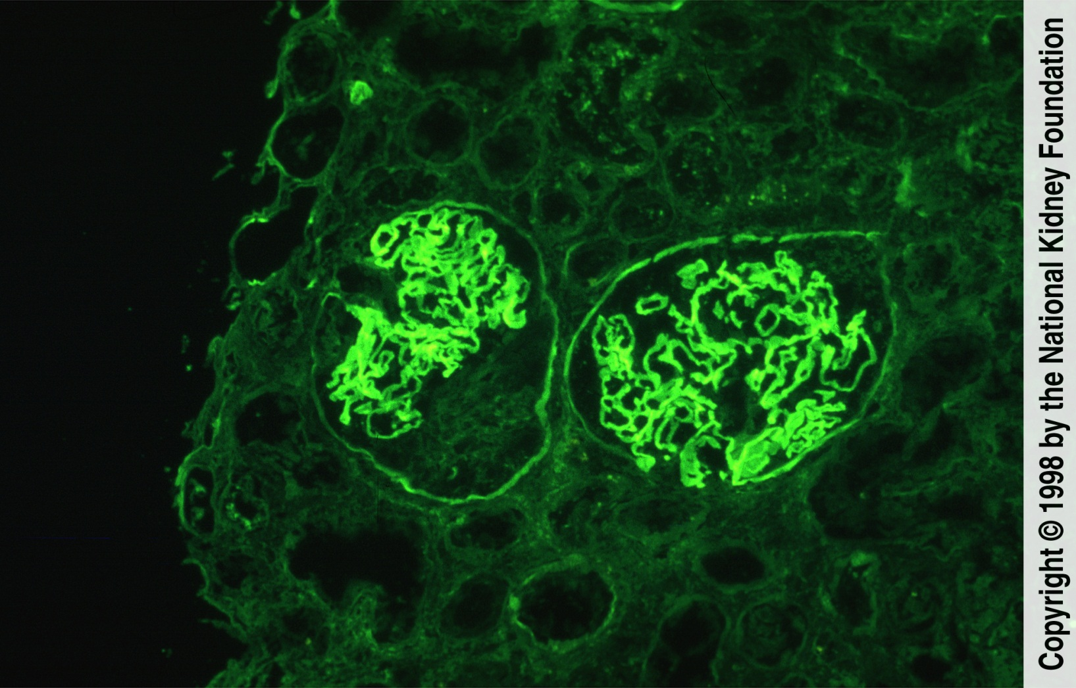
Anti-GBM - immunofluorescence
Linear deposition of anti-GBM antibodies
I

Slide 22
Treatment
Lancet 1976 Apr 3;1(7962):711-5.
Immunosuppression and plasma-exchange in the treatment of Goodpasture's syndrome.
Lockwood CM, Rees AJ, Pearson TA, Evans DJ, Peters DK, Wilson CB.
Abstract
Seven patients with Goodpasture's syndrome induced by anti-glomerular-basement-membrane (anti-G.B.M.) antibody were treated by a regimen of intensive plasma-exchange, cytotoxic drugs, and steroids. In the three patients retaining some renal function at presentation, this regimen led to suppression and eventual termination of antibody synthesis with improvement in renal function. In four patients, all anuric at presentation, antibody to G.B.M. persisted with variable reduction in the circulating levels. No return of renal function occurred in this group, all of whom had extensive changes on renal biopsy. Pulmonary haemorrhage, life-threatening in one patient, was rapidly controlled in all five patients in whom it was a presenting feature. In addition to its effect on antibody levels, plasma-exchange, using volume-replacement with plasma-protein fraction (P.P.F.), resulted in substantial depletion of complement and fibrinogen, mediators possibly contributing to the antibody-induced injury
I
Notes:
Patients received a standard immunosuppressive
regimen of plasma exchange, oral prednisolone (approximately
1 mg/kg of body weight per day to a maximum
of 60 mg/d) and oral cyclophosphamide (2 to 3 mg/kg
per day; the dosage was reduced in persons older than
55 years of age). Plasma exchange (50 mL/kg to a maximum
of 4 L) was usually performed by using a centrifugal
cell separator (or occasionally by using a hollowfiber
plasma filter) daily for at least 14 days or until
anti-GBM antibody was undetectable. Human albumin
(5%) with added calcium and potassium was used as
replacement fluid. Fresh frozen plasma (150 to 300 mL
at the end of the exchange) was used in patients with
recent surgery or renal biopsy (within 3 days) and those
with pulmonary hemorrhage. Most patients received
fresh frozen plasma for 1 or 2 days. Cyclophosphamide
was given for 2 to 3 months only (30 patients received
treatment for 2 months), and prednisolone treatment
was withdrawn slowly over 6 to 9 months. Nineteen
patients treated in the 1970s and early 1980s also received
oral azathioprine (1 to 2 mg/kg daily) for 8
weeks. No patient received high-dose intravenous methylprednisolone
at our institution.

Slide 23
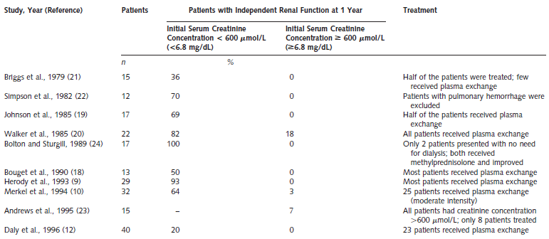
Anti-GBM studies
I
Levy et al. Ann Intern Med. 134:1033-1042; 2001.

Slide 24
Outcome of anti-GBM disease
Objective: To examine the long-term outcome of severe anti-GBM antibody disease.
Design: Retrospective review of patients treated for confirmed anti-GBM antibody disease over 25 years.
Setting: A tertiary referral center in the United Kingdom.
Patients: 71 treated patients with anti-GBM antibody disease.
Intervention: All patients received plasma exchange, prednisolone, and cyclophosphamide.
Measurements: Patient and renal survival, renal histology, and antibody levels.
I
Levy et al. Ann Intern Med. 134:1033-1042; 2001.

Slide 25
PEX protocol
  Daily plasma exchange (50 mL/kg to a maximum of 4 L) was usually performed by using a centrifugal cell separator (or occasionally by using a hollow fiber plasma filter) for at least 14 days or until anti-GBM antibody was undetectable.
  Human albumin (5%) with added calcium and potassium was used as replacement fluid.
  Fresh frozen plasma (150 to 300 mL) was used in patients with recent surgery or renal biopsy (within 3 days) and those with pulmonary hemorrhage.
  Most patients received fresh frozen plasma for 1 or 2 days
I
Levy et al. Ann Intern Med. 134:1033-1042; 2001.

Slide 26
Medication protocol
Oral prednisolone (approximately 1 mg/kg of body weight per day to a maximum of 60 mg/d)
  withdrawn slowly over 6 to 9 months.
Oral cyclophosphamide (2 to 3 mg/kg per day; the dosage was reduced in persons older than 55 years of age)
  given for 2 to 3 months only (30 patients received treatment for 2 months)
Nineteen patients treated in the 1970s and early 1980s also received oral azathioprine (1 to 2 mg/kg daily) for 8 weeks
No high-dose intravenous methylprednisolone was used
I
Levy et al. Ann Intern Med. 134:1033-1042; 2001.

Slide 27
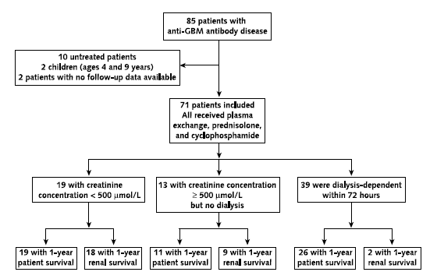
Study design
500 µmol/L = 5.7 mg/dl
I
Levy et al. Ann Intern Med. 134:1033-1042; 2001.

Slide 28
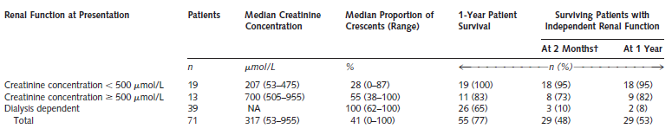
Renal function at entry and patient/renal survival
I
Levy et al. Ann Intern Med. 134:1033-1042; 2001.
Notes:
NA 5 not available.
† Renal survival at 2 months was calculated only for patients surviving at 2 months.

Slide 29
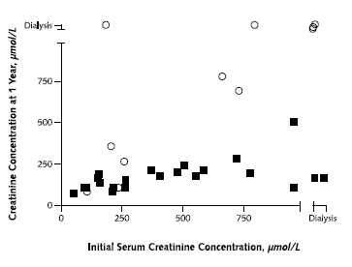
Renal Function on presentation and outcome
Correlation coefficient 0.96; P < 0.001
patients are classified by their final renal outcome:
dialysis dependent (circles) or
dialysis independent (squares).
I
Levy et al. Ann Intern Med. 134:1033-1042; 2001.
Notes:
Top. Bottom. Correlation coefficient, 0.91; P , 0.001. In both parts of the
figure, patients are classified by their final renal outcome: dialysis dependent
(circles) or dialysis independent (squares). To convert creatinine values
in mmol/L to mg/dL, divide by 88.402.

Slide 30
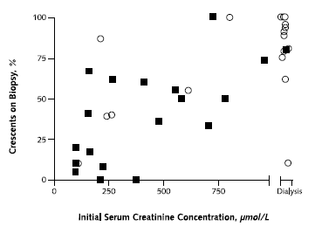
Crescents and renal function
Correlation coefficient 0.91; P < 0.001
patients are classified by their final renal outcome:
dialysis dependent (circles) or
dialysis independent (squares).
I
Levy et al. Ann Intern Med. 134:1033-1042; 2001.

Slide 31
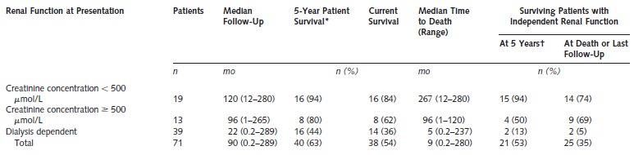
Patient and renal survival at 5 years
*Patient survival at 5 years was calculated only for patients with at least 5 years of follow-up.
† Renal survival at 5 years was calculated only for patients surviving at 5 years.
I
Levy et al. Ann Intern Med. 134:1033-1042; 2001.
Notes:
Patient survival at 5 years was calculated only for patients with at least 5 years of follow-up.
† Renal survival at 5 years was calculated only for patients surviving at 5 years.

Slide 32
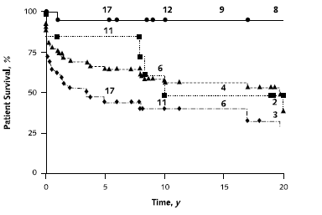
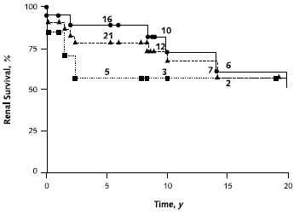
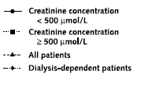
Patient and renal survival
I
Levy et al. Ann Intern Med. 134:1033-1042; 2001.
Notes:
The difference between patients with an initial creatinine concentration less than 500 mmol/L (5.7 mg/dL) and the other groups was significant
(P 5 0.0055). The number of patients at risk is shown on each curve. Bottom. Only patients who did not require dialysis at presentation are included.
The difference between the two groups is not significant. The number of patients at risk is shown on each curve.

Slide 33


Slide 34
Thrombotic Microangiopathy
Pathological features include:
  increased vessel wall thickness
  swelling and/or detachment of endothelial cells
  platelet aggregation/thrombosis
  accumulation of debris/material in subendothelial space
  partial or complete vessel occlusion
Clinical features include:
  microangiopathic hemolytic anemia—sheer stress from vessel lumen occlusion produces fragmented red cells
  thrombocytopenia—platelets are consumed by local thrombosis
  organ ischemia—renal failure or neurological symptoms
I-IV
Keir and Coward. Pediatr Nephrol 26:523–533, 2011.

Slide 35
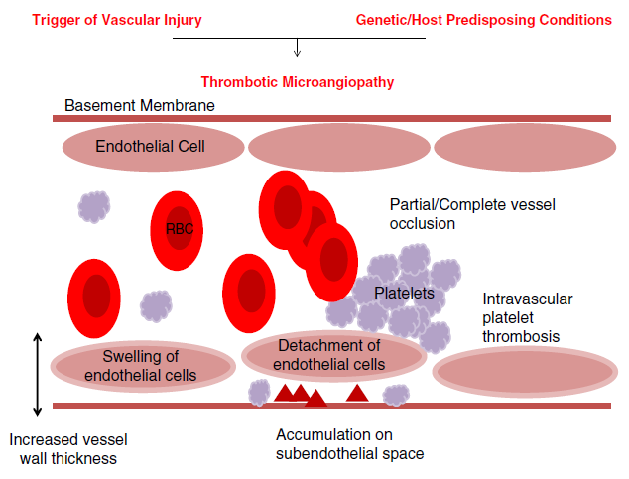
I-IV
Keir and Coward. Pediatr Nephrol 26:523–533, 2011.

Slide 36
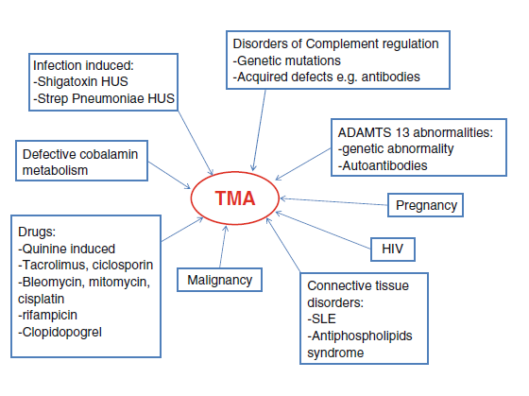
I-IV
Keir and Coward. Pediatr Nephrol 26:523–533, 2011.

Slide 37
Thrombotic thrombocytopenic purpura
First described in 1924
More common in females between the ages of 10 and 39 yrs
Incidence: 3.7 cases per 1,000,000
Classic pentad:
  Fever
  Microangiopathic hemolytic anemia
  Thrombocytopenia
  Renal dysfunction
  Neurological symptoms
I
Keir and Coward. Pediatr Nephrol 26:523–533, 2011.
Notes:
Moschcowitz E. Hyaline thrombosis of the terminal arterioles and capillaries: a hitherto undescribed disease. Proc N Y Pathol Soc. 1924;24:21–24.
Thrombotic thrombocytopaenic purpura
Thrombotic thrombocytopaenic purpura (TTP) was first
described in 1924 [33]. It is more common in female
subjects between the ages of 10 and 39 years. The highest
incidence is seen in the fourth decade. The annual incidence
is 3.7 cases per 1,000,000 [7]. Clinically, it presents as a
pentad of symptoms: microangiopathic haemolytic anaemia,
thrombocytopaenia, neurological symptoms, renal
damage and fever. It used to be a diagnosis of exclusion;
however, there is now an ADAMTS13 activity assay that
clinches the diagnosis [33]. Plasma exchange was shown to
improve symptoms and is now standard treatment for TTP
[2]. It took 20 years before the reason why plasma
exchange is a useful treatment in TTP was understood
[34]. In 1982, it was noted that TTP patients had ultra-large
multimers of von Willebrand factor circulating in their
blood during periods of remission; thus, it was hypothesised
that, as these were not seen in healthy people, that
TTP patients lack a protease that normally cleaves these
ultra-large multimers [33]
Thrombotic thrombocytopaenic purpura is now known to
be a disorder of von Willebrand factor (vWF) regulation [5].
vWF is a glycoprotein produced by endothelial cells that
regulates platelet aggregation and adhesion. When vascular
injury occurs, vWF is released from endothelial cells as ultralarge
multimers (UL-vWF). Some of these stay associated
with the endothelial cell surface providing platelet-binding
sites. They may bind other blood components too, e.g.
leukocytes. Platelet binding to UL-vWF is regulated by the
metalloprotease ADAMTS13 (a-disintegrin-like and metalloprotease
and thrombospondin repeats). It is a deficiency of
ADAMTS 13 that accounts for the majority of patients with
congenital TTP. The majority of acquired cases occur due to
antibody formation against this molecule [33].
Banno et al. [35] has developed an ADAMTS13
knockout mouse on a pure genetic background SV129.
These mice do not normally develop TMA, but do show a
UL-vWF multimers pattern similar to that seen in TTP.
However, when challenged with platelet and endothelial
agonists, they develop severe thrombocytopaenia. This
suggests that ADAMTS13 deficiency alone is not enough
to cause TMA. A further environmental or genetic hit is
required to develop TTP.

Slide 38
ADAMTS13
Moake et al linked von Willebrand factor (VWF) to TTP in 1982 noting that patients with relapsing acquired or congenital TTP had “ultralarge” VWF when in remission
Hypothesized that these patients lacked depolymerase or protease that normally cleaved ultralarge VWF to prevent platelat aggregation and thrombosis
Plasma therapy might replace this missing factor or remove and inciting co-factor
I
Sadler. Blood 112:11–18; 2008.
Notes:
deficient plasma factor would not be characterized for another 20 years, but a clue to its function was recognized much earlier by Moake, who published an influential paper in 1982 that linked von Willebrand factor (VWF) to the pathogenesis of TTP.¹³ He found that patients with relapsing acquired or congenital TTP had circulating “unusually large” or “ultralarge” VWF multimers when they were in remission, and ultralarge VWF was absent from the plasma of healthy persons. Moake proposed that his patients lacked a VWF depolymerase, possibly a protease, that normally cleaved ultralarge VWF to prevent it from causing the intravascular platelet aggregation and thrombosis that characterize TTP. Plasma therapy might replace this depolymerase or remove an inciting cofactor.¹³ Interestingly, 2 of Moake's 4 subjects were the same patients with congenital TTP who were studied as children by Schulman¹¹ and Upshaw.¹² Years later, they became central to deciphering and linking the pathophysiologic mechanisms of both congenital TTP and acquired idiopathic TTP in adults.
In 1996, a candidate VWF-cleaving protease finally was identified in human plasma by Tsai¹⁴ and independently by Furlan.¹⁵ The protease did not cleave VWF unless the substrate was subjected to fluid shear stress or treated with low concentrations of protein denaturants such as urea or guanidine hydrochloride. The next year, VWF-cleaving protease was shown to be missing from the plasma of patients with congenital TTP.¹⁶ Soon after, adults with acquired idiopathic TTP were reported to have severe VWF-cleaving protease deficiency caused by IgG autoantibodies that inhibit the enzyme.^{17,18}
During the next few years, the VWF-cleaving protease was purified,^{19,20} cloned,^{21–23} and named ADAMTS13 because it belonged to the recently discovered “a disintegrin-like and metalloprotease with thrombospondin repeats” family of metalloproteases (Figure 1).²⁴ Furthermore, mutations in the ADAMTS13 gene were shown to cause congenital TTP.²³ Almost 80 years after Moschcowitz published the first case report, we finally had a molecular mechanism for both congenital and acquired idiopathic TTP (Figure 2).

Slide 39
ADAMTS13
Tsai and Furlan independently identified a protease that cleaved VWF when subjected to fluid sheer stress in 1996
In 1997, this VWF-cleaving protease was found to be missing from plasma of patients with congenital TTP
This protease was purified and cloned and named ADAMTS13 as it belongs to “a disintegrin-like and metalloprotease with thrombospondin repeats” family of metalloproteases”
I
Sadler. Blood 112:11–18; 2008.
Notes:
In 1996, a candidate VWF-cleaving protease finally was identified in human plasma by Tsai¹⁴ and independently by Furlan.¹⁵ The protease did not cleave VWF unless the substrate was subjected to fluid shear stress or treated with low concentrations of protein denaturants such as urea or guanidine hydrochloride. The next year, VWF-cleaving protease was shown to be missing from the plasma of patients with congenital TTP.¹⁶ Soon after, adults with acquired idiopathic TTP were reported to have severe VWF-cleaving protease deficiency caused by IgG autoantibodies that inhibit the enzyme.^{17,18}
During the next few years, the VWF-cleaving protease was purified,^{19,20} cloned,^{21–23} and named ADAMTS13 because it belonged to the recently discovered “a disintegrin-like and metalloprotease with thrombospondin repeats” family of metalloproteases (Figure 1).²⁴ Furthermore, mutations in the ADAMTS13 gene were shown to cause congenital TTP.²³ Almost 80 years after Moschcowitz published the first case report, we finally had a molecular mechanism for both congenital and acquired idiopathic TTP (Figure 2).

Slide 40
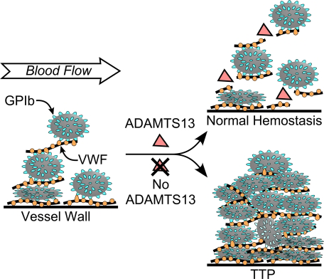
Sadler. Blood 112:11–18; 2008.

Slide 41
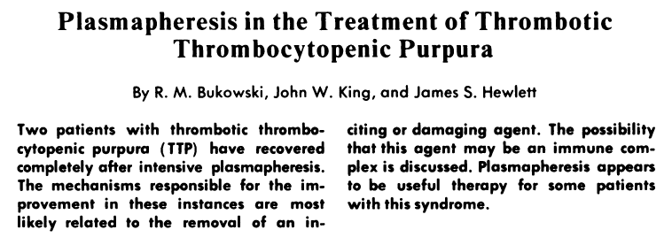
Blood. 50: 413-417; 1977.

Slide 42
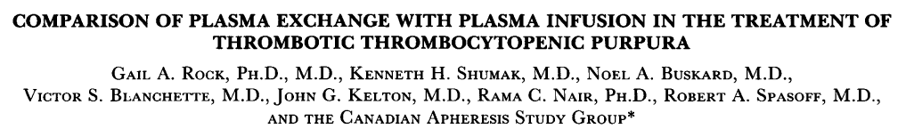
I

Slide 43
Methods
Prospective study
Randomly assigned to plasma infusion or plasma exchange
PEX group: Volume exchange was 1.5x predicted plasma volume for first three exchanges and then 1x predicted plasma volume
Plasma infusion: 30 ml/kg over the first 24 hours and then 15 ml/kg thereafter
Cycle of treatment:
  randomization until early response
  completion of 7 days of treatment
  clinical deterioration requiring removal from protocol (usually switch to PEX)
  death
I
Rock et al. N Engl J Med 325:393-397;1991.

Slide 44
Methods
All patients received dipyridamole (400 mg daily) and ASA (325 mg daily) for 2 weeks
Outcome was assessed at Day 9 and at 6 months
Endpoints: vital status, platelet count, change in platelet count, and neurologic status
Complete response: increase in platelet count >150,000 for 2 consecutive days with no deterioration in neurologic status
I
Rock et al. N Engl J Med 325:393-397;1991.

Slide 45
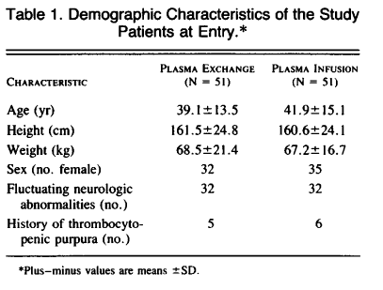
I
Rock et al. N Engl J Med 325:393-397;1991.

Slide 46
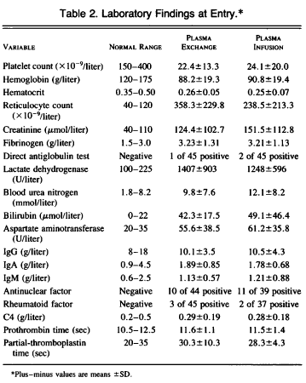
1.41 mg/dl
1.71 mg/dl
I
Rock et al. N Engl J Med 325:393-397;1991.

Slide 47
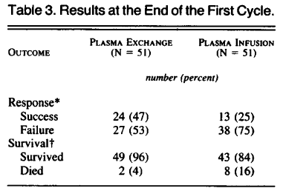
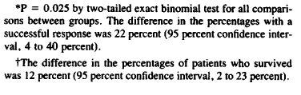
Results
I
Rock et al. N Engl J Med 325:393-397;1991.

Slide 48
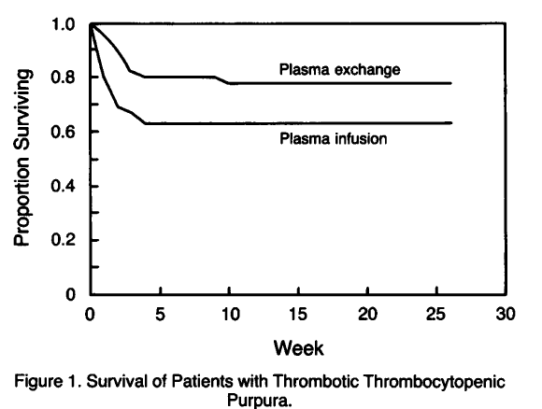
Patient Survival
I
Rock et al. N Engl J Med 325:393-397;1991.

Slide 49
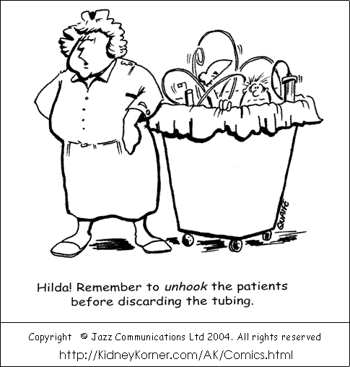

Slide 50
Cryoglobulinemia
Meltzer et al described as “palpable purpura, arthralgia, and asthenia accompanied by organ involvement (e.g., nephropathy and neuropathy) and elevated serum RF, defined as Ig capable of binding IgG” in 1966
Mixed cryoglobulinemia
  Associated with Hepatitis C in more than 90% of cases
  B-cell lymphoproliferative disorder characterized by the deposition of immune complexes containing rheumatoid factor (RF), IgG, HCV RNA, and complement on endothelial surfaces, eliciting vascular inflammation
I
Charles and Dustin. Kidney International. 76: 818–824, 2009.

Slide 51
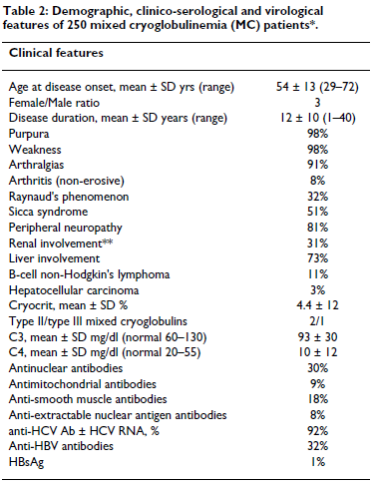
Clinical features
I
Ferri. Orphanet Journal of Rare Diseases. 3:25, 2008.

Slide 52
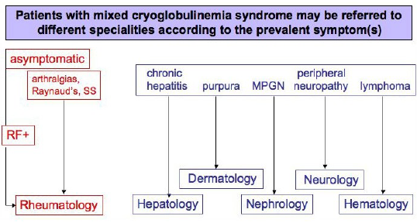
I
Ferri. Orphanet Journal of Rare Diseases. 3:25, 2008.

Slide 53
Cryoglobulimenia
Type | Composition | Pathologic Findings | Clinical Associations
I | -Monoclonal Ig (IgG or IgM or IgA) -Self-aggregation through Fc fragment | Alterations of underlying disorder | -Lympho-proliferative disorders (MM, WM, CLL, B-cell NHL)
II Mixed | -Monoclonal IgM (or IgG or IgA) with RF activity and polyclonal Ig (mainly IgG) | Leukocytoplastic vasculitis B-cell expansion with tissue infiltrates | -Infectious (HCV) -Autoimmune & lymproliferative disorders -Rarely essential
Rheumatoid factors are antibodies (typically IgM) directed at the Fc portion of IgG
I
Ferri. Orphanet Journal of Rare Diseases. 3:25, 2008.

Slide 54
Cryoglobulimenia
Type | Composition | Pathologic Findings | Clinical Associations
II-III Mixed | Oligoclonal IgM RF or mixture of poly/monoclonal IgM | Leukocytoplastic vasculitis B-cell expansion with tissue infiltrates | -Infectious (HCV) -Autoimmune & lymproliferative disorders -Rarely essential
III Mixed | Polyclonal mixed Ig (all isotypes) with RF activity of one polyclonal component (usually IgM) | Leukocytoplastic vasculitis B-cell expansion with tissue infiltrates | -Infectious (HCV) -More often autoimmune disorders -Rarely essential
I
Ferri. Orphanet Journal of Rare Diseases. 3:25, 2008.

Slide 55
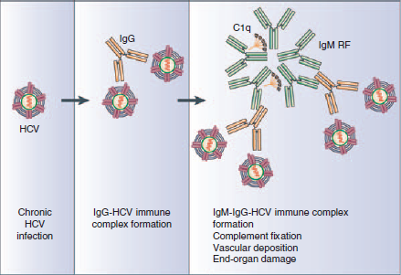
Formation of cryoglobulins
I
Charles and Dustin. Kidney International. 76: 818–824, 2009.

Slide 56
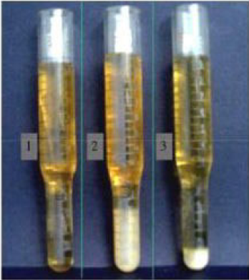
Cryocrit measurement
Tube 1: after serum separation from 20 cc whole blood
Tube 2: after 7 days at 4⁰ C
Tube 3: cryocrit after centrifugation at 4⁰ C
I
Ferri. Orphanet Journal of Rare Diseases. 3:25, 2008.
Notes:
Cryocrit determination in a patient with mixed cryoglobulinemia
(MC). Graduated glass tubes with serum
sample from cryoglobulinemic patient at different time intervals:
0- soon after serum separation from the whole blood
sample (at least 20 ml of whole blood); 7- after 7 days at
+4°C; and cryocrit measurement after serum centrifugation,
always at +4°C.af

Slide 57
Treatment
Nephron. 1986;43(4):246-53.
Treatment of the renal involvement in mixed cryoglobulinemia with prolonged plasma exchange.
Ferri C, Moriconi L, Gremignai G, Migliorini P, Paleologo G, Fosella PV, Bombardieri S.
Abstract
Nine patients with mixed cryoglobulinemia and severe membranoproliferative glomerulonephritis were treated with plasma exchange alone or in combination with medium to low amounts of corticosteroids, but never with cytotoxic drugs. In 5 patients renal function and/or proteinuria improved after plasma exchange, and no clinical relapse usually occurred when the procedures were reduced or discontinued. These procedures seemed of particular effect in the presence of histologically active and not irreversible lesions and rapid deterioration of renal function. While cryocrit almost invariably decreased, circulating immune complex or complement levels were unpredictably affected by plasma exchange. Cryocrit, but not immune complex or complement levels, was the serological parameter which most often closely correlated with signs of renal involvement (i.e., proteinuria and/or serum creatinine). Thus, plasma exchange might be a safe and useful tool in the treatment of an often drug-resistant and rapidly progressive renal involvement occurring in patients with mixed cryoglobulinemia.
I

Slide 58
Treatment
Despite a lack of randomized controlled studies, most experts agree PEX can be a useful adjunct for severe active disease manifested by progressive renal failure, coalescing purpura, or advanced neuropathy.
PEX can rapidly decrease cryoglobulin levels without the use of immunosuppressive agents, which might be problematic in hepatitis C–associated disease.
Reasonable PEX prescription is to exchange 1 plasma volume 3 times weekly for 2 to 3 weeks An average of 13 treatments may be required to induce clinical improvement (range, 4 to 39)
The replacement fluid can be 5% albumin, which must be warmed to prevent precipitation of circulating cryoglobulins
I
Kaplan. AJKD. 52:1180-1196, 2008.

Slide 59
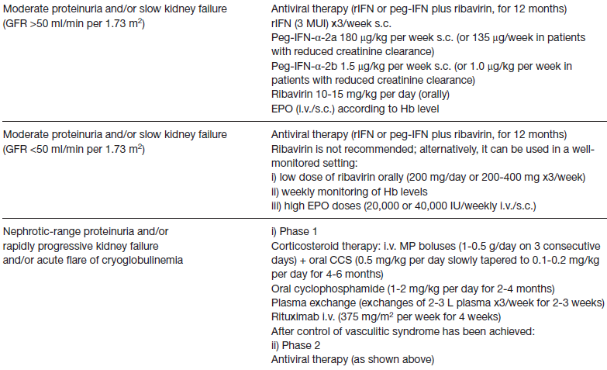
Treatment in Milan and Miami
I
Fabrizi et al. J Nephrol 21:813-825; 2008.
Notes:
CCS = corticosteroid; EPO = recombinant human erythropoietin; Hb = hemoglobin; i.v. = intravenously; MP = methylprednisolone;
rIFN = recombinant interferon; s.c. = subcutaneously.

Slide 60
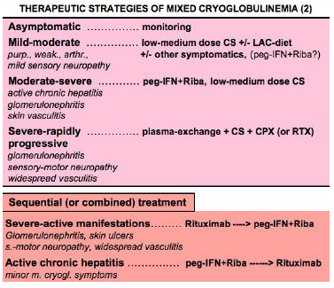
Treatment (Modena, Italy)
I
Ferri. Orphanet Journal of Rare Diseases. 3:25, 2008.
Notes:
Purp.: purpura; weak.: weakness; arthr.: arthralgias; CPX:
cyclophosphamide; CS: corticosteroids; LAC-diet, low-antigen-
content diet; MPGN, membranoproliferative glomerulonephritis;
peg-IFN: pegylated interferon-alpha; RIBA:
ribavirin.

Slide 61
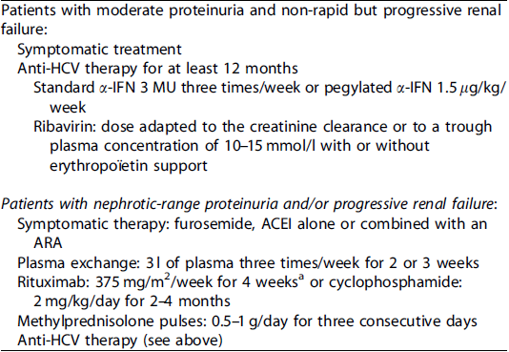
Treatment (France)
I
Kamar et al. Kidney International 69: 436–439; 2006.

Slide 62
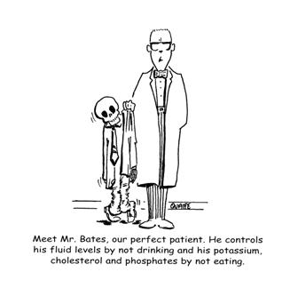

Slide 63
Rapidly progressive glomerulonephritis
PEX helpful in ANCA-associated disease and Goodpasture’s disease but NOT in RPGN caused by SLE, IgAN, post-infectious GN
Wegener’s granulomatosis and microscopic polyangiitis
  primary systemic vasculitic disorders
  associated with circulating autoantibodies to neutrophil cytoplasmic antigens (ANCA) with specificity for proteinase 3 (PR3) or myeloperoxidase (MPO)
  kidney involvement in 70% of patients
  histologic features of an intense, neutrophil-predominant inflammatory infiltrate; segmental glomerular necrosis reflecting a glomerular capillaritis; and intraglomerular monocyte proliferation
  pauci-immune, focal and necrotizing, crescentic glomerulonephritis
III
Jayne et al. J Am Soc Nephrol 18: 2180–2188, 2007.

Slide 64
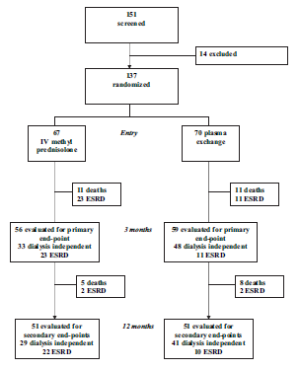
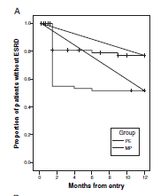
ANCA disease and PEX
P = .008
Primary end point →dialysis independence at 3 mo.
Secondary end points→renal and
patient survival at 1 yr.
III
Jayne et al. J Am Soc Nephrol 18: 2180–2188, 2007.
Notes:
Proportion of patients in each group without progression
to ESRD. ESRD required at least 6 wk of dialysis dependence
(intravenous methylprednisolone group [MP] versus
plasma exchange group [PE] P =0.008).

Slide 65
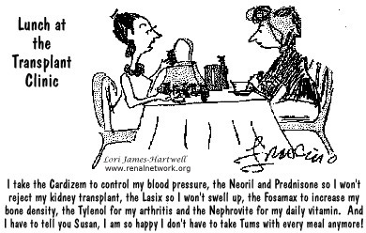

Slide 66
Multiple myeloma
Kidney injury results from:
  dehydration
  hypercalcemia
  hyperuricemia
  nephrotoxic drugs (eg, nonsteroid anti-inflammatory drugs, antibiotics, and contrast media)
  toxic effects of monoclonal light chains
  myeloma cell infiltration
  hyperviscosity
  cast nephropathy
  amyloidosis
  monoclonal deposition disease
III
Dimopoulos et al. J Clin Oncol 28:4976-4984, 2010.

Slide 67
Multiple Myeloma
Cast nephropathy
  main cause of kidney injury (90% of cases)
  characterized by tubular atrophy and tubular-interstitial fibrosis
  presents as acute oliguric renal failure often associated with significant dehydration
  massive cast deposition in distal and mainly in proximal tubules
Amyloidosis
  Fibrillar deposits with positive Congo red staining
Monoclonal immunoglobulin deposition disease (MIDD)
  Glomerular deposits of immunoglobulin light or heavy chains
  Nonfibrillar depositis that are negative for Congo red staining
III
Dimopoulos et al. J Clin Oncol 28:4976-4984, 2010.

Slide 68
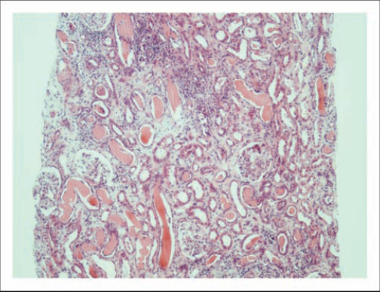
Cast Nephropathy
III
Cockwell and Hutchison. Curr Opin Nephrol Hypertens 19:550–555; 2010.

Slide 69
Initial RCTs
Author (yr) | Design | Outcome
Zucchelli P et al. Kidney Int.. 33:1175-80;1988. | 29 pts, 24 on dialysis at entry Group I (15 pts → PEX, steroids, cytotoxic drugs, and HD prn) Group II (14 pts → PD, steroids, cytotoxic drugs | Group I→ 13 of 15 patients recovered renal function Group 2→ 2 of 14 able to stop dialysis One-year survival rate was significantly higher in Group I (66%) than in Group 2 (28%, P<0.01).
Johnson et al. Arch Intern Med. 150: 863–869; 1990. | 21 pts, 12 on dialysis. Group 1 (11 pts→PEX) Group 2 (10 pts→no PEX) | No differences in the overall renal recovery rate (control 50% vs PEX 64%, P=NS) For the 12 pts on dialysis at entry, renal recovery occurred only in those getting PEX.
III

Slide 70
RCT of PEX in AKI associated with multiple myeloma
Objective: To assess the effect of 5 to 7 plasma exchanges on a composite outcome in patients with acute renal failure at the onset of multiple myeloma.
Design: Randomized, open, controlled trial, stratified by chemotherapy and dialysis dependence, conducted from 1998 to 2004.
Setting: Hospital plasma exchange units in 14 Canadian medical centers.
Participants: 104 patients between 18 and 81 years of age with acute renal failure at the onset of myeloma.
Intervention: Study participants were randomly assigned to conventional therapy plus 5 to 7 plasma exchanges of 50 mL per kg of body weight of 5% human serum albumin for 10 days or conventional therapy alone. Ninety-seven participants completed the 6-month follow-up.
III
Clark et al. Ann Intern Med. 143:777-784; 2005.

Slide 71
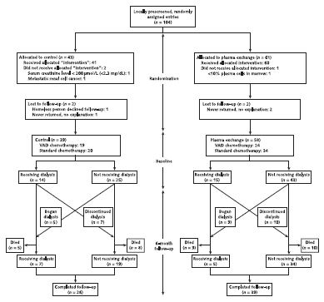
III
Clark et al. Ann Intern Med. 143:777-784; 2005.

Slide 72
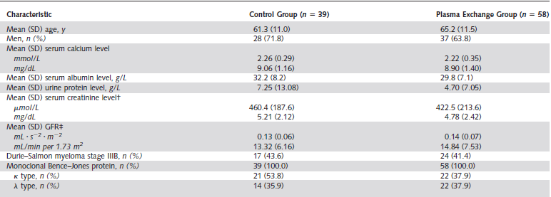
Table 1: Demographics
III
Clark et al. Ann Intern Med. 143:777-784; 2005

Slide 73
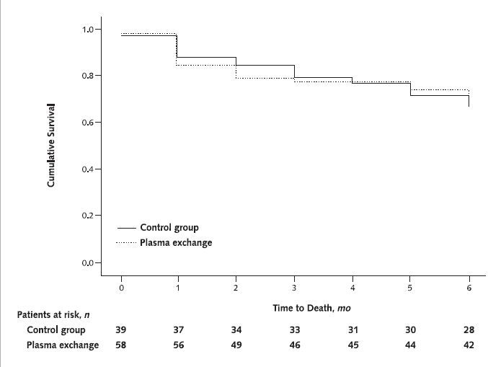
Cumulative Survival
III
Clark et al. Ann Intern Med. 143:777-784; 2005.

Slide 74
Limitations
Study not adequately powered
Composite outcome which disadvantaged PEX because patient who died with improved renal function and and those with eGFR <30 ml/min/1.73m2 were considered failures.
No renal biopsy to verify cast nephropathy as etiology of renal dysfunction
No method was employed to assess the adequacy of treatment (eg. decrease in serum free light chains
III
Leung et al. Kidney Int. 73:1282–1288; 2008.

Slide 75
But then…in 40 patients
Positive renal response was defined as a decrease by half in the presenting serum creatinine and dialysis independence.
No baseline differences were noted between eventual renal responders and non-responders.
Three quarters of the patients with biopsy proven cast nephropathy (n=18) resolved their renal disease when the free light chains present in the serum were reduced by half or more but there was no significant response when the reduction was less.
The median time to a response was about 2 months.
III
Leung et al. Kidney Int. 73:1282–1288; 2008.

Slide 76
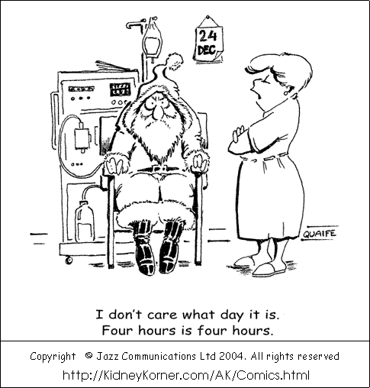

Slide 77
Complications of PEX
Death (incidence 0.05%)
Citrate-induced hypocalcemia
  Perioral or distal extremity tingling or paresthesia
  Give calcium gluconate 1 g IV and calcium carbonate PO
Depletion coagulopathy with albumin
Thrombosis with albumin
  Depletion of anticoagulant factors
Kaplan. AJKD. 52:1180-1196, 2008.

Slide 78
Complications of PEX
Infection
  Viral transmission with FFP
  Depletion of immunoglobulins with albumin
  May require infusion of IVIG
Anaphylactoid reactions to FFP
  Fever, chills, urticaria, wheezing, hypotension
Atypical reactions to ACE inhibitors
  Associated with use of Prosorba column
AJKD. 52:1180-1196, 2008.

Slide 79
Complications of PEX
Hypokalemia
  Low potassium content of albumin
Alkalosis due to citrate
Aluminum toxicity
  High aluminum content in albumin solutions
Vitamin removal transiently
Chills and hypothermia if replacement fluid not adequately warmed
Hypotension (incidence 1.7%)
Drug removal
AJKD. 52:1180-1196, 2008.

Slide 80
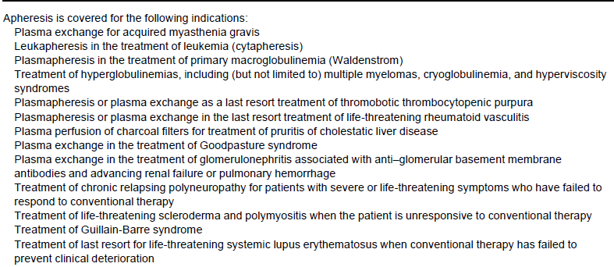
Medicare Reimbursement for PEX
Kaplan. AJKD. 52:1180-1196, 2008.

Slide 81
The End

Slide 85
Historic perspective
First performed at Johns Hopkins in 1914 by Abel, Rowntree, and Turner
Called “vivi-diffusion” and demonstrated that the blood of a living animal could be dialyzed and returned to the circulation
Schwab and Fahey performed first therapeutic plasmapheresis in 1960 to treat macroglobulinemia
Transfus Sci 11(2): 164-177; 1990
N Eng J Med 263:574-579;1960

Slide 86
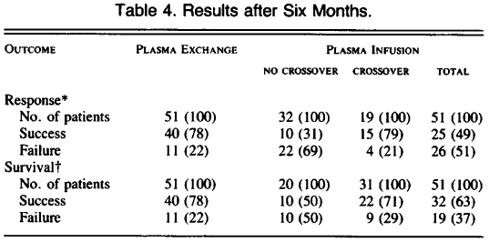
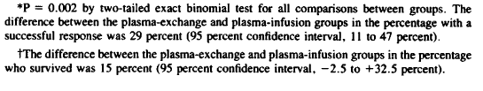
Results
I
Rock et al. N Engl J Med 325:393-397;1991.

Slide 87
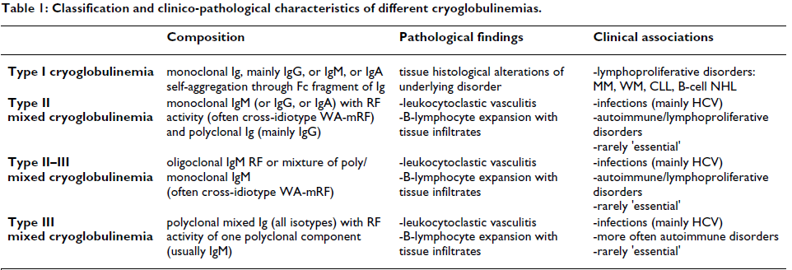
Orphanet Journal of Rare Diseases. 3:25, 2008

Slide 88
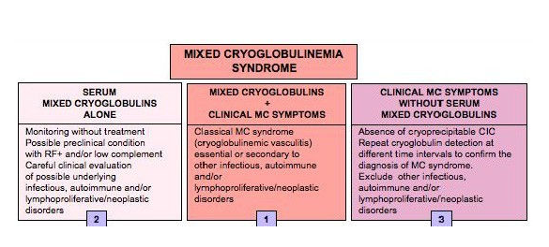
Orphanet Journal of Rare Diseases. 3:25, 2008

Slide 89
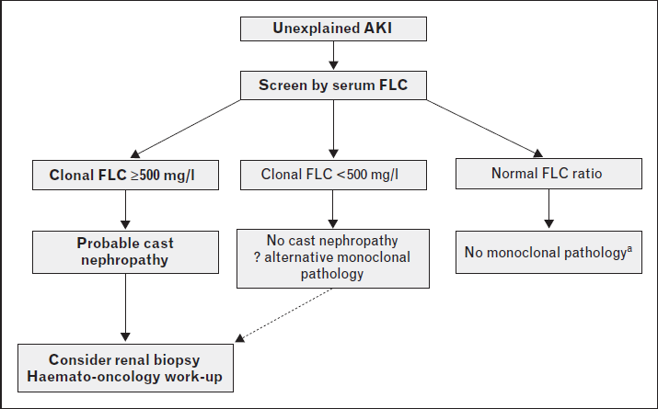
Curr Opin Nephrol Hypertens 19:550–555, 2010.

Slide 90
Kidney Int. 1988 Jun;33(6):1175-80.
Controlled plasma exchange trial in acute renal failure due to multiple myeloma.
Zucchelli P, Pasquali S, Cagnoli L, Ferrari G.
Source
Department of Nephrology, Malpighi Hospital, Bologna, Italy.
Abstract
We studied 29 patients affected by acute renal failure due to multiple myeloma with Bence-Jones proteinuria greater than 1 g/day to evaluate the effectiveness of plasma exchange in the treatment of severe myeloma nephropathy. Renal failure was severe enough to require dialysis in 24 cases, while the remaining 5 patients showed serum creatinine levels greater than 5 mg/dl. The patients were randomly allocated to Group I (15 patients undergoing plasma exchange together with corticosteroids, cytotoxic drug, hemodialysis only when needed) or to Group II (14 patients undergoing peritoneal dialysis together with corticosteroids and cytotoxic drug). In Group I Bence-Jones proteinuria decreased dramatically (P less than 0.01) with a significant increase in urine output (P less than 0.001), while Group II presented a slight reduction in Bence-Jones proteinuria without a significant increase in daily diuresis. Thirteen out the 15 Group I patients recovered renal function reaching serum creatinine levels less than or equal to 2.5 mg/dl in most cases. Only two patients in Group II improved renal failure well enough to stop dialysis. The one-year survival rate was significantly higher in Group I (66%) than in Group II (28%, P less than 0.01). We conclude that plasma exchange associated to chemotherapy rapidly removes large amounts of light chains, improves both renal function and long-term survival expectancies.

Slide 91
Am J Nephrol. 1999;19(1):45-50.
Plasma exchange in rapidly progressive renal failure due to multiple myeloma. A retrospective case series.
Moist L, Nesrallah G, Kortas C, Espirtu E, Ostbye T, Clark WF
Source
Division of Nephrology, Department of Medicine, University of Western Ontario, London, Ont., Canada. lmoist@julian.uwo.ca
Abstract
BACKGROUND/AIMS:
To evaluate the effect of plasma exchange on renal function in patients with rapidly progressive renal failure secondary to multiple myeloma.
METHODS:
The study was done through a retrospective chart review using a standardized form at a tertiary care centre in southwestern Ontario. Patients were included in the study if they had a diagnosis of multiple myeloma and rapidly progressive renal failure. Multiple myeloma was defined by a bone marrow aspirate >15% plasma cells plus one of the following: serum monoclonal paraproteins, monoclonal light-chain excretion, or lytic lesions. Patients were excluded if they had evidence of chronic renal failure or failed to complete three plasma exchanges. Twenty-six patients were reviewed; of these 24 were followed up to 1 year. All patients received hydration, standard chemotherapy, and plasma exchange. The plasma exchange volume was 50 ml/kg of 50% normal saline and 50% human serum albumin. Primary outcome measures included (1) prevention of acute dialysis and (2) prevention of progression from acute to chronic dialysis; secondary end points included (1) a decrease in creatinine of 25% or more within 3 months of the last plasma exchange and (2) survival at 1 year.
RESULTS:
Sixteen of 24 patients, followed up to 1 year, did not require dialysis. Two patients required dialysis initially, but were able to come off dialysis after 3 months. Fourteen patients were alive at 1 year, 13 of whom were dialysis independent. Twelve of 13 dialysis-independent patients had a >25% reduction in creatinine at 3 months. Two patients were lost to follow-up after discharge and were not included in the analysis.
CONCLUSIONS:
This retrospective study suggests that plasma exchange may offer some benefit in preventing the initiation or continuation of dialysis in patients with rapidly progressive renal failure secondary to multiple myeloma. A randomized controlled prospective study is needed to determine whether plasma exchange should be recommended as a standard treatment for patients with rapidly progressive renal failure due to multiple myeloma

Slide 92
Am J Kidney Dis. 1994 Jun;23(6):817-27.
Therapeutic plasma exchange: complications and management.
Mokrzycki MH, Kaplan AA.
Source
Department of Medicine, University of Connecticut School of Medicine, Farmington.
Abstract
Therapeutic plasma exchange is a treatment modality used in a variety of disease states, some of which are characterized by renal involvement (ie, Goodpasture's syndrome, multiple myeloma, cryoglobulinemia, and thrombotic thrombocytopenic purpura). To investigate the safety of this procedure we evaluated all patients receiving plasma-pheresis at the University of Connecticut from January 1988 to June 1991. Sixty-eight adverse reactions occurred in 699 treatments, resulting in an incidence of 9.7%. The most frequent complications were symptoms of hypocalcemia, hypovolemia, and anaphylactoid reactions. The incidence of hypocalcemic symptoms was lowered with the prophylactic administration of calcium. Without calcium prophylaxis the incidence of symptoms was 9.1% (six in 66 treatments), whereas with calcium prophylaxis the incidence was reduced to 1% (six in 633 treatments) (P < 0.01). Treatments in which albumin was administered as volume replacement were associated with fewer adverse reactions when compared with those using fresh-frozen plasma (1.4% v 20%). Our experience, combined with the 15,658 procedures reported in the literature, reveals that serious complications do not commonly occur. These are characterized by cardiovascular events (0.2%), respiratory events (0.2%), and anaphylactoid reactions (0.25%). Hemorrhage and infection are rare, each occurring at a rate of 0.02%. Death was reported in eight of 15,658 procedures (0.05%). We conclude that therapeutic plasma exchange is relatively safe and alterations in plasma proteins generally are well tolerated. Prophylactic calcium administration lowers the incidence of hypocalcemic symptoms. Adverse reactions are associated more commonly with the administration of fresh-frozen plasma.

