Slide 1
Renal Disease and Pregnancy
Robert Egerman, MD

Slide 2
Major points:
It’s preeclampsia until proven otherwise
Fetal reference not deference
More frequent evaluations/visits

Slide 4
Historical perspective

Slide 6
MMWR 2003

Slide 7
MMWR 2003

Slide 8
MMWR 2003

Slide 9
Case: 245.0
26 yof P0 at 24 weeks’ gestation
Confused, lethargic, febrile for 8 hours
T102 P130 BP 150/70 FHR 180
Difficult to arouse
Hyperdynamic precordium, Basilar crackles
Uterine contractions

Slide 10
Attribution / stereotyping

Slide 11
Attribution / Stereotype
Creating a stereotype (of the patient) in your mind and attributing symptoms and findings to the stereotype
Mrs. T is a complainer with abd. cramps
(and symptoms are viewed in this light)
Ms. V is a drug seeker with N/V/pain

Slide 12
Availability

Slide 13
Availability
Tendency that an easily remembered prior experience (diagnosis) explains the situation we are facing and immediately available to repeat
Ms. R. had reflux
Ms. H. has reflux
Mrs. S has ligamentalgia

Slide 14
Anchoring

Slide 15
Anchoring
Tendency to seize on the first symptom; “anchoring” the diagnosis
snap judgment may be right, but can lead us astray
Substernal chest pain is reflux
Lower abdominal pain is ligamentalgia

Slide 16
Case: 646.7
23 yof P2 at 34 weeks
Decreased fetal movement
Nausea, emesis for 3 days
T98 P100 BP 140/80 FHR 0
Cr 2.7 mg/dL
Glucose 51 mg/dL
INR 3

Slide 17
Overview
General aspects
Physiologic changes
Preeclampsia
AFL
AFE
Chronic renal disease

Slide 18
Motherisk.org [University of Toronto]

Slide 19
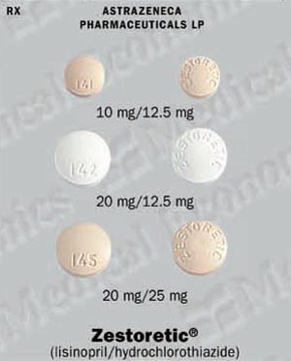
Review of Medications

Slide 20
Genetic issues
http://www.snof.org/maladies/tay.html
http://www.stanford.edu/class/psych121/humangenome-CF.htm

Slide 21
H₂O + CO₂ H₂CO₃ H⁺ + HCO₃⁻
40
30
24
18

Slide 22
Maintenance of Renal Blood Flow
Estrogen
Aldosterone
ACE
Angio AI AII
Renin

Slide 23
144
110
4
144
3.1
14
1.4

Slide 24
Physiology of Calcium and Pregnancy

Slide 25
Physiology of Calcium and Pregnancy

Slide 26
Physiology of Calcium and Pregnancy
Goal: get Ca++ to the fetus
Increase bone resorption
Increase intestinal absorption
Non PTH mediated: PTH levels are ____
PTHrP
Causes increase in 1,25 OH Vitamin D
See increase intestinal absorption by 12 weeks
See increase in hypercalciuria

Slide 27
Physiology of Calcium and Pregnancy- What happens to. . .?
Calcium levels in pregnancy
Ionized calcium levels
Albumin
Phosphate
25 OH Vit D
1,25 OH Vit D
PTH
Calcitonin

Slide 28
Physiology of Calcium and Pregnancy- What happens to. . .?
Calcium levels in pregnancy lower
Ionized calcium levels same
Albumin lower
Phosphate same
25 OH Vit D same
1,25 OH Vit D higher
PTH lower
Calcitonin higher

Slide 29
Physiology of Calcium and Pregnancy- What crosses the placenta?
Calcium
25 OH Vit D
1,25 OH Vit D
PTH
Calcitonin

Slide 30
Physiology of Calcium and Pregnancy-
So what makes PTHrP?
Placenta
Decidua
Amnion
Umbilical cord
Fetal parathyroid
Breast tissue
COOH terminal portion of PTHrP- osteostatin
May protect maternal bones

Slide 31
Hypertension and pregnancy
Chronic hypertension
Gestational hypertension
Preeclampsia
Mild
Severe
HELLP
Superimposed preeclampsia

Slide 32
Preeclampsia
Mild
systolic > 140 - 159 mmHg
diastolic > 90 - 109 mmHg
proteinuria > 0.3 - 4.9 gm / 24 hour
Severe
systolic > 160 mmHg
diastolic > 110 mmHg
proteinuria > 5 grams / 24 hour
or. . .

Slide 33
Complications of Preeclampsia
Cardiovascular
Severe hypertension/ pulmonary edema
Renal
Oliguria/ renal failure
Hematologic
Hemolysis/ thrombocytopenia
Hepatic
Rupture/ hepatocellular dysfunction
Neurologic
Eclampsia/ cerebral edema/ CVA
Uteroplacental
Abruption/ IUGR/ distress/ death

Slide 34
Preeclampsia:
Sibai, Obstet Gynecol 2005

Slide 35
Perinatal outcomes – Gestational Hypertension
Severe Gestational HTN vs Severe Preeclampsia
Outcome | Relative risk | 95% CI
Delivery <37 wks | 0.81 | 0.53-1.24
Delivery <35 wks | 0.7 | 0.32-1.56
SGA infant | 1.83 | 0.56-5.71
Abruption | 0.63 | 0.07-5.69
LGA infant | 1.87 | 0.28-12.49
NICU admissions | 0.55 | 0.23-1.31
RDS | 0.75 | 0.21-2.63
Buchbinder, Am J Obstet Gynecol 2002

Slide 36
Hypoxia
sFlt
Maternal spiral artery
Trophoblast
Preeclampsia
Normal
Notes:
Attempting to reach a low resistance low capacitance state

Slide 37
Endothelial dysfunction
Endoglin
TGF Β
Hypertension Renal dysfunction Capillary leak Edema
VEGF
PGF
sFlt
VEGF
PGF
sFlt
sFlt

Slide 38
Williams, N Engl J Med 2005

Slide 39
pg/ml
N = 102
N = 71
N = 29
N = 26
N = 14
N = 9
Adapted from Levine, N Engl J Med 2004

Slide 40
sFlt-1 and SLE
52 patients with SLE
9 with preeclampsia and 9 superimposed
Increased sFlt-1 with preeclampsia:
1768 + 196 pg/mL vs 1177 + 143 pg/mL p = 0.02
No association with SLEDAI
{commercial kit under development}
(Gestational age at sampling 22-32 weeks)
Qazi, J Rheumatol 2008

Slide 41
Postpartum preeclampsia
3988 patients-229 (5.7% pp);
151 patients 16% eclampsia,
6% pulm edema, 1.3% VTE, 1 death
Readmit 1-24 days (mean 7);
headache 62%, visual change 19%, SOB 13%, seizures 11%
Matthys, Am J Obstet Gynecol 2004

Slide 42
Preeclampsia and Calcium
Placental dysfunction
Decreased
1,25 (OH)2 D
Decreased calcium
Gut absorption
Decreased
Urine calcium
Decreased
Ionized calcium
Renin
JG cells
Increased PTH
HTN

Slide 43
Preeclampsia and Calcium
What’s going on?
PTH
PTHrP
25 (OH) D
Receptor
1,25 (OH)2 D
Calcium
T-lymphocytes
Receptor
PREECLAMPSIA

Slide 44
Preeclampsia and Calcium
CPEP Trial- 2 gm 13-21 weeks
Levine, N Engl J Med 1997

Slide 45
Preeclampsia and Calcium
WHO Trial-
1.5 grams < 20 weeks
Villar, Am J Obstet Gynecol 2006

Slide 46
Preeclampsia and Calcium
Cochrane Review 2006
Randomized trial 1 gram vs placebo
11/12 studies 14,946 RR HTN 0.7 (0.57-0.88)
12/12 studies 15,206 RR preecl 0.5 (0.33-0.69)
4 studies 9732 RR composite 0.8 (0.65-0.97
Benefit is in patients on low Ca++ diet

Slide 47
Preeclampsia and MgSO4
10,141 women randomized to MgSO₄ or placebo
Mg Placebo
(5055) (5055)
Severe preeclampsia 26% 27%
BP at entry
Syst >170 bpm 16% 16%
Dias >110 bpm 22% 23%
Eclampsia 40 (0.8%) 96 (1.90%) 0.42 (0.29-0.6)
Death 11 (0.2%) 20 (0.4%) 0.55 (0.26-1.14)
Magpie, Lancet 2002

Slide 48
Perinatal outcomes - CHTN
Chronic hypertension (n = 29,842) | Odds Ratio | 95% CI
Fetal growth restriction | 4.9 | 4.7-5.2
Low birth weight | 5.4 | 5.2-5.5
Preterm delivery | 3.2 | 3.1-3.3
Respiratory distress syndrome | 4.0 | 3.8-4.2
Gilbert, J Reprod Med 2007

Slide 49
Perinatal outcomes - CHTN
Chronic hypertension (n = 29,842) | Odds Ratio | 95% CI
Maternal death | 4.8 | 3.1-7.6
Fetal death | 2.3 | 2.1-2.6
Neonatal death | 2.3 | 2.0-2.7
Stroke maternal | 5.3 | 3.7-7.5
Severe preeclampsia | 2.7 | 2.5-2.9
Pulmonary edema | 5.2 | 3.9-6.7
Renal failure | 6.0 | 4.4-8.1
Abruption | 2.1 | 2.0-2.3
Gilbert, J Reprod Med 2007

Slide 50
Perinatal outcomes - CHTN
Chronic hypertension | Mild | Severe
Preeclampsia | 25% | 50 - 75%
Abruption | 1.5% | 10 – 20%
SGA | 11% | 25 – 40%
Sibai, JAMA 2007, Obstet Gynecol 2002 and NEJM 1998

Slide 51
Perinatal outcomes- Preeclampsia + CHTN
 | Superimposed Preeclampsia (n = 180) | Chronic hypertension (n = 642) | Risk Ratio (95% CI)
Early onset preecl | 79 (44%)
Preterm < 34 weeks | 42 (23%) | 48 (7%) | 3.12(2.13-4.56)
Inpatient days Mean, SD | 12.7 (9.3) | 5.4 (7.0) | 7.2 (5.8-8.7)
Antenatal days | 7.3 (7.9) | 2.3 (5.9) | 5.0 (3.7-6.2)
Postnatal days | 5.5(3.7) | 3.2 (2.6) | 2.3 (1.7-2.8)
Antenatal death | 5 (3%) | 12 (2%) | 1.11 (0.41-3.00)
Chappell, Hypertension 2008

Slide 52
Perinatal outcomes- Preeclampsia + CHTN
 | Superimposed Preeclampsia (n = 180) | Chronic hypertension (n = 642) | Risk Ratio (95% CI)
IVH | 6 (3%) | 3 (0.5%) | 7.13 (1.80-28.2)
< 10% Birth weight | 87 (48%) | 137 (21%) | 2.30 (1.85-2.84)
NICU admission | 64 (35%) | 77 (12%) | 2.98 (2.24-3.98)
Birth weight (kg) | 2.65 (1.84-3.34) | 3.29 (2.88-3.70) | -0.65 (-0.81- 0.48)
Birth centile | 14.0 (0.1-59.3) | 39.0 (13.7-73.5) | -24.8 (-34.5 -15.1)
Chappell, Hypertension 2008

Slide 53
Imitators of Preeclampsia
HELLP TTP/HUS AFLP
HTN ++ +/- +/-
Prot. Urine +++ +++ +/-
Platelets << <<< <<
Anemia + ++ +/-
Bilirubin > >> >>
AST >> +/- >>
Fibrinogen = = <
Ammonia = = +
Glucose = = <
Egerman, Clin Ob Gyn 1999

Slide 54
Preeclampsia in pregnancies complicated by SLE: with & without chronic hypertension
Egerman, Am J Obstet Gynecol 2005

Slide 55
Preeclampsia versus Flare
Both may have hypertension and renal involvement and thrombocytopenia
Preeclampsia typically does not have an active urinary sediment
Complement levels and anti DNA antibodies are unchanged in preeclampsia
Preeclampsia can be superimposed on other disorders

Slide 56
Why consider expectant management? Benefits
Fetal
Maternal
Decreased PNM
Improved neurologic
and pulmonary outcomes
Decreased LOS
None

Slide 60
Preeclampsia
Management of Severe Preeclampsia
< 23 weeks 23 to 32 - 34 weeks > 34 weeks
MgSO₄, Deliver and control BP
MgSO₄, Steroids and control BP
MgSO₄, Deliver and control BP

Slide 61
A protocol for management of severe preeclampsia - second trimester
 | Conservative | Aggressive | p
Admit gestation | 26.2 | 26.0 | < 0.0001
Delivery gestation | 28 | 26.3 | < 0.0001
Prolongation days | 13 | 2 | < 0.0001
Birthweight | 880 | 709 | < 0.0001
NICU days | 70 | 115 | < 0.02
Sibai, Am J Obstet Gynecol 1990
Notes:
Retrospective: 109 patients, (1985 - 1989)
(25) ≤ 24 wks; 10 terminations, of the 15 for conservative management, 6.7% survival
(84) > 24 – 27 wks
(30) immediate delivery
(54) Expectant
Similar HELLP, eclampsia, abruption, SGA, RDS, NEC, fewer IVH in conservative group

Slide 62
Aggressive vs expectant management for severe preeclampsia 28-32 weeks
 | Conserv-ative N = 49 | Aggressive N = 46 | p
Prolongation | 15.4 | 2.6 | < 0.0001
Delivery gestation | 32.9 | 30.8 | < 0.004
Birth weight | 1622 | 1233 | < 0.0004
NICU admissions | 76 | 100 | 0.002
RDS (%) | 22.5 | 50 | 0.002
SGA (%) | 30 | 11 | 0.04
NICU days | 20.2 | 36.6 | < 0.0001
Sibai, Am J Obstet Gynecol 1994

Slide 63
Corticosteriod therapy for prevention of RDS in severe preeclampsia
 | RR | CI
RDS | 0.53 | 0.35-0.82
IVH | 0.35 | 0.15-0.86
PDA | 0.27 | 0.08-0.95
Neonatal mortality | 0.5 | 0.28-0.89
Amorim, Am J Obstet Gynecol 1999
Notes:
Prospective, randomized: 218 severe preeclampsia, 26 - 34 weeks, 1997-1998
110 randomized to betamethasone 12mg q 24 hrs 2 doses
108 placebo
Average gestational age 29.6 weeks

Slide 64
Case 2: 673.13
30 yof P1 at 34 weeks’ gestation, breech, active labor
Taken to OR for C/S under regional anesthesia. Upon delivery of the fetus, experiences a tonic clonic seizure and becomes cyanotic
She is quickly intubated and ventilated with noticeable difficulty. Cardiac rhythm becomes sinus bradycardia which, after 1 minute, deteriorates into pulseless electrical activity

Slide 65
Anaphylactoid syndrome of pregnancy
Pulmonary hypertension
Right heart failure
Left heart failure
Hypoxemia
(profound shunt)
ARDS
Neurologic damage
Coagulopathy
Aurangzeb, Crit Care Clin 2004
Moore, Crit Care Med 2005

Slide 66
Anaphylactoid syndrome of pregnancy
Moore, Crit Care Med 2005

Slide 67
Anaphylactoid syndrome of pregnancy
IVF
Vasopressors
PA catheter
Hydrocortisone
Arteriovenous extracorporeal membrane oxygenation with intra aortic balloon counterpulsation {Hsieh, Am J Obstet Gynecol 2000}
Continuous hemodiafiltration {Kaneko, Int Med 2001}
Cardiopulmonary bypass {Stanten, Obstet Gynecol 2003}
Recombinant Factor VII (60 mcg/kg) {Prosper, Obstet Gynecol 2007}
? Inhaled Prostacycline or NO

Slide 68
23 yof P2 at 34 weeks
Decreased fetal movement
Nausea, emesis for 3 days
T98 P100 BP 140/80 FHR 0
Cr 2.7 mg/dL
Glucose 51 mg/dL
INR 3

Slide 69
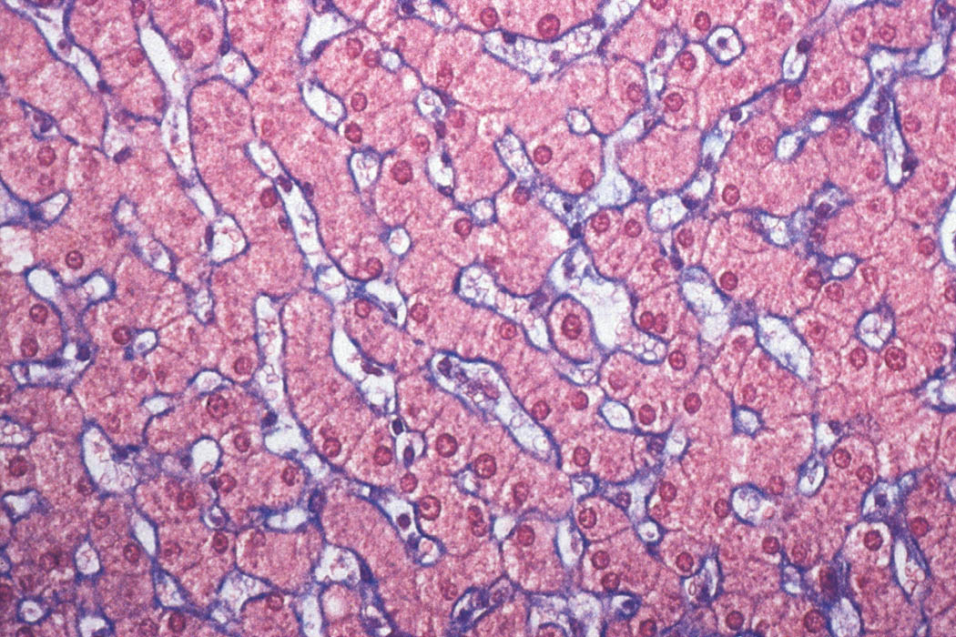
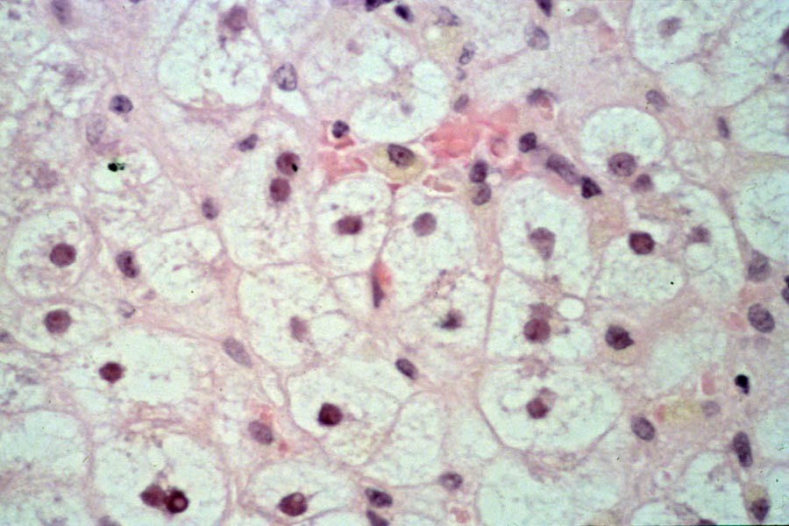
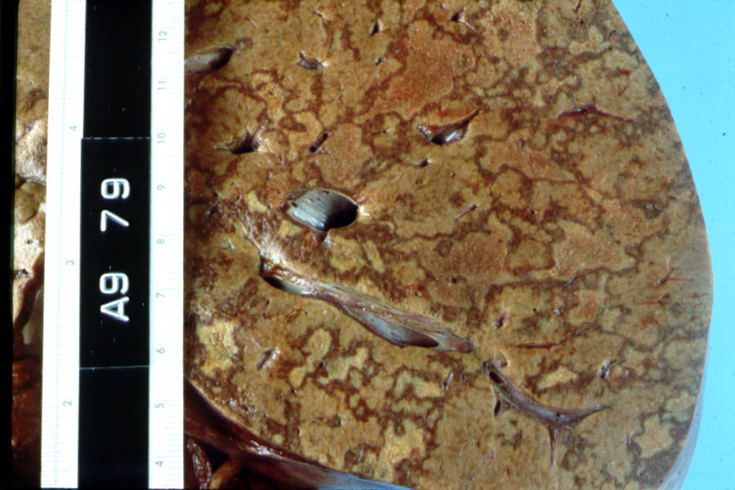

Slide 70
Acute fatty liver of pregnancy
Frequency 1 / 13,000 deliveries (mean 34 wks, 28-39)
Natural history death
Symptoms & Signs N / V, abdominal pain, jaundice
low glucose
prolonged PT / PTT
Treatment delivery (survival > 95%)
Associations tetracycline, erythromycin estolate
3-OH Acyl CoA dehydrogenase deficiency
Notes:
Problem with fatty acid oxidation

Slide 71
Imitators of Preeclampsia
HELLP HTN, Proteinuria
AFL Decr plts,
TTP Incr LFTs, Cr
SLE
DIC, Hypoglycemia, hyerammonemia
Decr ADAMTS 13

Slide 72
Progression of renal disease during pregnancy
Decline in function ESRD
(%) (%)
Mild
Cr < 1.5 mg/dL 16 < 5
Moderate
Cr 1.5 - 2.4 mg/dL 33 < 20
Severe
Cr > 2.5 mg/dL 50 35
Modified from
Jones, N Engl J Med 1996,
Cunningham, Am J Obstet Gynecol 1990

Slide 73
Renal disease during pregnancy and perinatal outcomes
Preterm SGA FDIU Preeclmp Live
(%) (%) (%) (%) (%)
Mild
Cr < 1.5 mg/dL 20 24 5 10 95
Moderate
Cr 1.5 - 2.4 mg/dL 50 35 16 40 85
Severe
Cr > 2.5 mg/dL 80 50 50 80 50
Dialysis > 90 > 90 50 75
Modified from
Jones, N Engl J Med 1996; Williams, BMJ 2008
Cunningham, Am J Obstet Gynecol 1990

Slide 74
Renal Disease and Pregnancy
Glomerulonephritis HTN, Rx
PCKD AD, aneurysm
Chronic infection Renal U/S, ABx
Congenital anomaly Renal U/S, ABx
Diabetic nephropathy Control BS, BP
SLE Rx
Periarteritis nodosa or Scleroderma

Slide 75
NKF Stages of Renal Dysfunction
Stage | GFR | Damage or Risk | Prevalence
1 | > 90 |  | 5,900,000
2 | 60 - 89 | Mild | 5,300,000
3 | 30 - 59 | Moderate | 7,600,000
4 | 15 - 29 | Severe | 400,000
5 | < 15 | Failure | 300,000

Slide 76
Blood pressure control
Determination for dialysis
Frequency of dialysis
Antenatal screening and testing
Observation for preeclampsia

