Slide 1
Case Conference
Hieu Vo
Fellow
UTHSC

Slide 2
Outline
2 Cases
Pathogenesis
Presentation
Diagnosis
Post-transplant
Treatment

Slide 3
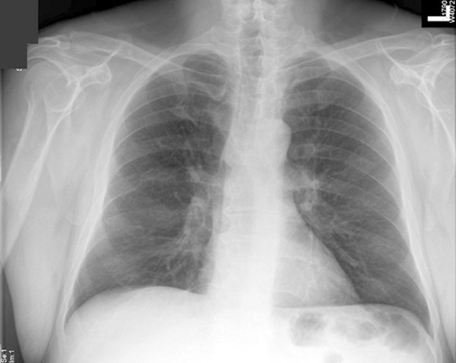

Slide 4
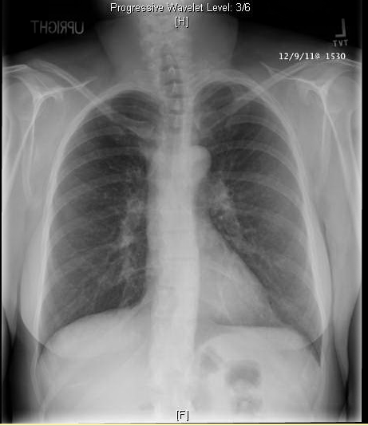

Slide 5
Case 1
a 39-year-old Caucasian female with history of FSGS from chronic vesicoureteral reflux, s/p living donor kidney transplant in 6/2010 with immediate allograft function, who is on Prograf 3 mg bid and Myfortic 540 mg bid , pred 5mg/day
She came to clinic after a 1-month history of not feeling well, flu-like, body aches, headache, night sweats. Negative for chest pain, palpitations, lightheadedness, dizziness, seizures,
1 week prior to admission, she has experienced fever as high as 102.3, SOB, nonproductive cough.
Seen in the transplant clinic, blood work was done, nothing given.
2 days later : seen by PCP who gave her an unknown dose of steroids, and advised her to come to theER if she is not feeling better by next week.
She called the transplant clinic and was advised to come to the hospital due to fever, cough, and shortness of breath.
Notes:
The patient also has a history of BK virus in her urine.
Oliver branch

Slide 6
PMH:
1. FSGS/ vesicoureteral reflux.
2. Hypothyroidism secondary to Graves disease, status post radioactive iodine in 2002.
3. GERD.
4. Anxiety and depression.
5. BK /urine.
6. Recurrent urinary tract infections.
PSH
1. Right nephrectomy in 1976 for reflux complications.
2. History of reimplantation of ureter bilaterally at the age of 9 months.
3. Left breast papilloma in 2009, status post resection.
4. Status post living donor kidney transplant in June 2010.
SOCIAL HISTORY: lives in MS, denies drinking, smoking, and use of illicit drugs.
No recent travel, no sick contact

Slide 7
MEDICATIONS
1. Prednisone 5 mg once a day.
2. Prograf 3 mg twice daily.
3. Myfortic 540 mg twice daily.
4. Microbid 400 mg once a day.
5. Aspirin 81 mg once a day.
6. Synthroid 127 micrograms once a day.
7. K-Dur 20 mEq once a day.
8. Multivitamin once a day.
9. Calcium carbonate with vitamin D 500 mg twice daily.
10. Magnesium oxide 3 times daily.
11. Vitamin D (cholecalciferol) 2000 units daily.
12. Xanax 25 mg once a day.
13. Celexa 20 mg once a day.

Slide 8
GEN: well-nourished , not in acute distress. She is alert and oriented.
100/67, PR 98 to 114, Temp 37.9.
HEENT: Normocephalic and atraumatic. Extraocular movements are intact. No scleral icterus. Dry mucous membranes. Pupils are equal, round, and reactive to light 2 mm.
NECK: Supple. No masses.
CHEST: Clear to auscultation bilaterally. No wheezes, rales, or rhonchi. Symmetric air movement.
CARDIOVASCULAR: Regular rate and rhythm. S1 and S2.
ABDOMEN: Soft, nontender, and nondistended. Status post surgery for kidney transplant with no tenderness over the graft area.
EXTREMITIES: No cyanosis, clubbing, or edema. Pulses are 2+. No skin lesions.
Neuro: no meningeal signs, no sinus tenderness

Slide 9
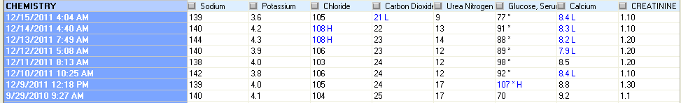
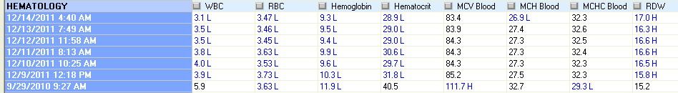
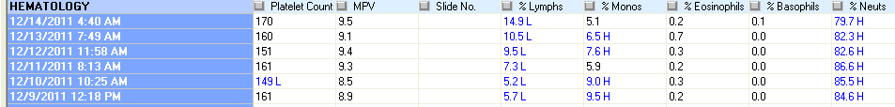

Slide 10
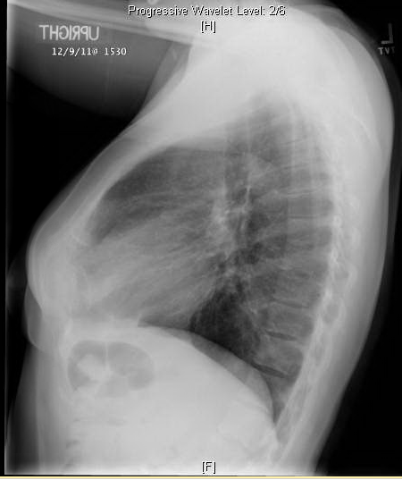
Notes:
interstitial process with reticular lung densities bilaterally, what appear to be small nodules.
To further characterize high-resolution CT of the chest may be of some benefit. If done, this should be done without contrast to include prone as well as supine imaging and thin sections for optimal assessment of the interstitium.

Slide 11
DDx
Atypical: mycoplasma, Legionella, chlamydia
PCP
Viral: influenza A, B, parainflu, adenovirus,RSV, rhinovirus, CMV
Histoplamosis, Blastomycosis, Coccidioidomycosis
Miliary TB
MAI
Lymphocytic interstitial pneumonitis
Bronchiolitis obliterans organizing pneumonia
Notes:
interstitial pneumonia
PCP= Bilateral diffuse symmetric finely granular / reticular interstitial / airspace infiltrates in 80% , central location , rapid progression to diffuse airspace disease

Slide 12
antibiotics : CAP vs HCAP?
ID : ok with avelox

Slide 13
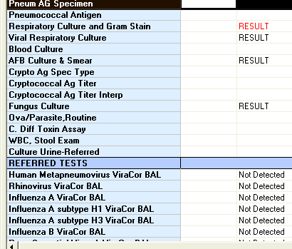
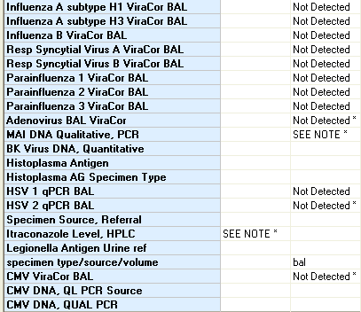
Notes:
GROUND-GLASS OPACITY IS NOTED IN THE LEFT UPPER LOBE ANTERIORLY. OTHERWISE, WIDELY SCATTERED RETICULAR NODULAR DENSITIES ARE NOTED THROUGHOUT BOTH LUNG FIELDS WITHOUT EVIDENCE OF PNEUMONIA OR EFFUSION. NO PULMONARY NODULARITY IS EVIDENT.
OPINION: MINIMAL GROUND-GLASS OPACITY IN THE LEFT UPPER LOBE WITH NO OTHER PULMONARY FINDINGS IDENTIFIED.
1. Alpha Hemolytic Streptococci < 1000 cfu/ml
2. Staphylococcus epidermidis < 1000 cfu/ml
Preliminary - December 14, 2011 10:48 AM -
No growth at 1 day.
GSR - December 13, 2011 6:16 PM -
WBCs seen.
No organisms seen.
Cytocentrifuge Prep

Slide 14
Viral Antigen Pool: negative
BAL GS: WBC, no organisms, Cx: ngtd
BAL AFB smear: negative, Cx: ngtd
BAL Fungus: ngtd
Serum crypto antigen: negative
Urine pneumococcal antigen: negative.
Urine legionella antigen: negative
CMV PCR: negative
Stool studies (O&P, C diff, WBC) are negative
Blood Cx: ngtd
Urine Histo antigen: moderately positive
Bronch, BAL, biopsy: non -caseating granuloma
traconazole suspension 200 mg po tid for 2 days then 200 mg po bid ,at least 6 months of Rx if response.
Notes:
Monitor itraconazole level, histoplasma AG urine and hepatic function

Slide 15
Case 2
A 59-year-old Caucasian male s/p deceased renal transplant in 2007 , HTN, Afib and COPD
SOB, cough, and wheezing : bronchodilators, steroids, antibiotics .
He did not improve and went into respiratory failure and was intubated …transferred to MUH
REVIEW OF SYSTEMS
Unobtainable due to intubation.
Notes:
During that hospital stay, his creatinine increased as well from baseline of 0.8 to 1.0 mg/dL.
Unsure if patient had contrast or hypotension during hospitalization in Delta Medical Center.

Slide 16
PAST MEDICAL HISTORY
1. Renal transplant in 2007
2. Atrial fibrillation, status post pacemaker placement.
3. COPD
4. Hypertension.
FAMILY HISTORY: Noncontributory.
SOCIAL HISTORY : ex-smoker, No recent travel, no sick contact
NKDA.

Slide 17
Calcium 600 mg.
Magnesium oxide 400-mg tablets p.o. b.i.d.
Potassium chloride 20 mEq daily.
Gabapentin 600 mg p.o. t.i.d.
Simvastatin 40 mg .
Fexofenadine 180 mg /day.
Amlodipine 5 mg .
Nexium 40 mg
Warfarin 3 mg
Citalopram.
Fish oil.
Lasix 40 mg by mouth daily.
Tacrolimus 2 mg bid.
Mycophenolate 500 mg bid

Slide 18
BP= 166/63, heart rate 78, respirations 19. Oxygen saturation 89%.
GEN: intubated.
HEENT: Pupils equal, round, reactive to light and accommodation bilaterally. Anicteric sclerae bilaterally. Head atraumatic.
RESPIRATORY: Clear to auscultation bilaterally.
CARDIOVASCULAR: Regular rate and rhythm. No murmurs, rubs, or gallops. No jugular venous distention.
ABDOMEN: Positive bowel sounds. Soft, nondistended. No hepatosplenomegaly appreciated.
EXTREMITIES: Mild pitting edema, bilateral lower extremities.
NEUROLOGICAL: Unobtainable due to sedation and intubation.

Slide 19
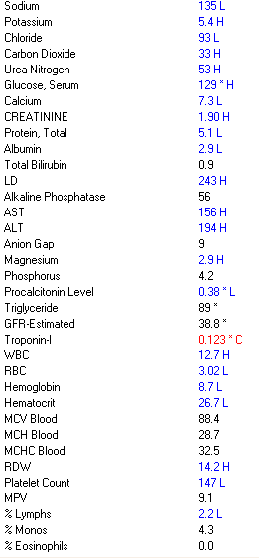
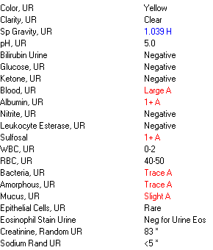

Slide 20
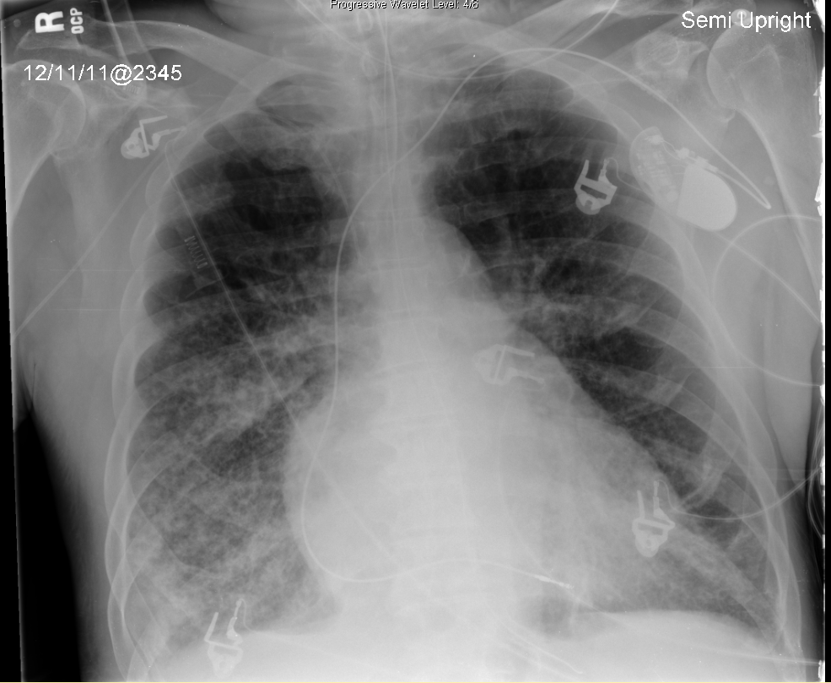

Slide 21
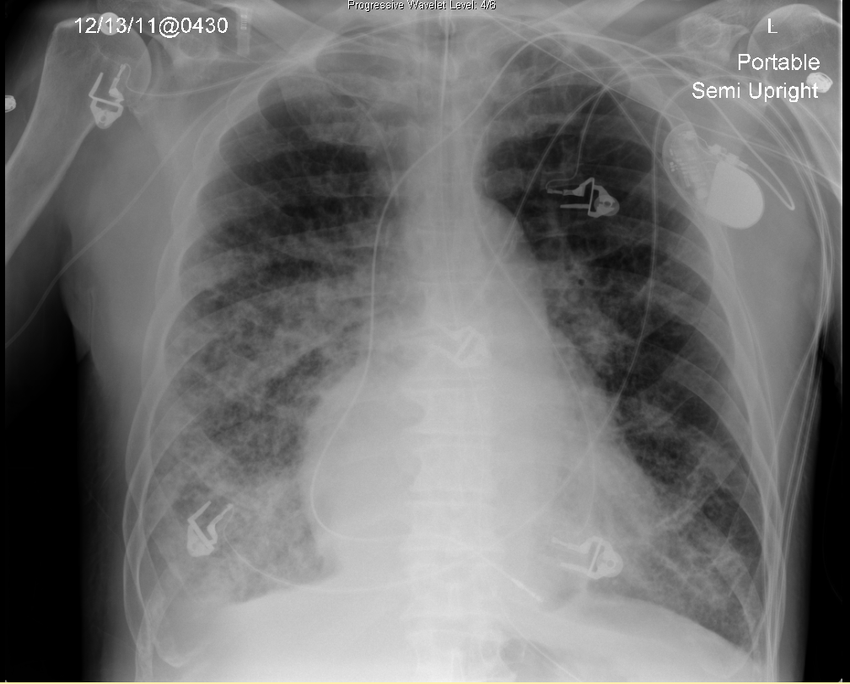

Slide 22
DDx
Atypical: mycoplasma, Legionella, chlamydia
PCP
Viral: influenza, parainflu, adenovirus, CMV
Histoplamosis, Blastomycosis, Coccidioidomycosis
TB
MAI
Lymphocytic interstitial pneumonitis
Bronchiolitis obliterans organizing pneumonia
Notes:
interstitial pneumonia
PCP= Bilateral diffuse symmetric finely granular / reticular interstitial / airspace infiltrates in 80% , central location , rapid progression to diffuse airspace disease

Slide 23
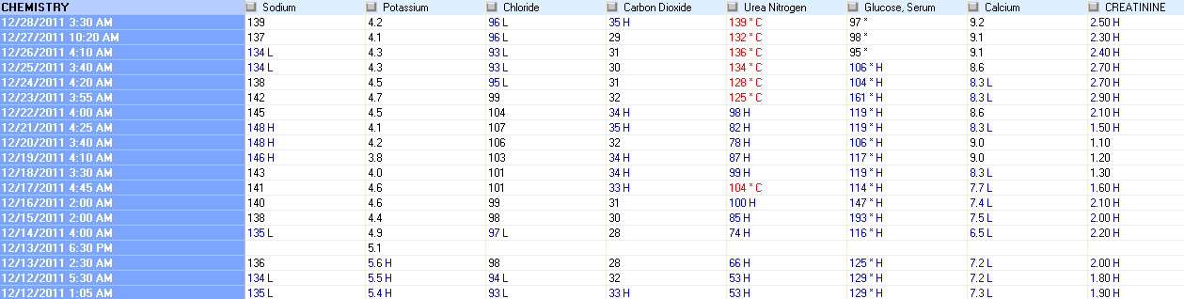

Slide 24
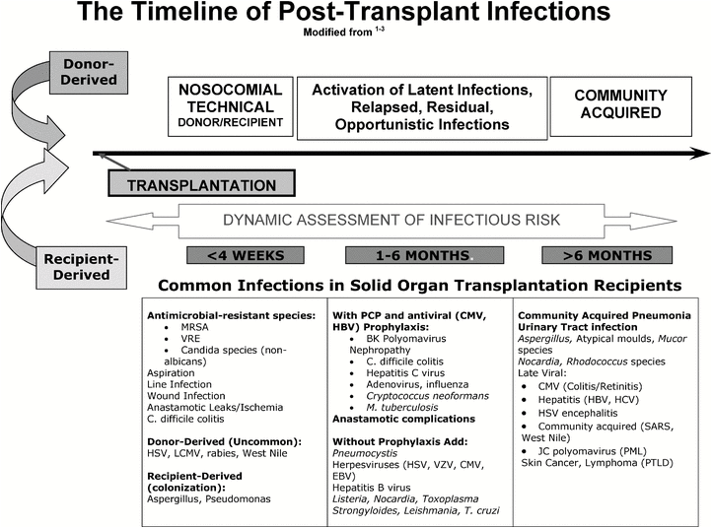
Notes:
In the first month posttransplant, there are 2 major causes of infection in all forms of solid organ transplantation: infection derived from either the donor or recipient and infectious complications of the transplant surgery and hospitalization. The major effects of exogenous immunosuppression are not yet evident. Exceptions include those patients who receive immunosuppression prior to transplantation (eg, for autoimmune hepatitis).
1-6 mos: This is the period when patients are most at risk for the development of opportunistic infections, although residual problems from the perioperative period can persist. There is significant geographic and institutional variation in the occurrence of opportunistic infections during the first six months posttransplantation. This reflects local epidemiology and varying immunosuppressive strategies and also the use of antimicrobial prophylaxis in the post-transplant period.
Prevention of the infections observed during this period is the basis of prophylactic antimicrobial strategies

Slide 25
Fever and Pulmonary infiltrates in immunocompromised pts
Multiple simultaneous infectious are common
Dual infection with Pneumocystis jirovecii and CMV, or
Superimposition of another process (lung injury or drug toxicity).
Sequential infection (eg, viral infection preceding bacterial or fungal infection) .
Most immunocompromised pts with any sign of possible invasive infection should be hospitalized for evaluation.
Early imaging (CT scan) and specific microbiologic diagnoses are essential.
Invasive procedures (biopsies and bronchoscopy) are often necessary to establish a microbiologic diagnosis.
Antimicrobial susceptibility testing and advanced diagnostic testing including immunohistology and quantitative molecular assays are essential components of the management of pneumonia in immunocompromised patients.
Empiric microbicidal therapy must be started ASAP
Reduction of the overall level of immune suppression may be as important as antimicrobial therapy in the ultimate success of treatment
Notes:
The importance of specific microbiologic diagnoses in the care of immunocompromised individuals cannot be over-emphasized.
therapy should be based upon the data that are available (epidemiologic history, sputum Gram stain, special stains, prior microbiologic data, previous courses of antimicrobial agents). Overly broad antimicrobial therapy can be modified based upon new microbiologic data.

Slide 26
Fever + Pulmonary infiltrates in immunocompromised pts
CAP:
same pathogens
often follows an infection caused by respiratory viruses, atypical pathogens, or CMV
These postviral infections : of greater severity, rapid onset of progression and high morbidity
The potential for antimicrobial resistance
Nosocomial: arise in pts with preexisting lung injury (COPD, bronchiectasis), during intubation, or following aspiration:
usually resistant gram-negative bacilli or fungi:
Klebsiella pneumoniae, Stenotrophomonas maltophilia, and Burkholderia cepacia are particularly resistant organisms that can colonize skin, catheters, endotracheal tubes, wound hematomas, and tracheal anastomoses
Notes:
Bacterial pneumonia in the immunocompromised host most often involves the same pathogens acquired in the community by immunocompetent hosts [8]. However, pneumonia in the immunocompromised patient in the community often follows an infection caused by respiratory viruses, atypical pathogens, or cytomegalovirus (CMV) . These postviral infections are of greater severity with rapid onset of progression and high morbidity. Knowledge of the local epidemiology of infection (eg, prevalence of metapneumovirus or influenza A in the community) may guide the approach to diagnosis and therapy

Slide 27
Fever and Pulmonary infiltrates in immunocompromised pts
Reactivation: CMV, strongyloidiasis, cryptococcosis, toxoplasmosis, or mycobacterial, histoplamosisis
Serologic testing for Strongyloides or Toxoplasma will generally demonstrate IgG antibodies consistent with prior exposure: IgG antibodies remain detectable for life.
Tuberculin skin testing : a 5 mm response
Environmental exposure:
contaminated water or air supply: Legionella pneumophila and Pseudomonas aeruginosa,nontuberculous mycobacteria
Soil : has been linked to infections with Aspergillus and Nocardia spp, or to Penicillium marneffei and Burkholderia pseudomallei in Southeast Asia.
Travel history is important in considering the risk of certain endemic fungi (Histoplasma, Coccidioides, Blastomyces)
Notes:
Immunocompromised patients can reactivate many latent infections, including cytomegalovirus, strongyloidiasis, cryptococcosis, toxoplasmosis, or mycobacterial, histoplasmosis infection, long after the initial exposure as a result of immune defects.
Knowledge of tuberculin skin testing (TST) prior to the development of immune compromise is helpful. If TST skin testing is performed, a 5 mm response is considered positive in most intensively immunocompromised patients
Unique epidemiologic risks (travel, gardening) must be considered.

Slide 28
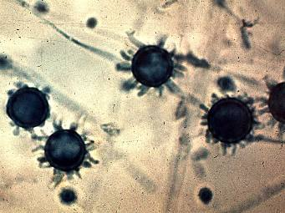
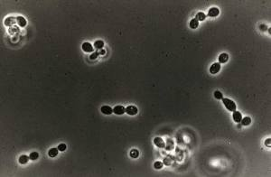
Histoplasmosis
First described in 1905 by Samuel Darling
macroconidia = tuberculate conidia= 8 -15 μm in diameter, a thick wall with distinctive projections on the surface;
microconidia : tiny, smooth structures 2- 5 μm in diameter
the infectious form: size is small enough to lodge in the terminal bronchioles and alveoli.
Thin walled oval yeast
Dimorphic:
  Mold in environment.
  Yeast in tissue
Notes:
At 37°C in vitro and in tissues, the organism converts into the yeast phase that is composed of tiny 2- to 4-m oval budding yeasts that are found both inside and outside macrophages. The organism is not encapsulated, although in tissues, it appears to be surrounded by a clear zone that was misinterpreted as being a capsule by Darling
Microconidia are small, smooth oval bodies with a diameter ranging from 2 to 5 μm : These forms are believed to be the infective phase because their size is small enough to
lodge in the terminal bronchioles and alveoli.

Slide 29
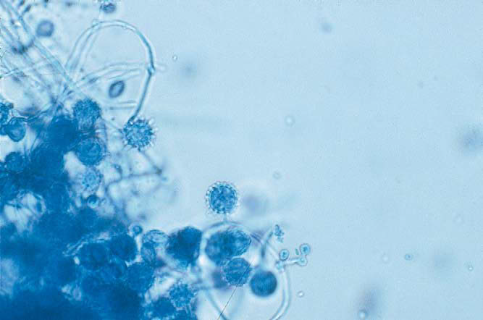
Notes:
Mycelial phase of Histoplasma capsulatum. Both macroconidia and microconidia are evident

Slide 30
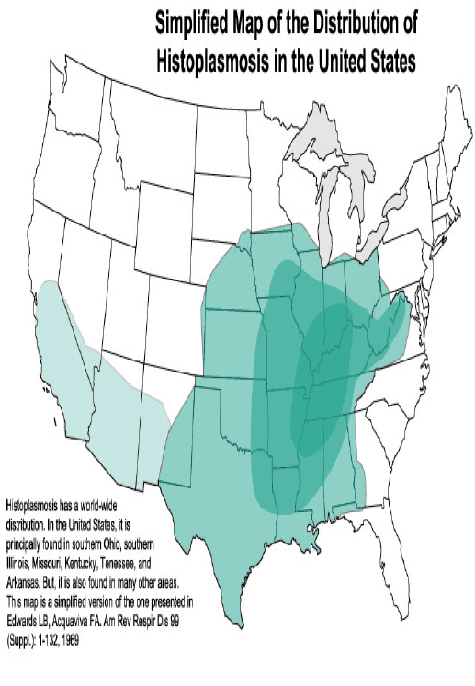
Notes:
Cases of histoplasmosis have been reported from every continent except Antarctica
Subsequent large-scale population studies by the Public Health Service defined the area where H. capsulatum is endemic (32) and demonstrated that over 80% of young adults from the states bordering the Ohio and Mississippi Rivers had been previously infected with H. capsulatum.

Slide 31
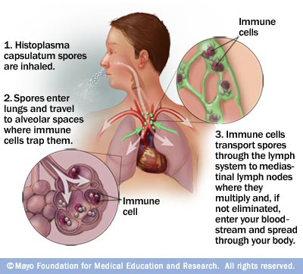
Notes:
The transition from the mycelial to the yeast phase is the most critical determinant in the establishment of infection. This contention is supported by several findings. First, it is rare to find mycelial particles in tissues of humans or mammals with established infection. Rather, yeast cells are commonly detected. Second, exposure of H. capsulatum mycelia to p-chloromercuriphenylsulfonic acid (PCMS), a sulfhydryl inhibitor, irreversibly blocks the conversion to yeasts but does not alter growth of yeasts or mycelia. PCMS-treated mycelia fail to infect
animals.
In addition to calcium, iron is another vital element required for survival of H. capsulatum. The organism can acquire iron from the intracellular environment by three means: release of iron scavenging siderophores, production of a ferric reductase, and modulating pH to remove iron from transferrin. α-1,3-Glucan has been found to be a key virulence factor in the pathogenesis of H. capsulatum.18 Synthesis of this carbohydrate, which is regulated by an amylase, and glucan appears to bind dectin-1 and thereby suppress generation of important proinflammatory cytokines.
After conidia settle into the alveoli, they bind to the CD11-CD18 family of integrins and are engulfed by neutrophils and macrophages.21 It is likely that the conversion of mycelia to the yeast phase transpires, at least partially if not entirely, intracellularly. The duration of the phase transition ranges from hours to days. Following transformation of the conidia into yeasts in the lungs, yeasts migrate, presumably intracellularly, to local draining lymph nodes and subsequently to distant organs rich in mononuclear phagocytes (e.g., liver and spleen). The yeasts grow readily within resting macrophages. Activation of cellular immunity is necessary for restricting growth, and in primary infection this arm of immunity matures by 2 weeks.

Slide 32
Pathogenesis
After microconidia settle into the alveoli, they bind to the CD11-CD18 family of integrins and are engulfed by neutrophils and macrophages.
On exposure to 37° C, microconidia undergoes genetic, biochemical, and physical alterations that result in the production of yeast cells that are uninucleate. The duration of the phase transition ranges from hours to days.
Yeasts migrate intracellularly to local draining lymph nodes and subsequently to distant organs rich in mononuclear phagocytes (e.g., liver and spleen). The yeasts grow readily within resting macrophages.
This transition from the mycelial to the yeast phase is the most critical determinant in the establishment of infection.
This contention is supported by several findings.
it is rare to find mycelial particles in tissues of humans or mammals with established infection. Rather, yeast cells are commonly detected.
Exposure of H. capsulatum mycelia to p-chloromercuriphenylsulfonic acid (PCMS), a sulfhydryl inhibitor, irreversibly blocks the conversion to yeasts but does not alter growth of yeasts or mycelia. PCMS-treated mycelia fail to infect animals.
Activation of cellular immunity is necessary for restricting growth, and in primary infection this arm of immunity matures by 2 weeks.
Notes:
On exposure to 37° C, the organism undergoes genetic, biochemical, and physical alterations that result in the production of yeast cells that are uninucleate. These forms are small, typically 2 - 5 μm in diameter, and reproduce by multipolar budding . The stimulus for the transition is heat, and the shift in temperature may be sensed by a change in the fluidity of the yeast membrane.
In addition to calcium, iron is another vital element required for survival of H. capsulatum. The organism can acquire iron from the intracellular environment by 3 means:
release of iron scavenging siderophores, production of a ferric reductase, and modulating pH to remove iron from transferrin. α-1,3-Glucan has been found to be a key virulence factor in the pathogenesis of H. capsulatum.18 Synthesis of this carbohydrate, which is regulated by an amylase, and glucan appears to bind dectin-1 and thereby suppress generation of important proinflammatory cytokines.

Slide 33
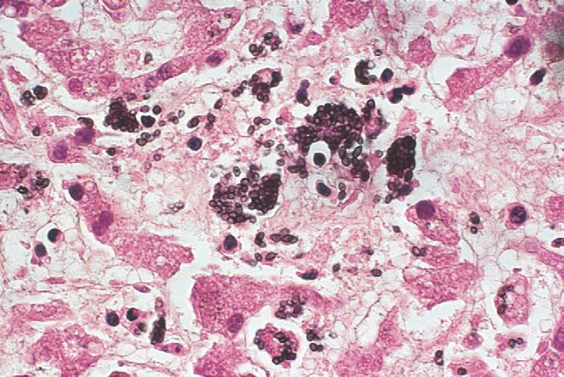
Notes:
Yeast cells of Histoplasma capsulatum a section of liver. (Gomori methenamine silver, ×1000).

Slide 34
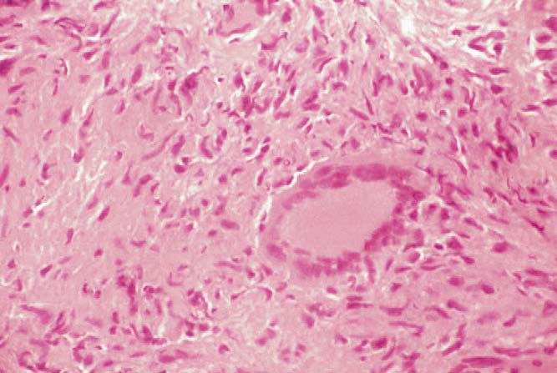
Notes:
The hallmark of the tissue response to histoplasma is the development of caseating or noncaseating granulomas in which calcium may be deposited .
The granuloma consists of an admixture of mononuclear phagocytes and lymphocytes, principally T cells. The putative function of the granuloma is to contain fungal growth

Slide 35
Clinical Syndromes of Histoplasmosis
Acute Primary Histoplasmosis
Chronic Pulmonary Histoplasmosis
Mediastinal Granulomatosis
Fibrosing Mediastinitis
Disseminated Histoplasmosis

Slide 36
Pulmonary Histoplasmosis
ACUTE INFECTIONS : primary infection or a reinfection.
Acute Primary Infection
> 90% asymptomatic or mild influenza-like
a small proportion of patients who become overtly ill..
the typical incubation time is 7 - 21 days, most individuals manifest symptoms by day 14
Fever , headache, nonproductive cough, chills, and chest pain
Most symptoms resolve within 10 days, but can persist for several weeks if there is an exposure to a heavy inoculum
Arthralgias, erythema nodosum, and erythema multiforme: 6%, women.
Notes:
The major determinant for the
In those who become ill, the typical incubation time is 7 to 21 days, most individuals manifest symptoms by day 14
development of symptoms is likely to be the inoculum size, although differences in strain virulence cannot be excluded

Slide 37
Contributing factors include
age(>65y, < 2),
inoculum size
immuno-compromised
Normal WBC
30% of pts will have leukocytosis or leukopenia during the course of this infection.
transient increase in the serum ALP .

Slide 38
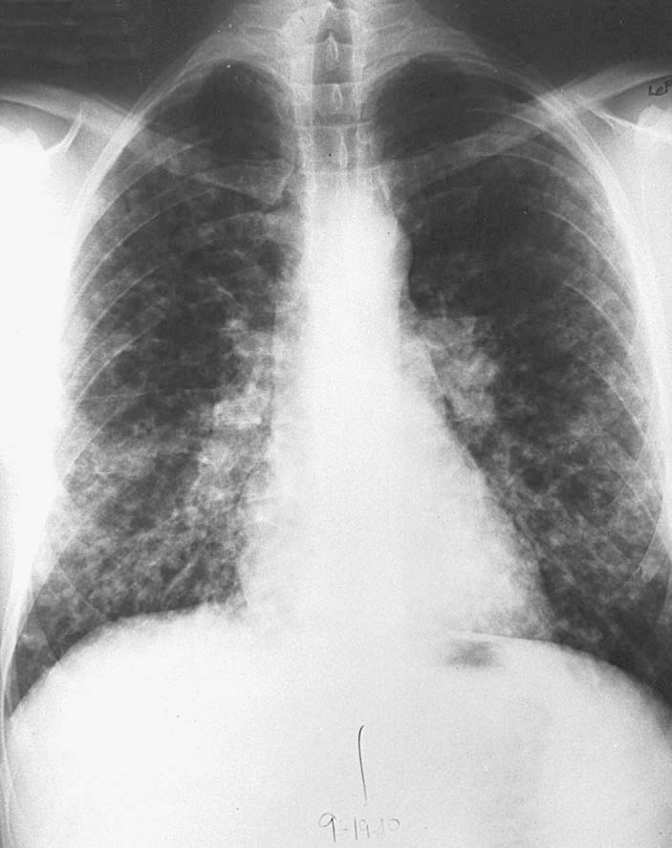
patchy pneumonitis that eventually calcifies and hilar lymphadenopathy
Notes:
Pleural effusions are distinctly uncommon.

Slide 39

Bob Dylan hospitalized with chest infection
May 28, 1997 Web posted at: 10:07 p.m. EDT
NEW YORK (CNN) -- Singer Bob Dylan has been hospitalized with a "potentially fatal" chest infection, according to a statement from his record label.
The rock/folk legend, who turned 56 on Saturday, was admitted over the weekend with severe chest pains, the Columbia Records statement said Wednesday.
He was diagnosed with histoplasmosis, which causes swelling of the sac that surrounds the heart, the statement said. Columbia did not say where he contracted it or whether the disease was associated with an underlying disorder such as HIV positivity.

Slide 40
Acute Reinfection
It is not uncommon for those who reside in endemic areas to be
exposed more than once to H. capsulatum.
Those who are reexposed to a large inoculum in heavily endemic areas present with a milder influenza-like illness.
The onset can begin within 3 days( shorter than in primary infection.)
The characteristic CXR is one of numerous small nodules that are diffusely scattered throughout both lung fields=miliary granulomatosis.
Hilar or mediastinal lymphadenopathy is absent.
The duration of illness often is briefer than in primary infection

Slide 41
Acute Progressive Disseminated Histoplasmosis
(acute PDH)
develop by reexposure to a large inoculum of the fungus or by reactivation of dormant endogenous foci.
abrupt onset , extending over just a few days: Fever, malaise ,weight loss, cough, diarrhea.
Hepatosplenomegaly, lymphadenopathy, esp the cervical chain, in about 30%,
Crackles.
Jaundice is observed in a minority,
oropharyngeal ulcers develop in less than 20%.
DH Septicemia :
  Hypotension, ARDS, hepatic, renal failure, DIC.
  Usually later in the course of DH-occur in pts who did not seek attention early: 13% of AIDS pt with histo*(1990 study).
Skin: papules to ulcers to E.multiforme
GI: 10% of cases, diarrhea, vague, abdominal pain. May have GI bleeding, polypoid, ulcerative lesions in colon.
Notes:
The estimated incidence is 1/2000 cases of histoplasmosis. Following the two Indianapolis epidemics, 8% of clinically recognized cases of histoplasmosis were PDH.49 The major risk
factors in those two epidemics for this manifestation of histoplasmosis were age older than 54 years and immunosuppression. In patients with AIDS, the incidence may approach 25%. The outcome of infection with H. capsulatum was poor among HIV-infected individuals, including the presence of a chronic medical condition and a history of herpes simplex
virus infection. Conversely, the use of antiretrovirals and triazoles was associated with a decreased risk. In an analysis of 1074 renal allograft recipients, 0.4% developed clinically recognized PDH over a 25-year span. This value is moderately different from the one reported during the Indianapolis epidemic, in which 2.1% of renal allograft recipients
exhibited PDH.51 Another risk factor for acquiring PDH is the use of tumor necrosis factor-α antagonists.

Slide 42
Acute Progressive Disseminated Histoplasmosis
Neuro:
AMS with focal neurologic findings(10-30%),
Encephalopathy, lymphocytic meningitis
Focal parenchymal lesions in brain/SC.
Historically, worse prognosis.
Notes:
In HIV-infected individuals, the risk factors for the development of histoplasmosis are a CD4+ cell count lower than 200 cells/mL, history of exposure to chicken coops, and a known positive serology for complement-fixing antibodies before illness.
Terminal events include DIC,GI bleed(severe thrombocytopenia) secondary bacterial sepsis associated with profound granulocytopenia
Anemia, thrombocytopenia, and leukopenia

Slide 43
Acute Progressive Disseminated Histoplasmosis
Anemia > 90% ( most HCT< 20%), Leukopenia, thrombocytopenia : 80% ? marrow infiltration.
ALT, alkaline phosphatase are elevated in a high proportion.
Markedly elevated LDH esp in AIDS (Corcoran et al, Clin Inf Dis 97),
Ferritin levels >10000 (Kirn, AIDS 1995).
Occasionally seen on a peripheral smear.
RADIOLOGY:
  -Severe immunosuppression: rarely causes focal infiltrates.
  Usually diffuse interstitial or reticulonodular patterns: resembles
  PCP or miliary TB.
  -Less immunosup: mediastinal LAD, nodular opacities, sometimes normal CXR.
Notes:
CXR: widely scattered nodular opacities or a diffuse reticular pattern
CT scan shows markedly enlarged adrenals, often with necrosis in the central area
Mucous membrane lesions are also more frequently seen in disseminated histoplasmosis than in other endemic mycoses, with the exception of paracoccidioidomycosis .
The tongue, gingival and buccal mucosa, lips, pharynx, and larynx can be involved

Slide 44
Chronic PDH
Older adults : not overtly immunosuppressed but probably have a selective defect in cell-mediated immunity to H. capsulatum.
characterized by overwhelming parasitization of the reticuloendothelial system: Macrophages in lymph nodes, liver, spleen, bone marrow, and lungs contain large numbers of yeasts.
Fever, night sweats, anorexia, weight loss, and fatigue.
Pancytopenia and an elevated alkaline phosphatase level are frequently noted,and patients should be examined for mucocutaneous ulcerations.
Diffuse adrenal involvement: Addison 's disease: weakness, orthostatic hypotension, hyperkalemia, and hyponatremia .
CXR: diffuse infiltrates.

Slide 45
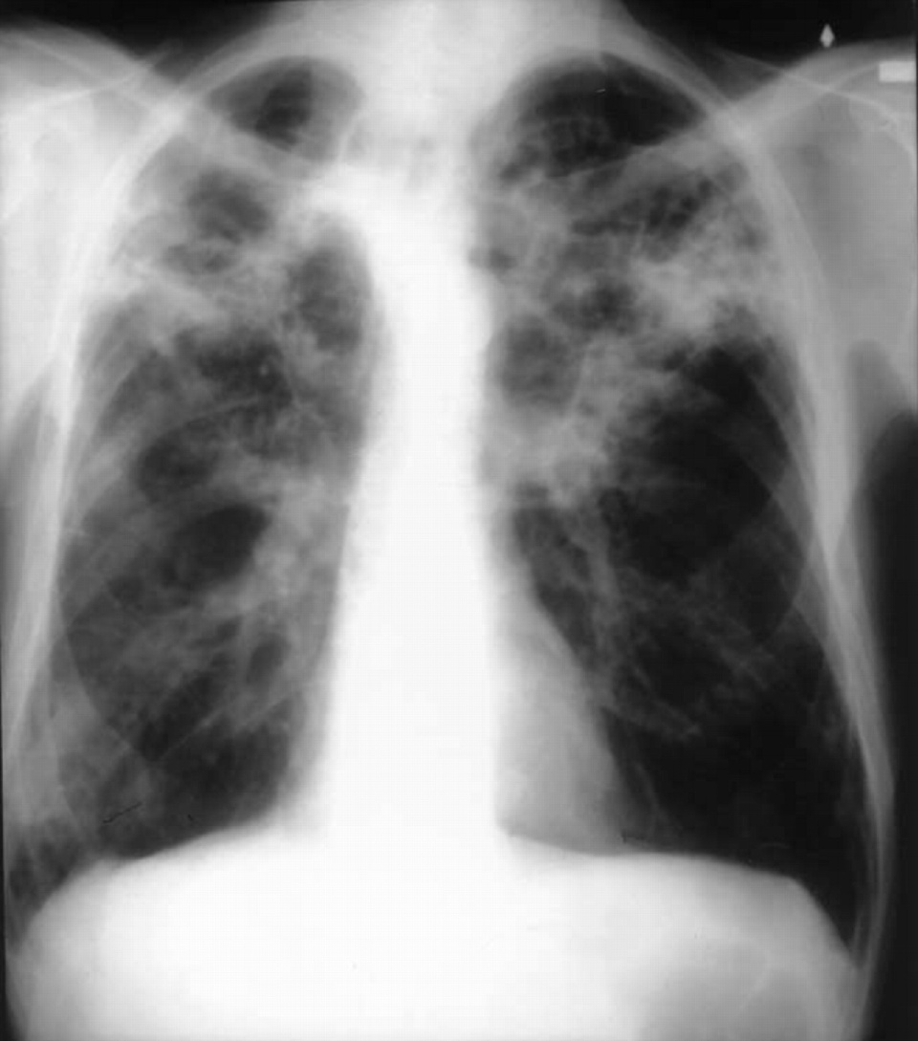
Chronic Cavitary Pulmonary Histoplasmosis
occurs, almost without exception, in older men who have emphysema
Notes:
Manifestations of infection mimic those of reactivation tuberculosis: fever, night sweats, anorexia, weight loss, chronic cough with sputum production, hemoptysis, and dyspnea.
CXR show bilateral or unilateral upper-lobe cavitary infiltrates, lower-lobe scarring, and emphysema .
Unless treated, this form of histoplasmosis is characterized by progressive pulmonary insufficiency that culminates in death

Slide 46
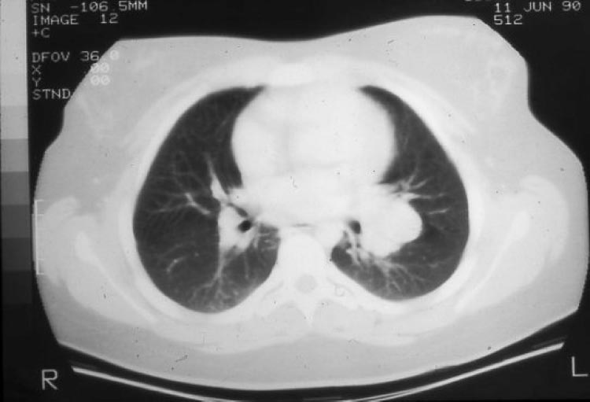
Mediastinal Granuloma
Notes:
However, instead of enlargement of a few nodes that eventually recede and ultimately calcify as the host handles the infection, granulomatous mediastinitis is characterized by the massive enlargement of multiple nodes that are often matted together and undergo caseation necrosis. This mass of nodes remains enlarged for months to even years
TB
Sarcoidosis

Slide 47
A definitive test
Culture : tissue or body fluids are plated onto Sabouraud’s dextrose agar and incubated at 25°C to allow for growth of the mycelial phase of H.capsulatum.
After several weeks up to 6 weeks, growth of a white to light tan mold occurs
Identification of the tuberculate macroconidia allows a presumptive diagnosis

Slide 48
A definitive test
Need to verify that the mold is H.capsulatum
A commercially available chemiluminescent DNA probe for H. capsulatum (Accu-Probe; GenProbe, Inc., San Diego, CA) is the confirmatory test most often used for definitive identification .
Highly specific; false-positive tests are very rare but have been reported .
Notes:
is the confirmatory test most often used for definitive identification .

Slide 49
Culture
The greatest yield of culture positivity:
Disseminated infection (samples can be taken from blood, bone marrow, liver, skin lesions, or any other site of infection)
Chronic cavitary pulmonary histoplasmosis,
Acute pulmonary histoplasmosis following exposure to a large inoculum of the organism.
Low yield:
mild to moderate acute pulmonary infection,
granulomatous mediastinitis, mediastinal fibrosis, and
Chronic meningitis.
Cultures usually yield no growth from CSF, and the diagnosis must be made in a different manner.

Slide 50
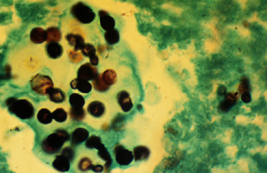
Histochemical identification
Tissue stained with methenamine silver or PAS stains to best visualize H. capsulatum.
Yeasts are typically found within macrophages but can also be seen free in tissues
Silver-stained section of lung tissue shows the budding yeast forms

Slide 51
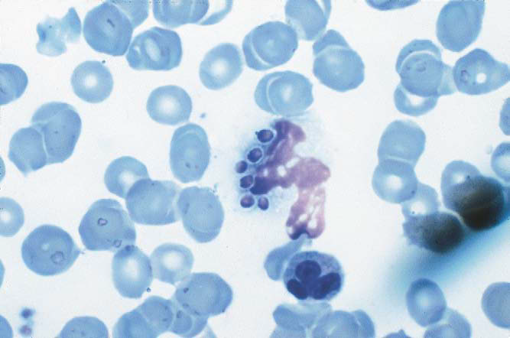
Yeast can be detected in peripheral blood smears stained with Wright-Giemsa in up to 40% of cases of acute disseminated histoplasmosis
yeasts within a Circulating neutrophils
Notes:
Circulating neutrophil with intracellular yeast cells. (Wright-Giemsa stain, ×400.)

Slide 52
Notes:
Granuloma in the lung of a patient with histoplasmosis.

Slide 53
Histochemical identification
Severely ill with diffuse pulmonary infiltrates are likely to have organisms that are apparent on a lung biopsy specimen
Milder disease often have no organisms seen in biopsy samples.
Granulomatous mediastinitis: caseous material taken from necrotic nodes may contain a few yeast-like organisms typical of H. capsulatum.
Fibrosing mediastinitis typically reveals no organisms

Slide 54
Antigen Detection in urine-serum
detects polysaccharide antigen in serum or urine by ELISA, is the mainstay of diagnosis, especially in those with disseminated disease.
The greatest experience was obtained in AIDS patients who had disseminated histoplasmosis and who had a large burden of organisms : Histoplasma antigen was detected in urine in 95% ,in serum in 86% of patients
Wheat, L. J. 2001. Laboratory diagnosis of histoplasmosis: update 2000. Semin. Respir. Infect. 16:131–140.
Fewer data are available for the use of the antigen assay in non-AIDS patients with disseminated histoplasmosis, but it appears to be a sensitive assay in this population also.
Published reports note that 92% of patients have antigenuria, but only approximately 50% have antigenemia
Notes:
Best for
disseminated histoplasmosis
Acute pulmonary histoplasmosis following exposure to a large number of conidia.

Slide 55
Antigen Detection in urine-serum
High Yield for
Disseminated histoplasmosis,
acute pulmonary histoplasmosis following exposure to a large number of conidia: detected in 75% of pts within the first few weeks of illness (151).
Low yield:
less severe acute pulmonary histoplasmosis or chronic cavitary pulmonary histoplasmosis : 10- 20% of patients detected in urine
Pts with granulomatous mediastinitis and mediastinal fibrosis generally do not have Histoplasma antigen detected in serum or urine
Few data on the usefulness of the Histoplasma antigen assay for bronchoalveolar lavage fluid obtained from patients with diffuse pulmonary infiltrates due to histoplasmosis or CSF
Wheat, L. J. 2001. Laboratory diagnosis of histoplasmosis: update 2000. Semin. Respir. Infect. 16:131–140.

Slide 56
False-positive reactions for Histoplasma antigen in urine are common among patients who have other endemic mycoses
In one study,
8 of 9 patients with paracoccidioidomycosis,
12 of 19 with blastomycosis, and
17 of 18 with penicilliosis had urine antigen tests that were positive for Histoplasma antigen (133).
There do not appear to be false positive tests in patients with coccidioidomycosis.
In North America, there is little concern about this lack of specificity,
except for those patients who have blastomycosis, because only the areas of endemicity of histoplasmosis and blastomycosis overlap (40).
Diagnosis should not be based on a urine antigen test alone; almost always, other serologic and culture data are available to confirm the diagnosis of histoplasmosis.
The amount of Histoplasma antigen detected in urine can be used to monitor a patient’s response to therapy
Wheat, J., et al. 1997. Cross-reactivity in Histoplasma capsulatum variety capsulatum antigen assays of urine samples from patients with endemic mycoses. Clin. Infect. Dis. 24:1169–1171.

Slide 57
PCR assay
At this point, no PCR assay for routine use is commercially available.

Slide 58
Antibody tests
Complement fixation test vs Immunodiffusion test -
The complement fixation test using antigens from the yeast and mycelial forms of H. capsulatum
Diagnosis is based on a 4-fold rise in CF antibody titer;
Complement fixation titers of 1:32 or higher are highly suggestive of acute infection, but titers of 1:8 or 1:16 should not be disregarded because titers in this range occur in about 1/3 of cases with active disease.
Slightly more sensitive than the immunodiffusion test.
serologic study of 276 patients during an urban outbreak of histoplasmosis found that complement fixation had a sensitivity of 95 % vs 90 % with immunodiffusion test.
Wheat J. The diagnostic laboratory tests for histoplasmosis: analysis of experience in a large urban outbreak. Ann Intern Med. 1982;97(5):680.
Positive results with the complement fixation test may represent a persistent antibody response from
a previous episode of histoplasmosis or
an infection with other fungi (eg, coccidioidomycosis, blastomycosis).
Cross-reactions occur with other fungal infections and other granulomatous processes(TB, and sarcoidosis): the cause of this is uncertain but may represent past histoplasmosis .
Picardi JL, Kauffman CA, Schwarz J, Phair JP. Detection of precipitating antibodies to Histoplasma capsulatum by counterimmunoelectrophoresis. Am Rev Respir Dis. 1976;114(1):171
Active histoplasmosis should be
excluded before making a diagnosis of sarcoidosis, and
considered in patients presumed to have tuberculosis in which mycobacterial cultures and stains are negative
The CF test appears to be less specific than the ID assay;
Notes:
Complement fixation
The complement fixation test is an immunological medical test that can be used to detect the presence of either specific antibody or specific antigen in a patient's serum. It was widely used to diagnose infections, particularly with microbes that are not easily detected by culture methods, and in rheumatic diseases. However, in clinical diagnostics labs it has been largely superseded by other serological methods such as ELISA and by DNA-based methods of pathogen detection, particularly PCR.
* Meditated by antibody
* Antibody binds to antigen
* Complement cascade of molecules in blood serum initiated, causing lysis of infected cell or pathogen
antibody tests play an important role in the diagnosis of several forms of histoplasmosis but are not terribly useful in others

Slide 59
immunodiffusion test
Results are reported as M or H precipitins or bands.
Most patients will develop an M band;
M band becomes positive sooner than the H band and persists longer
H precipitin band is detectable in < 20% of cases often in
Disseminated infection,
Chronic cavitary pulmonary histoplasmosis, or
More severe acute pulmonary histoplasmosis
ID test has greater specificity than the CF test.

Slide 60
Antibody tests
Tests for antibody are most useful in patients who have chronic forms of histoplasmosis that have allowed enough time for antibody to develop and in patients who have acute pulmonary histoplasmosis, in whom documentation of a fourfold rise in antibody titer to H. capsulatum can be diagnostic.
Because 2 to 6 weeks may be required for the appearance of antibodies, these assays are less useful for patients who have severe acute infection and in immunosuppressed patients, who mount a poor response .
For those patients who have mediastinal lymphadenopathy, antibody assays may or may not be positive and cannot be relied upon to make a definitive diagnosis. Tissue biopsy is always required in these instances.
False-positive CF tests occur in patients with lymphoma, tuberculosis,
sarcoidosis, and other fungal infections, all of which may present as a mediastinal mass.

Slide 61
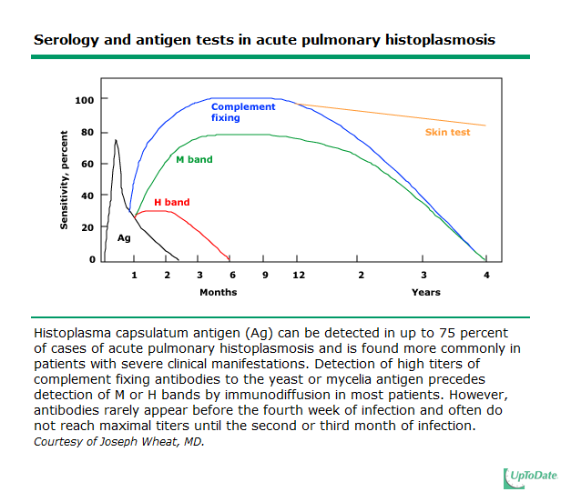

Slide 62
Antibody tests
One unique circumstance in which the presence of antibodies may be the only assay leading to a diagnosis of histoplas mosis is in a patient who has chronic meningitis due to H.capsulatum.
the presence of either CF or ID antibodies against H. capsulatum in the CSF allows one to make the diagnosis of Histoplasma meningitis even when the culture shows no growth

Slide 63
Histoplasmin skin tests
Historically, the histoplasmin skin test reagent was critically
essential in defining the area where H. capsulatum is endemic
and the unsuspected high frequency of asymptomatic infection
in this area (12, 32).
Not a very helpful diagnostic test because
cross-reactions with other fungi, especially Blastomyces dermatitidis,
interference with subsequent complement fixation antibody assays, and
insensitivity in ill patients who had disseminated infection.
skin test reagents are no longer commercially available.

Slide 64
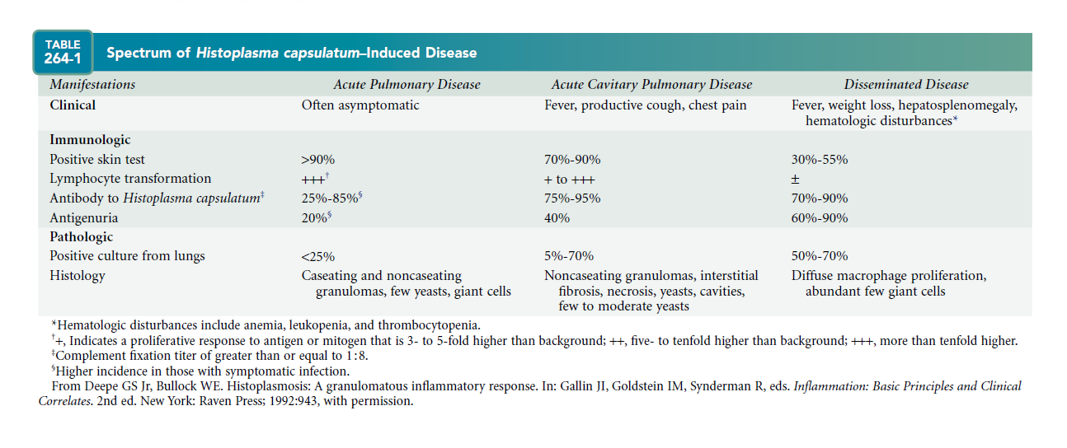

Slide 65
Histoplamosis in renal transplant
For solid organ transplant (SOT) recipients, the incidence of histoplasmosis is estimated to be low, with only a few case series, mostly among renal
and liver transplant recipients
There are only isolated case reports of histoplasmosis among lung or
heart transplant recipients .
For SOT recipients, disseminated disease may occur as primary infection, as a reactivation of latent infection, or as a donor-transmitted infection.
Given the scarcity of studies on which to make evidence-based recommendations, the 2007 update of the clinical practice guidelines for the management of patients with histoplasmosis, endorsed by the Infectious Diseases Society of America, provides no specific recommendations on the ideal treatment of histoplasmosis among SOT recipients
Vail GM, Young RS, Wheat LJ, Filo RS, Cornetta K, Goldman M. Incidence of histoplasmosis following allogeneic bone marrow transplant or solid organ transplant in a hyperendemic area. Transpl Infect Dis 2002; 4:148–51.

Slide 66
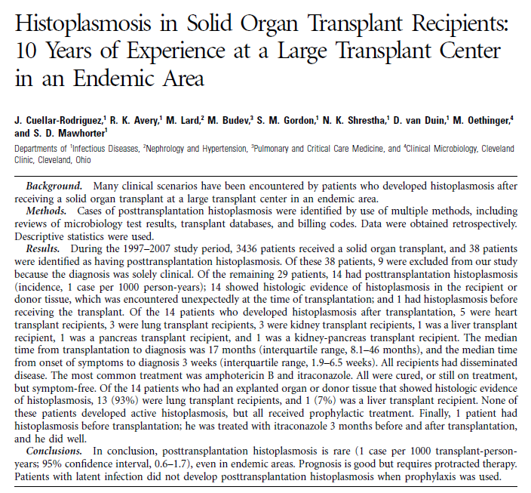

Slide 67
During the 1997–2007 study period, 3436 patients received a solid organ transplant, and 29 patients were identified as having posttransplantation histoplasmosis.
14 had posttransplantation histoplasmosis (incidence, 1 case per 1000 person-years);
14 showed histologic evidence of histoplasmosis in the recipient or
donor tissue, which was encountered unexpectedly at the time of transplantation;
1 had histoplasmosis before receiving the transplant.
Of the 14 pts who developed histoplasmosis after transplantation
5 were heart transplant recipients,
3 were lung transplant recipients,
3 were kidney transplant recipients,
1 was a liver transplant recipient,
1 was a pancreas transplant recipient,
1 was a kidney-pancreas transplant recipient

Slide 68
Active histoplasmosis.
Proven cases of active infection =compatible clinical manifestations + histologic (yeast forms compatible with H.capsulatum) and/or microbiologic (growth of H. capsulatum in culture) evidence of histoplasmosis.
Possible cases of active infection= compatible clinical manifestations + a positive Histoplasma urine antigen test result and/or a positive serology test result (which was previously negative or had a 4-fold increase in titers).

Slide 69
disseminated vs. localized
Disseminated disease: was based on radiographic, histologic, or microbiologic evidence of involvement of at least 2 organs or a blood or bone marrow sample that tested positive for H. capsulatum on culture;
Otherwise: localized disease.

Slide 70
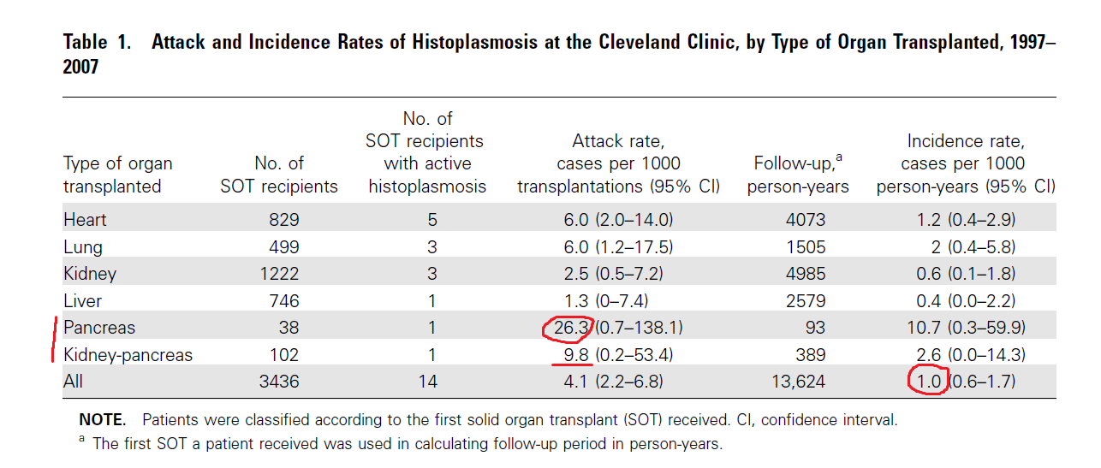
Scenario 1: Active Histoplasmosis after Solid Organ Transplantation
Notes:
Of the 3436 SOT recipients, 14 developed proven active The overall attack rate of histoplasmosis in the posttransplantation period per 1000 solid organ transplantations was 4.1 cases
Attack Rates were highest in pancreas transplant recipients at 26.3 cases (95% CI, 0.7–138.1 cases), followed by kidneypancreas, heart, lung, kidney, and liver transplant recipients
The global incidence of posttransplantation active histoplasmosis was 1 case per 1000 person-years.
By type of transplant, the incidence was again highest in the pancreas transplant group, with 10.7 cases per 1000 person-years (95% CI, 0.3–
59.9 cases), followed by kidney-pancreas, lung, heart, kidney, and liver transplant recipients.

Slide 71
9 (64%) : male.
median age : 45.5 years
13 (93%) :white, 1 (7%) was African American.
13 patients resided in Ohio, 1 lived in Buffalo, NY.
The most common immunosuppressive regimen at the time of presentation : prednisone, tacrolimus, and mycophenolate mofetil.
The median time from transplantation to infection was 17 months.

Slide 72
Clinical presentation
The median duration of symptoms before the diagnosis of active histoplasmosis was 3 weeks
nonspecific.
Fever (13 [93%] of 14 patients) and
Shortness of breath (8 [57%] patients)
Diarrhea (6 patients [43%]),
Cough (6 patients [43%]),
Diaphoresis (5 patients [36%]), and
headache (4 patients [29%]).
Surprisingly, weight loss was not as frequent (3 patients [21%]).
All patients had lung involvement as evidenced by radiologic studies, culture, and/or histopathology.
All patients had disseminated infection (11 patients had at least 2 compatible biopsies and/or positive culture results from different organs; the remaining 3 had a compatible lung biopsy and radiographic evidence of involvement of another organ).
Notable findings at presentation included hoarseness in a patient with a tonsillar abscess due to H. capsulatum infection and blurry vision in a patient with central nervous system involvement

Slide 73
Imaging
Only 7 (50%) with active histoplasmosis after transplantation had an abnormal CXR
all 13 patients had chest CT scans that revealed new abnormalities consistent with acute histoplasmosis : multiple nodular lesions and diffuse bilateral infiltrates.
Five (50%) of 10 patients who had abdominal CT scans had abnormalities suggestive of H. capsulatum infection, including splenomegaly (with and without focal lesions) and lymphadenopathy.

Slide 74
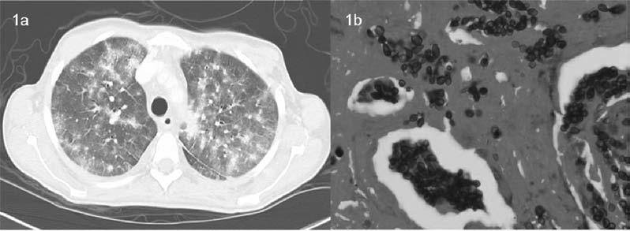
Notes:
Computed tomography of the chest with multiple bilateral nodular patchy infiltrates.
Lung biopsy. Gomori methenamine silver stain highlights yeast forms compatible with Histoplasma capsulatum

Slide 75
Laboratory results
The most common laboratory abnormalities were anemia and leukopenia (12 [86%] of 14 patients).
The median WBC was 3.84103 cells/mL , and the median Hg was 9.9 g/dL
In contrast to HIV-infected patients with disseminated disease, only 2 patients had mildly
elevated liver transaminase levels, and none had an increased alkaline phosphatase or total bilirubin level.
For 8 patients, data on lactate dehydrogenase level were available; 5 had elevated levels, with a median LDH of 287 U/L (range, 205.3–474.5 U/L; normal range, 100–220 U/L).
Ferritin levels were determined for 6 patients, and in all 6 patients, the levels were elevated, with a median ferritin level of 1007 ng/mL
The median immunoglobulin G level at the time of diagnosis was 645 mg/dL (IQR, 445.5–829.3
mg/dL; normal range, 717–1411 mg/dL).
For 5 patients, an adenosine triphosphate immune function assay (ImmuKnow; Cylex) was performed at the time of diagnosis, with a median of 254 ng/mL (IQR, 201–290 ng/mL; normal range, 225–525 ng/mL).

Slide 76
Diagnosis
7 (50%) had both positive culture results and positive
diagnostic histopathology test results ,
remaining 7 patients (50%) had 2 body sites where H. capsulatum was isolated.
For 13 patients, a Histoplasma urine antigen test was performed; 9 (69%) tested positive.
For 12 patient, Histoplasma serology testing, by complement fixation and immunodiffusion, was performed; 4 (33%) tested positive.

Slide 77
Scenario 2: Evidence of Histoplasmosis in the Explanted Organ of the Recipient or in Donor Tissue
The overall incidence= 2.9 cases per 1000 transplantations.
Of the 10 recipients,
9 were lung transplant recipients (for which donor and/or recipient lung and lymph node tissue were routinely evaluated), and
1 was a liver transplant recipient who had splenectomy due to massive splenomegaly. H. capsulatum was found in the explanted spleen.
lung transplant recipients comprised the 4 cases in which evidence of histoplasmosis was found in donor tissue. (donor lymph node tissue.)
Pretransplantation imaging. reports of the 10 explanted organs positive for H. capsulatum
were reviewed. All 9 lung transplant recipients had abnormal chest CT scans; 4 (44%) of the 9 lung transplant recipient showed indirect evidence of histoplasmosis (calcified lymph nodes and granulomata).
The liver transplant recipient had splenomegaly on the abdominal CT scans but no calcifications.
No information is available on the donors’ radiologic findings.

Slide 78
Management and outcome.
Antifungal prophylaxis for all lung transplant recipients at the Cleveland Clinic consists of 18 months of oral itraconazole (liquid formulation usually preferred) and a short course of inhaled amphotericin B, until oral treatment results in detectable levels.
All lung transplant recipients with evidence of histoplasmosis in their explanted organs or in the donor tissue received this regimen. The liver transplant recipient received 2 weeks of amphotericin B lipid complex and then completed 6 months of fluconazole as a result of significant itraconazole intolerance.
Patients were not managed with a lesser degree of immunosuppression on account of their preexisting histoplasmosis. No patient in this group, with a median followup period of 13.5 months (IQR, 9.5–45.7 months), developed posttransplantation histoplasmosis

Slide 79
Scenario 3: Pretransplantation Histoplasmosis
1 pt had possible active histoplasmosis while on the
waiting list for a kidney-liver transplant: had new onset of SOB ; a new lung nodule and a positive Histoplasma antibody (M band). Lung biopsy revealed loosely formed granulomata.
He received itraconazole for 3 months before the transplantation and continued treatment for 3 months after the transplantation.
Symptoms had subsided before he received the transplant.
The posttransplantation clinical course has been uneventful, with no evidence of recurrent histoplasmosis during 9 months of follow-up.

Slide 80
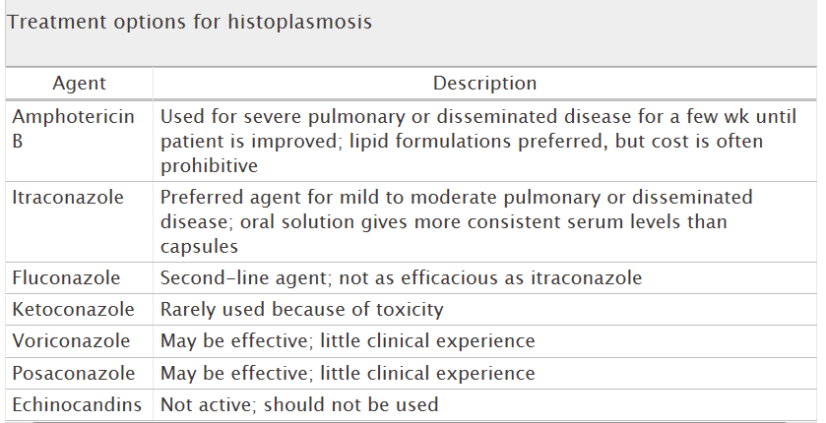
Duration of treatment: 12 weeks for acute disease to 12 months for progressive disseminated disease [12].
Treatment should be individualized on the basis of diagnosis, net state of immunosuppression, and potential consequences of location of disease (eg, CNS)

Slide 81
