Slide 1
UTHSC IRB:
A How-To Guide
http://www.uthsc.edu/research/research_compliance/IRB/
(901) 448-4824
irb@uthsc.edu

Slide 2
UTHSC Institutional Review
Board (IRB)
Charged with protecting human research subjects
Ensures compliance with the federal regulations (DHHS, FDA, & HIPAA) with regards to research applications, consent forms and other research materials to be used; and with regards to the conduct of the research itself
Operates under a Federalwide Assurance (FWA) with OHRP as a condition of receiving federal research dollars
Also protects the University and the researchers from liability

Slide 3
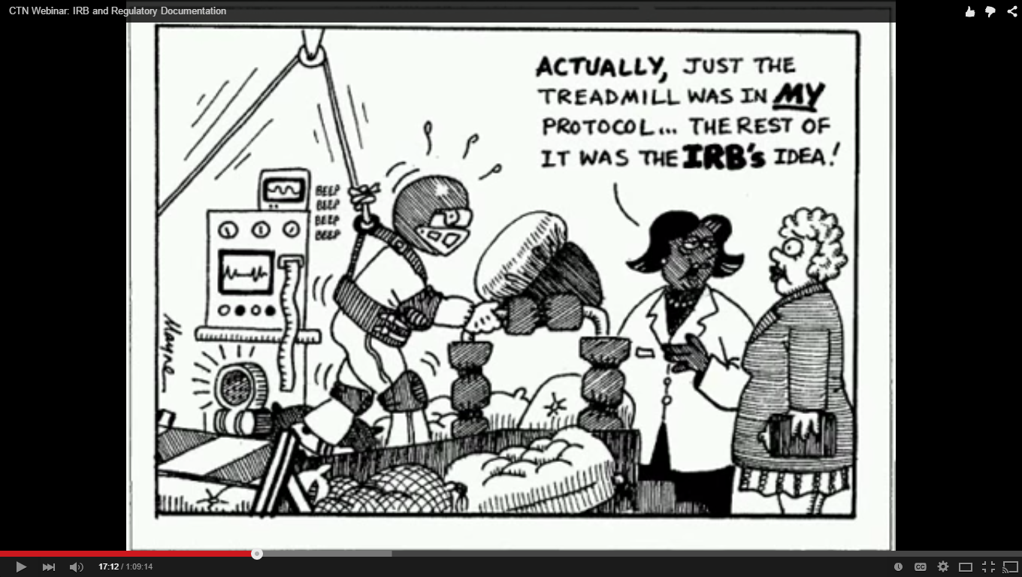
Added Protections

Slide 4
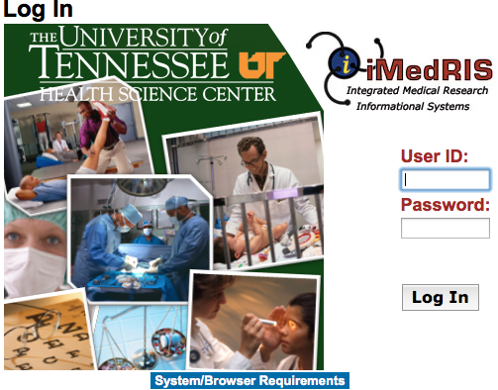
iMedRIS
All applications for IRB review must be submitted via iMedRIS, UTHSC’s electronic research application system, at https://ris01.uthsc.edu .

Slide 5
Step 1: Obtain a UT Net ID
iMedRIS requires the use of a UT Net ID and password for access.
  All UTHSC faculty, staff, and students should have a UT Net ID.
  Investigators and/or research staff who do not have a UT Net ID will have to be sponsored into the UT system by a current UT faculty, staff, or student who is part of the research team.
  The IRB provides step-by-step instructions for completing an online UTHSC form to request a UT Net ID on our Getting Started page http://www.uthsc.edu/research/research_compliance/IRB/started.php .
  If you need assistance with your UT Net ID and/or password, please contact the HELP Desk at 448-2222.
  Since all IRB communication comes to your UT email, if you do not check it, you MUST forward it to the email address you check on a regular basis. This can be done online via UTHSC Webmail.

Slide 6
Step 2: Human Subjects Protection Training
All key study personnel (KSP) must complete the online course, Collaborative Institutional Training Initiative (CITI) OR the NIH human subjects protection training. KSP must be listed in section 3.0 of your IRB application.
Go to www.citiprogram.org to take the online CITI Course for UTHSC (Group 3: Investigators and all Study Personnel) OR take the NIH online course at [http://phrp.nihtraining.com/users/login.php].
CITI Certification must be renewed every 3 years.
Your project will not receive final approval until all KSP have completed the online human subjects protection training.

Slide 7
Step 3: Find a Faculty Advisor
(if applicable)
Undergraduate and non-faculty investigators may serve as a principal investigator (PI) on a study; however, a faculty advisor must be included on the application for IRB review.
Section 3.0 of the study application will prompt you for the name of your faculty advisor. He/she must also sign off on your new application submission.
Faculty advisors are a great resource and can help guide students, residents, and fellows through the research process.

Slide 8
Step 4: Cooperative Agreements (if applicable)
The UTHSC IRB maintains cooperative agreements with the following entities:
    National Cancer Institute Central IRB (NCI CIRB)
    St. Jude Children’s Research Hospital
    University of Memphis IRB
If you will be conducting a cancer research study that has been reviewed by the NCI CIRB, please contact the UTHSC IRB office for assistance (901-448-4824).
If you will be conducting research at St. Jude Children’s Research Hospital or U of M, please contact the UTHSC IRB for assistance, and be sure to include these research locations in your study application [Section (1200) Study Site].

Slide 9
Step 5: Obtain Institution Approval
(if applicable)
The UTHSC IRB has oversight authority for all research with human subjects conducted by faculty, staff, & students at UTHSC, and for research conducted at its affiliated institutions, regardless of the researcher’s affiliation with UTHSC:
Methodist Le Bonheur Healthcare (institutional approval will be issued via iMedRIS correspondence)
Rexann G. Pickering, Ph.D., CIP, RN
Administrator, Human Protection
(901) 516-2323
rexann.pickering@mlh.org
Regional One Health (formerly known as The MED) (institutional approval will be issued via iMedRIS correspondence)
Maria van Werkhooven, BVM, FACHE
Director, Office of Medical Research
(901) 545-7453
mvanwerkhooven@regionalonehealth.org
http://www.regionalonehealth.org/employees-and-physicians/research/
Le Bonheur Children’s Hospital
Sheon Lynch, MSA, MT (ASCP)
Administrative Director
(901) 287-6208
sheonlynch@lebonheur.org

Slide 10
Step 6: Complete an Electronic IRB Application
iMedRIS User Guides are available on the IRB website at http://www.uthsc.edu/research/research_compliance/IRB/guides.php .
Consent form templates are available on the IRB website at http://www.uthsc.edu/research/research_compliance/IRB/consent.php .
Exempt and Expedited applications will be reviewed as they are received.
Applications requiring review by the full Board (convened IRB) follow the Electronic Meeting, Submission and Review Schedule at http://www.uthsc.edu/research/research_compliance/IRB/schedule.php
Call the IRB with any questions, before, during, or after the submission process!

Slide 11


Step 6: Complete an Electronic IRB Application, cont’d
Log into iMedRIS [https://ris01.uthsc.edu].
To start an electronic application, just click:
The application will guide you through the required sections depending on the type of study you are conducting.
Be sure to click to save your response and move to the next section.
Required sections are marked with a red asterisk *
If you forget to respond to a required field, you will receive a prompt:
If you are unsure about a question, please contact the IRB (901-448-4824)!
Once you have completed the electronic application, you will enter the Routing Form.

Slide 12
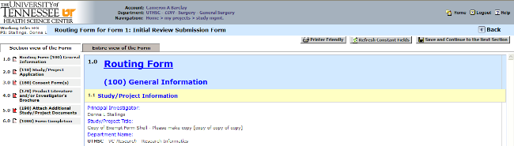
Step 7: Uploading Study Documents
You will upload all of your study documents in the Routing Form. You will be prompted to attach all of your study documents, such as:
  consent form(s),
  protocol,
  investigator’s brochure,
  questionnaires,
  flyers, etc.

Slide 13
Step 8: Obtaining Signatures & Submitting Application for IRB Review
After you save the last page of the Routing Form, when asked whether you wish to route your submission to additional personnel, change the answer to “Yes.”
Your new application and attachments should be routed to the appropriate personnel to apply their electronic signatures:
  Principal Investigator (PI)
  Co/Sub-Investigators
  Faculty Advisor (if PI is student, resident, or fellow)
  Department Chair (if PI is a UT student, fellow, resident, staff, or faculty member)
  Service Chief (for projects conducted at Regional One Health)
  NOTE: The IRB will not receive the application to review until all electronic signatures have been applied!

Slide 14
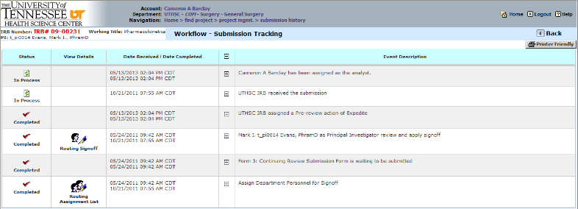
Step 9: Track Your Submission
Track your submission to ensure everyone signs off and it reaches the IRB office! You can also find out who to call about your submission in the IRB office (i.e., your analyst).
Once you log into iMedRIS, under My Projects, open your study, click the Submission History button, and then click Track Location to see where you submission is.

Slide 15
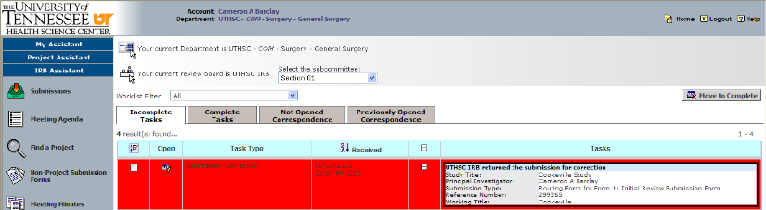
Step 10: Respond to Any Changes (Provisos) Requested by the UTHSC IRB
Many studies submitted for IRB review require some changes or clarifications. Provisos will be sent (via an automatic notice to his/her UTHSC email) to the PI and anyone listed as a Study Contact in Section 3.0 of the electronic study application.
To address provisos, complete the PI Response Form listed in your Incomplete Tasks in iMedRIS:
Only the PI, Co-PI, or Co/Sub-Investigator needs to apply his/her electronic signature to the PI Response Form, unless otherwise instructed by the IRB.

Slide 16
Receive IRB Approval
Once your study receives IRB approval, an approval letter will be issued to the PI and anyone else listed as a Study Contact in Section 3.0 of the electronic application (via an automatic notice to his/her UTHSC email) .
Approval letter(s) and IRB-stamped-approved study documents such as consent forms may be downloaded from iMedRIS using the Submission History button and the Informed Consent & Other Project Documents folders once you open your study in iMedRIS.
If you are conducting a study that is sponsored by a pharmaceutical firm or other for-profit-entity and your study is approved prior to payment of the IRB fee, your study will be listed in iMedRIS as Approved- Awaiting Payment.

Slide 17
Remember!
If you are a student and wish to conduct research at any institution, even on summer break, contact the UTHSC IRB to find out whether you must receive our approval to do so.
If you wish to conduct your study at another institution, call the UTHSC IRB and ask what you need to do/consider before drafting any IRB applications. If there is an IRB affiliated with the other institution, there may need to be an Institutional Authorization Agreement between the 2 institutions.
If you wish to conduct your study at an institution (e.g., YMCA, Walgreens, etc.) that does not have an IRB, you will also need a letter from them stating you have permission to conduct research in their institution.

