Slide 1
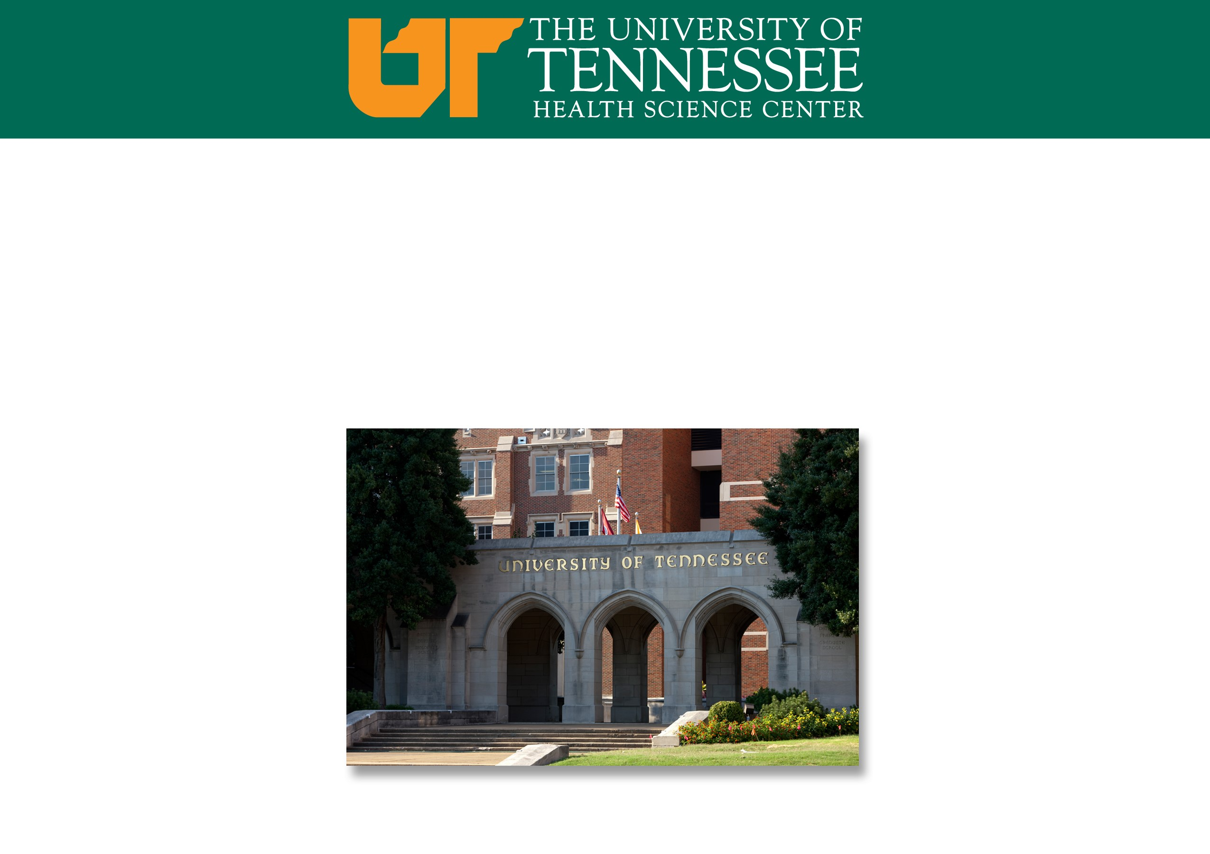
Strolling through the Match: Details and Dates
Andrew S Olinger, MD
Assistant Dean of Student Affair

Slide 2
Contents:
Where should I be now?
What is NRMP?
What is ERAS?
  Where do I get my token?
  What are my odds of matching?
When are these things due?

Slide 3
Where Should I be now?
Personal Statement should be finished
CV should be finished
You should have an idea of who will write your letter
You should have emailed your respective program inquiring about Chair’s letter
You should know what the MSPE is. Your MSPE meeting will be scheduled through he COM Student affairs scheduling software

Slide 4
National Resident Matching Program (NRMP)
Organization that manages the match
Runs off Nobel Prize-winning algorithm
  This algorithm uses the applicants rank order list (ROL) and the ROL of the programs participating in the NRMP to match the applicant and the programs in the fairest way possible.

Slide 5
Electronic Residency Application Service (ERAS)
Dashboard-style website that NRMP uses to gather data from applicants and programs
You will need a token to access this website.
  This will come from Alise Miller. You cannot apply without this token.
  The token is a key that will allow you to make an account.

Slide 6
What Predicts My Chances of Matching?
Ultimate: NRMP match data does
Number of interviews is very important to predict successful match
This is obviously specialty specific
We are encouraging a parallel plan for those who are not assured to match (>90%) chance

Slide 7
What Predicts My Chances of Matching (cont.)?
What is a parallel plan?
  Gracefully applying to multiple specialties in order to increase chances of matching
Is this allowed:
  Yes, it is! We encourage this.
  It is important to show commitment, so only apply to each program once. For instance, do not apply for UT OB/Gyn and general surgery.
  Applying to the same program in several specialties could undermine your attempts to appear committed.
  Ask if you are confused!

Slide 8
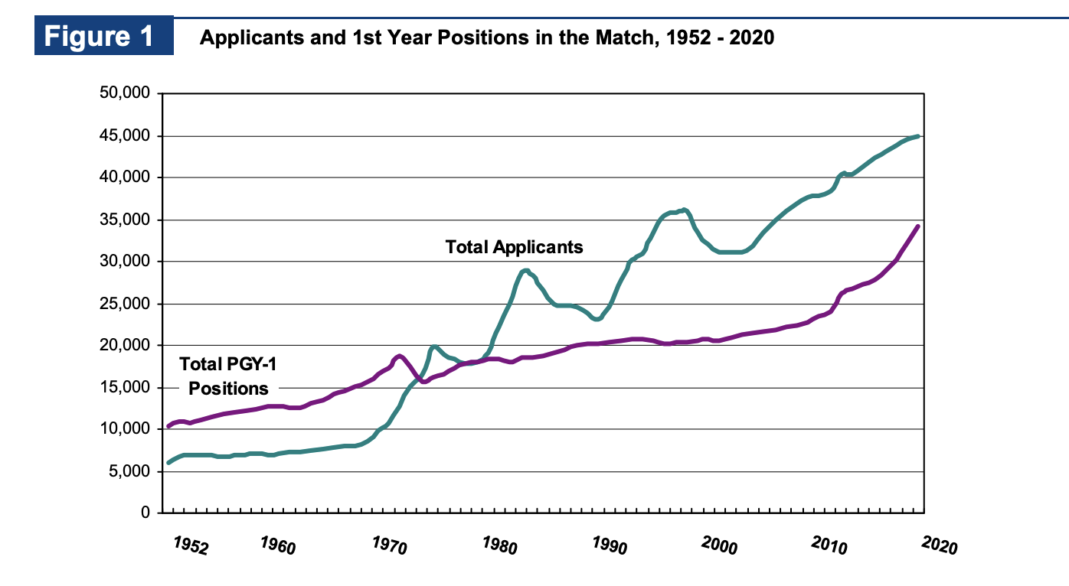
National Trends in Matching:

Slide 9
National Trends in Matching:
There are more applicants than ever
There are more applicants than spots.
You need a certain number of interviews to achieve success.
  This is specialty specific.
  This isn’t personal, there are just lots of applicants

Slide 10
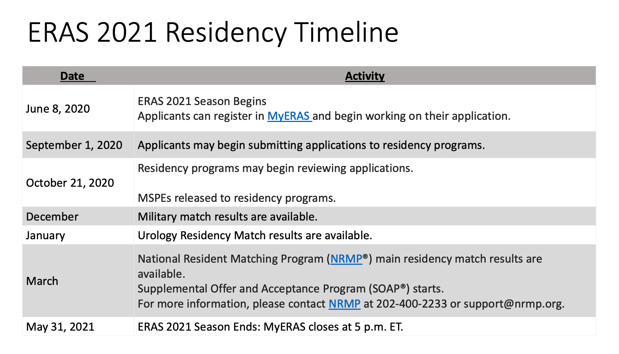

Slide 11
Questions?
Reach out if needed:
  Catherine Womack – cwomack@uthsc.edu
  Sara Cross – scross11@uthsc.edu
  Deirdre James – djames17@uthsc.edu
  Andrew Olinger – aolinge1@uthsc.edu

