Slide 1
Welcome to Preparation to Clerkships!
Kristen Bettin, MD, MEd
Senior Assistant Dean, Clinical Curriculum
Bill Dabbs, MD
Assistant Dean, Clinical Curriculum
Jenn Wilson, CAP
Lead Clinical Curriculum Coordinator
Ken Anderson
Clinical Records Specialist
Join Poll Everywhere: Text KBETTIN to 36707 or Respond online at PollEv.com/kbettin

Slide 2
What word best describes how you feel about starting clerkships?
What are you most nervous about?
What are you most excited about?
Notes:
Welcome to your Clinical Clerkships. This will be the best year yet of medical school. This is the year when you really get to bring everything from the last 2 years together. You’ll see how the body systems interact with each other, you’ll understand the importance of pathology, pharmacology, and pathophysiology (and all of the other basic sciences!) as they relate to patient care and disease prevention. You will create relationships with patients and families. This will be one of the most challenging, rewarding, stressful, life-changing years you will have in your medical training. The patients you meet and the experiences you walk through will forever change your perception of the world and your place in it.

Slide 3
Orientation Objectives
Describe the required rotations of the clerkship year.
1
Describe how to request time off, apply for housing, and other procedures related to the clerkship year.
2
Recognize where and how to find important policies related to the clinical years.
3
Identify ways to promote your professional identity throughout your clerkship year.
4

Slide 4
Prep Week Expectations
Attend all sessions. Notify Dr. Bettin for any illnesses or absences.
Review the Workshop Schedule and Workshop Group Assignments posted on eMedley in the "documents" section.
Review the Pre-brief and Pre-study materials for all skills sessions.
Complete the Re-Attestation of the Technical Standards.
Complete the Bloodborne Pathogens quiz on Blackboard.

Slide 5
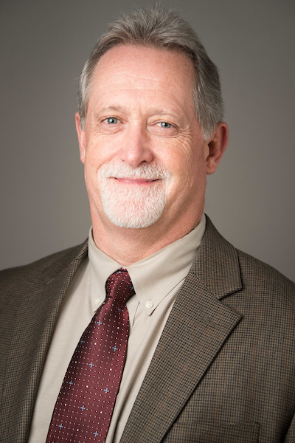
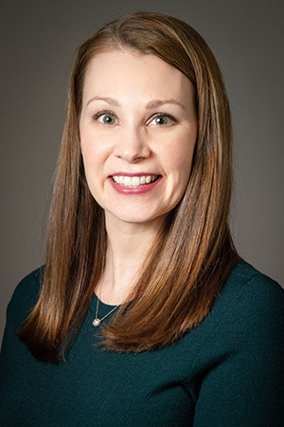
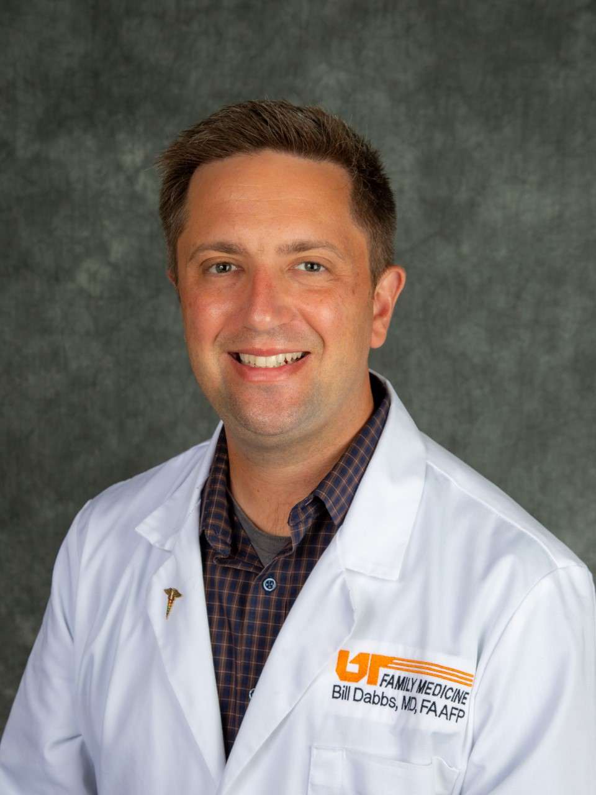
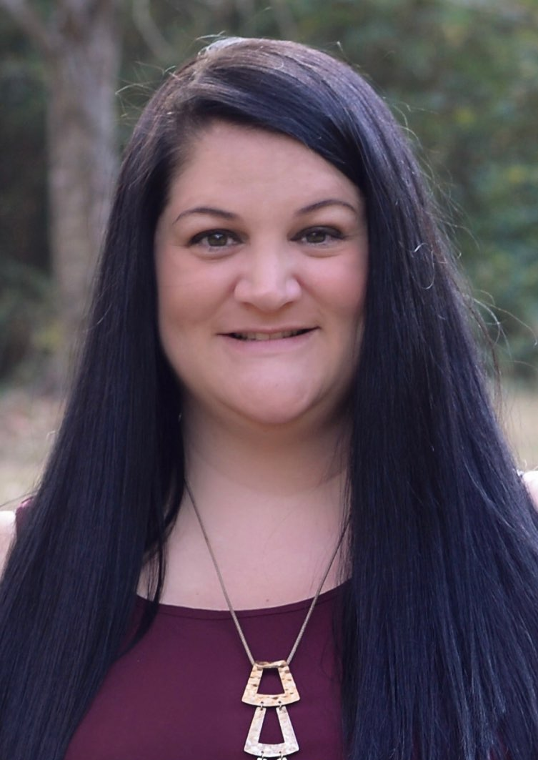
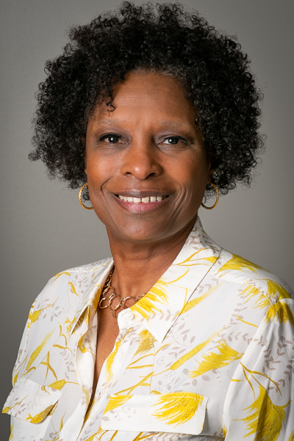
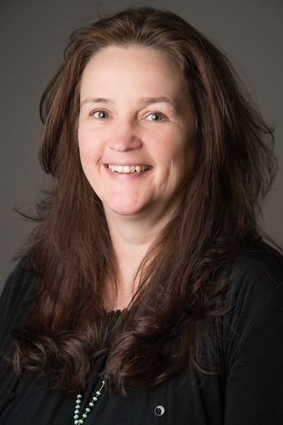
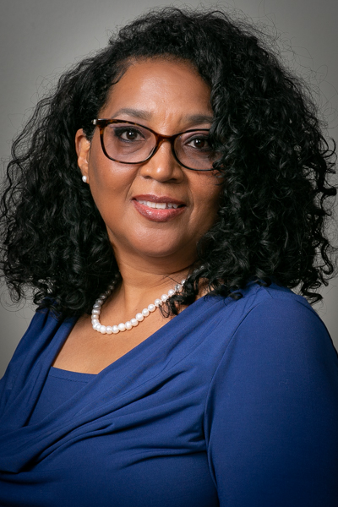
Clinical Curriculum Team
Dr. Mike Whitt
Associate Dean, Medical Education
Dr. Kristen Bettin
Senior Assistant Dean,
Clinical Curriculum
Dr. Bill Dabbs
Assistant Dean,
Clinical Curriculum
Jenn Wilson
Lead Clinical Curriculum Coordinator
Ke’Nosha (Ken) Anderson
Clinical Records Specialist
Away Rotation Evaluations
Deborah Barton
Geri-Palli and
Capstone Coordinator
Kimberlee Norwood, MA
Clinical Onboarding,
Away Rotations, and
International Rotations
Coordinator
Alesia McQueen
Student Services Specialist and ExamSoft Testing
NBME Subject Exam

Slide 6
Required Core Clerkships
Internal Medicine – 8 weeks
Surgery – 8 weeks
Family Medicine – 6 weeks
OB/GYN – 6 weeks
Pediatrics – 6 weeks
Neurology – 4 weeks
Psychiatry – 4 weeks

Slide 7
Career Explorations (CEs) and Option Blocks
You will have the opportunity to take two 2-week CEs during your third year to be counted toward your total of 20 weeks elective time
One 2-week CE can be used as an option block (off time)

Slide 8
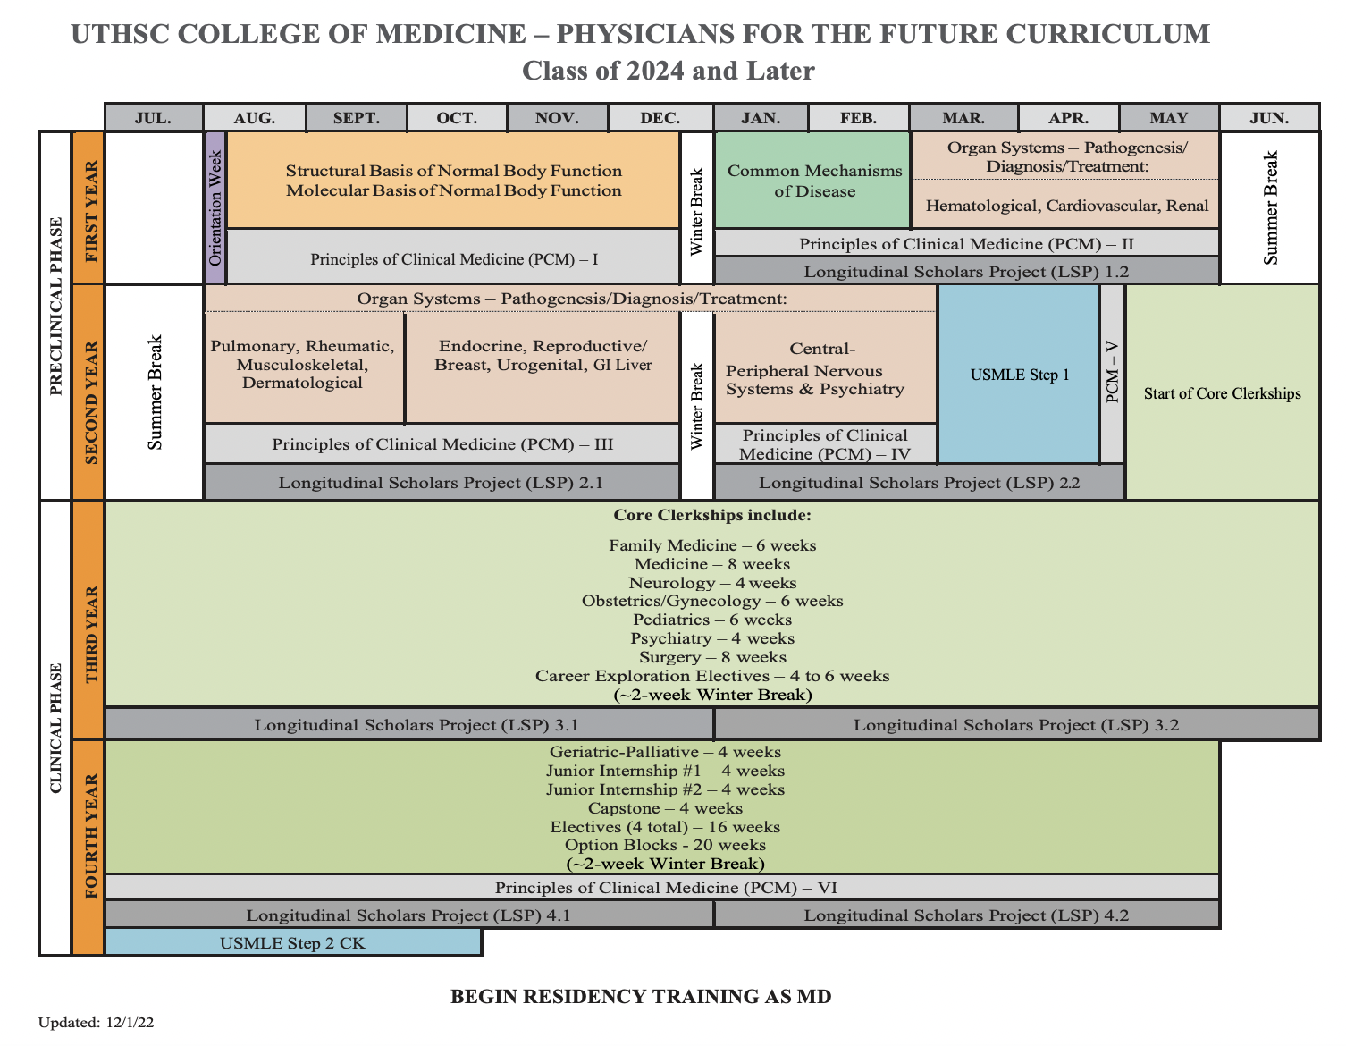

Slide 9
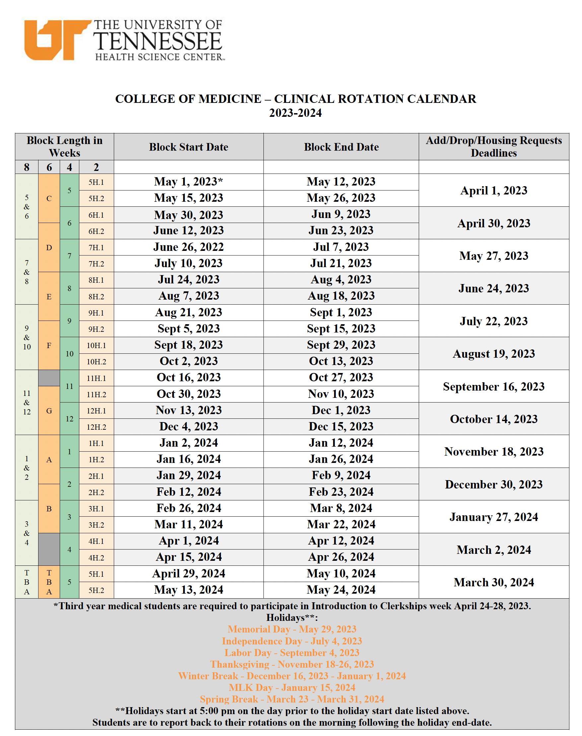
Clinical Rotation Calendar 2023-2024
Holidays: Memorial Day, Independence Day, Labor Day, MLK Day
Thanksgiving break: November 18-26, 2023
Winter break:
Dec 16, 2022 – Jan 1, 2024
Spring break:
March 23 – March 31, 2024
Notes:
Notice there are only 5 holidays
no 4th of July
no Labor Day,
no Memorial Day
Block F actually starts September 8th

Slide 10
Scheduling Updates or Changes
All adds/drops need to be completed by the add/drop date on the clinical rotation calendar.
Apply EARLY for housing out east, at least 30 days in advance.
Reach out ASAP for any prior approvals for CEs/electives and forward to Jenn Wilson.
For students needing to delay Step 1, we will work with you individually.
Primary goal is to complete all clerkships by the end of M3 year.

Slide 11
Housing
Housing is provided for students going to East locations for a required clerkship that is not available in their domicile city.
Requests for housing MUST be submitted at least 30 days in advance of the rotation, but the sooner the better. Housing fills up quickly, so do not delay!
Students on core clerkships, Geri-Palli, and Capstone get first priority.
If there is housing left over then JI, M4 elective, and M3 CE students may utilize housing (Chattanooga and Knoxville only).
Maximum of 4 months of housing will be covered by UT (combined over the 3rd and 4th year).
Do NOT assume that you will have housing for an East rotation if you have not requested housing!

Slide 12
Regional Coordinator Contacts for Housing and Onboarding
Chattanooga: Ms. Tiffany Nabors, tiffany.nabors@erlanger.org
Knoxville: Ms. Brittany Bracco, bbracco@utmck.edu
Nashville: Ms. LaQuinta Murphy, laquinta.murphy@ascension.org
Check the onboarding links on OLSEN for how to apply for Housing, as well as other onboarding information.
OLSEN → Clerkships → Chattanooga/Knoxville/Nashville Clerkships

Slide 13
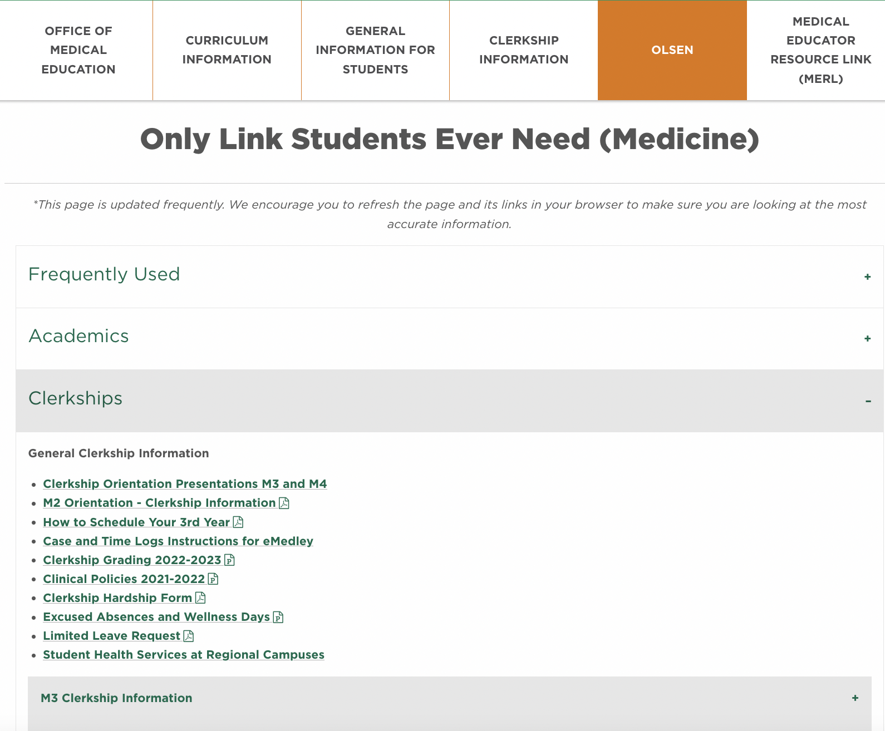
OLSEN
Only Link Students Ever Need!
All calendars, academic bulletin, policies are here
Mistreatment reporting form and Professionalism form here also
https://uthsc.edu/medicine/medical-education/olsen.php

Slide 14
Medical Educator Resource Link (MERL)
One-stop shop for faculty, fellows, residents, and staff regarding COM policies, procedures, and guidelines.
Also available for students
https://uthsc.edu/medicine/medical-education/merl.php

Slide 15
Re-attestation to the Technical Standards
Students must attest that they meet the Technical Standards established by the COM at 1) matriculation, 2) upon entering clinical rotations, and 3) prior to graduation
The Technical Standards include the following:
Motor Skills
Sensory and Observational Skills
Communication Skills
Conceptual, Integrative, and Quantitative Skills
Behavioral and Social Skills, and Professionalism
Please review these from the email sent this morning and re-attest by April 28, 2023. We are not permitted to allow you to enter clerkships until you submit your re-attestation.
If you require an accommodation, please contact SASSI to request the Interactive Process.

Slide 16
Clerkship Policies (Available on OLSEN and MERL)
COM 105: Progress, Promotion, and Graduation
COM 106: Excused Absences and Wellness Day
COM 107: Grading for the MD Curriculum
COM 108: Student Mistreatment Policy
SA105: Preventing Student Mistreatment
COM 110: Narrative Feedback
COM 112: Work (Duty) Hours
UTHSC Student Code of Conduct
COM 121: Professionalism Policy
COM 124: Appearance Code
Religious Accommodations Policy
SA 116: Student Substance Abuse Policy
Drug and Alcohol Policy
Sexual Harassment Policy
COM 116: Inclement Weather
COM 117 & 118: Exposures Policy and Reporting
Incident reporting, Emergency Preparedness

Slide 17
Excused Absences and Wellness Days - Rationale
Excused absences – Students should be able to attend general preventive medical care, urgent/acute medical care, and have appropriate time off for sickness.
Wellness Days – Goal is to promote mental health and wellness among students.
Take a day to rest, recharge, reboot, etc.
NOT a substitute for professional counseling or mental health treatment for a student experiencing a more significant mental health concern!
NOT intended as a “use it or lose it” day off
Notes:
Excused absences – Students should be able to attend general preventive medical care, urgent/acute medical care, and have appropriate time off for sickness.
Wellness Days – Goal is to promote mental health and wellness among students.
Take a day to rest, recharge, reboot, etc.
NOT a substitute for professional counseling or mental health treatment for a student experiencing a more significant mental health concern!
NOT intended as a “use it or lose it” day off

Slide 18
How to Request an Excused Absence or Planned Wellness Day
1. Notify (email) your Clerkship Director and Clerkship Coordinator 30 DAYS IN ADVANCE of the START of the clerkship to request permission.
2. Please be professional in your interactions with your administrators!
3. Complete a Limited Leave Request form (on OLSEN) and email along with your request.

Slide 19
Requesting Permission
“I will be taking a wellness day for my sister’s wedding on xx/xx/xx.”
vs.
“I am emailing you to request the possibility of a wellness day on xx/xx/xx for my sister’s wedding. Thank you!”

Slide 20
What counts as an Excused Absence?
Funerals (death of a close family member)
Acute illness/urgent medical appointments (includes SICK DAYS!)
Preventive or routine healthcare (e.g. PCP appointment, dentist, etc.)
Religious observances/Holy Days
Jury duty and other legal obligations
Step 2 CK*
Residency interviews*
Attendance at professional meetings if presenting or representing the College of Medicine
* Step 2 CK and residency interviews NOT allowed on M3 clerkships.

Slide 21
Sick Days
Notify your Clerkship Director, Clerkship Coordinator, and your team/attending AS SOON AS YOU KNOW you will miss the day.
Prompt notification is not only the professional thing to do, but also let’s us know that you are alive and not missing!!
Complete a Limited Leave Request as soon as you return.
Doctor’s note is required if you miss more than 2 days for any illness.

Slide 22
Professional Meeting Attendance
Notify CD/CC 30 days prior to the START of the affected rotation.
Must be either presenting (poster/oral) or representing the COM.
Provide documentation (email/letter) of your acceptance to the meeting AS SOON AS YOU GET THIS.
Goal is to maximize your participation in your event while also minimizing the time away from your clerkship.
Approval is at the discretion of the Clerkship Director.

Slide 23
Wellness Days
Four wellness days per year (Maximum 2 per clerkship)
No half days or hourly counts

Slide 24
Anticipated (Planned) Wellness Days
Notify CD/CC 30 day prior to the START of the rotation.
May NOT be used during:
Course/shelf exams
Clerkship orientations
Simulation/skill training days
OSCEs
Oral, slide exams
JI rotations
On-call days
Days before or immediately after vacations or administrative closings (i.e. MLK Day)
2-week rotations
Notes:
Advanced notice of 30 days before the start of the rotations is needed.

Slide 25
Emergent (Unplanned) Wellness Days
Urgent/emergent need for a day away from clerkships that does not fall into an excused absence category.
Notify (email) the clerkship director or clerkship coordinator ASAP when you need to take an emergent wellness day. Does not require 30 days advanced notice.
Be professional. Complete a Limited Leave Request as soon as you return to the clerkship.
No questions asked policy to preserve student privacy. However, this should not be treated as a use it or lose it benefit.
If you are struggling, please reach out to your CD. We can help you!

Slide 26
Examples
Planned Wellness Days
Emergent Wellness Days
Weddings
Family reunions
Planned mental health day
Nondisclosed reasoning (e.g. appointment that you prefer not to disclose)
Other important events that don’t fall under an excused absence
Unplanned mental health day
Need for urgent counseling
Any other unforeseen event that does not qualify for an acute excused absence
Notes:
What counts as a wellness day?
Important life events (weddings, reunions, etc.)
Nondisclosed reasons (counseling appointments, “mental health day”, rest, recharge, reboot)

Slide 27
Clinical Supervision
Only assume responsibilities that are commensurate with your ability and experience
You may perform or assist with procedures if you have adequate training, skills, and knowledge as determined by your supervising physician.
Supervision may be by attendings, fellows, and residents.
Notes:
Students may only assume responsibilities that are commensurate with their ability and experience, based on prior training and direct supervisory assessment.
Students may perform or assist with procedures if the supervising physician agrees that the student has had previous training and has the skill and knowledge necessary for the procedure.
Students may be supervised by attendings, fellows, and residents. The attending physician is always ultimately responsible even if they are not physically present with the student
Procedures – the attending of record must be documented on the procedure note and is ultimately responsible for the procedure.

Slide 28
Clinical Supervision – Why?
Patient safety
Student safety
Adequate oversight of patient care
Optimize educational experiences
Assess knowledge and clinical skills of students

Slide 29
Clinical Supervision
Direct observation
Indirect supervision
Type of supervision depends on clinical location, scope of practice, acuity (severity) of the situation, student’s knowledge and skill level
An attending or resident must also physically evaluate any patient seen by a student and review the documentation and plan of care daily to ensure accuracy and completeness
Notes:
Direct observation – Supervising physician is physically present with student and patient
Indirect supervision – Supervising physician is present within the hospital or clinic and is immediately available.
Type of supervision depends on clinical location, scope of practice, acuity (severity) of the situation, student’s knowledge and skill level
An attending or resident must also evaluate in person any patient that a student sees and review the documentation and plan of care daily to ensure accuracy and completeness
**Must be directly observed for any procedure that could pose a risk to the patient

Slide 30
Lapses in Clinical Supervision
Report any witnessed lapse in medical student supervision to your course/clerkship director
If you have concerns about your own supervision, discuss with your immediate supervisor first then the course/clerkship director.
The full policy can be found on the Medical Education Resource Link (MERL) at https://www.uthsc.edu/medicine/medical-education/merl.php.

Slide 31
Inclement Weather
During the clinical years, management of a weather event must balance the demands of patient care and personal safety.
Students on clinical services are expected to continue to provide care for their patients, provided students feel that traveling would not place them at risk of injury.
Students should immediately contact their supervising resident or attending regarding potential risks associated with travel, to report any anticipated absence or delay in arrival, and to make appropriate alternative arrangements.
Students should also immediately report an inability to participate in patient care to the Clerkship Coordinator and/or Clerkship Director.
Days missed due to weather cre considered excused absences. Complete a LLR form and indicate “weather” as the cause.
Notes:
During the clinical years, management of a weather event must balance the demands of patient care and personal safety.
Students on clinical services are expected to continue to provide care for their patients, provided students feel that traveling would not place them at risk of injury.
Students should immediately contact their supervising resident or attending regarding potential risks associated with travel, to report any anticipated absence or delay in arrival, and to make appropriate alternative arrangements.
Students should also immediately report an inability to participate in patient care to the Clerkship Coordinator and/or Clerkship Director.
Clinical experience missed due to inclement weather is considered an Excused Absence.
Complete a LLR form and indicate “weather” as the cause. A single form can be submitted for a series of days missed during the same weather event, but you still need to notify your supervisors and coordinators about your absence each day.
Submit an LLR form even if your ambulatory clinical site was closed for the day or if you were excused from clinical activities by your resident supervisors.
A student missing more than 2 days of a rotation may be required to make up the missed time, at the discretion of the Clerkship Director.
Students should make every effort to fulfill their patient responsibilities. However, they should not place themselves at undo risk and should not be subject to harassment for choosing to avoid travel under conditions perceived to be unsafe. Any such behavior should be reported directly to the Clerkship Director, or anonymously in the course evaluation.

Slide 32
Work Hours Policy
No more than 80 hours/week averaged over a 4-week period
Continuous on-site duty cannot exceed 28 (24+4) consecutive hours, inclusive of clinical care and educational activities
Overnight call may not be more frequent than every 3 days
Night shifts cannot exceed 16 hours and you must have 10 hours off in between shifts.
Students must have 1 day off in 7 averaged over a rotation.
Students must log work hours (Time Logs) for all core clerkships and JI rotations in eMedley.
Any violation of work hours should be reported to the clerkship/course director and is considered mistreatment.

Slide 33
COVID Policies and Procedures
Students should follow standard PPE precautions as directed by the clinical facility in which they are rotating.
Students are permitted to see COVID patients unless there are any restrictions to this imposed by the facility (e.g. pregnant students in the past have not been permitted to see COVID patients).
The majority of clinical facilities are requiring COVID vaccination, but some allow for exemptions.
If you are not vaccinated, you may not be able to rotate at certain facilities. This may result in delayed clinical rotations and delayed graduation.

Slide 34
UTHSC Campus Resources
SASSI
Safety and Security
Exposures, Incident Reports
Study and Relaxation Space
Student Health Services – UHS

Slide 35
SASSI and the M3 Year
Same consultation services (test-taking, shelf exam preparation, test anxiety, time management, etc.) with educational specialists as in M1/M2 years
Here in Memphis or via phone or virtual appointments in Chattanooga, Knoxville, Jackson or Nashville.
Clerkship books on reserve in Chattanooga and Knoxville also
To schedule an appointment – sassi@uthsc.edu or 901-448-5056

Slide 36
SASSI - Wellness and Mental Health
SASSI Share a Concern
https://cm.maxient.com/reportingform.php?UnivofTNHSC&layout_id=1
Counseling services
https://uthsc.edu/sassi/resources/counseling.php

Slide 37
Student Health Services
Memphis – Universal Health Services (UHS)
https://uthsc.edu/student-health-services/
Alternative locations: https://uthsc.edu/student-health-services/locations.php
Chattanooga – Chattanooga Student Health Services
Knoxville – Student Health Services
Nashville – UT students have access to Vanderbilt Student Health Services

Slide 38
Campus Safety
https://uthsc.edu/campus-safety/

Slide 39
Reporting an Incident (e.g., injury, needlestick)
Incident reporting form

Slide 40
Campus Police and Security Escorts
For safety or security issues (that are not emergent) or to request a security escort, call
901-448-4444

Slide 41
Campus Study Spaces
https://uthsc.edu/sace/campus-study-space.php

Slide 42
Clinical Spaces (available on OLSEN)

Slide 43
Professional Identity
A complex structure that the individual uses to link their motivations and competencies to their career role.
Slide content courtesy of MacKenzi Preston, MD

Slide 44
Professional Identity Formation
Acting like a doctor → Being a doctor
This is the transition from M2 → M3 → M4 → Resident → Practicing physician

Slide 45
Things that shape PIF
Perception of the “ideal” doctor
Choosing a specialty
Sentinel events
Inclusion vs Marginalization

Slide 46
How can you develop your Professional Identity?
Surround yourself with supportive, helpful mentors and advisors
Shadow physicians in your areas of interest, ask them about their day-to-day lives and practices
Practice routine, structured reflection
Use narrative medicine
Notes:
Surround yourself with supportive, helpful mentors and advisors
Shadow physicians in your areas of interest, ask them about their day-to-day lives and practices
Practice routine, structured reflection
Indirectly – on clinical experiences
Directly – on one’s current professional identity
Use narrative medicin

Slide 47
Do yourself a favor…as you move through each clerkship take time to:
Reflect on what you liked about the rotation.
Reflect on what you did not like about the rotation.
Consider the lifestyle.
Consider the day-to-day “bread and butter” of the specialty.
Be in tune with your own feelings and motivations.
Build relationships with patients and teammates.
Learn as much as you can from everyone and every rotation.
Keep an open mind.

Slide 48
What to Expect on your Clerkships (Mornings)
Start time – varies by rotation
Patient handover – the time when the night team hands over patient care to the day team (~15-30min).
Pre-rounding – you will review the EMR individually, then go see your patients on your own, start your progress notes, get your thoughts together before rounds, look things up so that you are prepared
Rounds – table vs walking vs bedside. May be short (surgery) or much longer (Peds, Internal Medicine). For medicine-related specialties, this is really the “meat” of the day. This is where a lot of the teaching, thinking, discussing happens.

Slide 49
What to Expect on your Clerkships (Afternoons)
OR – If on a surgical rotation, then this is how you will spend most of your day.
Education – morning report, grand rounds, noon conferences, other afternoon didactics or sessions
Afternoons – scrub into surgical cases, follow up on patients in the afternoon, get to know your patients, study, update handover list, help obtain outside medical records, call for culture results, write notes, read about your patients, etc
Signout – end of the day for the day shift, finish your notes, ask if you can help the team – if they say no then that’s your cue to leave!

Slide 50
How to Succeed while also Enjoying Yourself
Know
Really get to know your patients
Read
Read about their diseases and treatments
Present
Be present. Come early and stay late (without violating work hours!)
Show
Show interest and be a team player
Ask
Ask how you can help the team
Own
Take ownership of your patients and their care – you should know every detail
Be an advocate for your patients. Consider SDoH and ACEs.
Advocate

Slide 51
Enjoy the best year yet!! Questions? Contact Us!
Dr. Kristen Bettin – kbettin@uthsc.edu
Ms. Jenn Wilson – jmcadoo3@uthsc.edu
Ms. Kimberlee Norwood – knorwood@uthsc.edu
Dr. Bill Dabbs – wdabbs@utmck.edu

