Slide 1

Clerkship Grading
2020-2021
Kristen Bettin, MD, MEd
Assistant Dean, Clinical Curriculum
Pediatrics Clerkship Director
Valerie Jameson, MD
Senior Assistant Dean, Clinical Curriculum
Updated July 16, 2020

Slide 2
Why grade at all?
Grading is the summative (ultimate) feedback for student performance.
Grading allows outside entities (residencies) to know how a student’s performance compares with his/her peers in that institution.
Using national norms helps assure that the grading is meaningful outside of just our institution.
Notes:
Grading is the summative (ultimate) feedback to student performance.
Am I performing at a high, low, or acceptable level?
Do I have the skills necessary to be a competent physician?
Do I have the skills necessary to succeed in a highly competitive field?
Grading allows outside entities (residencies) to know how a particular student performance compares with his/her peers in that institution.
Using national norms helps assure that the grading is meaningful outside of the particular institution.

Slide 3
Grading in the pre-clinical years
Primary based on the average of several Multiple-Choice Question tests.
Caveat - Measuring true performance is complicated by the additional uneven skill of MCQT Test Taking ability.
You can argue about a few questions, but the score probably reflects what a student would do on a similar test on any given day.
Notes:
Grading in the basic science courses is mostly based on objective data derived from Multiple Choice Question Testing.

Slide 4
Three components of clerkship grading
Medical knowledge (expertise)
Professionalism
Clinical skills and performance
Notes:
More complex
Now students must also be graded on
Clinical skills – patient interaction, communication, eye-hand coordination, reasoning skills, team integration, self-perception, etc.
Professionalism, ethical behavior
While the opinion of an experienced faculty member in judging student performance is considered “objective”, the reality is that subjectivity and perception have an increased influence on feedback.
While this may seem to allow for unfair variability, this is exactly how patients and peers judge physicians in the real world. (Learning how people perceive you is incredibly valuable knowledge and that’s what you get in your clinical grade).

Slide 5
Grading in the clinical years is more complex
Clinical skills and performance are assessed by faculty members and residents.
Evaluations by experienced faculty members have the goal of being fair, just, and objective; however, subjectivity and perception may influence feedback.
While this may seem to allow for unfair variability, this is exactly how patients and peers judge physicians in the real world.
Notes:
More complex
Now students must also be graded on
Clinical skills – patient interaction, communication, eye-hand coordination, reasoning skills, team integration, self-perception, etc.
Professionalism, ethical behavior
While the opinion of an experienced faculty member in judging student performance is considered “objective”, the reality is that subjectivity and perception have an increased influence on feedback.
While this may seem to allow for unfair variability, this is exactly how patients and peers judge physicians in the real world. (Learning how people perceive you is incredibly valuable knowledge and that’s what you get in your clinical grade).

Slide 6
Medical Knowledge and Expertise
Equally important in describing student performance is knowledge and reasoning ability → expertise.
Patients come to physicians for compassion and ethical treatment, but they expect expertise as well.
Expertise is more easily quantified through MCQT, which allows for national comparisons.

Slide 7
It’s vital that all three aspects contribute to the summative clerkship grade
Students often excel in one aspect or the other.
However, the good physician must be competent in all three areas.
Grading therefore must fairly evaluate all three domains.
This allows students to accurately identify their strengths and weaknesses.
It satisfies the public that medical schools are producing competent physicians.
It informs residencies which students would best fit their discipline.

Slide 8
How to achieve this goal
NBME subject exams (shelf exams) → assess medical knowledge and expertise
Clinical evaluations → assess clinical skills, performance, and professionalism
Notes:
Clinical evaluations → assess clinical skills, performance, and professionalism
Faculty use a standardized evaluation to evaluate where students are on a given set of behavior (performance) descriptors.
Faculty do NOT assign grades to students.
Clinical evaluations use the Entrustable Professional Activities (EPA) framework.
NBME Subject exams (shelf exams) → assess medical knowledge and expertise
Every clerkship utilizes shelf exams.
Minimum passing scores and scores to be eligible for receiving a “A” are standard percentiles across clerkships and across the state.

Slide 9
Minimum Passing and Honors Scores
The NBME reports scores as “raw scores” which are mean equated percent correct scores, like a percent correct.
Minimum passing score | 5th percentile
Minimum score to be eligible for an “A” in the clerkship | 50th percentile
Score that is equal to an “A” on the shelf exam. | 75th percentile
Notes:
A 89.5-100
B 78.5-89.49
C 67.5-78.49
F < 67.49

Slide 10
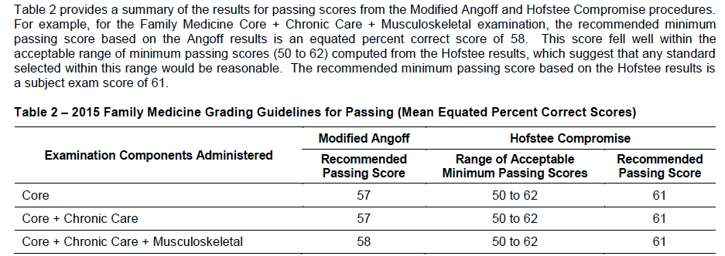
NBME- nationally recommended minimum passing score for the Family Medicine Shelf Exam

Slide 11
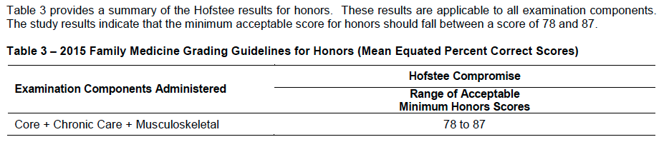
Minimum honors score for the shelf exam

Slide 12
What about students at the beginning vs. the end of clerkships?
Students naturally improve their performance on the shelf exams throughout the year.
These cutoff scores will be based on the “Quarter” of the year and based on how many clerkships a student has completed.
NBME reports all of these scores!
# of Clerkships Completed | Score used
0-1 | Q1
2-3 | Q2
4-5 | Q3
6-7 | Q4

Slide 13
Family Medicine Shelf Exam Cut-off Scores 2020-2021
Quarterly Conversions |  | Q1 | Q2 | Q3 | Q4
Number of clerkships completed PRIOR to the START of THIS rotation |  | 0-1 | 2-3 | 4-5 | 6
Raw shelf score = 89.5 (i.e. A on the shelf) | 75th percentile | 79.7 | 80.4 | 81.8 | 81.8
Raw shelf score to be eligible for an A in the clerkship | 50th percentile | 74 | 75 | 77 | 77
Minimum passing raw shelf score | 5th percentile | 60 | 60 | 62 | 64

Slide 14
Internal Medicine Shelf Exam Cut-off Scores 2020-2021
Quarterly Conversions |  | Q1 | Q2 | Q3 | Q4
Number of clerkships completed PRIOR to the START of THIS rotation |  | 0-1 | 2-3 | 4-5 | 6
Raw shelf score = 89.5 (i.e. A on the shelf) | 75th percentile | 80.2 | 80.8 | 82 | 82.8
Raw shelf score to be eligible for an A in the clerkship | 50th percentile | 74 | 75 | 76 | 77
Minimum passing raw shelf score | 5th percentile | 58 | 59 | 60 | 61

Slide 15
Neurology Shelf Exam Cut-off Scores 2020-2021
Quarterly Conversions |  | Q1 | Q2 | Q3 | Q4
Number of clerkships completed PRIOR to the START of THIS rotation |  | 0-1 | 2-3 | 4-5 | 6
Raw shelf score = 89.5 (i.e. A on the shelf) | 75th percentile | 84 | 85 | 85.6 | 86
Raw shelf score to be eligible for an A in the clerkship | 50th percentile | 79 | 79 | 80 | 81
Minimum passing raw shelf score | 5th percentile | 64 | 65 | 66 | 66

Slide 16
OB/GYN Shelf Exam Cut-off Scores 2020-2021
Quarterly Conversions |  | Q1 | Q2 | Q3 | Q4
Number of clerkships completed PRIOR to the START of THIS rotation |  | 0-1 | 2-3 | 4-5 | 6
Raw shelf score = 89.5 (i.e. A on the shelf) | 75th percentile | 82.8 | 83.5 | 84 | 84
Raw shelf score to be eligible for an A in the clerkship | 50th percentile | 77 | 78 | 79 | 79
Minimum passing raw shelf score | 5th percentile | 62 | 63 | 65 | 65

Slide 17
Pediatrics Shelf Exam Cut-off Scores 2020-2021
Quarterly Conversions |  | Q1 | Q2 | Q3 | Q4
Number of clerkships completed PRIOR to the START of THIS rotation |  | 0-1 | 2-3 | 4-5 | 6
Raw shelf score = 89.5 (i.e. A on the shelf) | 75th percentile | 82.5 | 82.8 | 84.2 | 84.5
Raw shelf score to be eligible for an A in the clerkship | 50th percentile | 77 | 77 | 79 | 79
Minimum passing raw shelf score | 5th percentile | 62 | 62 | 64 | 65

Slide 18
Psychiatry Shelf Exam Cut-off Scores 2020-2021
Quarterly Conversions |  | Q1 | Q2 | Q3 | Q4
Number of clerkships completed PRIOR to the START of THIS rotation |  | 0-1 | 2-3 | 4-5 | 6
Raw shelf score = 89.5 (i.e. A on the shelf) | 75th percentile | 86.2 | 86.7 | 87.2 | 87.2
Raw shelf score to be eligible for an A in the clerkship | 50th percentile | 82 | 82 | 83 | 83
Minimum passing raw shelf score | 5th percentile | 68 | 69 | 71 | 71

Slide 19
Surgery Shelf Exam Cut-off Scores 2020-2021
Quarterly Conversions |  | Q1 | Q2 | Q3 | Q4
Number of clerkships completed PRIOR to the START of THIS rotation |  | 0-1 | 2-3 | 4-5 | 6
Raw shelf score = 89.5 (i.e. A on the shelf) | 75th percentile | 77.8 | 79.5 | 80.2 | 80.8
Raw shelf score to be eligible for an A in the clerkship | 50th percentile | 72 | 74 | 75 | 76
Minimum passing raw shelf score | 5th percentile | 57 | 59 | 60 | 61

Slide 20
Weighting clinical and exam scores
The competent student excels in all three areas – patient care, ethics and expertise.
However, if all student clinical evaluations are glowing, then the shelf exam, by default, becomes the discriminating factor.
We must strive to make the clinical evaluation discriminating and to weight it sufficiently to counterbalance the ruthless objectivity of the shelf score.

Slide 21
Correct weighting
Potential outcomes
  Super nice, hard working student but average performance on the shelf
    Clerkship Grade B
  Never available and only putting in the minimal work on the ward in order to be off studying for the shelf which they blow out of the water
    Clerkship Grade B
  Excellent performance on the wards, intimately integrated into the team, barely makes above the cutoff for honors on the shelf
    Clerkship Grade A
The student must excel in all areas to receive an A in the clerkship.
Notes:
So just because a student achieved the minimum honors score on the shelf, it does not guarantee that he/she will get an A for the clerkship.

Slide 22
Review of Grading 2019-2020
Fall semester, large scale effort to review all semester of clerkship grades and determine fairness in weight of the shelf exam and percentile cutoffs.
Resulted in a fairer distribution of A’s across clerkships.

Slide 23
Why don’t we just give all A’s?!
Notes:
Until recently, the Dean’s Letter, MSPE, simply provided a GPA along with the student transcripts.
Now, the MSPE must include the grade distribution for each clerkship.
Residency Program directors will know that getting an A when 80% of the class did as well is meaningless.
Getting an A when only a third of the class did as well is discerning.
Our goal is to identify the top third of the class in any given clerkship, BUT our job is to also assure that that assignment is fair and valid.

Slide 24
Lastly, apples and oranges
⍯
The NBME reports the raw scores (mean equated percent correct score).
When using these for calculation of the final grade (along with clinical evaluations, oral/slide exams, etc), it is essential to convert the raw score to the same format we use for grading.
All “raw scores” are then converted to the UTHSC grading scale to be included in the final grade calculation.
You will receive your “composite score” at the end of the clerkship which will list the individual components of your grade including your raw shelf and converted shelf scores. (This can be done either via email or through the gradebook function on eMedley.)
UTHSC Clerkship Grading Scale:
A = 89.5-100
B = 78.5-89.49
C = 67.5-78.49
F < 67.49
=

Slide 25
Why should we grade at all?
To reduce reliance on USMLE Step 1 scores.
Because residencies DO look at the MSPE (Dean’s Letter) to see who will be a good fit for their program. Your overall comments on your evaluations can be used for your MSPE.
Most importantly, the only way for a student to improve his/her skills is by receiving valid, useful, timely, specific, discerning feedback.
Notes:
Remove this?

Slide 26
Course Evaluations
Your feedback is important to us! https://youtu.be/CA-sOSv9d98
Feedback Rewards: http://bit.ly/utmedfeedbackrewards

