Slide 1
Applying through Visiting student learning opportunities system or vslo
Kimberlee Norwood, MA
Program Lead Visiting Affiliations and Clinical Onboarding

Slide 2
Applying through VSLO
Introduction
What you may need
How you do it
Timeline
Summary

Slide 3
Visiting student learning opportunities - VSLO
VSLO is pronounced Veez-low
not Vee-slow per the AAMC

Slide 4
Gaining access and using VSLO
Receive invite from AAMC sent by Ms. Norwood
Follow instructions in invite
Use netID@tennessee.edu for the email
Complete application profile
Review host requirements
Search for and apply to electives
Upload and assign documents
Track application status

Slide 5
Students must meet with their specialty advisor prior to applying for an away rotation
https://www.uthsc.edu/medicine/student-affairs/counseling/m3.php

Slide 6
What information might I need to apply in VSLO? https://www.uthsc.edu/medicine/medical-education/away-rotation.php
Identification information:
Contact Information:
Last four digits of social security number (SSN)
Date of birth (DOB)
Gender
**ONLY displayed to host if you accept their elective offer.
Full legal name
AAMC ID
Address
Phone number
Email address
Emergency contact
Citizenship and Visa information, if applicable
Verification Data:
Supporting verification data is supplied by your home school (i.e., indicating you are in good academic standing and the amounts of your liability coverage)
Supporting Documents:
Core Clerkships:
Include dates core clerkships have
Been/will be completed.
Transcript
Photograph
Curriculum vitae (CV)
AAMC Immunization Form
Supplemental documentation
Elective Requests:
The electives and dates you are requesting,
in order of preference.

Slide 7
Key Information for VSLO
Helpful link: https://www.uthsc.edu/medicine/medical-education/away-rotation.php
Request transcripts from Self-Service Banner, Student tab, Student Records, then top option: ERAS/VSAS Transcript request (Medical Students only).
AAMC Immunization Forms can be completed at University Health Services (UHS).
Letters of Good Standing can be requested from knorwood@uthsc.edu
Certificate of Malpractice coverage is posted on OLSEN. If additional coverage is needed, student acquires at student’s expense.
If need a criminal background check (other than at matriculation), student can request from Verified Credentials at student’s expense.
Letters of Recommendation (LOR) are the student’s responsibility. Have the person send the LOR to knorwood@uthsc.edu to attach to your application.
Need to have current copy of BLS/ACLS certification.
TB Mask fit card – know where it is, if you are asked to provide.
HIPAA Training certificate – know where it is, if you are asked to provide. HIPAA Privacy and Security Training
OSHA Training certificate – know where it is, if you are asked to provide.
Drug Screening – You may have it done at UHS. 6 panel or 10 panel? 6 months or 12 months?
Board Scores – know where your report is, in case the report is requested.
Home School Evaluation Form – this is located on OLSEN. Ms. Norwood will send them to VSLO schools as well, if requested from school.

Slide 8
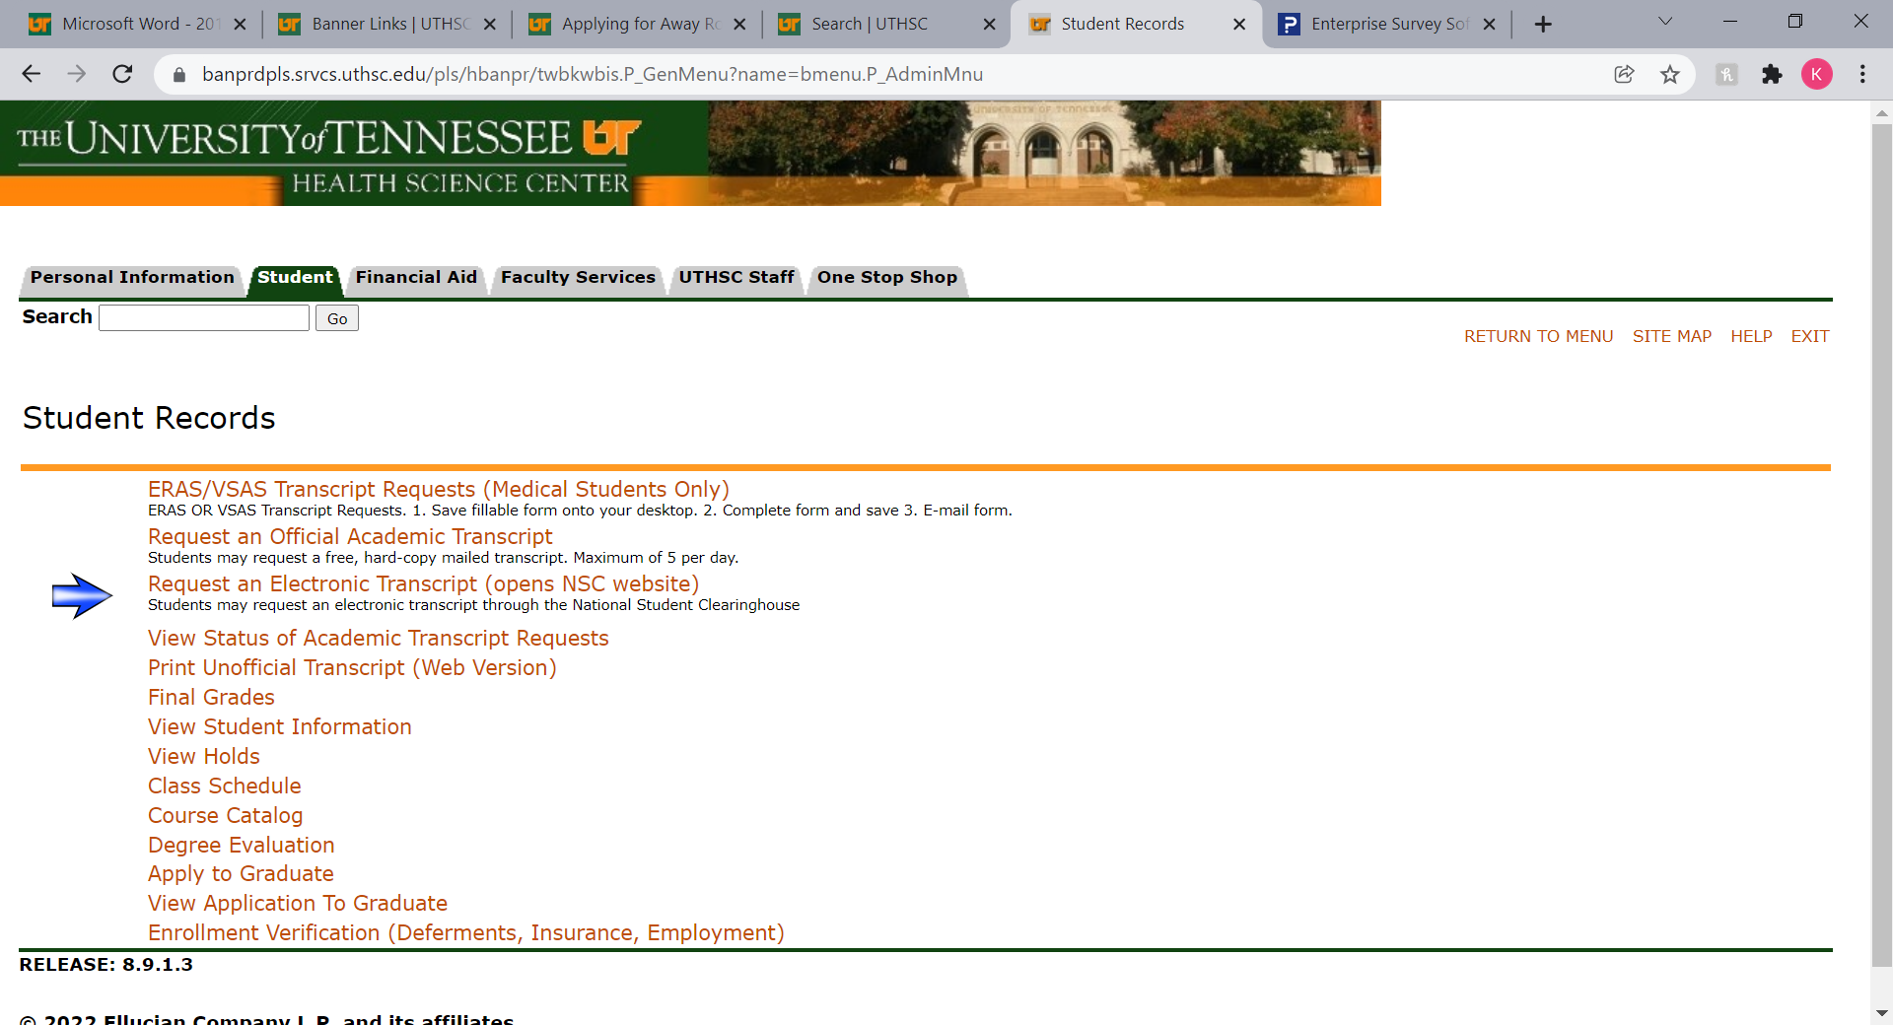

Slide 9





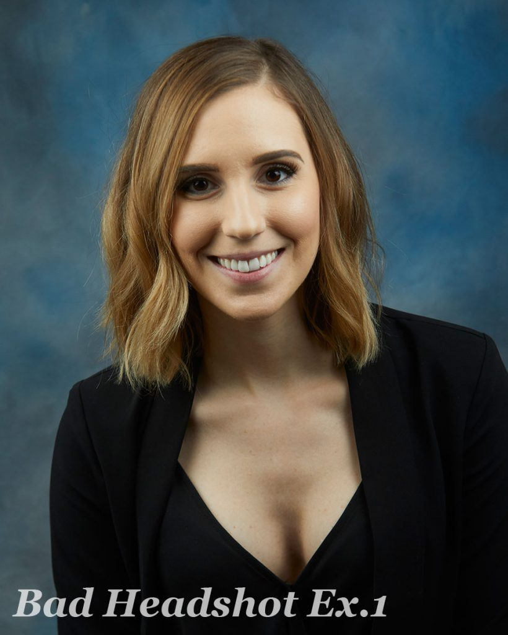
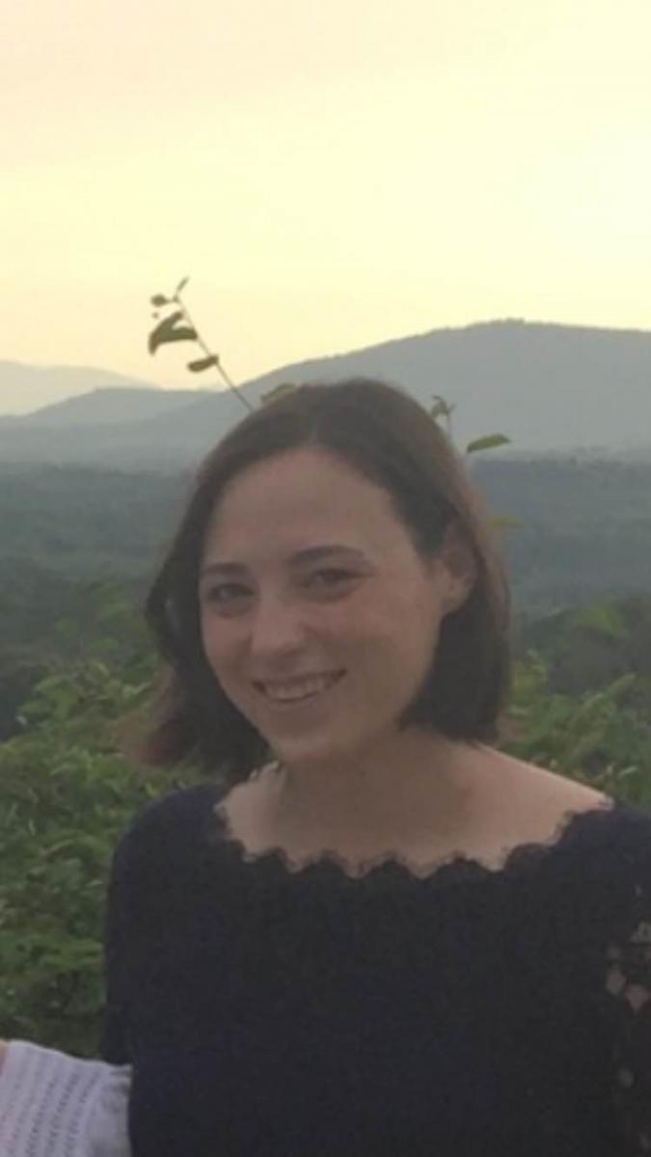
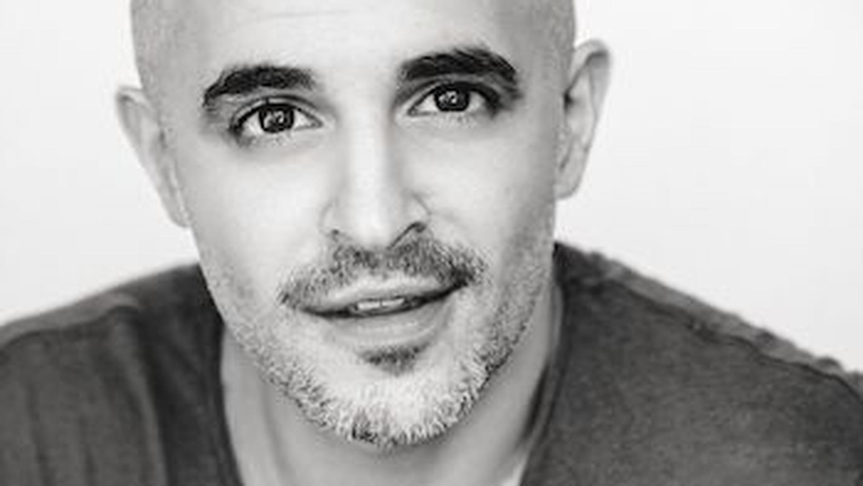

VSLO Photograph bad examples

Slide 10
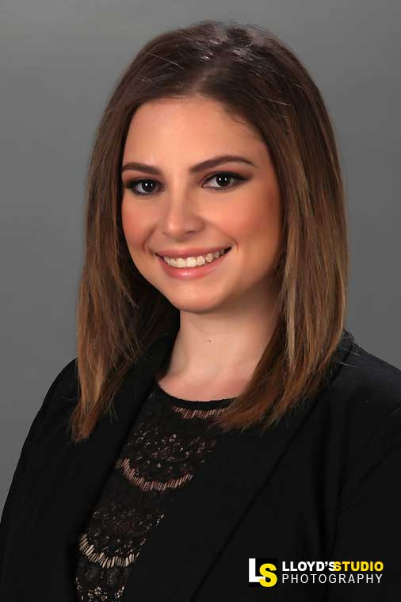
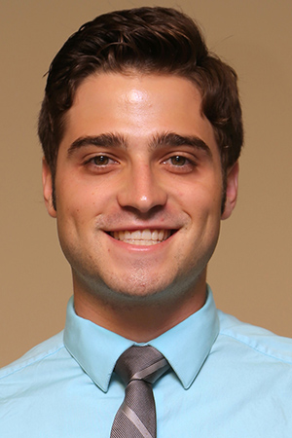
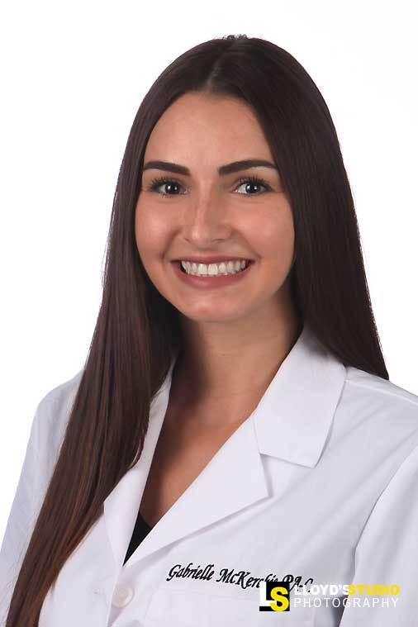
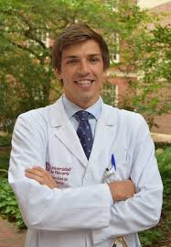
Professional photograph

Slide 11
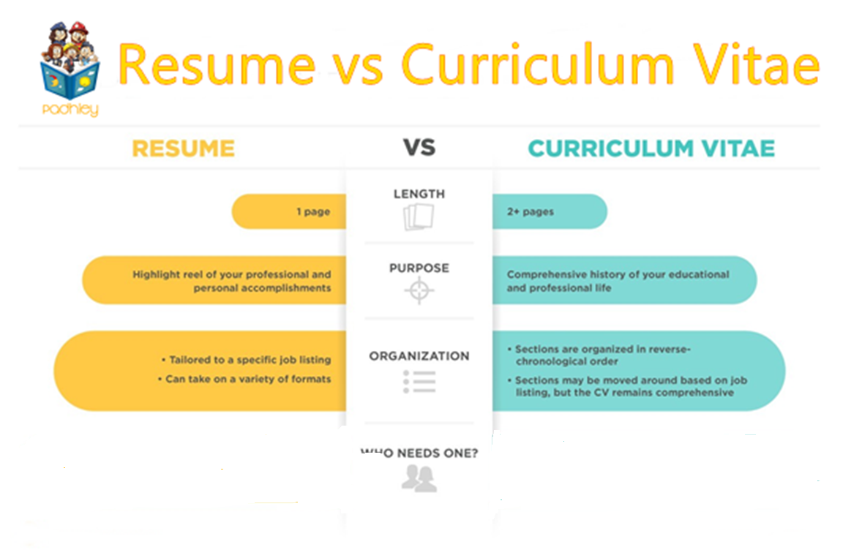
Richard Branson
Physicians when applying for a specific position – highlighting relevant skills and experience
Medical students, residents, physicians – living document, full history including academics, presentations, publications, etc.

Slide 12
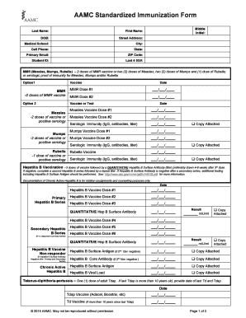

Slide 13
Fees for VSLO
Who pays VSLO fees?
  Student
Fees based on number of institutions applied to not number of electives
First institution is $35
  $15 second institution fee
  $15 third institution fee
If the student re-apples to one of these three institutions, they will not be charged a second time.

Slide 14
Not sure if a rotation is the right fit for you
Away elective reviews are posted by students that have done a previous away at said location. You may view those here:
https://reportview.tennessee.edu/reports/powerbi/UTHSC/COM/Course_Evals/Away_Electives

Slide 15
Key links for VSLO
VSLO website:
https://students-residents.aamc.org/visiting-student-learning-opportunities/visiting-student-learning-opportunities-vslo
How to use VSLO:
https://students-residents.aamc.org/visiting-student-learning-opportunities/how-use-vslo-application-service
VSLO Training Videos:
https://students-residents.aamc.org/attending-medical-school/vslo-application-student-training
VSLO FAQs:
https://students-residents.aamc.org/visiting-student-learning-opportunities/vslo-frequently-asked-questions
VSLO Coronavirus (COVID) FAQs:
https://students-residents.aamc.org/visiting-student-learning-opportunities/coronavirus-covid-19-and-vslo-program-0
Explore URiM Opportunities:
https://students-residents.aamc.org/students/explore-urim-opportunities-visiting-students

Slide 16
Non-vslo away electives
If you want an away rotation not in VSLO, you must complete the Application Form for NonVSLO Away/International Electives and submit to knorwood@uthsc.edu
  Section 1 – student completes
  Section 2 – corresponding UT Department completes
  Section 3 – Office of Medical Education approves (knorwood@uthsc.edu)
  Section 4 – Completed by the Host Institution
  Form MUST be completed and returned with legible host institution information to knorwood@uthsc.edu PRIOR to beginning the rotation.

Slide 17



questions

Slide 18
THANK YOU
Kimberlee Norwood, MA
Program Lead Visiting Affiliations and Clinical Onboarding
knorwood@uthsc.edu

