Slide 1
Welcome to Fourth Year Class of 2021
Prepared by
Phillip Link & Andrew McBride (Class of 2020)
with Dr. Catherine Womack, MD

Slide 2
Goals of Fourth Year
Completing your M.D.
Applying to Residency
UT COM requirements
USMLE Step 2 CK and CS
Preparing to be an intern
Courses for future specialty
Completing application
Securing letters
Interviewing
Ranking
Matching
Choosing a specialty

Slide 3
Main variables in scheduling M4 year
What is required to graduate?
What should I specialize in?
Away rotations – Do I need to do aways? When? How many?
Step 2 CK and CS – When should I take these exams?
When do I apply for residency, and when are interviews?
[How do I apply for residency? – This information comes later.]

Slide 4
MSEC Introduction to M4 Year
What you will see in the PDF provided by MSEC
Aimed at helping you plan your fourth-year schedule

Slide 5
UT COM Requirements
13 four-week blocks
Block 5 (2020) through Block 5 (2021)
2 Junior Internships
4 Electives
1 Geriatrics-Palliative Care
1 Capstone
5 Option Blocks
* (2 option blocks must be taken consecutively in Blocks 11, 12, or 1, during interview season)

Slide 6
Quick Master Calendar
Can help you plan your 13 blocks
Useful in helping you nail down your dates for Step 2 CK and CS
Also helpful in figuring out how to plan away rotations
What needs to happen before submitting application

Slide 7
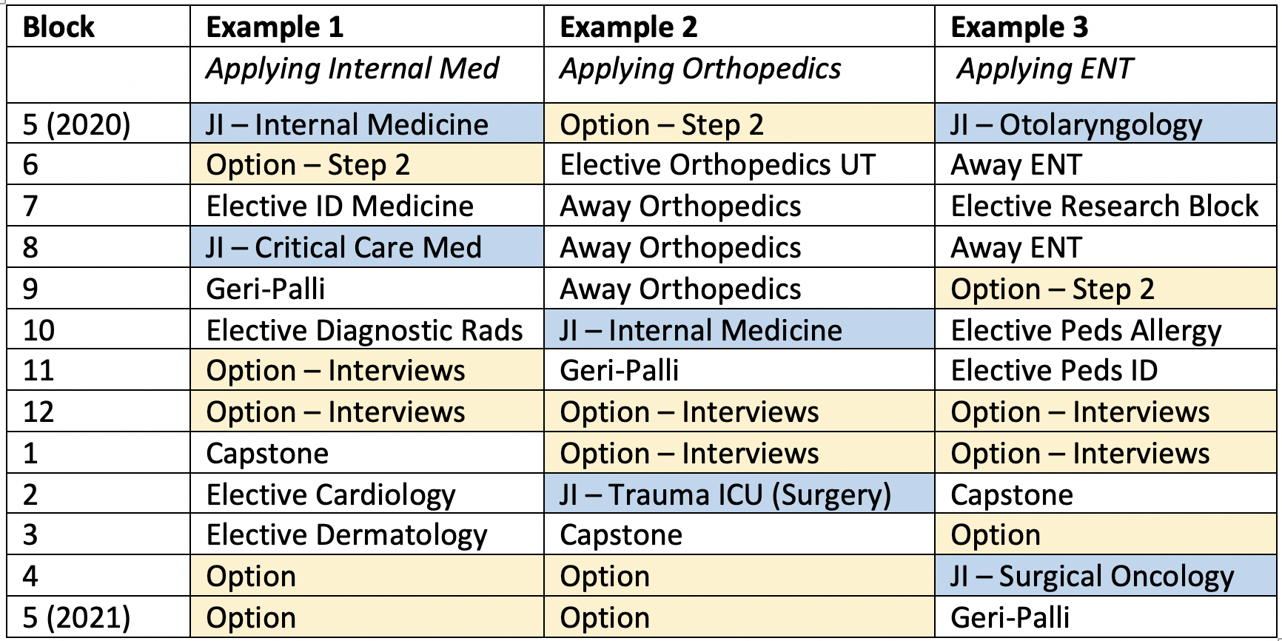
Example Schedules
Notes:
Things to think about
When does Step 2 need to be taken
When should I do JIs
Who is going to write my letters
When do I need to submit ERAS – Sept 15
When will I be interviewing?

Slide 8
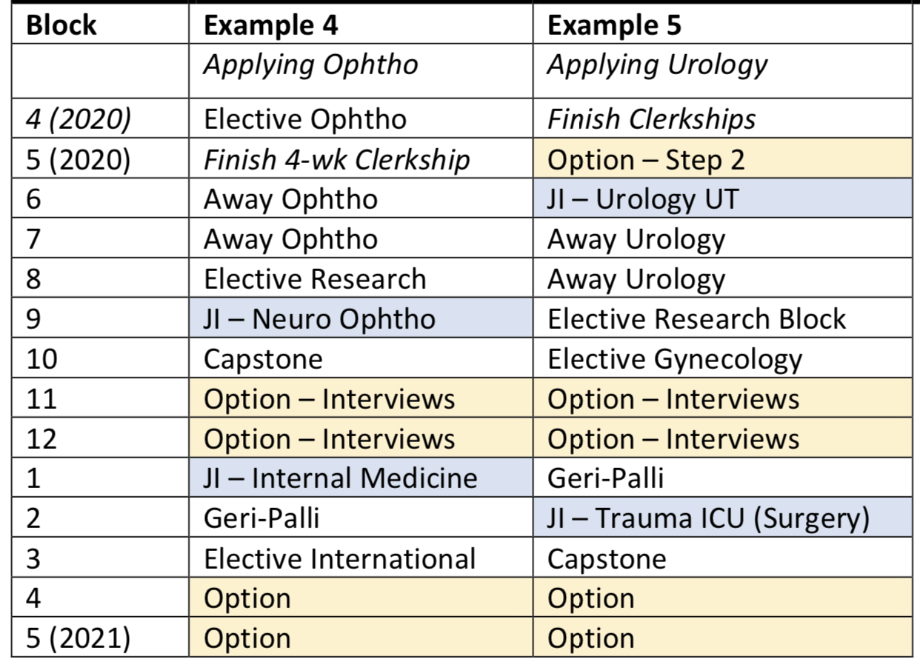
Example Schedules – Early match
Notes:
Some notes:
Can potentially move one clerkship a bit later with approval from Dr. Jameson
Many students applying early take Step 2 later (block 9 or 10)
Interviews are early; Match is January

Slide 9
Specialty Advisor
By the end of January, you have to fill out this form
Some of these questions may be useful to ask now

Slide 10
Good questions to ask
Ask about whatever you think is important in your life and if it lines up with the specialty
Ask about if you are competitive to match in the specialty (and where)
Where do I plan to apply?
Do I need to do an away?
Do I need to do research?
How do letters of recommendation work?
Should I apply to an alternate residency?
Should I look into prelim programs?
Should I discuss alternate career options with the Dean of Students?
Notes:
Some of these questions are pertinent now to scheduling your fourth year.

Slide 11
Residency Guide – Advice from experts
UT Residency Program Directors and Department Chairs:
Have information for:
Scores, GPA
Research
Aways
Ideal Candidate
Courses for M4s
Anesthesia
Dermatology
Emergency Medicine
Family Medicine
General Surgery
Internal Medicine
Medicine-Pediatrics
Neurology
Ophthalmology
Otolaryngology (ENT)
Pediatrics
Plastic Surgery
Radiology

Slide 12
Residency Guide – an example

Slide 14
Other Resources – AAMC
Careers in Medicine

Slide 15
Other Resources – AAMC
Applying to Residency

Slide 16
Other Resources – AAMC
Information about Cost

Slide 17
Other Resources – AAMC
Residency Explorer

Slide 18
Other Resources – NRMP
Charting Outcomes in The Match

Slide 19
Other Resources – NRMP
Video – How the Algorithm Works

Slide 20
Other Resources – NRMP
Program Directors Survey

Slide 21
Very last page - contacts
Authors – Phil and Andrew
Student Affairs Deans
CUME – Jordan Luttrell and David Wallace
IMPORTANT
Current M4s to reach out to. Cell phone numbers and emails.
https://docs.google.com/document/d/1Ue-NZeutjxshiICar2_HuPPy7W-a0D2TegKRf7fq880/edit?usp=sharing

