Slide 1
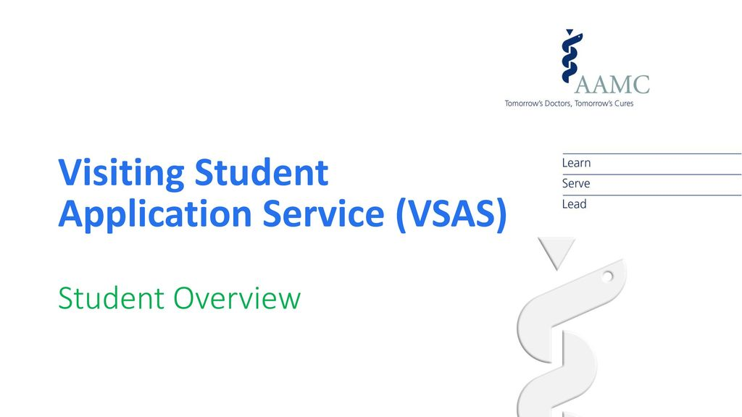

Slide 2
Visiting Student Learning Opportunities (VSLO)
As it is now called.
Pronounced – Veez Low.
Not Vee Slow.

Slide 3
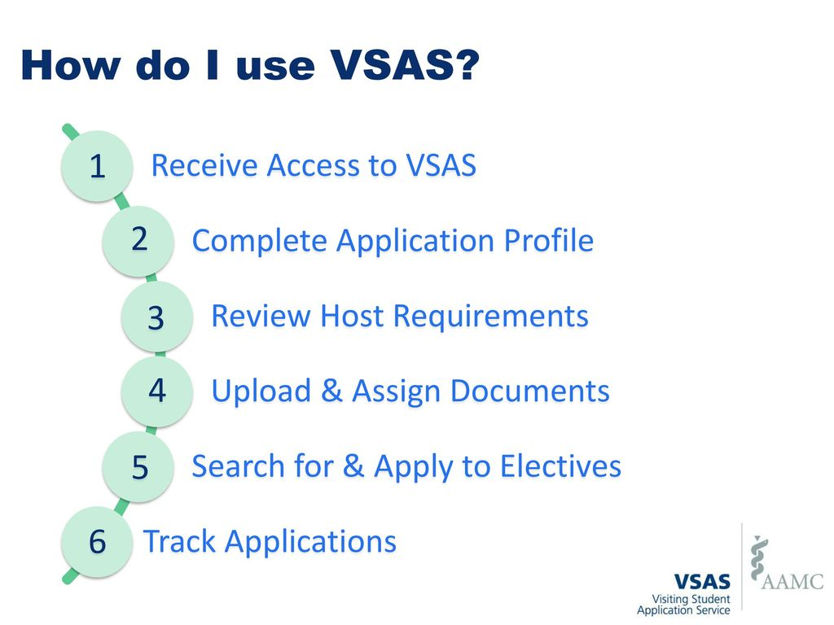

Slide 4
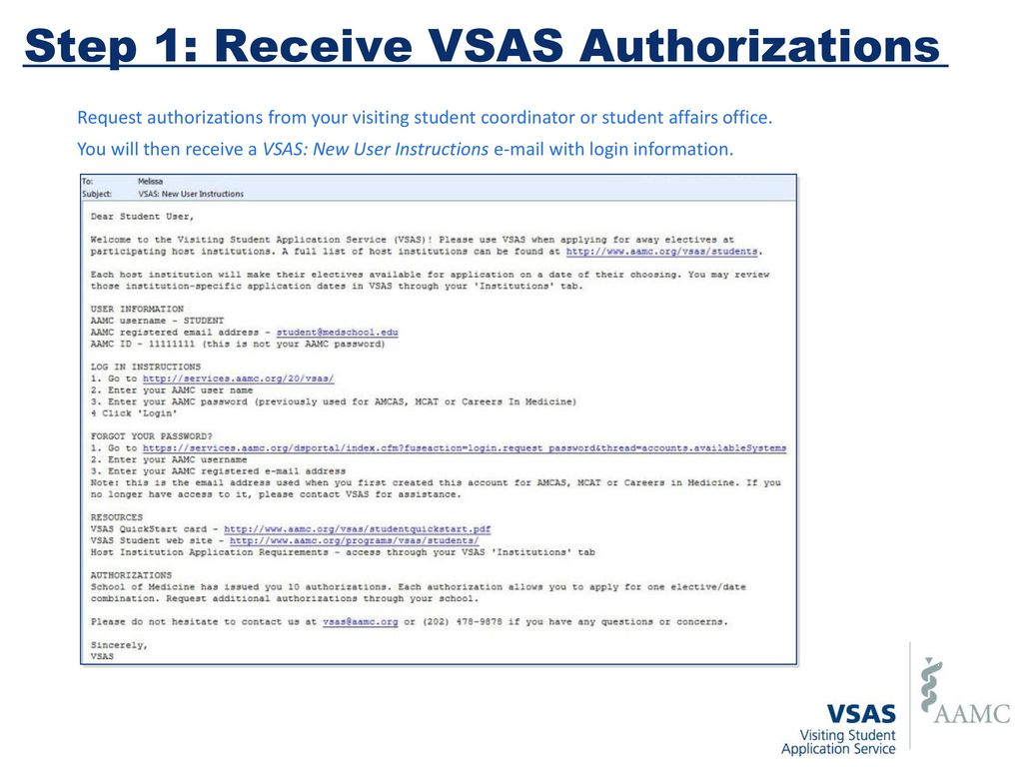

Slide 5
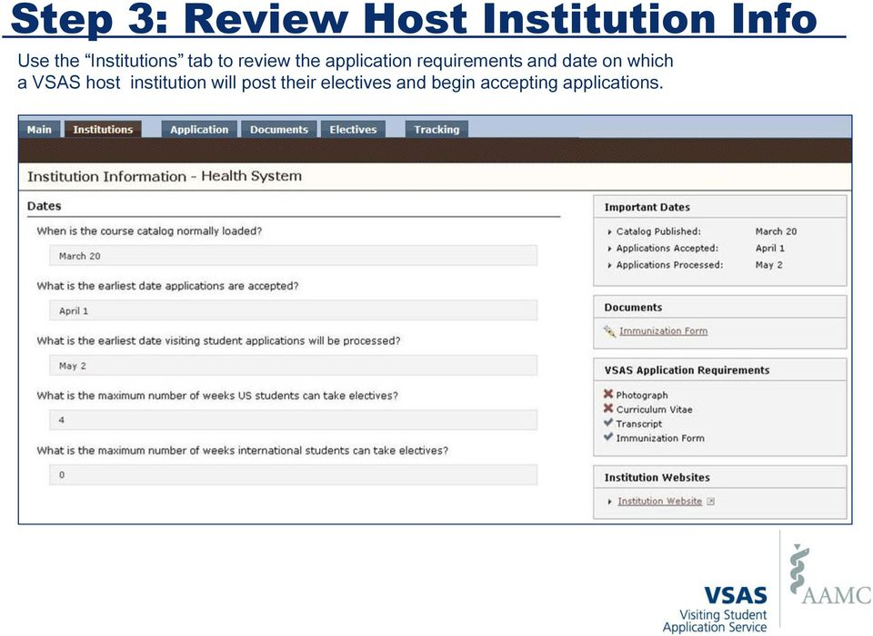

Slide 6
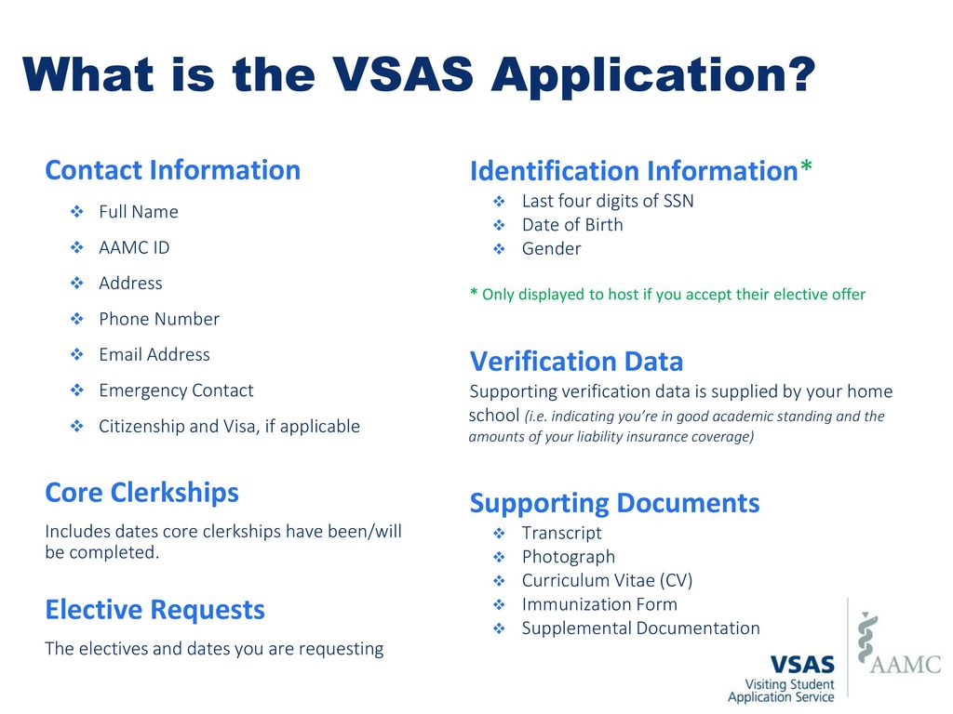

Slide 7
Key Information for
Applying to Away Rotations
https://uthsc.edu/medicine/medical-education/away-rotation.php

Slide 8

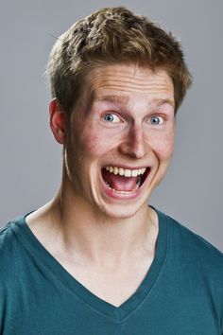
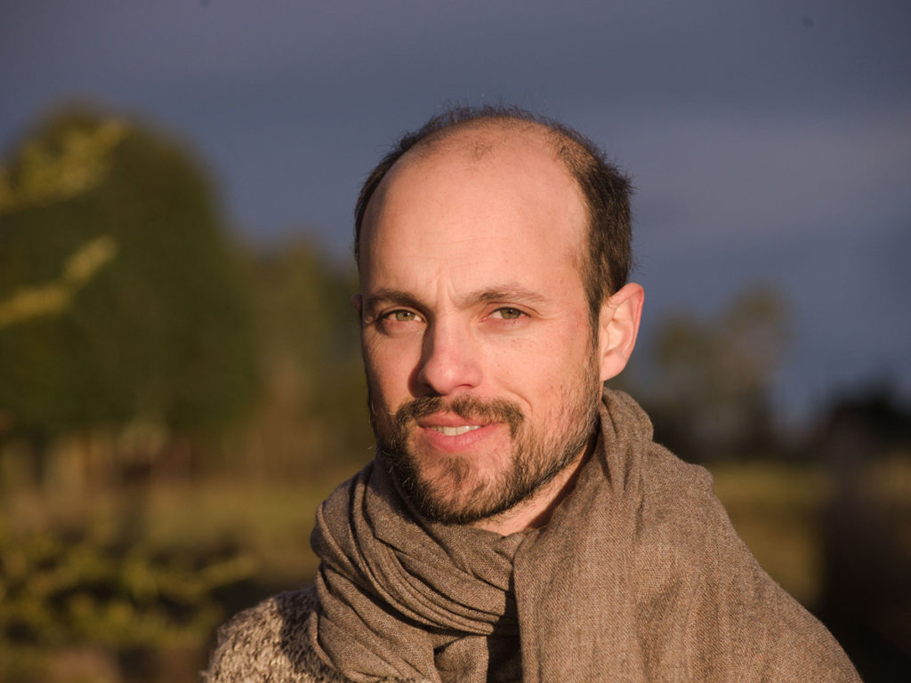
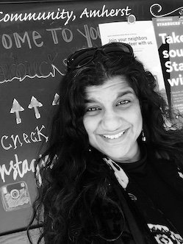

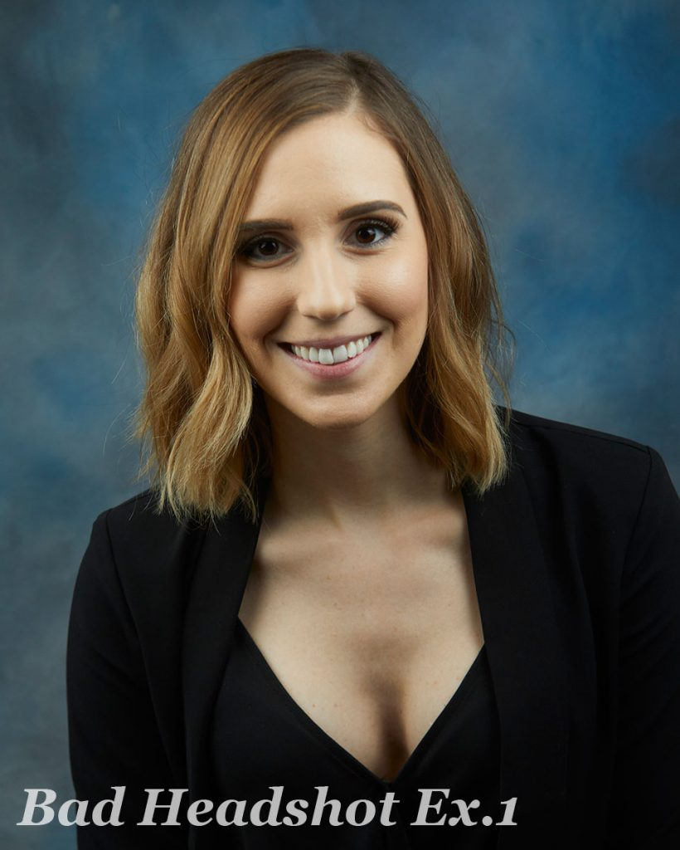
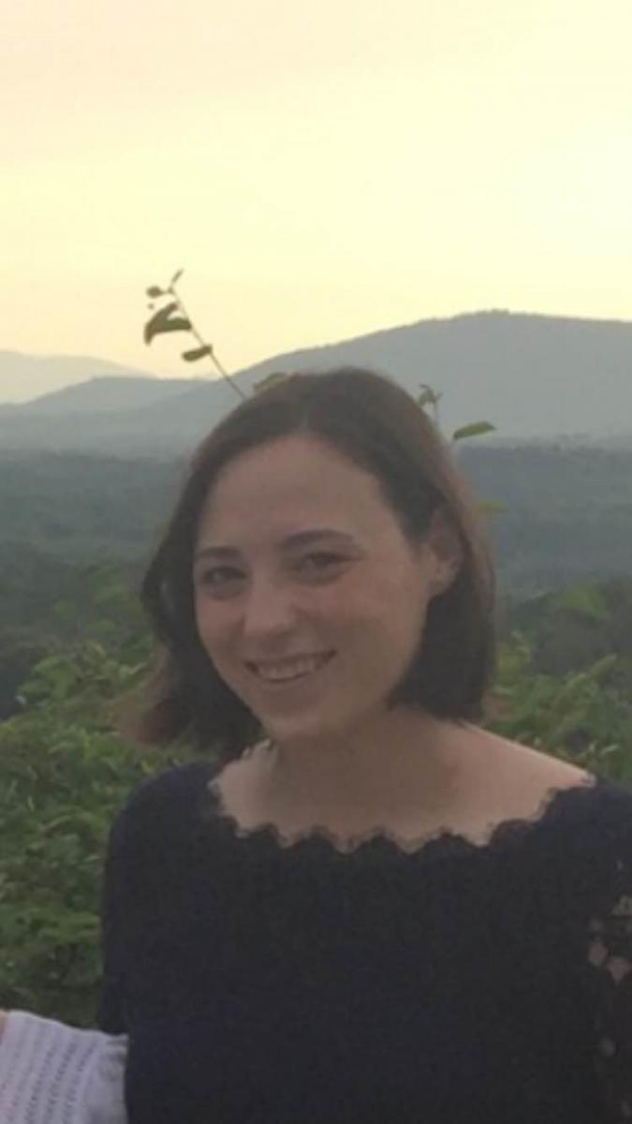
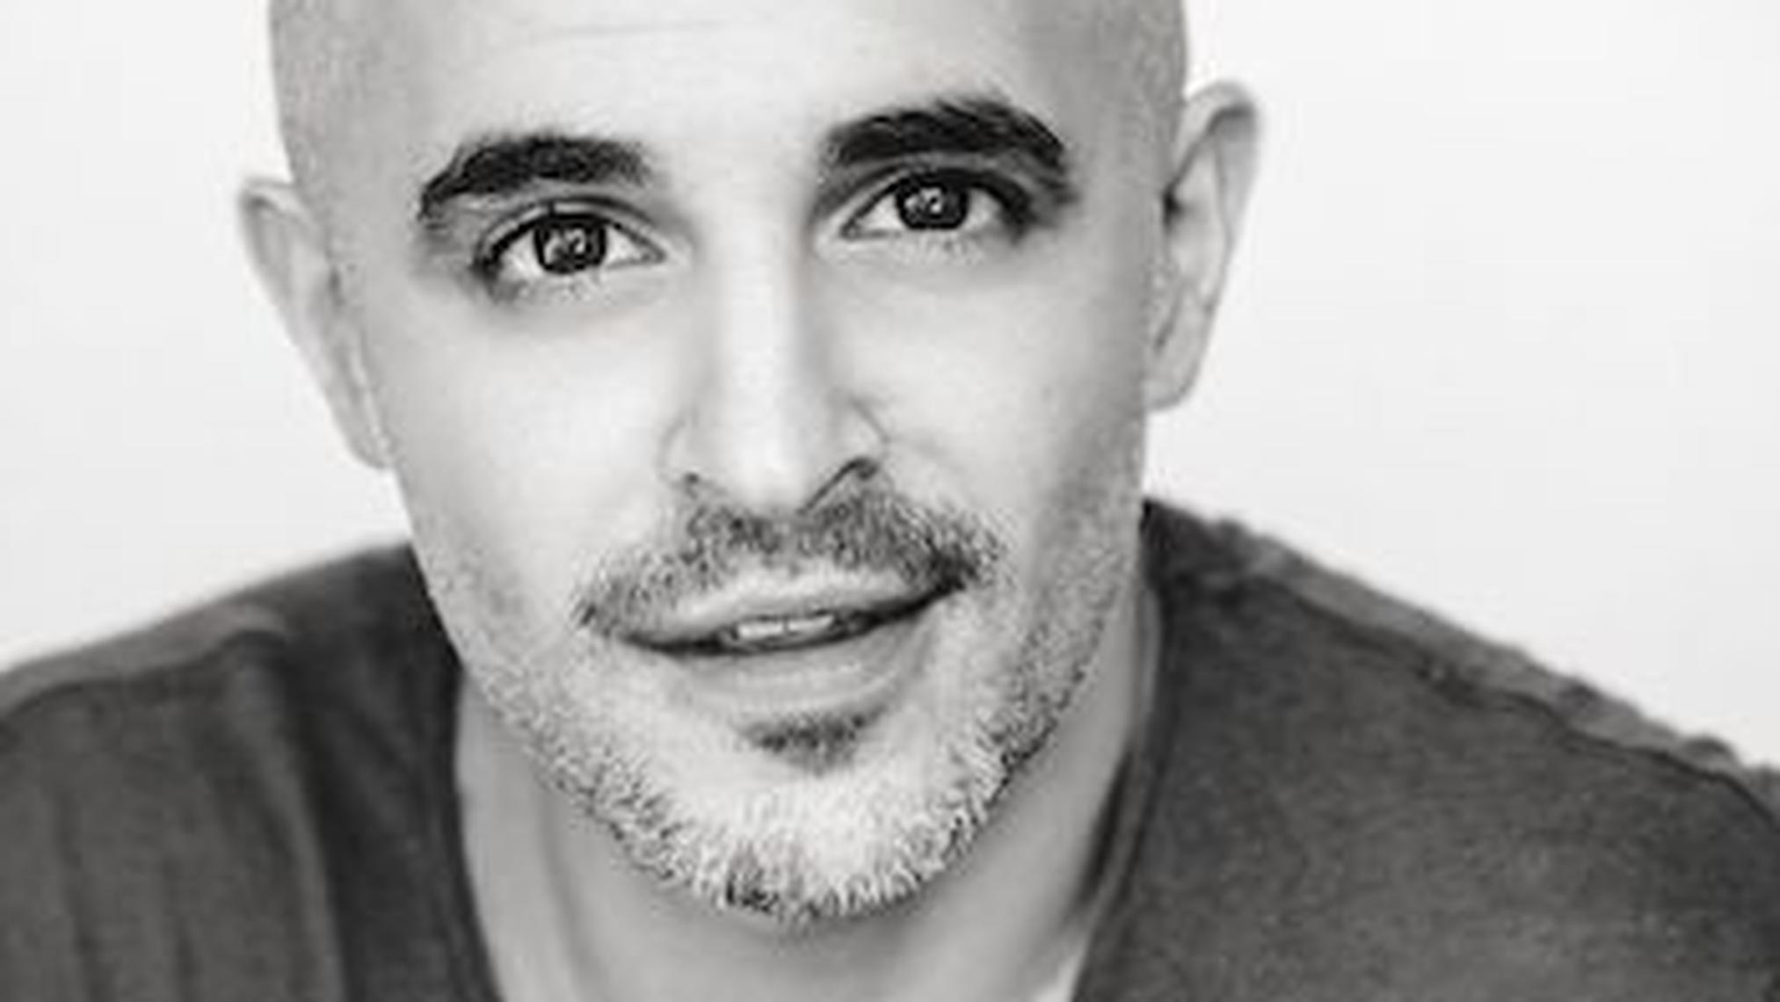

VSLO Photograph

Slide 9
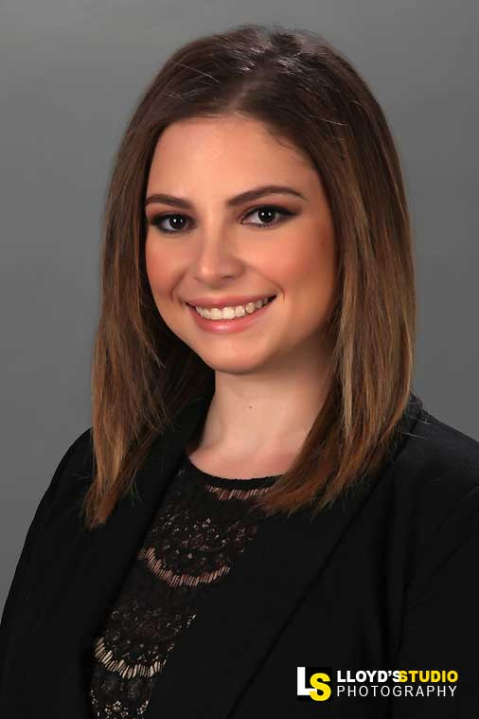
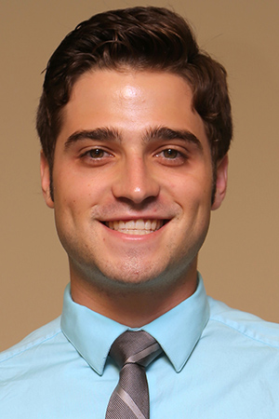
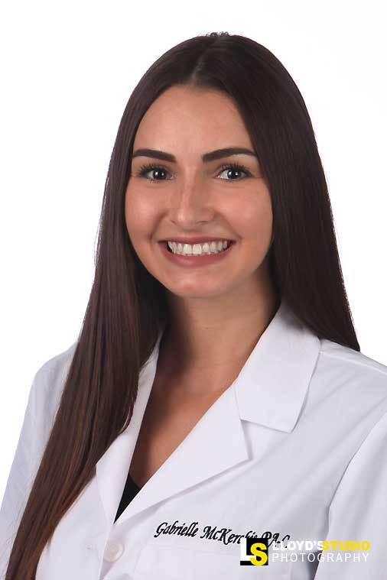
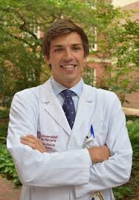
Be Professional

Slide 10
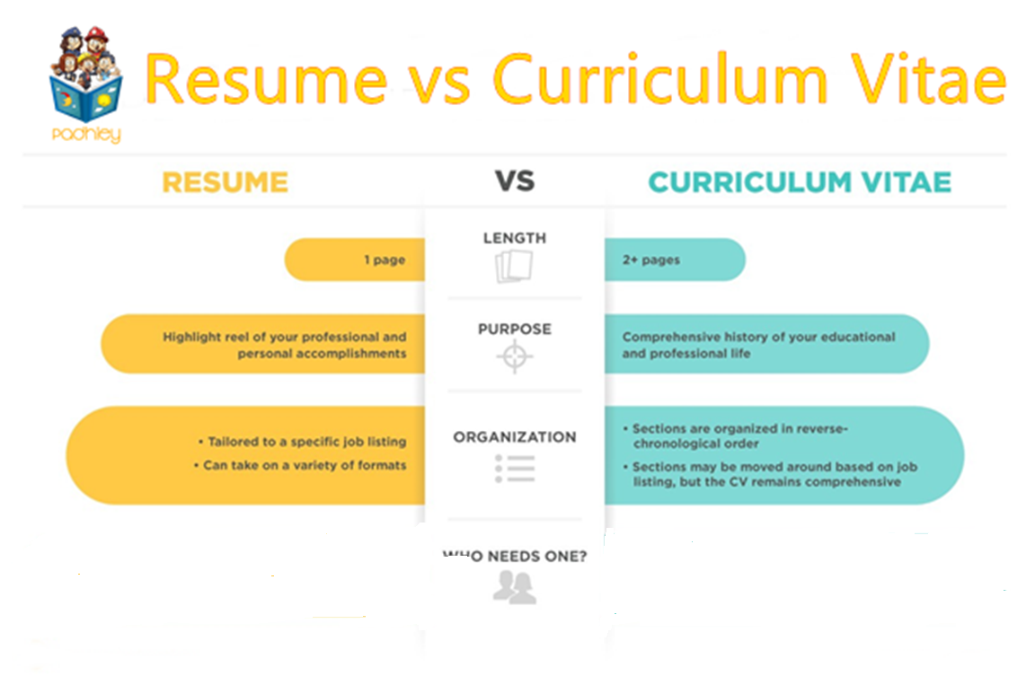
Physicians when applying for a specific position – highlighting relevant skills and experience
Medical Students, Residents, Physicians – living document, full history including academics, presentations, publications, etc.

Slide 11
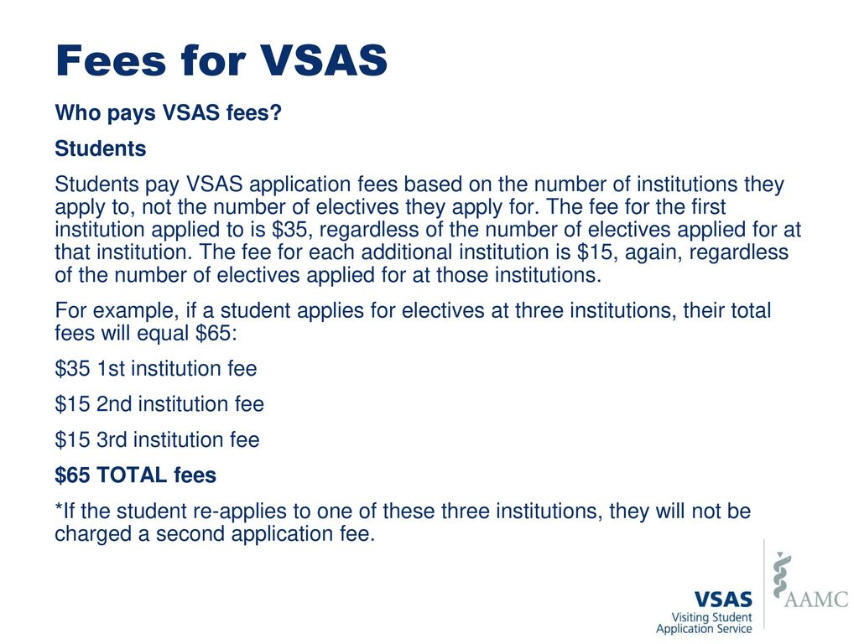

Slide 12
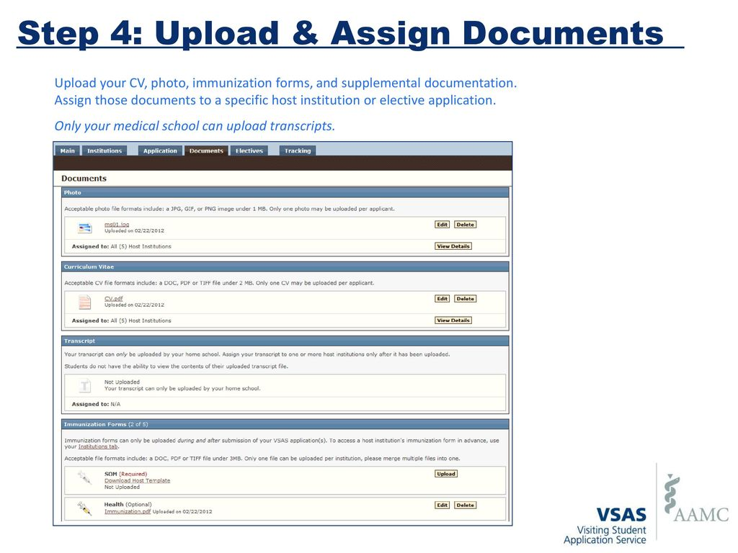

Slide 13
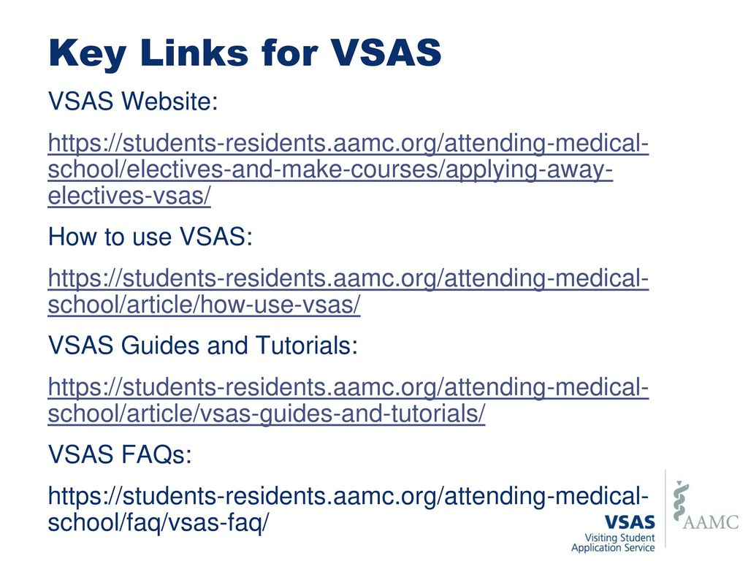

Slide 14
Non-VSLO Away Rotations
If you want an away rotation not in VSLO, you must complete the Application and Evaluation Form for Senior Electives and submit to knorwood@uthsc.edu
  Section 1 – student completes
  Section 2 – corresponding UT Department completes
  Section 3 – Office of Medical Education approves (knorwood@uthsc.edu)
  Section 4 – Completed by the Host Institution
  Form MUST be completed and returned with legible host institution information to knorwood@uthsc.edu PRIOR to beginning the rotation.

Slide 15



Questions?
Kimberlee Norwood, knorwood@uthsc.edu, 901-448-3843

