Slide 2
Visiting Student Learning Opportunities (VSLO)
As it is not called.
Pronounced – Veez Low.
Not Vee Slow.

Slide 7
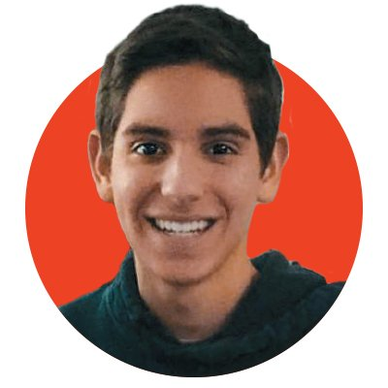
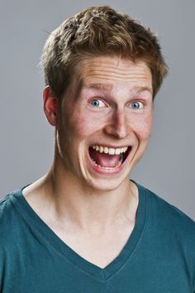
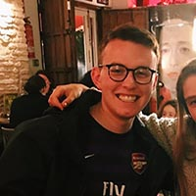
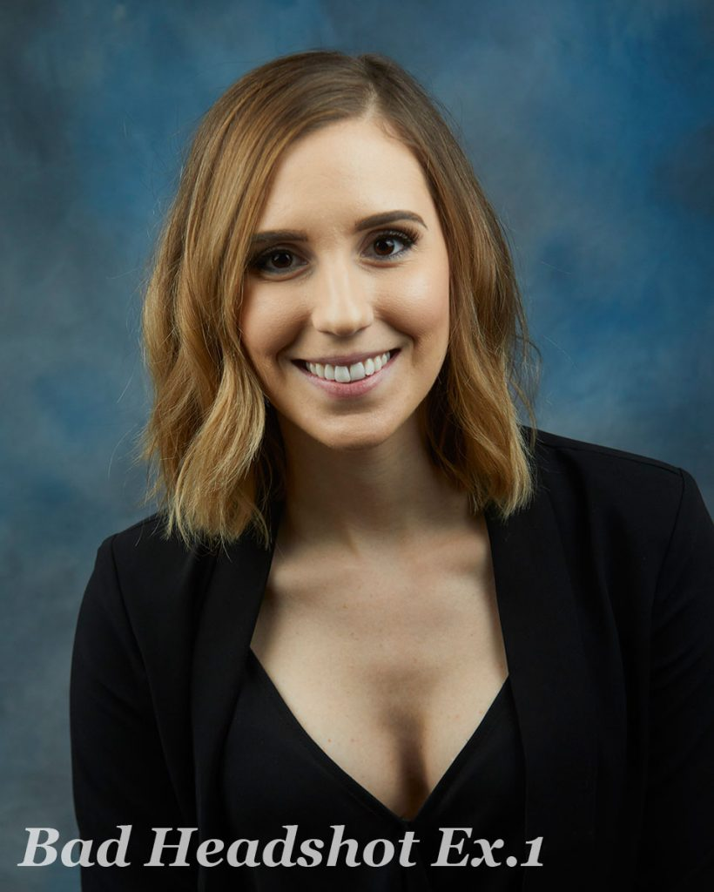
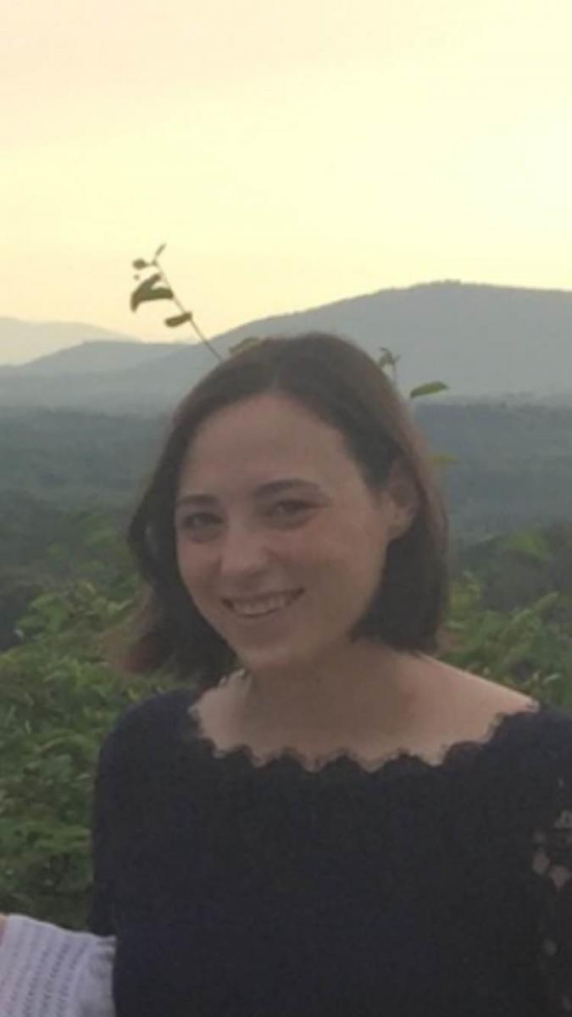
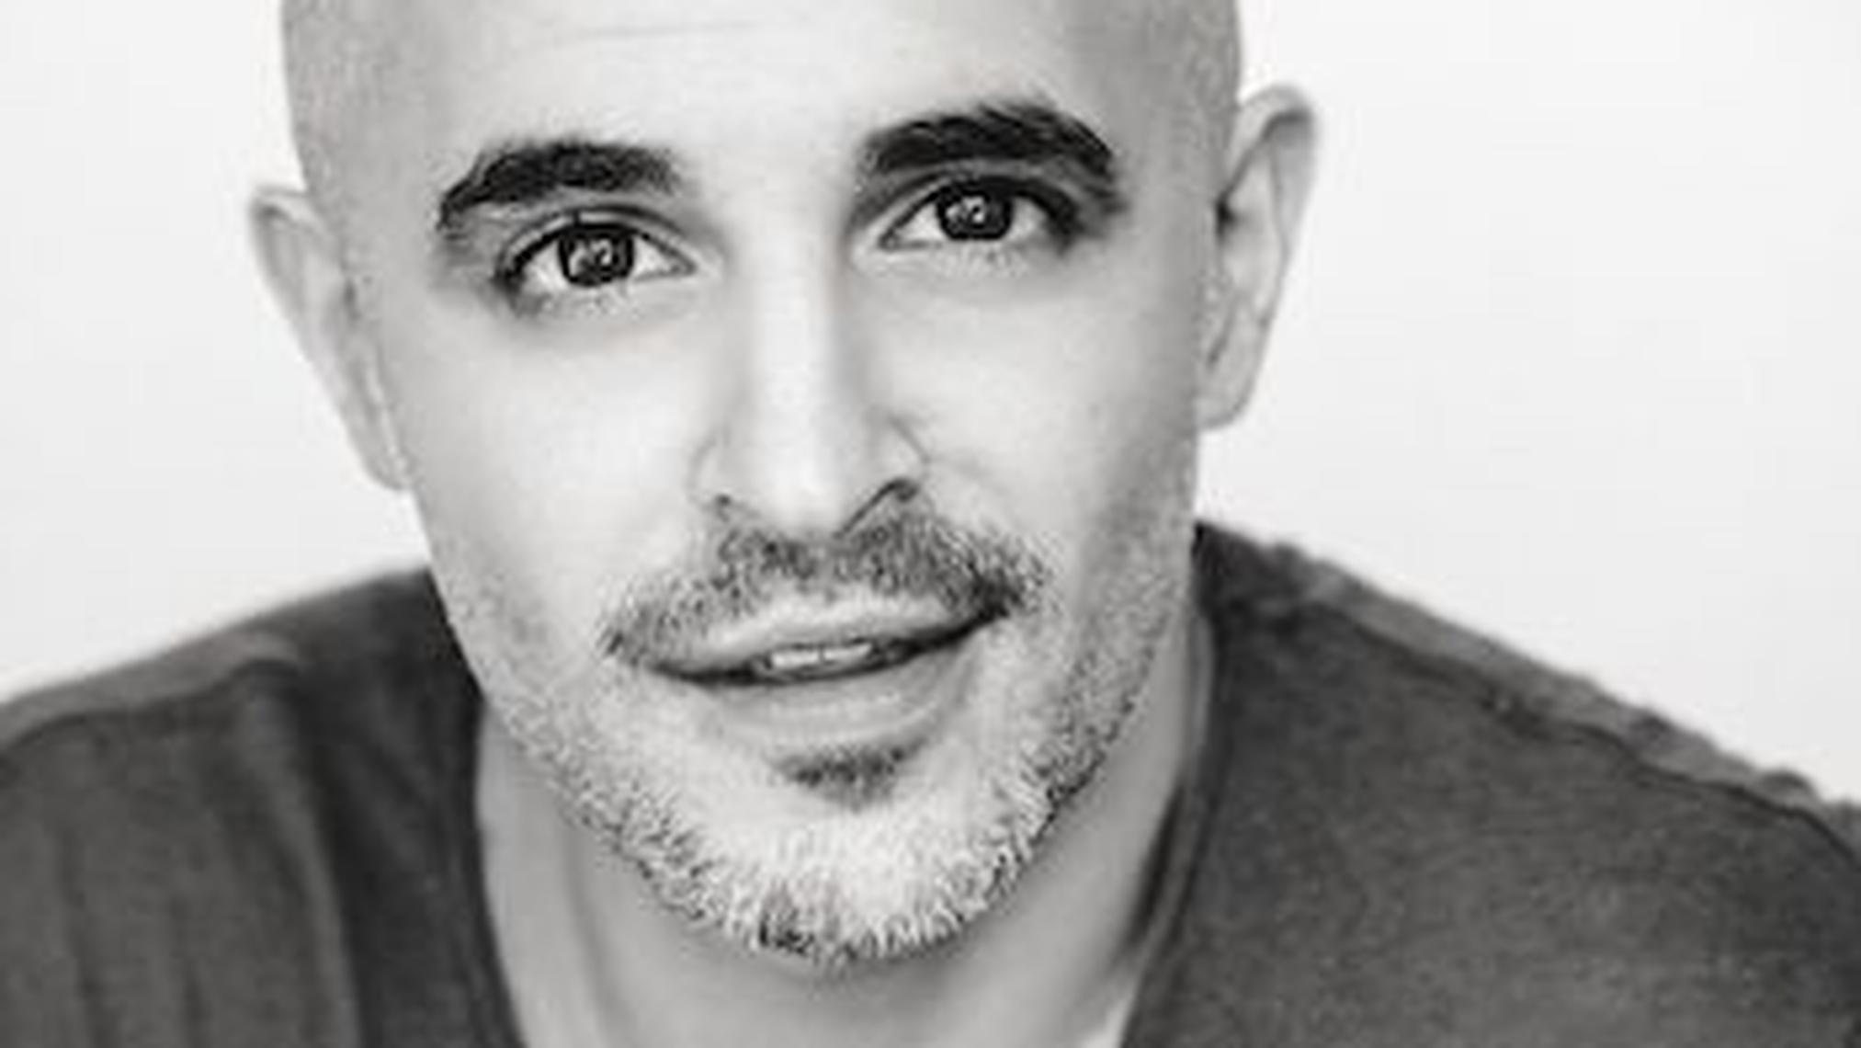
VSLO Photograph

Slide 8
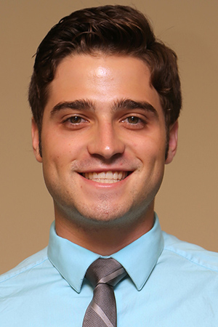
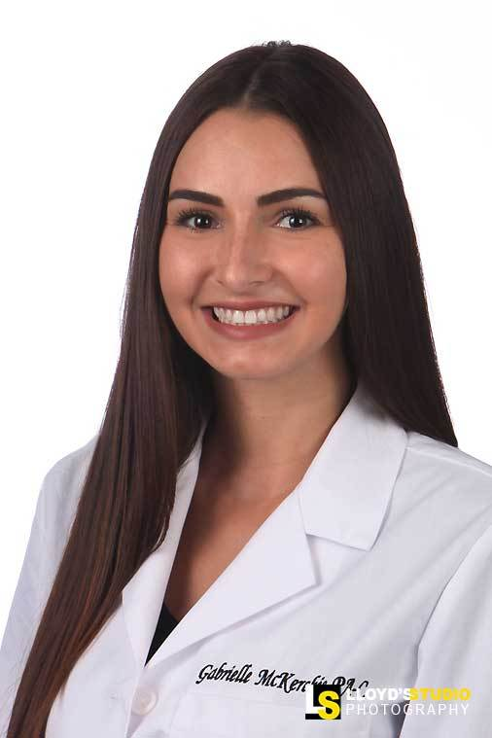
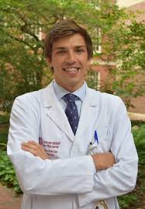
Be Professional

Slide 9
Physicians when applying for a specific position – highlighting relevant skills and experience
Medical Students, Residents, Physicians – living document, full history including academics, presentations, publications, etc.

Slide 10
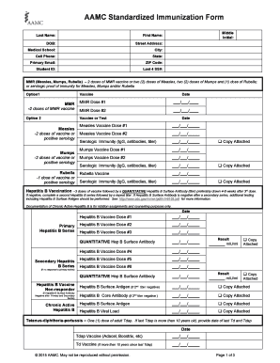

Slide 13
Key Information for VSLO
Request transcripts from: https://uthsc.co1.qualtrics.com/jfe/form/SV_24Q1kb2wEEGWu9v
AAMC Immunization Forms can be completed by Kimberlee Norwood. *Be sure your Verified Credentials account is up-to-date.
Letters of Good Standing can be requested from knorwood@uthsc.edu
Certificate of Malpractice coverage is posted on OLSEN. If additional coverage is needed, student acquires at student’s expense.
If need a criminal background check (other than at matriculation), student can request from Verified Credentials at student’s expense.

Slide 14
Key Information for VSLO
Letters of Recommendation (LOR) are the student’s responsibility. Have the person send the LOR to knorwood@uthsc.edu to attach to your application.
Need to have current copy of BLS/ACLS certification.
TB Mask fit card – know where it is, if you are asked to provide.
HIPAA Training certificate – know where it is, if you are asked to provide. HIPAA Privacy and Security Training
OSHA Training certificate – know where it is, if you are asked to provide.

Slide 15
Key Information for VSLO
Drug Screening – UTHSC does not do this. You may have it done at UHS. 6 panel or 10 panel? 6 months or 12 months.
Board Scores – know where your report is, in case the score is requested.
Home School Evaluation Form – this is located on OLSEN. Ms. Norwood will send them to VSLO schools as well.

Slide 17
Non-VSLO Away Rotations
If you want an away rotation not in VSLO, you must complete the Application and Evaluation Form for Senior Electives and submit to knorwood@uthsc.edu
Section 1 – student completes
Section 2 – corresponding UT Department completes
Section 3 – Office of Medical Education approves (knorwood@uthsc.edu)
Section 4 – Completed by the Host Institution
Form MUST be completed and returned with legible host institution information to knorwood@uthsc.edu PRIOR to beginning the rotation.

Slide 18
Questions?
Kimberlee Norwood, knorwood@uthsc.edu, 901-448-3843

