Slide 1

Excused Absences and Wellness Days
UTHSC College of Medicine
Office of Medicine Education
Updated April 17, 2020

Slide 2

Rationale
Excused absences – Students should be able to attend general preventive medical care, urgent/acute medical care, and have appropriate time off for sickness.
Wellness Days – Goal is to promote mental health and wellness among students.
  Take a day to rest, recharge, reboot, etc.
  NOT a substitute for professional counseling or mental health treatment for a student experiencing a more significant mental health concern!

Slide 3
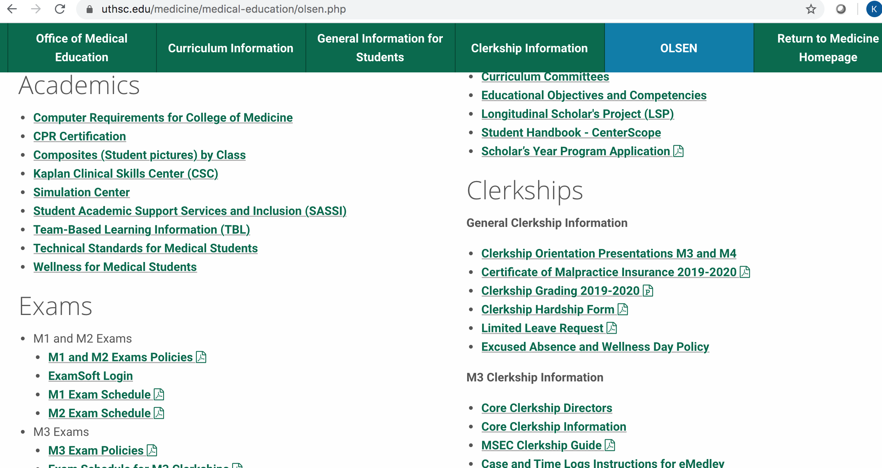

Slide 4
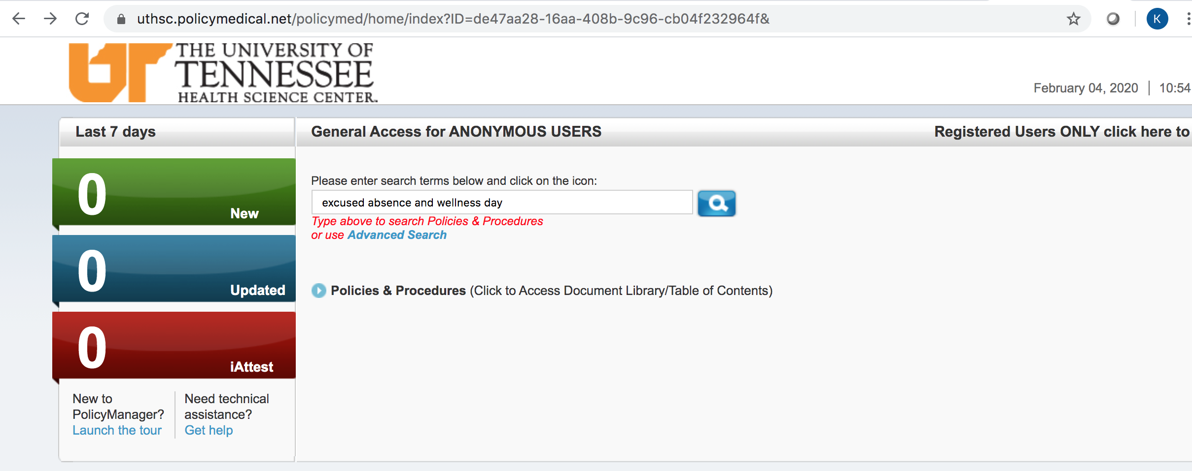
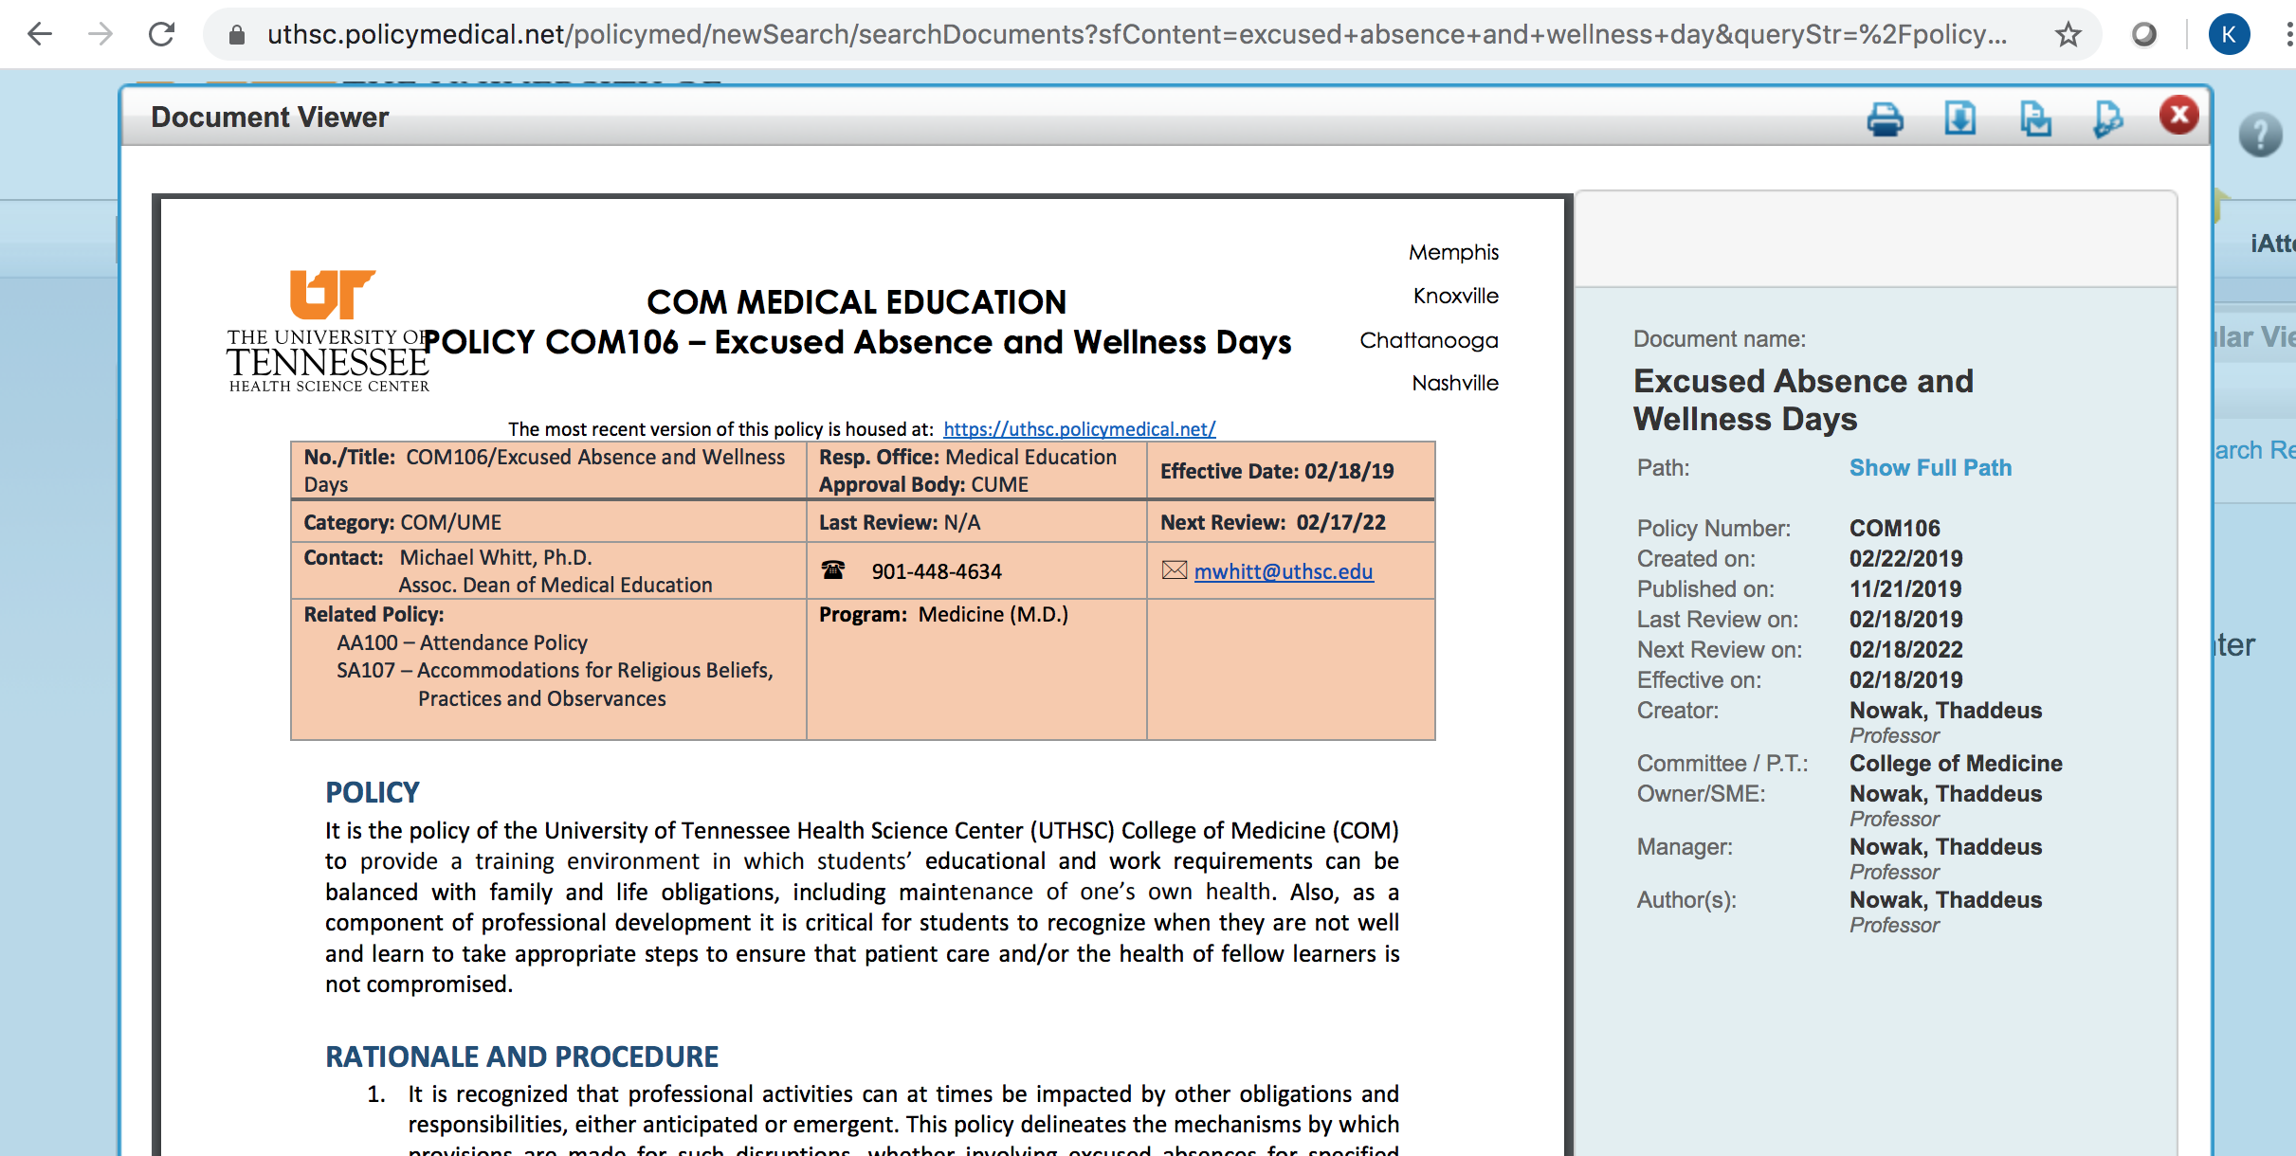
Policy Manager

Slide 5
How to Request an Excused Absence or Planned Wellness Day
1. Notify (email) your Clerkship Director and Clerkship Coordinator 30 DAYS IN ADVANCE of the CLERKSHIP to request permission.
2. Please be professional in your interactions with your administrators!
3. Complete a Limited Leave Request form (on OLSEN) once approved.

Slide 6
Requesting Permission
“I will be taking a wellness day for my sister’s wedding on xx/xx/xx.”
vs.
“I am emailing you to request the possibility of a wellness day on xx/xx/xx for my sister’s wedding. Thank you!”

Slide 7
What counts as an Excused Absence?
Funerals (death of a close family member)
Acute illness/urgent medical appointments (includes SICK DAYS!)
Preventive or routine healthcare (e.g. PCP appointment, dentist, etc including mental health/counseling visits)
Religious observances/Holy Days
Jury duty and other legal obligations
Step 2 CK/CS*
Residency interviews*
Attendance at professional meetings if presenting or representing the College of Medicine
* Step 2 CK and residency interviews NOT allowed on M3 clerkships. Step 2 CS can only be taken on a Monday but not during a clerkship orientation. HOWEVER, note that exceptions will be made due to the coronavirus pandemic.

Slide 8
Sick Days
Notify your Clerkship Director, Clerkship Coordinator, and your team/attending AS SOON AS YOU KNOW you will miss the day.
Prompt notification is not only the professional thing to do, but also let’s us know that you are alive and not missing!!
Complete a Limited Leave Request as soon as you return.
Doctor’s note is required if you miss more than 2 days for any illness.

Slide 9
Professional Meeting Attendance
Notify CD/CC 30 days prior to the START of the affected rotation.
Must be either presenting (poster/oral) or representing the COM.
Provide documentation (email/letter) of your acceptance to the meeting AS SOON AS YOU GET THIS.
Goal is to maximize your participation in your event while also minimizing the time away from your clerkship.
Approval is at the discretion of the Clerkship Director.

Slide 10
Wellness Days
Four wellness days per year
No half days or hourly counts

Slide 11
Anticipated (Planned) Wellness Days
Notify CD/CC 30 day prior to the START of the rotation.
May NOT be used during:
  Course/shelf exams
  Clerkship orientations
  Simulation/skill training days
  OSCEs
  Oral, slide exams
  JI rotations
  On-call days
  Days before or immediately after vacations or administrative closings (i.e. MLK Day)

Slide 12
Examples
Planned Wellness Days
Emergent Wellness Days
Weddings
Family reunions
Planned mental health day
Nondisclosed reasoning (e.g. counseling appointment)
Other important personal or family events that don’t fall under an excused absence
Unplanned mental health day
Need for urgent counseling
Any other unforeseen event that does not qualify for an acute excused absence or which the student does not wish to disclose
Notes:
What counts as a wellness day?
Important life events (weddings, reunions, etc.)
Nondisclosed reasons (counseling appointments, “mental health day”, rest, recharge, reboot)

Slide 13
Emergent (Unplanned) Wellness Days
Available for when a student has an urgent/emergent need for a day away from clerkships that does not fall into an excused absence category.
Notify (email) the clerkship director and clerkship coordinator ASAP when you need to take an emergent wellness day. Does not require 30 days advanced notice.
Be professional. Complete a Limited Leave Request as soon as you return to the clerkship.
“No questions asked” policy to preserve student privacy.
However, if you are struggling, please reach out to your CD. We can help you!

Slide 14
Wellness and Mental Health
SASSI Take Care
https://uthsc.edu/sassi/
Counseling services
https://www.uthsc.edu/student-health-services/behavioral-health/index.php

