Slide 1
Promotion & Tenure for
Dept Coordinators of P&T
2020-2021
Polly Hofmann, PhD
Sr Associate Dean of Faculty affairs
phofmann@uthsc.edu

Slide 2
Agenda
New! P&T 2020-2021 – Required Documents with Descriptions
Letters of Reference
  Minimum Number
  Solicitation
  Letter Database for Each Faculty
  Judging Acceptability of Letters
Early Promotion and Tenure
Requirement for Tenure: Peer Review of Teaching & Documentation
Requirement we need to follow for Promotion of Tenured Faculty
Promotion Metric – For Paid Faculty with Effort%
Department Committee Template
Chair Letter “If-Thens”

Slide 3
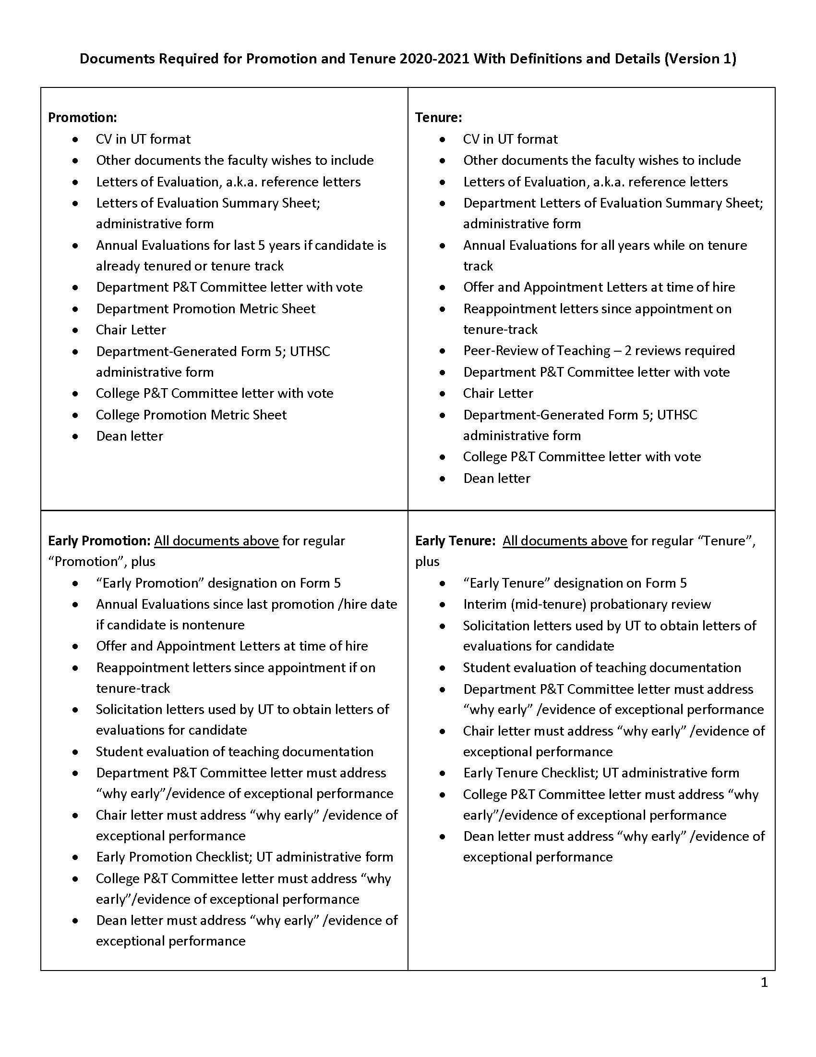
From: P&T 2020-2021 Required Documents with Descriptions

Slide 4
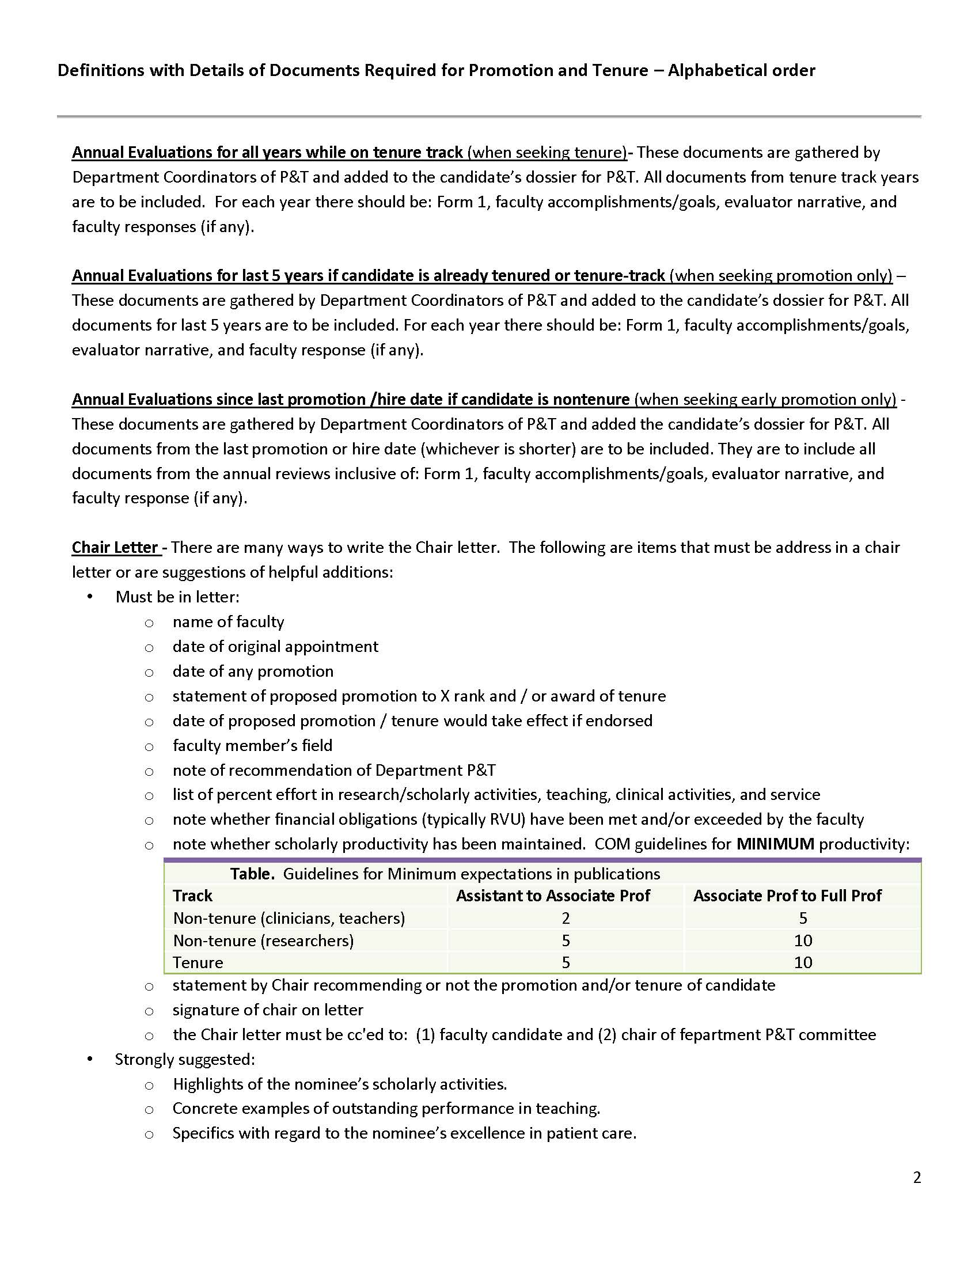
From: P&T 2020-2021 Required Documents with Descriptions

Slide 5
From: P&T 2020-2021 Required Documents with Descriptions

Slide 6
Minimum Letters Needed
Type of Action | Min# of ¹Internal Letters | Min # of ²External Letters
A. Instructor to Assistant Professor | 3 | 0
B. Assist to Assoc WITHOUT tenure | 3 | 2
C. Assist to Assoc WITH tenure | 2 | 3
D. Assoc to Professor with or without tenure | 2 | 3
E. Tenure without Promotion (“a” below) | 2 | 3
Internal versus External
¹Internal: UTHSC or UTHSC affiliates like St Jude or VA
²External: not employed or affiliated with UTHSC
Letter writer must be (a) at or above the candidate’s current rank, in the case of tenure review only, or (b) at or above the rank to which the candidate aspires to be promoted.
For consideration for the award of tenure for a UTHSC faculty, the letter writer MUST be tenured and state as much in the letter of reference. For already tenured faculty going up for promotion, tenured letter writers should be used wherever possible.

Slide 7
Soliciting Letters
Must use email template provided
Send as text in body of email
Fill out information in red font and change it to black font
Add TWO attachments
FORMs: Solicitation Letter from UT
Requesting Evaluation Letter

Slide 8
Soliciting Letters
Date should be BEFORE meeting of department committee
They may just reply to you or they may send to me and I will get to you ASAP
Note the requirements they must do – this will become important in a minute
FORMs: Hofmann Letter of Solicitation
UTHSC Promotion and Tenure Criteria

Slide 9
Soliciting Letters
Note enclosures
Note this email should be cc’ed to the chair of dept
FORMs: Hofmann Letter of Solicitation
UTHSC Promotion and Tenure Criteria

Slide 10
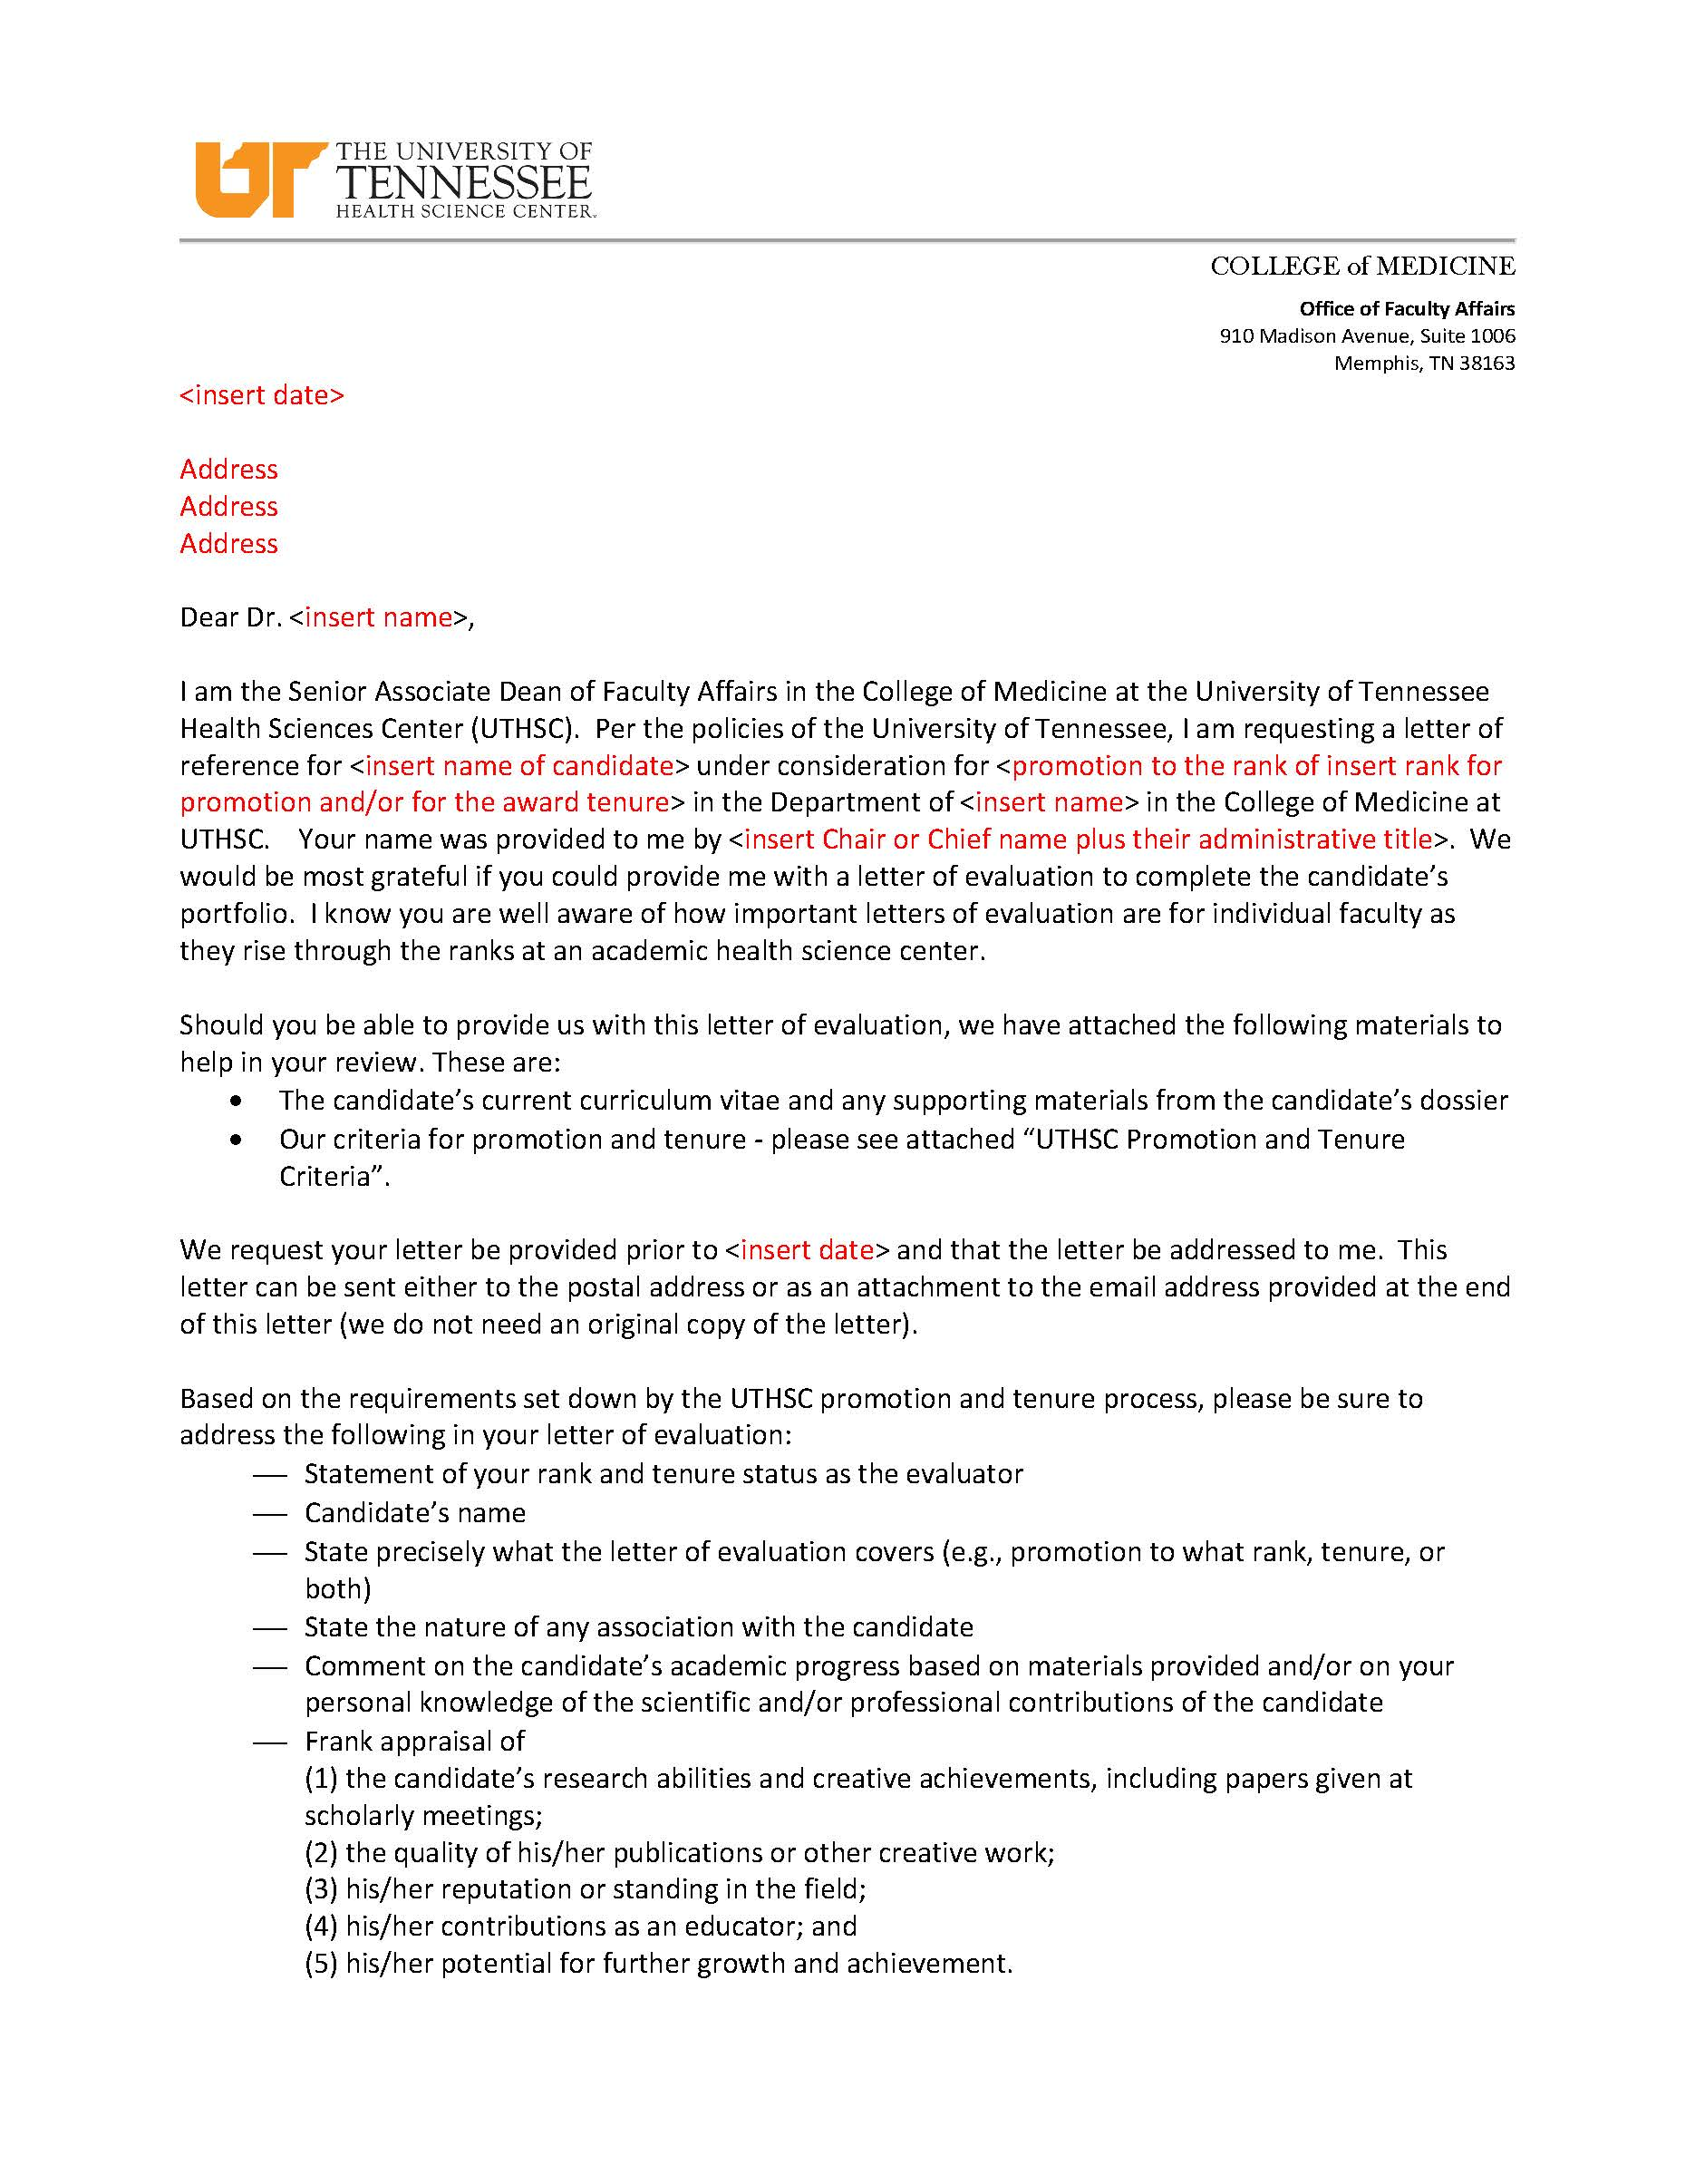
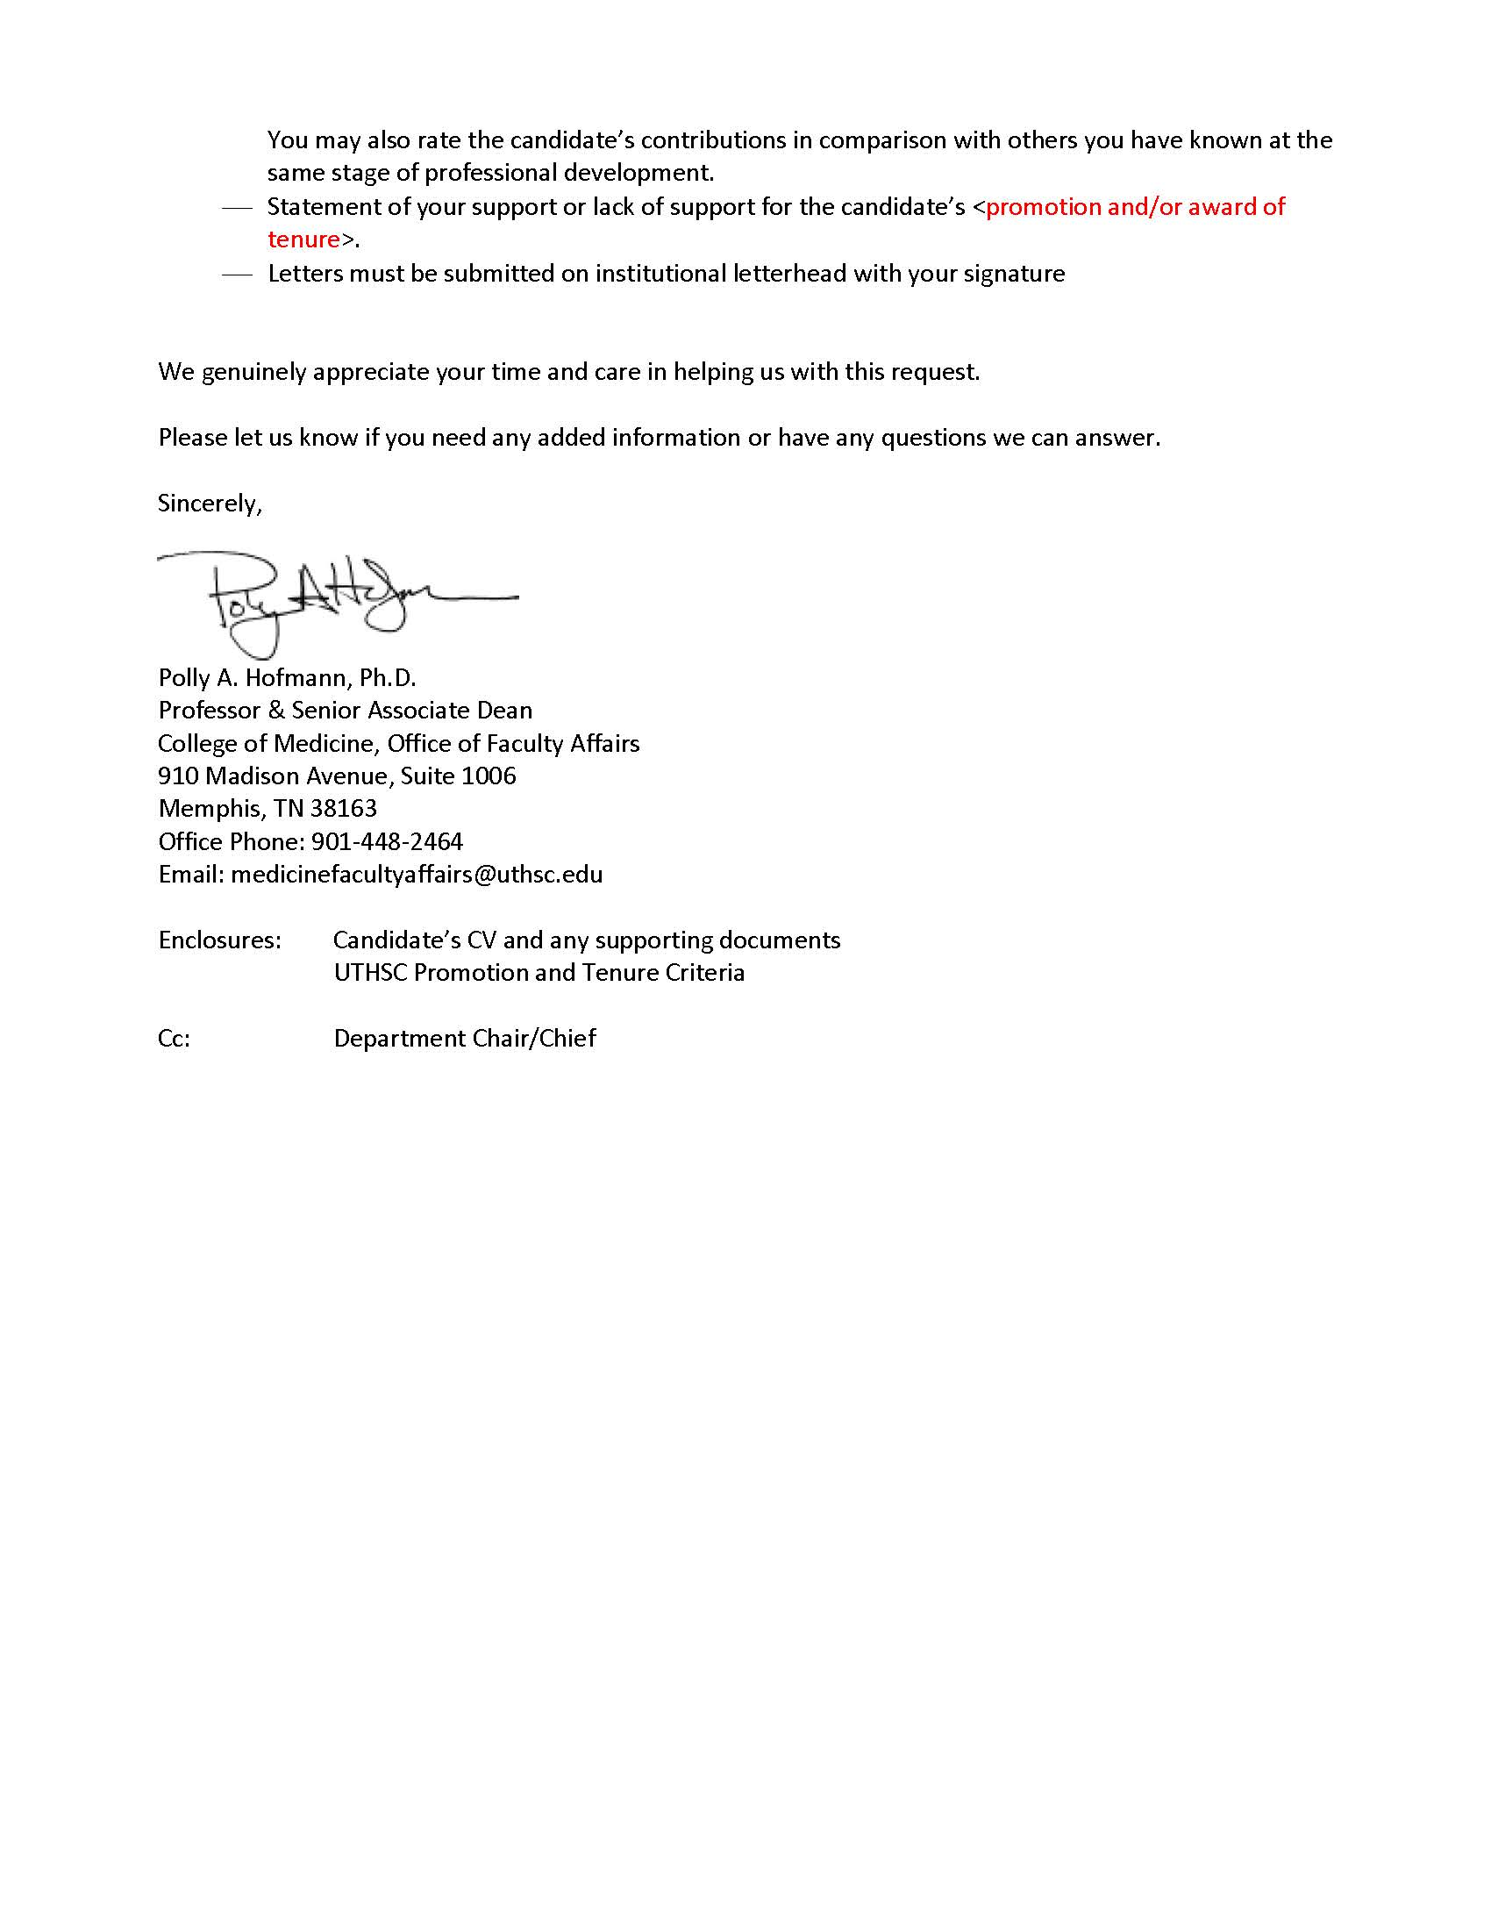
QUESTIONS?

Slide 11
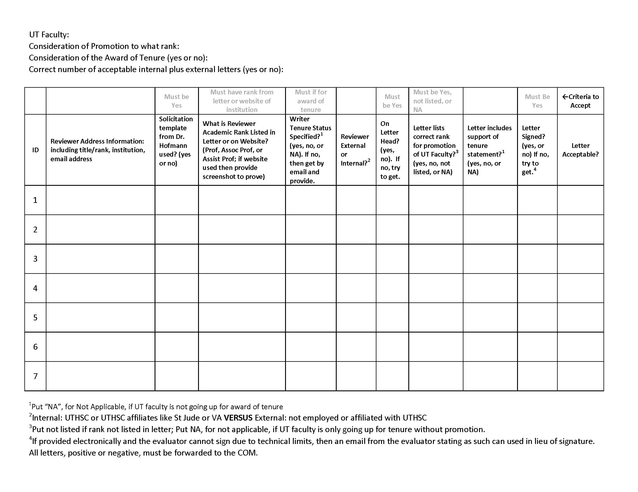
Required Letter of Evaluation Summary Sheet for Each Faculty
FORM: Letter of Eval Summary Sheet

Slide 12
Example
Letter Database for Dr Bob Smith
UT Faculty: Bob Smith
Consideration of Promotion to what rank: Associate Professor
Consideration of the Award of Tenure (yes or no): Yes
Correct number of acceptable internal plus external letters (yes or no):
Patricia Smith, PhD
Professor, Dept Physiology
University of Texas at Austin
Psmith@texas.edu
yes
?
?
?
?
?
?
?
¹Put “NA”, for Not Applicable, if UT faculty is not going up for award of tenure
²Internal: UTHSC or UTHSC affiliates like St Jude or VA VERSUS External: not employed or affiliated with UTHSC
³Put not listed if rank not listed in letter; Put NA, for not applicable, if UT faculty is only going up for tenure without promotion.
FORM: Solicitation Letter from UT Requesting Evaluation Letter

Slide 13
Rank???

Slide 14
Example
Letter Database for Dr Bob Smith
UT Faculty: Bob Smith
Consideration of Promotion to what rank: Associate Professor
Consideration of the Award of Tenure (yes or no): Yes
Correct number of acceptable internal plus external letters (yes or no):
Patricia Smith, PhD
Professor, Dept Physiology
University of Texas at Austin
Psmith@texas.edu
yes
Prof
?
?
?
?
?
?
¹Put “NA”, for Not Applicable, if UT faculty is not going up for award of tenure
²Internal: UTHSC or UTHSC affiliates like St Jude or VA VERSUS External: not employed or affiliated with UTHSC
³Put not listed if rank not listed in letter; Put NA, for not applicable, if UT faculty is only going up for tenure without promotion.
FORM: Solicitation Letter from UT Requesting Evaluation Letter

Slide 15
Tenure Status???

Slide 16
What to do if you need tenure status of evaluator?
Follow up email
Dear Dr. Smith,
Thank you for providing a letter of evaluation for Dr. Bob Smith.
To finalize this letter for use in the dossier for Dr. Smith’s promotion and tenure,
can you please share with me your own tenure status. Our Board of Trustees
requires that we obtain such information related to our evaluators.
Again, thank you for your help
Judy Farmer
P&T Coordinator Department of Pediatrics
Response
Judy, I am tenured. Pat

Slide 17
Example
Letter Database for Dr Bob Smith
UT Faculty: Bob Smith
Consideration of Promotion to what rank: Associate Professor
Consideration of the Award of Tenure (yes or no): Yes
Correct number of acceptable internal plus external letters (yes or no):
Patricia Smith, PhD
Professor, Dept Physiology
University of Texas at Austin
Psmith@texas.edu
yes in attached email
yes
Prof
external
yes
?
?
?
?
¹Put “NA”, for Not Applicable, if UT faculty is not going up for award of tenure
²Internal: UTHSC or UTHSC affiliates like St Jude or VA VERSUS External: not employed or affiliated with UTHSC
³Put not listed if rank not listed in letter; Put NA, for not applicable, if UT faculty is only going up for tenure without promotion.
FORM: Solicitation Letter from UT Requesting Evaluation Letter

Slide 18
Lists correct Rank for Bob Smith???

Slide 19
Example
Letter Database for Dr Bob Smith
UT Faculty: Bob Smith
Consideration of Promotion to what rank: Associate Professor
Consideration of the Award of Tenure (yes or no): Yes
Correct number of acceptable internal plus external letters (yes or no):
Patricia Smith, PhD
Professor, Dept Physiology
University of Texas at Austin
Psmith@texas.edu
yes in attached email
yes
Prof
external
yes
Not listed
?
?
?
¹Put “NA”, for Not Applicable, if UT faculty is not going up for award of tenure
²Internal: UTHSC or UTHSC affiliates like St Jude or VA VERSUS External: not employed or affiliated with UTHSC
³Put not listed if rank not listed in letter; Put NA, for not applicable, if UT faculty is only going up for tenure without promotion.
FORM: Solicitation Letter from UT Requesting Evaluation Letter

Slide 20
Support of tenure statement?

Slide 21
Example
Letter Database for Dr Bob Smith
UT Faculty: Bob Smith
Consideration of Promotion to what rank: Associate Professor
Consideration of the Award of Tenure (yes or no): Yes
Correct number of acceptable internal plus external letters (yes or no):
Patricia Smith, PhD
Professor, Dept Physiology
University of Texas at Austin
Psmith@texas.edu
yes in attached email
yes
Prof
external
yes
Not listed
yes
yes
yes
¹Put “NA”, for Not Applicable, if UT faculty is not going up for award of tenure
²Internal: UTHSC or UTHSC affiliates like St Jude or VA VERSUS External: not employed or affiliated with UTHSC
³Put not listed if rank not listed in letter; Put NA, for not applicable, if UT faculty is only going up for tenure without promotion.
FORM: Solicitation Letter from UT Requesting Evaluation Letter

Slide 22
Minimum Letters Needed
Type of Action | Min# of ¹Internal Letters | Min # of ²External Letters
A. Instructor to Assistant Professor | 3 | 0
B. Assist to Assoc WITHOUT tenure | 3 | 2
C. Assist to Assoc WITH tenure | 2 | 3
D. Assoc to Professor with or without tenure | 2 | 3
E. Tenure without Promotion (“a” below) | 2 | 3
Internal versus External
¹Internal: UTHSC or UTHSC affiliates like St Jude or VA
²External: not employed or affiliated with UTHSC
Letter writer must be (a) at or above the candidate’s current rank, in the case of tenure review only, or (b) at or above the rank to which the candidate aspires to be promoted.
For consideration for the award of tenure for a UTHSC faculty, the letter writer MUST be tenured and state as much in the letter of reference.

Slide 23
Required Letter of Evaluation Summary Sheet
For Each Faculty
→ Footnote 4
→ Questions?
FORM: Letter of Eval Summary Sheet

Slide 24
Policies
For Early Promotion or Tenure
When is a promotion considered “early” (for 2019-2020 P&T cycle)?
  For faculty to be promoted to Associate Professor, they must have been an Assistant Professor (at any reputable institution) for a total of 4 years.
  Thus, if they were initially named an Assistant Professor after July 1, 2016, then they are requesting an EARLY promotion.
  For faulty to be promoted to Professor, they must have been an Associate Professor (at any reputable institution) for a total of 5 years.
  Thus, if they were initially named an Associate Professor after July 1, 2015, then they are requesting an EARLY promotion.
  There may be some exceptions to these rules if a faculty took time off from being on faculty, i.e. entered private practice. Consult with me if there is such a break in their academic record.

Slide 25
Policies
For Early Promotion or Tenure
When is the award of tenure considered “early” (for 2019-2020 P&T cycle)?
  All tenure-track periods are now set at 6 years per our Board of Trustees. The 6 years is only counted for time spent at UTHSC.
  Thus, if a tenure-track faculty was initially name on to the tenure-track after July 1, 2014 at UTHSC, then they are requesting an EARLY tenure review.
  There will be exceptions to this rule if the faculty received an extension or suspension of their tenure clock. Consult with me in these cases.

Slide 26
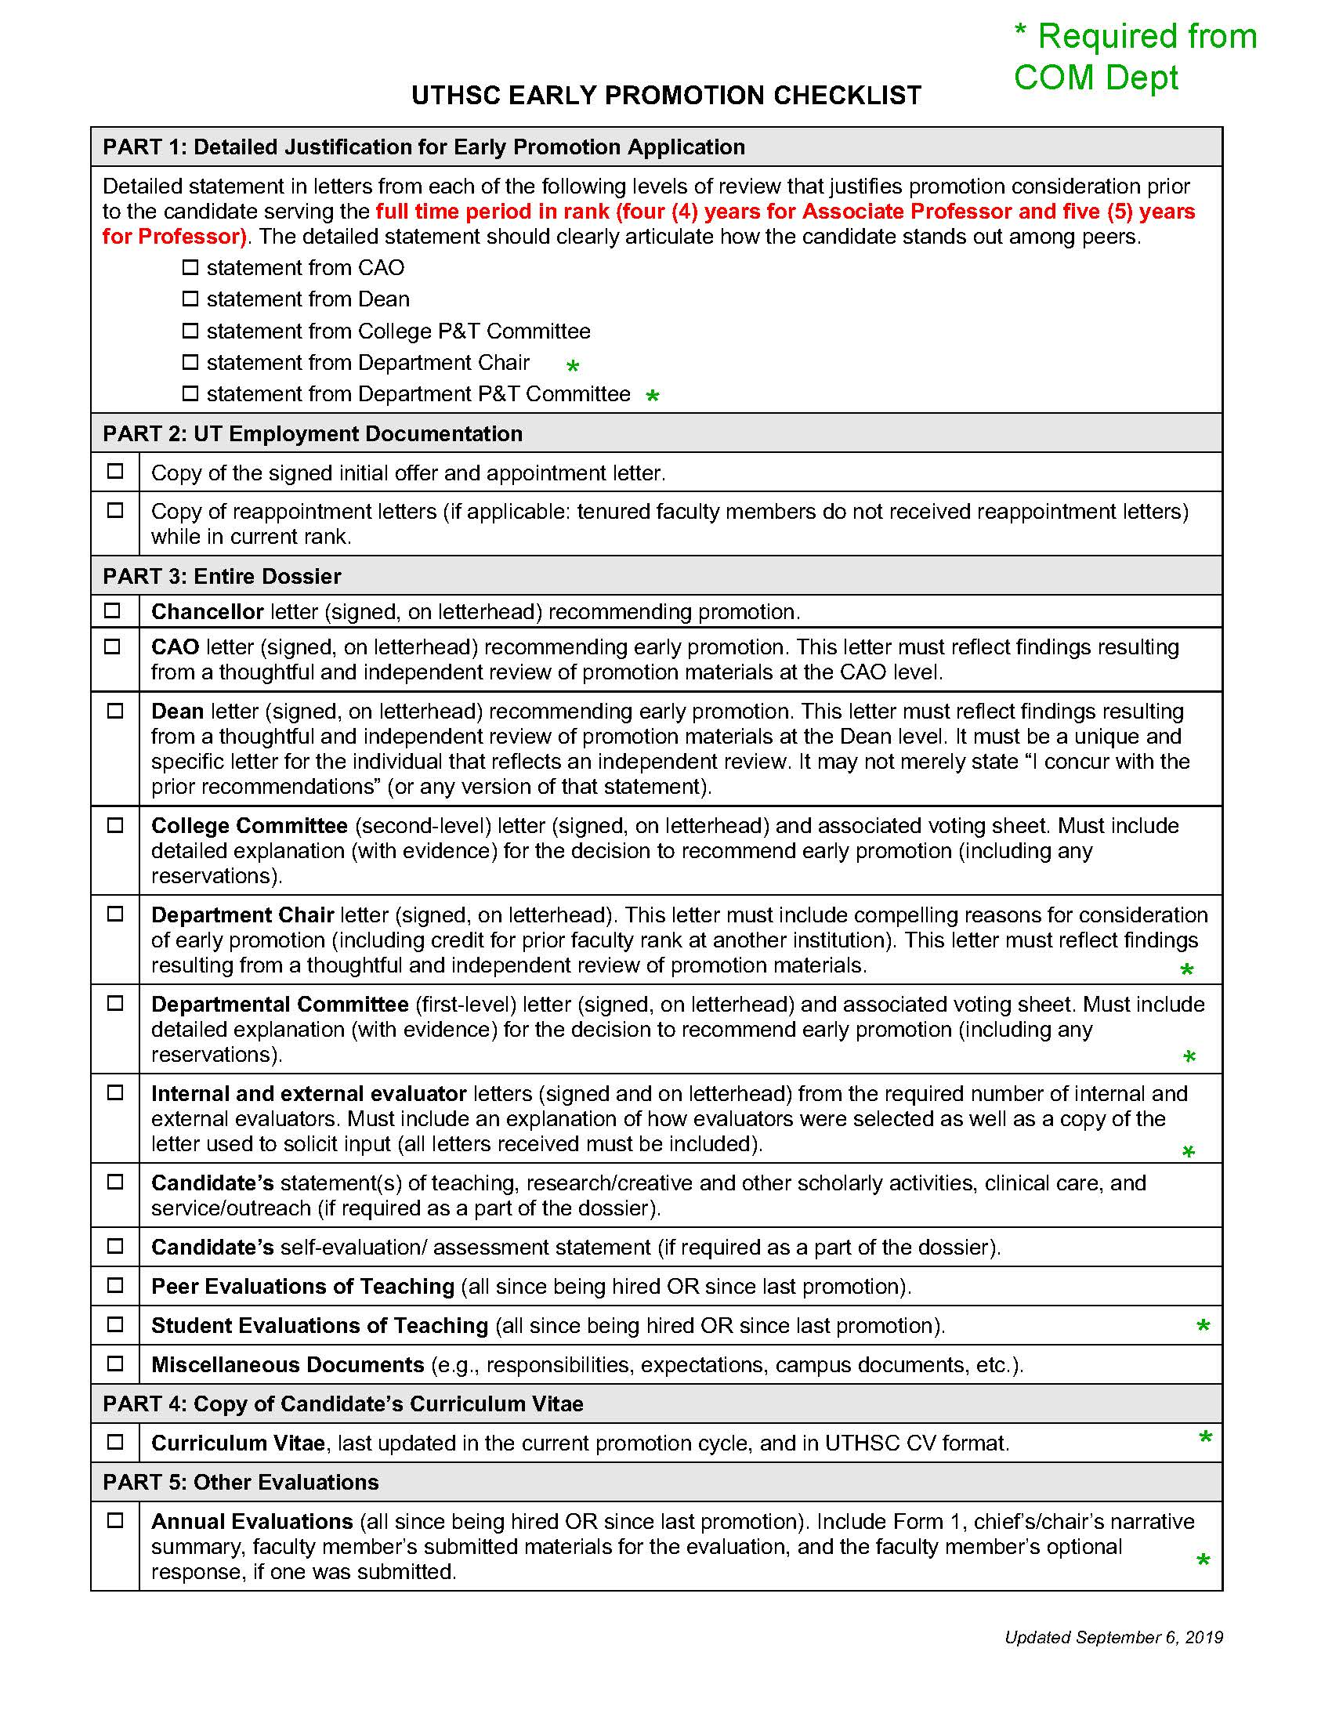
Extra Documents Needed
For Early Promotion at Department Level
Annual Reviews since being hired or last promotion
Documentation on Student Evaluation of Teaching
Print out of Hofmann Letter (email) of Solicitation for ALL evaluators which supplied a letter
Department P&T Letter must have explanation/evidence for basis of decision for early promotion – “Why are they are rock star?”
Chair Letter must have explanation/evidence for basis of decision for early promotion – “Why are they a rock star?”
FORM: Request for Early Promotion – Checklist COM Depts

Slide 27
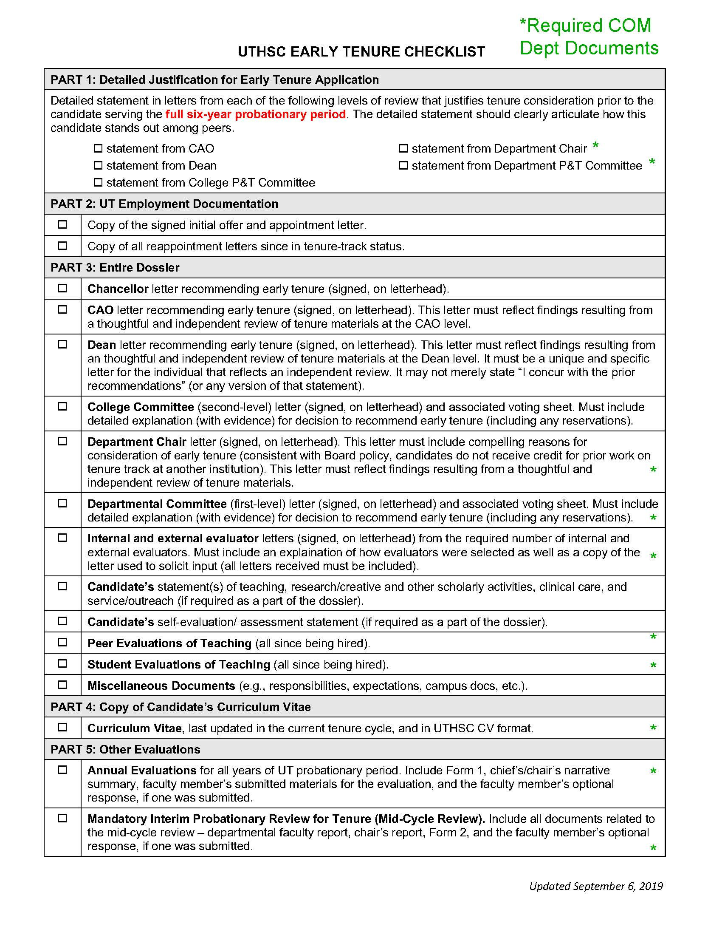
Extra Documents
For Early Tenure at Department Level
Interim (AKA MidTenure) Review
Annual Reviews for all years while on tenure track
Documentation on Student Evaluation of Teaching
Peer Evaluation of Teaching
Print out of Hofmann Letter (email) of Solicitation for ALL evaluators which supplied a letter
Department P&T Letter must have explanation/evidence for basis of decision for early tenure – “Why are they a rock star?”
Chair Letter must have explanation/evidence for basis of decision for early tenure – “Why are they are rock star?”
FORM: Request for Early Tenure – Checklist COM Depts

Slide 28
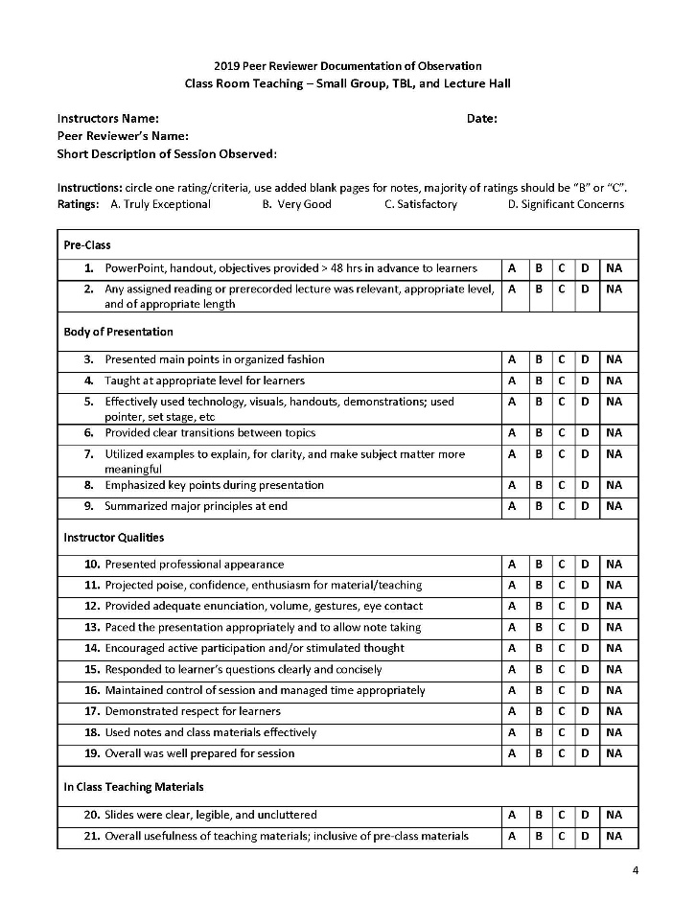
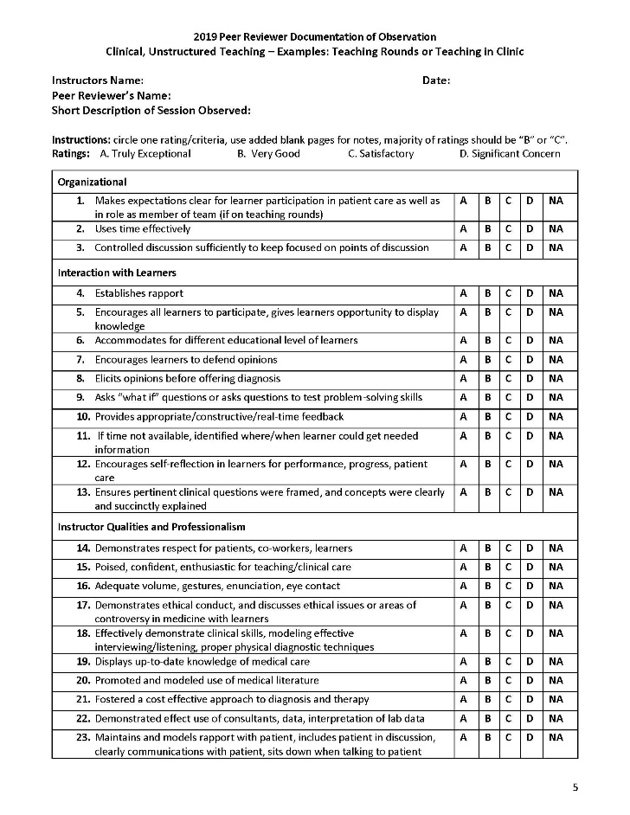
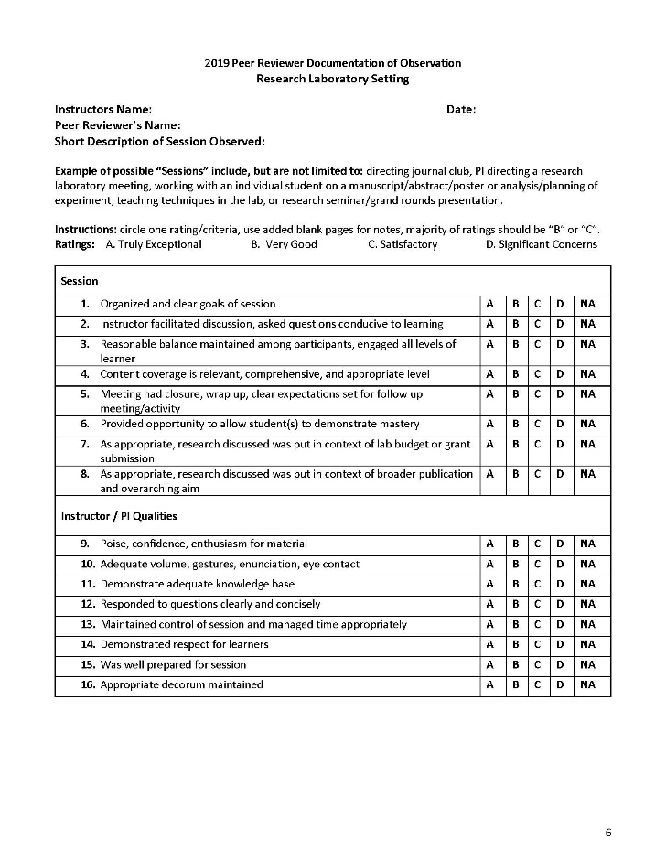
Requirement for ALL Faculty Up for Consideration of the Award of Tenure
Peer Review of Teaching
  2 completed forms required
  Entire Document Outlining Process plus Forms “Peer Review of Teaching 2020-2021”

Slide 29
Requirement we need to follow for Promotion of Already Tenured Faculty
For Dossiers From Appendix N – For Promotion
For tenured or tenure-track appointments, the dossier must include at least the following items:
CV and Annual performance documents for last 5 years.
For non-tenure-track faculty appointments the faculty member’s dossier must include at least a current Curriculum Vitae.

Slide 30
Promotion Metric
For Paid Faculty with %Efforts
One score is required from Department; completed by Department P&T
IF %efforts have changed over the years in rank, go with the effort that is most recent. But be sure Department P&T committee recognizes ALL the faculty has done.
FORMs:
Promotion Metric with Instructions
Promotion Metric Short Version with Auto Calculate

Slide 31
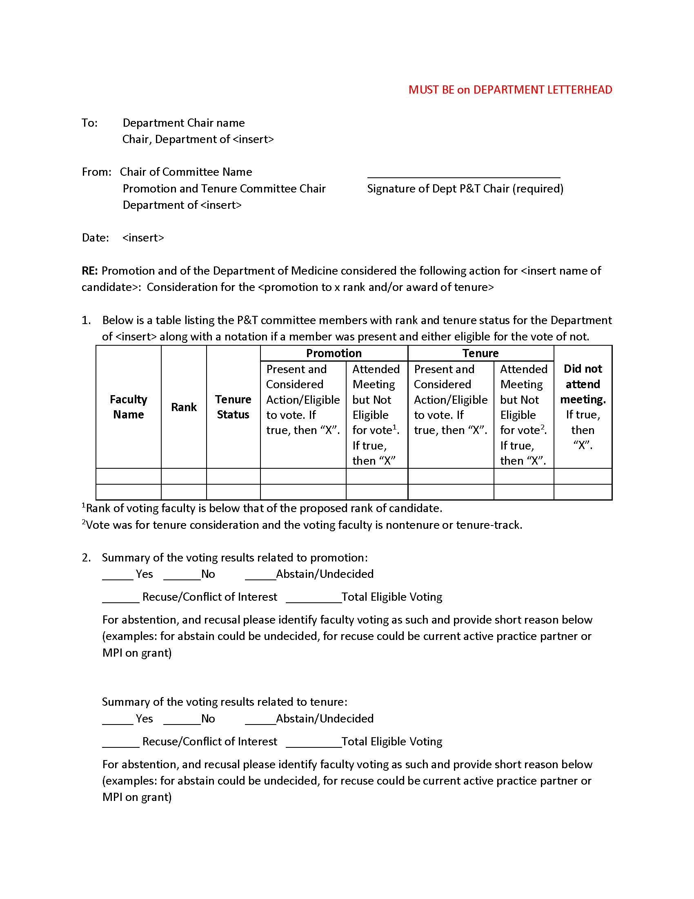
Department
Committee Letter, pg 1
FORM: Template Dept P&T Letter to Chair

Slide 32
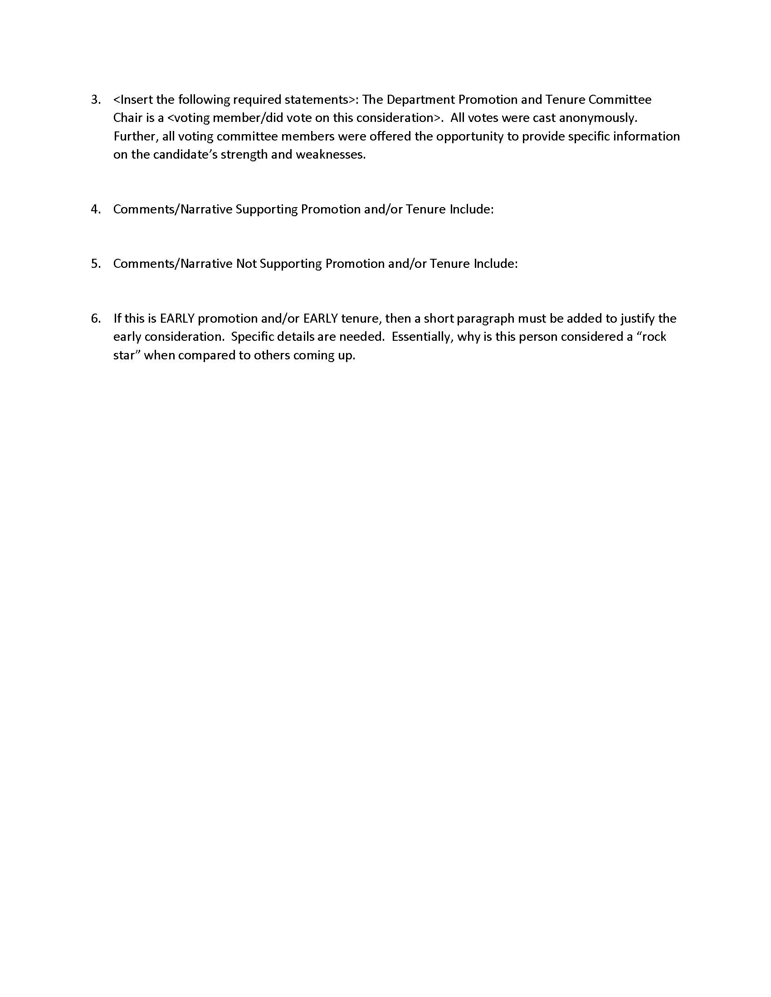
Department
Committee Letter, pg 2
FORM: Template Department P&T Committee Letter

Slide 33
Chair Letter “If - Thens”
Now all found in the
“P&T 2020-2021
Required Documents
With Descriptions”
If early promotion and/or early tenure, then must have detailed justification as to why.
If department faculty vote was not unanimous, then must suggest possible explanation.
If tenure-track went longer than 6 years, then must provide explanation.
If some of the “time in rank” credit was at another institution, then must confirm faculty candidate did X years at X institution at the rank of X.
If there is no department P&T committee vote, then must provide justification as to why.
If there has been a major change in the effort allocation of the faculty candidate over the years, then the letter should note as much to better explain productivity in the various missions.
REQUIRED cc’s to Chair letter:
  Faculty Candidate
  Chair of Department Promotions and Tenure Committee

